Slide 1
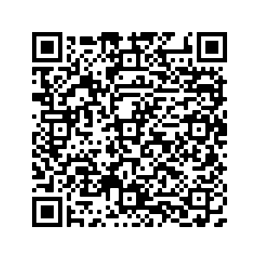
Check and Optimize Performance and Security of Moodle servers
Workshop at MoodleMoot 2022, Gerhard SCHWED
https://tinyurl.com/4ts9dr82
think modular – digital solutions GmbH
Wollzeile 24/18
1010 Vienna, Austria
g.schwed@think-modular.com

Slide 2
Disclaimer
This workshop addresses common and typical problems with Moodle security and performance, which can be solved easily.
It is not intended to train how to setup a high performance server structure.
Target audience: People with some IT knowledge who run small and medium Moodle instances on own servers.

Slide 3
Agenda
Short introduction about me and Think Modular
Security
Short overview about different levels and aspects of server security
Basic security checks with free tools
Moodle security report + solutions in practise
Performance
General aspects, scenarious and bottlenecks
Performance tests with JMETER
Optimization in practice
https://tinyurl.com/4ts9dr82

Slide 4
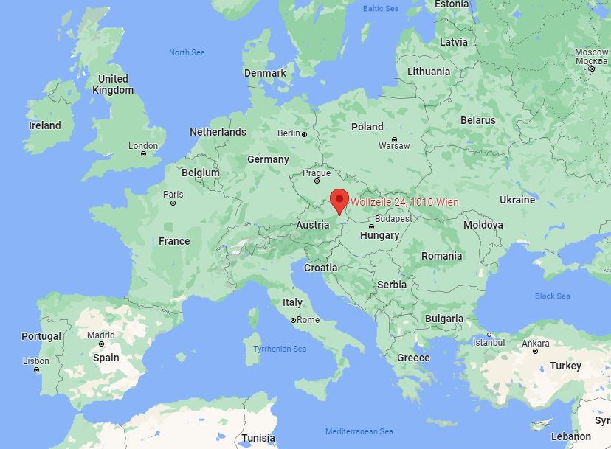
Who we are – what we do
Founded in 2019 in Vienna, Austria by Christian Zange, Gerald Henzinger and Gerhard Schwed
>15years experience with IT, eLearning and Moodle
Preferred tools: Drupal + Moodle + BigBlueButton (official BigBlueButton Partner)
Holistic approach: Consulting, hosting, programming, course development, training, support
Many international projects and customers

Slide 5
Where we are
Notes:
Derzeit in ca. 15 Ländern auf vier Kontinenten aktiv

Slide 6
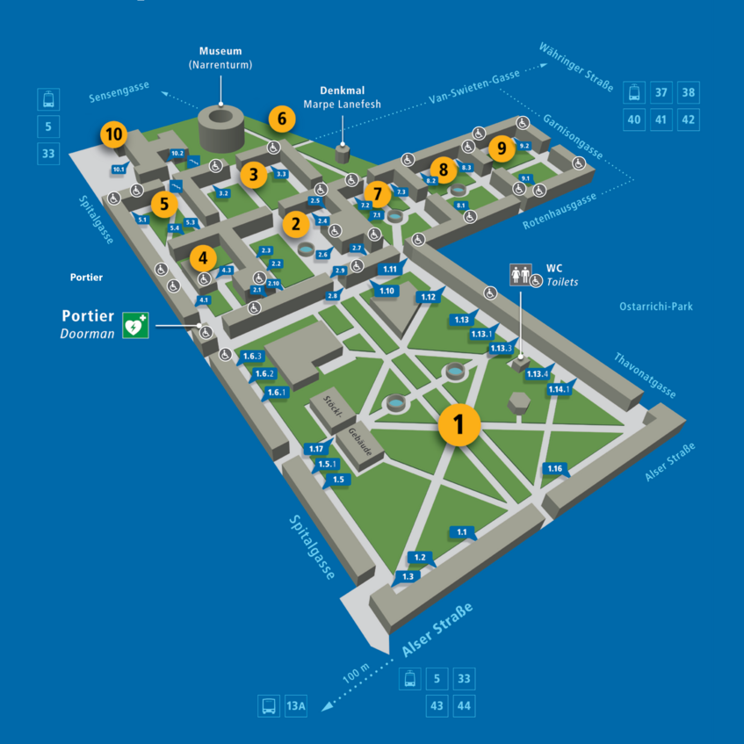
Security Overview
… like a complex building with many doors. => You must know and control every single entry point!
Levels / Layers
Operating system + system users
open ports and services (like ftp, email, …)
Webserver security and encryption (https)
other applications beside Moodle (like Wordpress, Testmoodle, …)
Moodle application itself
Users and roles
passwords
Source: https://campus.univie.ac.at
Campus of University Vienna

Slide 7
Important aspects
You have to trust the maintainers of main components because you cannot control everything.
Update and implement security patches always as soon as possible.
You never can reach 100% security. (Only possible, if the server is offline.)
Find the balance between highest security and functionality !

Slide 8
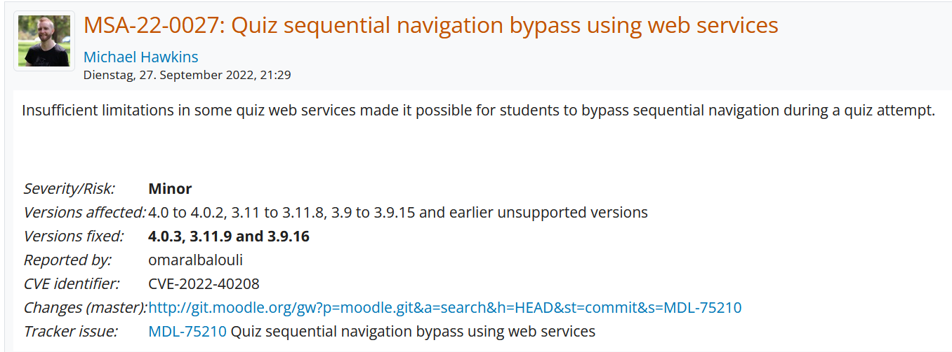
Important security information
US Cyber Security Database CVE: https://www.cvedetails.com/vulnerability-list/vendor_id-2105/Moodle.html
General recommendations for Moodle https://moodledev.io/general/development/policies/security
Regular security announcements: https://moodle.org/security/

Slide 9
Free security checks / tools
XSS Scan: (Cross Side Scripting) https://pentest-tools.com/website-vulnerability-scanning/xss-scanner-online
Portscan: https://pentest-tools.com/network-vulnerability-scanning/tcp-port-scanner-online-nmap
SSL check (https): https://www.ssllabs.com/ssltest/index.html
HTTP security headers: https://securityheaders.com/
Server Signature: http://security.firewallmonitor.org/
Mailtester: https://www.mail-tester.com/

Slide 10
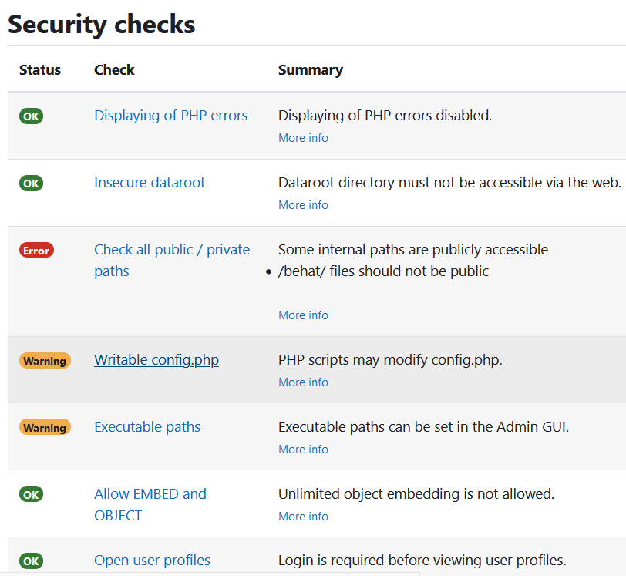
Moodle security report
Checks (only) main settings in Moodle:
Roles and permissions
Write access to config.php
Access to sensible files in Moodle
…
It does not check the server itself!
It does not check weak passwords and wrong role assignments !

Slide 11
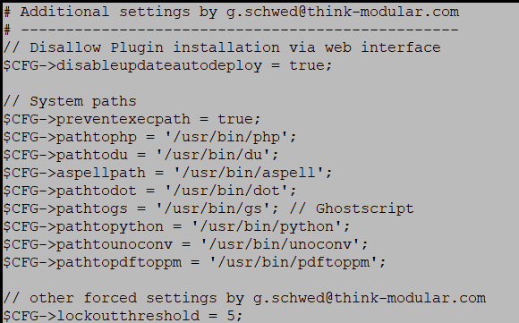
Moodle security improvements
Follow the guidelines in https://moodledev.io/general/development/policies/security
Some improvements need access to server and Apache config files
Server status
Hide some system files
ssl implementation
Ownership of important files (like Moodle config.php)
Additional settings in config.php

Slide 12
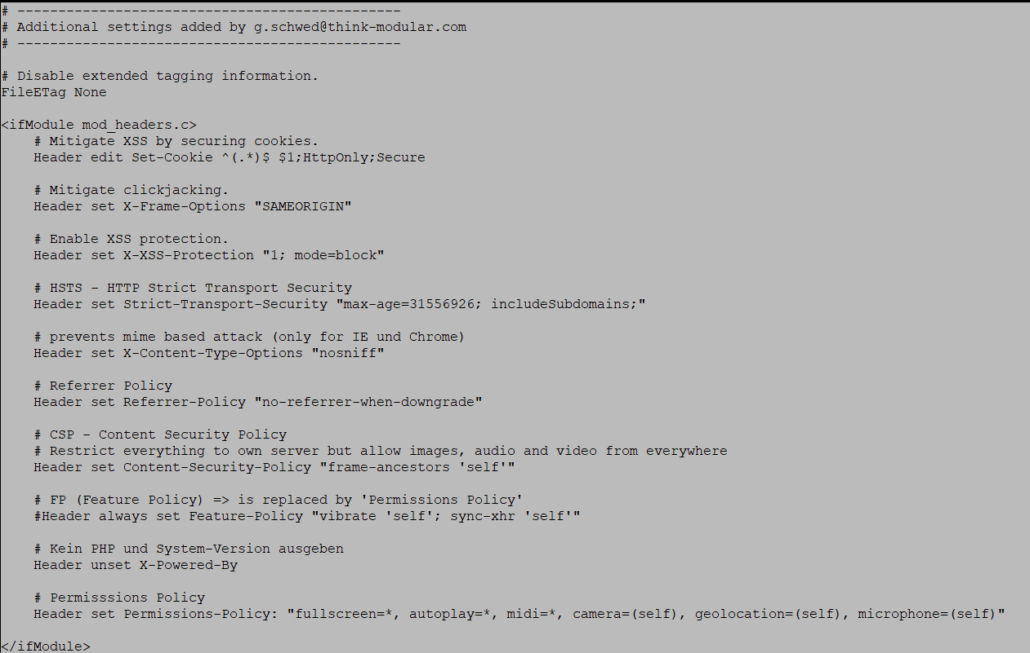
Set HTTP Security Headers
.

Slide 13
Moodle security improvements
Be careful with role assignments. Provide always only minimal rights.
Ev. create additional role “view only” for people who wants to see everything but should not get rights to change everything.
Enable user lockout after n failed login attempts! Very important. Very helpful against brute force attacks.

Slide 14
Performance

Slide 15
Performance – general aspects
Performance tuning is less critical than security issues.
Find the bottleneck!
Network – bandwidth
CPU speed
Amount of RAM / Memory
Speed of Hard Drive / Storage
Database
Configuration – limitation by default settings !
Depends very much on how Moodle is used.

Slide 16
Performance – usage scenarios
Every “active” user needs ~50MB of RAM/Memory. 8GB RAM => ~160 concurrent users.
Use case | Possible bottleneck | Less affected
Access to content, download of (big) files | Disk drive, network | CPU, database, memory
Interactive Content, forum discussions | Database, memory, CPU | Disc drive, network
Quizzes – online assessments | CPU, database, memory | Disc drive, network
Surfing through courses and content | Memory, database | Disc drive, network, CPU
Login | CPU, memory, database | network

Slide 17
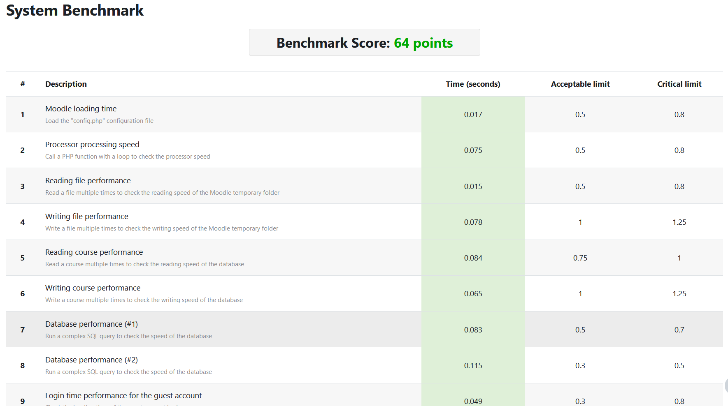
Moodle benchmark report (plugin)
Gives standardized overview of important components and tasks.
Test under load! An idle system is mostly fine.

Slide 18
Improvements
Follow the guidelines: https://docs.moodle.org/400/en/Performance_recommendations
Apache tuning:
Raise MaxRequestWorkers, default: 100 (Be sure to have enough memory!)
Switch from mpm_prefork to mpm_worker or mpm_event
Switch from mod_php to php_fpm (FastCGI-Process-Manager) https://www.cloudbooklet.com/how-to-install-php-fpm-with-apache-on-ubuntu-20-04/
Add more Memory (RAM) (Remember: 50MB for each concurrent user + 1GB for the system itself)

Slide 19
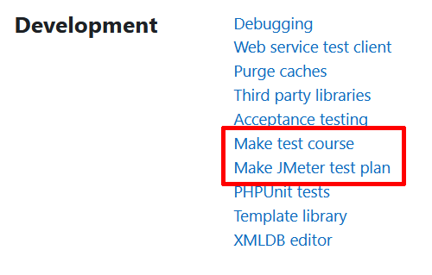
Systematic stress tests with JMETER
Prepare a server and Install Jmeter: https://jmeter.apache.org/
To test Moodle, JMeter needs:
a Moodle course with specific components
100 or 1000 user accounts with usernames + passwords enrolled in to that course
a testplan
Prepare files in Moodle
Enable debug mode
“Make testcourse”
“Make jmeter test plan” (includes user accounts)
Download files and copy to JMeter

Slide 20
Systematic stress tests with JMETER
Ev. adapt testplan in JMeter or just edit the testplan.jmx file.
Run JMeter either via GUI – to see more details or via CLI – better performance. jmeter -n -t <testplan.jmx> [-p property-file] [-l results-file] [-j log-file] -e -o [Path to output folder] (Do high performance tests only via CLI and watch report later.)
Modify the settings of your Moodle server and repeat the tests.

Slide 21
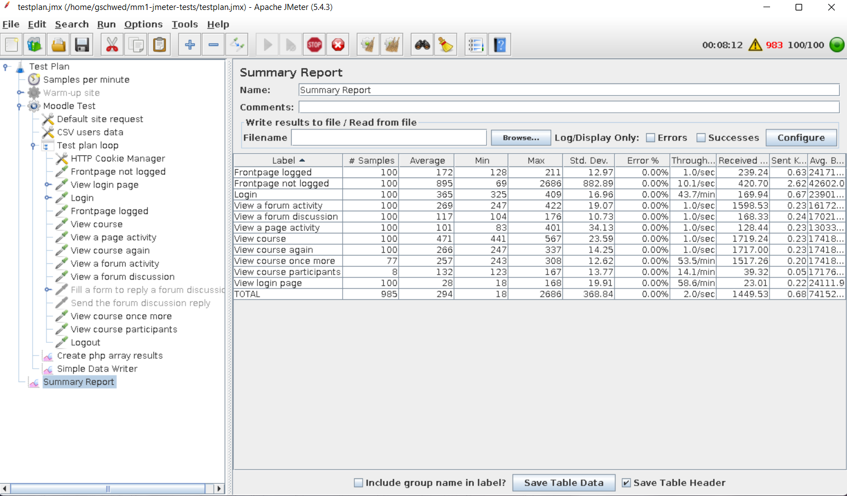
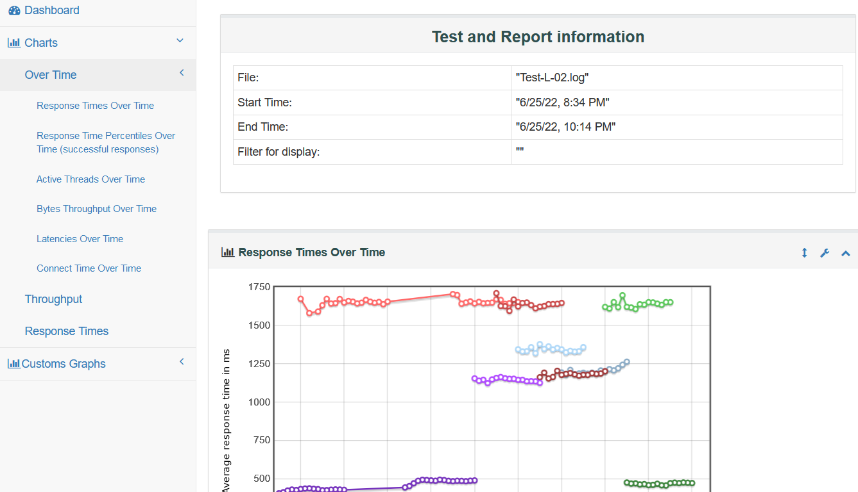
Systematic stress tests with JMETER
.

Slide 22
What can we do for you?
https://tinyurl.com/4ts9dr82
think modular – digital solutions GmbH
Stiegengasse 11
1060 Vienna, Austria
info@think-modular.com

