Slide 1
Building a Federated MoodleNet Site: What We Have Learned So Far
Martin MEADOWS, Don HINKELMAN,
Moodle Association of Japan

Slide 2
Abstract
Building a federated MoodleNet site: What we have learned so far
The Moodle Association of Japan (MAJ) has, for many years now, had a MAJ Showcase for open courseware where members may submit their courses and other self-created content for sharing as OER with fellow educators. Coinciding with the annual MAJ MoodleMoot, an Open Courseware Awards is held, and outstanding courses are awarded with a certificate of excellence and a commemorative prize. The Showcase is a simple Moodle instance with a few tailored plugins that display available courseware in a central window, show useful metadata about each course, and make it possible for site users to add courseware ratings and personalized review comments. With the recent development of a stable and robust MoodleNet, MAJ has initiated a transition from the Showcase to a federated MAJ MoodleNet installation. While still incomplete, this presentation will discuss what we have learned in the process of transition; problems encountered and resolved, customizations implemented, and visions for the future of localized and federated MoodleNet sites.

Slide 3
Outline
Introduction
Experiences making a MoodleNet Server
History of Sharing Content in MAJ
Questions for the Future

Slide 4
History:
2006: Repository
2007: Sharing Cart
2008: Publish >> Moodle.net
2010: Hub >> Showcase
2012: Best Open Courseware Awards
2020: MoodleNet

Slide 5
Repository (2006)
What is useful to share?
A. Learning objects? or
B. Whole courses?
(Johnson & Hinkelman, 2006; 2008)

Slide 6

Sharing Cart (2007)
1. Hub
Share whole course
2. Sharing Cart
Share course items
*2300 sites *Top10 block
https://moodle.org/plugins/stats.php?plugin=block_sharing_cart

Slide 7
Publish >> Moodle.net
2008: Publish >> Moodle.net
Course Administration: Choose a hub
Click “Publish”
Send to sharing hub
Enter metadata

Slide 8
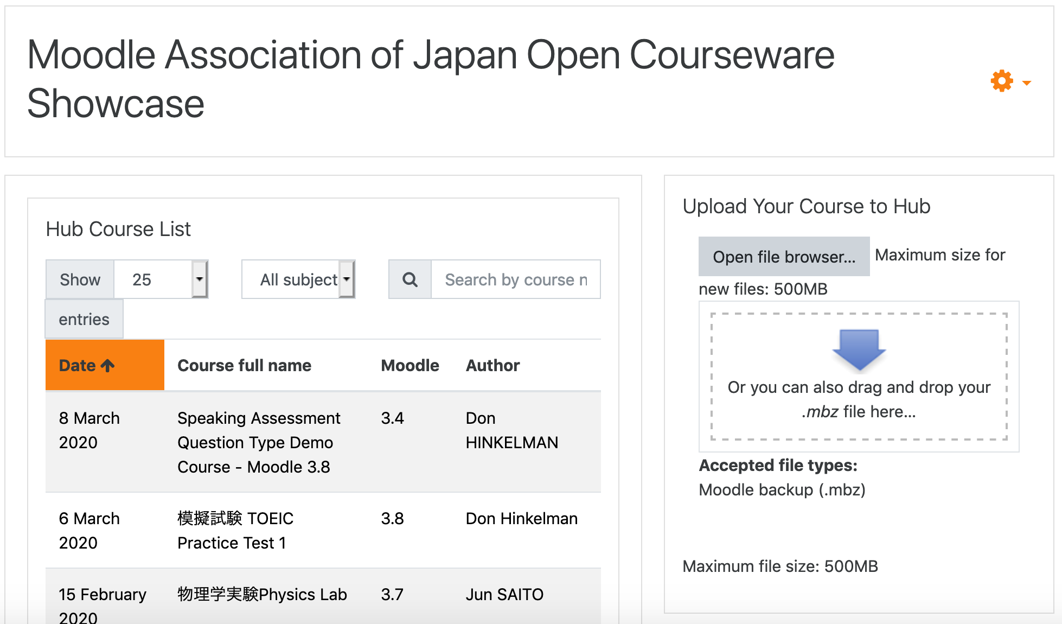
Hub >> Showcase
2010: MAJ Hub >> MAJ Showcase

Slide 9
Hub >> Custom Plugins
2018: Three custom blocks for hubs
(by Ponlawat Weerapanpisit, Chiang Mai University)
HubCourseList: (center column listing)
https://github.com/ponlawat-w/moodle-block_hubcourselist
HubCourseInfo: (metadata, ratings, reviews)
https://github.com/ponlawat-w/moodle-block_hubcourseinfo
HubCourseUpload: (drag-and-drop)
https://github.com/ponlawat-w/moodle-block_hubcourseupload

Slide 10

Best Open Courseware Awards
2012:

Slide 11



Slide 12
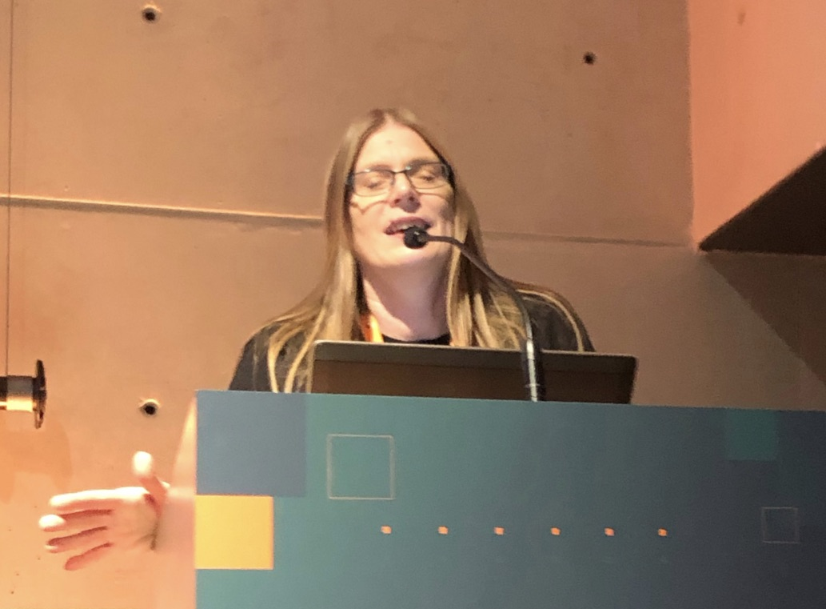
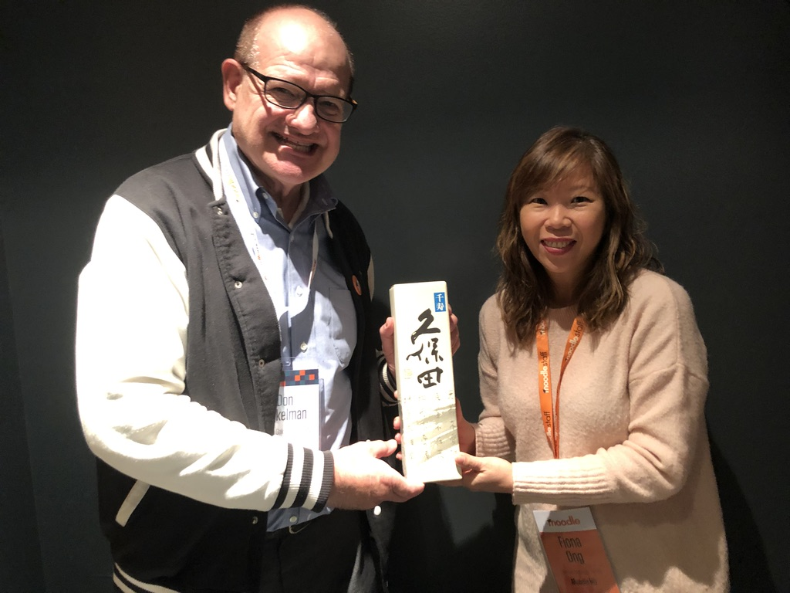



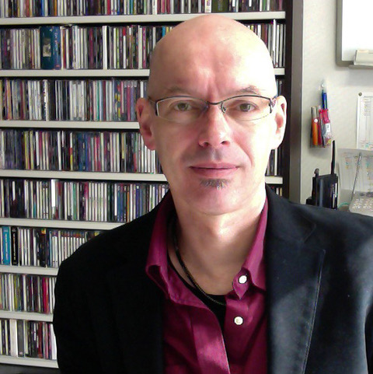
Volunteers
Past judge: Mary Couch
1 week
Moodle HQ Fiona Ong, Asia Marketing Chief
Classroom Teachers: Science, Foreign Languages, Computer Skills

Slide 13

MoodleNet
2020: MoodleNet >> Communities?

Slide 14
Why a local MoodleNet?
We want to curate our own resources.
We want to be the face of Moodle in Japan.
We want to create a local community based on shared resources.
We want to tie it in with our annual conference/Moot and Showcase awards.
We want to create a repository of Japanese-language resources managed in Japanese.

Slide 15
Why MoodleNet?
The Future
Federation
- The chance to push our resources to a wider audience and share
with the global Moodle community
- allows the world to find us more easily
- open to all (no logins)
Future-proof architecture – fast, robust, secure
Broadens the scope if things that can be shared

Slide 16
Showcase >> MoodleNet
Linode server: Shared CPU / 1GB RAM / 1 core / 25GB storage
Debian 11
Install node.js (easy)
Install arangoDB (easy)
Install & configure MoodleNet …. Not so easy.
- documentation?
- https?

Slide 17
Where are we now?
A MoodleNet site that is viewable on web browsers.
- create user accounts
- upload content
Showcase (Moodle 4.0)
- customized
- 10 yrs of content
- accessible to existing MAJ site users

Slide 18
Where do we go from here?
Customize our MoodleNet (just logo)
Transfer content from the Showcase
Promote MAJ MooodleNet and encourage content sharing
Get federated (MoodleNet 3?)
Upscale server depending on use (more storage, more RAM)

Slide 19
Questions/concerns for the Future
How do we get federated?
How long do we keep the MAJ Showcase?
How do we “try before we buy”?
How do we reward excellence and encourage contributions?
How do we access the opinions of other users—recommendations?
How to develop a collection or course with a team?
How will we manage contributions?
How can we personalize and “take ownership” of our MoodleNet?

Slide 20
Building a Federated MoodleNet Site:
What We Have Learned So Far
Martin Meadows
meadows@nayoro.ac.jp
Don Hinkelman
hinkelman@mac.com
2022.09.29 MoodleMoot Global Barcelona

