Slide 1
Assessment Rubrics for Moodle courseware:
Two models
Martin Meadows
Nayoro City University
JAPAN
Sille Paas
Tallinn University of Technology
ESTONIA
Global MoodleMoot 2022 - Sept. 27th, 2022
Barcelona SPAIN

Slide 2
presentation outline
General considerations in assessing courseware
Framework: The Assessment Purpose Triangle (Archer 2017)
Estonian e-course quality label
MAJ Open Courseware “Showcase” Awards
Comparison of two models
Questions & comments

Slide 3
What makes A good Moodle COURSE?

Slide 4
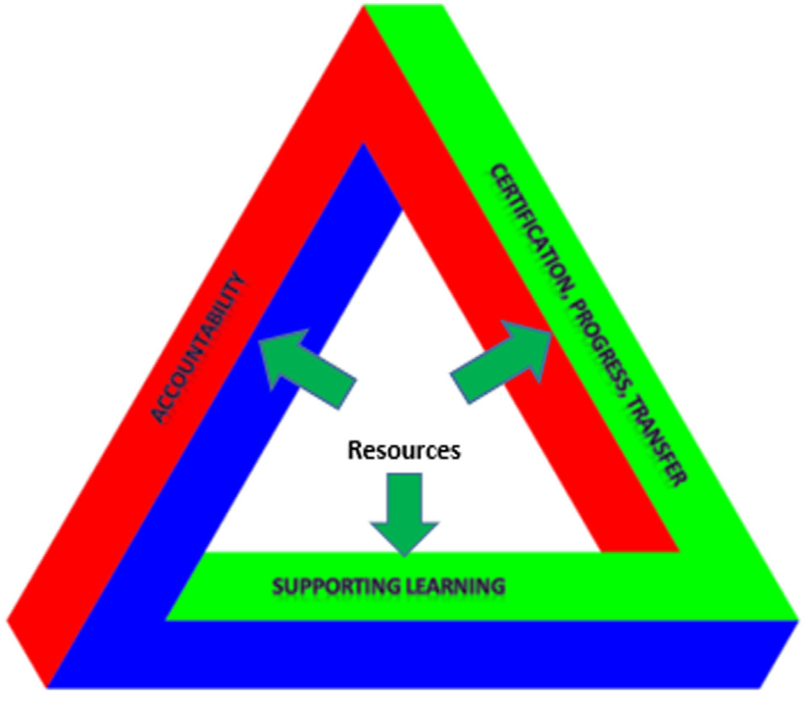
Why Assess COURSeware? PURPOSE & priorities
The Assessment Purpose Triangle (Archer, 2017)
ASSESSMENT FOR LEARNING (PEDAGOGICAL)
ASSESSMENT FOR ACCOUNTABILITY (ETHICAL, COMMUNAL)
ASSESSMENT FOR CERTIFICATION, PROGRESS & TRANSFER (INSTITUTIONAL)
Balancing priorities for equity, not equality
Archer (2017)

Slide 5
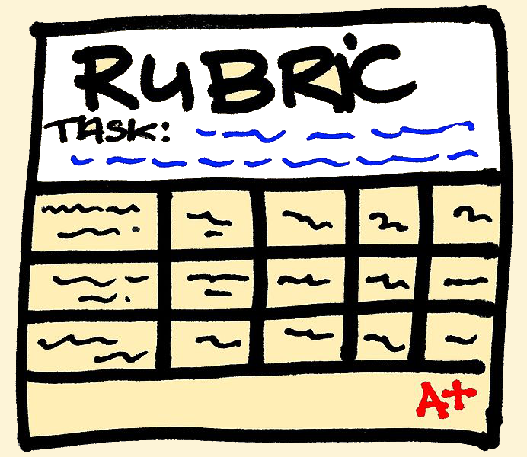
HOW TO ASSESS: Rubrics for multiple purposes
Categories for assessment - detailed levels of analysis and data points
Contexts of use - holistic assessments of features that are not easily quantified.

Slide 6
WHO DOES THE ASSESSing?
Learners
Content creators / teachers
Institutional members - colleagues and superiors with specific, contextual knowledge
External experts - experienced courseware and content creators with a wider perspective
Others - parents? politicians? lobbyists?

Slide 7
Two ASSESSMENT models
Estonian E-course quality LABEL
MAJ Open courseware awards

Slide 8
Estonian E-course Quality label
Increase the quality of e-courses in:
higher education,
vocational training
and general education

Slide 9
E-course Quality Label (LogoS)

Slide 10
ADDIE MODEL

Slide 11
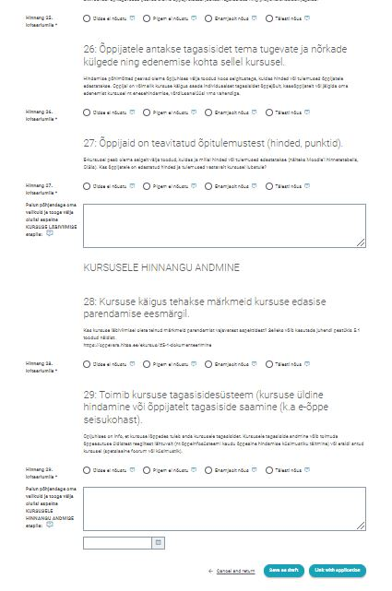
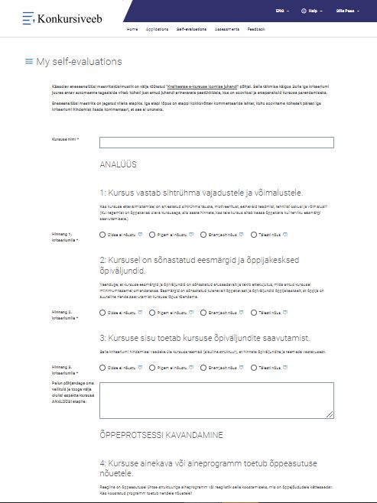
ONLINE SELF-EVALUATION

Slide 12
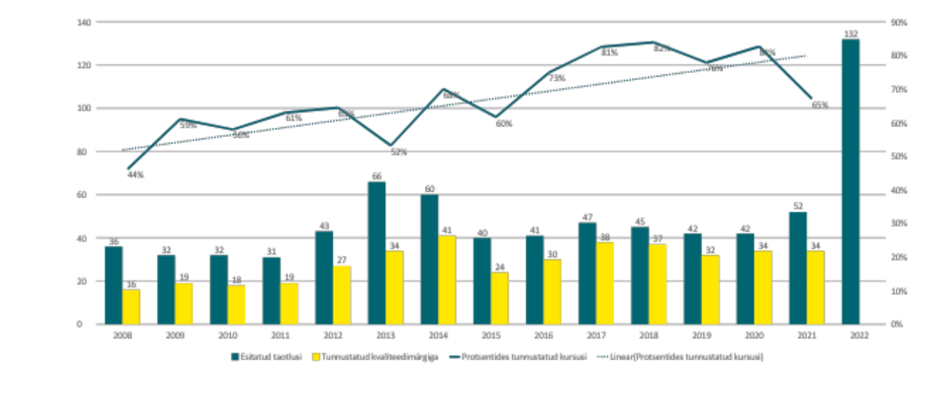
SUBMITTED COURSES per Year

Slide 13
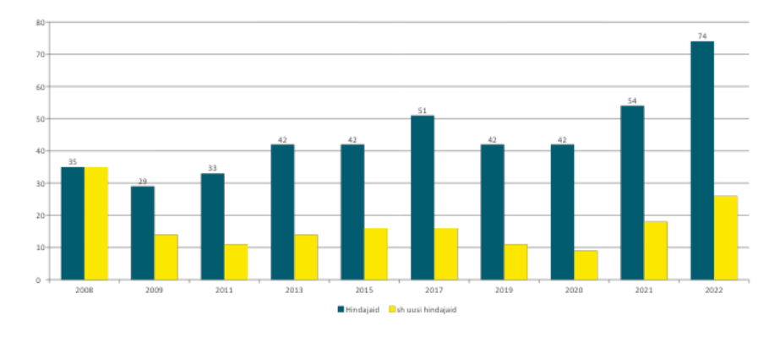
Judges per Year

Slide 14
judGing Process 1. Seminar for the new Judges + grouping
2. Confidentiality agreements 3. Individual assessments
4. group assessments + Mentor
5. Best E-course seminar
6. Sending anonymous feedback to the course author

Slide 15
MOODLE ASSOCIATION OF JAPAN (MAJ): SHOWCASE

Slide 16
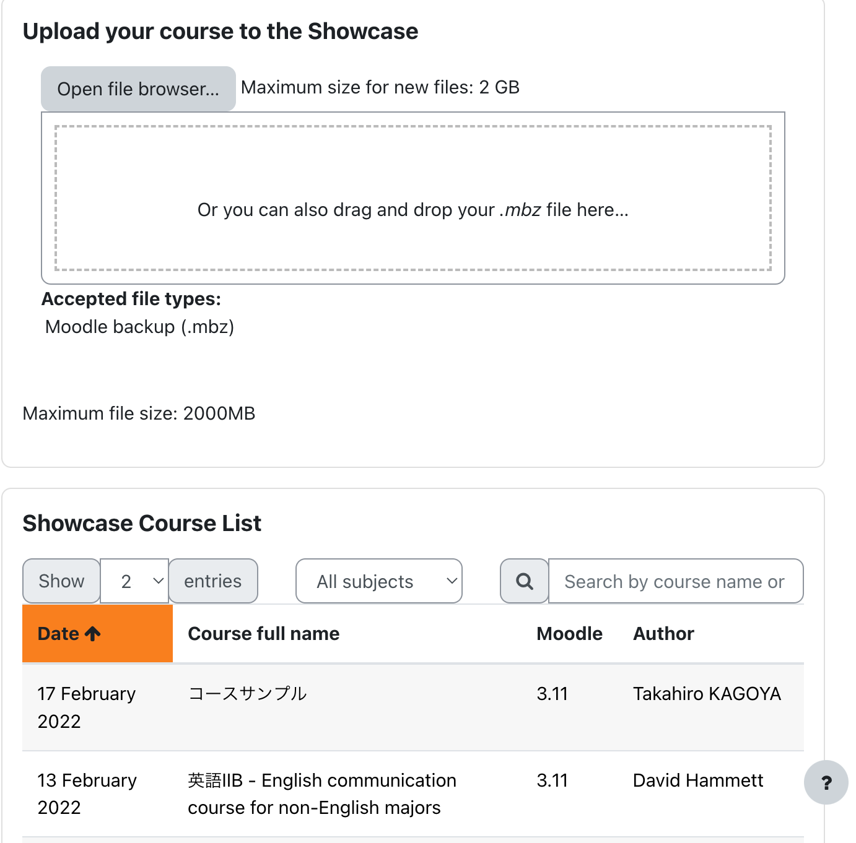
MOODLE ASSOCIATION OF JAPAN (MAJ): SHOWCASE

Slide 17
PURPOSES OF ASSESSMENT TRIANGLE
ASSESSMENT FOR LEARNING: striving for excellence of content - well-designed & varied activities that incorporate multi-media and creative plugins - interactivity and timely feedback - appropriate amount / extensiveness of content
ASSESSMENT FOR ACCOUNTABILITY: striving to serve the Japanese Moodle community - value courseware in Japanese (languages other than English) - seek to promote a wide range of content topics / subjects - value courseware that provides fair and transparent assessment of users (grade book) - encourage teachers to create original and open/shareable content (OER)
ASSESSMENT FOR CERTIFICATION, PROGRESS & TRANSFER: striving to give credibility and authority to stakeholders in Japan - opportunity for advancement - provide opportunities to teachers & content creators to build portfolios for advancement - posit MAJ as a body of authority with Moodle expertise - create a Japan-wide standard of quality

Slide 18
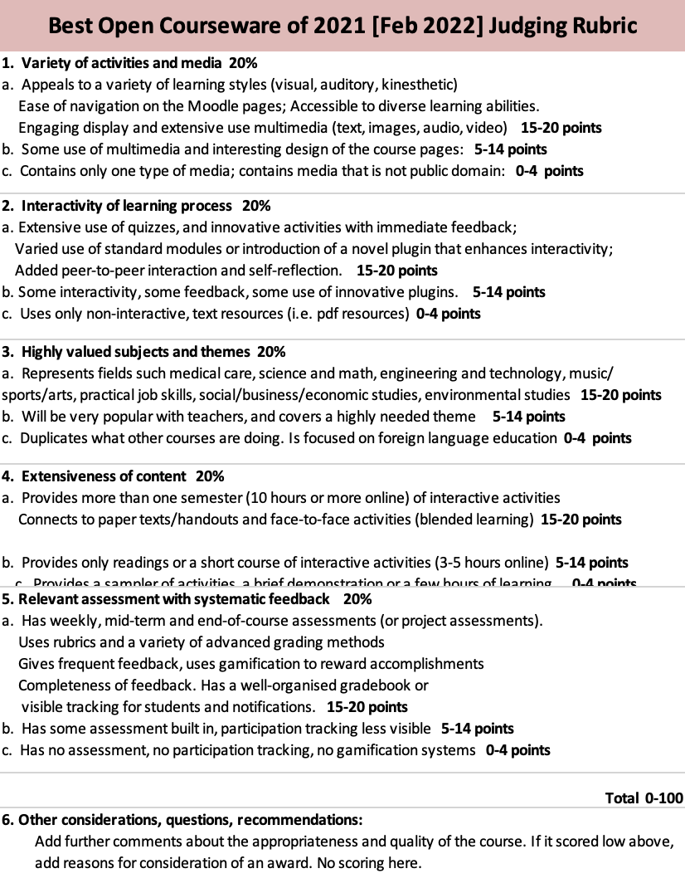
THE ASSESSMENT RUBRIC (2021)
Five (5) categories
1. Variety of activities & content
2. Interactivity of learning process 3. Highly values subjects & themes
4. Extensiveness of content 5. Relevant assessment with systematic feedback + other considerations/comments (holistic)

Slide 19
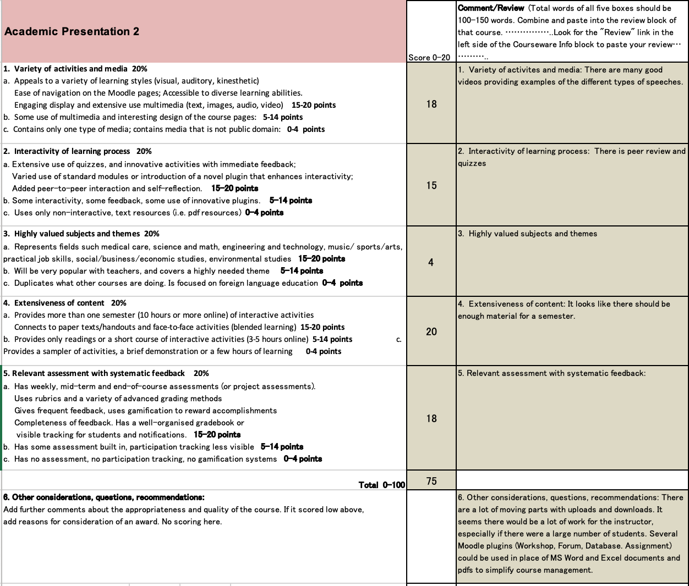
JUDGING PROCESS
panel of about 10 judges
submission deadline
3-4 courses / judge
results compiled
feedback posted
judge meeting
award ceremony
certificates & prizes

Slide 21
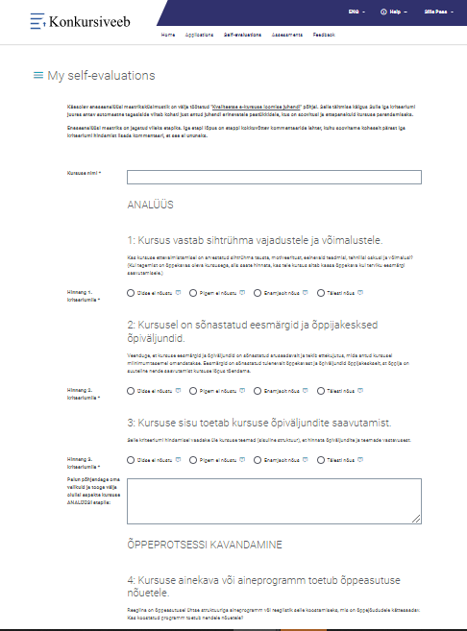
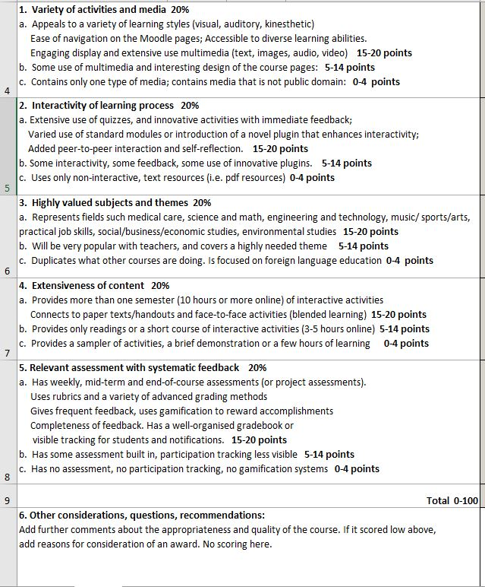
Estonian matrix (29 Q) vs Japanese Matrix (6 Q)
Notes:
https://konkursiveeb.edu.ee/ee/minu_eneseanalyysid?4b85b0f8068c7744f89023a0e93f98063b92469894b5d05579e9fa75bb0741da

Slide 22
e-course evaluation - Estonian vs Japanese system
Feature | Japan | Estonia
Moodle courseware | Yes, to promote Moodle | Yes, but not necessarily
Self-evaluation | No | Yes
Access to original e-course site | possible | Yes
Technical information about the course | Moodle ver. / plugin info | Maybe
Downloadable courses | Yes open courseware | No
Preparation support | Published rubric only | Available
Anonymous judges/evaluators | No | Yes
Bonus points | Additional comments | Yes
Judging process | One week | 4 months
Winner Prizes | 1-2-3 Cert/mug | Top 10 /1st=€2000

Slide 23
Two ASSESSMENT models
MAJ Open courseware awards
Estonian E-course quality LABEL
Two models. How would yours be different?

Slide 24
meadows@nayoro.ac.jp
sille.paas@taltech.ee

Slide 25
References
Archer E. (2017) The Assessment Purpose Triangle: Balancing the Purposes of Educational Assessment. Frontiers in Education, 2:41. doi: 10.3389/feduc.2017.00041
On-line sources:
https://moodle.taltech.ee/course/view.php?ID=5946
https://ekka,edu.ee/e-kursuse-kvaliteedimark
https://oppevara.edu.ee/ekursus/#ekursus
https://sites.google.com/view/kvaliteedimark2022
https://showcase.moodlejapan.org

