Slide 1
Histopoly: Moodle, H5P and Monopoly holding hands
Hugo Ribeiro
Educational Technologist
Ricardo Marcos Professor
University Of Porto, Portugal

Slide 2
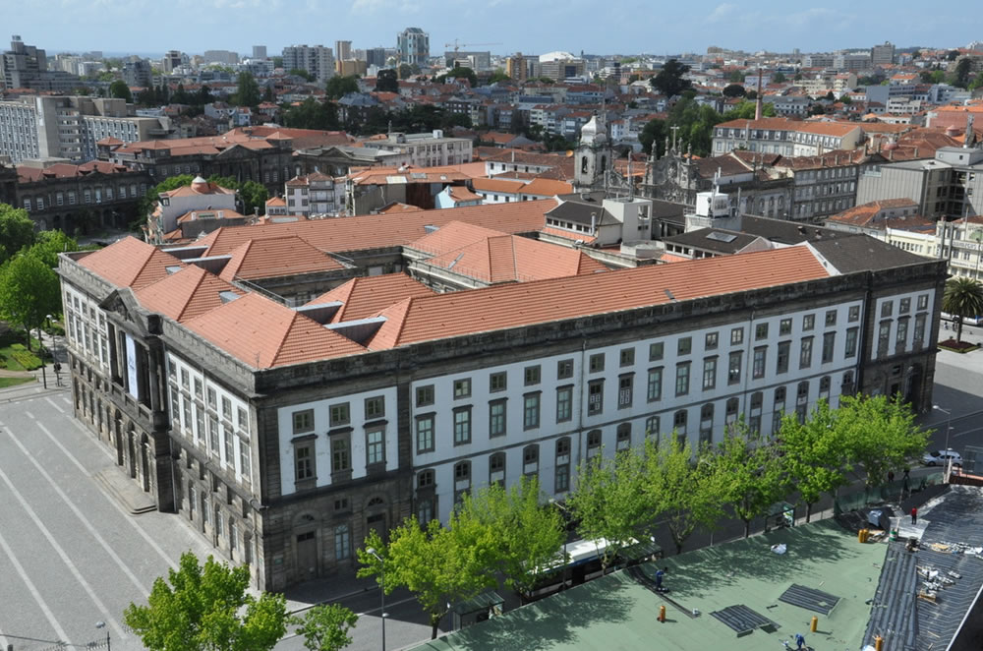
Technologies for Education Office
Support teachers that combine F2F classes with on-line component;
Staff training;
On-line tutoring;
LMS management;
Support to online assessment;
Multimedia development;
30k students;
4k teaching staff;
2 Moodle Installations;

Slide 3
Course Context
Animal Histology course
Master in Veterinary Medicine
Tissues analysis based upon images
Around 50 students
Low motivation and involvement from students
Gamification as a strategy

Slide 4
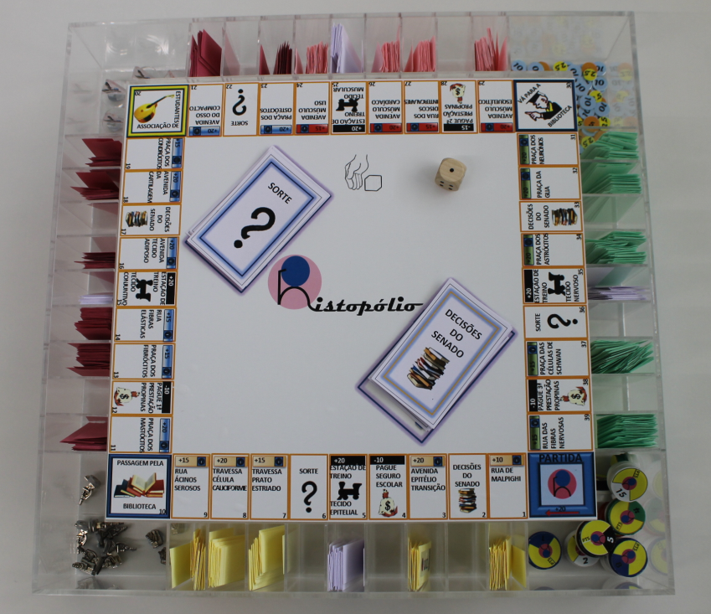
Histopoly I
Board game based upon Monopoly©
Cards and tiles related to Histology
Played on class
QR Codes linking to h5p.org
Questions tiles
Help tiles
Buy out badges
Physical version of Histopoly

Slide 5
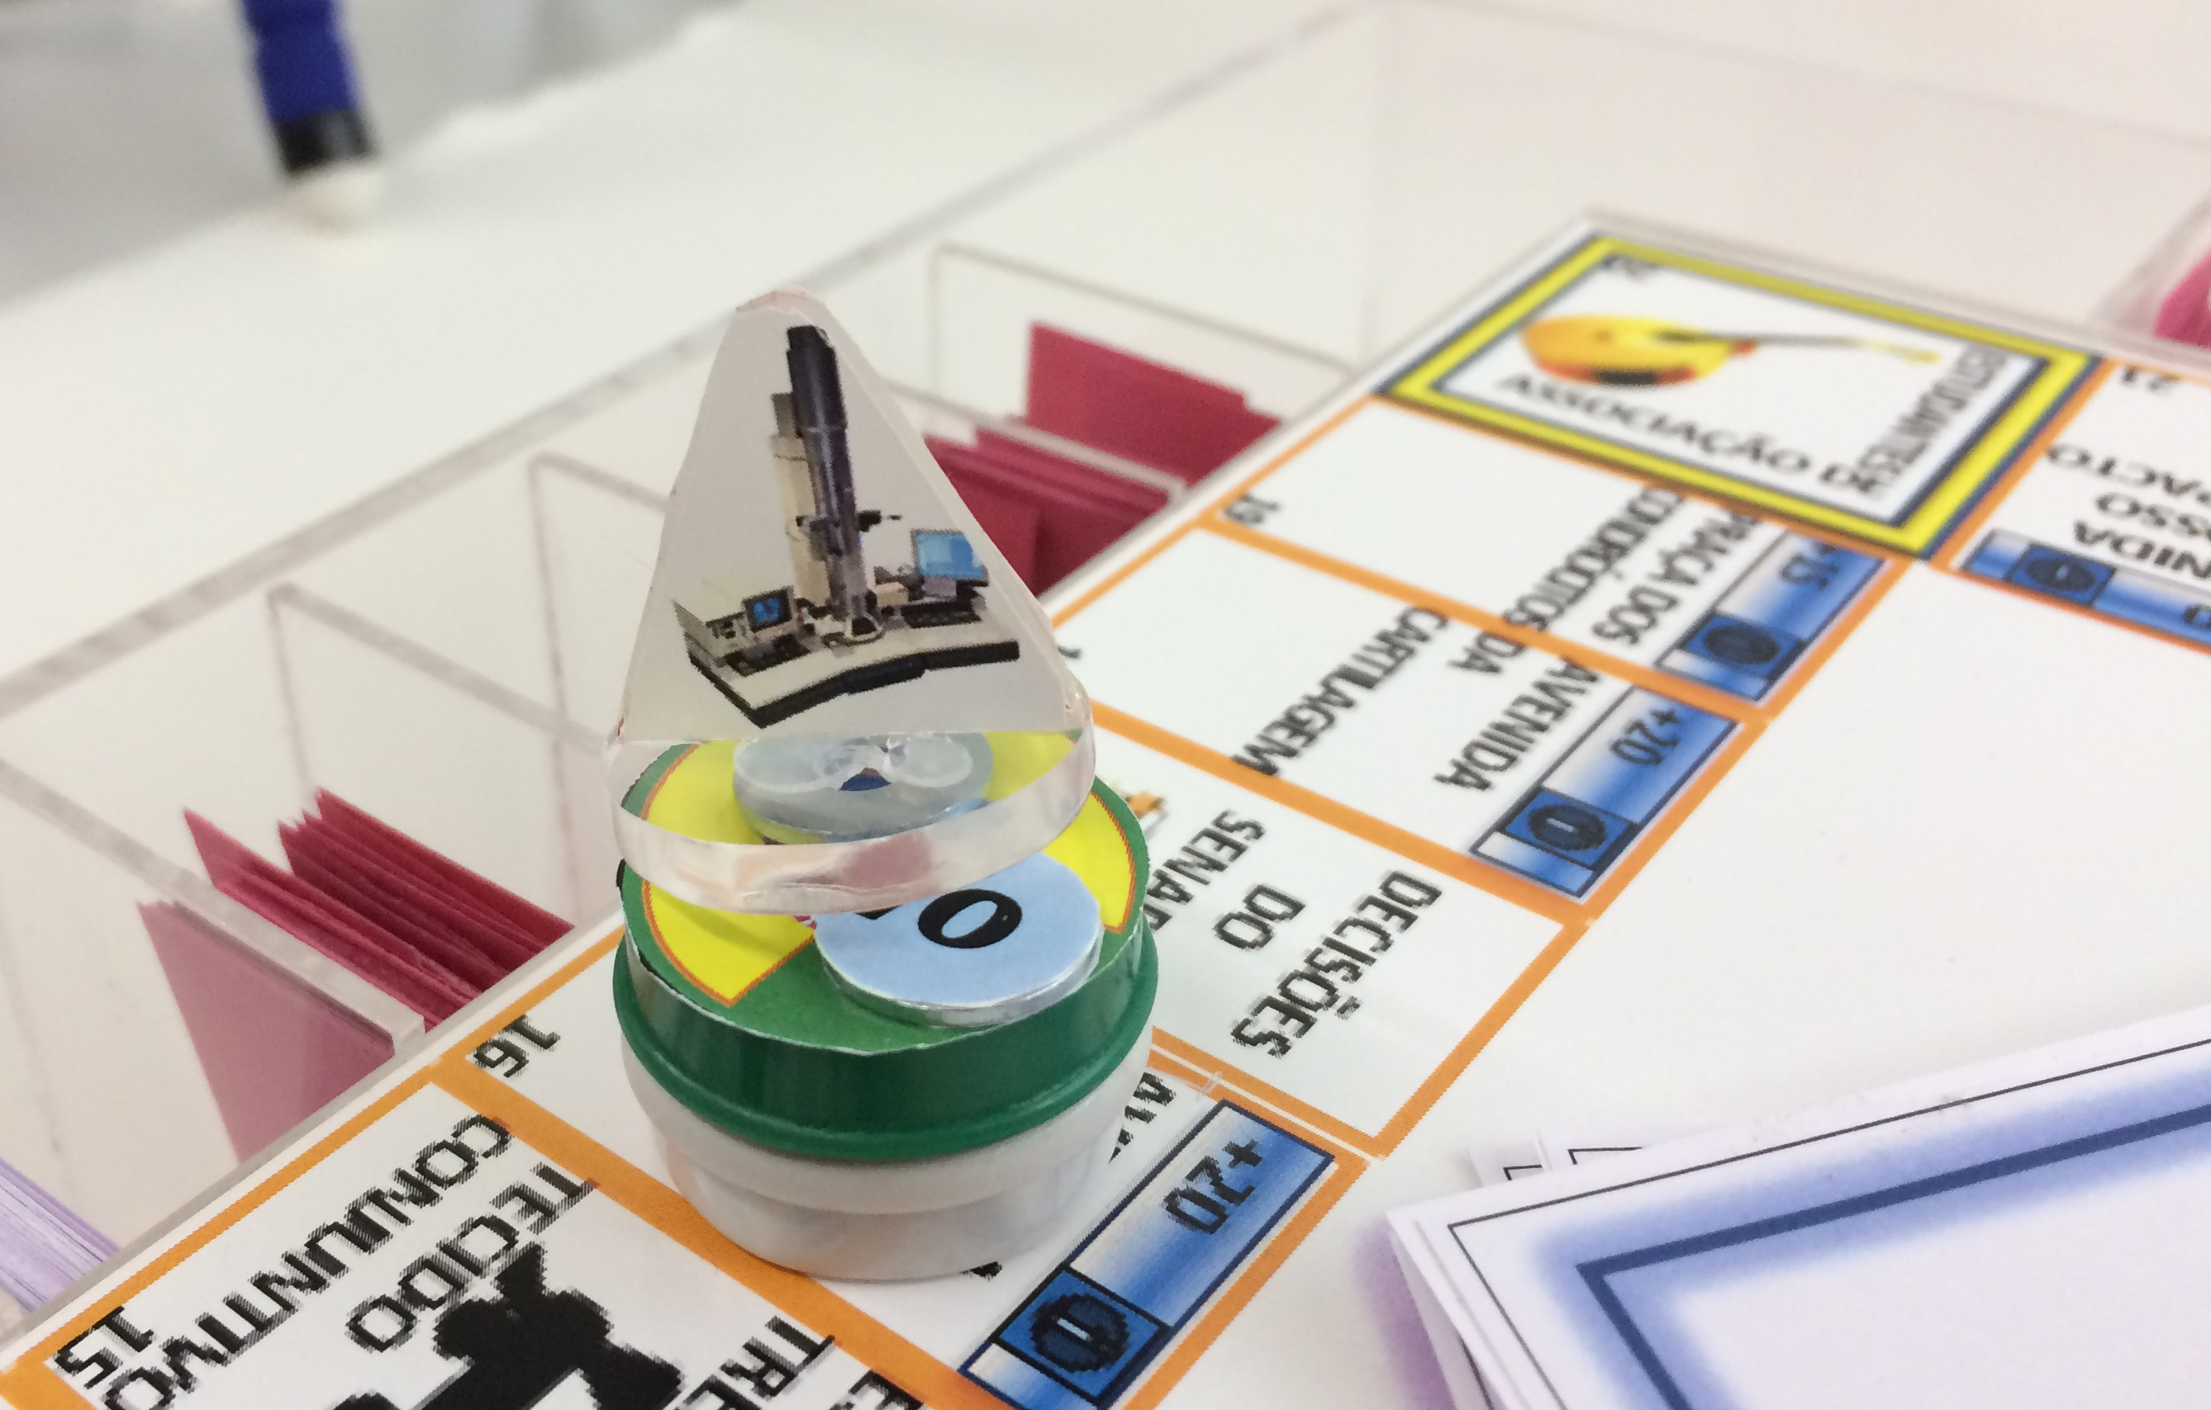
Microscopes Badges
Notes:
Headline, image and dot points slide

Slide 6
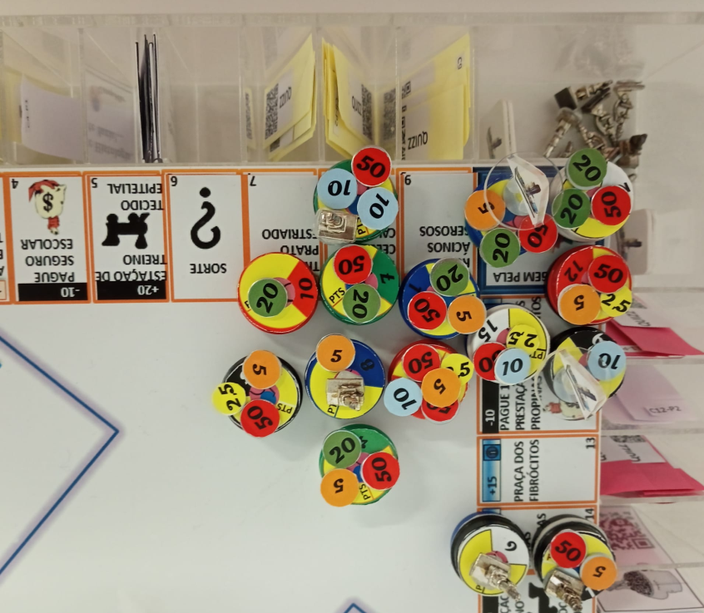
Histopoly I - Issues
Easy to cheat
Lack of analytics
Tracking points

Slide 7
Histopoly II
Using Moodle and H5P
Auto enroll
QR codes linking to H5P stealth activ
Grade = 0/1
Grade to pass = 1
Activity completion: get a grade

Slide 8
Histopoly II - Issues
H5P questions
Time for development
Adding new questions

Slide 9
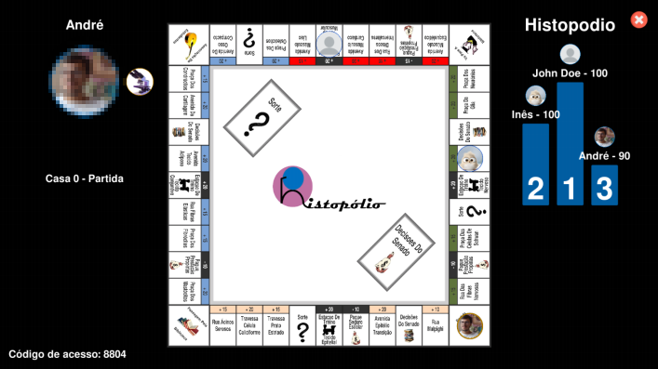
Histopoly III
Fully digital
Web app
Unity engine
Manageable board
Manageable questions
Custom reporting

Slide 10
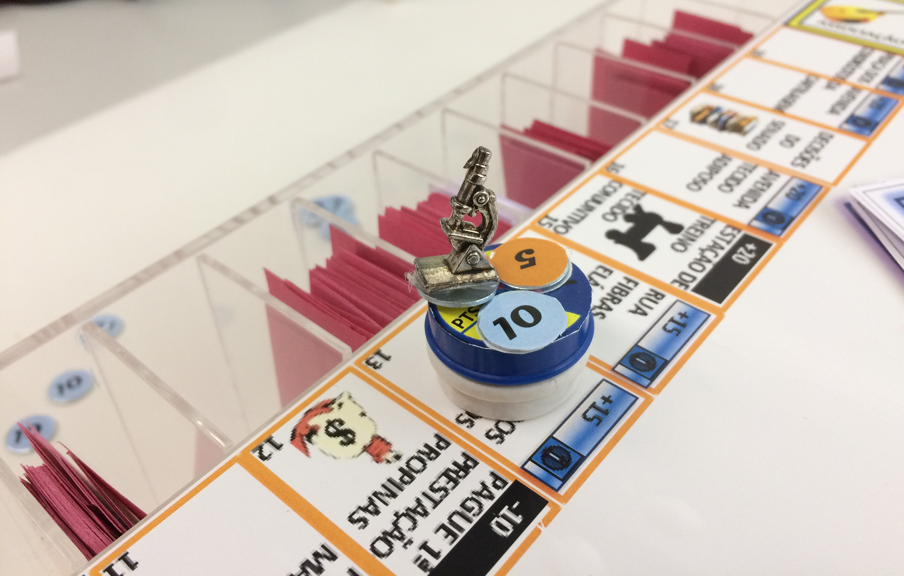
Achievements
Have the grades improved?
Has the motivation improved?
Was it worth it?

Slide 11
Closing slide
Hugo Ribeiro
hribeiro@uporto.pt

