Slide 1
think modular
Digital Learning Agency
Using Moodle in Developing Countries
Gerald Henzinger
Notes:
Title:Using Moodle in Developing CountriesAuthors:Gerald Henzinger - Think modular - digital Solutions GmbH, Austria; Gerhard Schwed - think modular - digital solutions GmbH, AustriaSession:Supporting an international and diverse community - Catalyst Room, 27/09/2022, 10:30 - 13:00Time:12:30 - 13:00
Using eLearning in developing countries come with challenges and opportunities. Major challenges may be limited digital access due to unstable internet or power as well as economic factors.
Nevertheless, there are opportunities in that area. Digital Devices like Smartphones become more affordable and the motivation for gaining competencies is very high, especially in developing countries.
These circumstances require a creative learning design and technology, which allows your users to access. Concepts like offline learning, “Bring Your Own Device” (BYOD) thin content and a smart scaffolding of asynchronous and synchronous interactivities are part of the implementation.
We would like to share our experiences in setting up eLearning Projects in the developing context and showcase these using Moodle and the Moodle App as learning platforms.
You will see projects in Malawi, using the Moodle App or a Teacher training Setup in Rwanda or a prototype of a local ContentBox implementation using the RaspberryPi and 3D Printed case with Moodle installed.

Slide 2
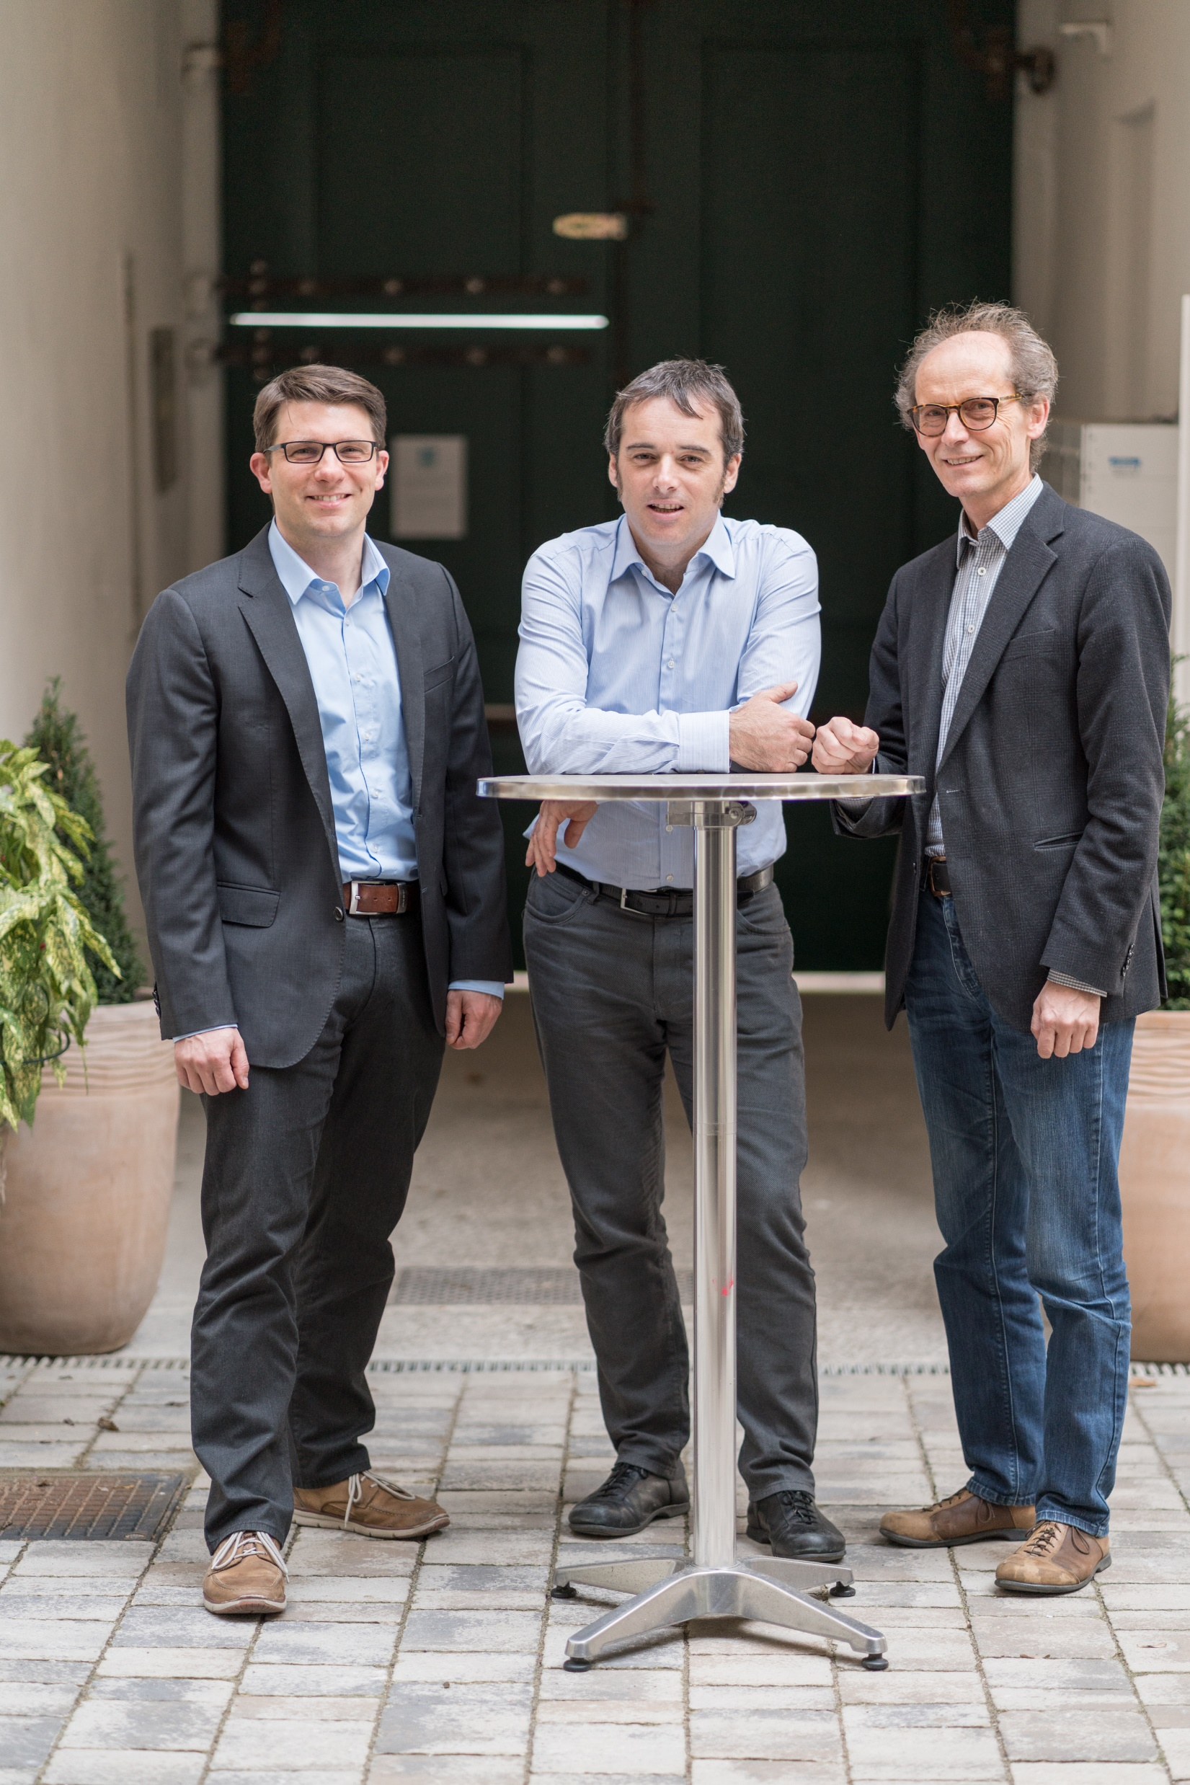
About us
Creating engaging eLearning environment since 2019
Based in Vienna/Austria
3 founders and 10 eLearning experts, programmers, instructional designers…

Slide 3
think modular – one stop shop
Conception and implementation of eLearning Strategies
Training and communication in digital learning
Digital Platform and Content development
Application Services (SaaS) (Moodle, Drupal…)

Slide 4
Where we are
Notes:
Derzeit in ca. 15 Ländern auf vier Kontonenten aktiv

Slide 5
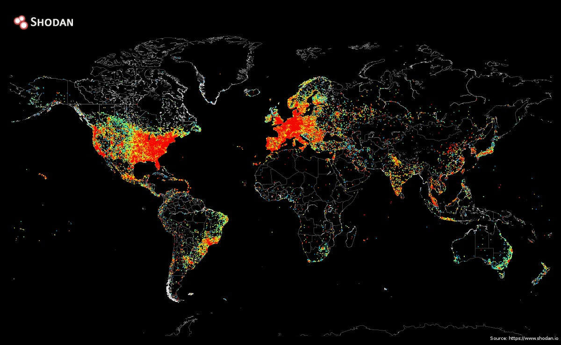

Slide 6
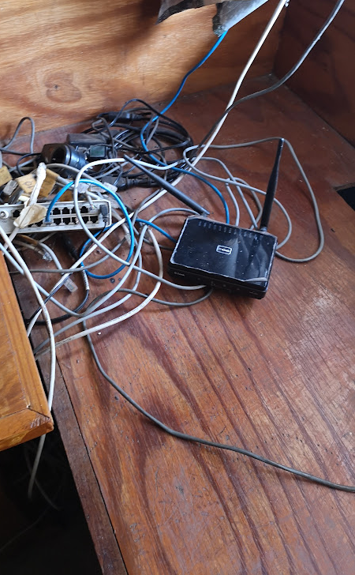
Challenges
Unstable Internet
Unstable Power
Devices uncertain
Security (content)
Economic limitations
Content development limitations

Slide 7
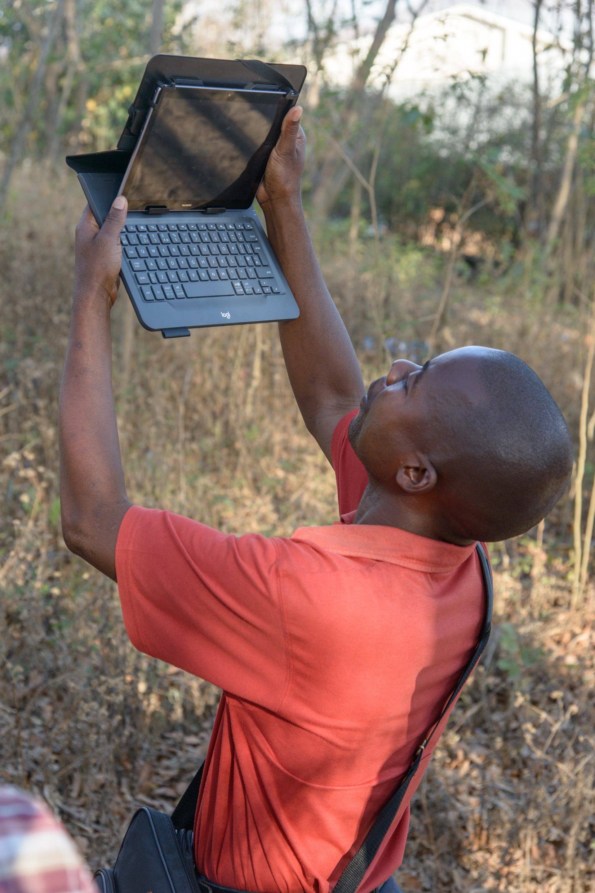
Opportunities
Strong demand
High Impact
Global delivery
empowerment

Slide 8
Some Aspects
Learners
Technology
Didactics
Content development
Delivery of learning
Sustainability

Slide 9
Content criteria
Content
Typical size
Preferrable devices
Resources for production
Notes:
Some criteria for choosing conten. Not all of them might be relevant to you. Eg. When you get ready made content
Typical size: how large can content be? Video vs. Text
Playable devices: Is this content useable on the preferred devices. Video vs. Text
Resources for production: How many resources do you need for production and adaption. Consider also localization
Integration: Is it easy to integrate content into your onlien learning especially on the LMS. Interactive content may be more complicated to integrate than eg. textfiles

Slide 10
Example: Video
Vergleich video
Notes:
2,8mb vs. 660k: Faktor 5

Slide 11
content
Media | Typical size | Devices | Resources for production | Added value | Comment
Images | 100kb – 5mb | Mobile, desktop | Low-mid | Images are sometimes easier to understand than text | Compress for saving bandwith
Video | 3mb(screen casts) – 50mb | Mobile, desktop | Mid-high | Keep videos short - max. 5 min | Transcode for saving bandwith. Bear in mind the resolution
Audio | 100kb – 3mb | Mobile, desktop | Mid-high
PDF | 50kb – 10mb | Mobile, desktop | Low-mid | Text and images. Maintains the integrity of the document. Document cannot be edited. | Easy to create. No video and sound
Interactive Video | Same as video | Mobile, desktop | Mid-high | Very effective. Hotspots to external links, quizzes…content creation needs to be executed well | Same as video. Offline with Camtasia, otherwise just online

Slide 12
Criteria activities
Activity
Usability
Management resources
Offline capabilites
Devices
Synchronous vs. asynchronous
Notes:
Usability: for the participant. Can you use the interactivity straight forward or do you need to introduce it explicitly to the participant
Management resources: What effort is needed to manage, tutor, moderate this interactivity.
Synchronous vs. Asynchronous: Impact on the responsetimes and the offline availability.
Offline capable: Is this interactivity available offline. Relevant if you use offline learning. Relates trongly to the sync and async capabilities of the
Devices: Depends mostly on the LMS implementation. Eg. If the LMS offers also an App version which can provide downloadable content.

Slide 13
Interactions
interaction | usability | Management resources | Synchronous vs. asynchronous | Devices | Offline
Forum | Yes, but needs an introduction | Moderation can be challenging | asynchronous | Mobile, desktop | In Moodle App: Yes
Assessment | Needs introduction |  | asynchronous | Mobile, Desktop | In Moodle App: Yes
Whatsapp group | Very easy | Moderation can be challenging | asynchronous | Mobile | Yes
Moodle Chat | Easy to use | Moderation can be challenging | synchronous | Mobile, Desktop | No
Feedback | Easy to use | Support to the participant | asynchronous | Mobile, Desktop | Yes
Checklist | Easy to use | Trainer needs to support and evaluate | asynchronous | Mobile, Desktop | No
Peer review | Needs introduction | Trainer needs to support | asynchronous | Desktop | No
Messaging | Easy to use | Reponse times should not be too long | asynchronous | Mobile, Desktop | Yes
Self learning Modules | Depend on the ID of the Module | Effort in content creation. No effort in using it | asyn | Mobile, Desktop | In Moodle App: Yes
Quizzes | Easy to use, needs introduction | Development of questions can be challenging. | asynchronous | Mobile, Desktop | In Moodle App: Yes
Video conferencing | Vc is very common in the meanwhile | Good bandwith, headset, moderating | synchronous | Mobile, Desktop | No
Activity | Usability | Management resources | Synchronous vs. asynchronous | Devices | Offline
Forum | Yes, but needs an introduction | Moderation can be challenging | Asynchronous | Mobile, desktop | In Moodle app: Yes
Assessment | Needs introduction |  | Asynchronous | Mobile, desktop | In Moodle app: Yes
WhatsApp group | Very easy | Moderation can be challenging | Asynchronous | Mobile | Yes
Moodle chat | Easy to use | Moderation can be challenging | Synchronous | Mobile, desktop | No
Feedback | Easy to use | Participant support | Asynchronous | Mobile, desktop | Yes
Checklist | Easy to use | Trainer to support and evaluate | Asynchronous | Mobile, desktop | No
Peer review | Needs introduction | Trainer to support | Asynchronous | Desktop | No
Messaging | Easy to use | Response times should not be too long | Asynchronous | Mobile, desktop | Yes
Self learning modules | Depends on the ID of the module | Effort in content creation. No effort in using it | Asynchronous | Mobile, desktop | In Moodle app: Yes
Quizzes | Easy to use, needs introduction | Development of questions can be challenging. | Asynchronous | Mobile, desktop | In Moodle app: Yes
Video conferencing | VC is very popular | Good bandwith, headset and requires moderating | Synchronous | Mobile, desktop | No

Slide 14
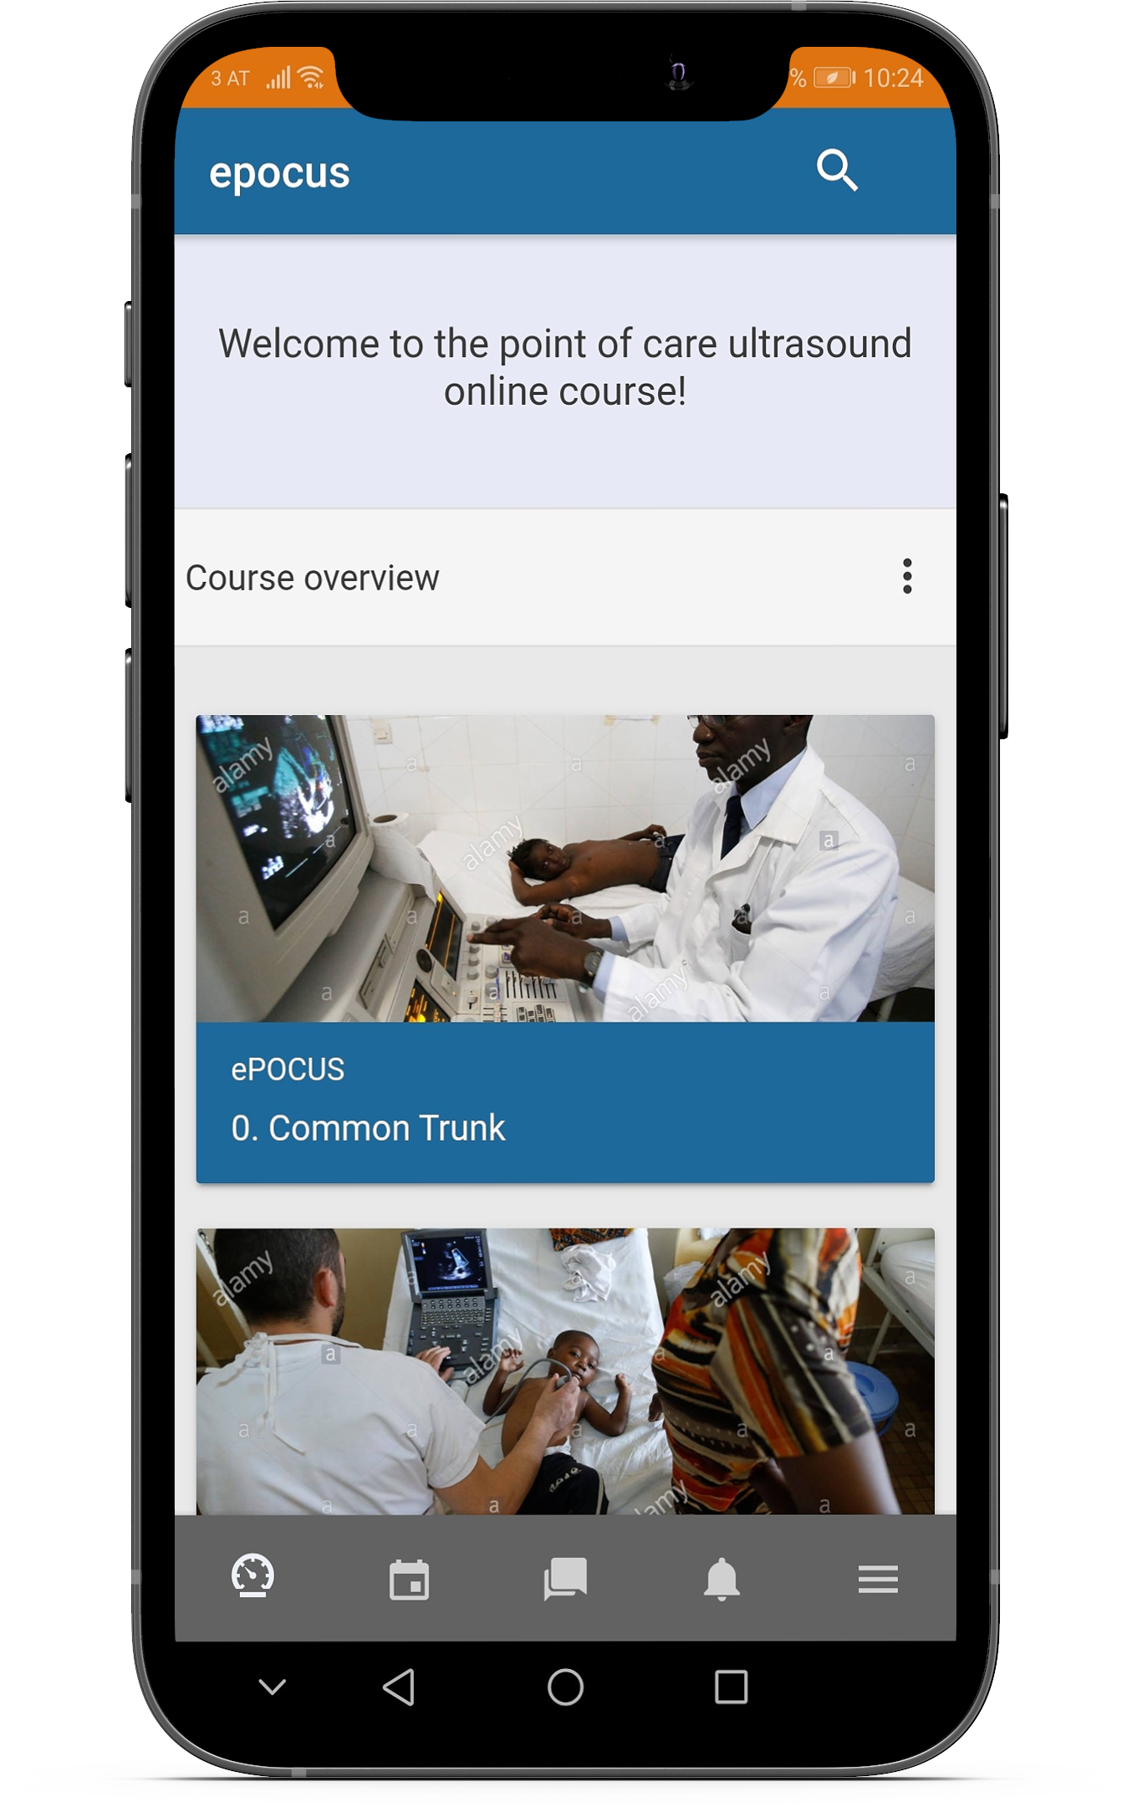
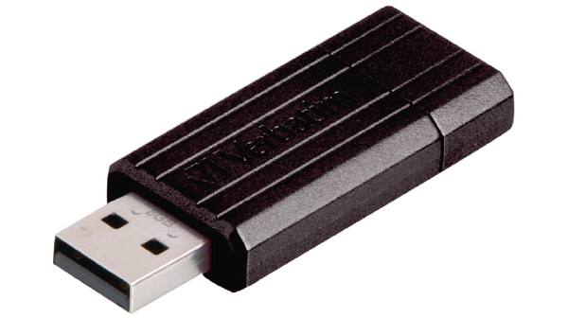
Moodle?

Slide 15
epocus: offline learning in health
Training of medical staff (doctors and medical technicians) in Malawi
Ultrasound POCUS training
Targeted audience: different medical areas
Notes:
Technology
Didactics
Content
Delivery

Slide 16
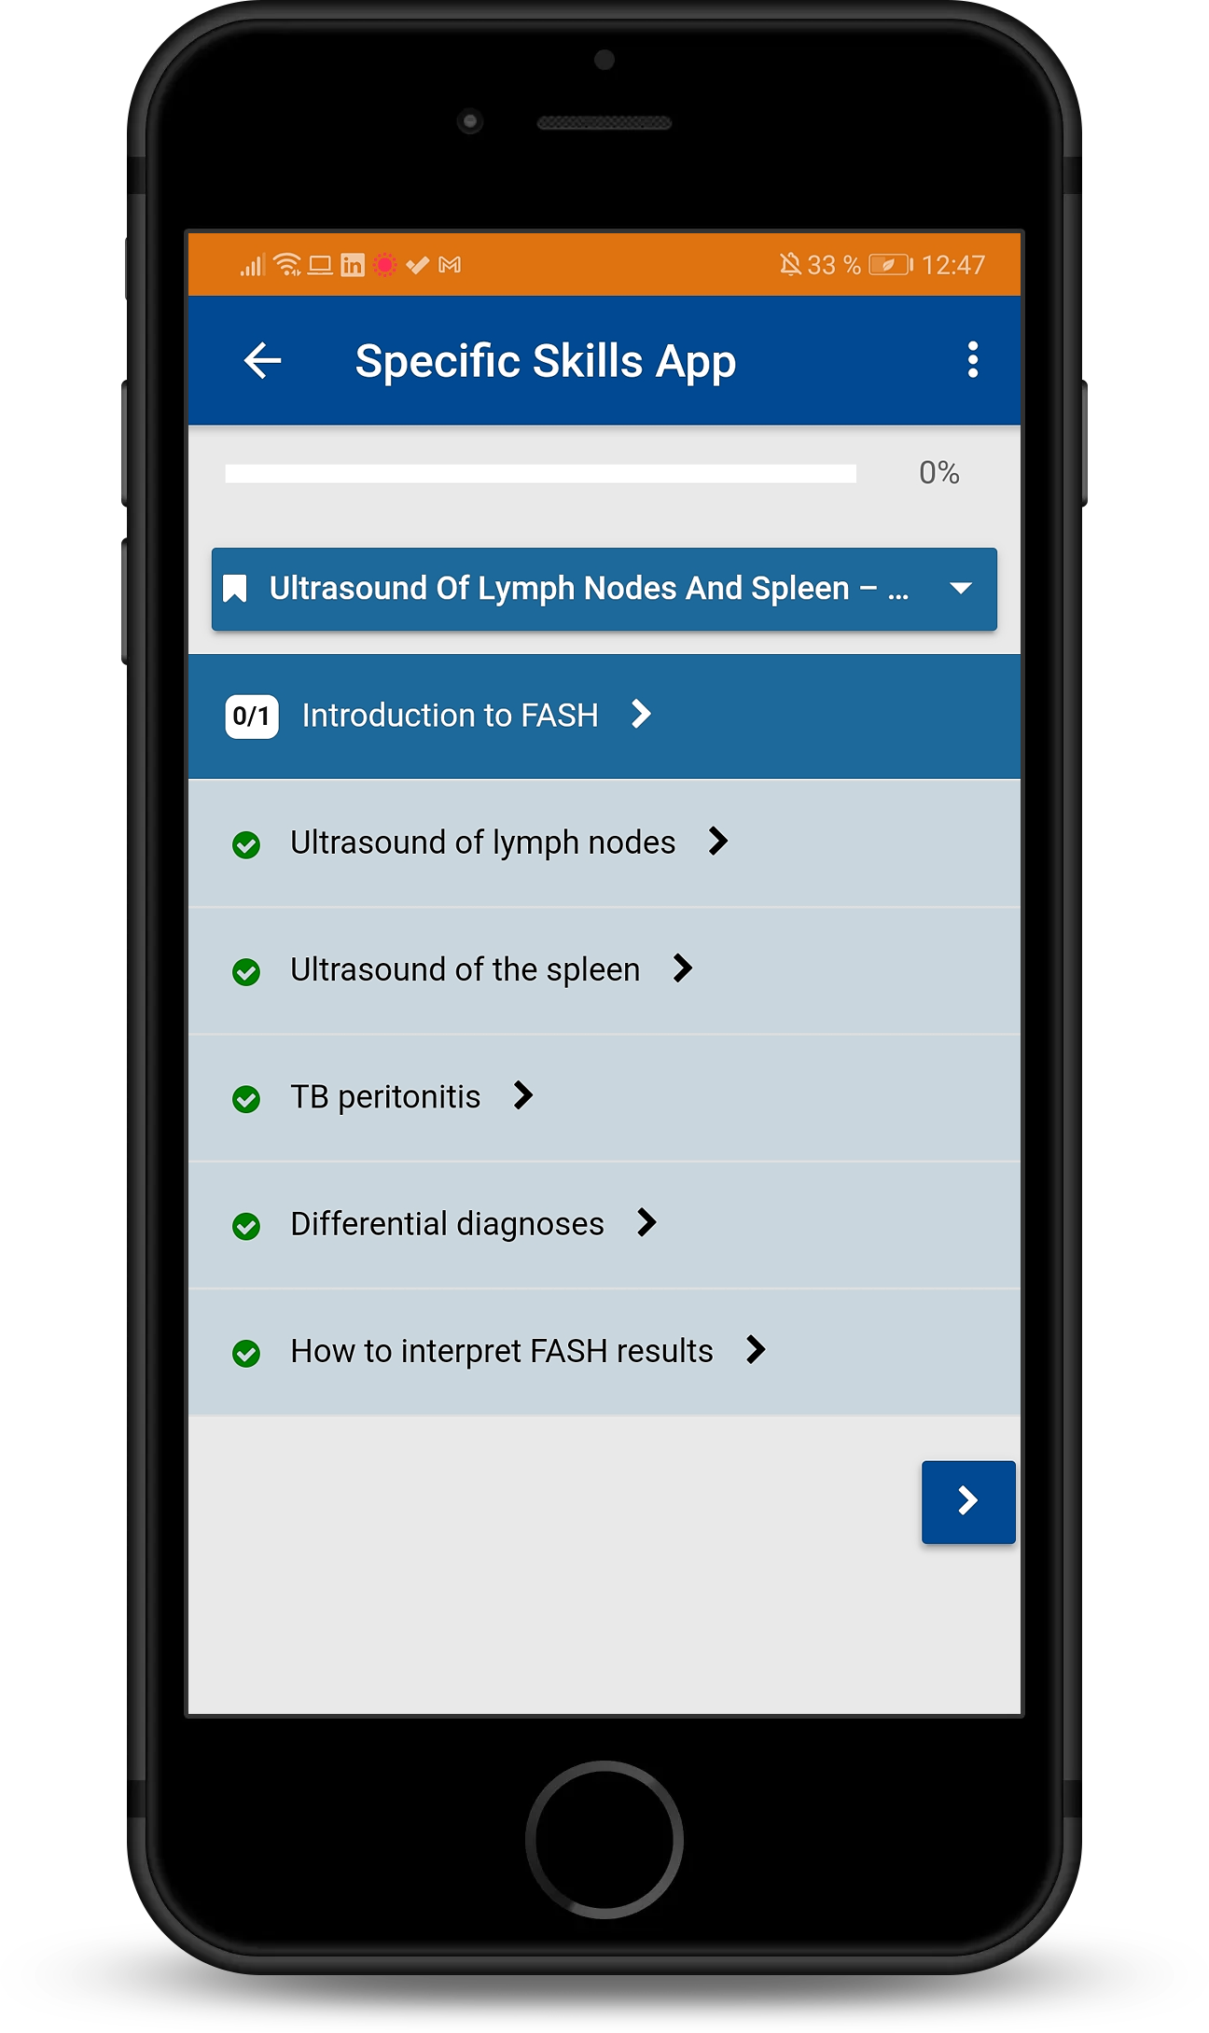
epocus
8h learningtime
Mobile devices well available
Content production with Camtasia, PPT and H5P
Accordeon Course format
Course colorkey

Slide 17
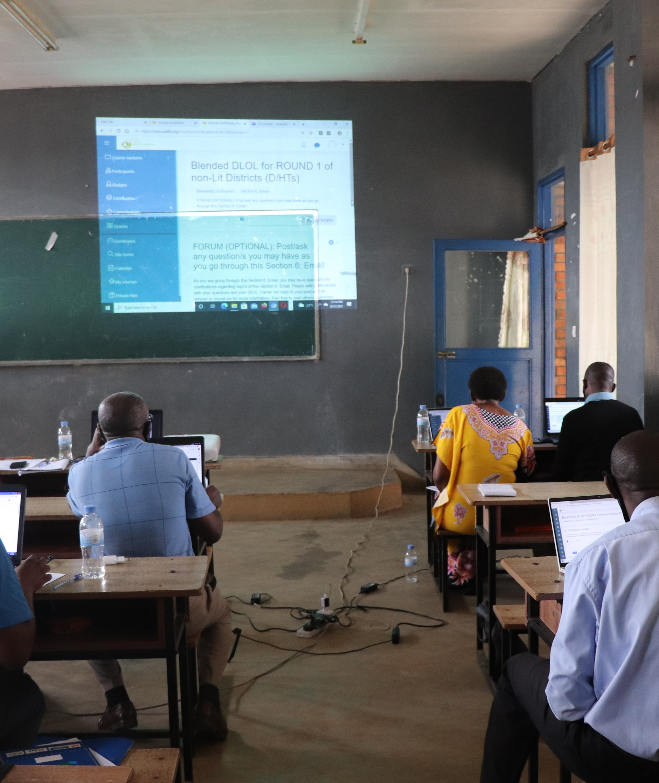
Moodle for Schoolteachers in Rwanda
Embedded in a large capacity building project
High student numbers
Moodle as backbone
High peaks in usage
Online only. Laptops available
Challenges with access

Slide 18
Trainingcenter KAIPTC
Focus on Trainingsmanagement
Internal LMS for administration and evaluation
Internet ok-good
Delivery on campus possible
Delivery outside: unstable

Slide 19
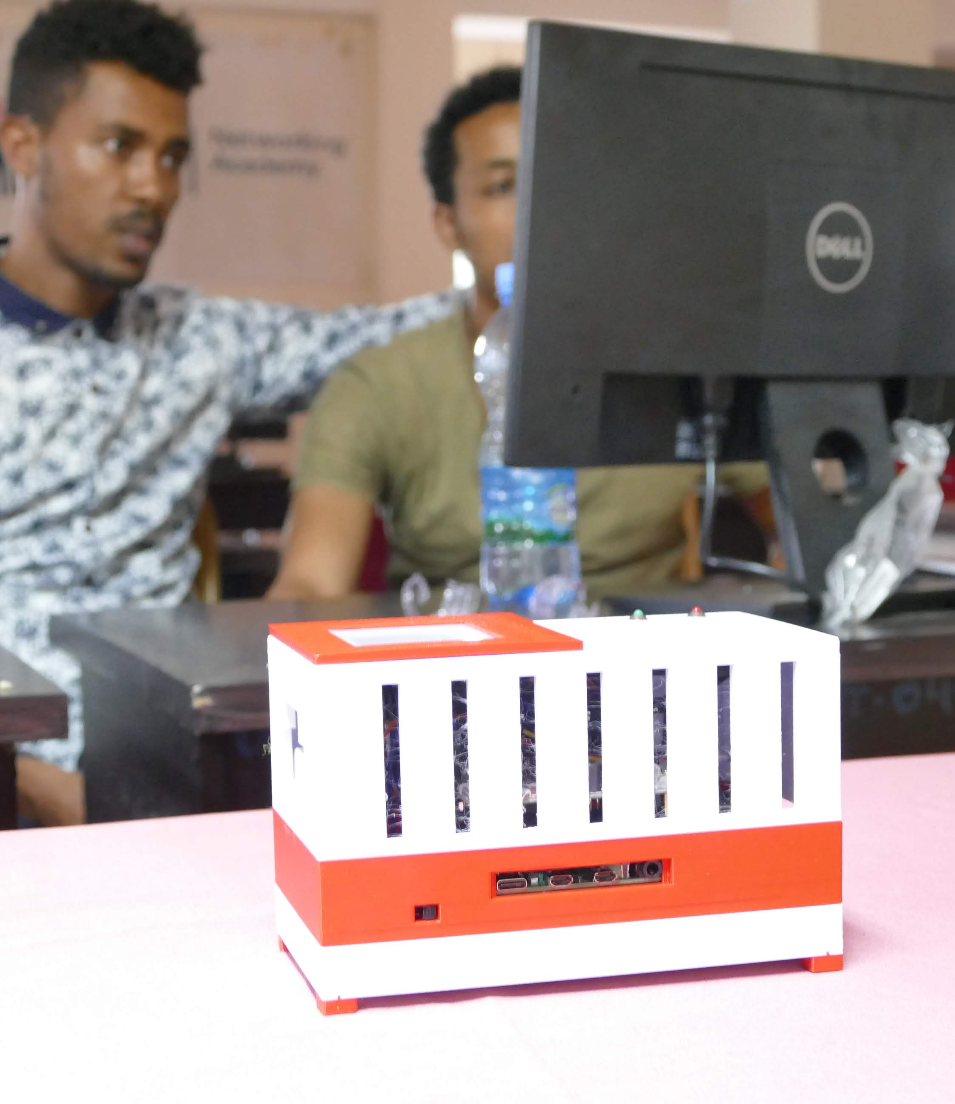
contentbox
Standalone box
Open
Scaleable
Based on moodlebox initiative

Slide 20
Thank you
g.henzinger@think-modular.com

Slide 21
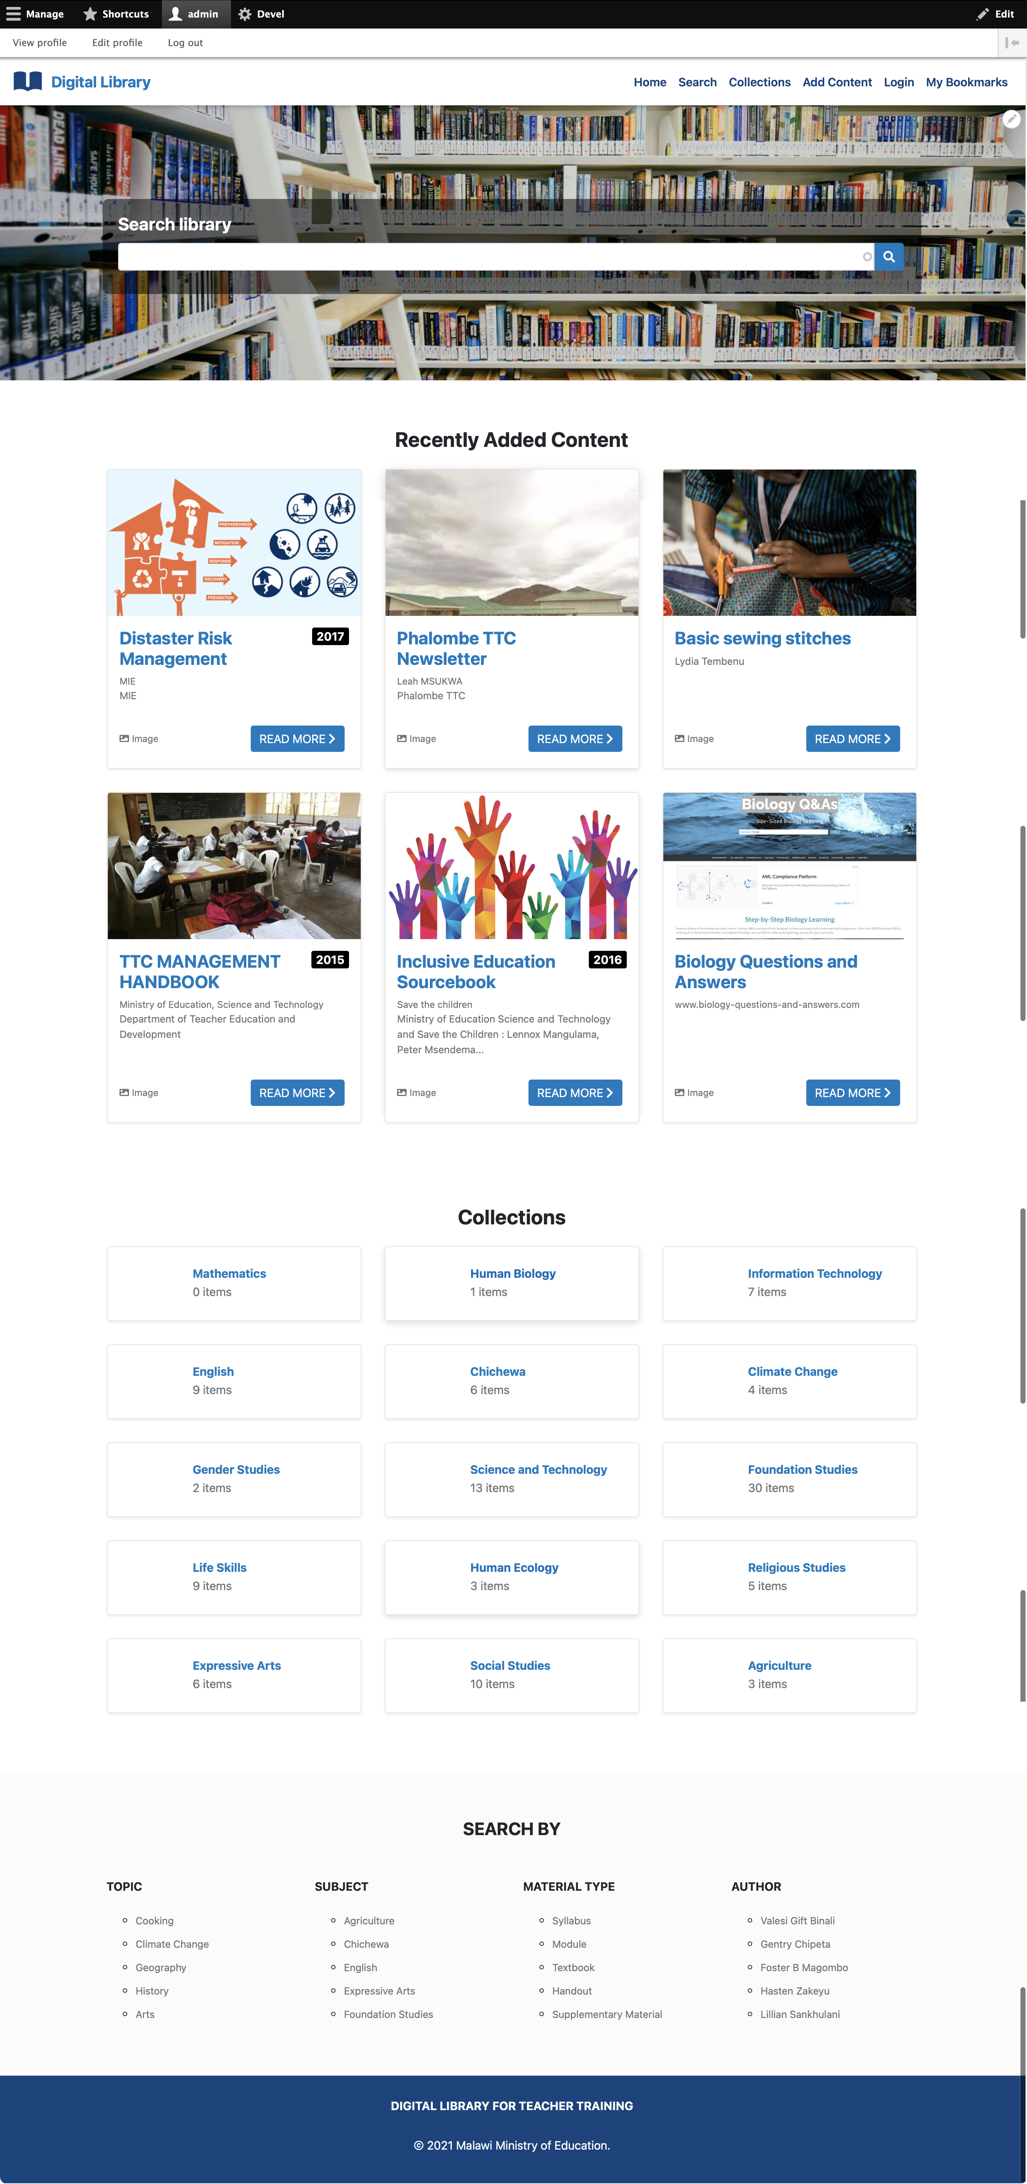
Digital Library for Teacher Training
Implementation of a digital library for Malawi Teacher Training Collegues
Providing a digital multimedia repository and asset management system

Slide 23
Digital Library Value proposition
Multimedia: supports any media type and provides player for Video, Audio, Pictures, SCORM etc.
Search, Drill-Down OR Browse – you decide
Search: Full-text search (includes text inside of media)
Drill-Down: Powerfull facetted search
Browse: Hierarchical structure of content collections
Automatic Text-Recognition
Meta-Data / Information Architecture freely adaptable
Freely configurable permissions and roles
Supports data and content preservation (based on Fedora) for serious asset management and digital library systems, cultural hertiage etc.
Bookmarking, commenting, e-commerce integration and much more etc.

Slide 24
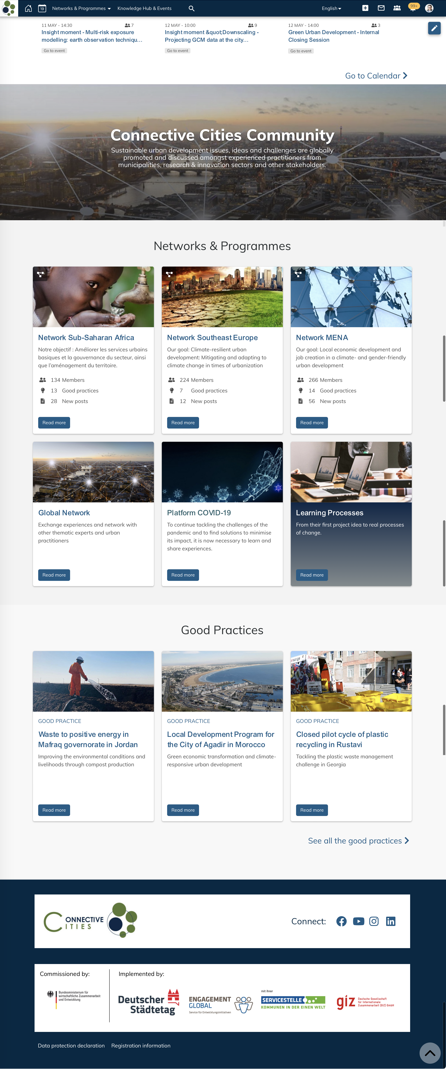
Connective Cities Community Social platform for collaboration and networking
Flexible digital space for digital learning events and community management
Hosting all virtual and hybrid connective cities conferences incl. video-conferencing and interpretation

Slide 25
Travel Vienna - Barcelona
How Connectivity may be
Gipfel: Wer macht dort schon elearning?
10 Bezirk
Wer?

Slide 26
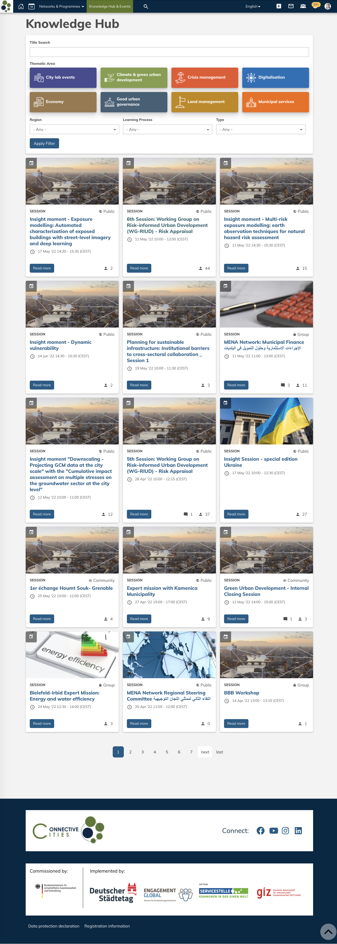
Connective Cities

Slide 27
Community Connective Cities Value Proposition
Flexible digital space for digital learning events and community management
Bringing together cities from all continents
Social Stream advertises relevant content to the community members
Providing all required digital tools for the community on one single platform: Event management, Video-Conferencing (incl. interpretation), Surveys, E-Learning Modules, Knowledge Library, Document Sharing etc.

Slide 28
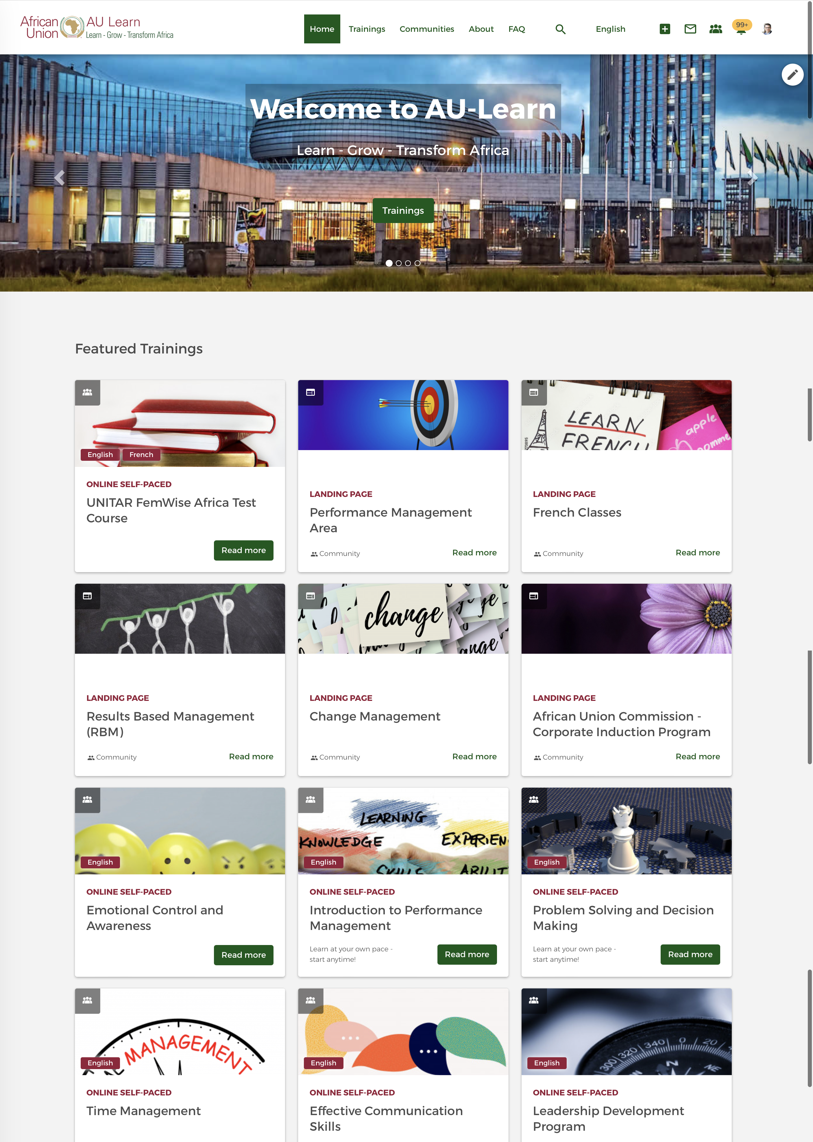
learn.au.int Digital Learning for the African Union Commission
One digital learning platform for the AU and its different bodies and suborganisations
Offering courses to AU-staff members, partner organisations and external stakeholders on one

Slide 29
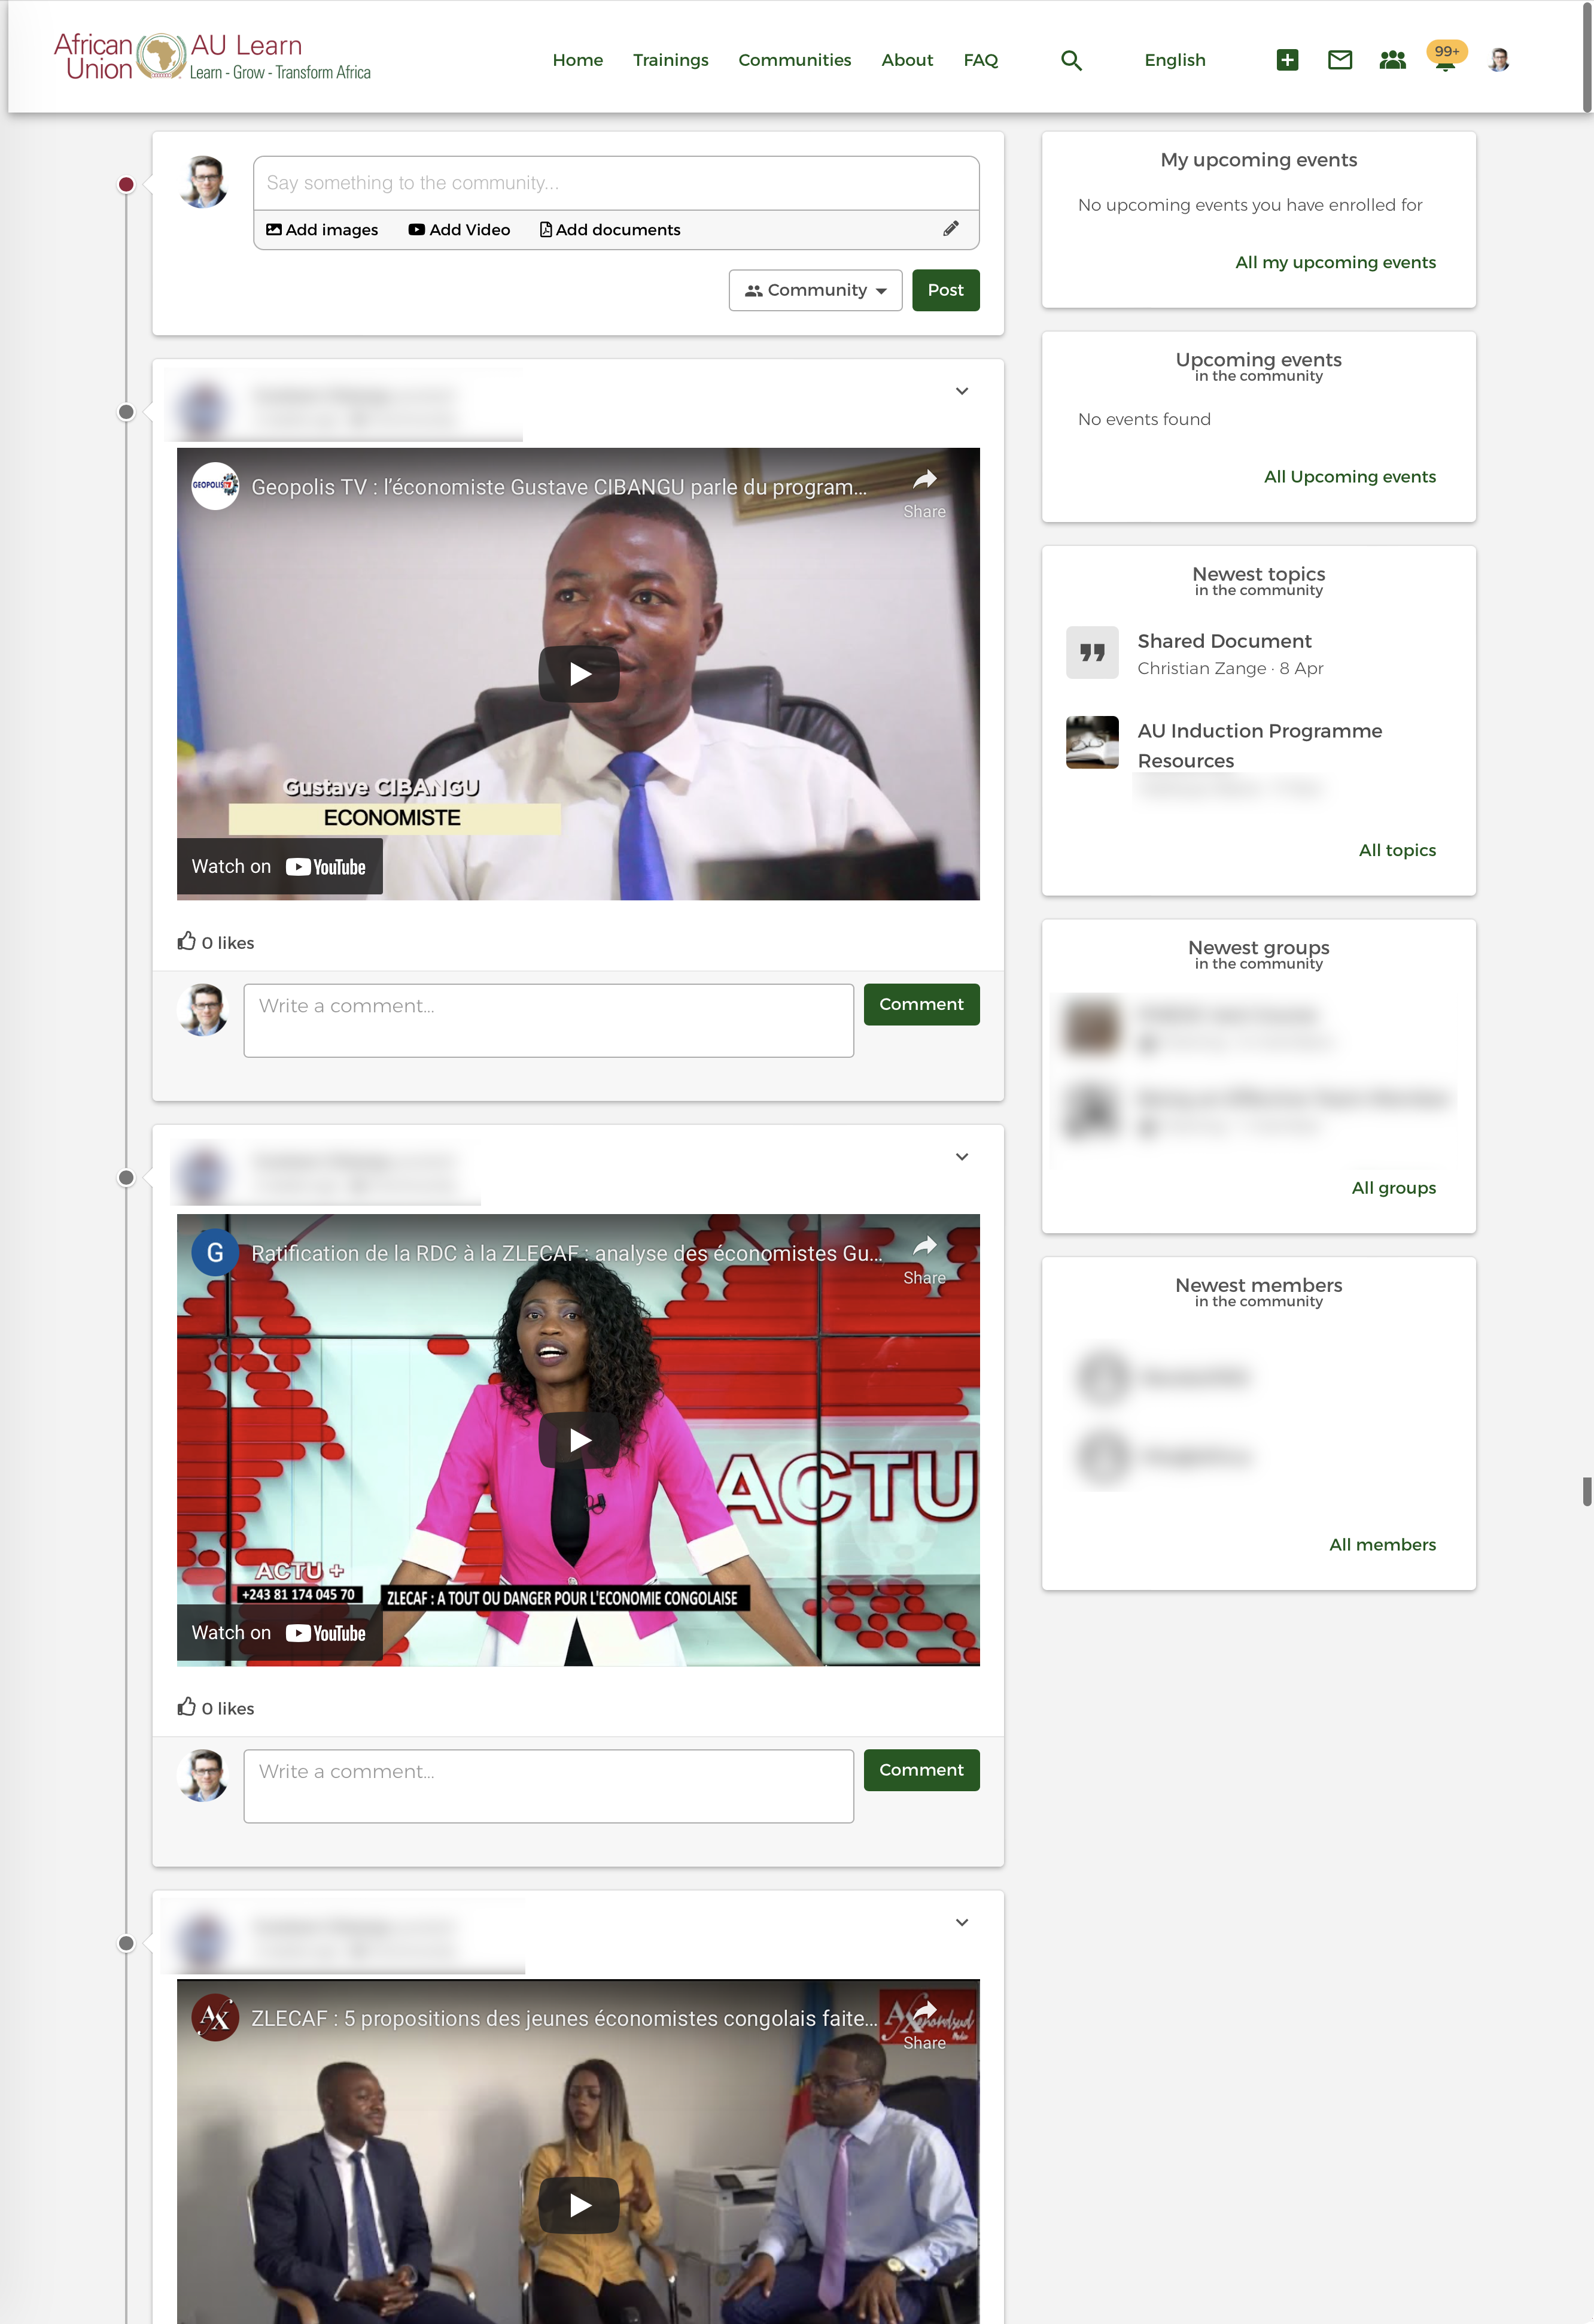

Slide 30
learn.au.int Value proposition
Offering courses for AU-staff and externals on one single platform
Integration between OpenSocial (Drupal), Moodle, Active Directory and SAP
Course management systems supporting the full life-cycle from course development, course rollout to archiving (incl. versioning system)
Reporting dashboards
Learning communities and knowledge bites (Mikro-Learning)

Slide 31
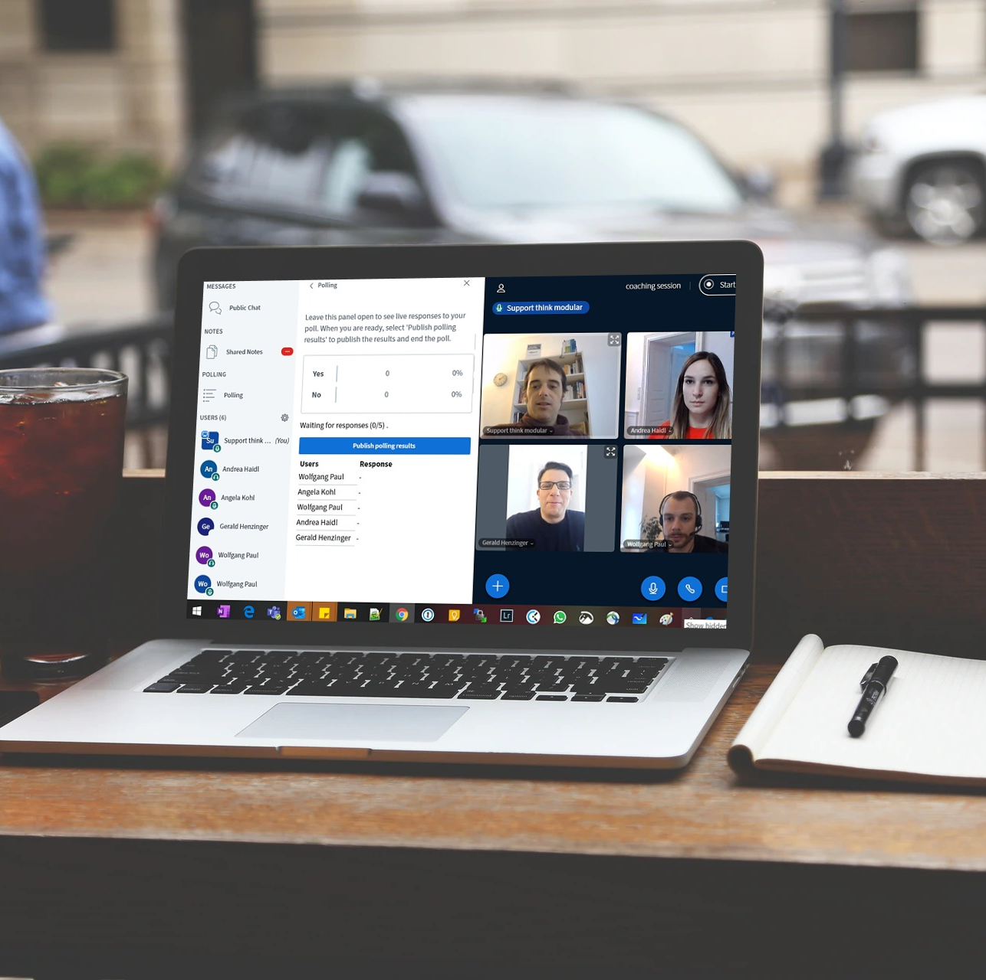
Video-Conferencing Platform BigBlueButton incl. interpretation tools
Multilingual conferences (incl. relay translation)
Breakout rooms, Shared notes, whiteboard, quiz etc.
Sharing of slides, documents and videos
Public & private chat
Focused on data security and GDPR-compliance

