Slide 1
MoodleNet The Educational Resources Ecosystem
Paul Hodgson
Product Manager
Notes:
MoodleNet as an idea is many years old, it was first used with Moodle LMS in version 2
Raise your hand if have used MoodleNet ever
Keep your hand up if you have used MoodleNet in the last year
Welcome to the latest iteration of MoodleNet

Slide 2
MoodleNet team
Bru
Anna
Paul
Alessandro
Ettore
Notes:
Firstly I’d like to introduce you to the small but growing MoodleNet team, mainly so you can speak to them if you have any questions
Bru – please make yourself known. Bru looks after the front end design and user experience of MoodleNet – Bru is based in Switzerland
Anna – please make your self know. Anna is our education adviser and you will know Anna from MEC and the Moodle Academy team. Anna makes sure we pay attention to standards and details – Anna is based in Greece
Alessandro and Ettore are our back end devs and sadly cannot be here at the moot – they are both based near Rome in Italy.
Finally I’m Paul, the Product Manager.

Slide 3
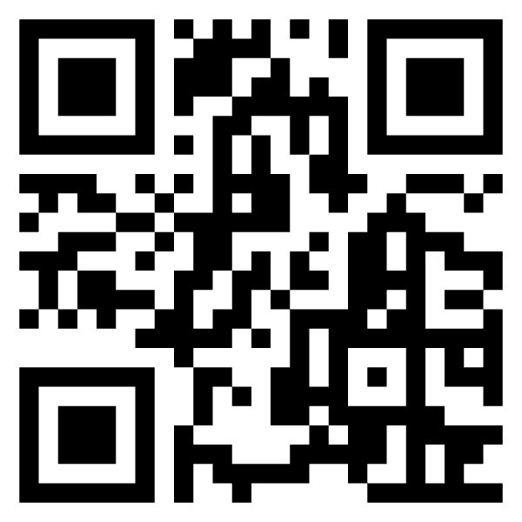
MoodleNet 2
Our global network that allows anyone to share and curate open educational resources.
moodle.net
Your Instance
Notes:
We are calling the current version of MoodleNet version 2, you can visit it right now by scanning the QR code. It’s a year old, open source just like Moodle LMS and has all of the same Moodle principles. Every thing I’m going to talk about is available on both versions. We released version 2 on the 1st October 2021 and we’ve had 12 releases since then.
Techie bit! It isn’t PHP. MoodleNet is built on NodeJS using React and TypeScript with an Arango database. Ask us about that later, the discussion could be long.
MoodleNet 2 is two things:
It’s the first step in the creation of an eco system of open educational resource that can be used anonymously and you can send any resource to a Moodle course in a couple of clicks or download and use the resource with any system.
It’s available for download to install for yourself to provide your content to your LMS, a group of LMSs or a mix of systems.

Slide 4
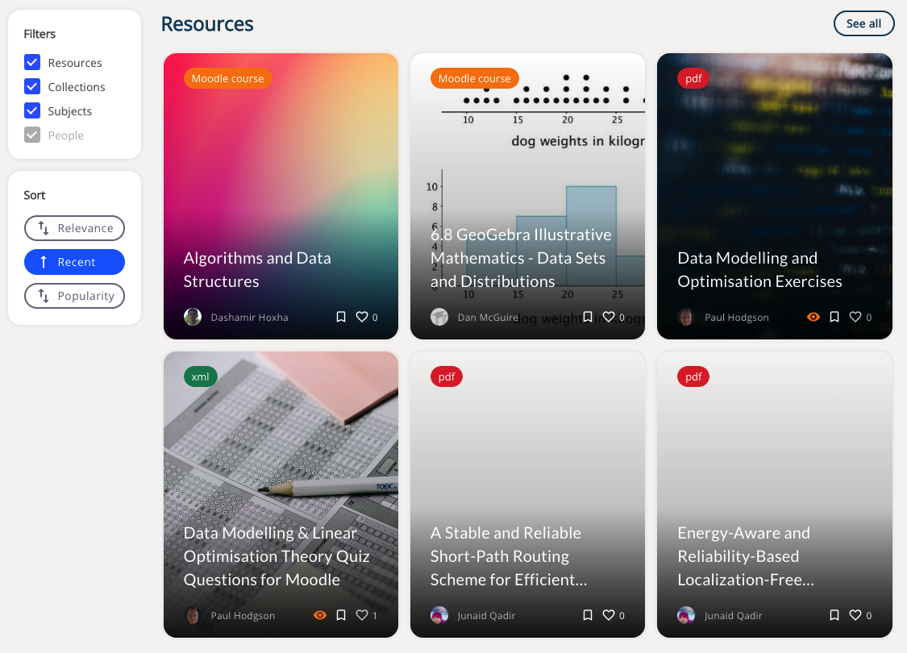
MoodleNet search
Notes:
Let’s start by looking at search. In the last year we’ve have 500,000 new users searching for resources.
The MoodleNet is designed to be responsive, it searches as you type and returns resources, collections, subjects and people.
You may sort these by relevance, recency or popularity.

Slide 5
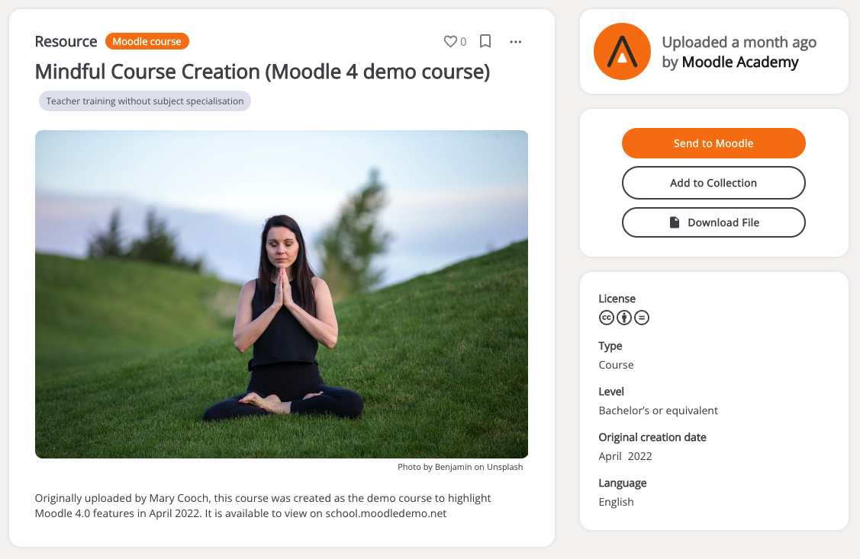
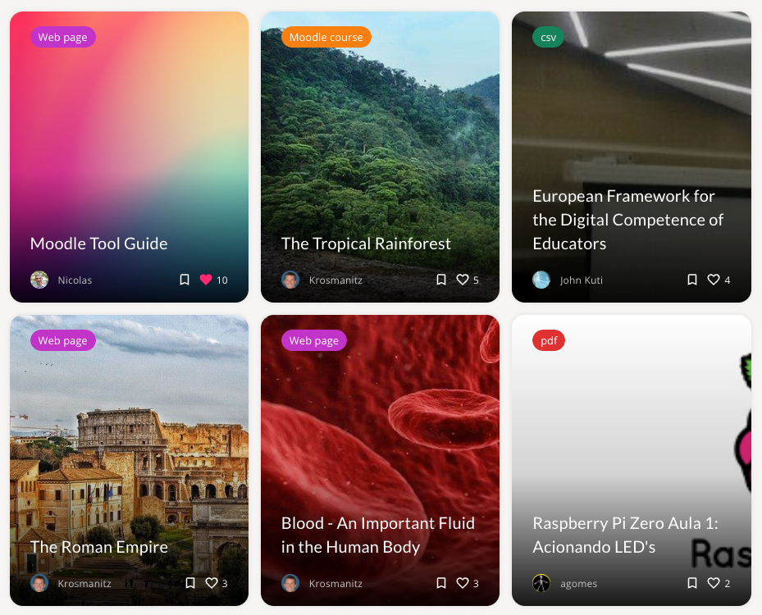
MoodleNet resources
Notes:
Looking at resources.
In order to publish a resource you need a MoodleNet account. It’s a simple signup system to validate your email, once that’s done, you can get started. On our central moodle.net service you need to add at least 5 resources and ask us to approve your account, once we’ve done that, your resources are available to anyone.
A resource can be any content; a pdf, an image, a video, a question bank or a full moodle course. It supports any MIME type.
MoodleNet needs a few pieces of information to make the resource searchable; a title, a description, a creative commons licence if the resource is not a link, a subject (Based on ISCED categorisation, thanks Anna) and whether you would like it to be hidden or visible.
You can also add it to a collection and add more metadata, the more the better for searchability, including the type (IEEE Learning Object model, thanks Anna), the educational level, creation date and language.
You can also add your own images but we’ve built in Unsplash to help you with that in case you don’t have anything.

Slide 6
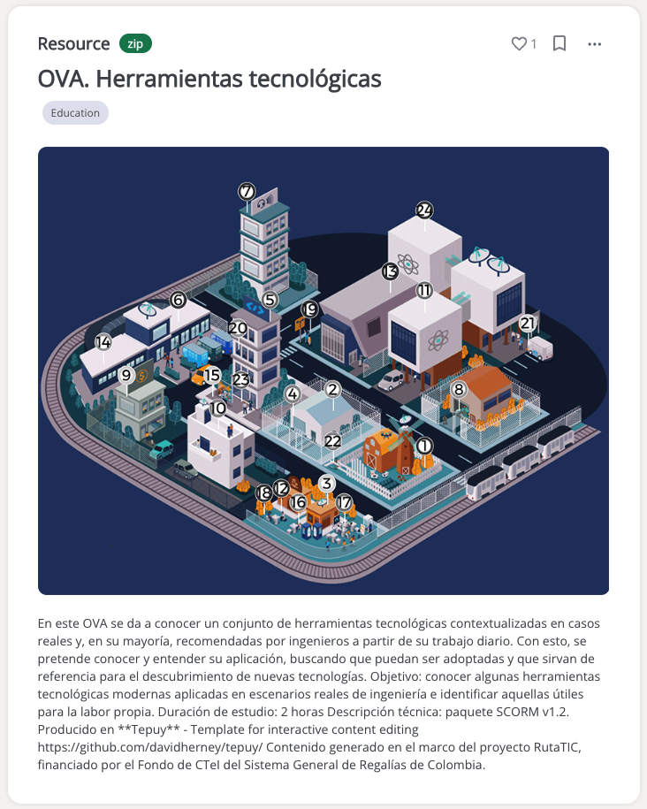
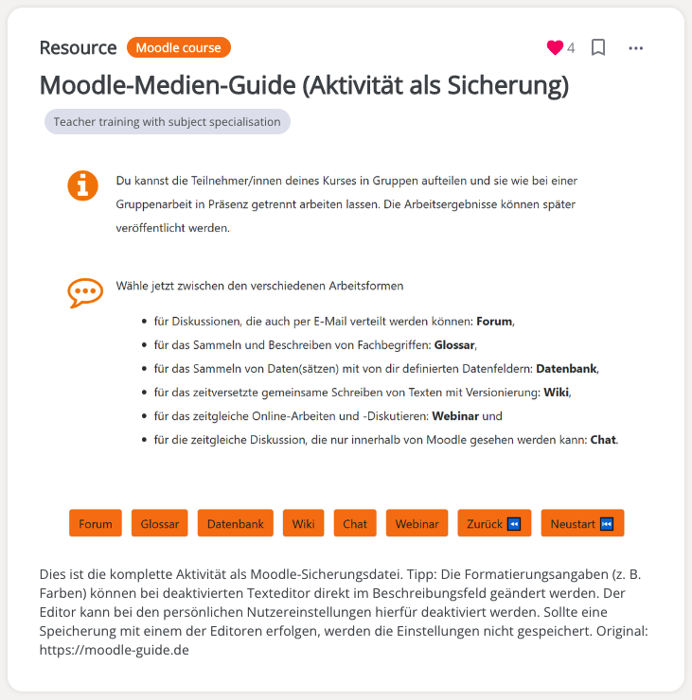
MoodleNet resources
Notes:
Even though the interface of MoodleNet is only in English currently, resources can be and already are in many languages. Some of these have been provided by people in this room, so thanks if that’s you.
Something to add about resources is that if you have an account on MoodleNet, you may bookmark and like any resource. By liking a resource you award the author KUDOS, which pushes that resource up the list in the search results when filtered by popularity.
Also if you have an account, you may create collections and add resources; your or those of others to your collection...

Slide 7
MoodleNet collections
Notes:
Collections are curated content and they can be followed and bookmarked.

Slide 8
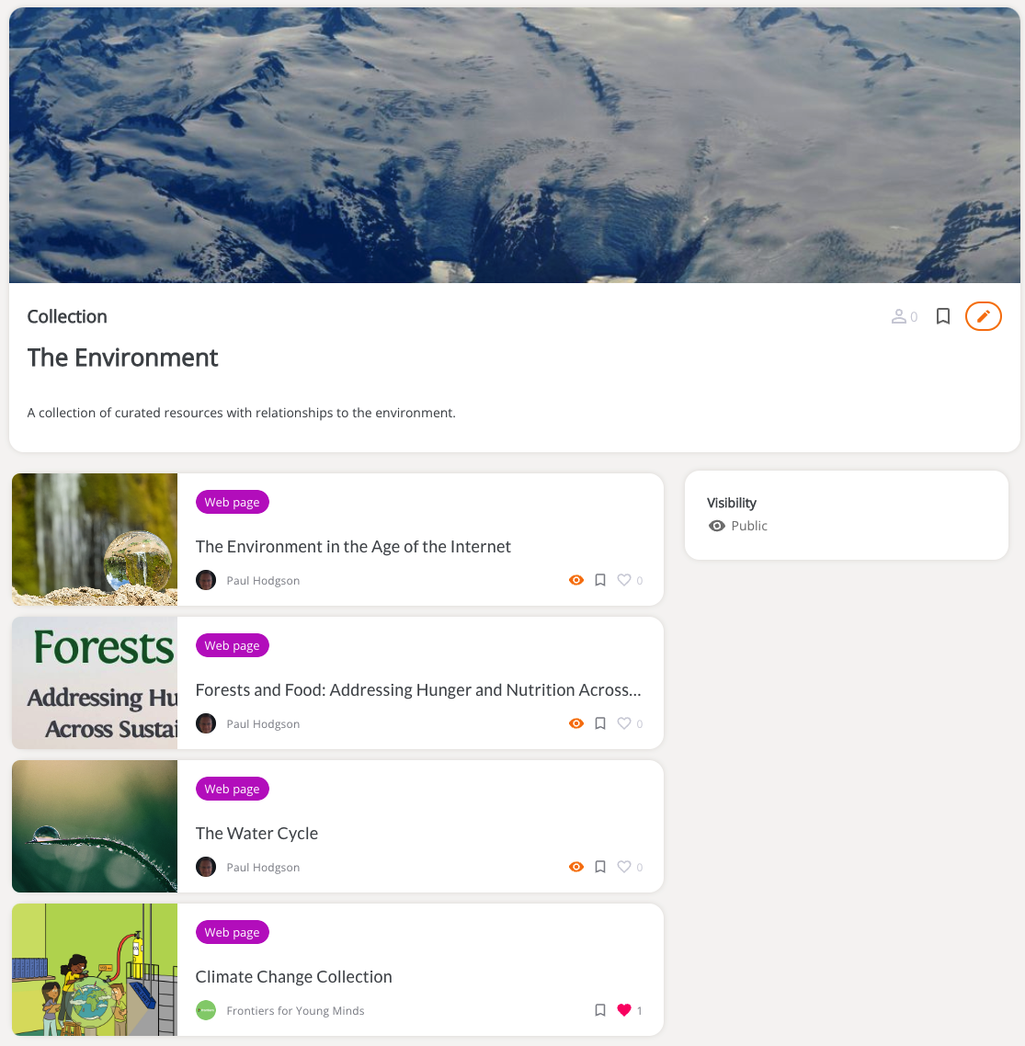
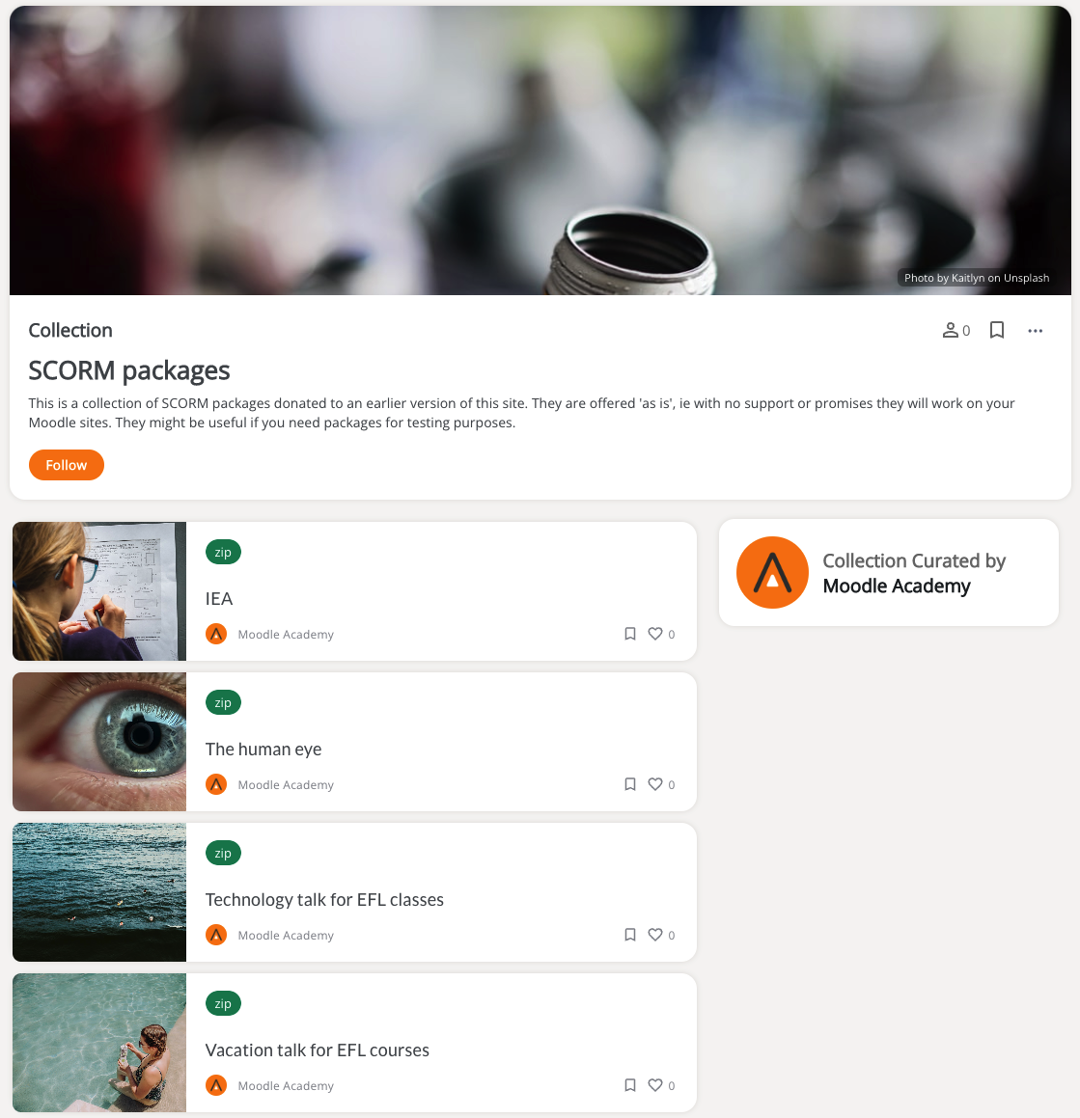
MoodleNet collections
Notes:
Here we see a couple of collections available on MoodleNet today, the left is a view from my own profile as the owner of the collection, the right as you see someone else’s collection. In this case Moodle Academy have provided access to all relevant content from past versions of MoodleNet, thanks Mary Cooch.

Slide 9
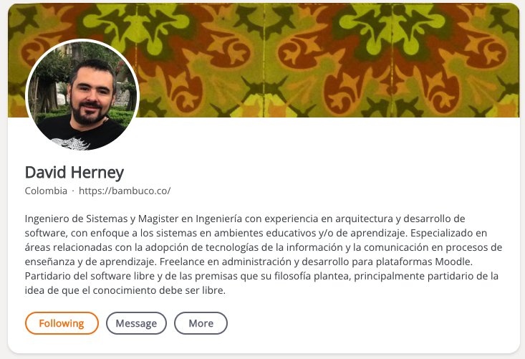
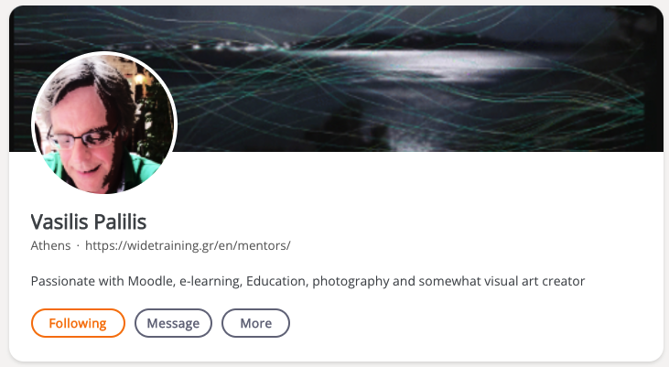
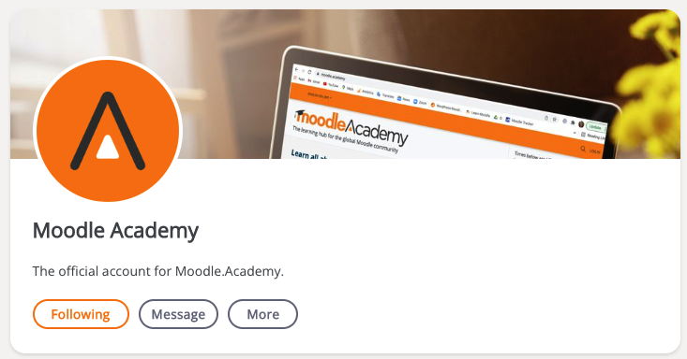
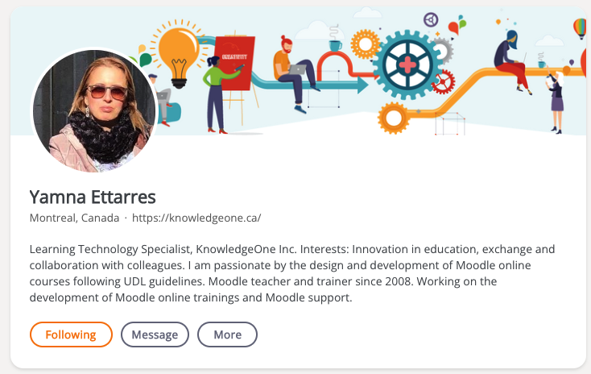
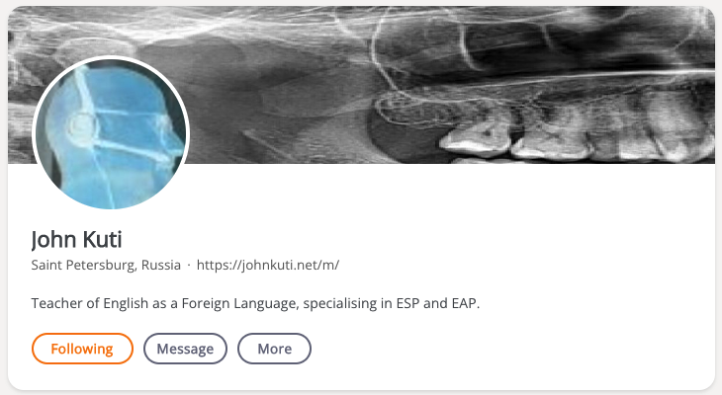
MoodleNet authors
Notes:
And here are some of the content providers.
Some are educators, some publishers, some institutions, some in this room.
We are encouraging anyone with good quality open educational resources to create a profile, share their work to give back to society.
We are also forging content partnerships with others in the open education space, you can see there Frontiers for Young Minds, you’ll soon see Grasple for mathematics and statistcs, you’ll see the UNESCO moodle courses designed by Lauren Goodman and we are wrking with others in UNESCO and open education resources to share everything and reach the widest audience.
These resources potentially reach over 42,000,000 moodle courses in a couple of clicks and we like to think of them helping those that don’t have the ability or facilities to create their own.

Slide 10
MoodleNet 3.0.0
What’s coming next
moodle.net
Your Instance
Notes:
That’s what has been released now, so what are we working on now that’s coming next?
MoodleNet 3.0 will start

Slide 11
Hosting, installation and customisation
Notes:
We’ve received feedback that installing MoodleNet is an overly technical process and because it is different to Moodle LMS with no step by step guide, we are going to change that.
We are going to provide a customisation wizard, thanks Bru, and the opportunity with Moodle Cloud to use MoodleNet on MoodleCloud, without the need to get involved in command line interfaces and environment configuration.
We are also going to completely review and improve our documentation for installing your own instance.

Slide 12
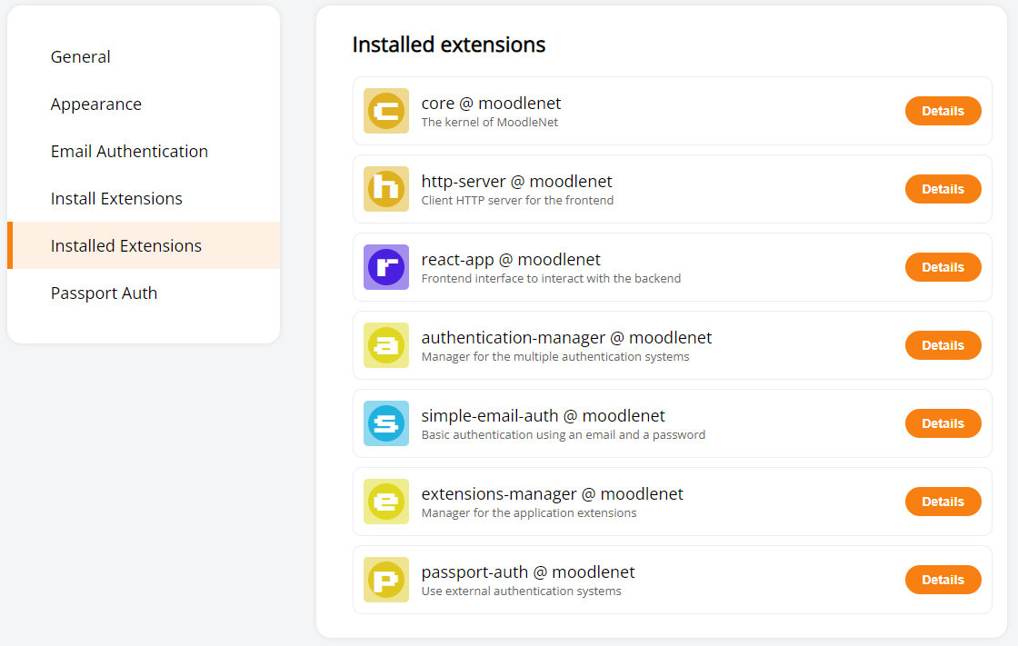
Make extending easy
Notes:
We’ve been working with a few partners, thanks to Bern University and the Moodle Associations of Italy and Japan, we also received lots of feedback at the OER Global conference this year from librarian associations and others involved in sharing and using resources.
The overriding feedback and number one on our list was to create an environment to let you fit MoodleNet into your other processes, systems and standards (I know you are nodding Anna).
For example, we all use single sign on, or SSO, if you like your TLAs, yet MoodleNet 2 requires you to create an account. Whilst this may be fine for individuals who are privately sharing their resources, it doesn’t allow an institution to use their login system without changing the core code.
We’ve chosen ISCED for subject categorisation and Creative Commons for licensing, you may use something different, so you’ll be able to turn these off and add your own.
We’ve stripped as many features as possible in MoodleNet 3 out of the core software to allow you to add and remove things like authentication, standards and anything else that will appear as a contribution in your own instance of MoodleNet.

Slide 13
Developing MoodleNet
Keep an eye on Moodle Academy for our MoodleNet Developer Webinar later this year.
Notes:
Keep an eye on Moodle Academy for our upcoming webinar on developing MoodleNet and accompanying course and documentation.

Slide 14
MoodleNet 3.x & Moodle LMS 4.?
Notes:
Finally, coming next is a better integration with Moodle LMS. You may have heard Barry our LMS Platform Manager talk yesterday about the hope that this will come in Moodle LMS 4.1 but it’s a stretch goal so it may move a little later.
Essentially this will allow any Moodle LMS after version 4.erm, to share to moodle.net to add to our global open educational resources eco-system or to another instance of the MoodleNet software from directly within a course.
You could of course just share a course which would be great but also imagine being able to share resources and standardised course templates beyond your own LMS, to a group of Moodle LMSs as we move towards federation (more on that in a moment).

Slide 15
MoodleNet 3.x
What’s coming after 3.0.0?
moodle.net
Your Instance
Notes:
That’s what has been released now, so what are we working on now that’s coming next?
MoodleNet 3.0 will start with 2 main themes:
Search Results
Federation

Slide 16
Make finding easy
MoodleNet will bubble quality resources to the top of the search results.
This will use collaborative efforts powered by gamification and other motivations for quality.
Notes:
Currently the MoodleNet search engine relies on keywords and metadata to give you accurate results but we should be able to filter these by language, licence, educational level and any other metadata that a resource possesses.
Also as MoodleNet content grows, we are going to have to get smarter in how we float the best resources to the top of the search results. We do this currently by using a system of KUDOS if you sort your search results by popularity, you’ll see the resources with the most kudos at the top of this list. This is simplistic and open to being ”gamed”, we’ve already seen some authors attracting hundreds of Kudos from their friends, colleagues and peers, rather than from the community.
Thanks to Bern University we’ve seen a gamification system that awards Kudos based on valuable actions such as provision of a resource, good metadata, sharing, uses, MIME types and many more metrics that then feeds into a badge achievement system that also includes a DigiCompEdu element to allow teachers to gain CPD achievements.
We are still to finalise this but you can expect to see a version of it next year.

Slide 17
Federation
Notes:
MoodleNet instances will be able to connect to allow for global searching across the entire network.
Imagine you have installed MoodleNet for your own use, we call this an instance. You will be able to select other MoodleNet instances to share your content with; maybe moodle.net and the whole world (we hope so) but maybe just for a group of institutions or companies.
MoodleNet will also connect and share with any other OER repository that is interested via an API.
This is our vision to create an eco-system of educational resources that can be used with Moodle LMS in a couple of clicks or with ANY other system, any other LMS.

Slide 18
MoodleNet 3.y
What’s coming after 3.x?
moodle.net
Your Instance

Slide 19
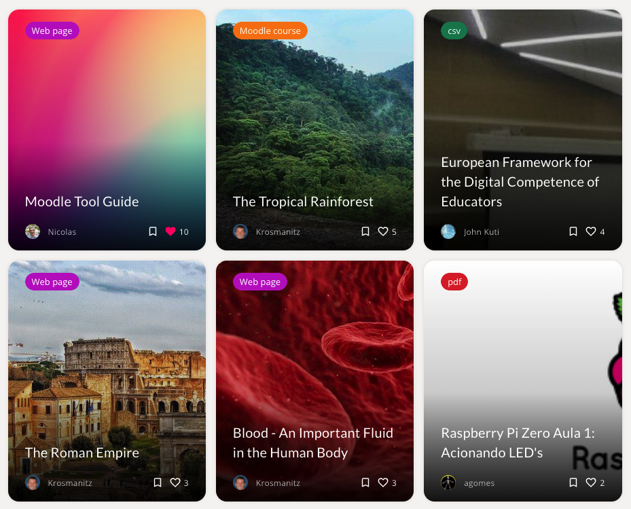
MoodleNet & Moodle LMS
Notes:
This is the current search bar for MoodleNet.
We’d like to see that embedded in Moodle LMS so that you can bring content directly into any course.
Not just by searching, but by it being smart enough to suggest what will be useful to you by looking at the sorts of resources you already use, the courses you have taught in the past. Which resources do analytics say received the highest learner engagement?
We will be asking the community to join us in designing this one. We want to avoid the Microsoft Paperclip situation, for those of you old enough like me to remember it.

Slide 20
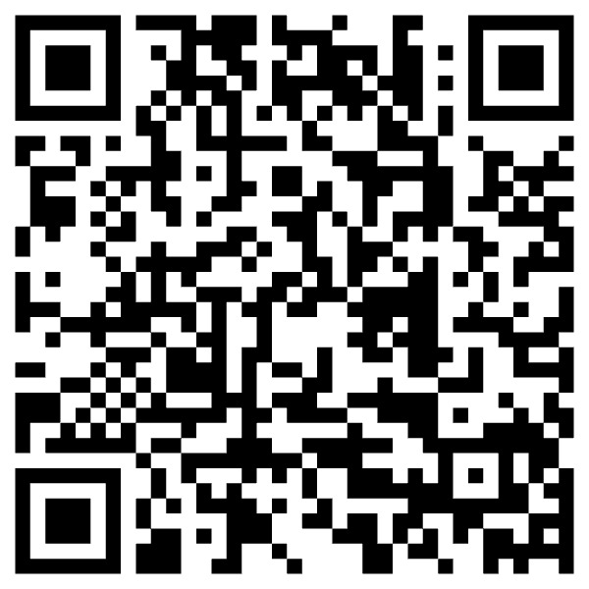
One collection multiple authors
Discuss resource
Send a collection to Moodle as a course
Suggested resources
Vote for suggestion
Suggest a resource
Preview and try resources before using
Bulk send and download
Allow or deny domain signups
MoodleNet embedded in Moodle LMS
Discuss collection
Multilingual interface
Collections of collections
Bulk upload
Notes:
Any finally we’ll be going through our backlog, the QR code links to everything we are looking at and you can add your suggestion or vote for other there.
Have a look at one or two and explain them.

Slide 21
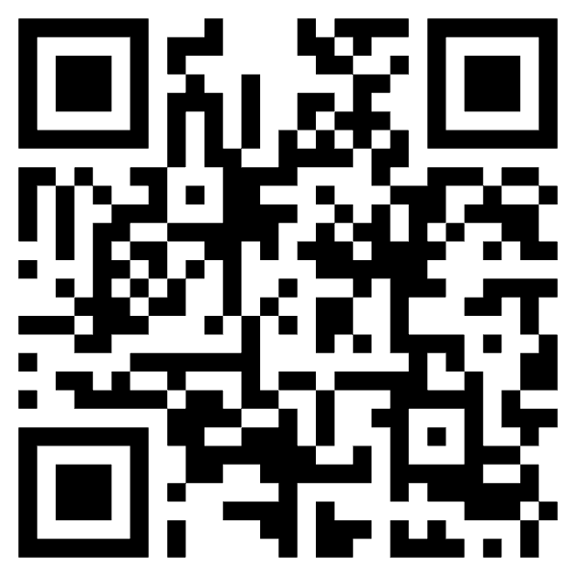
Get involved
Educators, share your open educational resources on moodle.net & curate collections on any subject
Administrators, install your own instance of MoodleNet for your institution to serve content to your LMS
Ask us to help test with your institution.
Help find and fund development.
Engage in community discussions
Propose and vote for features
Notes:
Finally, please get involved, the QR code there links straight to our community where you can engage directly with the team.
Educators, share your open educational resources on moodle.net & curate collections on any subject
Administrators, install your own instance of MoodleNet for your institution to serve content to your LMS
Ask us to help test with your institution. For larger projects we will help a limited number get started, contact us to have a chat.

Slide 22
Closing slide
MoodleNet
moodlenet@moodle.com

