Slide 1
Card Box
a collaborative tool to help students memorize vocabulary and other information
Author: Valentin Koser CLS, RWTH Aachen University
This work is licenced under a Creative Commons Attribution-ShareAlike 4.0 International License

Slide 2
Card Box - a collaborative tool
The Card Box plug-in allows teachers and students to work together to create flashcards that can be used in different learning scenarios
Flashcards help students memorize vocabulary, technical terms, formulas and definitions
The plug-in was developed by RWTH Aachen University and recently added to the Plugin directory to make it available for every Moodle site (URL: https://moodle.org/plugins/mod_cardbox)
Card Box

Slide 3
Side note: Existing Flashcard systems in Moodle
Dialog Cards
Flashcards
Content Types

Slide 4
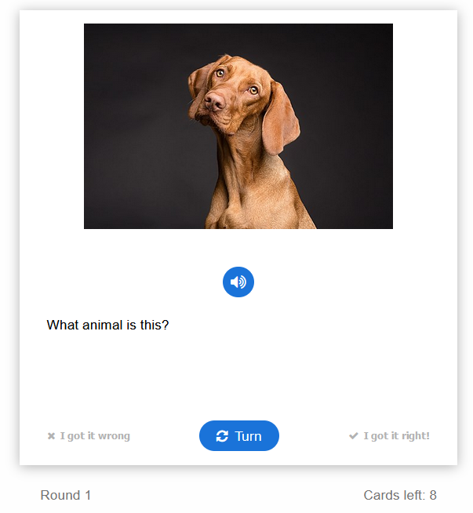
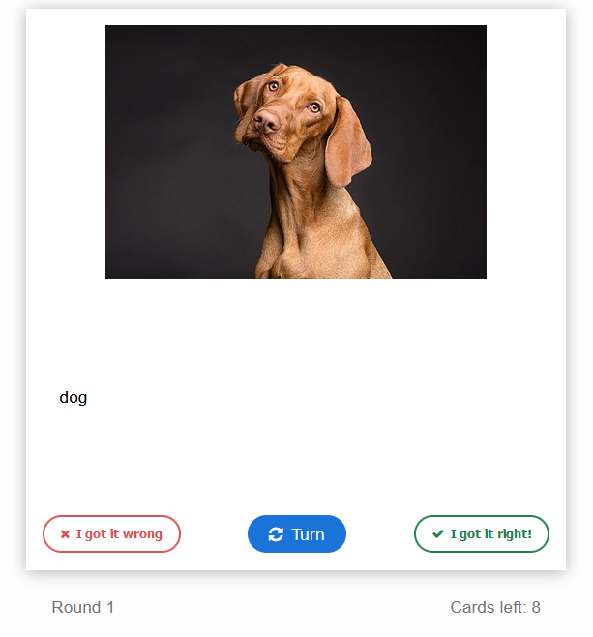
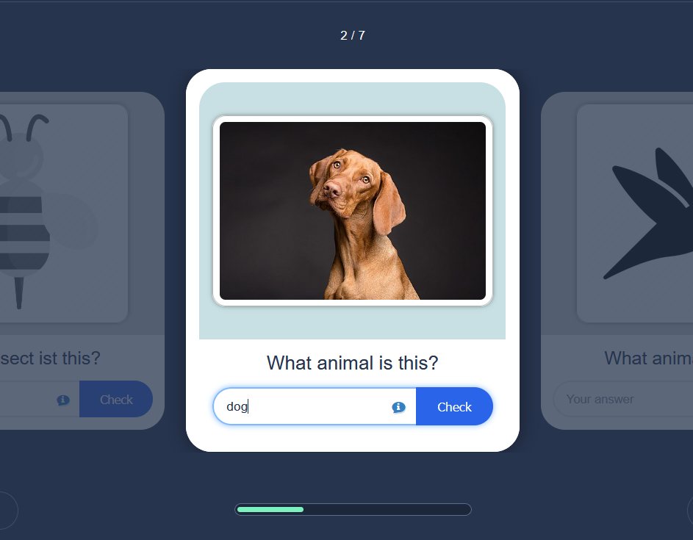
Dialog Cards & Flash Cards
Dialog Cards
A dialog card has a front side and a back side.
On the front there is a hint for a word or expression. By turning the card the learner reveals a corresponding word or expression.
Front side
Back side
Flashcards
Learners are required to fill in the text field and then check the correctness of their solution.
Cards containing a hint (e.g. a picture) for a word or expression.

Slide 5
Comparison Dialog Cards vs. Flashcards in detail
Function |  | Dialog Cards | Flashcards
Add image to a card
Add audio to a card
Add hints
Learner Input |  | only thoughts | only written
Spaced Repetition
Save learning progress
*
*no elaborated spaced repetition
Korrektur

Slide 6
Features
The following features are not implemented in Dialog Cards and Flashcards but in the Card Box:
Save learning progress
Collaboration
Import cards
Allow alternative answers
Categorize flashcards
Learning statistics

Slide 7
Spaced Repetition and Leitner System
Spaced Repetition → newly introduced flashcards are shown more frequently than older flashcards
Leitner System
A card box consists of seven boxes. New cards are sorted into the first box.
Correctly answered flashcards move one box further, wrong or not answered flashcards move back to the first box.
In total, a flashcard must be answered correctly five times at increasingly long intervals until it is considered permanently learned and leaves the card box.
Correctly answered cards
The numbers on the boxes indicate after how many days the cards should be repeated
Card Box Plugin
Incorrectly answered cards

Slide 8
Flashcards – Scope of Application
Apart from vocabulary, you can also learn other contents with a flashcard:
Topic |  | Question (Front side) | Answer (Back side)
Vocabulary |  | Hund | Dog
Specific dates |  | Shakespeare's birth year | 1564
Formulas |  | Pythagorean theorem
Definitions |  | Define the term "logistics“ | Logistics is generally the detailed organization and implementation of a complex operation.
Rules |  | What to do first after a car accident? | Stop your vehicle and move to safety
Questions |  | What is the capital of Germany? | Berlin
… |  | … | …

Slide 9
Card Box
Feature Presentation
Card Box

Slide 10
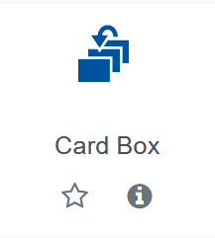
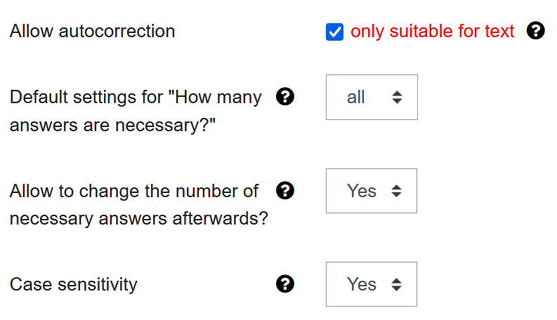
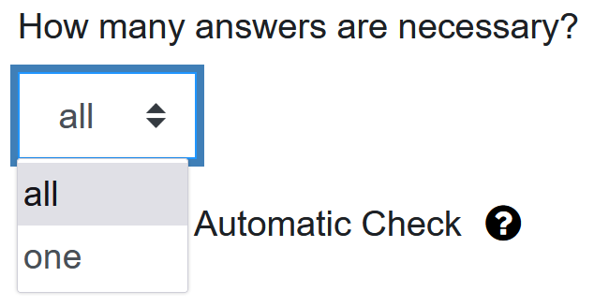
Card Box – edit settings
Students
If activated, students can choose whether they want to type in their answers and have them checked automatically by the program ("Automatic check")
If this option is set to "Yes, then the number of required responses can be changed when creating or editing a map.
If upper and lower case should be ignored, set the setting to “No"
Managers determine whether the correctness of the answers given can automatically be assessed by the system
In further settings, the number of required answers as well as correct upper and lower case letters can be required.
Students

Slide 11
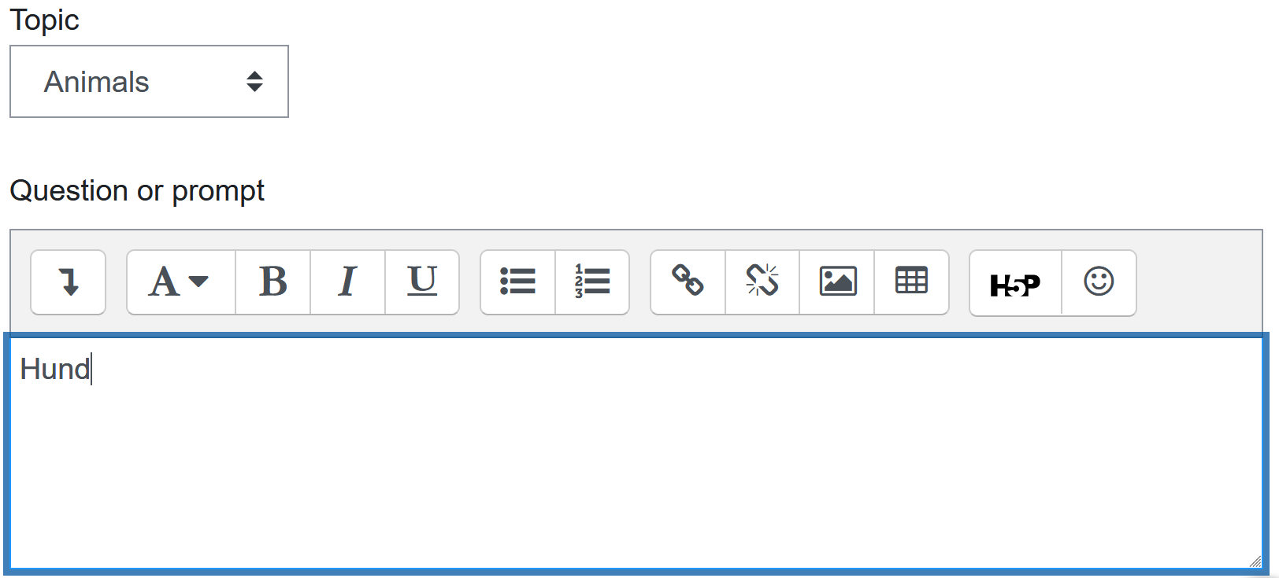
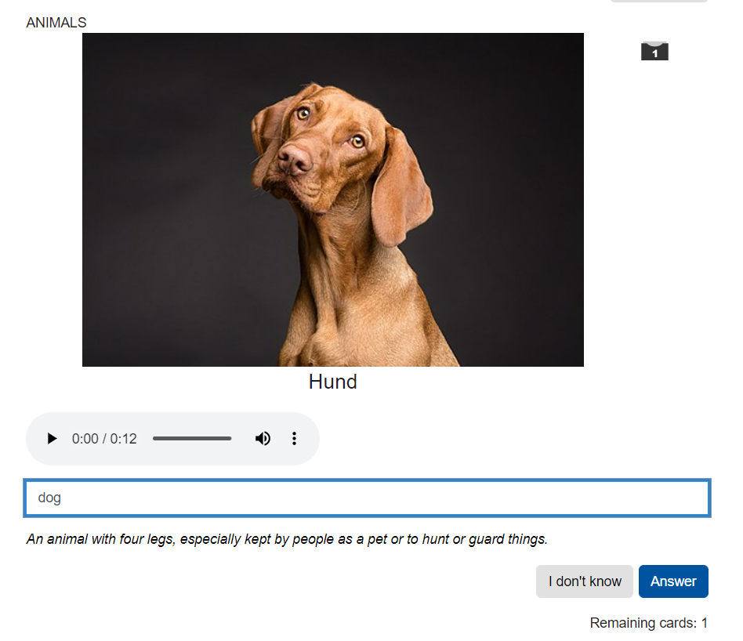
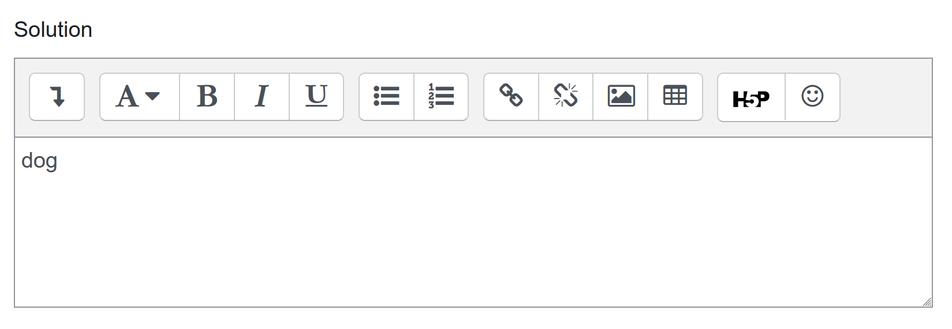
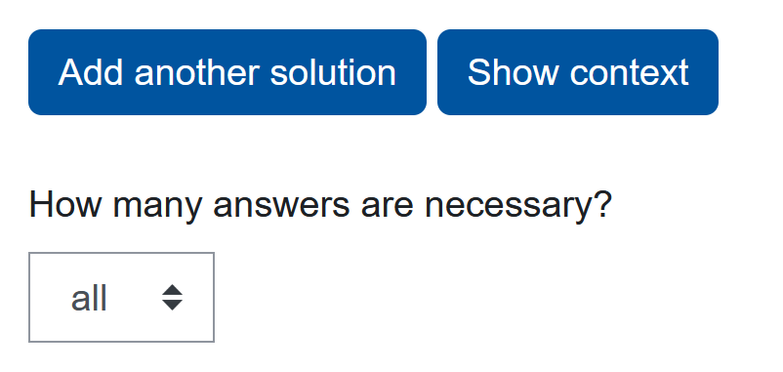
Add flashcards
Box in which the flashcard is currently stored
Students

Optionally further solutions can be added. Likewise, another context line can be displayed together with the solution.
In case of multiple answers: Selection of whether all answers must be given or only one

Slide 12
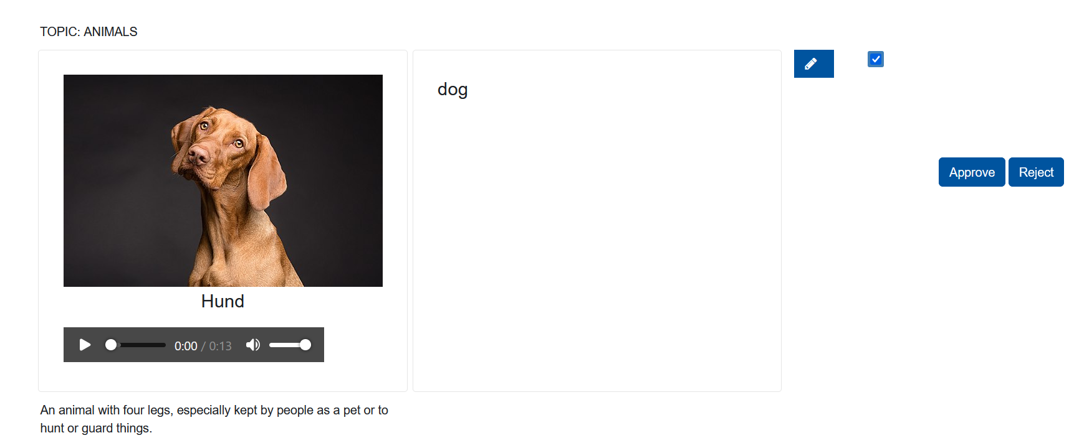
Review flashcards
Students
Flashcards added by students must be approved by the manager before students can practice them.
1
2
In the Review tab, Managers can edit, approve or reject each flashcard submitted by students.
Managers

Slide 13
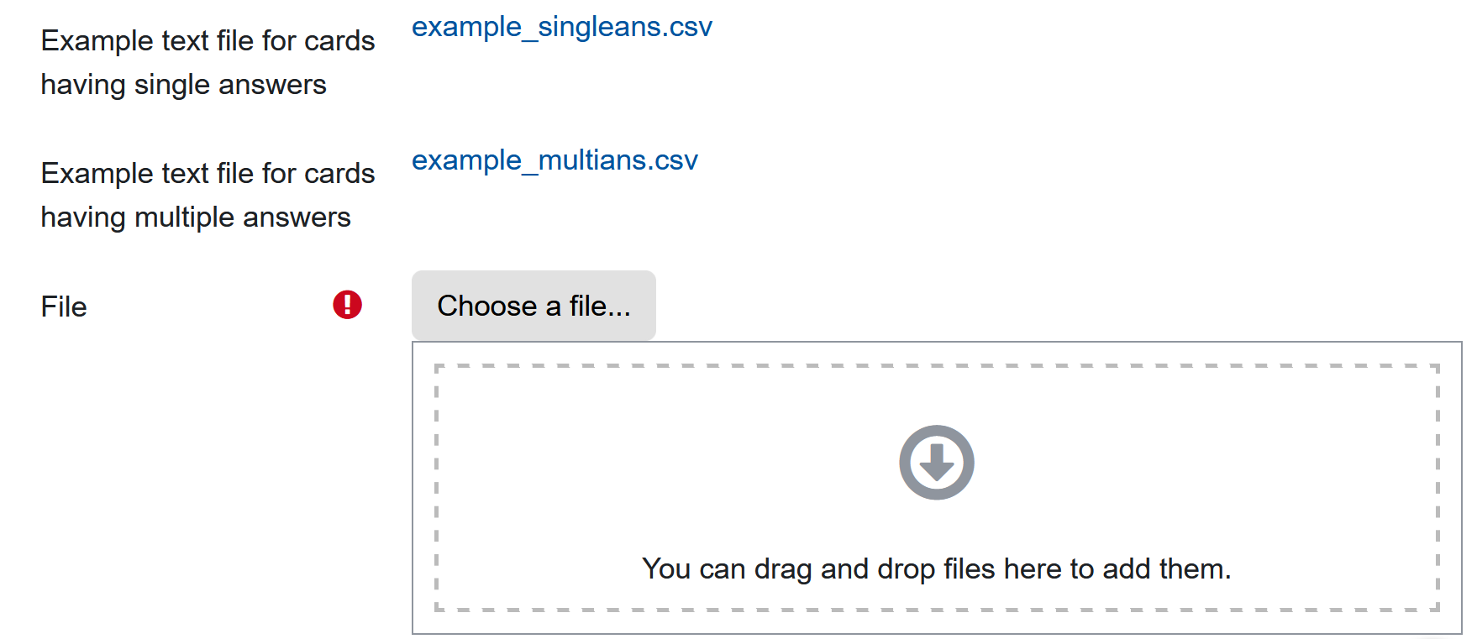
Import flashcards
The sample file contains the column structure needed for the upload. The dummy entries only serve as an example of how the entries are to be made. Remove all dummy entries before filling the file
1
CSV
2
CSV
3
4
Make the necessary entries. If necessary, add further columns for additional solution alternatives. Then Upload the saved CSV file.
The import function is especially useful when a large number of flashcards are to be created at the same time and manually adding each card takes a lot of time.

Slide 14
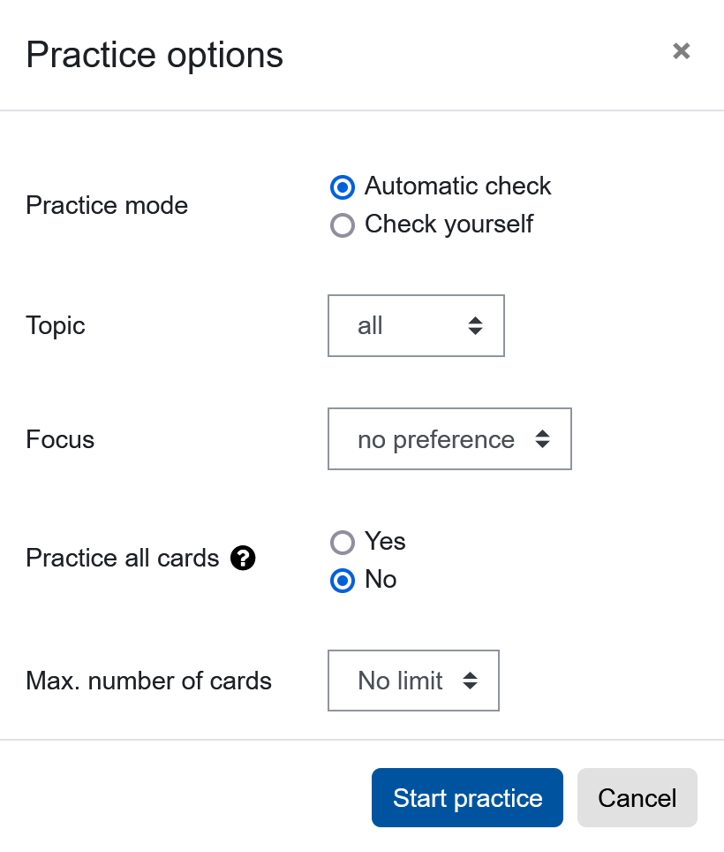
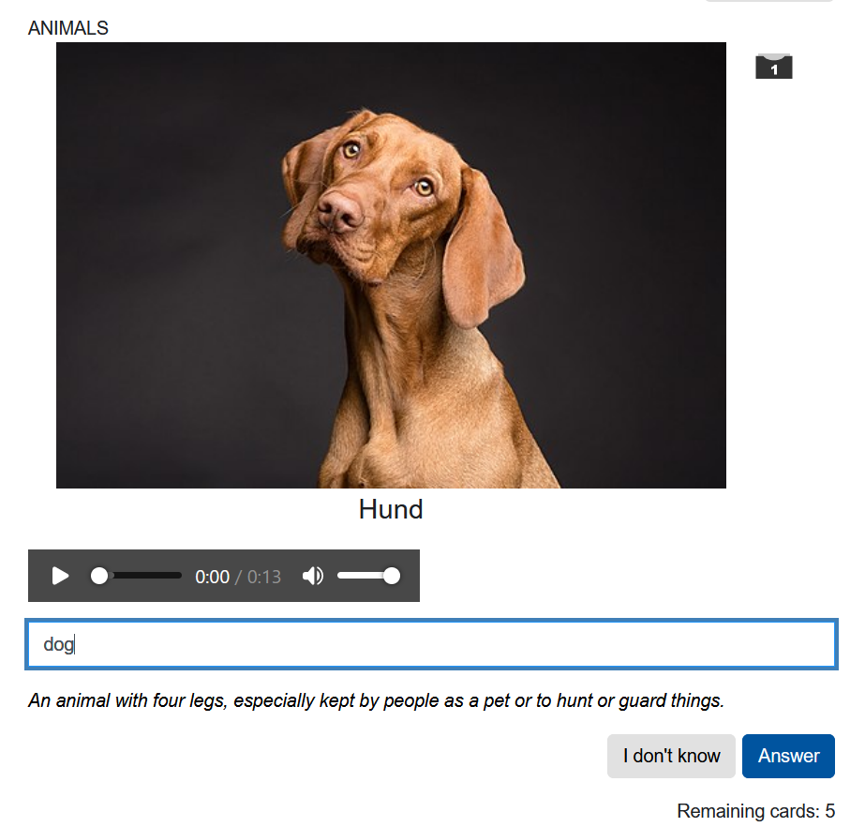
Practice Mode „Automatic Check“
In the "Automatic check" exercise mode, students type in their answers. The answers are checked automatically.
If a focus is set Flashcards for all topics are still displayed, but the cards for the selected topic are selected more frequently

Slide 15
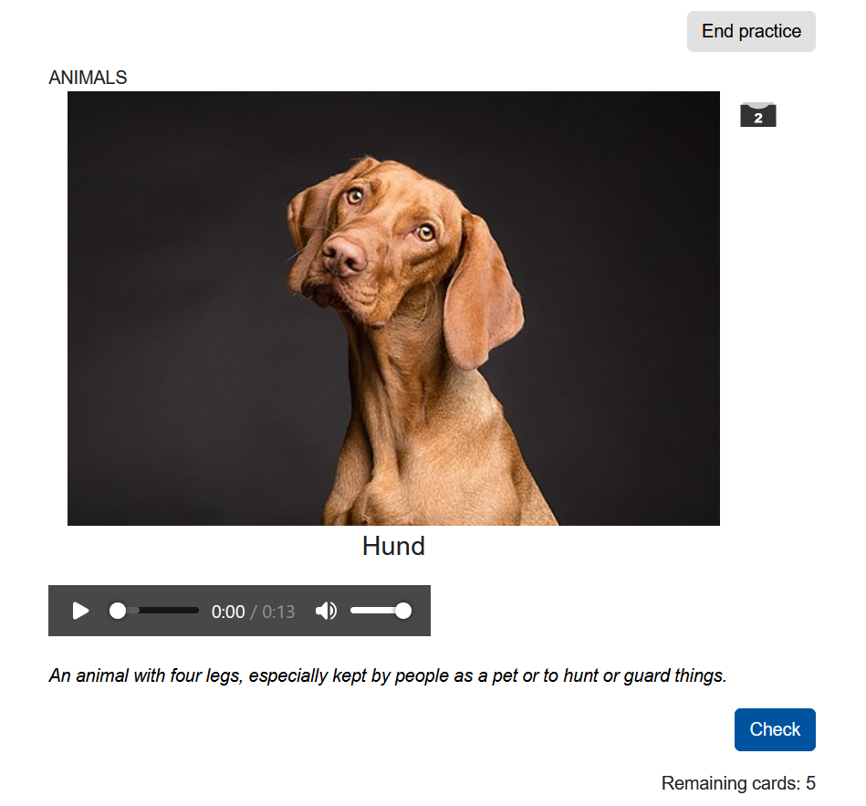
Practice Mode „Check yourself“
In the “Check yourself” exercise mode students can check for themselves whether the answer is correct.
This mode is particularly recommended for longer answers
Students must manually select if they answered the question correctly

Slide 16
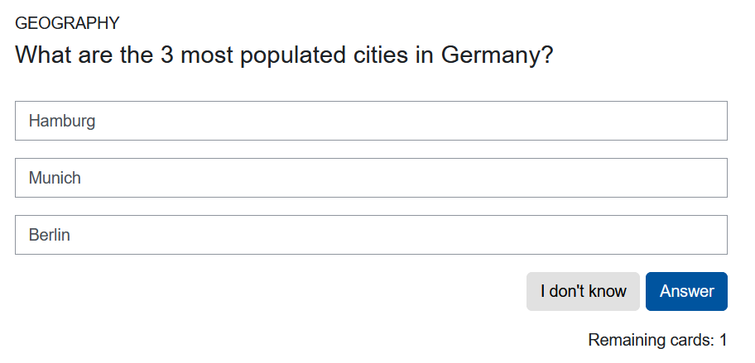
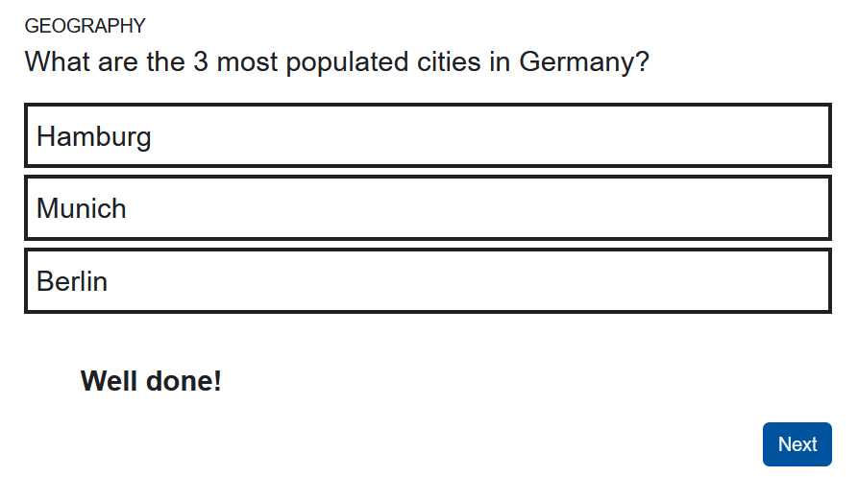
Flashcards with partial solutions
For each flashcard it can be seen in the “Overview” tab whether one or all answers are necessary
For flashcards with partial answers, all added solutions must be named by the student.
For each question it is necessary to select whether all or only one answer is required
All three answers have to be given. The order of the partial answers does not matter.
Students

Slide 17
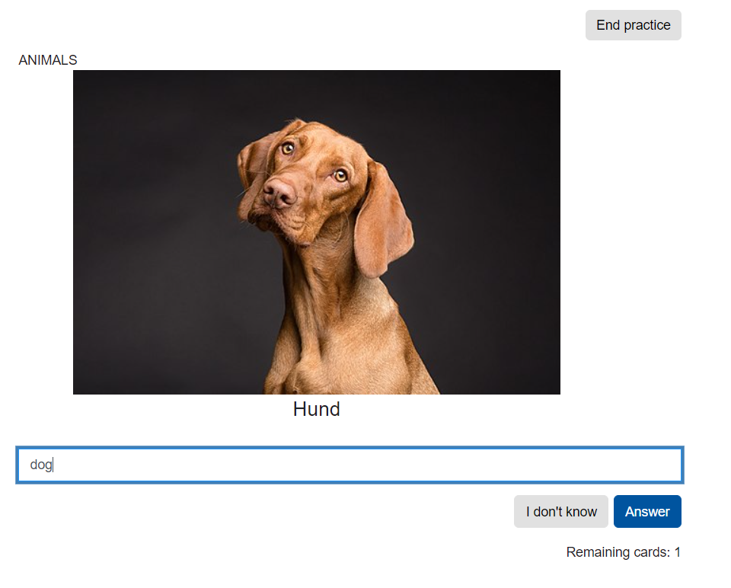
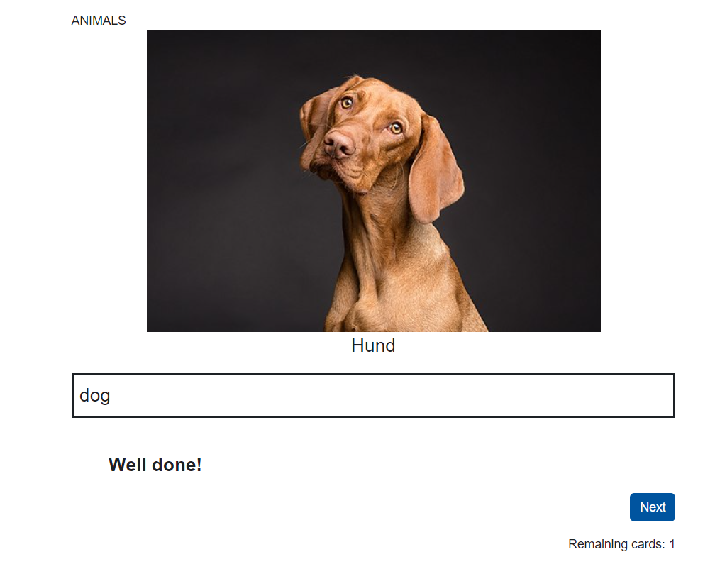
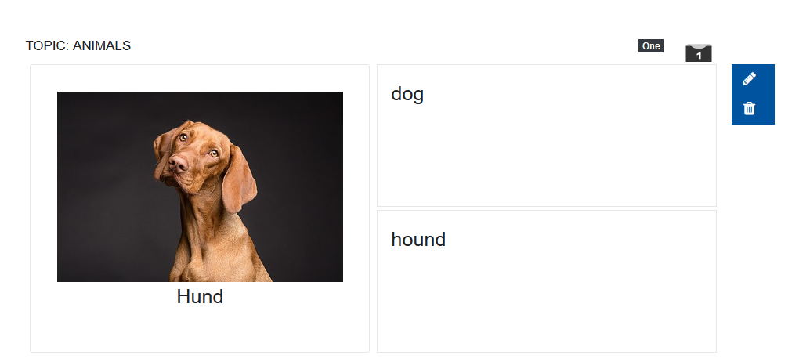
Flashcards with alternative solutions
For each flashcard it can be seen in the “Overview” tab whether one or all answers are necessary
Students
Only one of two alternative answers is necessary
For each question it is necessary to select whether all or only one answer is required
For flashcards with alternative answers, only one added solution must be named by the student.

Slide 18
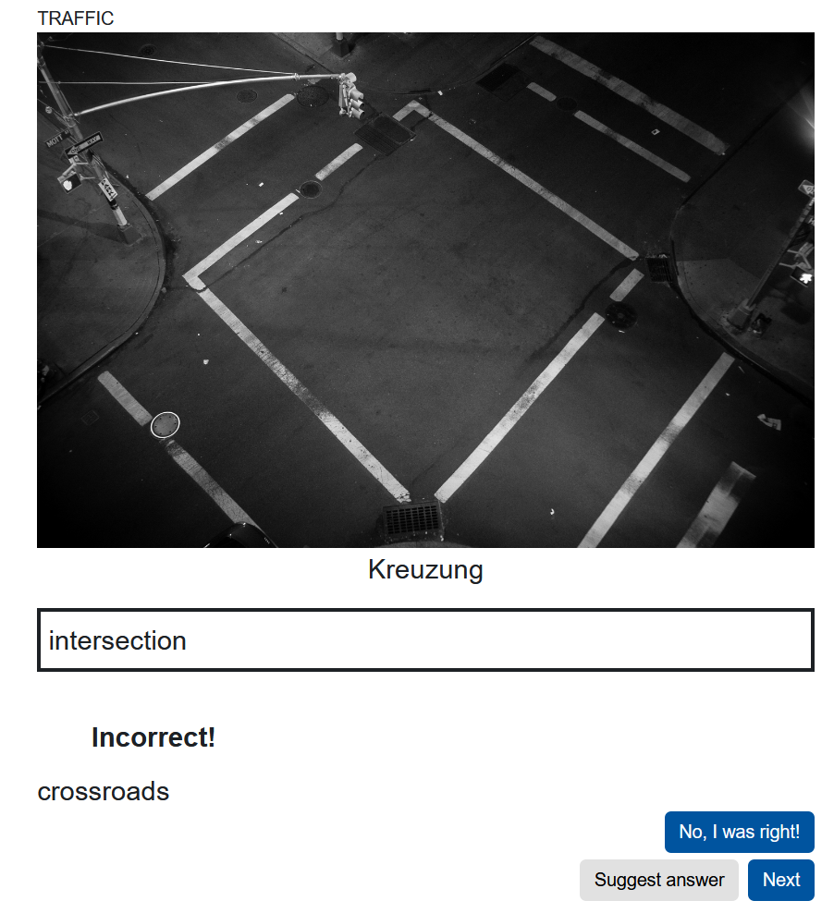
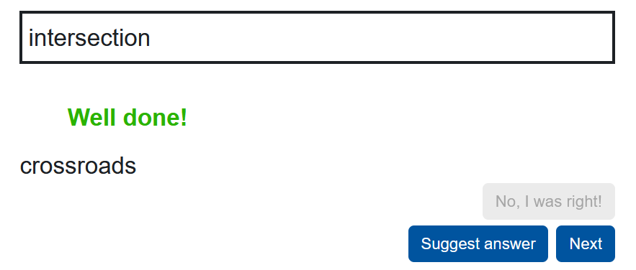
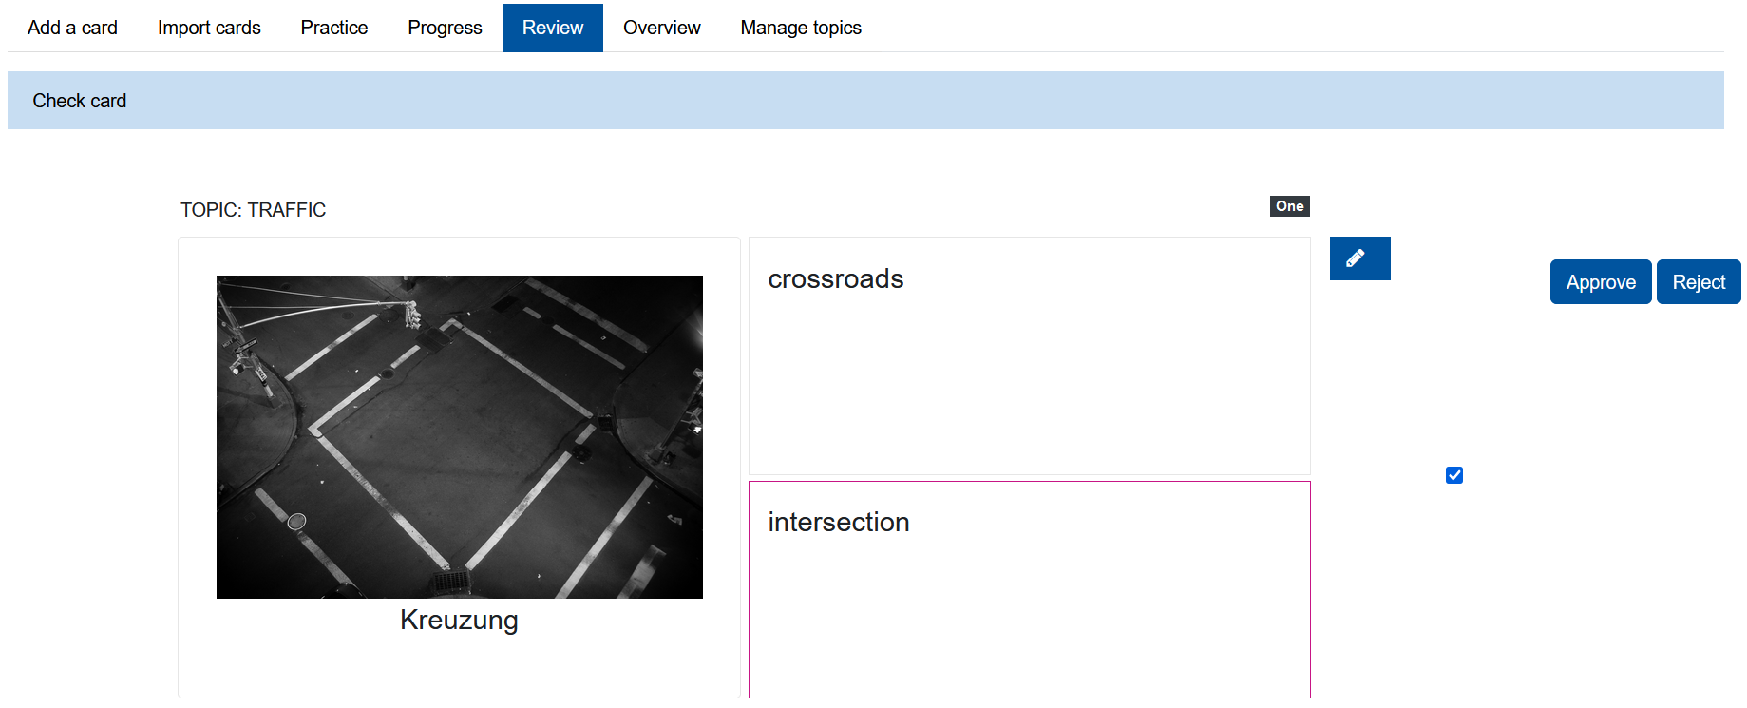
Mark wrong answers as correct and suggest your own answers as alternative solutions
1
Students have the possibility to suggest answers that are regarded as incorrect as alternative solutions.
These alternative solutions have to be approved by the lecturer afterwards.
2
3
By clicking on “Suggest answer” students can then submit their own solution as an alternative solution
If a solution given by the student is regarded as incorrectly answered, it can be manually evaluated as correct.
Manager
Before the submitted alternative solution is considered as a correct answer in future exercise phases, it must be approved by the manager.

Slide 19
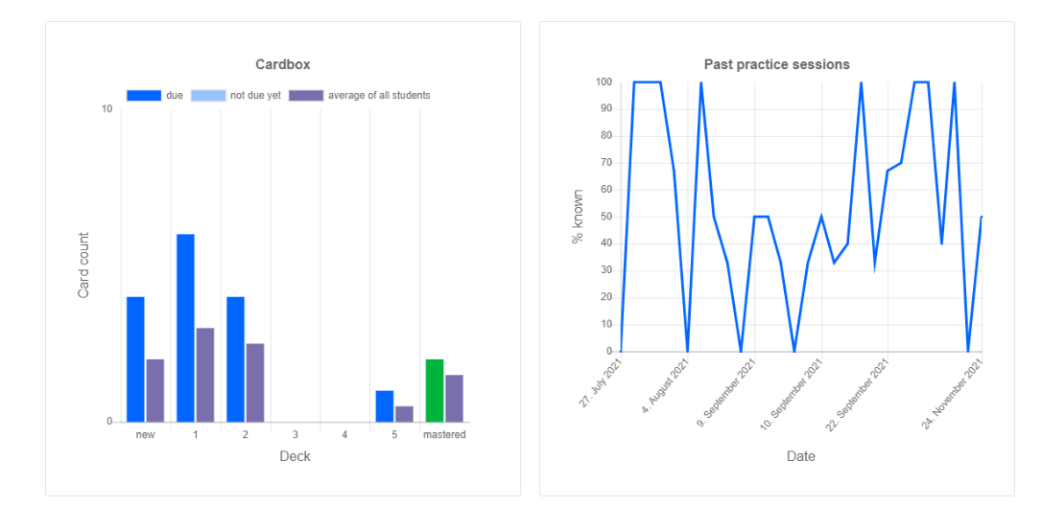
Card Box – Learning statistics
Students
Students can see
the current fill level of their individual flashcards (on the left of the image)
their previous practice success (on the right of the image).

Slide 20
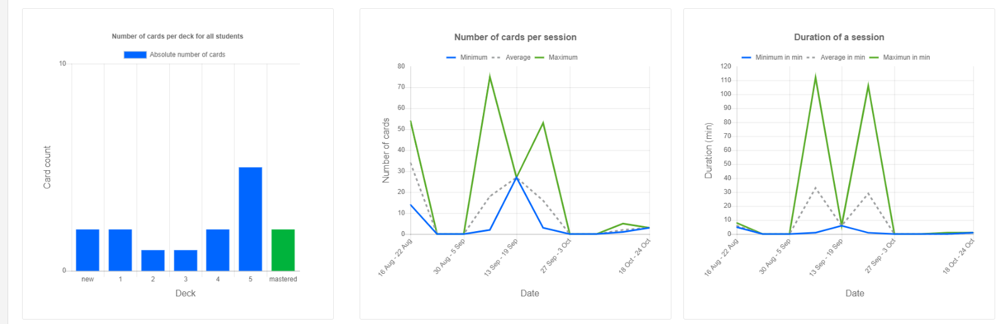
Card Box – Learning statistics
Managers can see the following metrics from the "Progress" tab:
Number of cards per box across all students
Number of practiced cards per practice session (differentiated by calendar weeks)
Duration of an exercise in minutes (differentiated by calendar weeks)
Managers

Slide 21
Usage Example
The Card Box as an (academic) vocabulary trainer
An example from the field of English Studies

Slide 22
Usage Example
Card Box is used at RWTH Aachen University in the Department of English Studies for academic vocabulary training
Students start their studies at university with varying English language skills
Tests have shown that some students lack essential vocabulary
Goal: improve students’ academic vocabulary and their academic performance in general
Card Box is introduced as a tool for self-study in the first semester and is loosely attached to the language competence courses

Slide 23
Usage Example
Tool affords great flexibility in creating different types of cards
Top 500 words in in Gardner and Davies’ Academic Vocabulary List
Each vocabulary item is embedded inside a sentence → provides context of use
Description of each word is in English
Positive feedback
Students appreciate the availability of such a tool
Helps students identify problem areas in their academic vocabulary skills

Slide 24
Contact
Valentin Koser koser@cls.rwth-aachen.de
Dr. Harald Schnurbusch schnurbusch@cls.rwth-aachen.de Card Box Plugin: https://moodle.org/plugins/mod_cardbox
This work is licenced under a Creative Commons Attribution-ShareAlike 4.0 International License

