Slide 1


Experiences on Open Badges for Creating an Open Digital Education Community
Dr. Andrei TERNAUCIUC, Dr. Diana ANDONE,
eLearning Center, Politehnica University of Timisoara, Romania

Slide 2
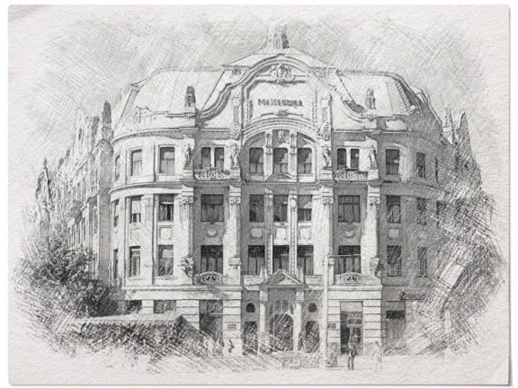


Politehnica University of Timisoara, Romania
1920

Slide 3

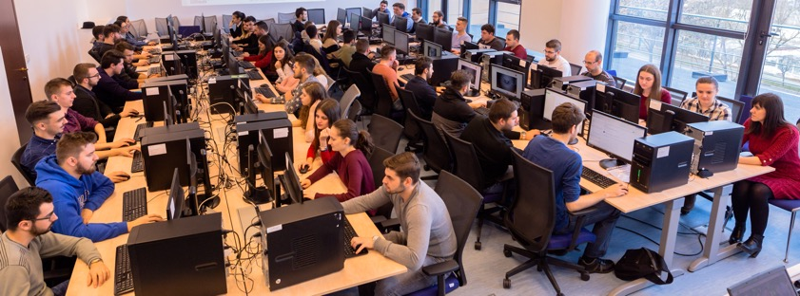
Elearning.upt.ro

Slide 4
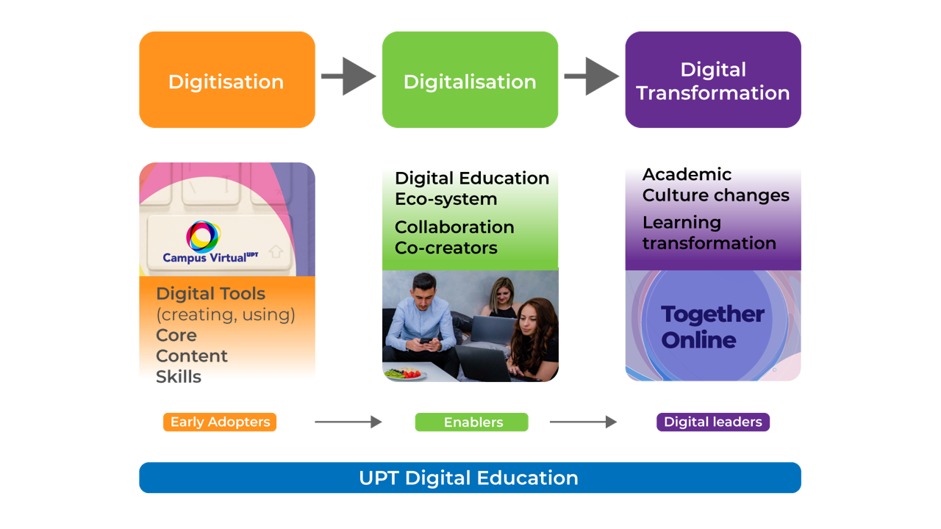

Slide 5
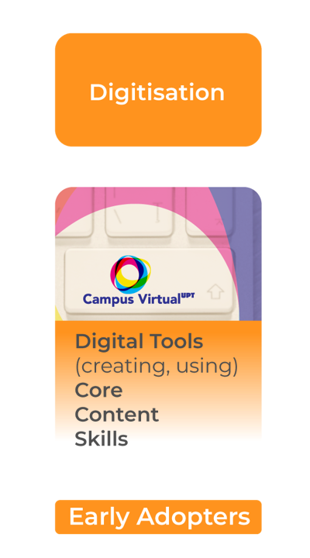
Digitisation
Core
UPT Virtual Campus (Unique Access point)
UniCampus - MOOCs courses
Training & Support

Slide 6
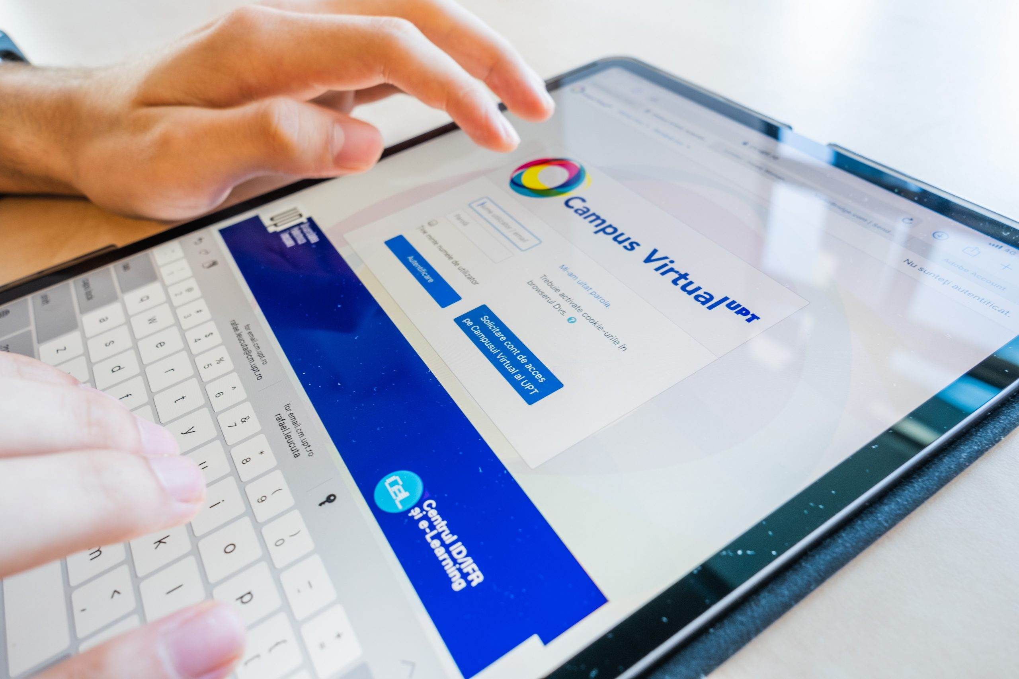
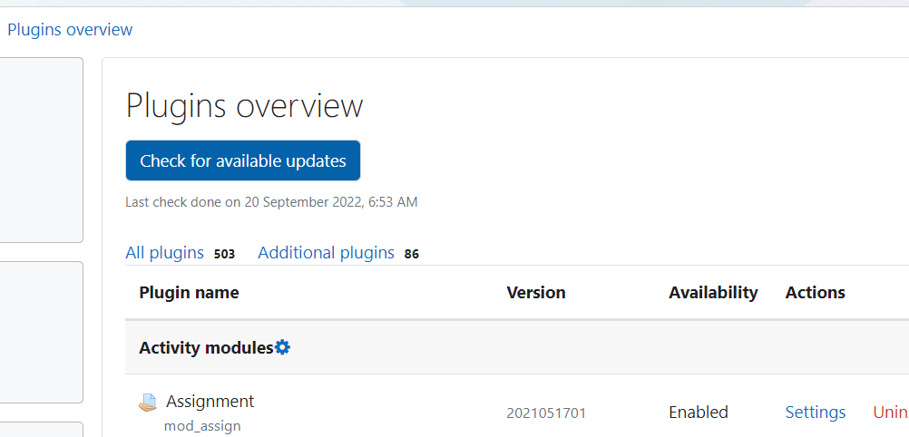
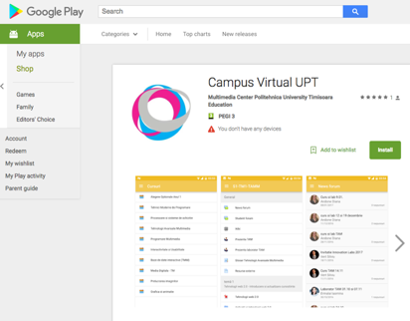
UPT Virtual Campus (Unique Access point) – Customised, scalable
Moodle 3.11.10
503 plugins
86 additional
11 developed by UPT
26 since March 2020
Since 2008 – open-source Moodle, customised and upgraded
Since 2015 - Mobile app CVUPT
Closed platform only for UPT students and professors
https://cv.upt.ro/

Slide 7
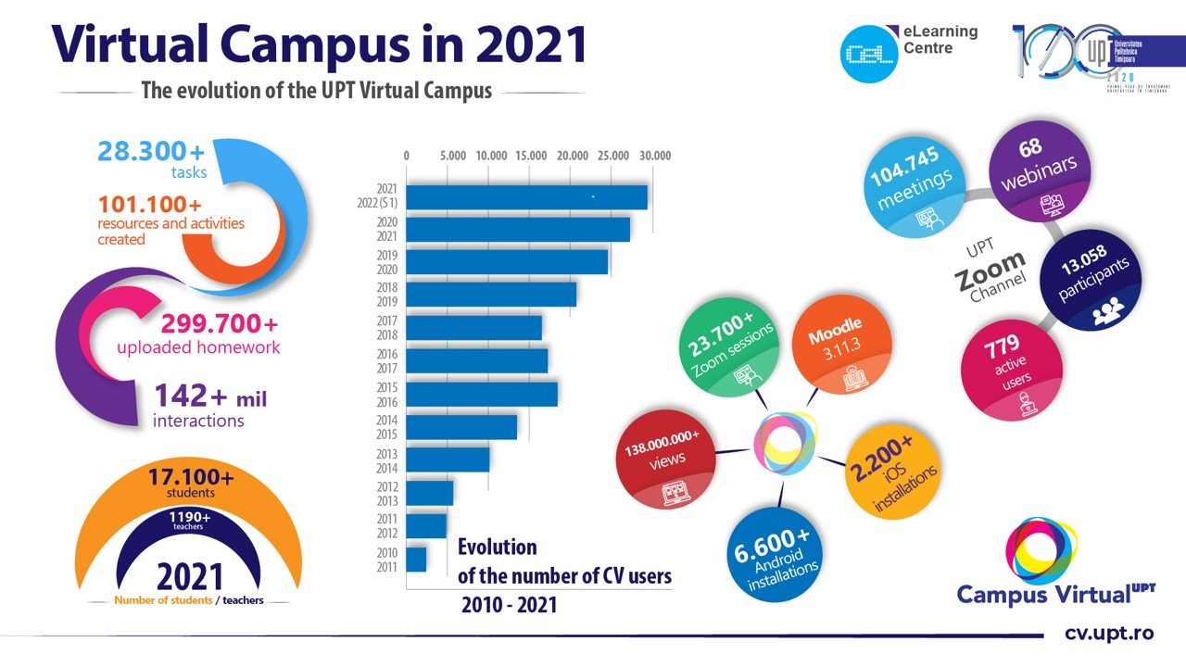

Slide 8
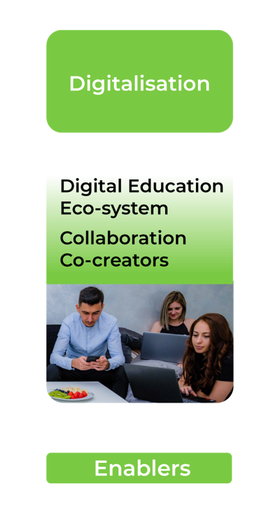

Digitalisation
Digital Education Eco-system
Collaboration
Co-creators
Collaboration
Virtual mobilities

Slide 9
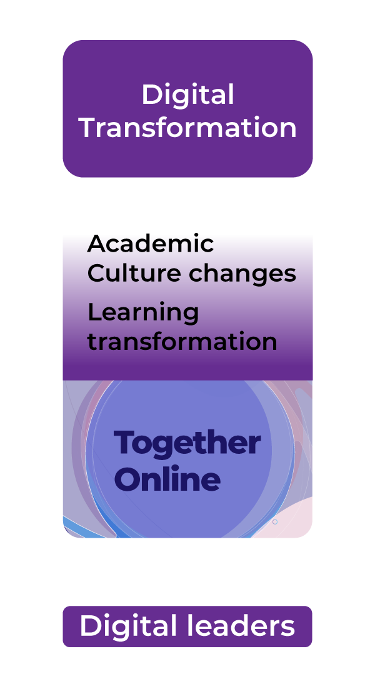
Digital Transformation
Academic Culture changes
Learning transformation
Microcredentials
Community collaboration & Knowledge exchange

Slide 10
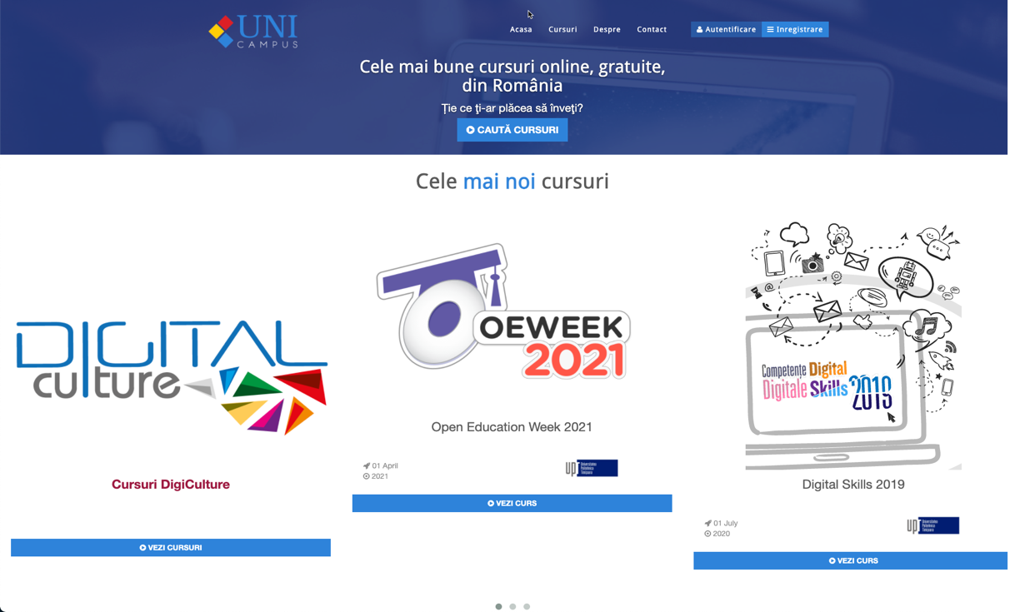
UniCampus
www.unicampus.ro

Slide 12
Why microcredentials?
Formal - informal

Slide 13
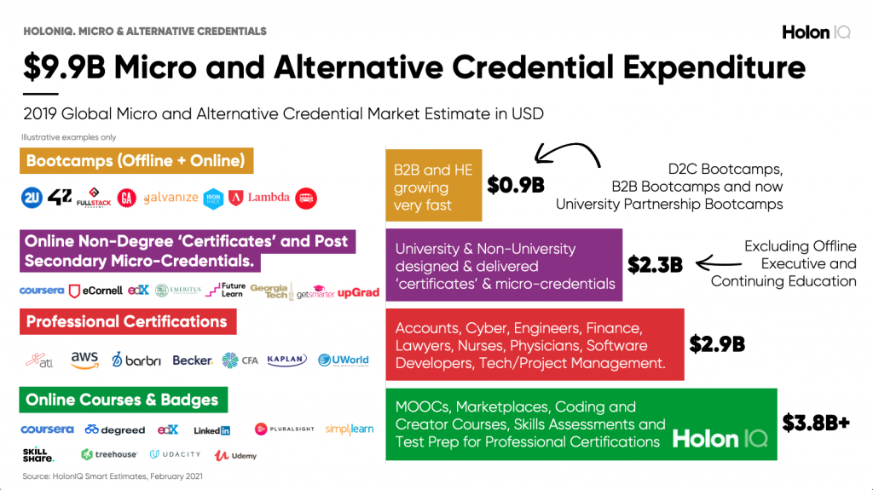
https://www.holoniq.com/notes/micro-and-alternative-credentials.-size-shape-and-scenarios-part-1/

Slide 14
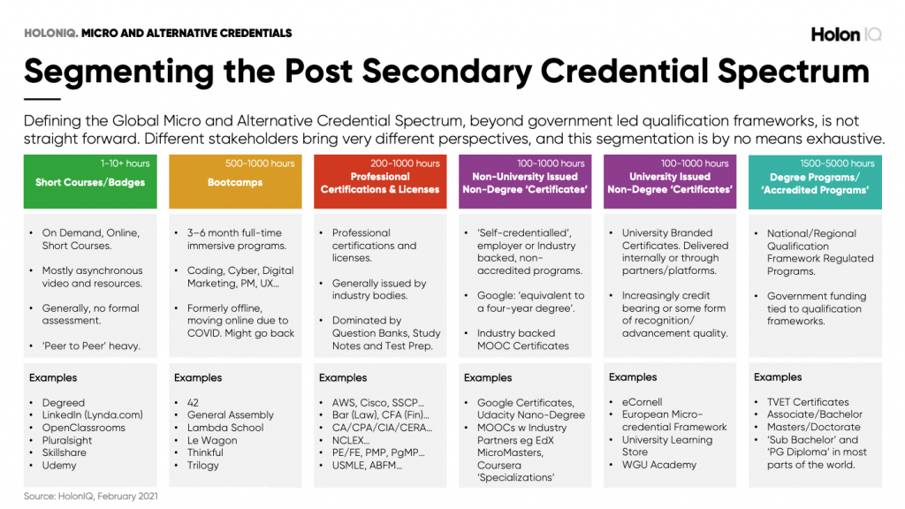
https://www.holoniq.com/notes/micro-and-alternative-credentials.-size-shape-and-scenarios-part-1/

Slide 15
Micro-credentials – formal & informal
Lessons learned
vision
policies & structure
Evidence effects

Slide 16
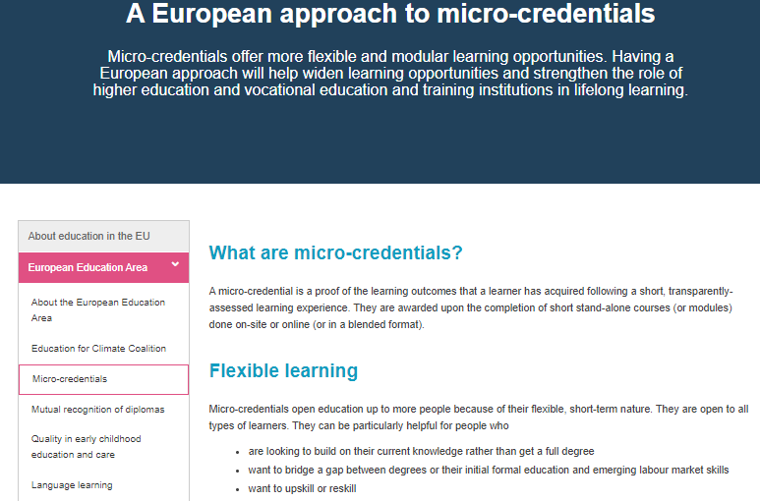
Micro-credentials
Dec 14, 2020 - https://ec.europa.eu/education/education-in-the-eu/european-education-area/a-european-approach-to-micro-credentials_en

Slide 17
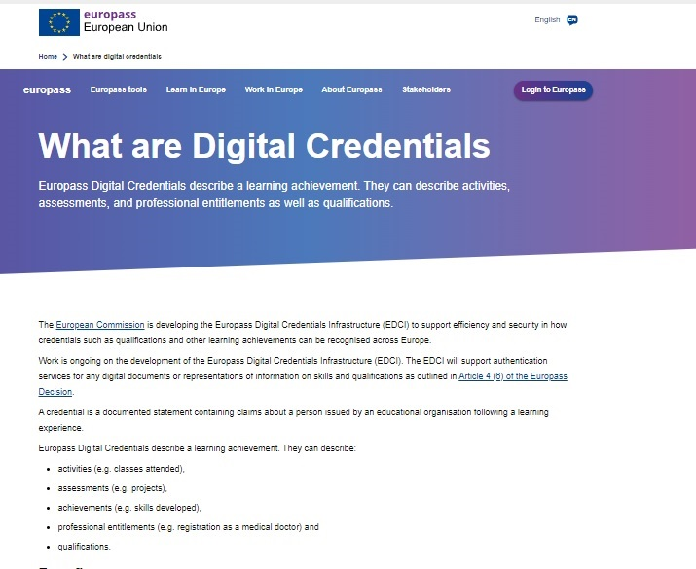
European Digital Credentials for Learning
European Digital Credentials can be used to certify formal and non-formal education.
https://youtu.be/foOcnD0uCyU
https://europa.eu/europass/en/news/launch-event-report-european-digital-credentials-learning
Oct 25, 2021 - https://europa.eu/europass/en/what-are-digital-credentials

Slide 18
European Digital Credentials for Learning
16 June 2022, the Council of the European Union (EU) adopted a Recommendation on a European approach to micro-credentials for lifelong learning and employability
Definition
‘Micro-credential’ means the record of the learning outcomes that a learner has acquired following a small volume of learning. These learning outcomes have been assessed against transparent and clearly defined standards. Courses leading to micro-credentials are designed to provide the learner with specific knowledge, skills and competences that respond to societal, personal, cultural or labour market needs. Micro-credentials are owned by the learner, can be shared and are portable. They may be standalone or combined into larger credentials. They are underpinned by quality assurance following agreed standards in the relevant sector or area of activity.
June 2022 https://education.ec.europa.eu/education-levels/higher-education/micro-credentials

Slide 19
European Digital Credentials for Learning
Micro-credential
Providers of micro-credentials
Learning settings
Formal learning
Non-formal learning
Informal learning
Assessment
‘Portability’ means the ability for a credential-holder to store their micro-credential in a system of their choice, to share the credential with a party of their choice (whether national or transnational) and for all parties in the exchange to be able to understand the content of and verify the authenticity of the credential.
‘Stackability’ means the possibility to combine different micro-credentials and build logically upon each other.
June 2022 https://education.ec.europa.eu/education-levels/higher-education/micro-credentials

Slide 20
European Digital Credentials for Learning
Standard elements to describe a micro-credential (Annex I) including the following mandatory elements:
(1)identification of the learner
(2)title of the micro-credential
(3)country/Region of the issuer
(4)awarding body
(5)date of issuing
(6)learning outcomes
(7)notional workload needed to achieve the learning outcomes (in European Credit Transfer and Accumulation System, wherever possible)
(8)level (and cycle, if applicable) of the learning experience leading to the micro-credential (European Qualifications Framework, Qualifications Frameworks in the European Higher Education Area), if applicable
(9)type of assessment
(10)form of participation in the learning activity
(11)type of quality assurance used to underpin the micro-credential
2022 https://education.ec.europa.eu/education-levels/higher-education/micro-credentials

Slide 21
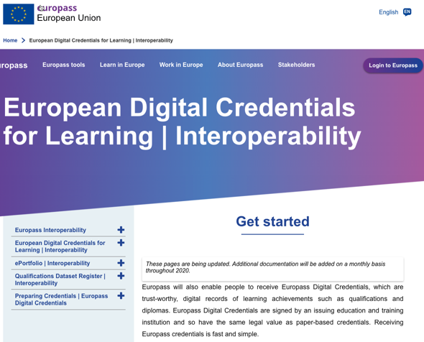
European Digital Credentials for Learning | Interoperability
EDCI Data Model is an extension of the W3C Verifiable Credentials Data Model
aligned with the ELMO/EMREX Standard
Issuer information https://europa.eu/europass/digital-credentials/issuer/#/home
https://europa.eu/europass/en/european-digital-credentials-learning-interoperability

Slide 22
Informal microcredentials
informal

Slide 23


Workshops – Hybrid and flexible – online, free courses – open badges
https://unicampus.ro/

Slide 24
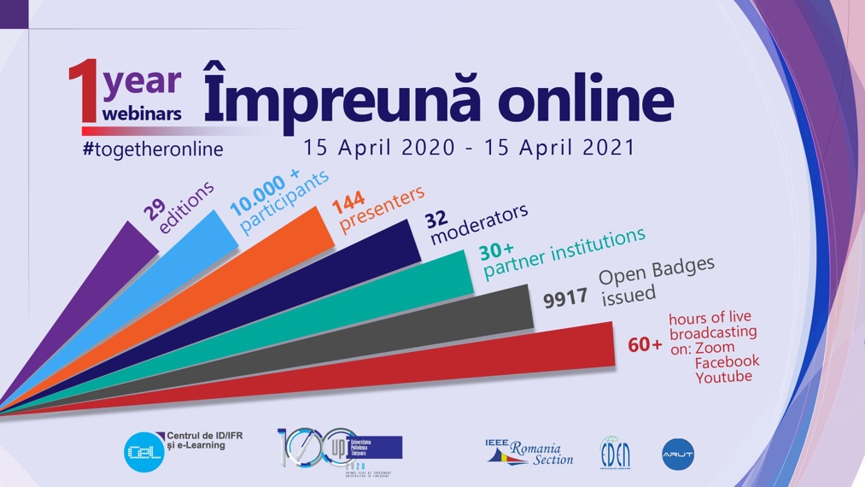

Digital Transformation

Slide 25
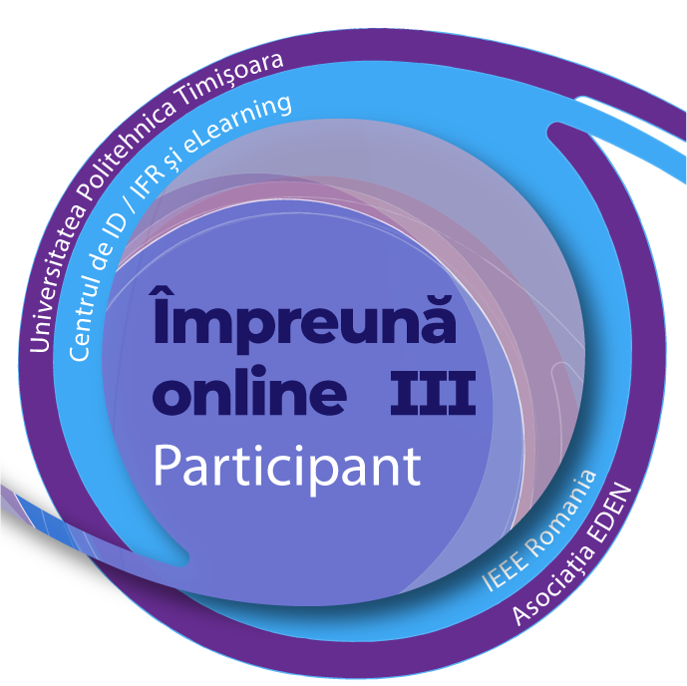
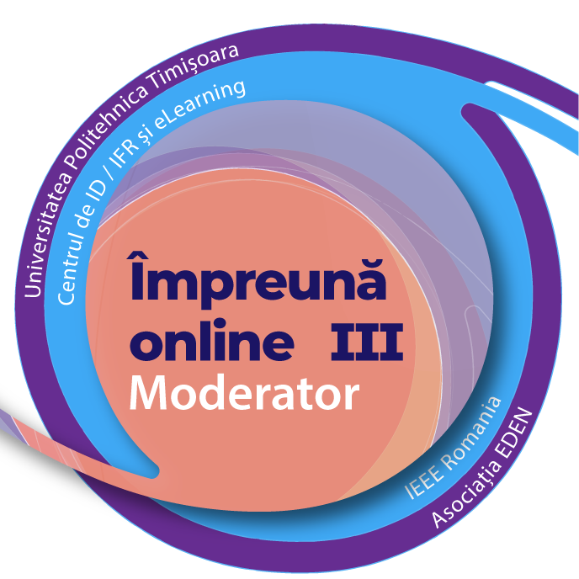
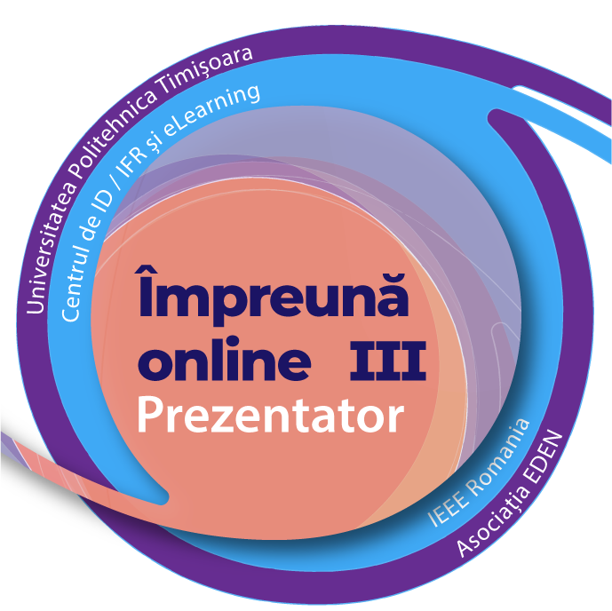
Microcredits – open badge in informal learning (webinars)
https://elearning.upt.ro/ro/impreuna-online/
Integrated with Badgr
Notes:
https://elearning.upt.ro/ro/impreuna-online/

Slide 26
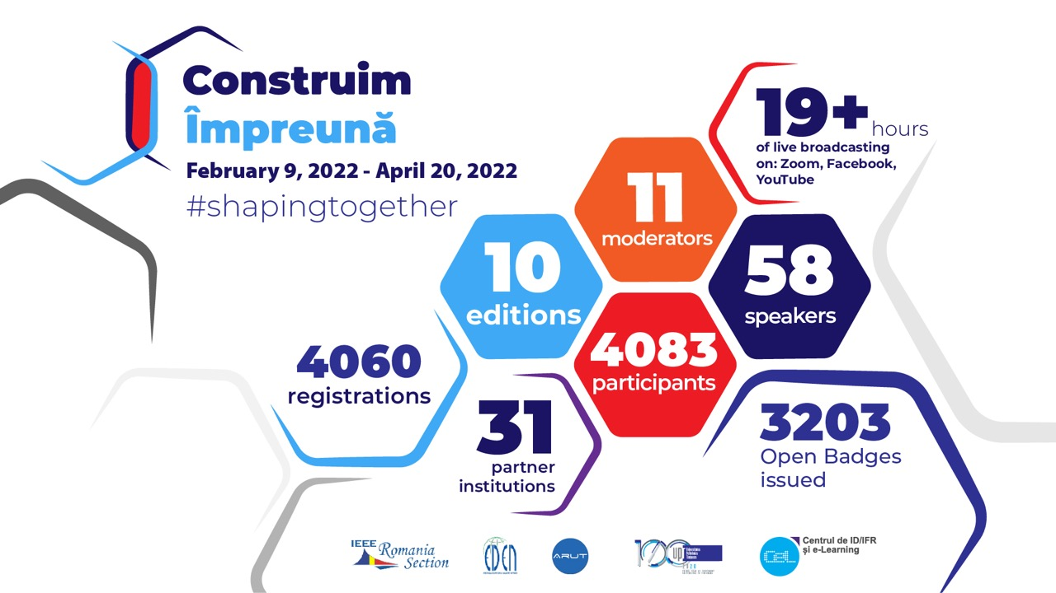

Slide 27





Microcredits – open badge badge in informal learning (workshops, development)
Integrated with Badgr
Notes:
Workshops, webinar, open badges, contributor open badges

Slide 28
Formal – short courses microcredentials
formal

Slide 29

Short Courses – Program training – Micro-specializations
Series of short courses
Stackability - validation
Personalisation
Modular
Validation through industry, associations

Slide 30


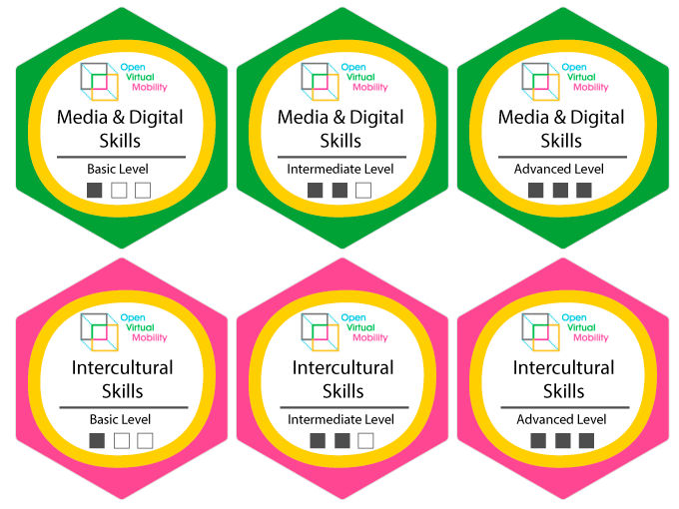


Open Credentials to recognise virtual mobility skills
Opening the skill recognition!
http://www.openvirtualmobility.eu
Open Virtual Mobility | www.openvirtualmobility.eu | @openVM_erasmus

Slide 31
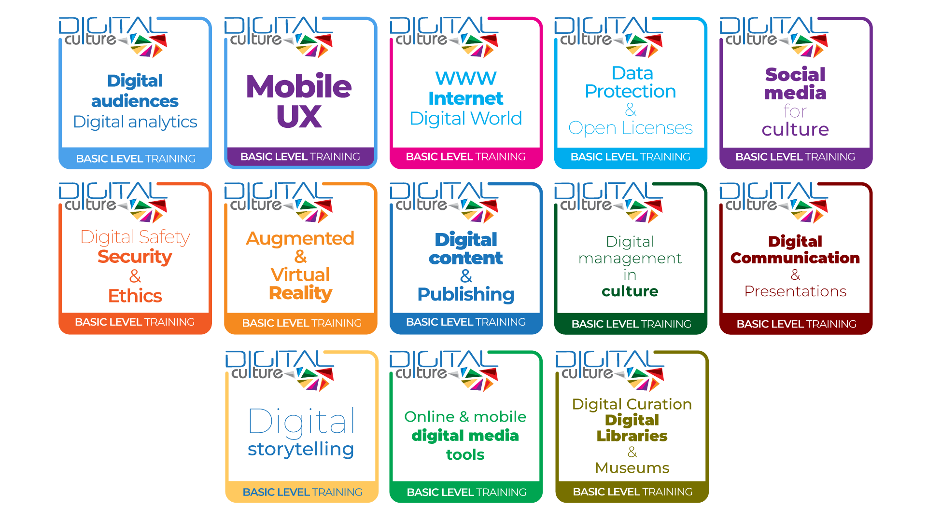
DigiCulture OPEN BADGES
www.digiculture.eu
https://digiculture.eu/

Slide 32
Technical digital microcredentials

Slide 33
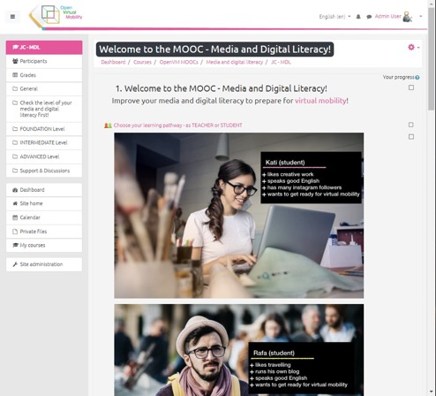
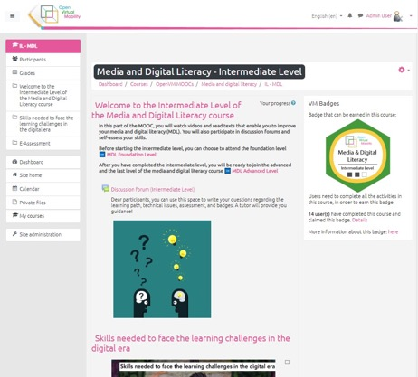

Course implementation
24 courses to get ready for Virtual mobilities
http://www.openvirtualmobility.eu
Open Virtual Mobility | www.openvirtualmobility.eu | @openVM_erasmus

Slide 34
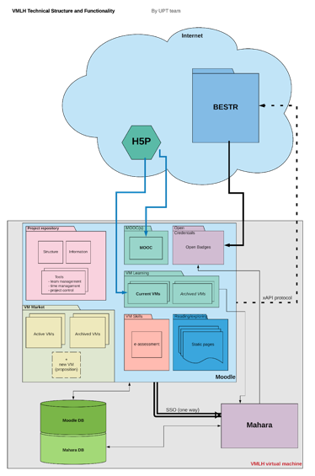
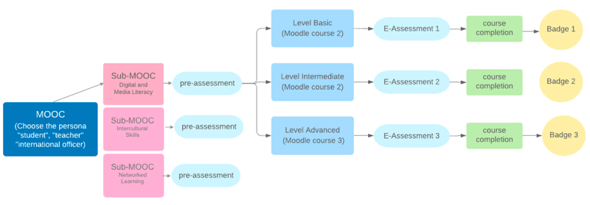
Open Virtual Mobility Learning HUB - Concept
OpenVMLH - MOODLE-based open platform
Bestr LRS
  xAPI plugin
  Custom API for displaying acquired Open Badges in the HUB
http://www.openvirtualmobility.eu

Slide 35
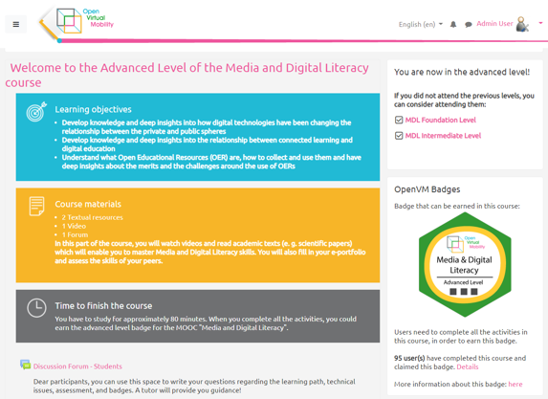
Open Virtual Mobility Learning HUB - implementation
http://www.openvirtualmobility.eu
Moodle based

Slide 36
Open Credentials to recognise virtual mobility skills
Opening the skill recognition!
http://www.openvirtualmobility.eu
Open Virtual Mobility | www.openvirtualmobility.eu | @openVM_erasmus

Slide 37

DigiCulture Courses
– online/ blended learning, free courses
1. The Internet, World Wide Web and introduction to the digital world
2. Digital Content & Publishing (including wikis)
3. Data Protection and Open Licenses
4. Digital Curation - Digital Libraries and Museums
5. Digital Safety, Security and Ethics
6. Digital Storytelling
7. Digital Audiences, Digital Analytics (Google, Facebook, Twitter, SEO)
8. Social Media for Culture
9. Augmented and Virtual Reality
10. Mobile Apps and Mobile User Experience
11. Digital Management in Culture
12. Digital Communication & Presentations
13. Online and Mobile Digital Media Tools (audio-video)
Basic Level Training
www.unicampus.ro

Slide 38
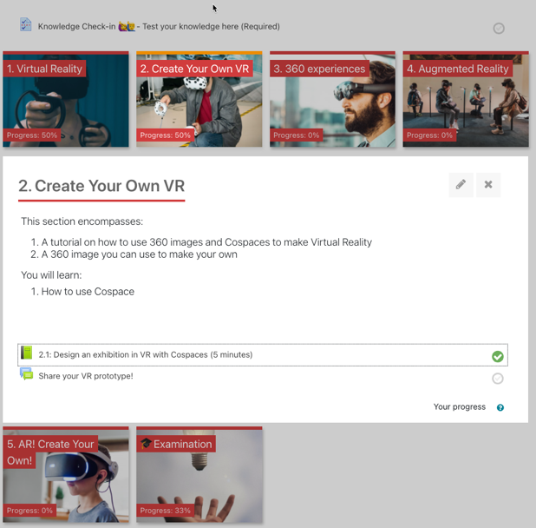
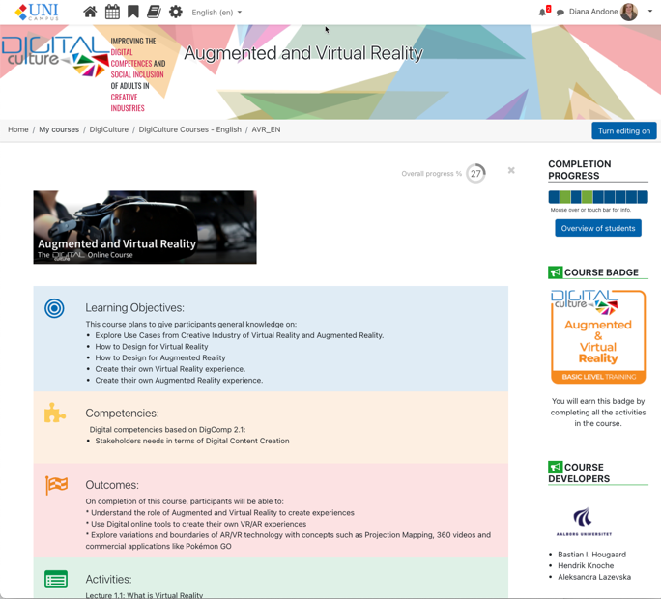
DigiCulture Courses
– online/ blended learning, free courses
Moodle based
https://digiculture.eu/

Slide 39
DigiCulture OPEN BADGES
www.digiculture.eu
https://digiculture.eu/

Slide 40
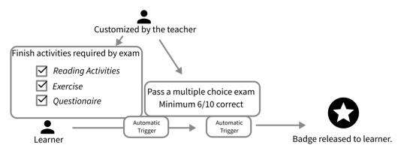
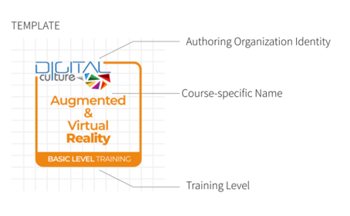
DigiCulture – Badges Concept
DigiCulture - MOODLE-based open (sub)platform
Native Badges
  Integration with Badgr
https://digiculture.eu/
^{*)} https://digiculture.eu/en/publication-of-output-4-digital-skills-e-assessment-and-open-digital-badges-for-adult-education/

Slide 41
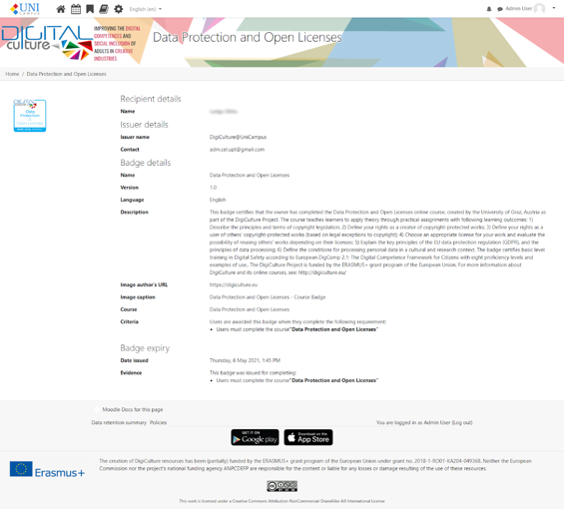
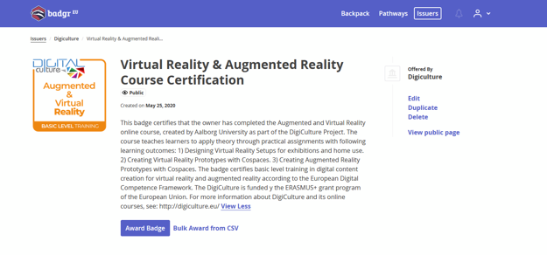
DigiCulture – Badges Implementation
https://digiculture.eu/
www.unicampus.ro

Slide 42
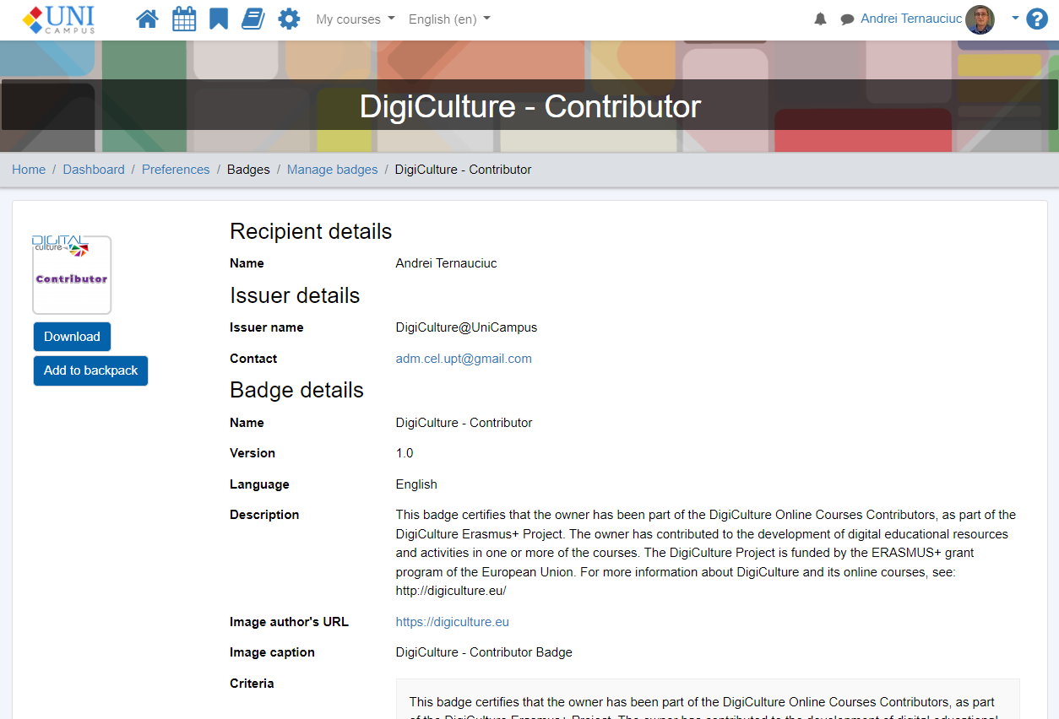
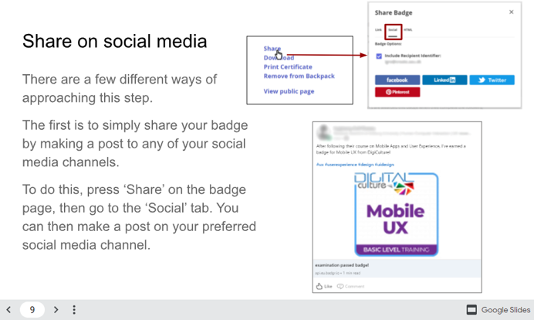
DigiCulture – Badges export
https://digiculture.eu/

Slide 43
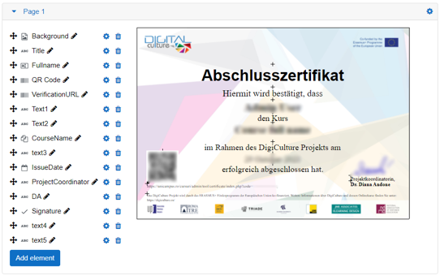
DigiCulture – Course completion Certificates
Course Certificate
Certificate Manager
  Part of Moodle Workplace
Multiple language
https://digiculture.eu/
www.unicampus.ro

Slide 44
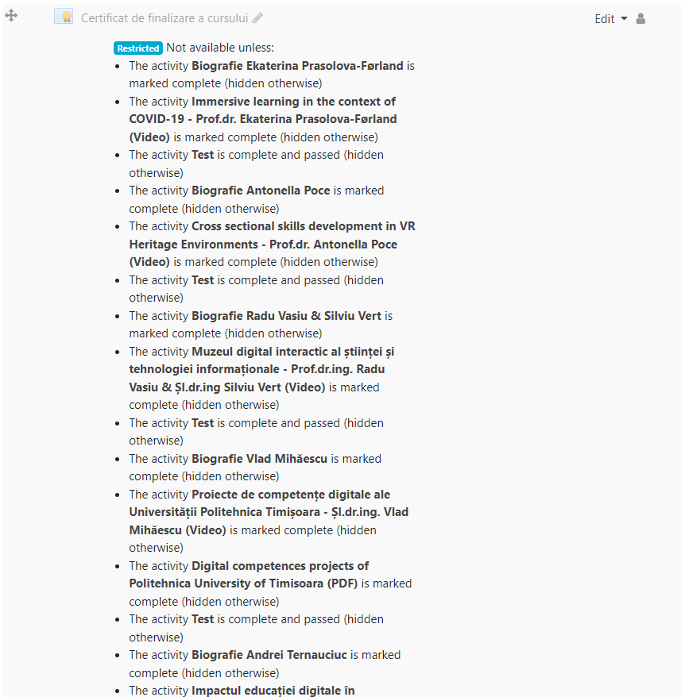
UniCampus – Course completion Certificate
www.unicampus.ro

Slide 45
Virtual Campus of UPT – CVUPT – Badgr integration
https://cv.upt.ro/

Slide 46
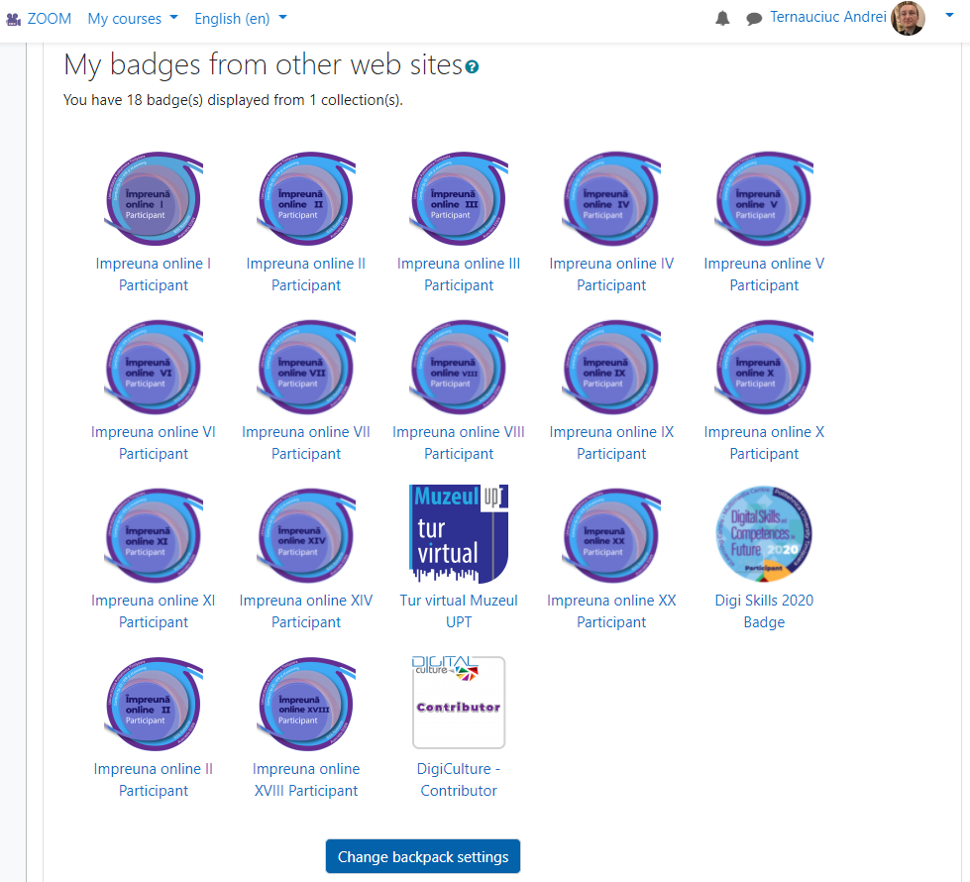
Virtual Campus of UPT – CVUPT – Badgr integration
https://cv.upt.ro/

Slide 47
Formal – diploma microcredentials
formal

Slide 48
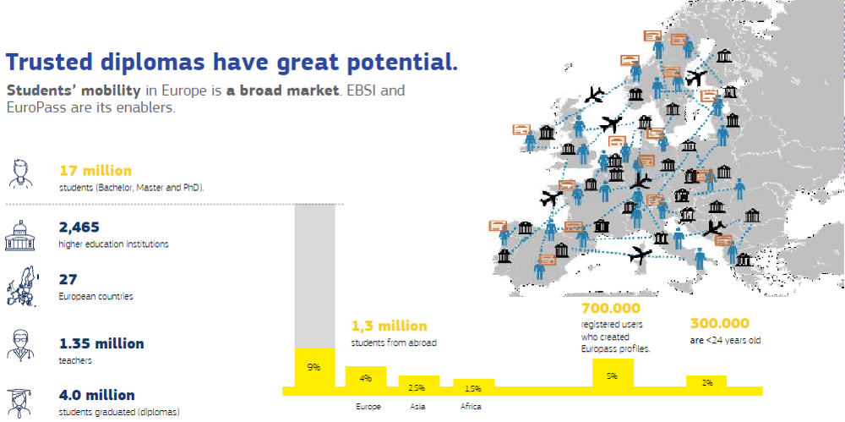

EBSI4RO
Connecting Romania through Blockchain
From Early Adopters EBSI Programme Webinar - March 2021 -
https://ec.europa.eu/cefdigital/wiki/display/CEFDIGITAL/EBSI+Early+Adopters+programme+kick-off+webinar

Slide 49
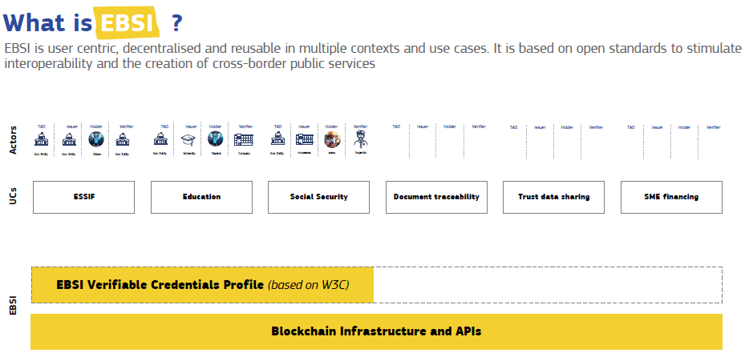
EBSI4RO
Connecting Romania through Blockchain
https://ec.europa.eu/cefdigital/wiki/display/CEFDIGITAL/EBSI

Slide 50
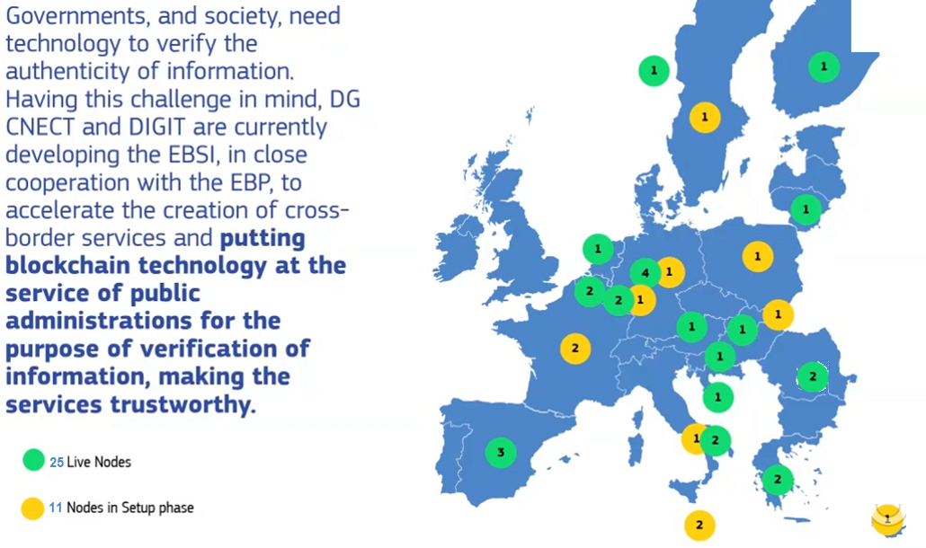
EBSI nodes
EBSI4RO
Connecting Romania through Blockchain

Slide 51
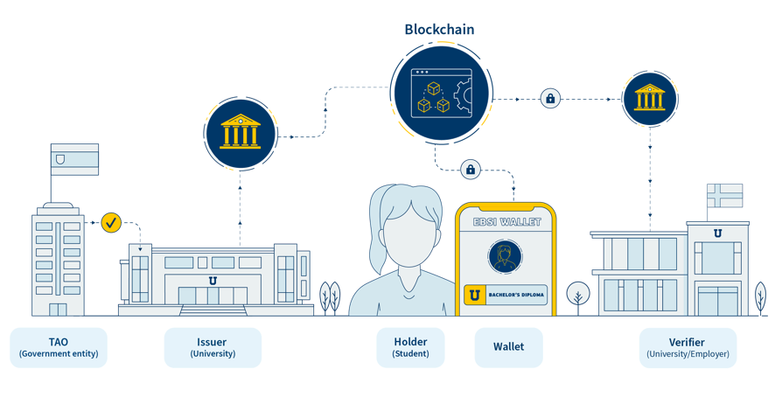
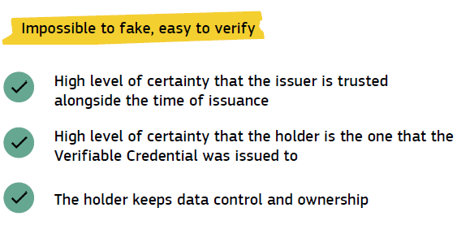
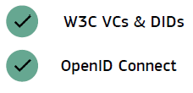
Verifiable Credentials on EBSI
EBSI4RO
Standards

Slide 52





















EBSI Early Adopters: Multi-University Pilot
2 European universities alliances, +18 universities from +15 countries
EBSI4RO participates in the EA Programme – July 2021 -December 2023
https://ec.europa.eu/cefdigital/wiki/display/CEFDIGITAL/Early+Adopters+Programme

Slide 53
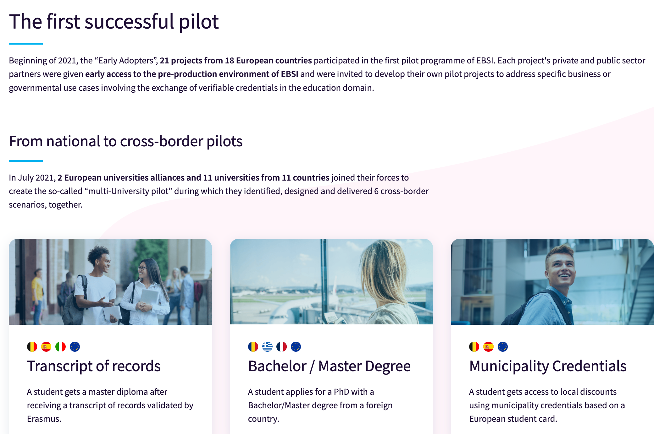
EBSI4RO
Connecting Romania through Blockchain

Slide 54

EBSI4RO Connecting Romania through Blockchain
Central scope: to create an extendable and sustainable ecosystem to facilitate and accelerate the awareness, knowledge and adoption of the Blockchain technologies and European Blockchain Services Infrastructure (EBSI) by the Romanian citizens, businesses, institutions and administration; proposals for Blockchain policies in education.
Partners:
Executive Unit for Financing Higher Education, Research, Development and Innovation (UEFISCDI)
  Dr.Cosmin Cioranu
  Elena Stefania Nicolaescu
Politehnica University of Timisoara (UPT)
  Prof.dr.ing.Radu Vasiu
  Dr.Diana Andone
  Prof.dr.ing.Carmen Holotescu
  Drd.Victor Holotescu
  S.l.dr.Andrei Ternauciuc
April 2021 – March 2023
https://ebsi4ro.ro
https://www.facebook.com/ebsi4ro
https://twitter.com/ebsi4ro
Moodle certificate – link to EBSI?

Slide 55

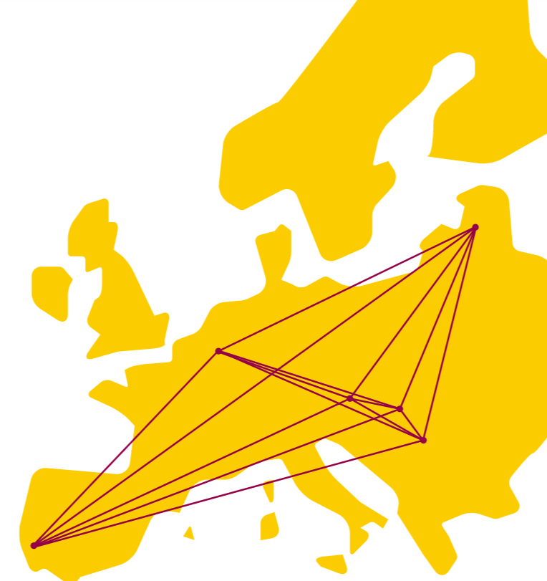
European University Alliance
https://www.eudres.eu/

Slide 56
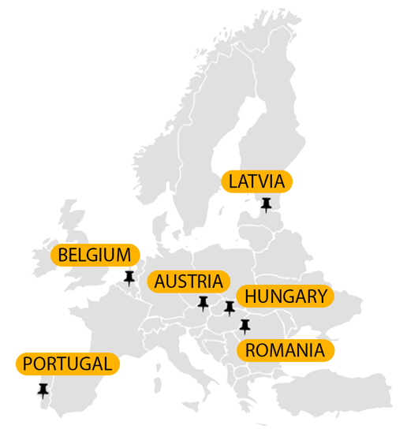
AUSTRIA
St. Pölten University Of Applied Sciences (Lead)
https://fhstp.ac.at/
PORTUGAL
Instituto Politécnico de Setúbal
https://www.ips.pt/
HUNGARY
Hungarian University of Agriculture and Life Sciences
https://www.uni-mate.hu/
BELGIUM
UC Leuven-Limburg UAS
https://www.ucll.be/
ROMANIA
Politehnica University Timișoara
http://www.upt.ro/
LATVIA
Vidzeme University of Applied Sciences
The NETHERLANDS
Saxion University of Applied Sciences
GERMANY
Fulda University of Applied Sciences
The NETHERLANDS
GERMANY
https://www.eudres.eu/

Slide 57
Micro-credentials – technical
Lessons learned – EU & Moodle
European Digital Credentials for Learning | MOODLE Certificate & Badge
(1)identification of the learner | Full name / email address – from user profile
(2)title of the micro-credential | Name of badge / certificate
(3)country/Region of the issuer | Optional. Multi language / international consortiums
(4)awarding body | Logos, disclaimers, etc. (for certificates)
(5)date of issuing | Automatically generated
(6)learning outcomes | Criteria (badges)
(7)notional workload needed to achieve the learning outcomes | Optional, only as text (certificate)

Slide 58
Micro-credentials – technical
Lessons learned – EU & Moodle
European Digital Credentials for Learning | MOODLE Certificate & Badge
(8)level (and cycle, if applicable) of the learning experience leading to the micro-credential (European Qualifications Framework, Qualifications Frameworks in the European Higher Education Area), if applicable | Alignment section (badges); text/links (certificates)
(9)type of assessment | Missing
(10)form of participation in the learning activity | Online/blended
(11)type of quality assurance used to underpin the micro-credential | Implicit from awarding body, Missing

Slide 59
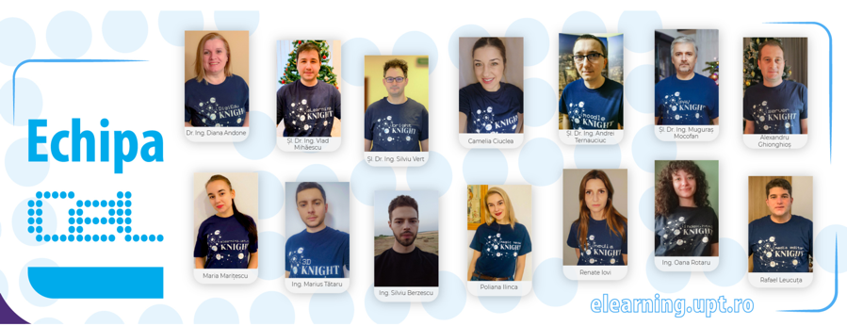


Contact
Dr. Andrei Ternauciuc
Head of Virtual Campus of UPT
e-Learning Center
Politehnica University of Timisoara, Romania
Email: andrei.ternauciuc@upt.ro
Dr. Diana Andone
Director
e-Learning Center
Politehnica University of Timisoara
Romania
Email: diana.andone@upt.ro
Elearning.upt.ro/diana.andone
@diando70
EDEN Fellow 2011, Senior Fellow 2021
EDEN Vice-president (2017-2021)
IEEE Romania Education Chair,
IEEE Education Board of Governors
IEEE Computer Society, TCLT Open Chair
IEEE Education and Women in Engineering
elearning.upt.ro
cv.upt.ro
unicampus.ro

