Slide 1
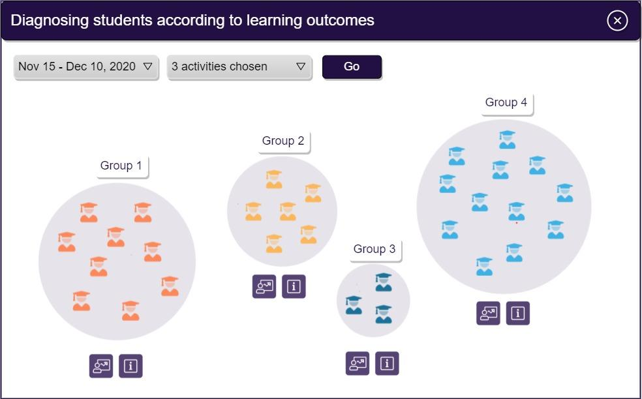
GrouPer Group-based Personalization
Presenter: Nadav Kavalerchik
The department of science teaching, Weizmann Institute of science,
Israel.
Notes:
AI for Teachers (GrouPer) assessment technology to support personalised instruction in blended learning environments. It is implemented through a tool that combines machine learning, student response data, and expert knowledge, to perform a multidimensional analysis of student responses into clusters capturing types of reasoning.
<number>

Slide 2
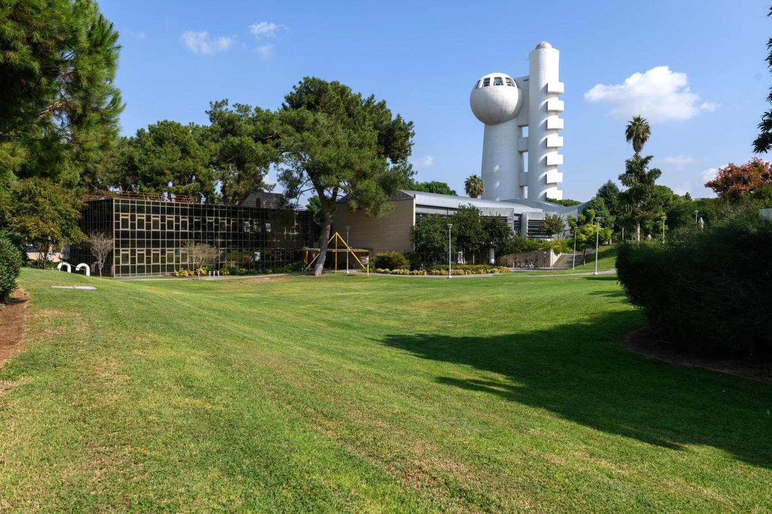
Research and development
Creating high quality professional content
STEM Teacher training
Notes:
<number>

Slide 3
Notes:
<number>

Slide 4
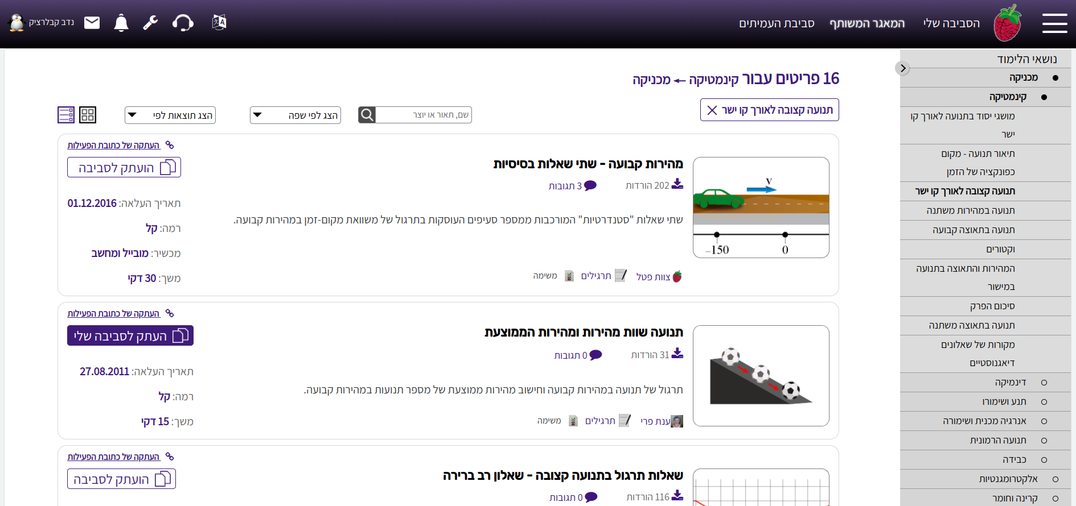
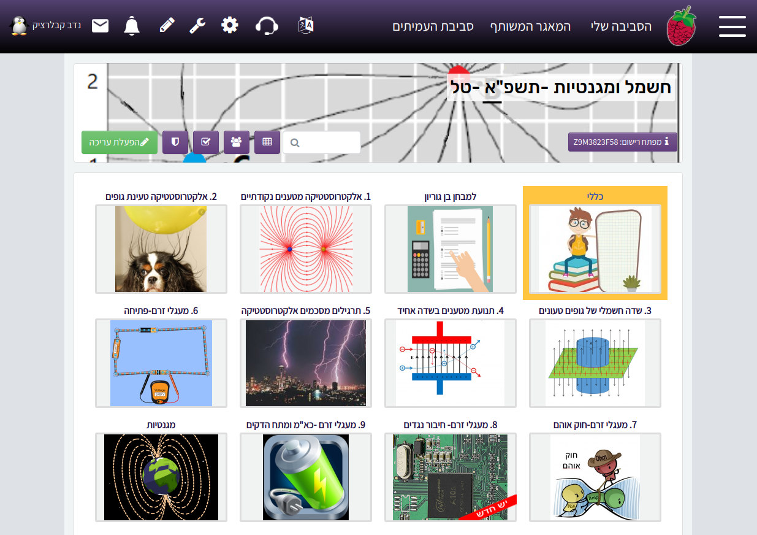
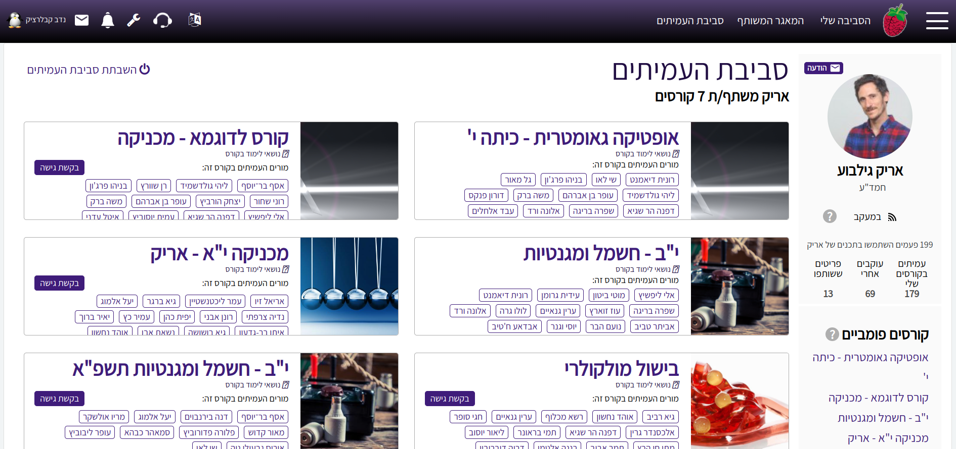
PETEL Personalized teaching and learning
OER Catalog
Social network
Notes:
<number>

Slide 5
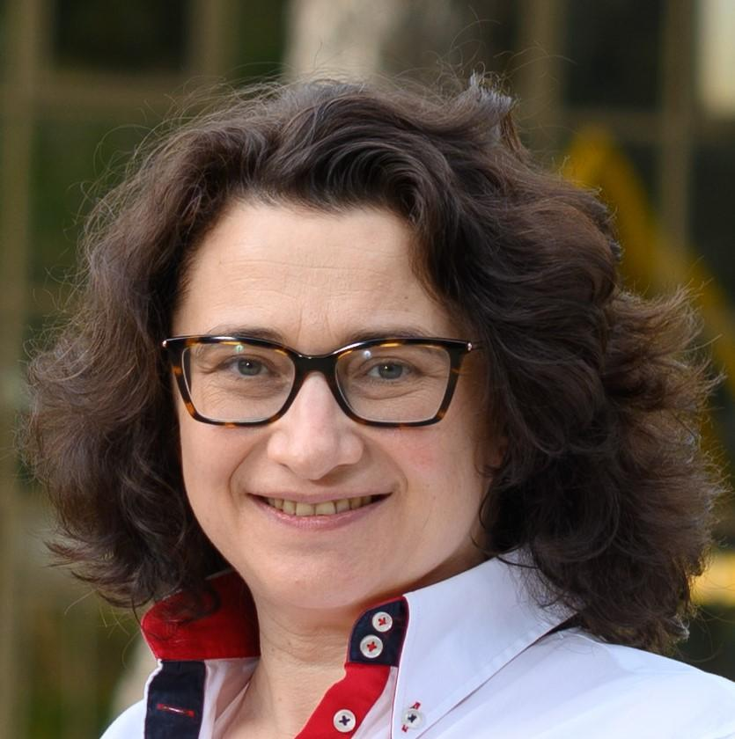
GrouPer Core Team
Tanya Nazaretsky
PhD Student, Weizmann Institute,
AIED Researcher
Dr. Giora Alexandron
Assistant Professor, Weizmann Institute,
PI of the GrouPer Project
Nadav Kavalerchik
Head of Moodle software development team & system architect, The department of science teaching, Weizmann Institute.
Notes:
<number>

Slide 6
Every good research start with a question
And some assistance from an AI…
OpenAI DALL-E draw me a picture of: a researcher asking teachers what is their greatest challenge teaching students
Notes:
<number>

Slide 7
“If only I could see the gaps in their understanding and misconceptions early, when they are still small”
Notes:
"If I could only see the gaps early when they are still small, "said one of the teachers.
<number>

Slide 8
GrouPer
(Group-based Personalization)
Identifies student’s knowledge profiles in real-time
&
Guides teachers in providing a tailored response to each profile
Notes:
We call it GrouPer – Group-based personalization. GrouPer identifies knowledge profiles in real-time and guides the teacher in providing a tailored response to each profile. So how does GrouPer work?
<number>

Slide 9
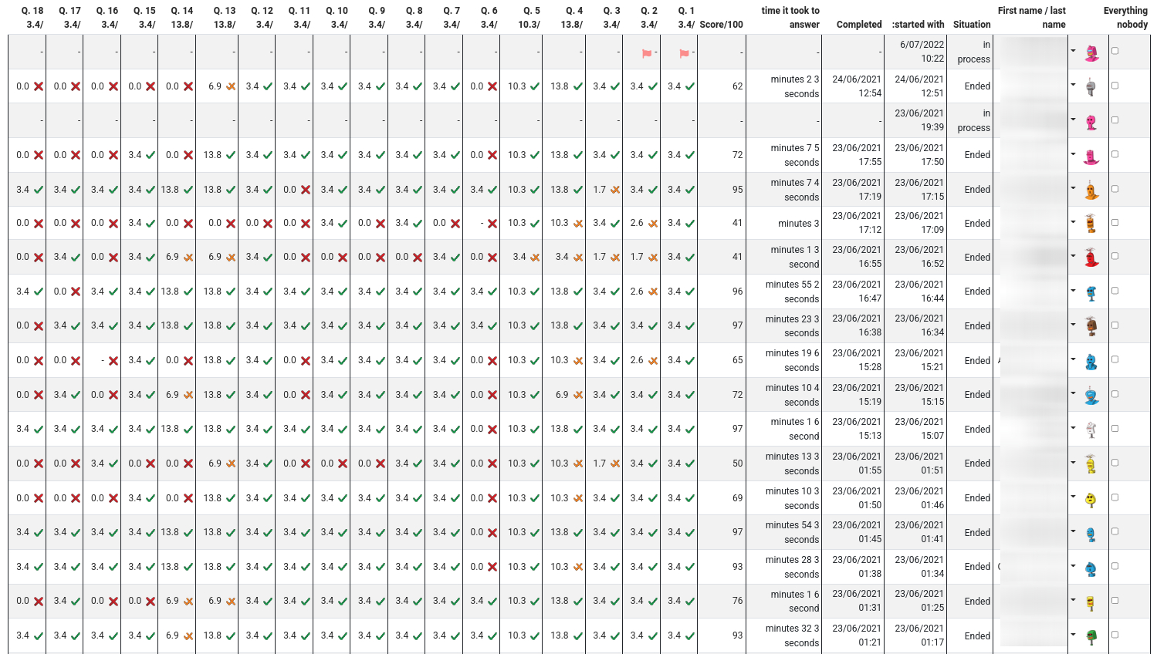
Notes:
<number>

Slide 10
Teacher & AI partnership
Notes:
In opposite, we believe that there is no substitute for human teachers.So we wanted our tool to combine AI's computational power with the touch of a great teacher. We call it a teacher-AI partnership.
<number>

Slide 11
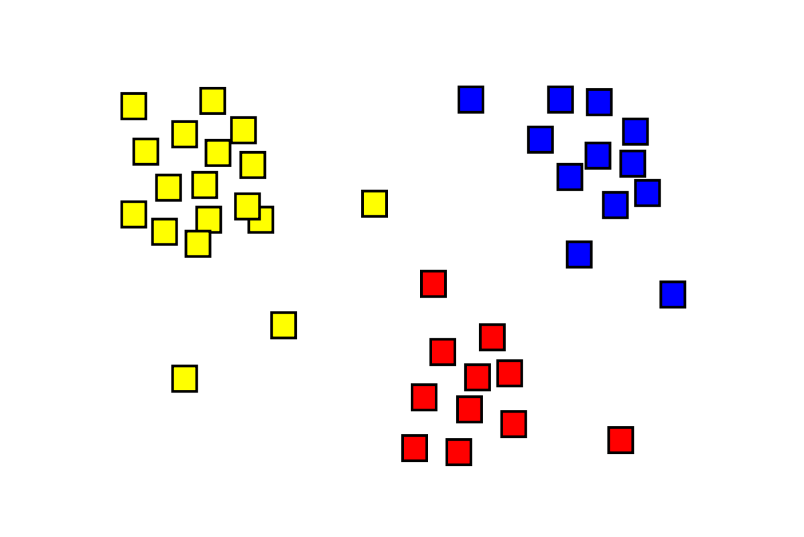
GrouPer uses ML to discovers knowledge profiles based on big data
Notes:
GrouPer collects big data from thousands of students participating in the interactive assessment.
Then GrouPer's machine learning component analyses the data into knowledge profiles. Groper uses this analysis to assign students in the class into similar knowledge groups.
<number>

Slide 12
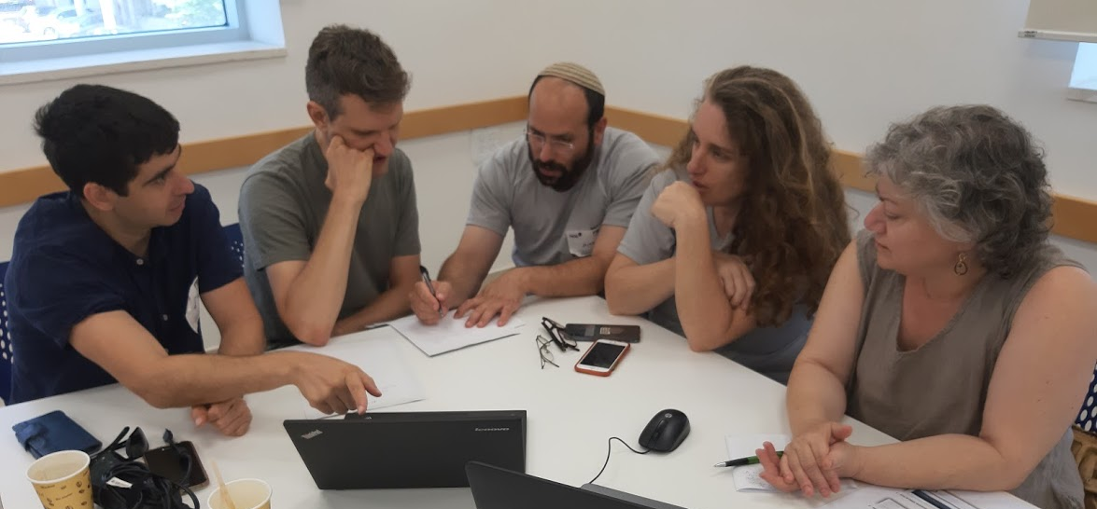
Co-design with teachers
Notes:
And it's partnership all the way! We co-designed our tool with teachers.
<number>

Slide 13
GrouPer presents interactive dashboard
Notes:
Then, Grouper's interactive dashboard presents the groups to the teacher.
<number>

Slide 14
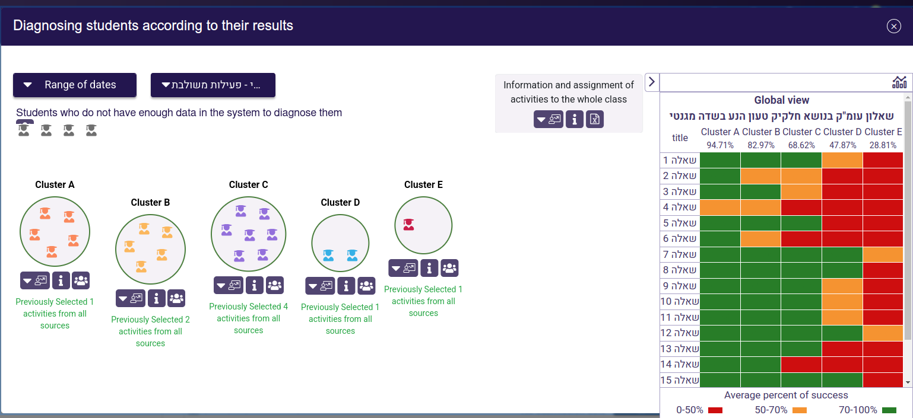
Notes:
Our clustering method is based on the assumption that students tend to have similar performance on items that require the same skill and competencies.
So we can cluster them based on their responses to interactive assessment activities.
The clustering is done on the entire set of students who completed the activity, and each teacher is provided with the projection of the clustering to her class.
Basing the clustering on the entire dataset, rather than on the data of each teacher’s class, increases the robustness and stability of the clusters.
<number>

Slide 15
GrouPer provides actionable descriptions
These students have difficulties in:
applying Newton's Third Law
interpreting data from figures
Notes:
It also provides pedagogically meaningful actionable descriptions for each group. We call it EXPLAINABLE AI.
<number>

Slide 16
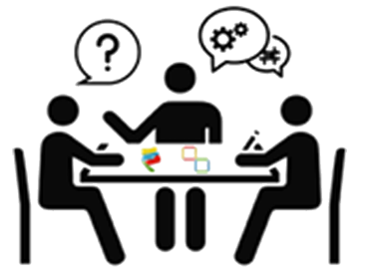
GrouPer recommends flexible learning sequences
Notes:
Then, GrouPer recommends learning sequences that match the needs of each profile.
GrouPer keeps the teachers' autonomy. They can use it in FLEXIBLE ways: group work, individual tutoring, interactive homework.
<number>

Slide 17
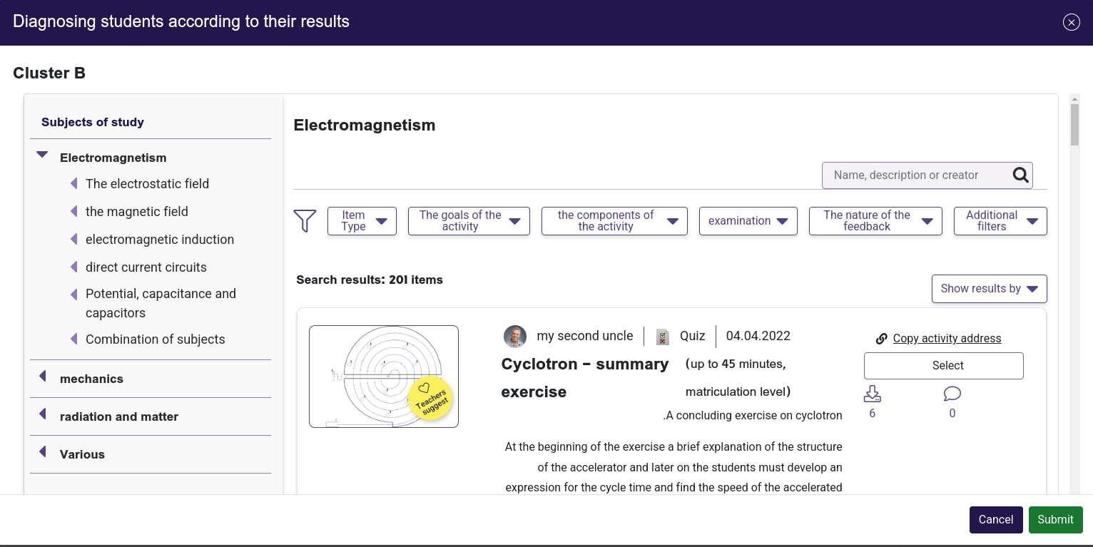
A teacher chooses from their own course or use the OER catalog recommandations
Notes:
<number>

Slide 18
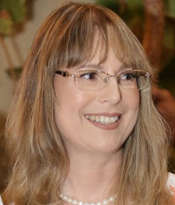
GrouPer shares teachers’ collaborative wisdom
Added activity
Added recommendation
Added recommendation
Notes:
Grouper also encourages collaboration between teachers.
Teachers can share recommendations on what they did with each student profile.
So other teachers can apply these insights to their students.
We call it the collective wisdom.
<number>

Slide 19
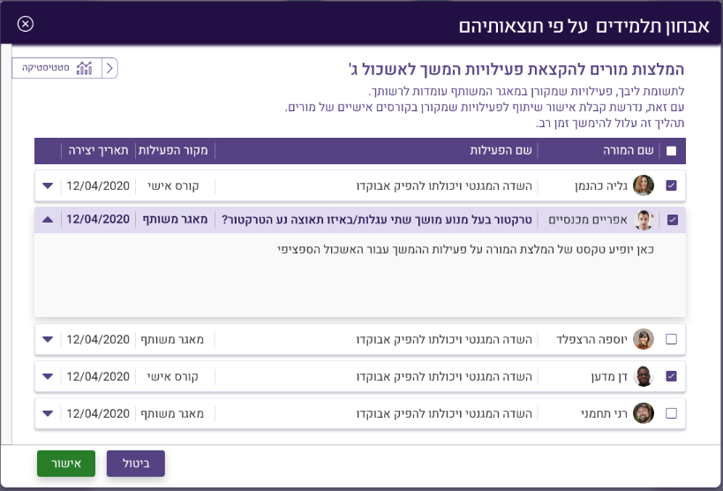
Recommendations by other teachers
Notes:
<number>

Slide 20
100 STEM teachers and 2000 students already use GrouPer
(40% from underrepresented communities)
“The tool allows to see the real picture of the class and provides the ability to treat a specific problem”
“The tool can assess in a more objective way, which is something that I struggle to achieve”
“This tool is very effective and will improve and focus the learning process”
Some of the papers published on GrouPer
“Empowering Teachers with AI: Co-Designing a Learning Analytics Tool for Personalized Instruction in the Science Classroom” (LAK’22)
“An Instrument for Measuring Teachers’ Trust in AI-Based Educational Technology” (LAK’22)
“Confirmation bias and trust: Human factors that influence teachers' attitudes towards AI-based educational technology” (EC-TEL’21)
“Encouraging Teacher-sourcing of Social Recommendations Through Participatory Gamification Design” (ITS’21)
Notes:
The beta version of Grouper was ALREADY INTEGRATED into a Moodle-based teaching and learning environment.
We are piloting it with hundred STEM teachers and two thousand students now.
40% from them from underrepresented communities
And Teachers LOVE GrouPer.
research also shows that GrouPer approach is effective.
<number>

Slide 21
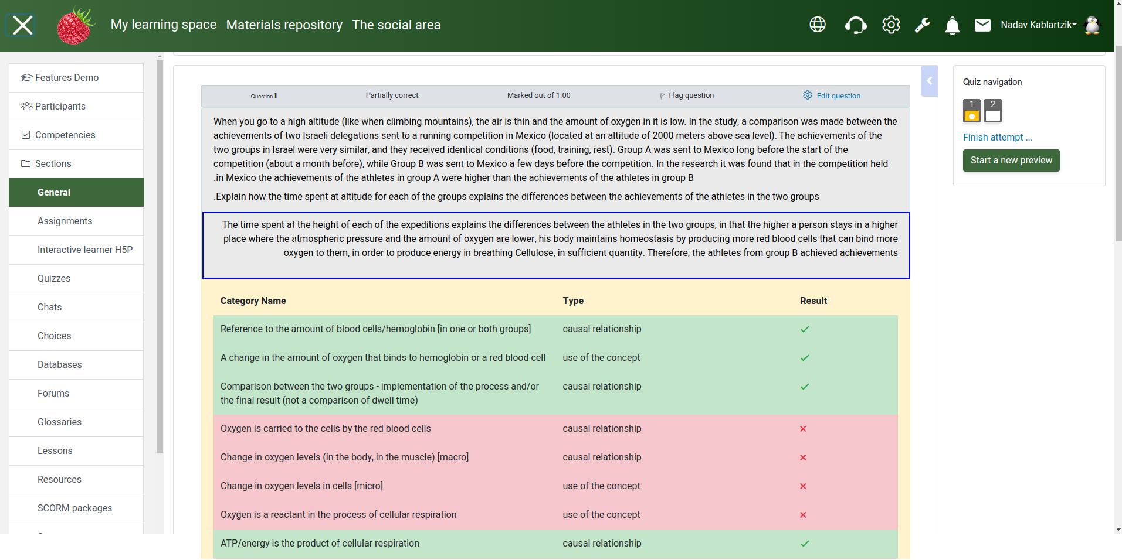
Use deep learning to grade open questions using rubrics found in student’s answer
Notes:
Future plans and beta testing: Auto detect student’s understanding from free text open answers to open questions, based on pre trained Deep Learning of a large pool of students answers and teacher’s grading them on a specific disciplinary domain (subject matter)
<number>

Slide 22
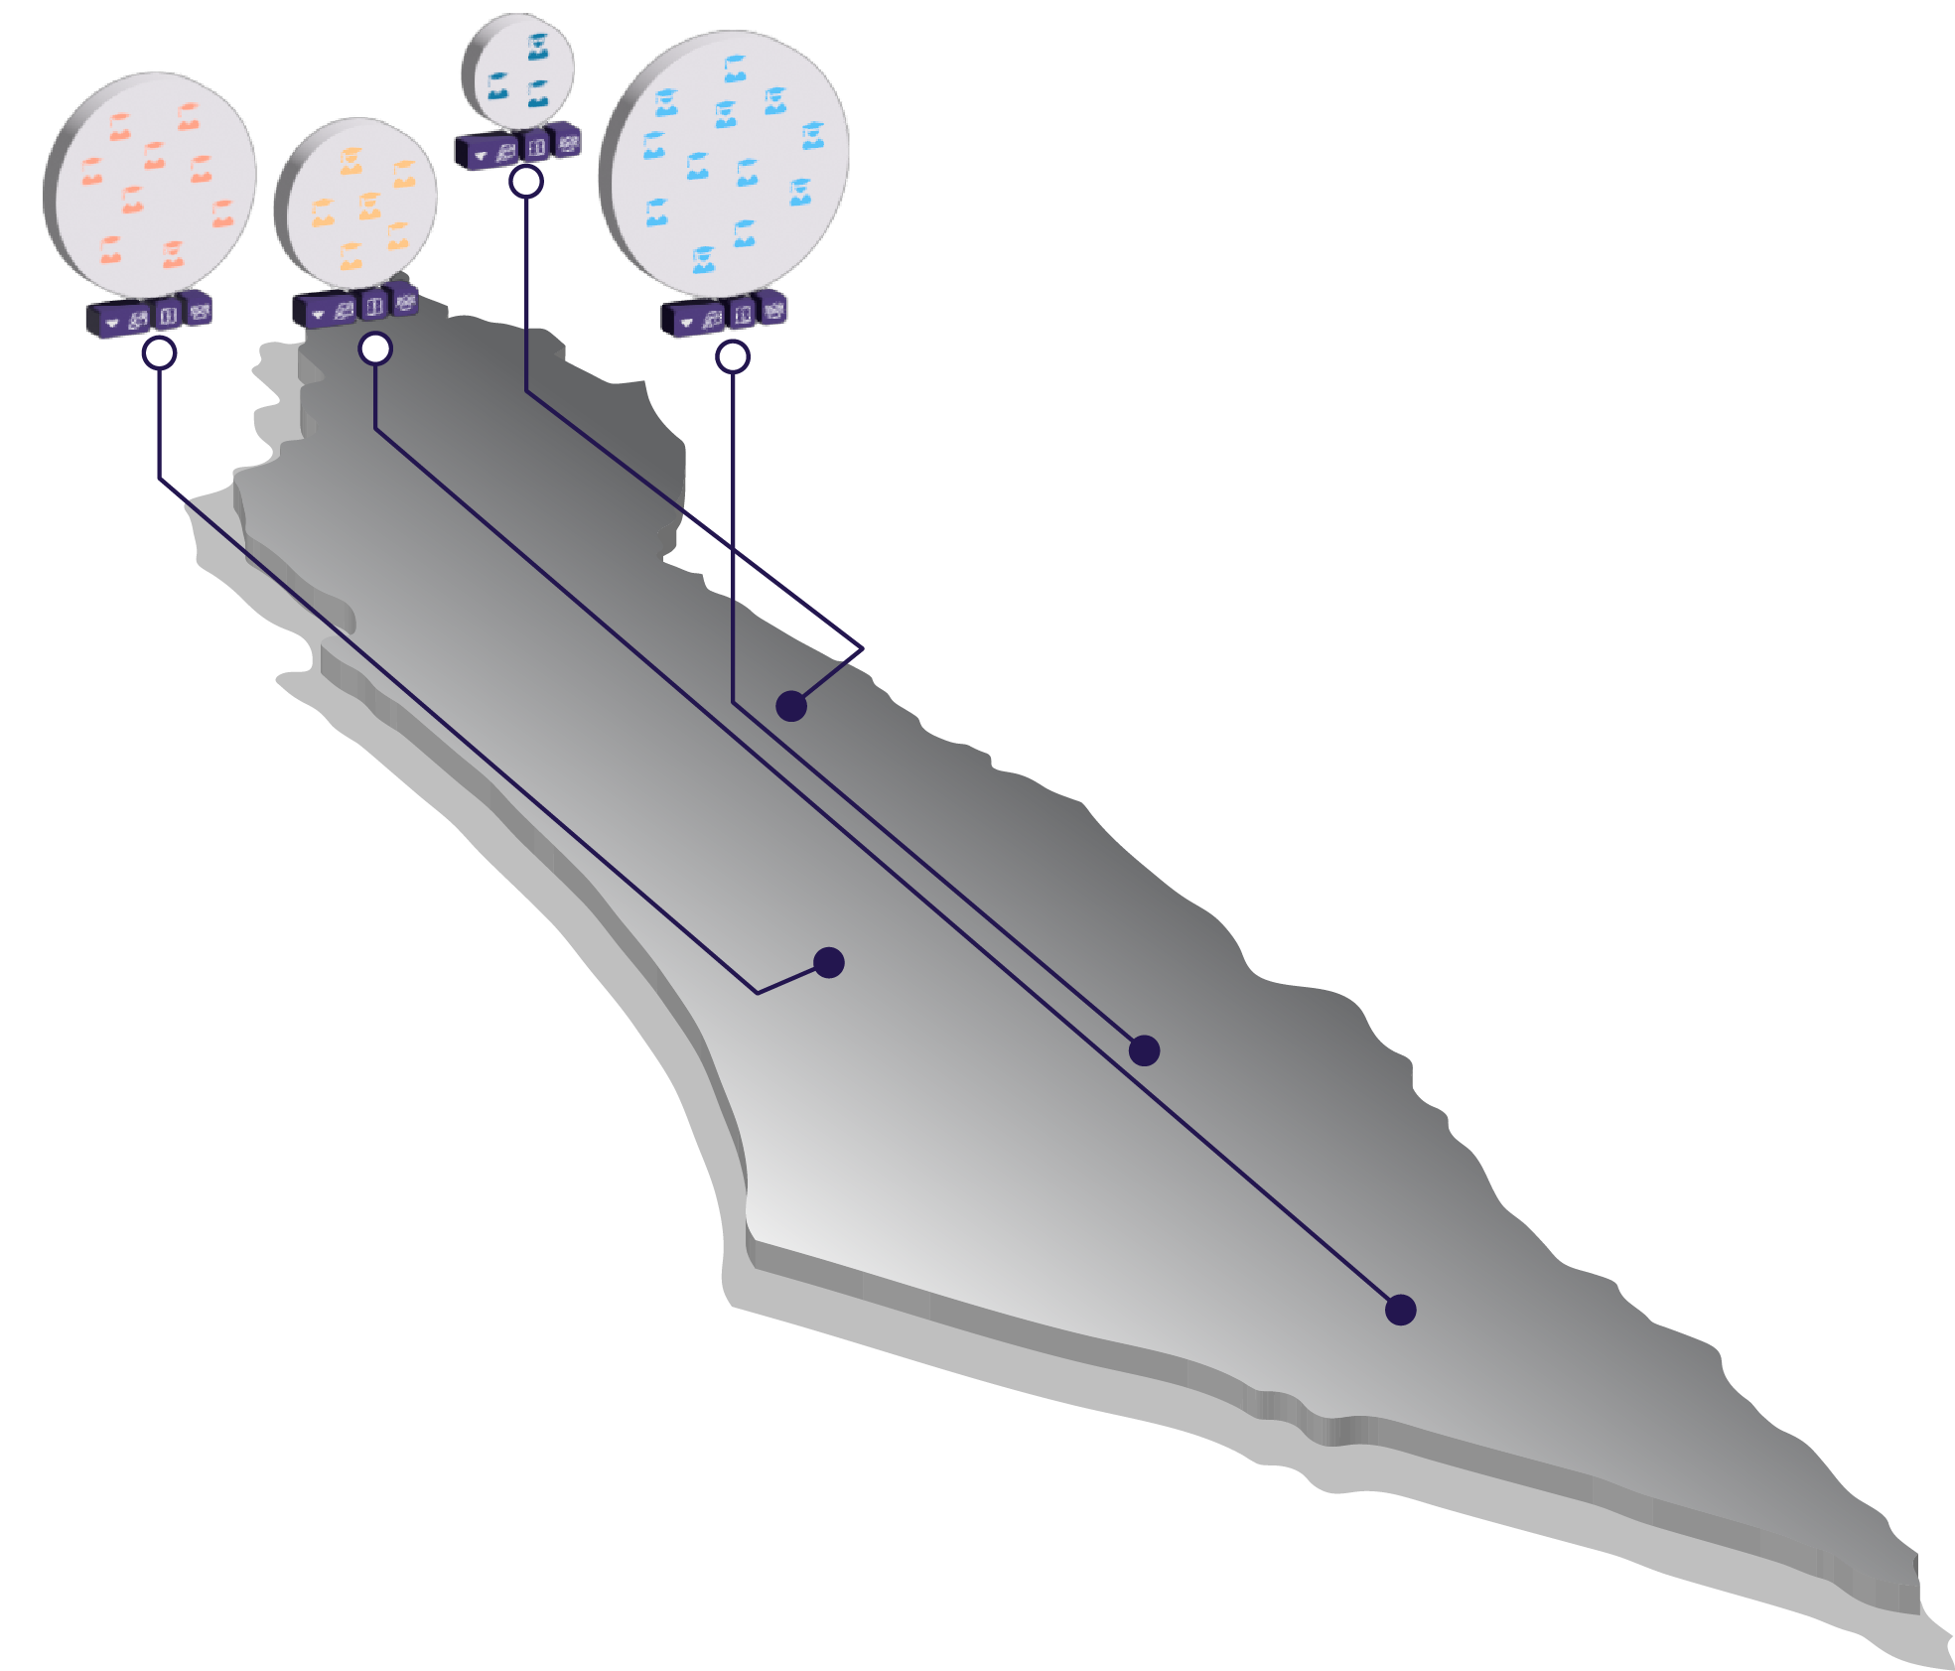
The GrouPer roadmap and challenges
 | Stage | Years | Main Challenge
 | Scale nationally to 1000 teachers | 2022-2023 | Recruitment Teacher Professional Development User support (Teachers+Learners)
 | Functionality and Maturity | 2022-2023 | Software Development
 | Scale Globally | 2023-2024 | All the above + Migration
Notes:
<number>

Slide 23
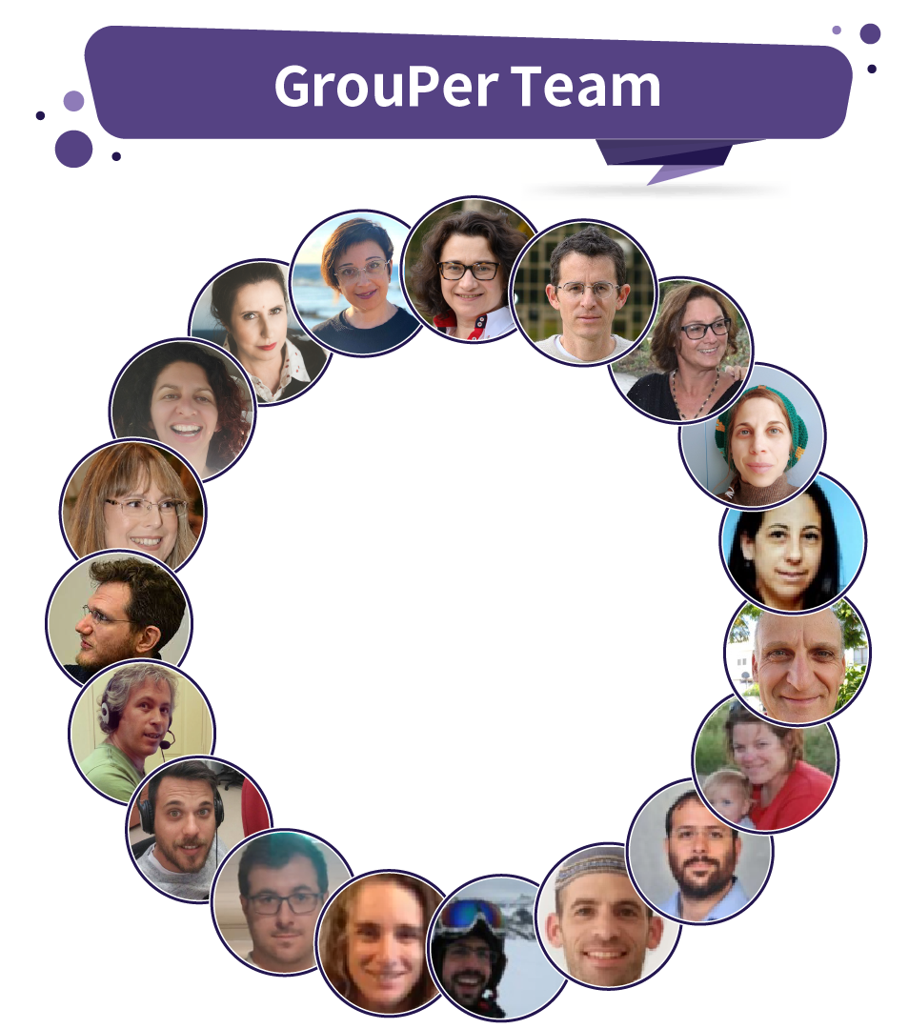
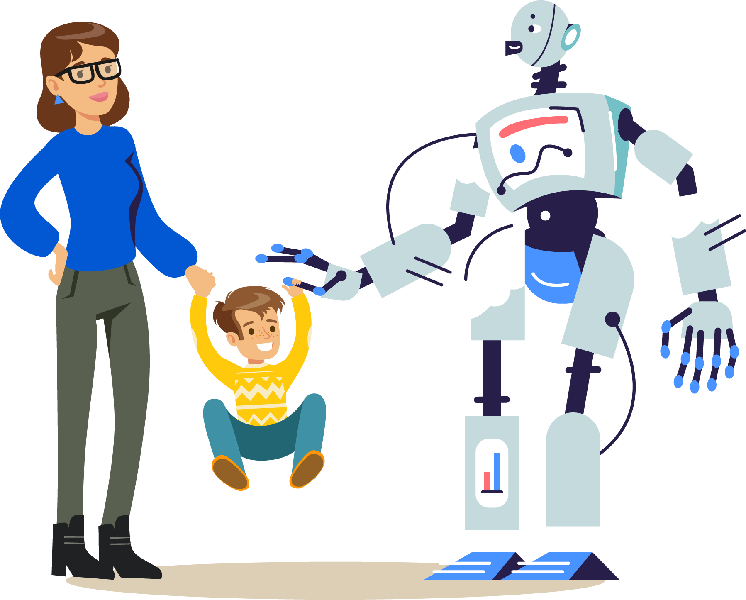
STEM Teachers
AIED Researchers
R&D
Science Ed
UI & UX Experts
Project Management
Notes:
It takes a village to put together the GrouPer tool and make it come to live :-)
<number>

Slide 24
The GrouPer team would like to share this tool with you and is grateful for the opportunity to receive feedback from you
Thank You!
Please contact us for getting this tool and start using it in your institution.
Notes:
The GrouPer team is thankful for this wonderful opportunity to be part of this competition.
WE have a mission to empower teachers so they can raise their students as high as possible.
And we invite you to join us in this journey!
Thank you for listening
<number>

