Slide 1
OpenStudio: Promoting collaborative learning and student connection
Chris Nelson
Senior Product Manager, Learning Systems, The Open University (UK)
chris.nelson@open.ac.uk
Michelle Carrington - Product Development Manager
Learning Systems
The Open University (UK)
1
Notes:
Hi, - Michelle Carrington etc.
I’m going to talk about OpenStudio to include its features, findings from various research studies aimed at identifying the value of using OS for collaborative and Peer learning and I’ll touch on new features introduced to further enhance student interaction.

Slide 2
CONTENTS
1 Background & features
2 Examples of use
3 Research
4 Level 1 Health and Social Care
5 Enhancements
2

Slide 3
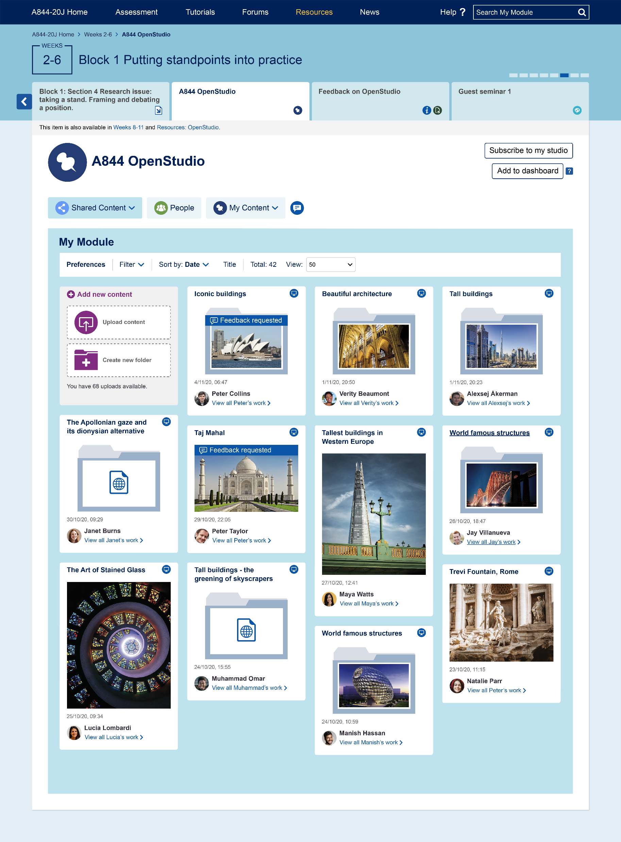
Background
Independent online study can lead to feelings of isolation and remoteness
Engagement and motivation in online learning can be a challenge
2016: developed OpenStudio - a structured, collaborative tool allowing student interaction and peer learning
A community to harness social learning and help students overcome feelings of isolation
Notes:
We know from research that online learning can lead to students feeling lonely and isolated which can effect their engagement and motivation levels. Can lead to them leaving before completion.
In 2016 we developed OpenStudio and redeveloped in 2019 – a collaborative online studio space allowing students to interact with each other in an informal, visual learning environment
In using this plugin, we hoped students would build a better sense of community and it would enhance social learning to overcome feelings of isolation and help develop interaction skills.

Slide 4
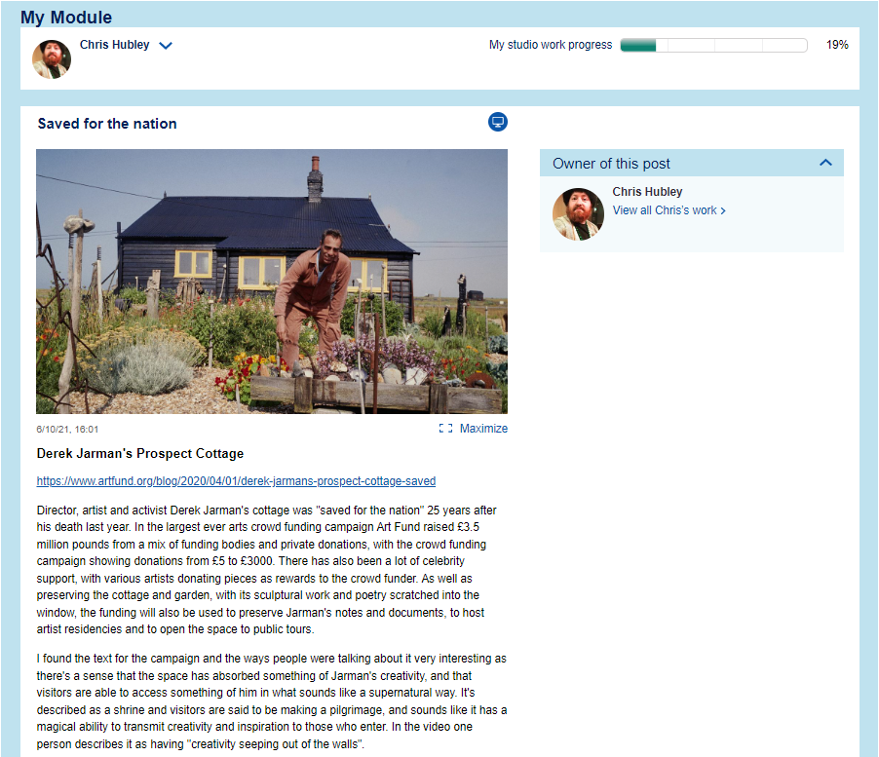
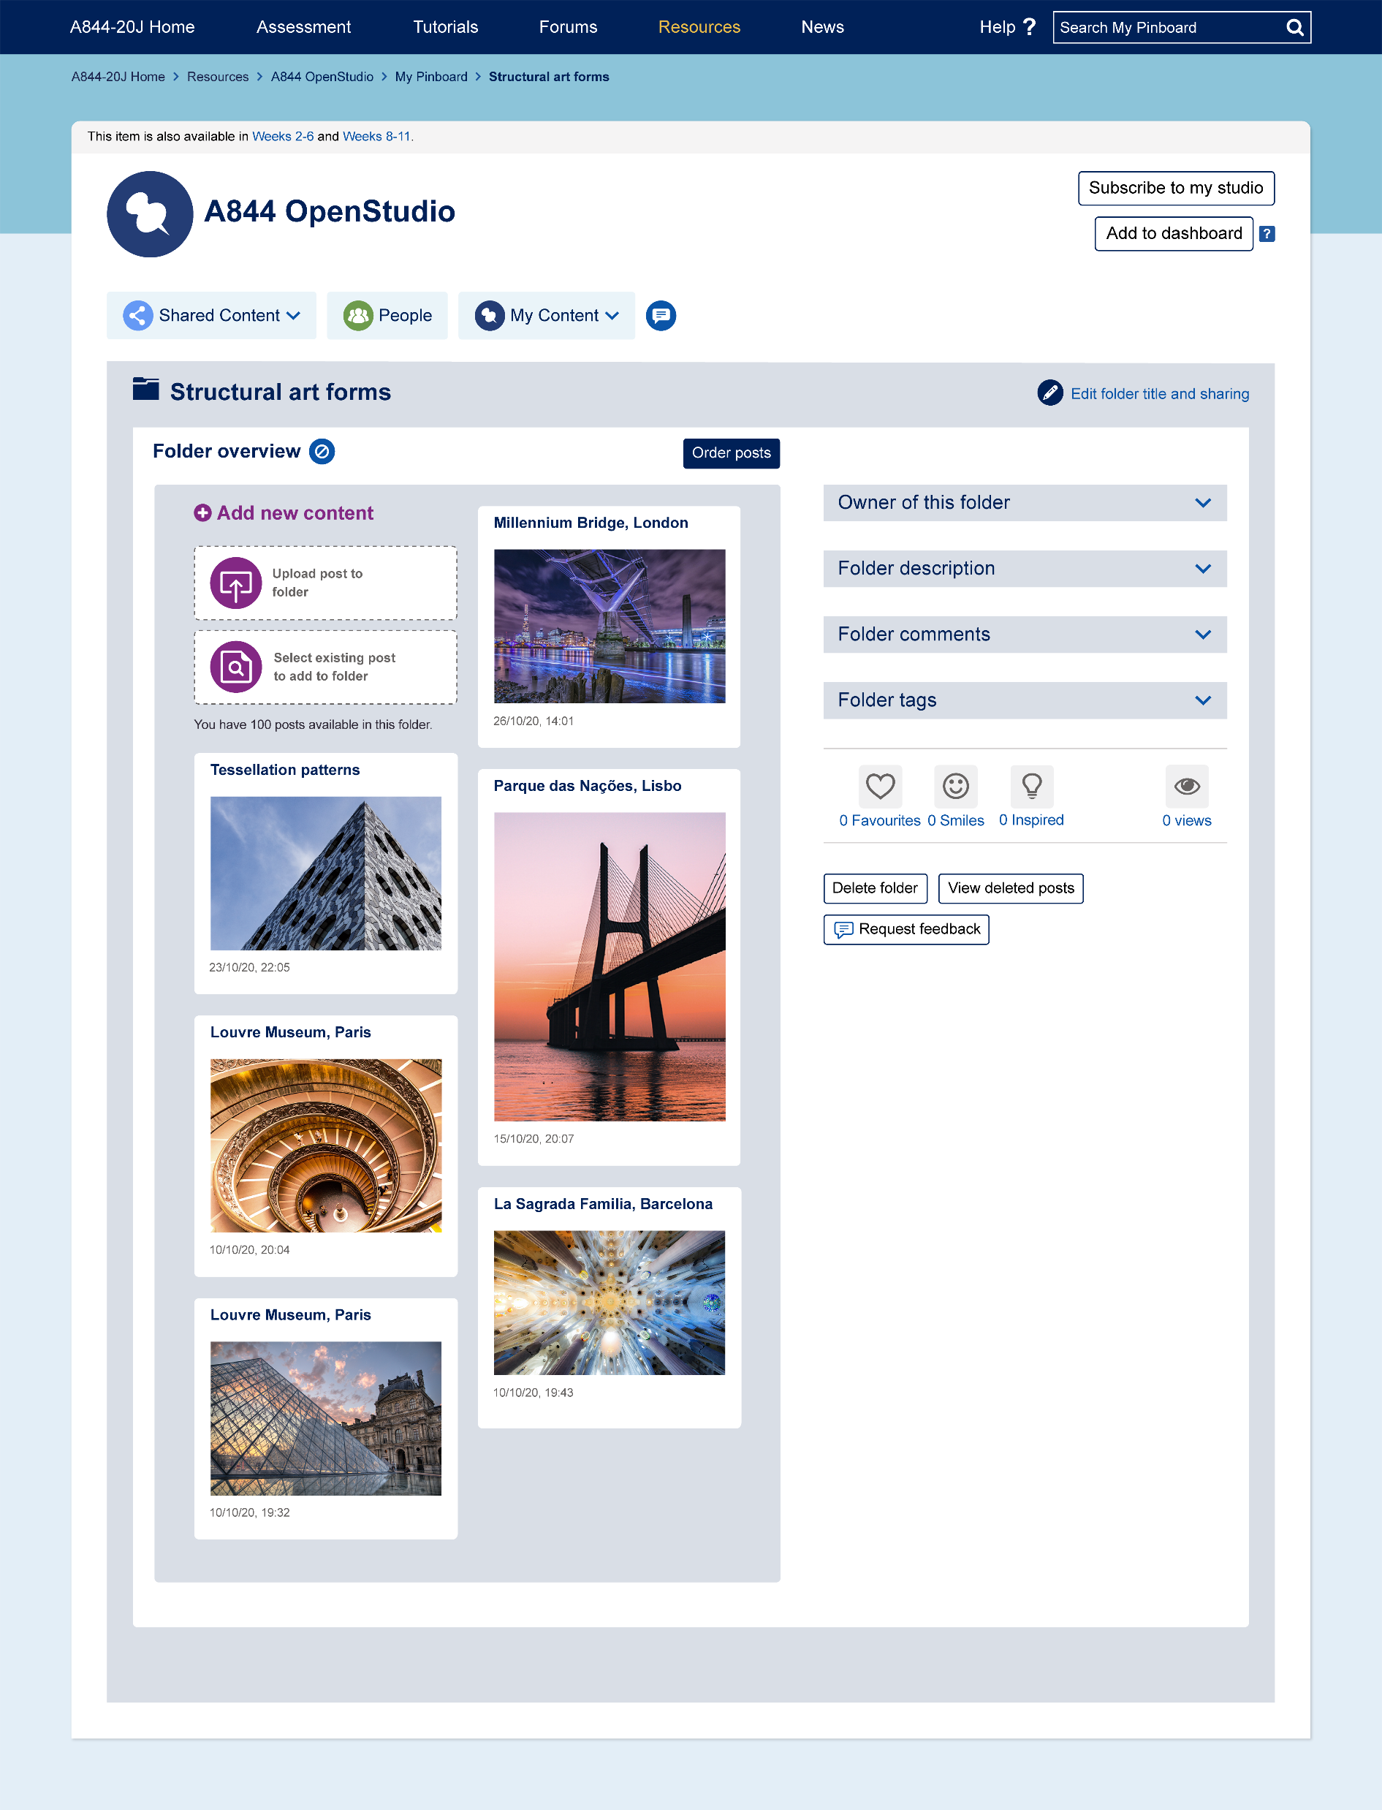
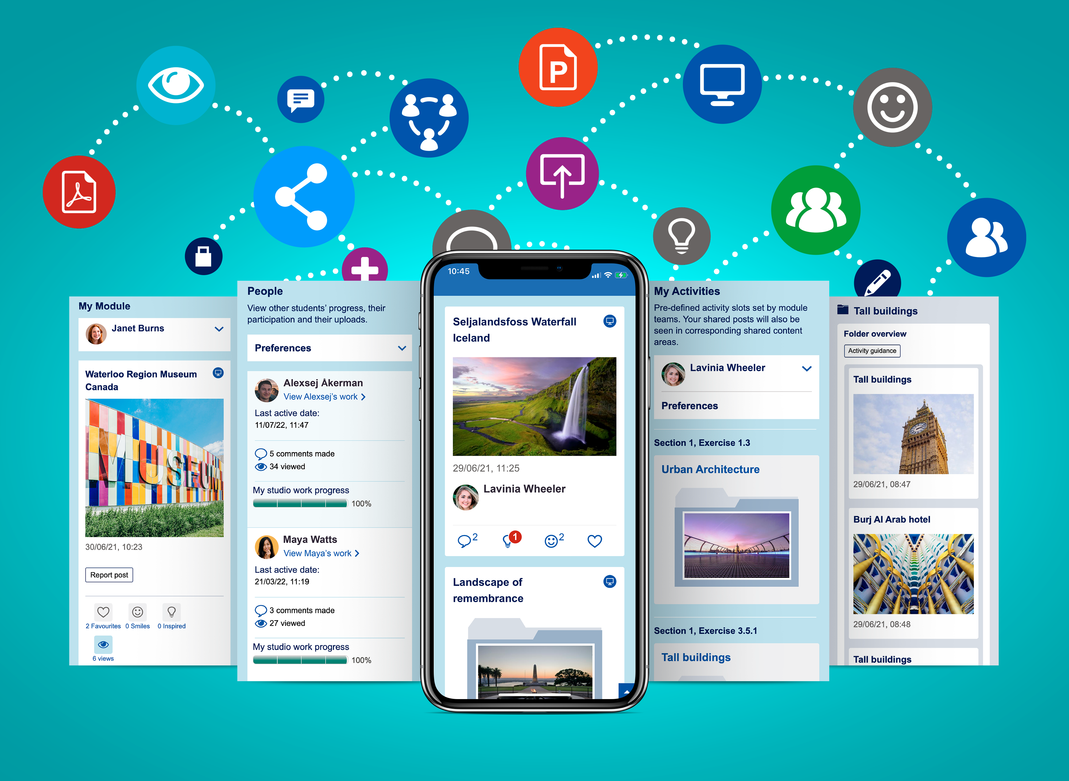
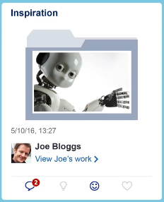
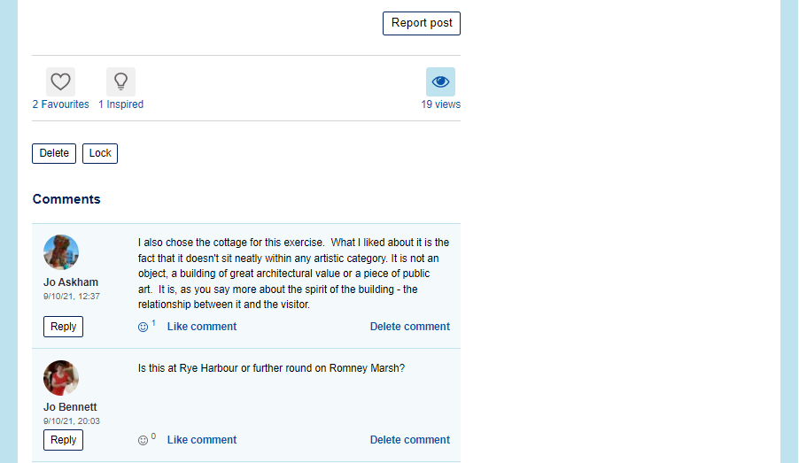
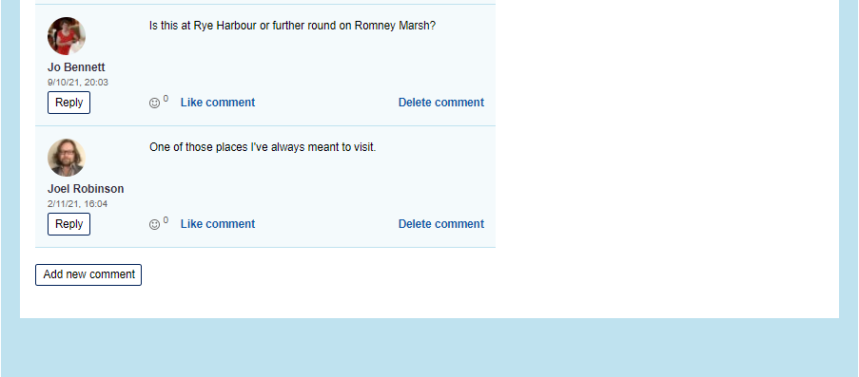
Features
Chris Ye
Share work with others
Chris Ye
Iconic buildings
Create collections, exhibitions and portfolios uploading content in multiple digital format
Feedback requested
Mix with students globally sharing feedback and experiences
Social media inspired notifications to drive engagement
Jane Doe
Mobile responsive
Jenny Hill
Daniel Taylor
Notes:
Students can share their work with other students at whole course level, group level, with their tutor or keep a private portfolio
They can create collections and portfolios by building folders of work using multimedia content
They can mix with students globally
There are social media inspired notifications to drive engagement and interaction.
The plug in is mobile responsive so students can make uploads directly from their phone with ease

Slide 5
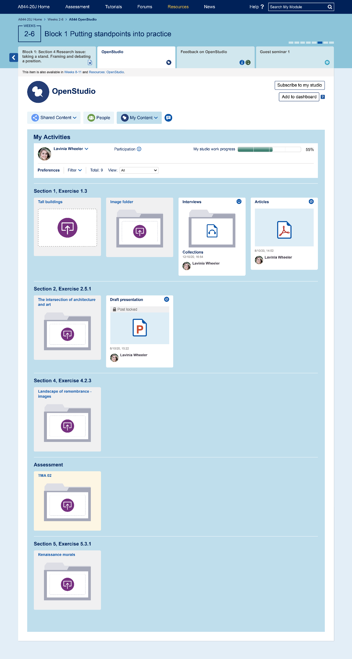
Since its creation, the use of OpenStudio has diversified allowing a different type of study experience across varied subjects and levels
There are over 100 instances of OpenStudio in our courses due to start next month.
Notes:
Originally designed to replicate an online design studio, it’s use has diversified and various courses and levels are now using OpenStudio
We have over 100 courses using openStudio in our October presentations, some of which have several instances within them.

Slide 6
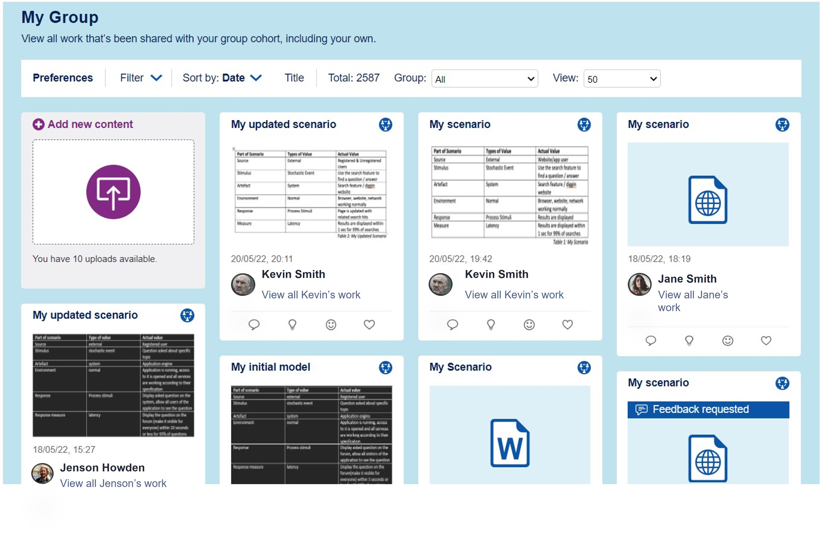
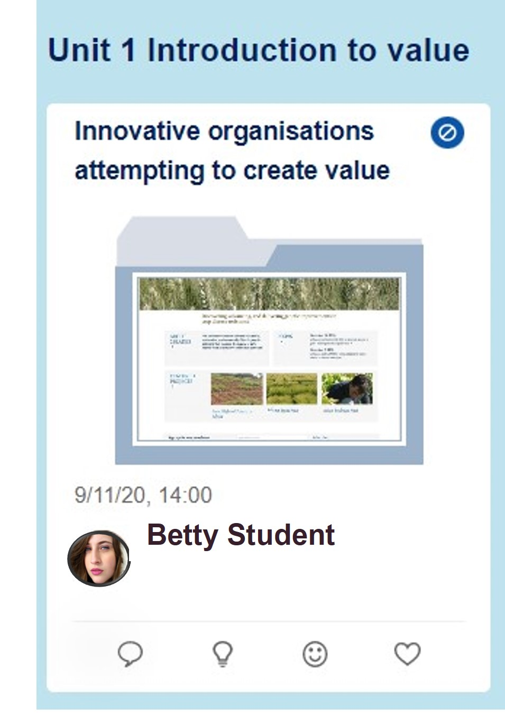
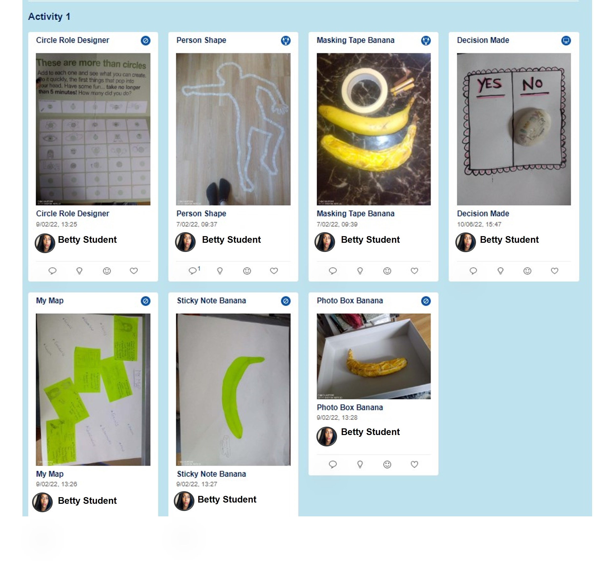
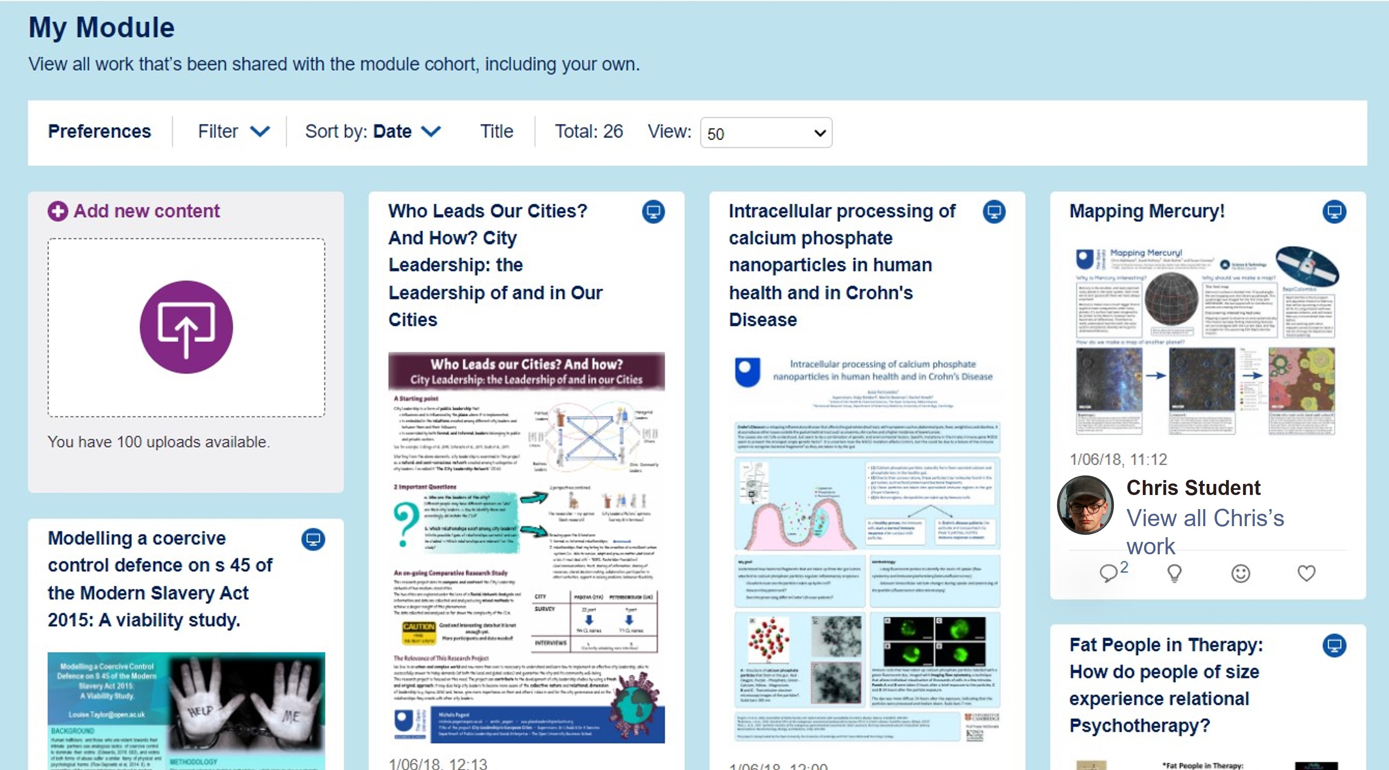
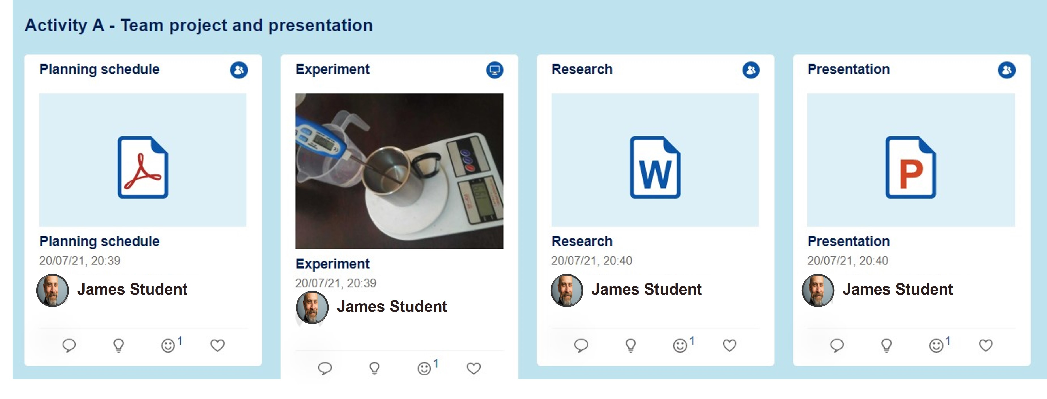
Examples of use
‘Show me what religion means to you’ - Arts
‘Show and Tell’ Learning Environments Early years
Visual Essay, case method in entrepreneurship Business
Graduation Poster Competition Careers and Employability
Ice breaker what does care mean to you? Health and Social Care
Plus many more…..
* All names anonymised
Notes:
Here are some of the examples taken from our modules –
some using the pre set activity feature, some where students can upload their work freely to the studio space –
In the images there are examples from a business module where students build a learning journal,
practical group science experiments with associated methods and conclusions,
IT problems with shared solutions and student critique
, a traditional design studio
and an online STEM conference.
Other examples include ‘what is religion’ in an Arts module,
visual essays through recorded PowerPoints or embedded YouTube video,
icebreaker activities,
Poster competitions for graduates,
show and tell activities aimed at students considering study and much more.
As you can see OpenStudio can be adapted to suit many different activities

Slide 7
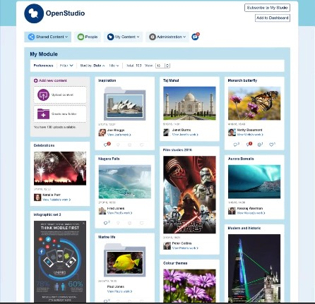
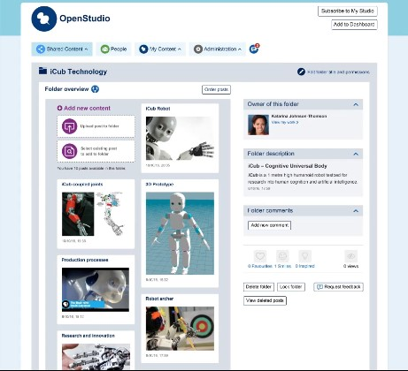
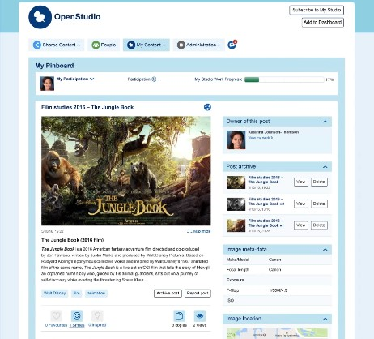
Academic research and analytics have shown a link between use of OpenStudio and improved skills development and student success….
2017 Jones et al: Lurking and Learning: Making learning visible in a virtual design studio
2017: Lotz N, Jones D, Holden G: Are we making progress? Progression through learners’ interaction in OpenStudio across a qualification
2018 Thomas E, Barroca L, Donelan H, Kear K: Using OpenStudio in STEM Learning
2018 Maiden J and Sinclair S: Personalised and Multi sensory approaches to engaging students at a distance: A case study from Religious Studies
2019 Halliwell C, Duckworth J: Can asynchronous student conference in OpenStudio develop students’ critical evaluation skills
Notes:
Since its creation, there have been several studies, research projects or scholarships on the use of OpenStudio to support peer or collaborative learning. These are some of them, but there have been a couple prior to this

Slide 8
Common findings
High level of engagement among the students.
Critiquing or feedback activities > improved their work and / or skill
Learnt through comparing, contrasting and observing different perspectives
Enabled students to connect to other students
Notes:
All studies have seen common findings
High levels of student engagement,
Where there were critiquing or feedback activities, students on the whole felt like their work or skill had improved as a result of the feedback they had received on their posts
Students learnt from seeing other students work by observing different perspectives and points of view or different ways to solve problems (sometimes learning from what not to do as well).
Students connected with other students, they interacted and reflected on their feedback

Slide 9
Common findings
Majority enjoyed the different approach to learning
Supports transferable & core skills:
Sharing and discussion
Giving feedback and reflection
Receiving feedback and incorporating in to own self development
Application of analytical and critical thinking skills
Helped students to place theories / concepts in to everyday contexts
Image © Google Maps.
Notes:
The Majority of students enjoyed the different approach to learning, compared with standard course activities
Findings showed it supported transferrable skills which varied across the studies but some are listed there
It helped students visualise more complicated theories and concepts enabling them to place them in to every day contexts and apply them in some cases.

Slide 10
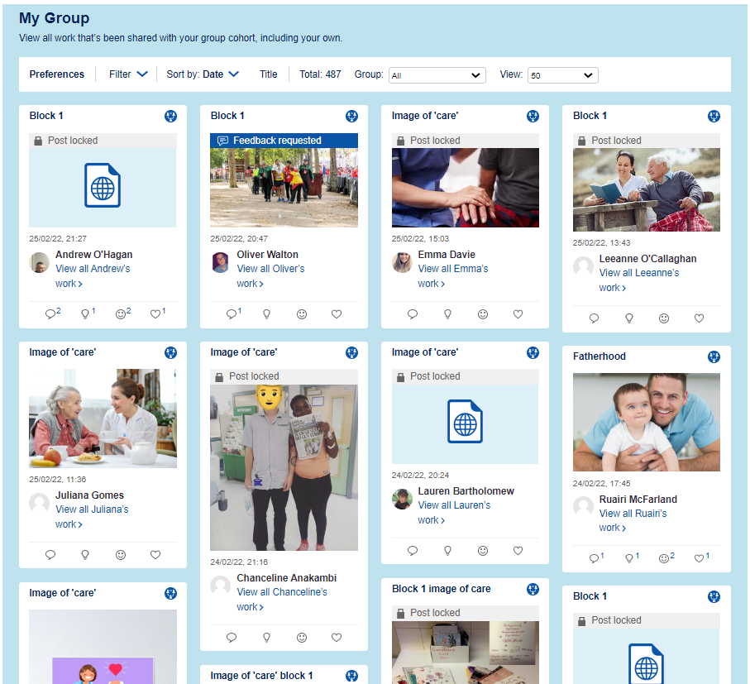
Level 1: Introducing Health and Social Care
2021 Scholarship: An evaluation of the use of OpenStudio adapted for a 1st level foundation module to encourage multi modal learning and peer interaction.
(Rai L, Ogut S, Gill T, Jones K, Gwilym C, Carrington M, Ismail N)
Over 2000 students
Higher proportion of neurodivergent students
Higher proportion of students where English isn’t their first language
Collaborative activity to support retention
Aim: To engage and encourage development of communication skills for employability and develop foundations steps in peer learning.
Notes:
This brings us on to the most recent scholarship on OS that I was actively involved in through data collection and analysis and this was looking at the use of OS in a Level 1 health and social care module.
This module has a high student number – at the time of the study there were (over 2000), and a higher proportion of students who are neurodivergent and where English isn’t their first language, therefore students that may struggle with more traditional study methods
They had previously withdrawn a collaborative activity in a different Level 1 module due to the lack of student satisfaction and engagement so chose OpenStudio as a different collaborative activity option based on findings from previous studies.
Their aim in using OpenStudio is to encourage the development of communication skills for employability and develop foundation steps in peer learning that they could take forward to further study.
The findings from this research were similar to previous findings but there are some other interesting insights and differences that may be attributed to the fact that this is specifically looking at a L1 module, or the diverse nature of the students but that’s not conclusive.

Slide 11
Level 1: Introducing Health and Social Care
Overcame IT challenges
Built self confidence
A global connection
Control over their learning
Enjoyed visual approach
Value in passive peer learning
Some disappointment
Engagement higher
Notes:
A lot of the students felt that they overcame some IT barriers and learnt new skills as a result. It was challenging – but in a good way for some.
They built self confidence by overcoming these barriers but also by checking and comparing what others had uploaded to make sure they were on the right track.
They did feel connected to other students and just to pull out a specific example of a Polish student I spoke to who said that she was able to find and connect with some other students of the same nationality
They mentioned that they felt in control over their learning and were really able to be creative about what they uploaded to meet the task briefs
They found the multi modal approach more enjoyable and found the visual nature easir than reading chunks of text or writing reports or essays
There was real value identified n passive peer learning – some students didn’t feel confident to comment all of the time but they read other comments and took information from other settings and were able to reflect on different practices and apply to their own settings. There were students here from childcare, social care or care homes for example and they found it really interesting to see care from different perspectives and in different settings.
However, on the flip side, students were disappointed when they didn’t receive any notifications or comments. Some were demotivated by that.
Engagement was higher than previous presentations. (Although not conclusively because of OpenStudio).

Slide 12
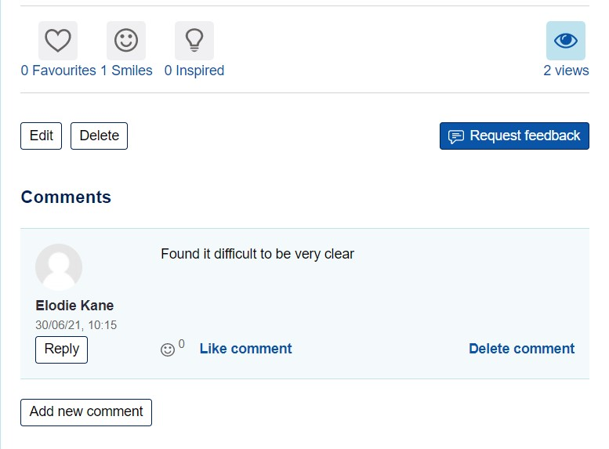
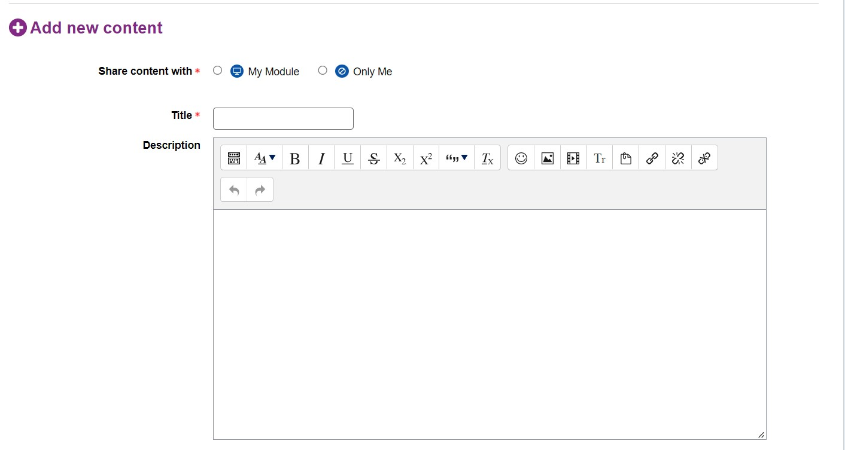
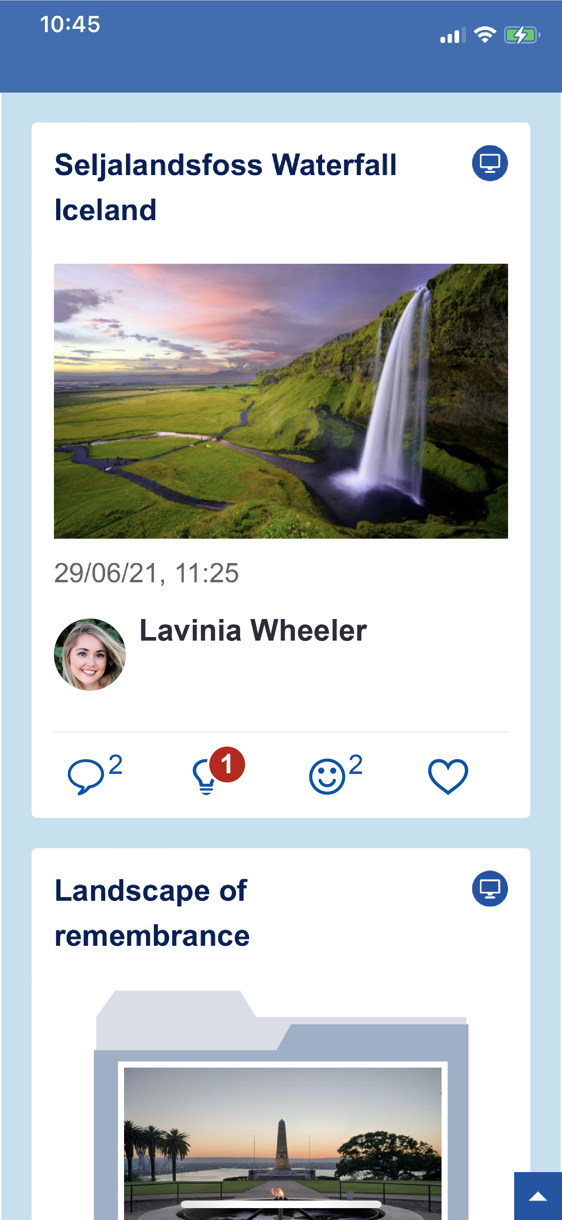
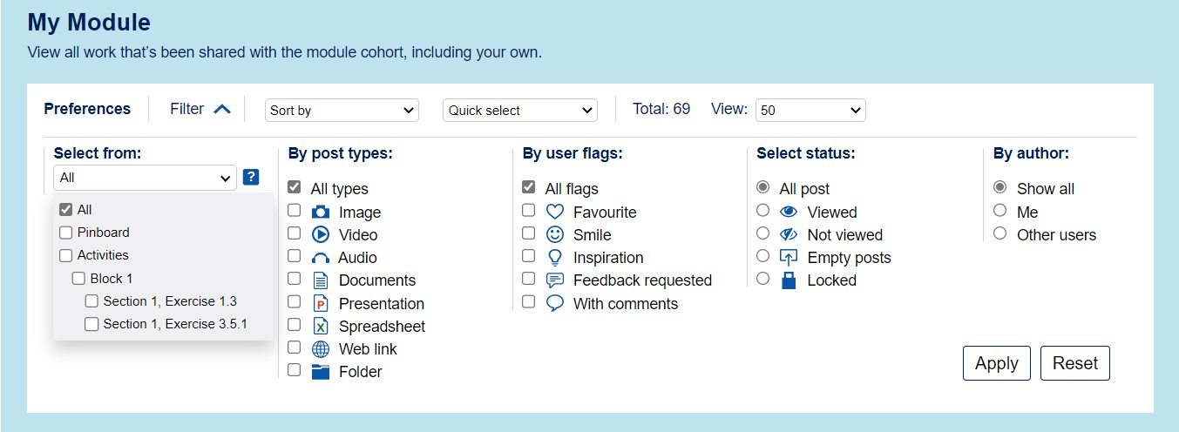
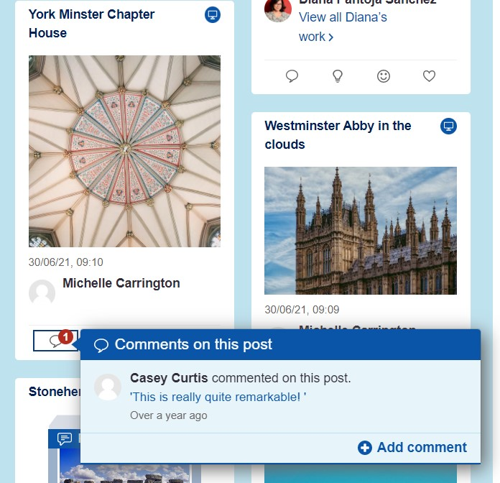
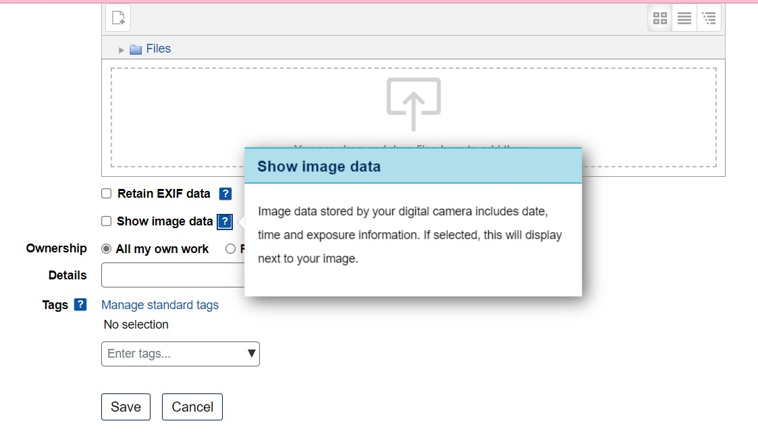
This research has led to enhancements to OpenStudio
to further support and improve student collaboration and connection
OpenStudio is an open source plugin, available to download in any Moodle environment.
Notes:
We’re always looking at ways to make peer learning and collaboration easier for students so Using feedback from this and previous studies, we’ve recently made some enhancements to the plugin.
We’ve made it easier for students to view their comments, add comments and use the social icons where they may not perhaps want to add a comment but want to acknowledge another students’ work. We found that for some students, they didn’t interact with posts as it took more than 1 click.
We’ve improved guidance throughout the studio to reduce frustrations and encourage continued and prolonged use of the plugin throughout the life of the module.
Improvements to the upload form mean it’s clearer for students to identify exactly who they can share their content with without worrying that their work can’t be seen by others
We’ve Added the option to filter uploads by specific activity which will make it easier for students to find specific pieces of work to comment on and interact with.
Worth saying that This plug in is an open education source so can be added to any Moodle environment

Slide 13
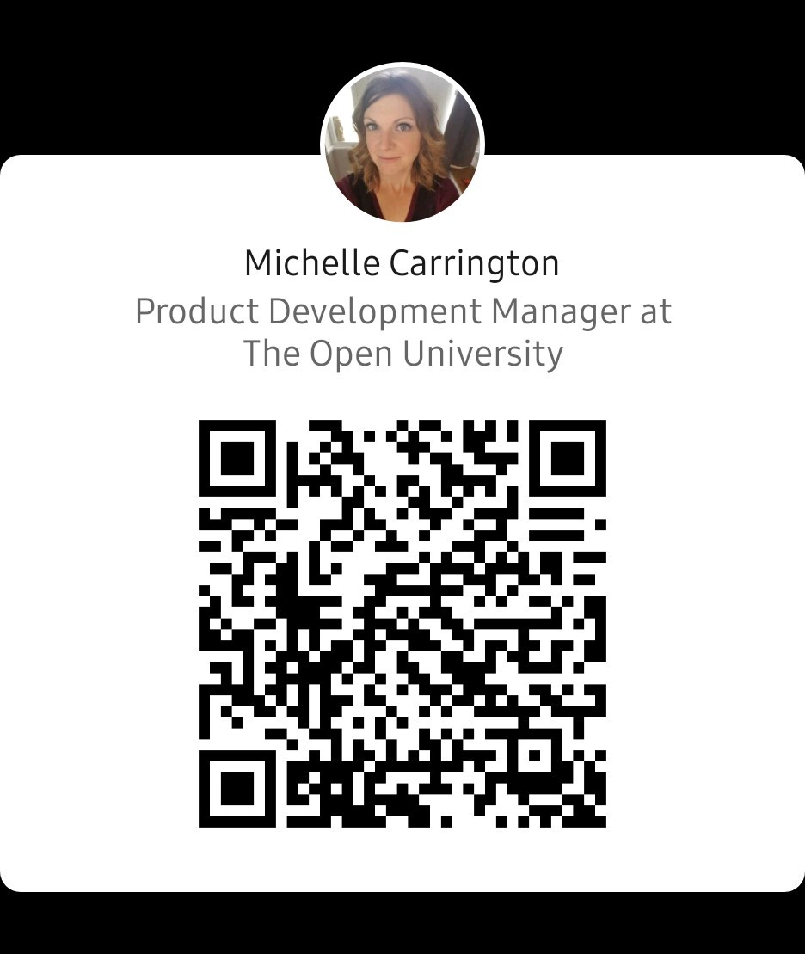
Find OpenStudio on GitHub
THANK YOU
Find me on LinkedIn
Michelle Carrington
Product Manager, Learning Systems, The Open University (UK)
Michelle.carrington@open.ac.uk
68

