Slide 1
Journey to using Moodle offline in Corrections Environments
Sioux-Hudson Literacy Council
Good Learning Anywhere
MoodleMoot
September 2022
Notes:
www.goodlearninganywhere.com
Good Learning Anywhere provides free online distance learning opportunities for adult learners in Ontario to assist them in upgrading their reading, writing, math, computer, and other Essential Skills. Celebrated 20 years in 2022!
We are funded by the Ministry of Labour, Immigration, Training and Skills Development

Slide 2
Our Target Audience:
Good Learning Anywhere works with Indigenous communities, organizations, and individuals to identify and meet their learning goals in our flexible online learning environment.

Slide 3
Learning with GLA
Our courses are 100% online
They are Free to adults across Ontario who want to upgrade their Essential Skills for school, work, or home
We offer Live courses and Independent online options
Using Moodle to build our own independent curriculum for +15y
Currently over 30 moodle courses offered

Slide 4
Why we love Moodle
Open Source
Managed by Contact North so GLA looks after users and instructs
Build our own Curriculum - Essential Skills and Indigenous Content
Added H5P activities to make it more interactive
Using the main Moodle tools courses are easy to update as needed
Wish list:
Really good text to speech tool
Preferred Name option

Slide 5
Why Corrections and Literacy!
Adults in custody face significant barriers to education, training, employment, and social inclusion.
Approximately 75% of the correctional population has not completed Grade 12, and 20% has less than a Grade 9 education.
-CLI
Offenders typically return to prison due to a variety of factors: most often, a lack of education, stable employment and housing, addiction, and other mental health issues.
Digital literacy will reduce recidivism in the long term
Notes:
About 5 years ago CLI started - and I began talking to other partners on what programs existed in facilities and was surprised to learn that they ranged from little to none in our provincial system and that digital skills were very nearly never included.

Slide 6
Why Corrections for GLA
Overrepresentation of Indigenous peoples in the criminal justice system is a longstanding issue that has only increased over time. Public Safety Report Sept 2022
A lawyer with the attorney general's office estimated 89% of inmates at the Kenora Jail were Indigenous, and 90% of them were presumed innocent. However, they were incarcerated while awaiting court dates, since most couldn't meet bail conditions. Kenora Online Sep 2018
…..Many of the inmates come from remote First Nations north of Kenora and may have never left their home communities before their arrest
CBC Feb 2017
Notes:
Overrepresentation of Indigenous peoples in the criminal justice system (CJS) is a longstanding issue that has only increased over time. While Indigenous peoples represent 4% of the Canadian population, they are overrepresented on both the offender and victim sides. In the Federal Correctional system, the proportion of Indigenous peoples in the Correctional Service of Canada’s (CSC) custody has reached an all-time high of 26.1% This disproportionate overrepresentation is even more acutely felt in women’s corrections where 48% of women in CSC’s custody are Indigenous.
Further, between 2015-16 and 2019-20, the proportion of Indigenous peoples within CSC’s total offender population has increased by 15.3 %. The root causes behind the overrepresentation of Indigenous people are found in the intergenerational trauma Indigenous peoples live with as a result of colonization in Canada.
Retrieved Sept 25/2022 https://www.publicsafety.gc.ca/cnt/rsrcs/pblctns/2022-fdrl-frmwrk-rdc-rcdvsm/index-en.aspx
The number of people identifying as Indigenous in Canada grew almost twice as fast as the non-Indigenous population and now stands at 1.8 million — about five per cent of the population — according to newly released census data.
Retrieved Sep 21/2022 https://www.cbc.ca/news/politics/indigenous-housing-census-statscan-1.6589825

Slide 7
Digital Technology could be part of the solution but….
Prisons are caught between the legitimate security concerns and the necessity of digital literacy in prisons

Slide 8
Youth Justice Centre MUST-HAVES
Guaranteed absolutely no access to internet
No camera on hardware
Educational content
Hardware and Content had to be easy to use independently for client AND staff

Slide 9
PILOT PROJECTS | Technology | Internet Access
John Howard Society Thunder Bay | Moodle & Rumie App on Tablet | Yes
Youth Justice Centre in Southern Ontario | Moodle on computers Rumie for offline use | No/Yes
CORCAN | Moodle course into D2L *whitelisted | Yes*

Slide 10
CORCAN pilot
Development
Delivery
Looking for Literacy and Indigenous curriculum
Downloaded our Moodle Courses and sent to CORCAN
Staff work with inmates to take Moodle courses and make them D2L compatible in a whitelist environment
Inmates have been piloting them with positive feedback
CORCAN Staff support registration and send it to GLA
System automatically alerts GLA staff when a class has been completed and GLA sends a certificate
CORCAN looking at expanding across Ontario and then across Canada
Notes:
Ideally GLA would like this to be the Moodle platform - but the lessons learned from this pilot are something we can take forward to the provincial system

Slide 11
No Internet? No access

Slide 12
The Corrections Literacy Initiative pilot will...
examine options for filling this gap in service and measure the effectiveness, so that these adults can get the literacy, numeracy and digital skills they need to actively participate and succeed in the workforce and society.

Slide 13
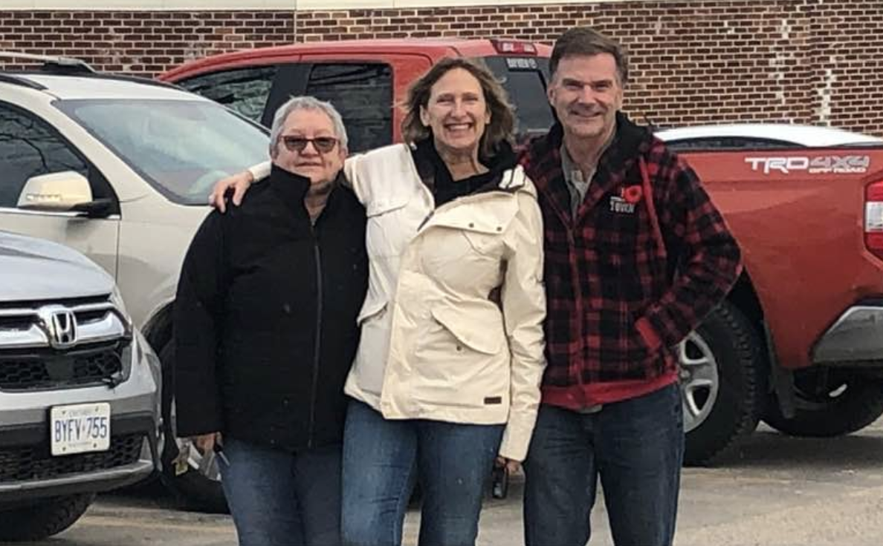
Kenora Corrections
Notes:
App makes content available offline: PDF, Youtube, Apps
No demonstration of learning happens - it’s more like a library
Tablets
We were able to curate material for requested by instructors and even have a library for the Women’s section

Slide 14
PILOT PROJECTS | Technology | Internet Access
John Howard Society Thunder Bay | Moodle & Rumie App on Tablet | Yes
Youth Justice Centre in Southern Ontario | Moodle on computers Rumie for offline use | Yes/No
CORCAN | Moodle course into D2L *whitelisted | Yes*
Kenora CLI | Rumie offline **Testing Moodle App offline** | No
Notes:
Similar to Youth - very strict rules on technology in the Kenora jail
Moodle offline: Books, Forums and Files are working
H5P - core?
Wishlist:
Easier to navigate for new tech users

Slide 15
Next Steps?
Continue to explore Moodle App offline for applicability in corrections and replace Rumie App/Tablet
Look for ways to make navigating the app easier for staff and clients
Build courses that can be used in offline or whitelist situations
Explore partnerships to whitelist Moodle with sites

Slide 16
Contact
Linda Wright
Director of Distance Projects
Sioux-Hudson Literacy Council
Good Learning Anywhere
linda@shlc.ca
www.goodlearninganywhere.com

