Slide 1
Translate a full course using the power of Neural Machine Engines
Renaat Debleu

Slide 3
Notes:
Headline, image and dot points slide

Slide 4
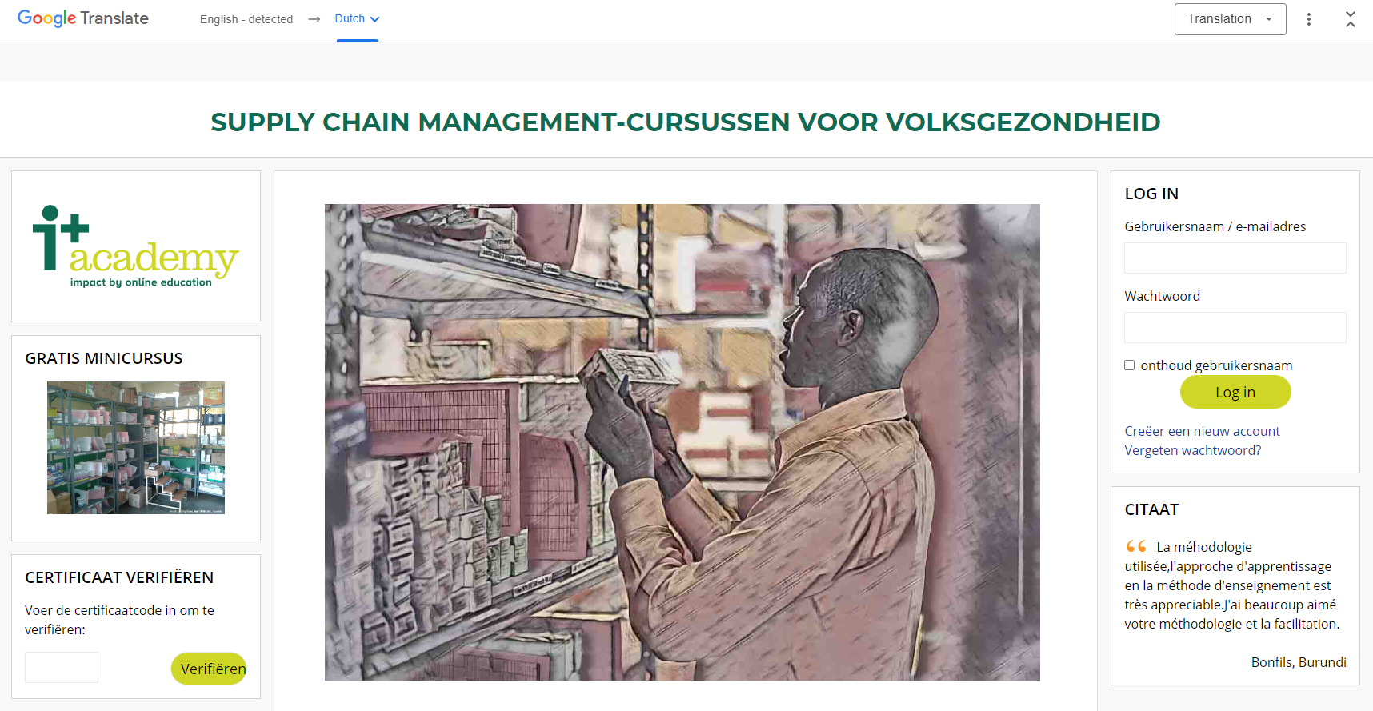
Notes:
Headline, image and dot points slide

Slide 5
Notes:
Headline, image and dot points slide

Slide 6
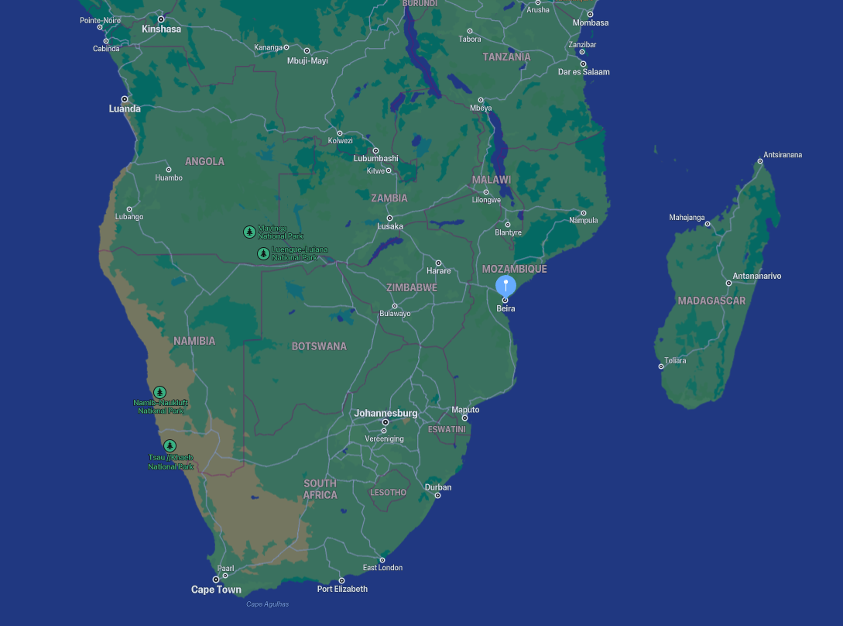

Slide 7
And then the Russians came
We use cookies so that users who log in to this site and browse through our pages, receive cleaner and safer URLs. If you want to log in, you have to accept the MoodleSession cookie. This cookie is destroyed when you log out or close the browser. Other cookies can be safely deleted and/or refused.
Мы используем файлы печенье, чтобы пользователи, которые входят на этот сайт и просматривают наши страницы, получали более чистые и безопасные URL-адреса. Если вы хотите войти в систему, вы должны принять файл печенье MoodleSession, этотфайл печенье уничтожается при выходе из системы или закрытии в браузере. Другие файлы печенье могут быть безопасно удалены и/или отклонены.

Slide 8
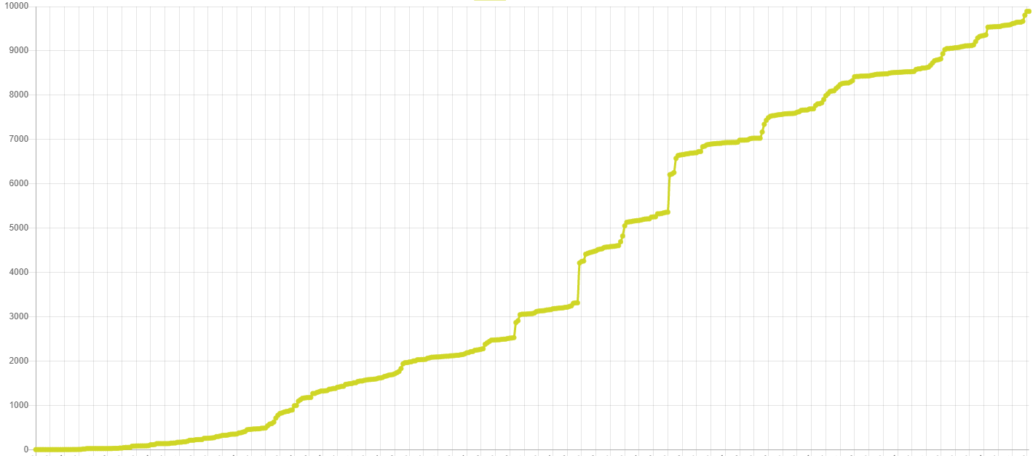
Growth report for managers
Users
Guests
Mobile devices
Badges
Course completions
Certificates
Courses
Enrolments
Questions
Resources
Files
Messages
Countries
Words / course

Slide 9
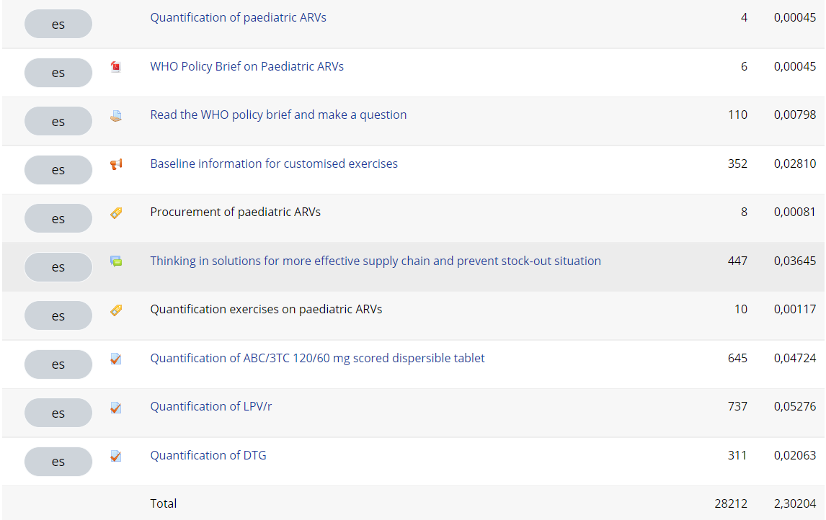

Slide 10
Quality

Slide 11
Speed
Price
Translate a course by command line.
6 weeks => 6 minutes
8000 $ => 18 $

Slide 12
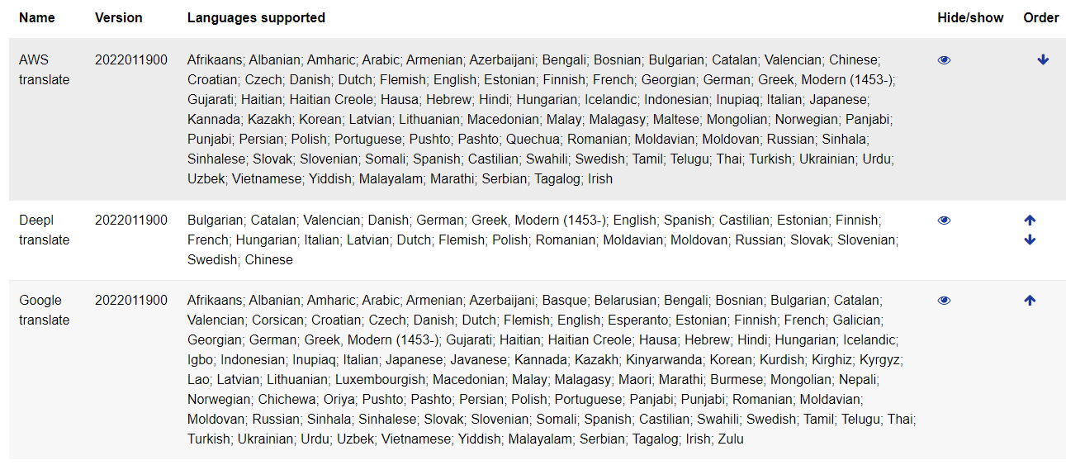
Supported engines

Slide 13
Warnings - TODO
All translated text has to be reviewed by a native speaker.
This plugin is still in Beta version - do not use it in a production environment.
The translation engines are mostly a Paying service.
implement Active Custom Translation (Extra parallel data to customize the machine translated output)
Translate async
Moodle 4.00 questions
support translation of Microsoft Word / PDF documents

Slide 14
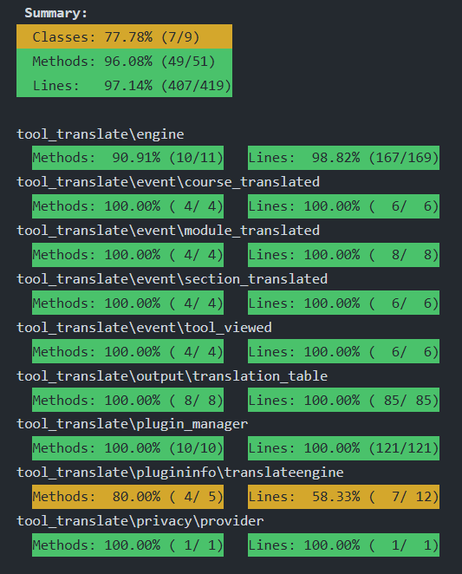

Slide 15
URLs
github.com/ewallah/moodle-tool_translate
www.nhk.or.jp/irotoridori/sdgs_song
www.eWallah.net
www.iplusacademy.org
Notes:
Headline, image and dot points slide

Slide 16
Closing slide
Renaat Debleu
info@eWallah.net

Slide 17
Translate a full course using the power of Neural Machine Engines
Renaat Debleu

