Slide 1
Interact with us: Get more out of H5P
Micky Lomman & Sara Arjona
Moodle Mischief Makers

Slide 2
Interact with us: Get more out of H5P
Micky Lomman & Sara Arjona
Moodle Mischief Makers
Notes:
LIST OF IDEAS:
here are the ideas so far
embedding
escape room
essay question type
aspect ratio on course presentation
course presentation in interactive book
improving drag and drop
grader report
combining
altering text behaviours
adding feedback
resize images before uploading
use defaults when unsure
explore settings
add imagery
when to embed and when to add as an activity
change view to do INSIGHTS ABOUT: How things work on a certain work
Future
Link vs Copy (benefits, problems…)

Slide 3
Notes:
frump to fab

Slide 4
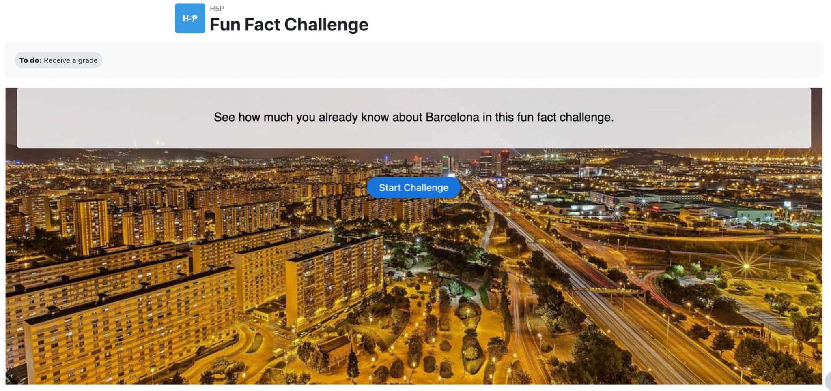
Notes:
Headline, image and dot points slide

Slide 5
Notes:
Headline, image and dot points slide

Slide 6
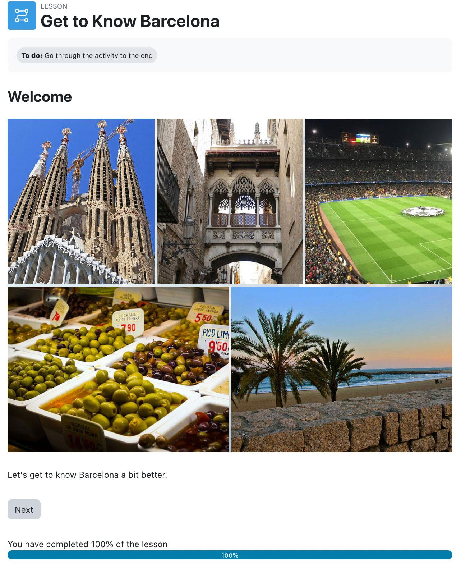

Slide 7
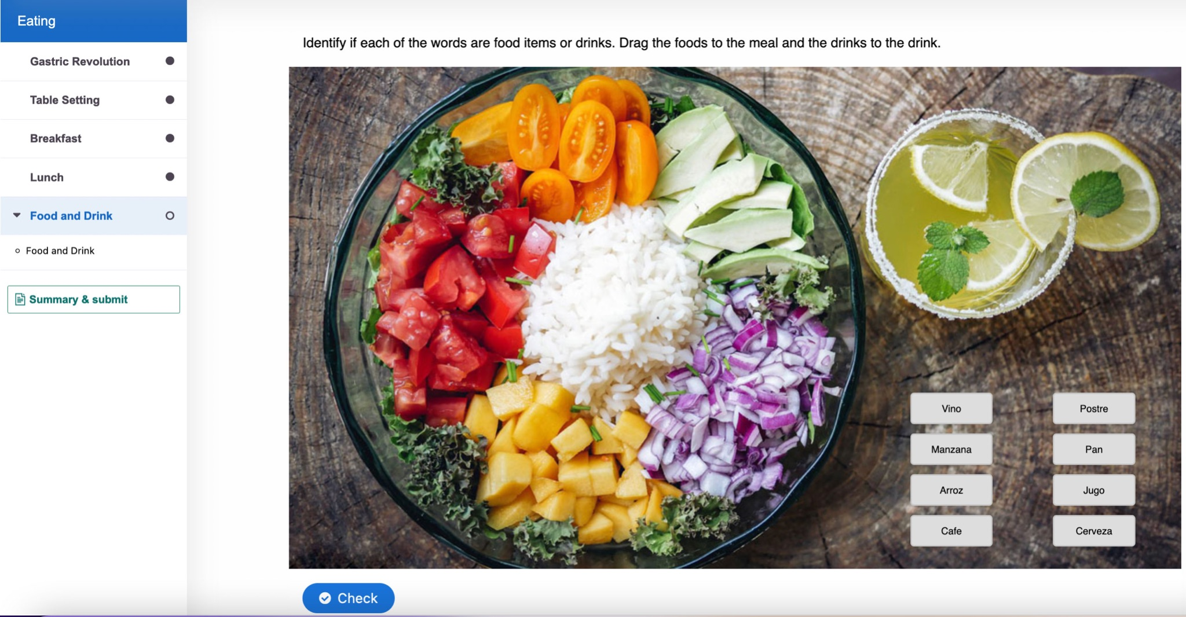
Notes:
Headline, image and dot points slide

Slide 8
Notes:
set a theme

Slide 9
Notes:
Headline, image and dot points slide

Slide 10
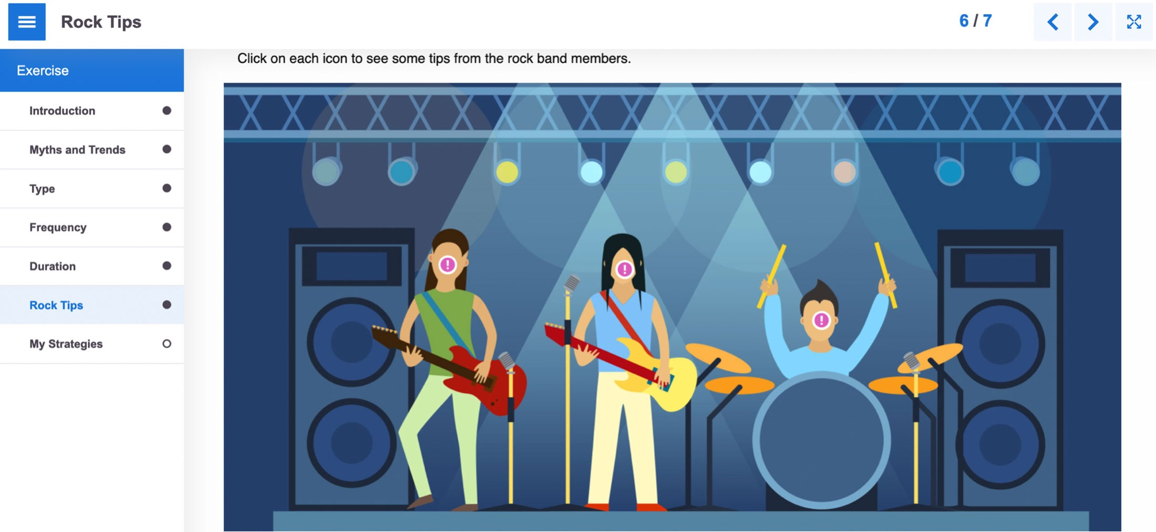
Notes:
Headline, image and dot points slide

Slide 12
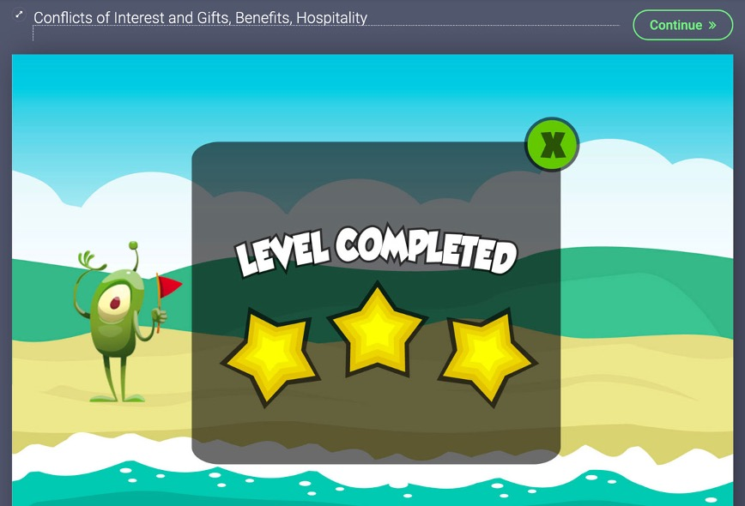
Notes:
Headline, image and dot points slide

Slide 13
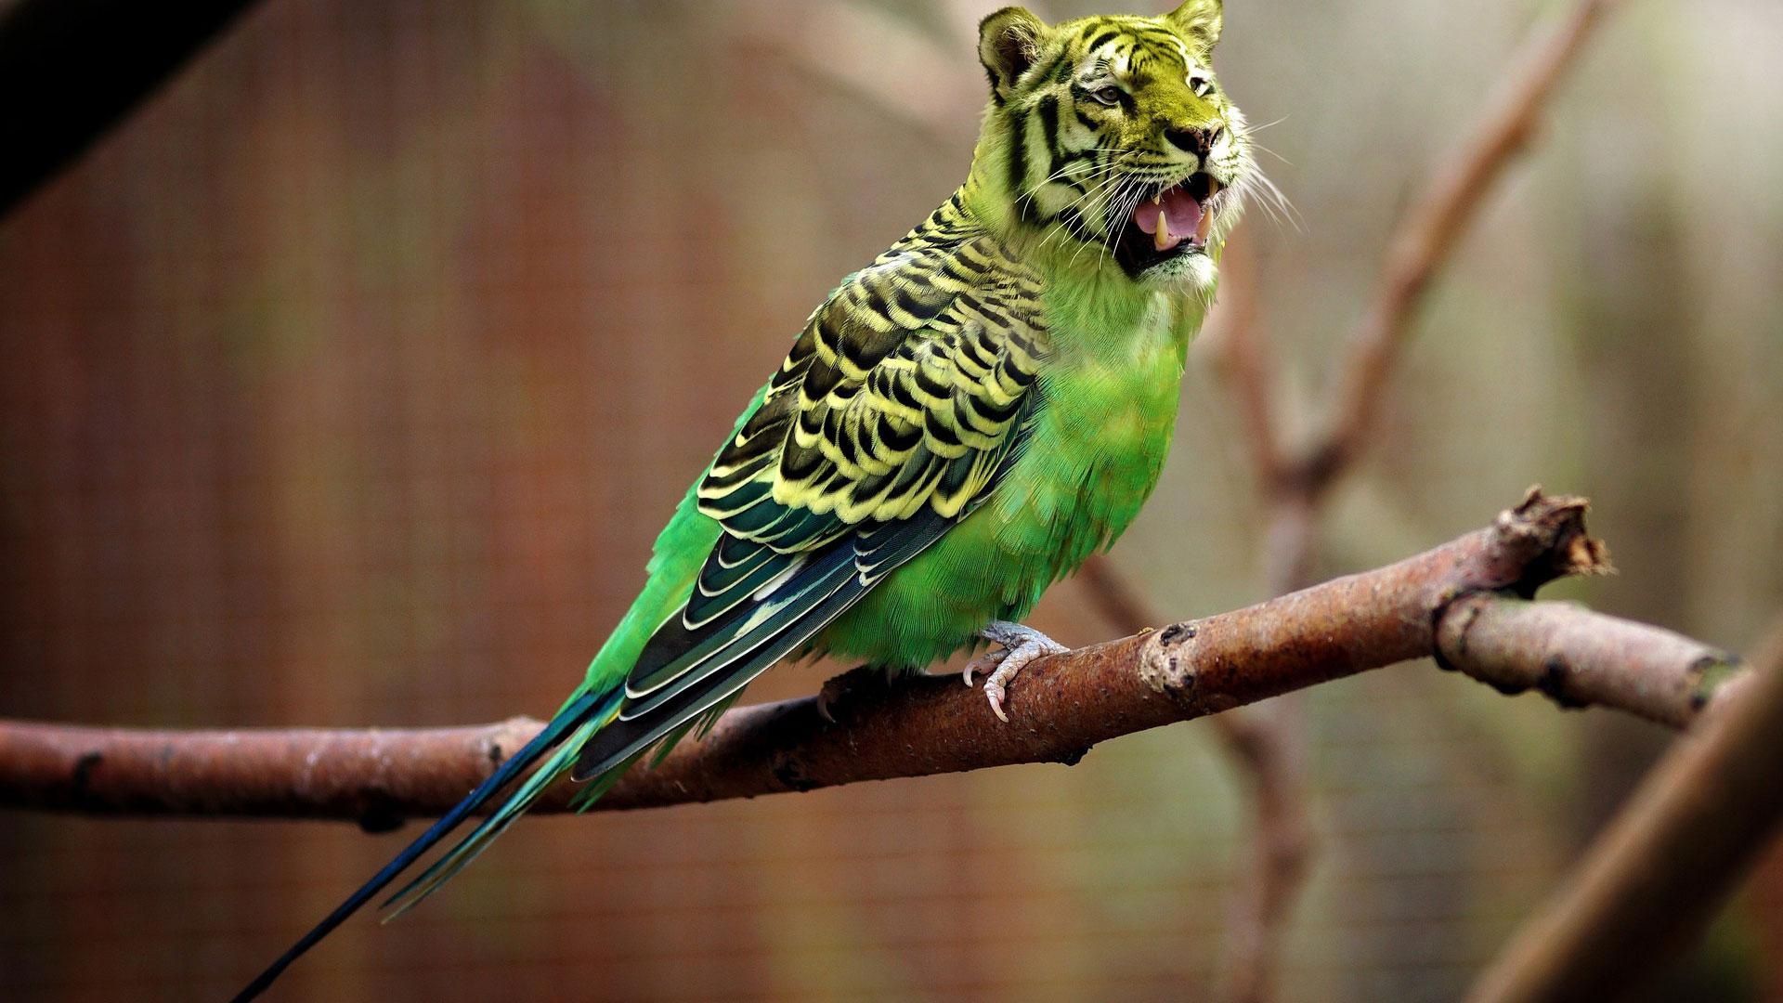
Notes:
Headline, image and dot points slide

Slide 14
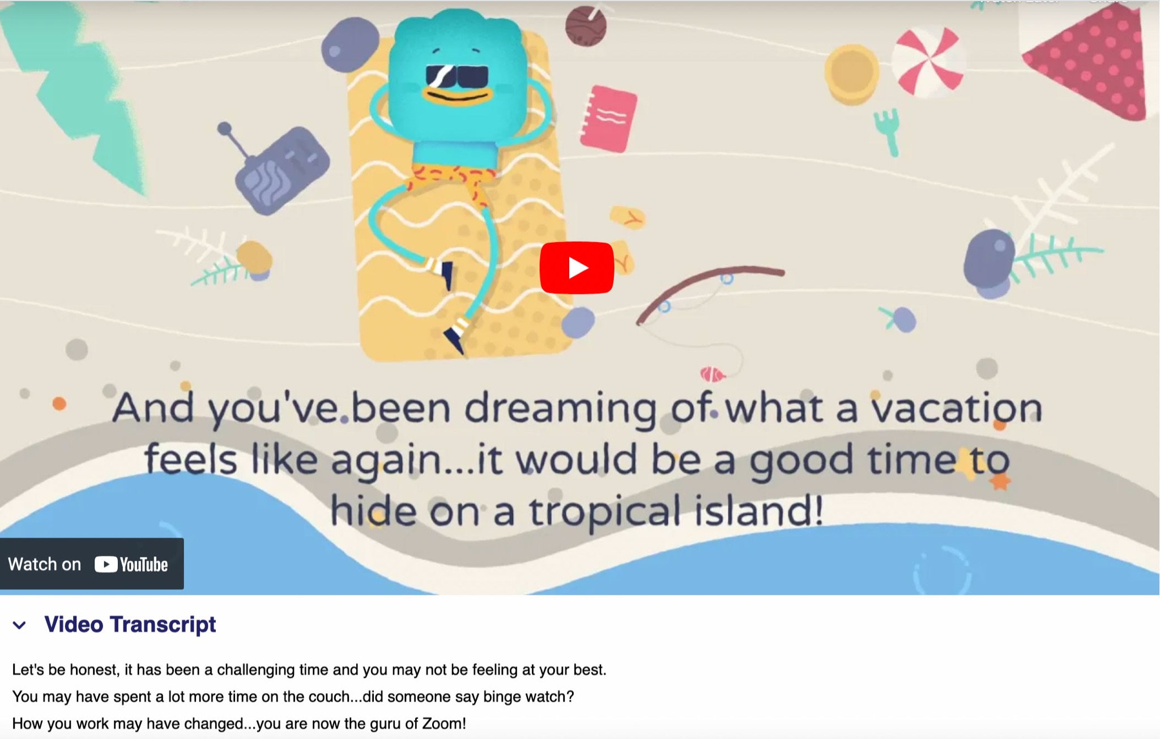
Notes:
Headline, image and dot points slide

Slide 15
Notes:
Headline, image and dot points slide

Slide 16
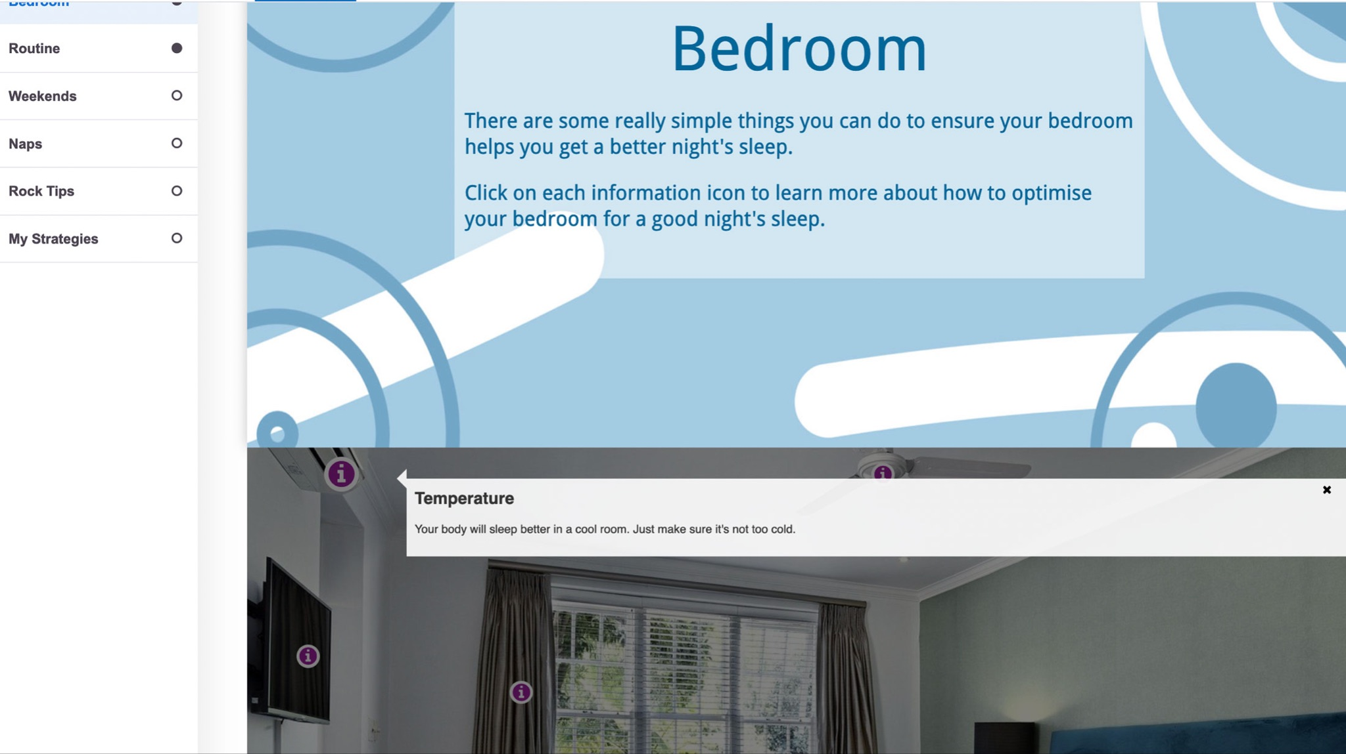
Notes:
Headline, image and dot points slide

Slide 18
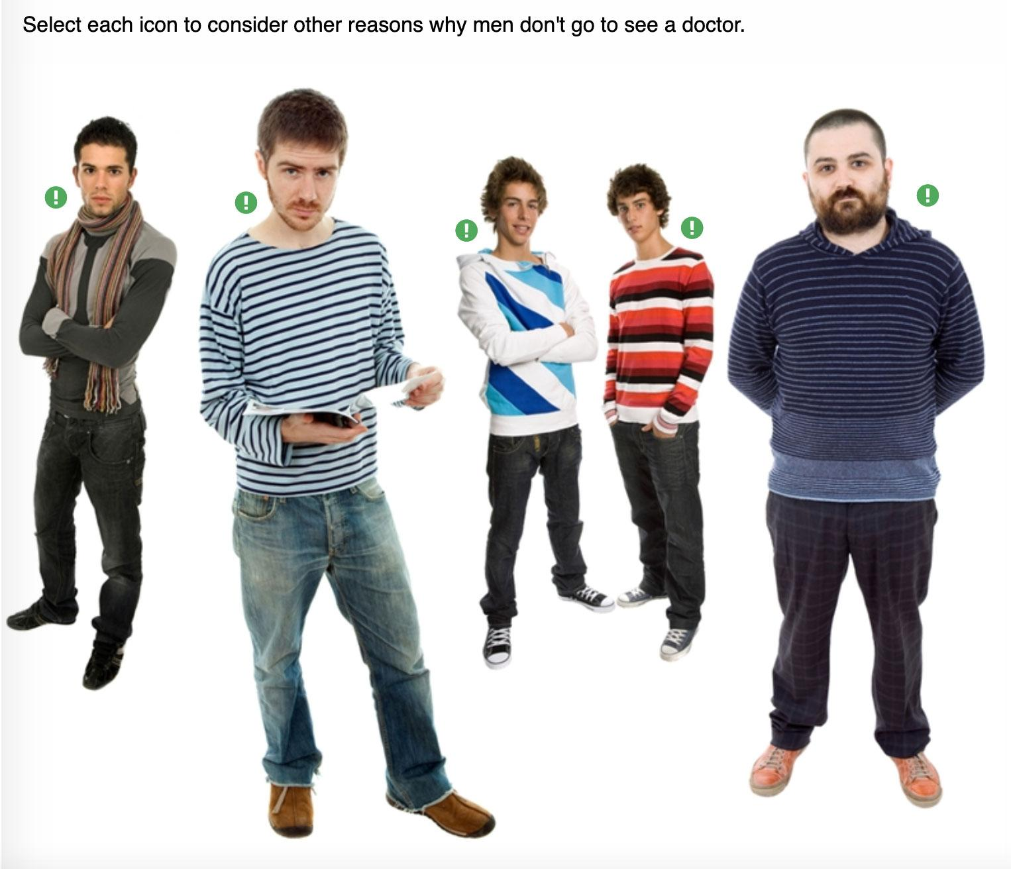

Slide 21
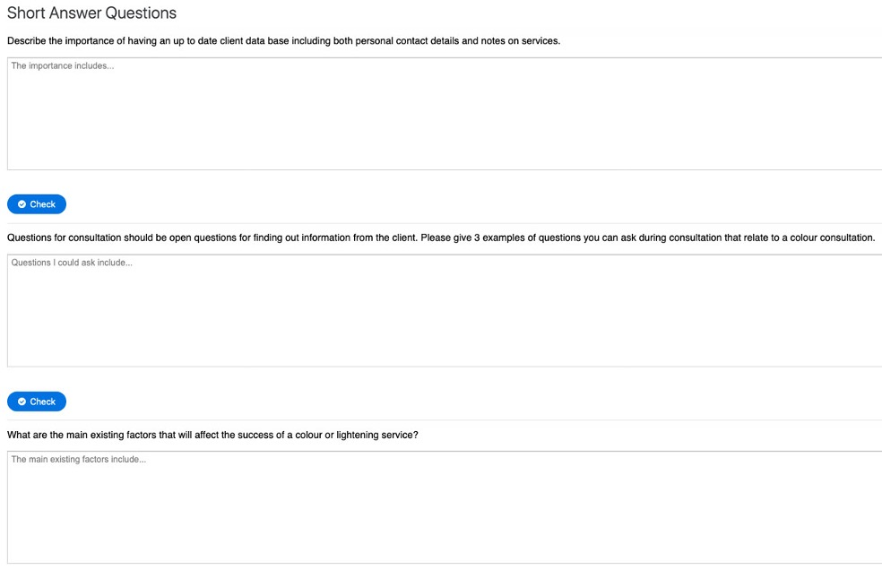

Slide 22
Notes:
Headline, image and dot points slide

Slide 23
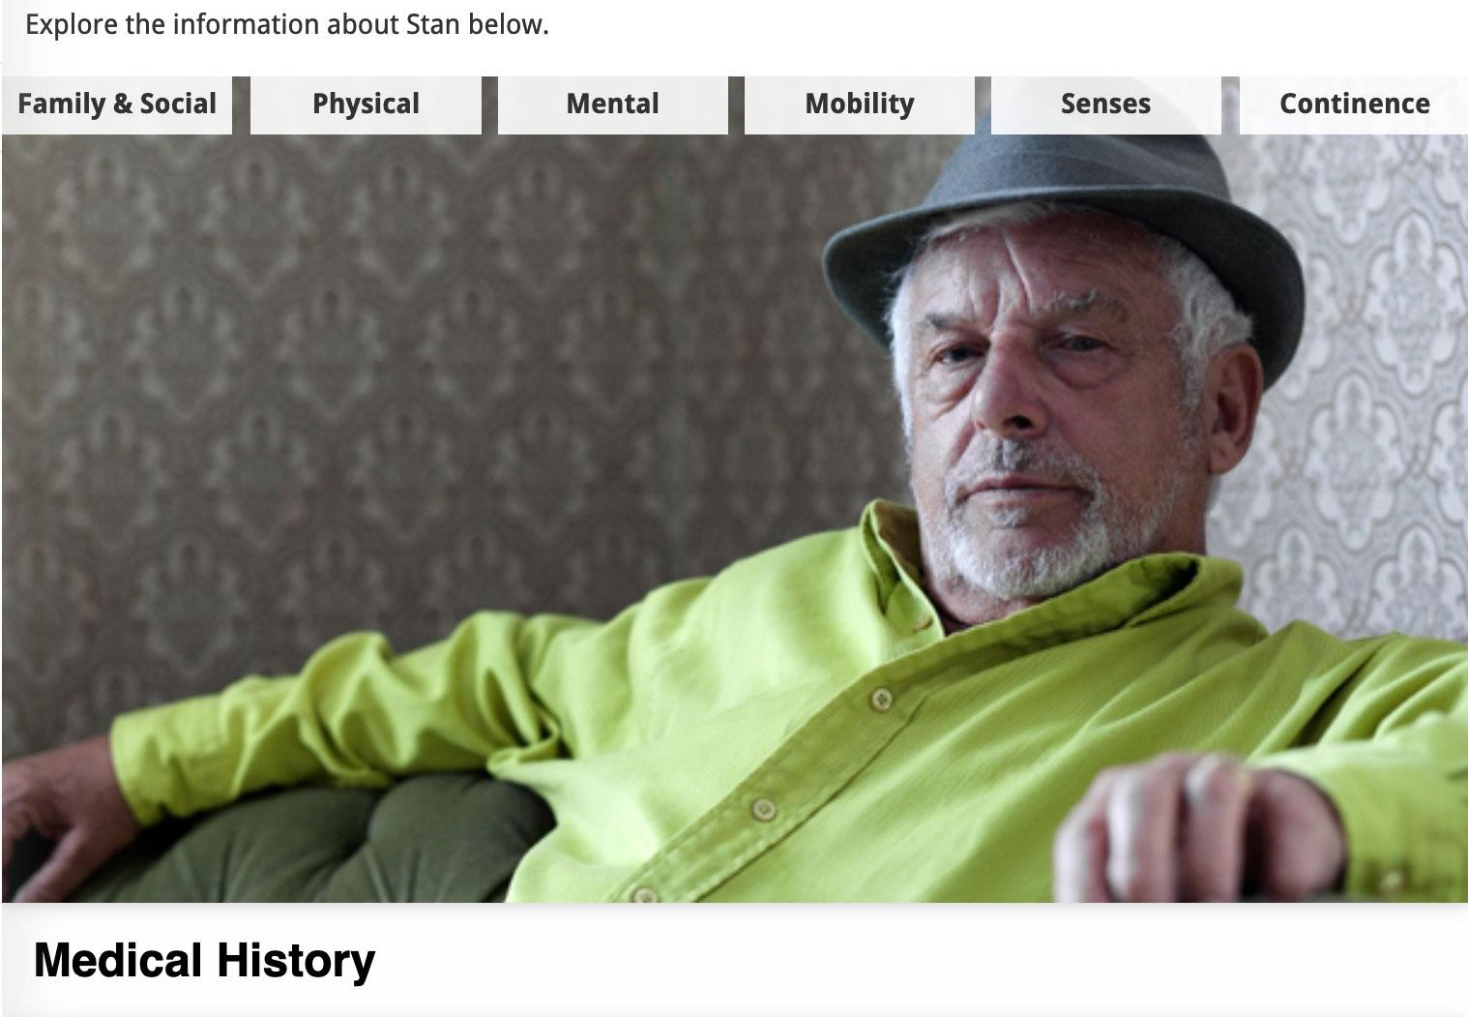
Notes:
Headline, image and dot points slide

Slide 24
Notes:
Headline, image and dot points slide

Slide 25
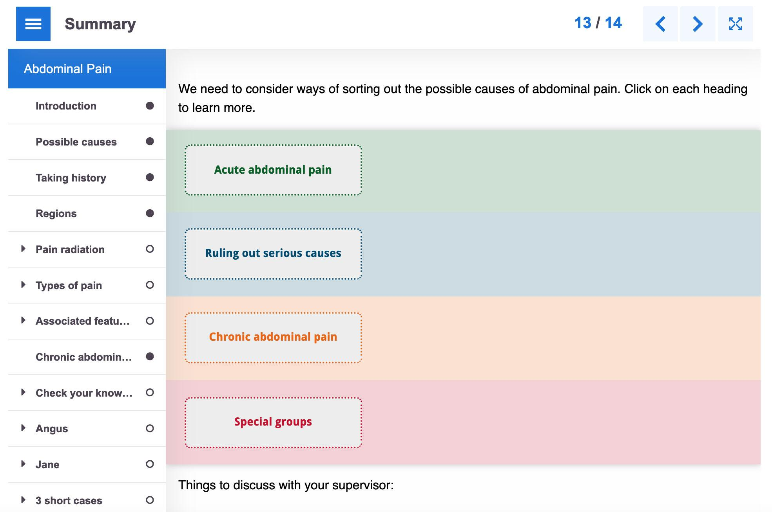
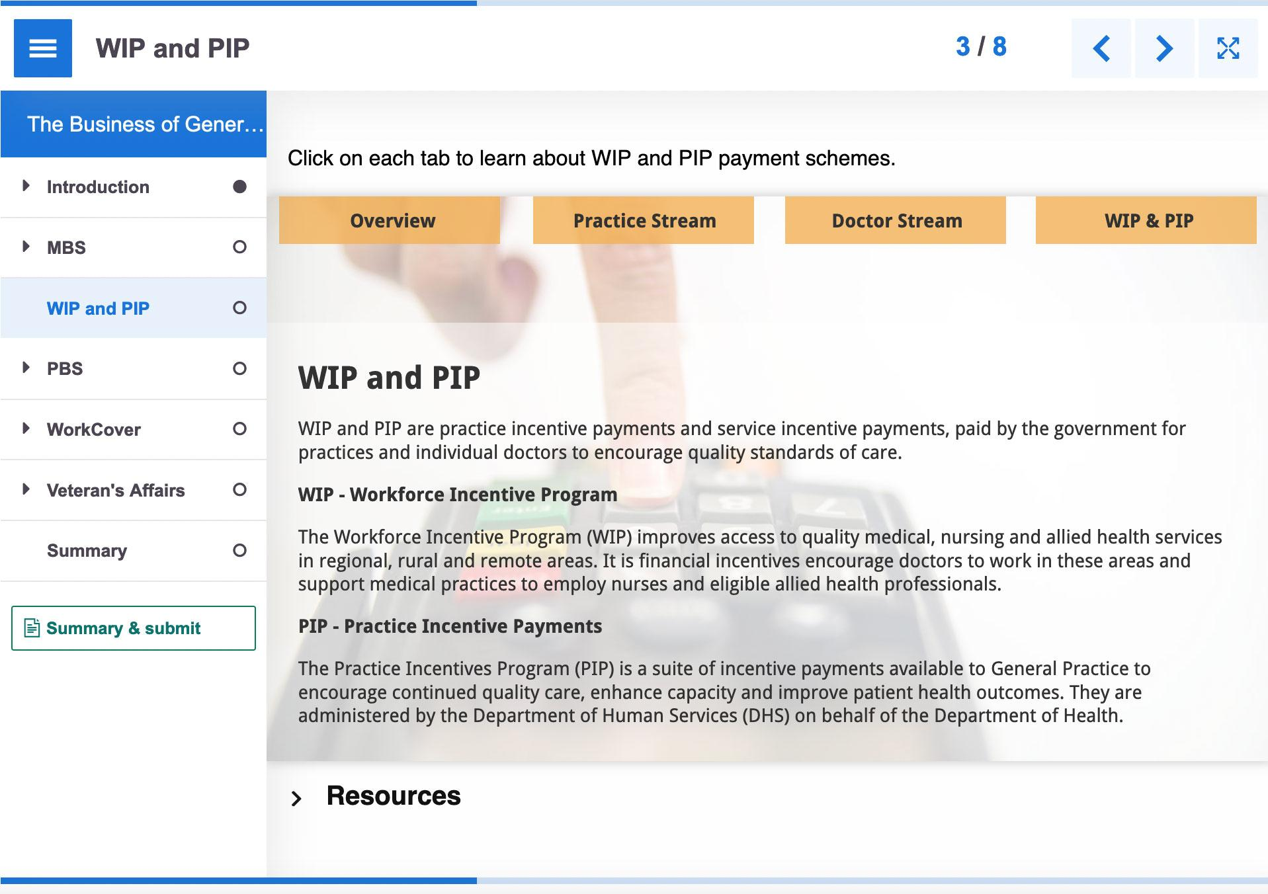
Notes:
Headline, image and dot points slide

Slide 26
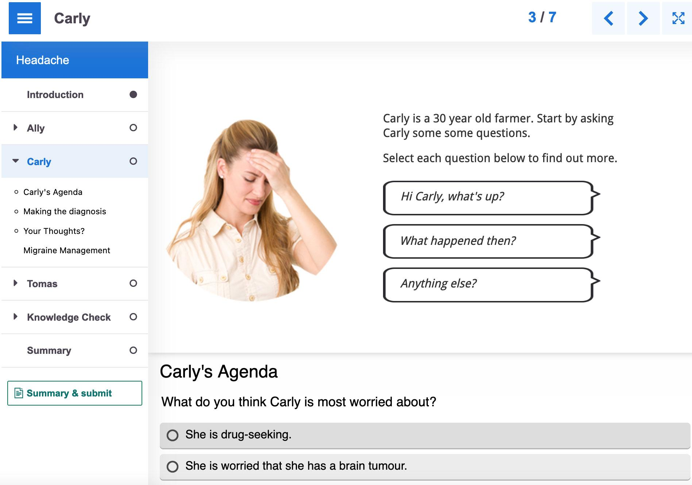
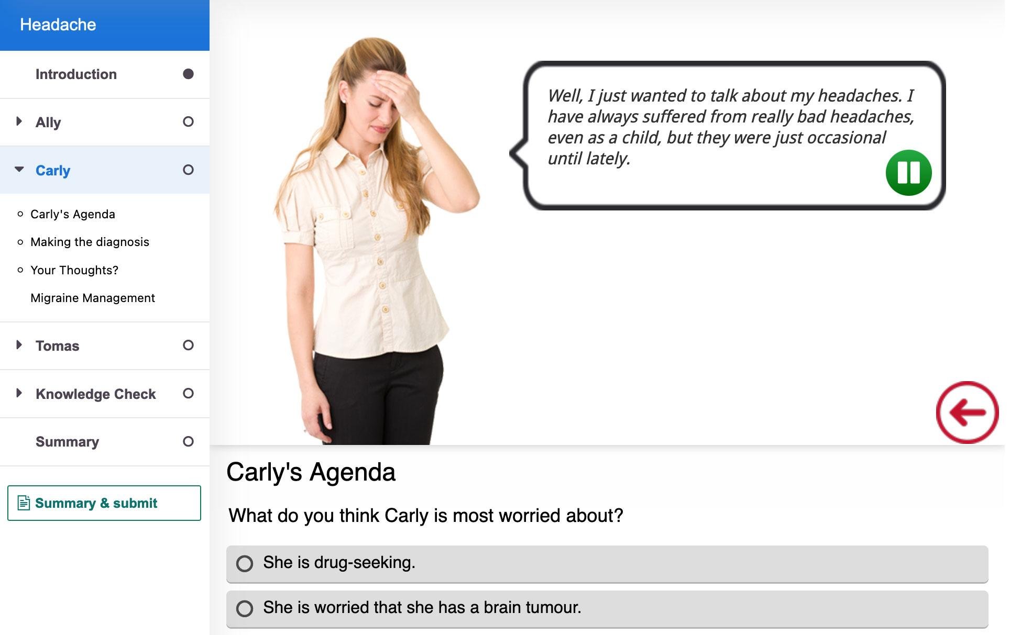
Notes:
Headline, image and dot points slide

Slide 27
Notes:
Headline, image and dot points slide

Slide 28
Notes:
Headline, image and dot points slide

Slide 29
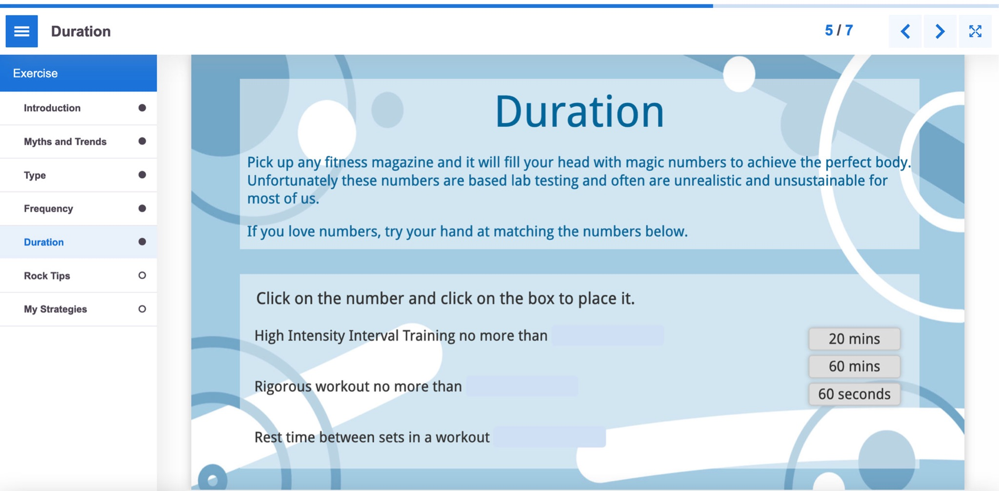
Notes:
Headline, image and dot points slide

Slide 30
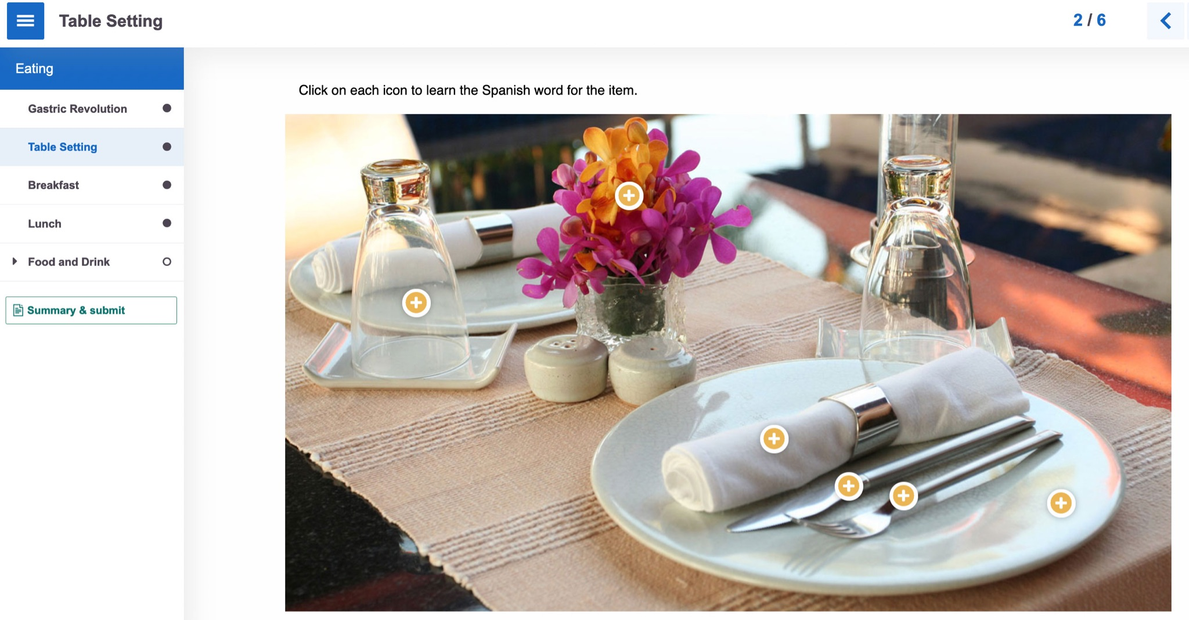
Notes:
Headline, image and dot points slide

Slide 31
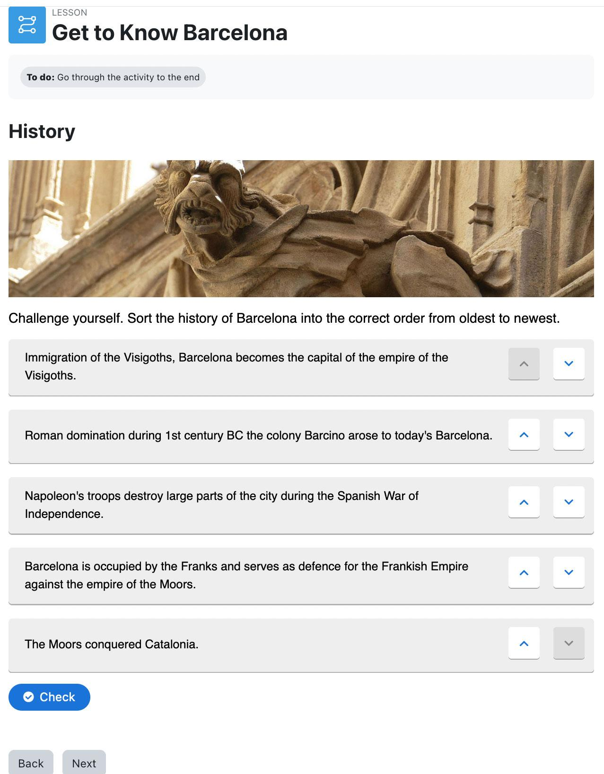

Slide 32
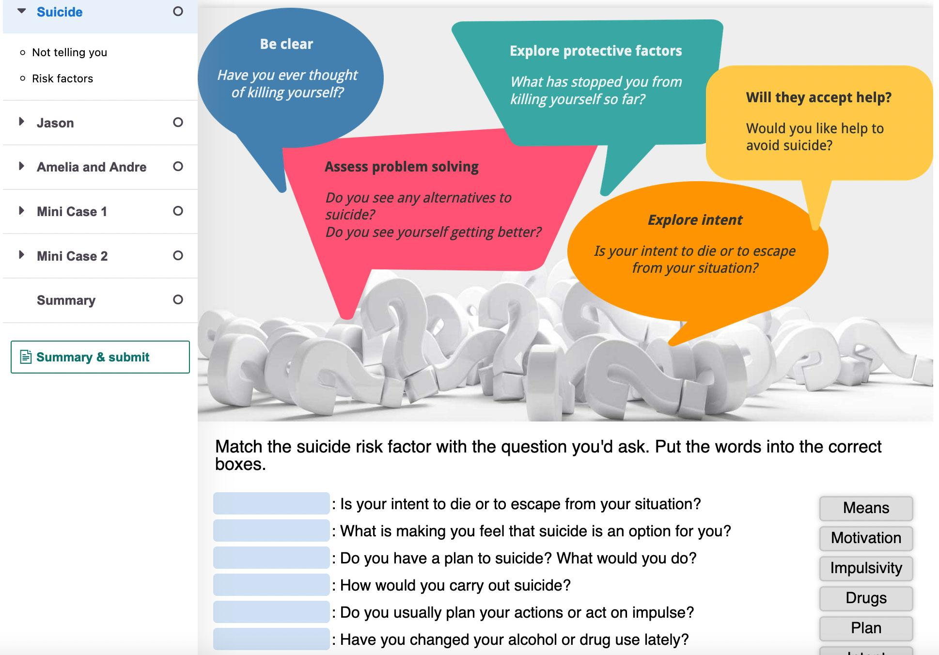

Slide 33
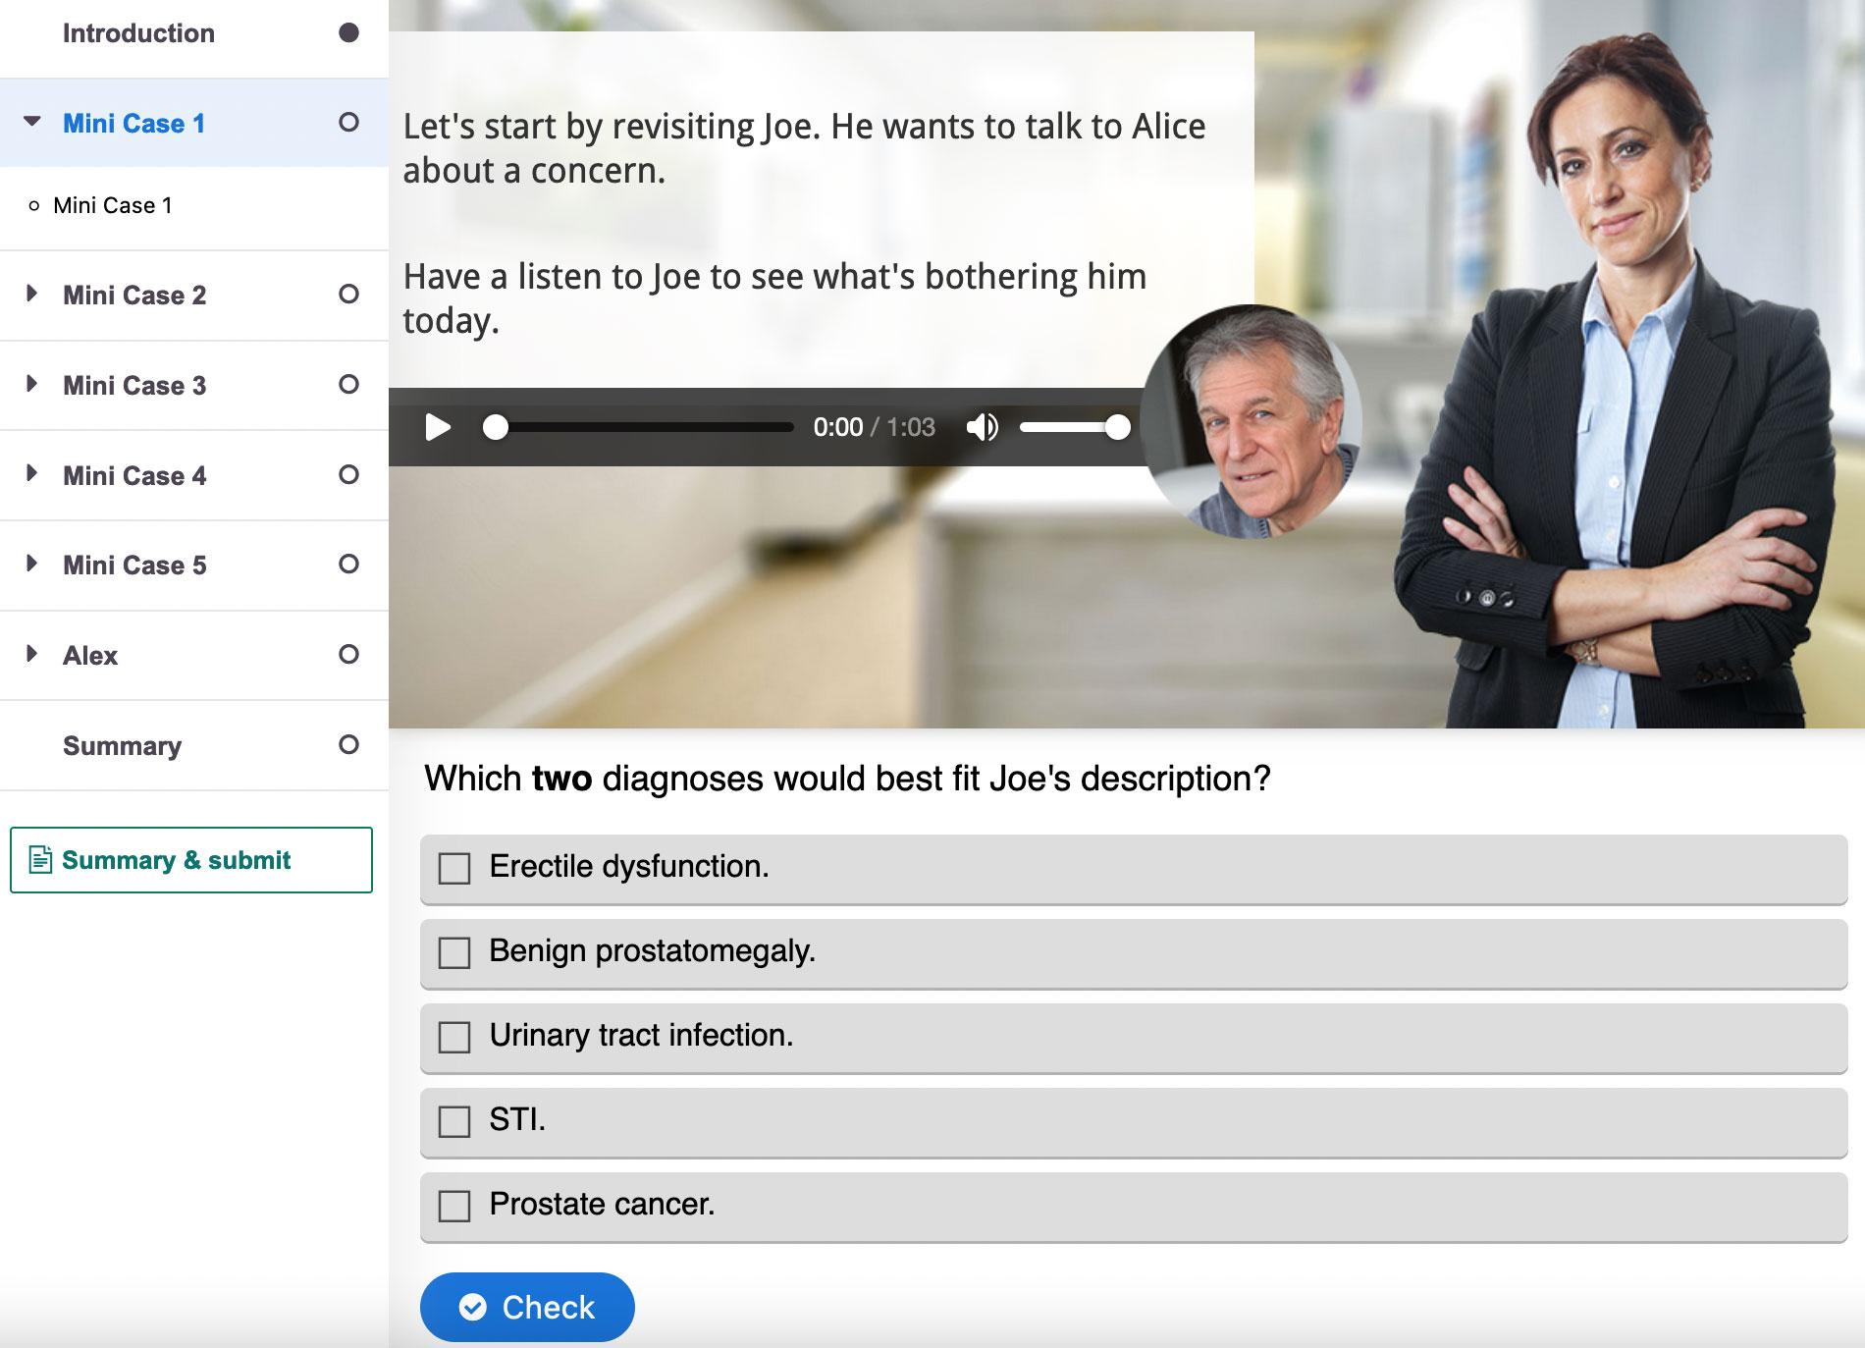

Slide 34
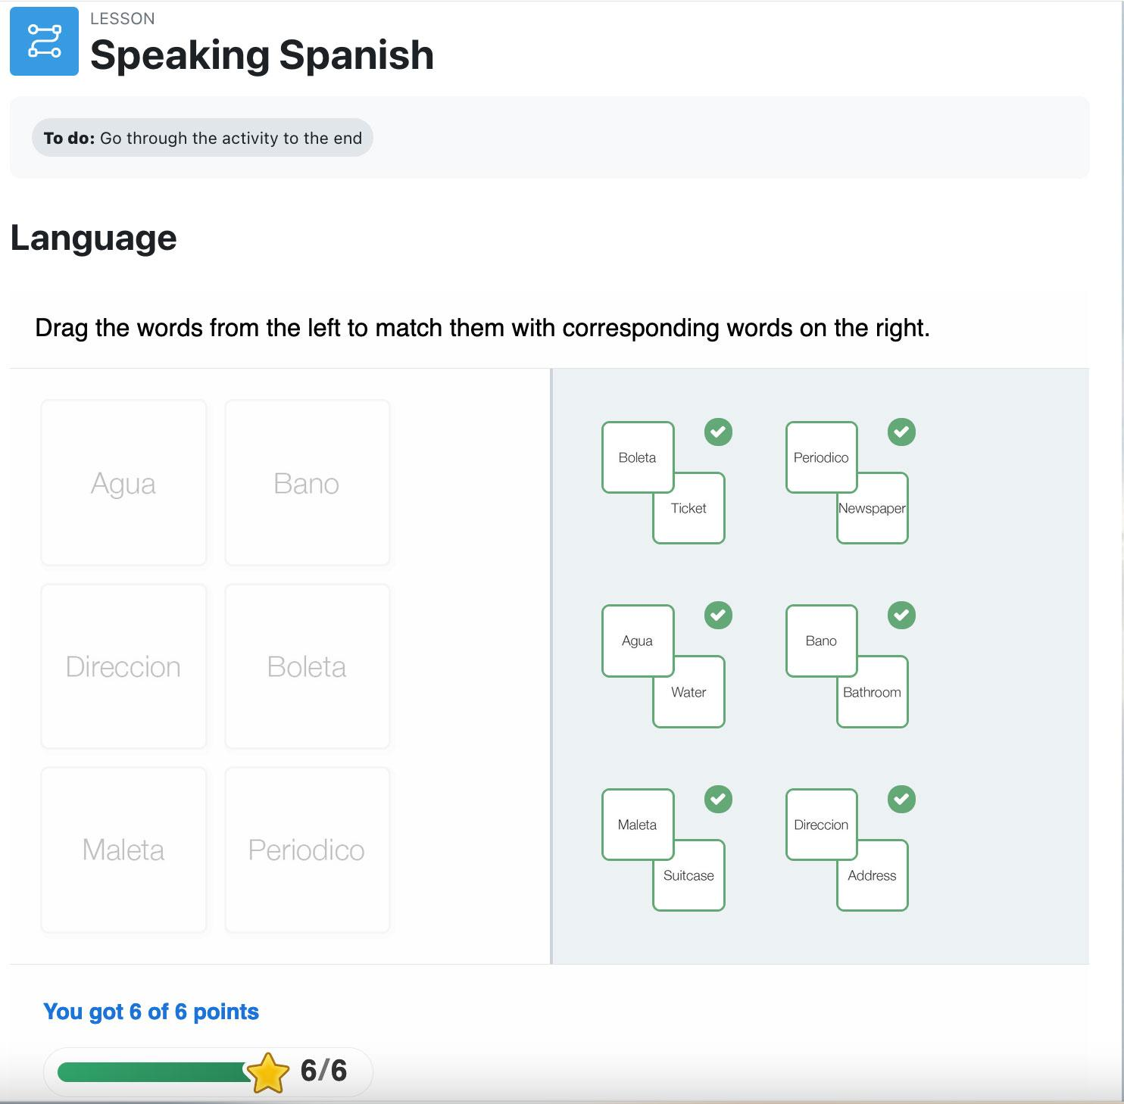

Slide 35
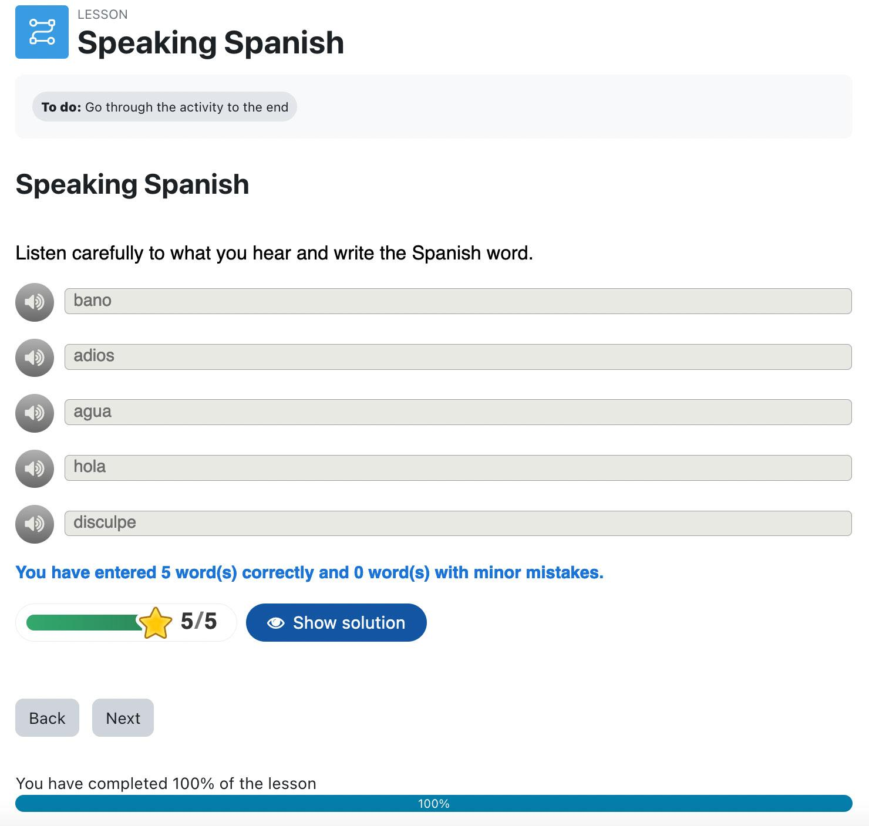

Slide 36
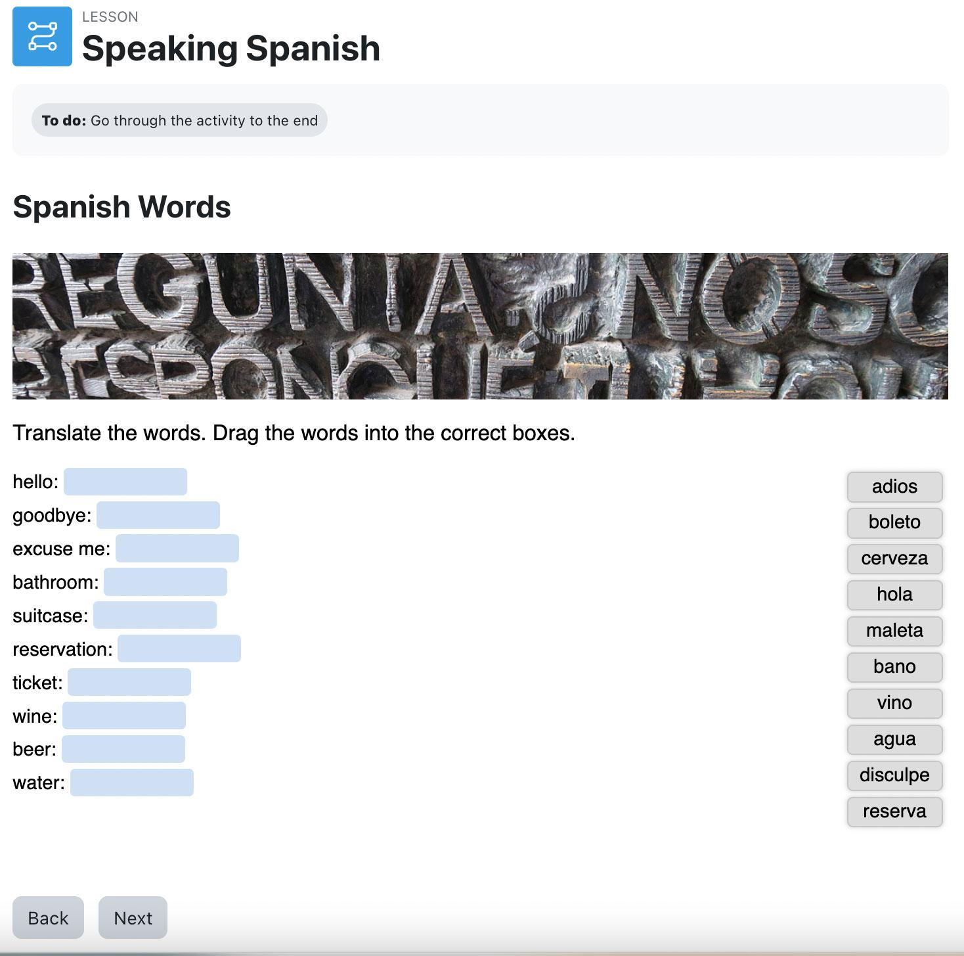

Slide 37
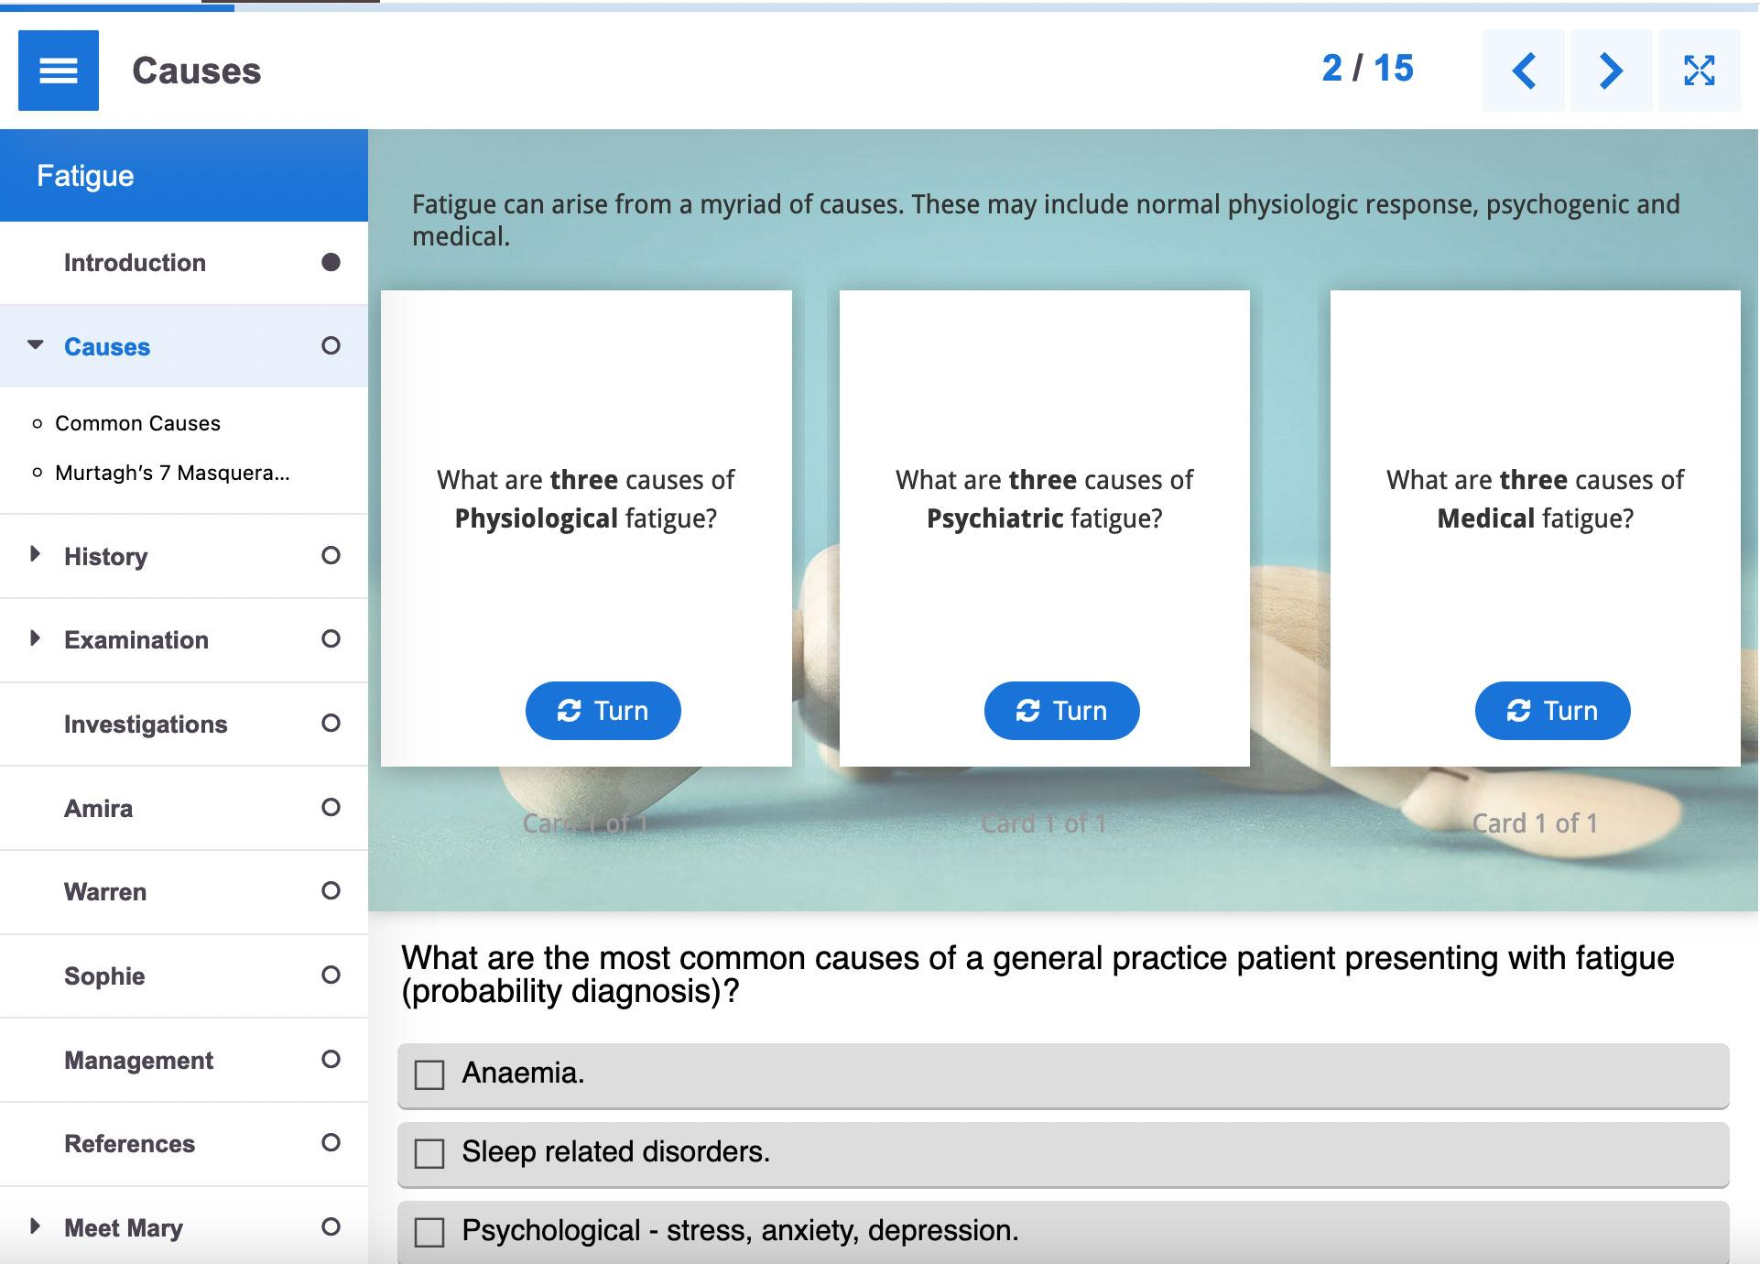
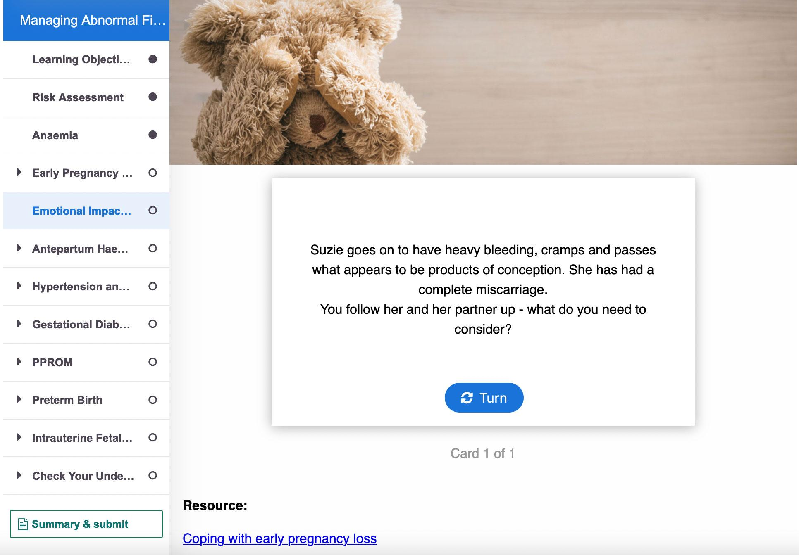

Slide 38
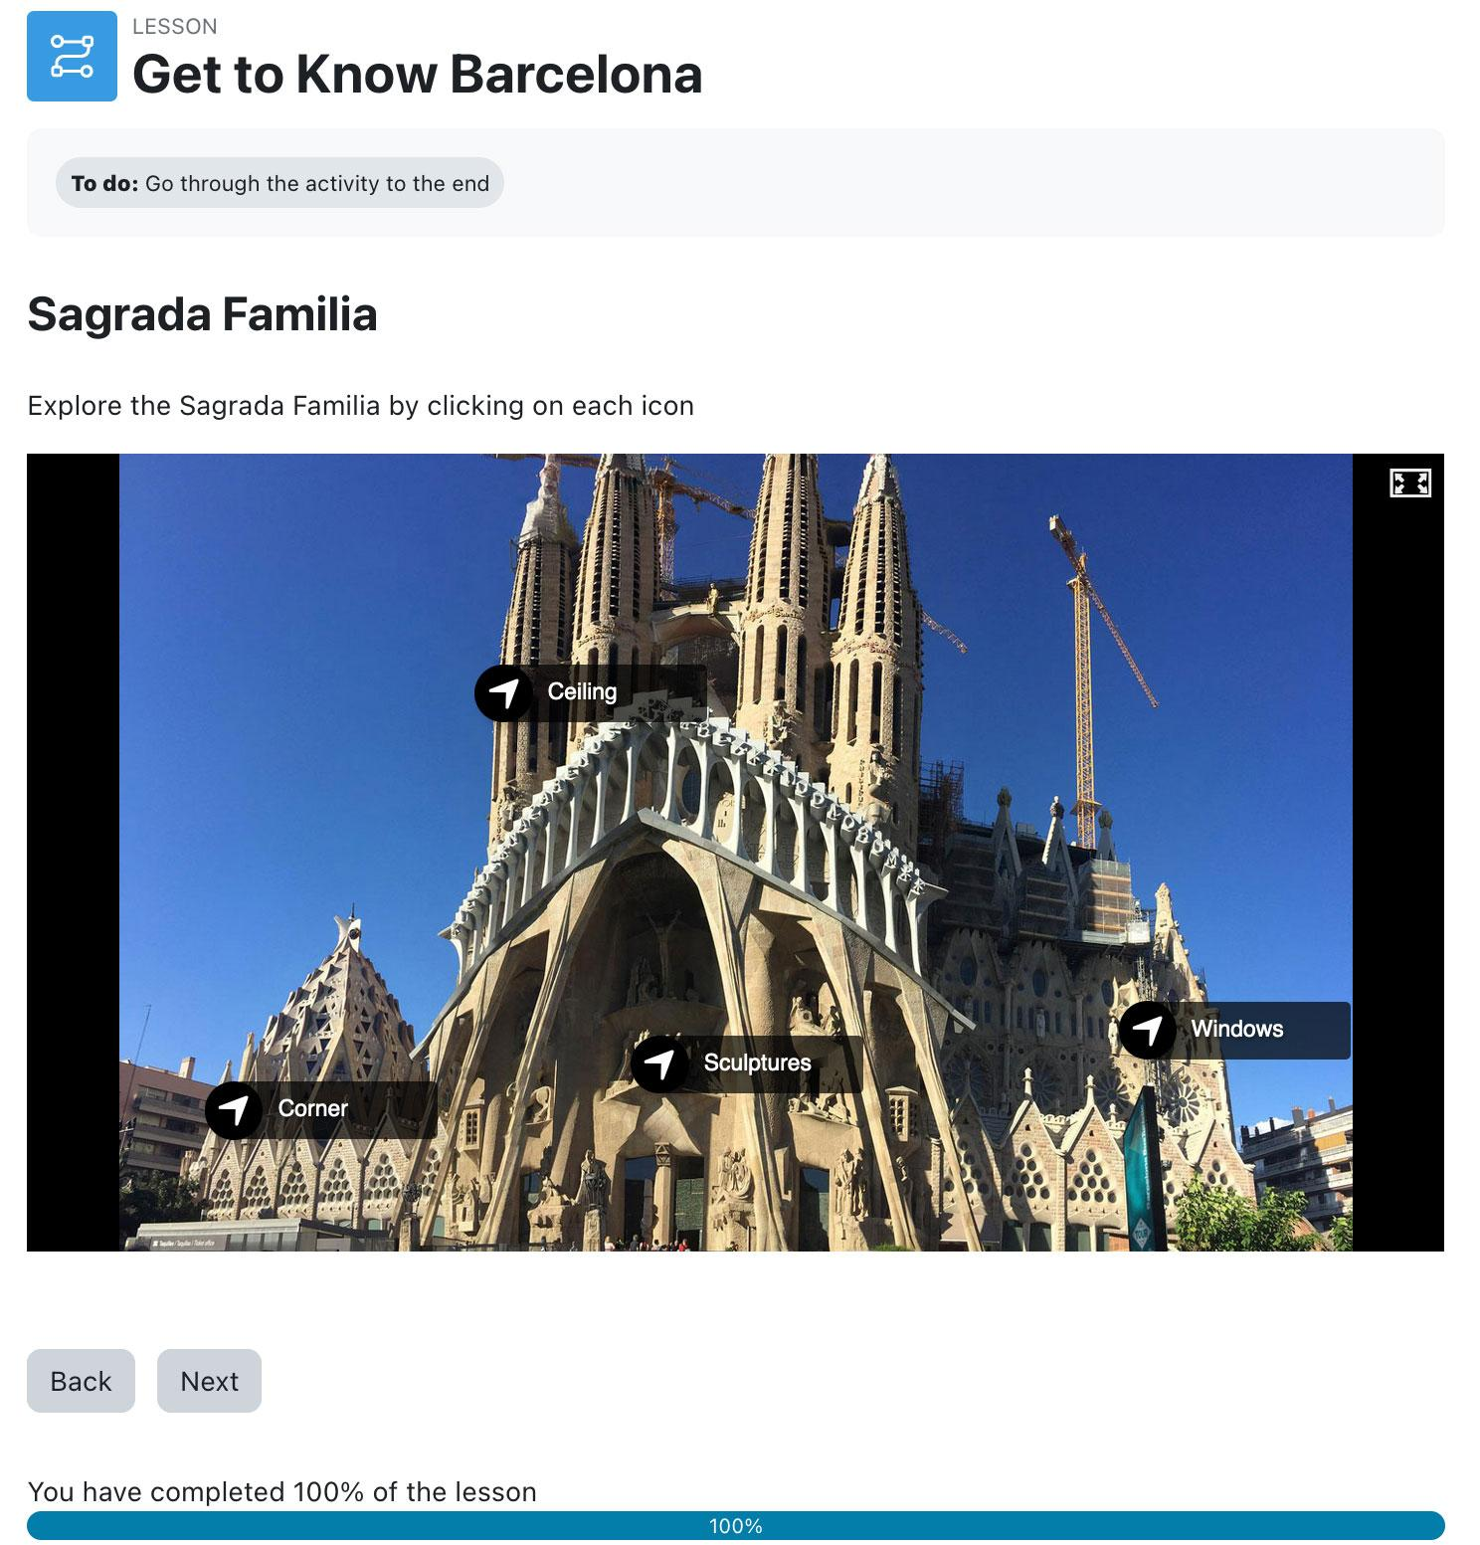

Slide 39
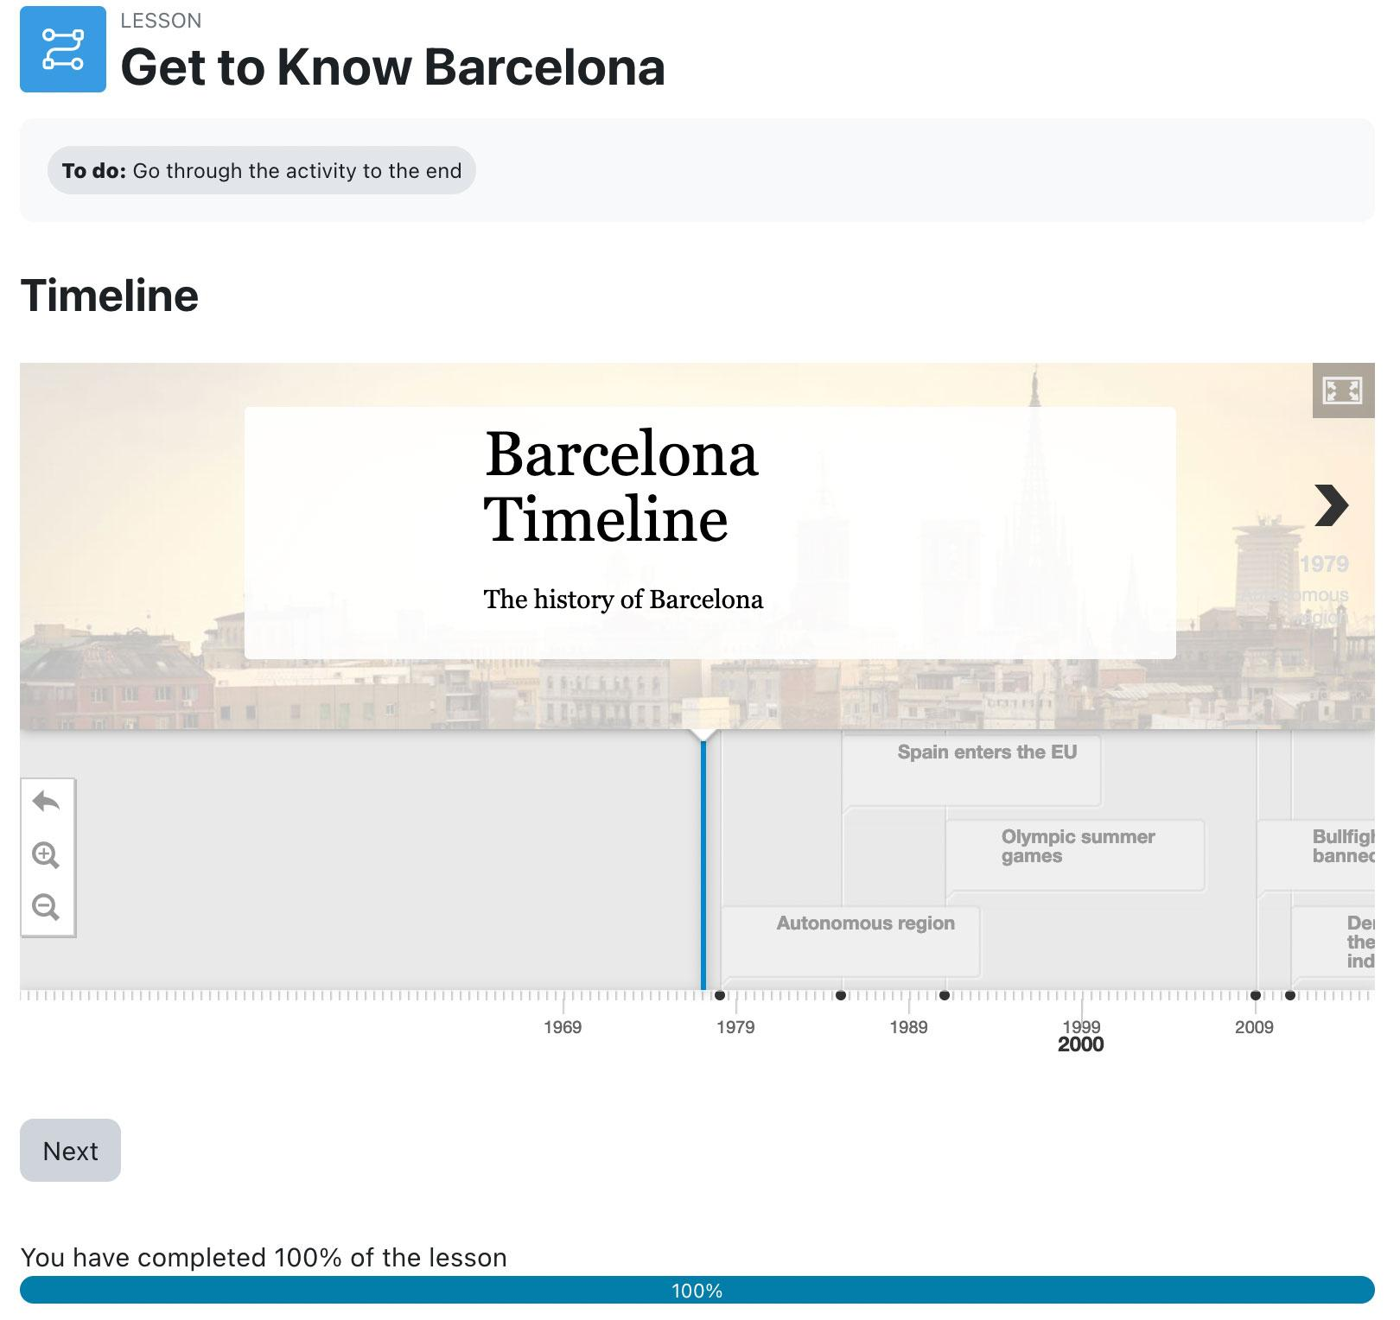

Slide 40
Notes:
let’s focus on some settings

Slide 41
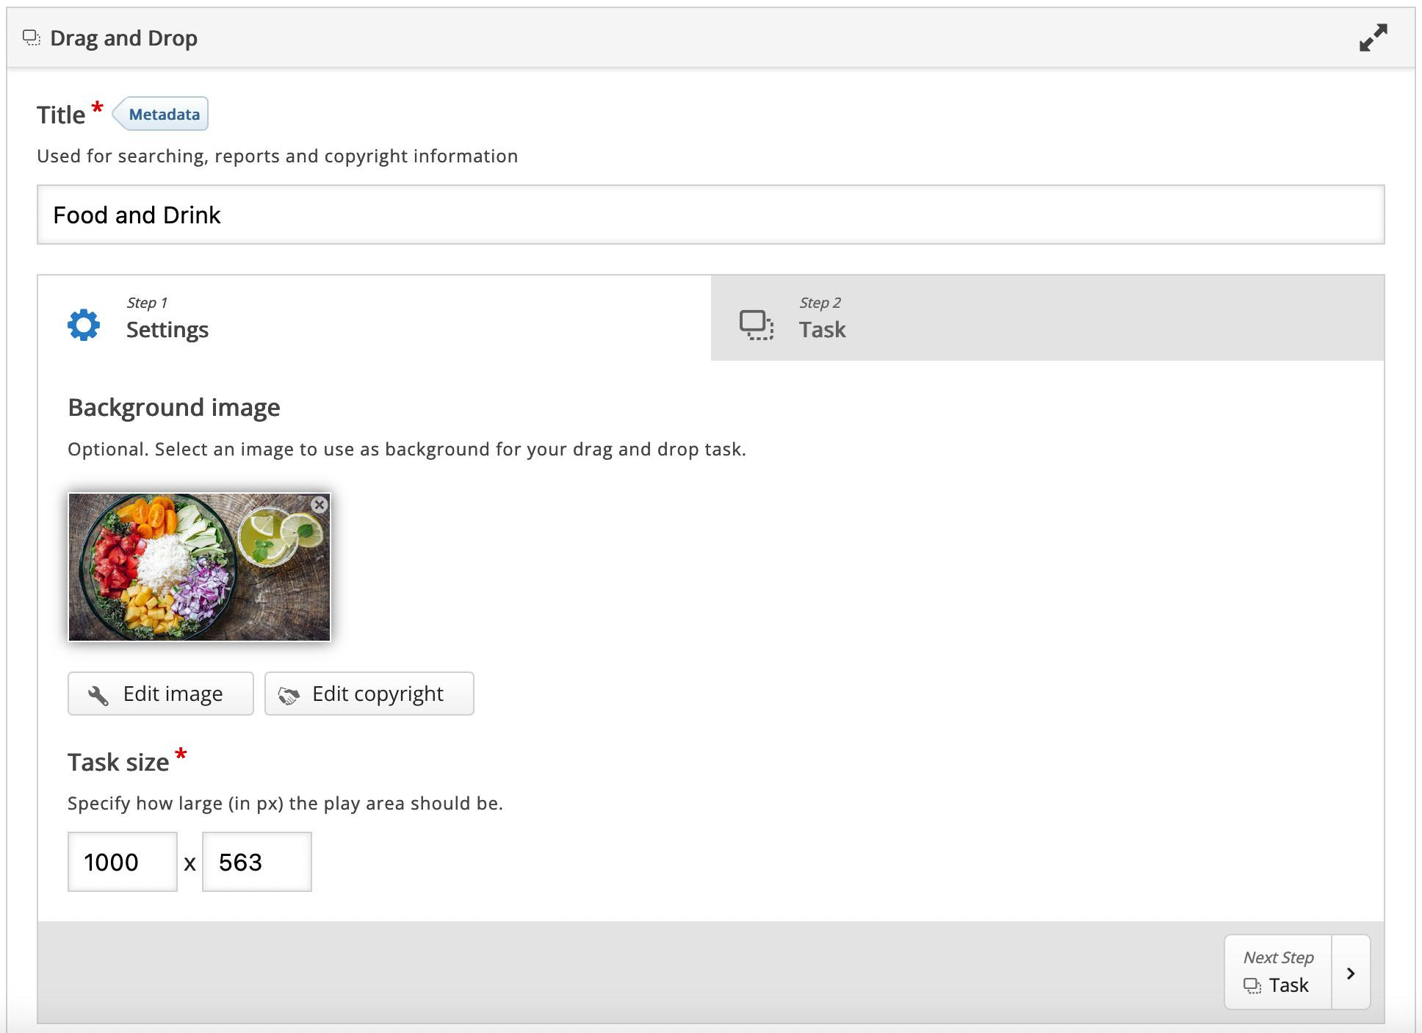

Slide 42
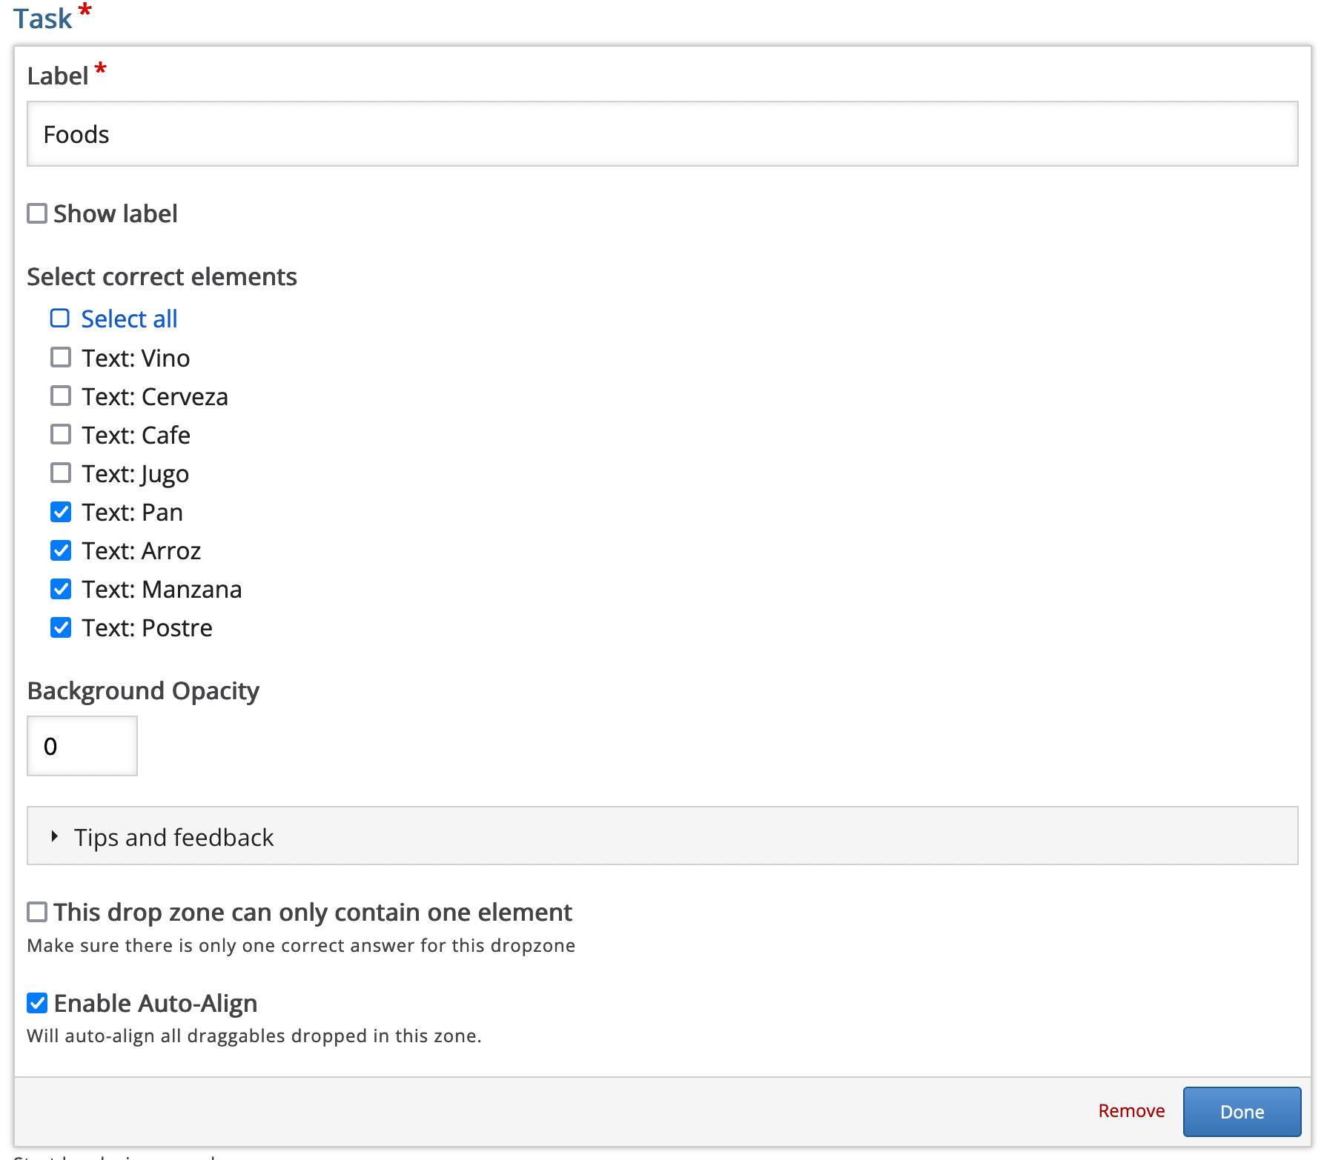

Slide 43
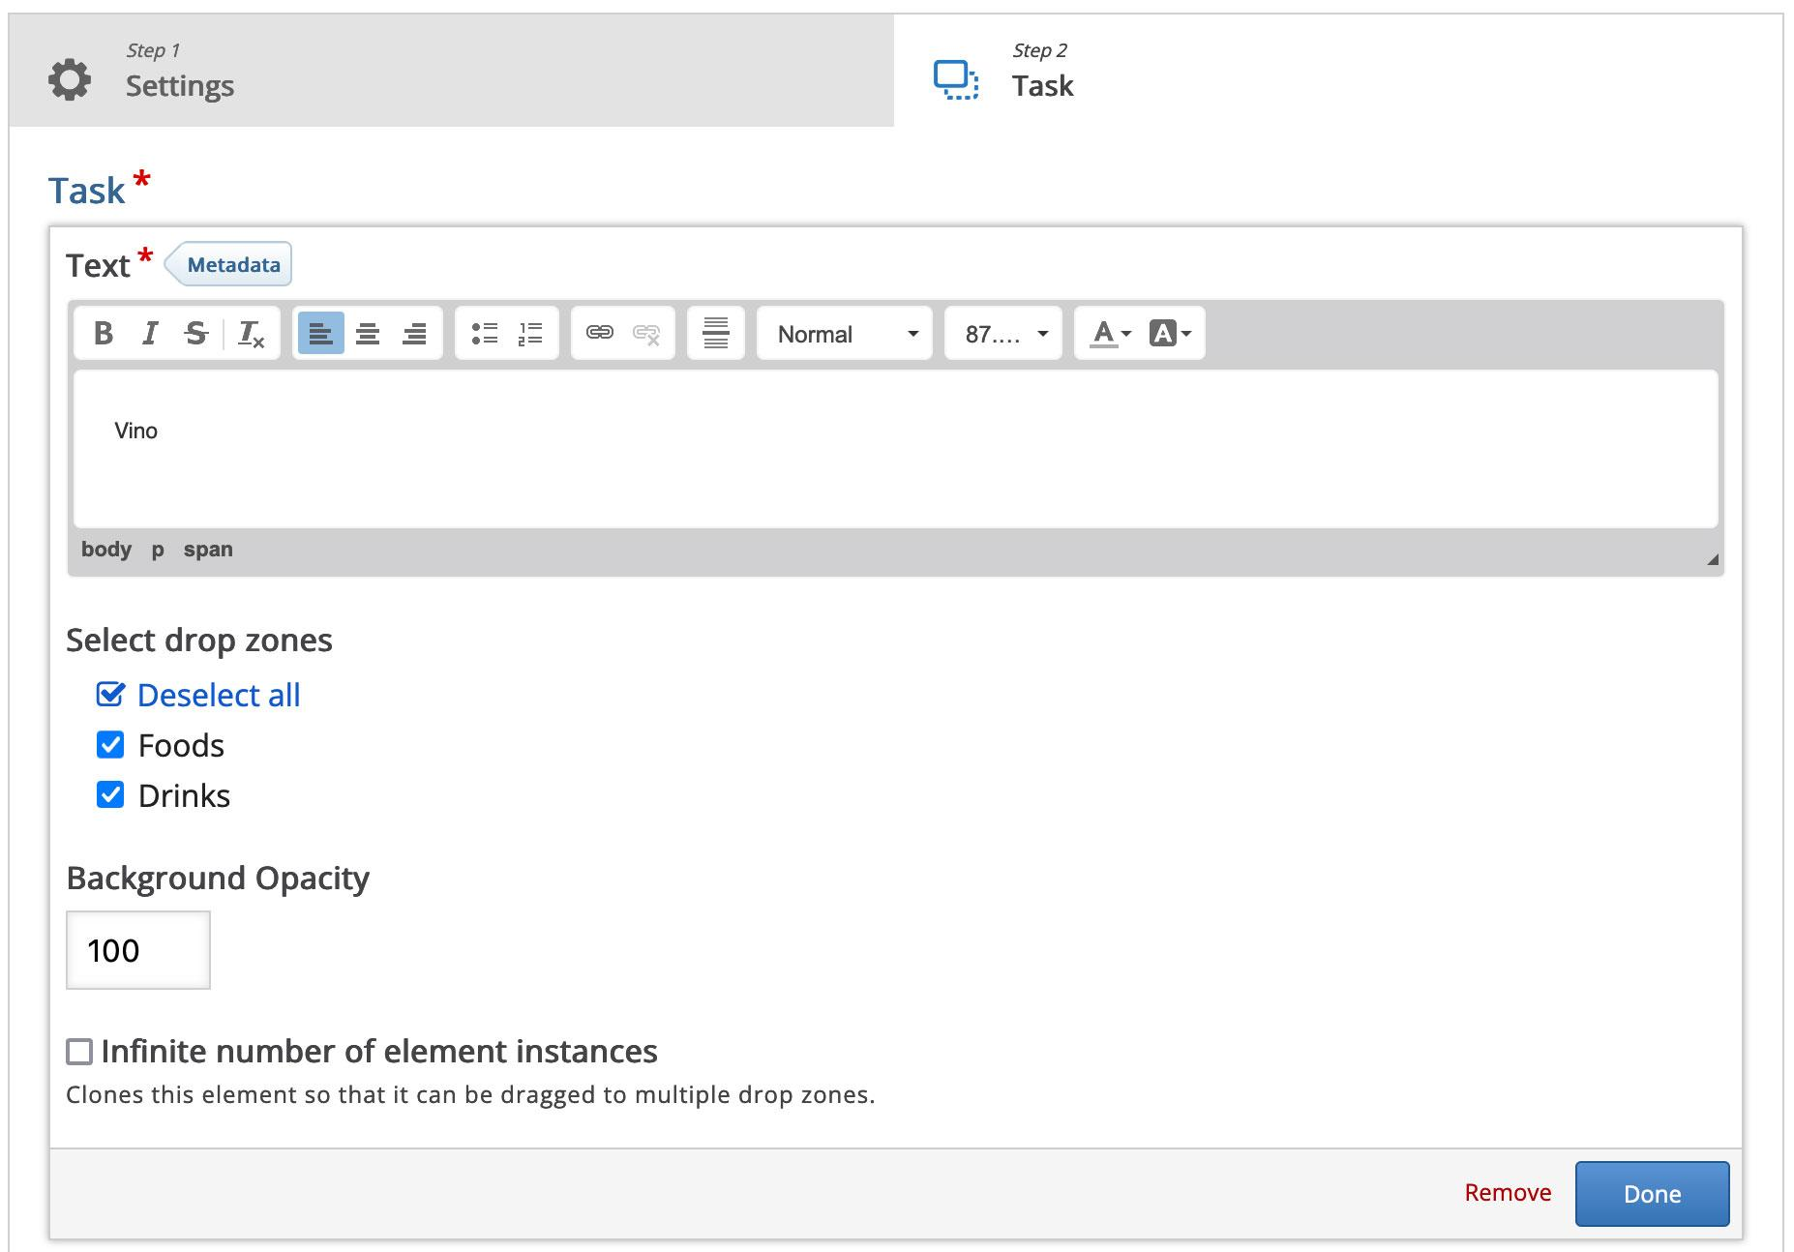

Slide 44
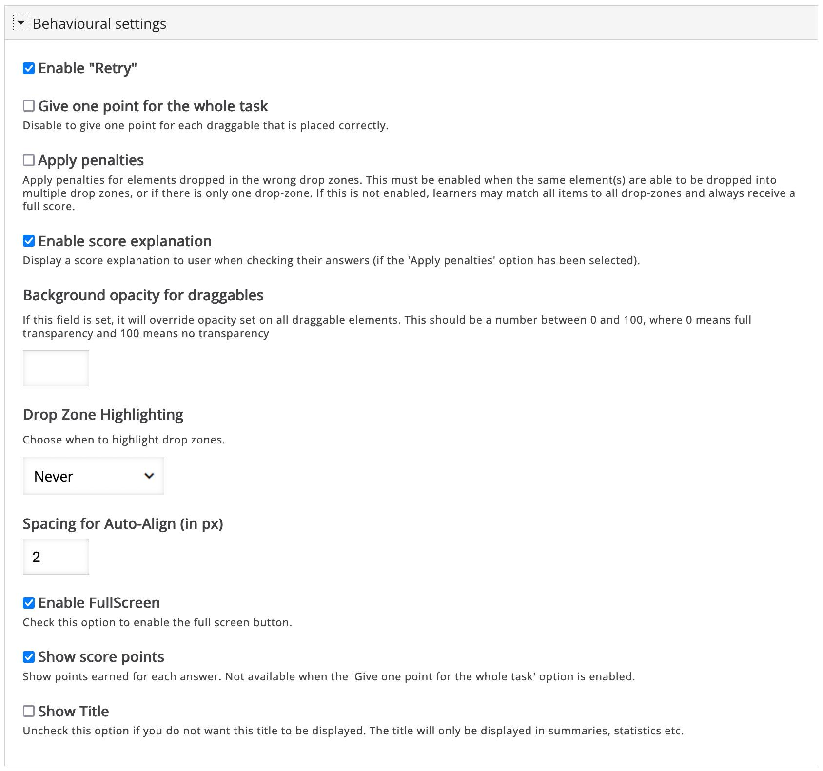

Slide 45
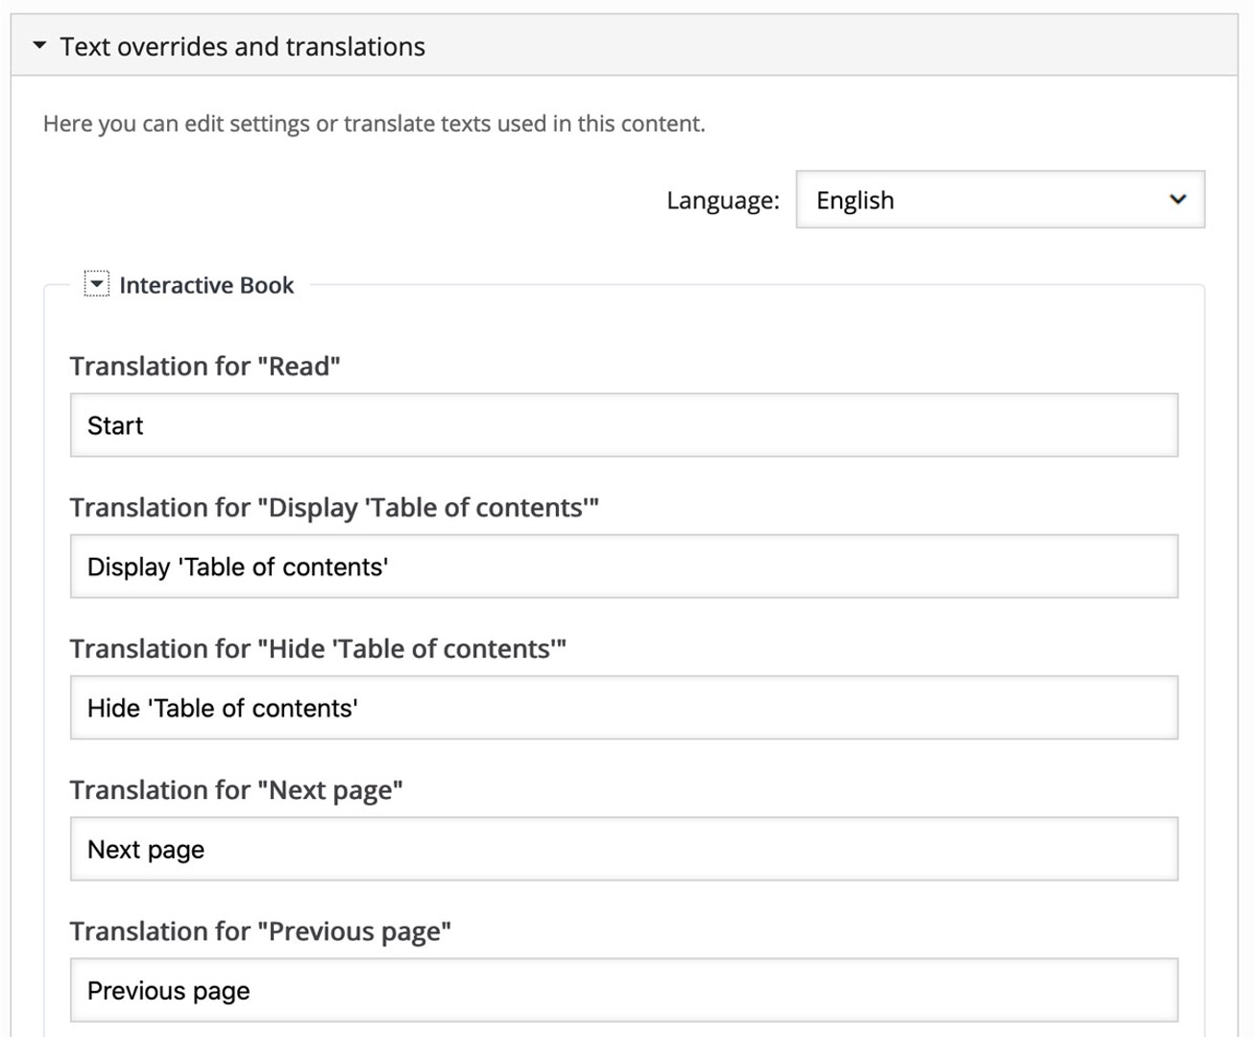

Slide 46
Notes:
Insights from Sara - including embedding versus activity and linking to content bank

Slide 47
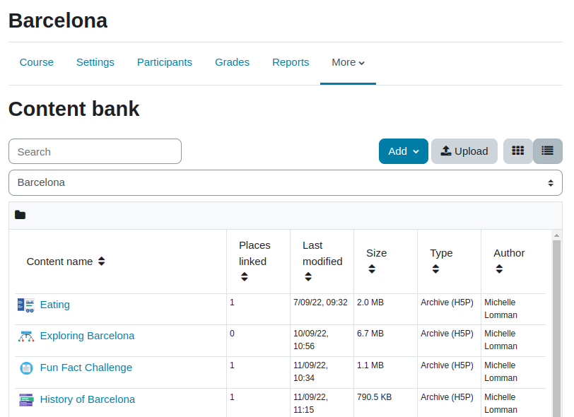
Notes:
Create content from the Content Bank (instead of from the activity)
Reuse content in different courses (easy to maintain)
Apart from the icons view, there is a list view with information about places linked and author.
It’s possible to switch to different CB using the course selector.
Content bank is not just for H5P. Content bank type plugins can be implemented. Currently, there is one in the plugins database created by Daniel Thies: https://moodle.org/plugins/contenttype_repurpose
Repurpose resources supports creating H5P from questions in the Moodle question bank and from Moodle repository files

Slide 48
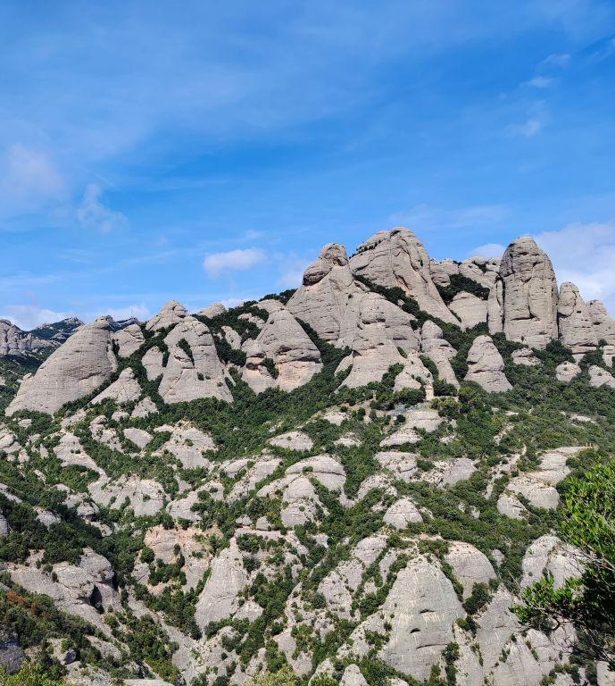
Activity
Embedding
vs
Notes:
However, some H5P content types might not support grading.

Slide 49
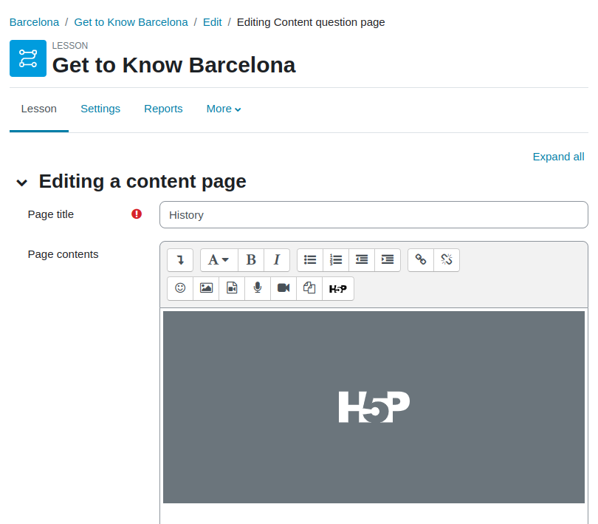

Slide 50
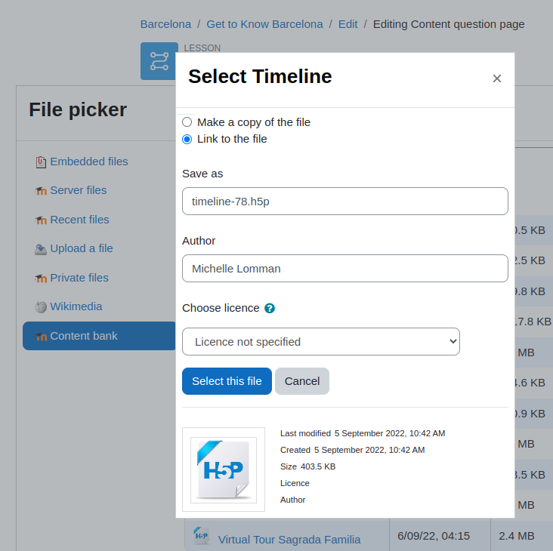
📢 Vote for MDL-31094 Missing support for external repo backup/restore
Notes:
Link to the file vs Make a copy of the file:
Link to the file automatically updates the content in all the linked places.
ATTENTION, there are issues with backup/restore in different Moodle sites (when using links).

Slide 51
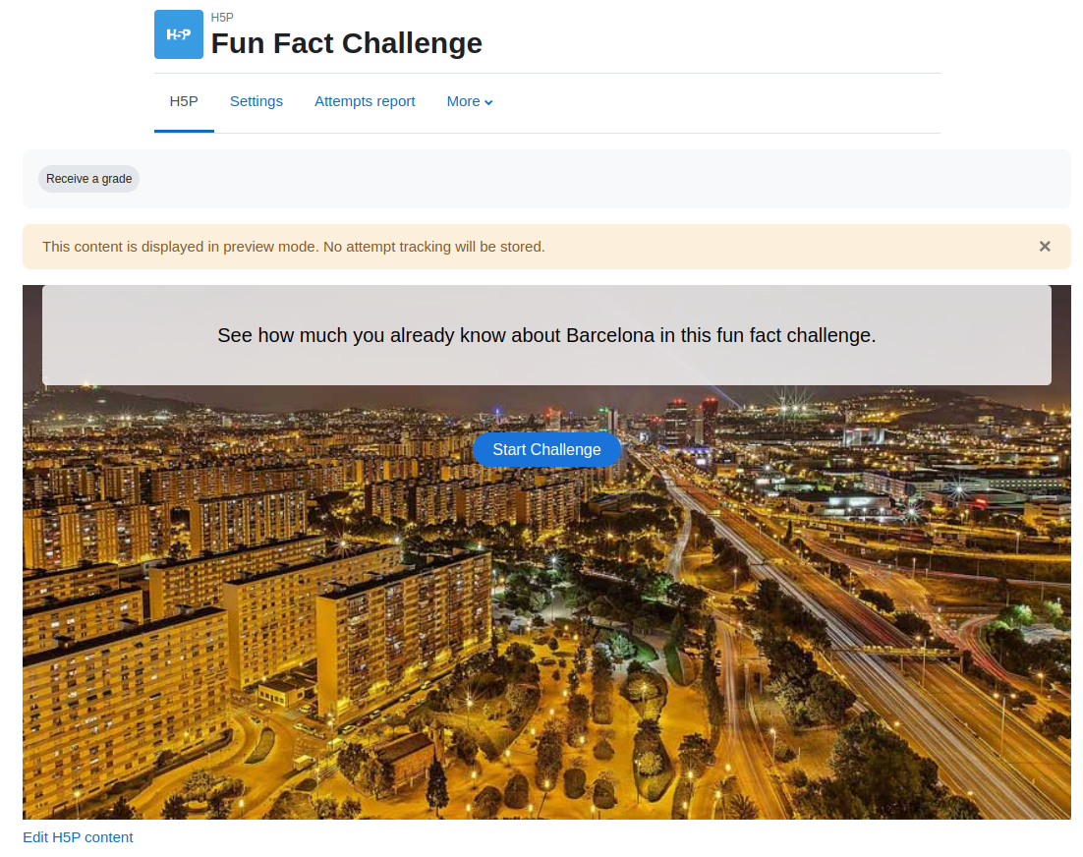
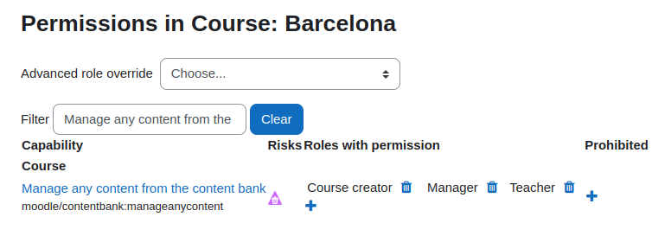
Notes:
Since Moodle 4.0, there is a direct link to the H5P editor (https://tracker.moodle.org/browse/MDL-71885 and https://tracker.moodle.org/browse/MDL-71956).
If there are more than content creators in a course, the recommendation is to add the “Teacher” role to the “Manage any content from the content bank” capability.

Slide 52
H5P content can be embedded everywhere
Better reporting and integration with gradebook
Content is created in a centralised place (content bank)
Easy to manage H5P content types
Migration tool
Integrated with the Moodle app
Missing features:
Students must complete activity to save the results (MDL-67789)
H5P hub integration (MDL-70925)

Slide 53
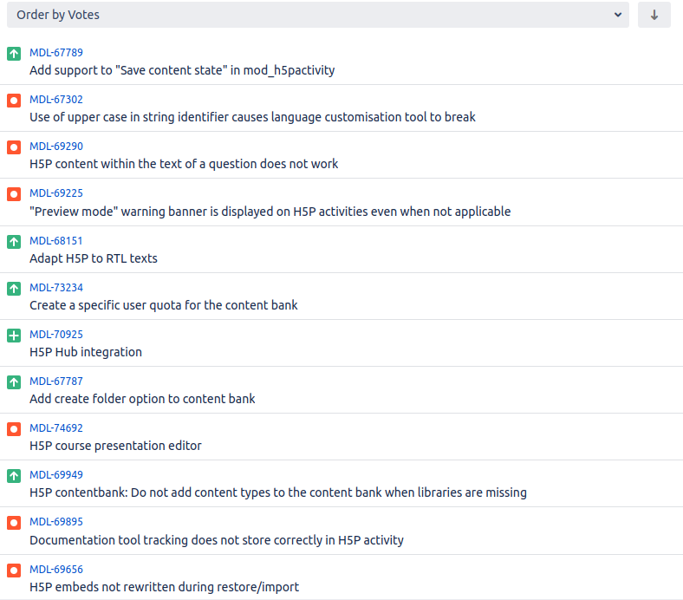
Notes:
Missing features: you can vote them, comment or work on them. It will help us to prioritise the next steps with H5P!

Slide 54
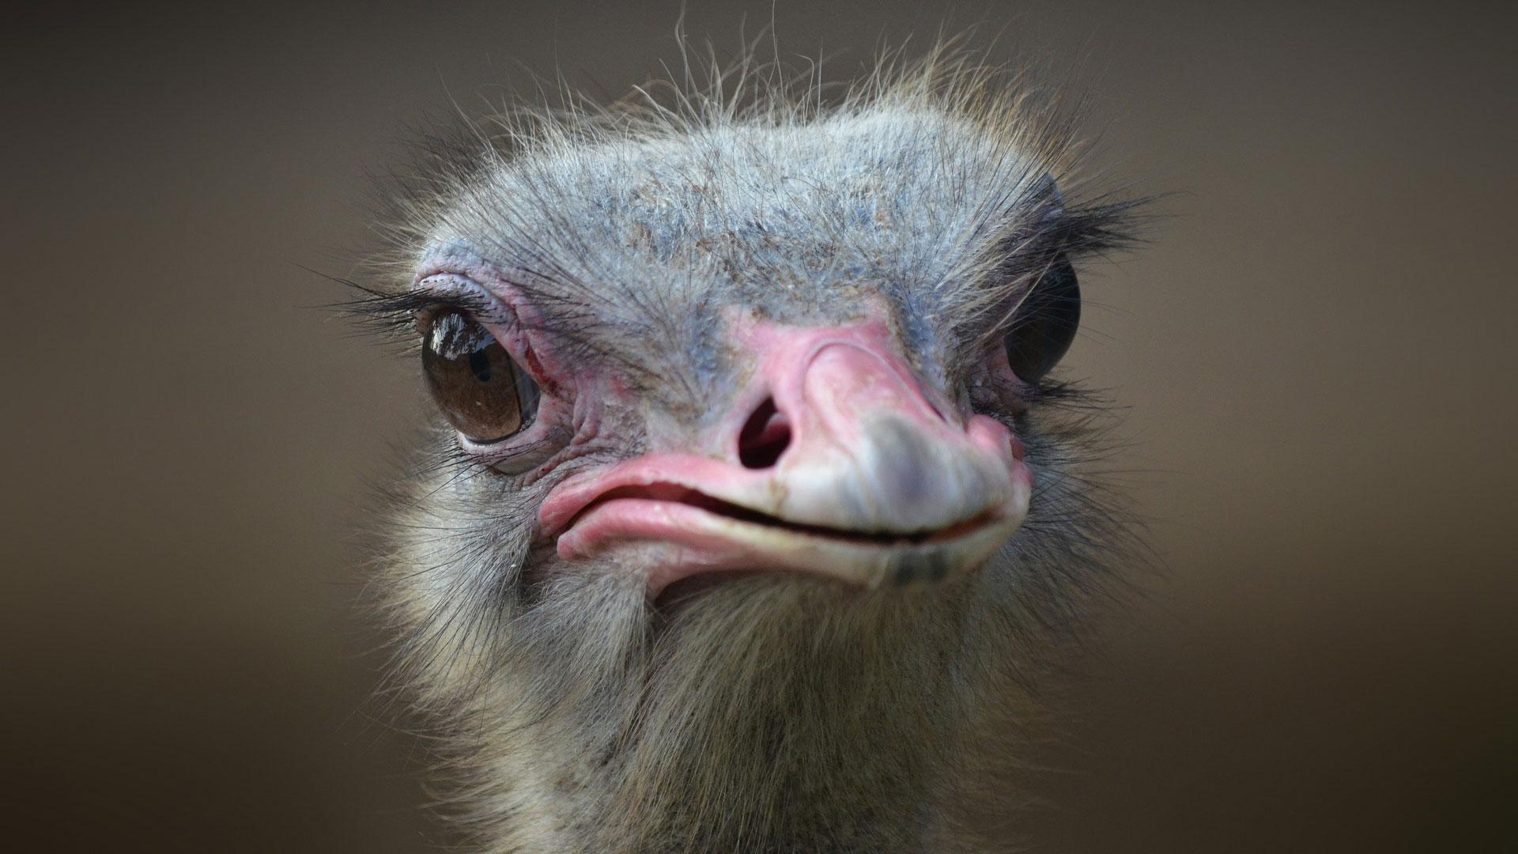
Questions ?
Notes:
Headline, image and dot points slide

Slide 55
Closing slide
Micky Lomman - @michellelomman
michellelomman@yahoo.com
Sara Arjona - @sara_arjona
sara@moodle.com

Slide 56
Questions ?
Thanks for your attention! 😘

Slide 57
Hent, si diciend esequi que vendisIs essincte cus, consequi con providem qui oditi
tem harum qui tem. Nam ut omnimus andiciam qui arum, odit re rest, eaqui doluptatem eiur
Image goes here

Slide 58
Image goes here
Hent, si diciend esequi que vendisIs essincte cus, consequi con providem qui oditi

Slide 59
Image goes here
Notes:
Headline, image and dot points slide

