Slide 1
Why behat and automated testing are so important? Learning the basics!
Sara Arjona & Pau Ferrer
Super devs

Slide 2
Why behat and automated testing are so important? Learning the basics!
Sara Arjona & Pau Ferrer
Super devs

Slide 3
What do you think about MANUAL testing?
😍 I love it!
🤮 I hate it!
🤷 I don’t care

Slide 4
What do you think about AUTOMATED testing?
😍 I love it!
🤮 I hate it!
🤷 I don’t care

Slide 5
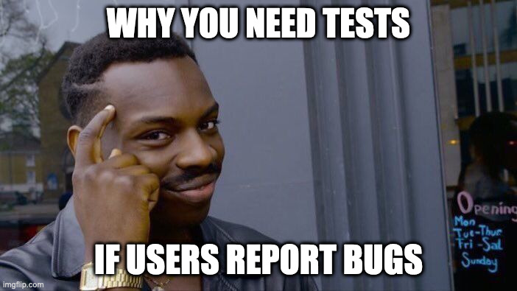
Notes:
Source: https://twitter.com/CodelyTV/status/1567120734350098436
More information about UDD: https://blog.inf.ed.ac.uk/sapm/2014/03/12/user-driven-development/

Slide 6
What is automated testing?
“Automated testing is the application of software tools to automate a human-driven manual process of reviewing and validating a software product”
Tests will prove that your code pass a defined quality threshold.
Notes:
All the scripts and processes that validates and review the code
Source: https://www.atlassian.com/continuous-delivery/software-testing/automated-testing

Slide 7
Benefits | Drawbacks
Manual testing is tedious and hence error-prone Early bug detection Few human resources Reliable in results Increases speed of test execution 24h x 7 days Same test on different versions Fix a bug with a test and it’s fixed forever | Write automate tests is tedious Failures limited to tested cases More machine resources Manual testing introduces randomness that can help to find bugs
Notes:
Benefits + which test cases automate: https://www.guru99.com/automation-testing.html

Slide 8
Misconceptions about automated testing
Automation is here to replace manual testers
The goal is to reduce the number of test cases to be run manually, not to eliminate manual testing altogether.
Everything under the sun can be automated
No application can be 100% tested.
Test cases to be automated:
Business critical (important scenarios)
Repeatedly executed
Difficult to perform manually
Time-consuming
Automation only involves recording and playback
There are no magical tools for creating automated tests from recordings.
Source: https://www.softwaretestinghelp.com/automation-testing-tutorial-2/
Notes:
Source: https://www.softwaretestinghelp.com/automation-testing-tutorial-2/

Slide 9
Testing challenges
Testing the complete application
Relationship between testers and developers
Regression testing
Lack of skilled testers
Testing always under time constraint
Which tests to execute first?
Understanding the requirements
One test team under multiple projects
Notes:
Source: https://www.softwaretestinghelp.com/manual-and-automation-testing-challenges/
#1) Testing the Complete Application
Is that possible? That’s indeed impossible. There are millions of test combinations.
It is not possible to test each and every combination in both Manual as well as Automation Testing. If you try all these combinations you will never ship the product :-)
#2) Relationship with Developers
It’s indeed a big challenge. It requires a very skilled tester to handle this relationship positively and even by completing the work in a tester’s way.
There are simply hundreds of excuses that the developers or testers can make when they do not agree with some points. For this, the tester also requires Good Communication, Troubleshooting and analyzing skills.
#3) Regression Testing
If a project continues to expand, then regression testing work simply becomes uncontrolled. There will be pressure to handle current functionality changes, previous working functionality checks, and bug tracking.
#4) Lack of Skilled Testers
This could be called as a “wrong management decision” while selecting or training testers for their project task in hand.
These unskilled fellows may add more chaos than simplifying the testing work. This results in incomplete, insufficient and ad-hoc testing throughout the Testing Life Cycle.
#5) Testing always under Time Constraint
Hey tester, we want to ship this product by this weekend, are you ready for completion?
When this order is from the boss, the tester simply focuses on task completion and not on the test coverage and quality of work. There is a huge list of tasks that you need to complete within the specified time. This includes writing, executing, automating and reviewing test cases.
#6) Which Tests to Execute First?
If you are facing the challenge stated in point no 6, then how will you decide which test cases should be executed and with what priority? Which tests are more important than others? This requires a good experience to work under pressure.
#7) Understanding the Requirements
Sometimes testers are responsible for communicating with customers to understand the requirements.
What if the tester fails to understand the requirements? Will he be able to test the application properly? Definitely not! Testers require good listening and understanding capabilities.
#8) One Test Team under Multiple Projects
It is quite challenging to keep track of each task. Communication challenges are also involved. Many times, it results in failure of one or both the projects.

Slide 10
Types of automated testing
Code standardization checks I.e. Code linting | These are not tests but will check the code is correctly written
Unit testing / API testing Tools: PHPUnit, JEST | Methods do what they say
Acceptance / Behaviour testing Tools: Cucumber, Fitnesse | Features behave as they say
User experience testing: difficult to automate | Users can do what they want

Slide 11
Code standardization checks
Types of automated testing checks
Moodle LMS
Coding style
CiBoT (cime label)
PHP CodeSniffer
Moodle App
Language checks
ESLint: JS Linter
JS code compatibility (Android 5, iOS 11, Chrome 61)
Build the app to find compilation errors

Slide 12
Unit testing
Types of automated testing
Unit & Integration tests
Run without a browser
They are fast!
Good for TDD
Frameworks:
PHP → PHPUnit
JavaScript → Jest

Slide 13
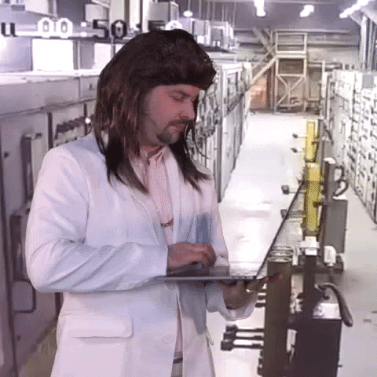
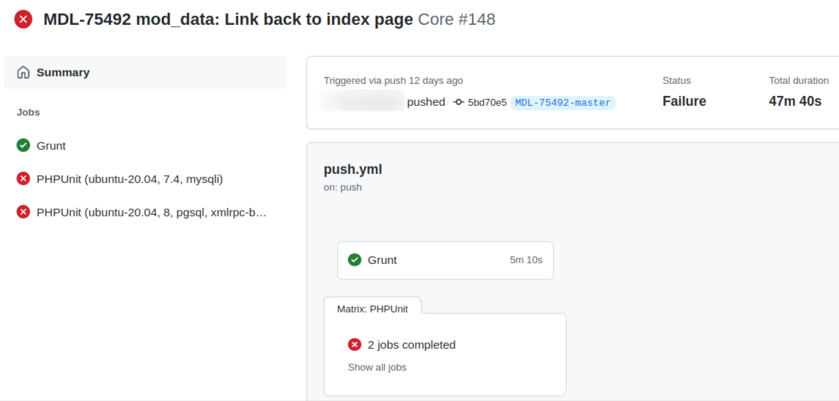
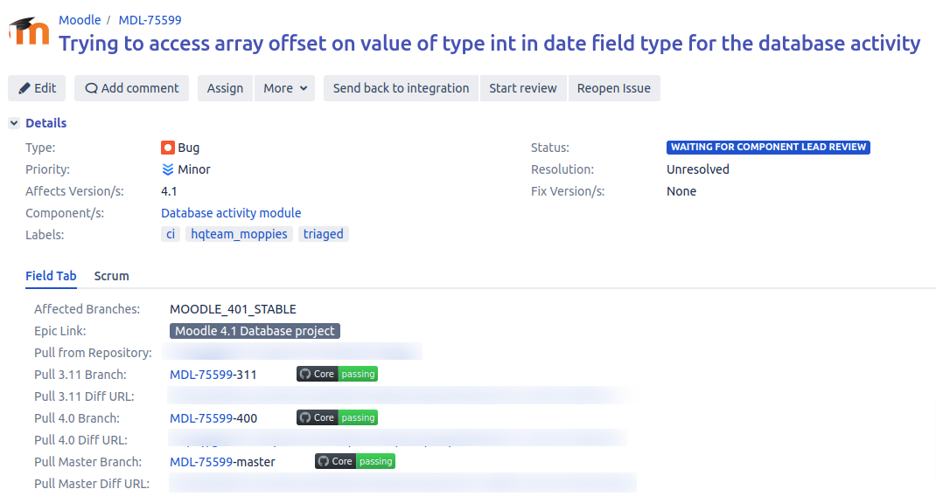
Unit testing · PHPUnit
Types of automated testing
Best practices:
Set the @covers (and @coversDefaultClass) annotation
Use @group annotation to run just the tests for your plugin
Keep use of resetAfterTest() to a minimum (avoid using it in setUp() and tearDown())
Make use of the dataProvider functionality
Integrated with GitHub Actions
More information: https://moodledev.io/general/development/tools/phpunit

Slide 14
Unit testing · PHPUnit (example)
Types of automated testing
/**
* Data provider for test_is_directory_a_preset().
*
* @return array
*/
public function is_directory_a_preset_provider(): array {
global $CFG;
return [
'Valid preset directory' => [
'directory' => $CFG->dirroot . '/mod/data/preset/imagegallery',
'expected' => true,
],
'Invalid preset directory' => [
'directory' => $CFG->dirroot . '/mod/data/field/checkbox',
'expected' => false,
],
'Unexisting preset directory' => [
'directory' => $CFG->dirroot . 'unexistingdirectory',
'expected' => false,
],
];
}
/**
* Test for is_directory_a_preset().
*
* @dataProvider is_directory_a_preset_provider
* @covers ::is_directory_a_preset
* @param string $directory
* @param bool $expected
*/
public function test_is_directory_a_preset(string $directory, bool $expected): void {
$this->resetAfterTest();
$this->setAdminUser();
$result = preset::is_directory_a_preset($directory);
$this->assertEquals($expected, $result);
}

Slide 15
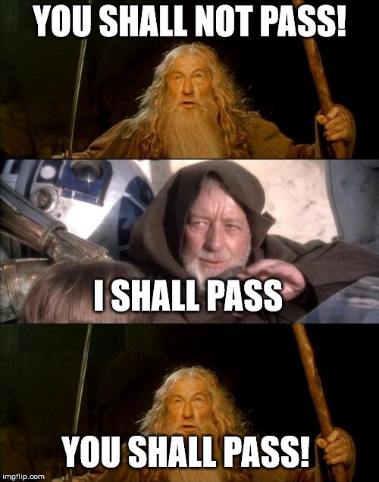
Unit testing · Jest
Types of automated testing
Installed as NPM dependency
Issue MOBILE-4069 to add more tests.
Integrated with GitHub Actions
More information: https://moodledev.io/general/app/development/testing/unit-testing

Slide 16
Behaviour testing · Basic Concepts
Types of automated testing
Behaviour-Driven Development (BDD): Test-driven development (TDD) based on behavioural definitions.
Tests are written in a customer friendly language.
Cucumber: Software tool to automate BDD.
Gherkin: Language that Cucumber uses to define test cases.
Behat: “A PHP framework for auto testing your business expectations.” Cucumber for PHP.
Mink: Library to control browser (ie Goutte, Selenium, Sahi…).
More information: https://moodledev.io/general/development/tools/behat
Notes:
Slide 21 of https://www.slideshare.net/VladimirArutin/bdd-cucumber-238389348

Slide 17
Gherkin · Syntax
Types of automated testing
A feature is a use case that describes a specific function of the software.
A single scenario is a flow of steps (not a manual testing script) that describe an specific scenario.
Type of steps:
Given - Describes the preconditions and initial state.
When - Describes actions taken by a user during a test
Then - Describes the outcome resulting from actions taken in the When clause
Source: https://en.wikipedia.org/wiki/Cucumber_(software)#Gherkin_language

Slide 18
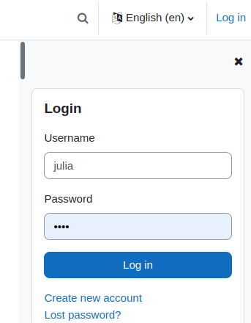
Gherkin · Example
Types of automated testing
Natural language
Feature: Login from the “Login block”
A user with an account should be able to login through the Login block.
Scenario: Júlia wants to login as student using the block
Given Júlia has a valid user account
And the “Login block” is added to the homepage
When she inserts her username and password in the Login block
Then she should be logged in
Gherkin (behat)
@block @block_login
Feature: Login from the “Login block”
In order to make it easier to login
As an user
In need to login through a block
Scenario: Login as student through login block
Given the following "users" exist:
| username | password | firstname | lastname | email |
| julia | tstpwd | Júlia | User | julia@example.com |
And I log in as "admin"
And I am on site homepage
And I turn editing mode on
And I add the "Login" block
And I log out
When I set the field "Username" to "julia"
And I set the field "Password" to "tstpwd"
And I click on "Log in" "button" in the "Login" "block"
Then I should see "You are logged in as Júlia User"
And "Login" "block" should not exist

Slide 19
Who writes tests?
The Three amigos
BUSINESS ANALYST OR
PRODUCT OWNER
Defines scope
Translate user stories into features
Notes:
https://cucumber.io/blog/bdd/who-should-actually-write-bdd-scenarios/

Slide 20
Who writes tests?
The Three amigos
DEVELOPER
Add steps to scenarios
Think about how it works

Slide 21
Who writes tests?
The Three amigos
TESTER
Generate scenarios
Think edge cases
Break the application

Slide 22
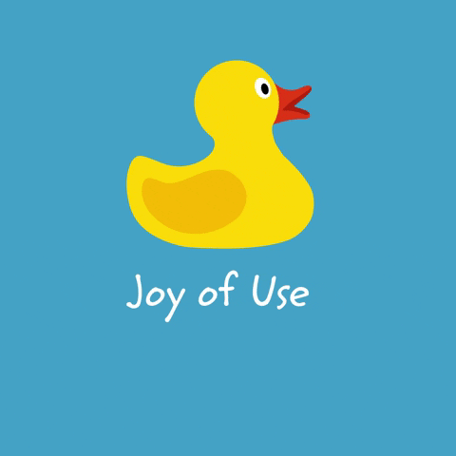
Usability testing
Types of automated testing
Research to find improvements, not bugs.
UX Researcher in Product Experience team.
How to participate?
Subscribe to the forum in https://moodle.org/ux
Visit the Product bar and contact to any of the UX members in the Moot:
Database activity project - Sabina
Moodle App - Edu

Slide 23
Quality Assurance (QA)
testing
Dedicated team in Moodle for manual testing:
Weekly testing, for integrated issues
Release QA cycle → The community also participates in!
Get involved!
https://moodledev.io/general/development/process/testing/qa
Notes:
Promote next QA cycle: dates, how it works…
https://moodledev.io/general/development/process/testing/qa

Slide 24
Add a QA team to your life
Functional / Manual QA
Analyse, writes tests to detect usability, performance and issues
Exploratory tests
Executes manual tests
Multiplatform/browser coherence
Creates a report and a list of improvements
Non functional / Automation QA
Write Test plan: What to test, How (tools) and when
Run tests: regression, performance…
Sets a priority for automation scenarios
Write documentation on selected tests and tools

Slide 25
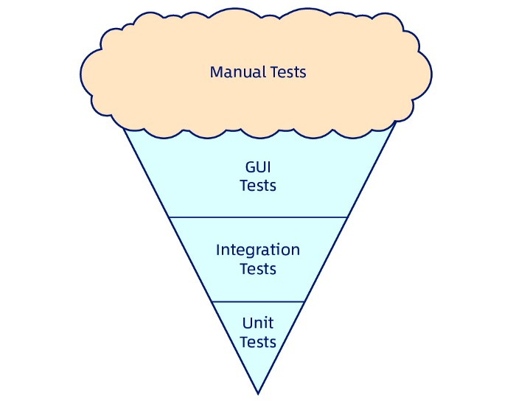
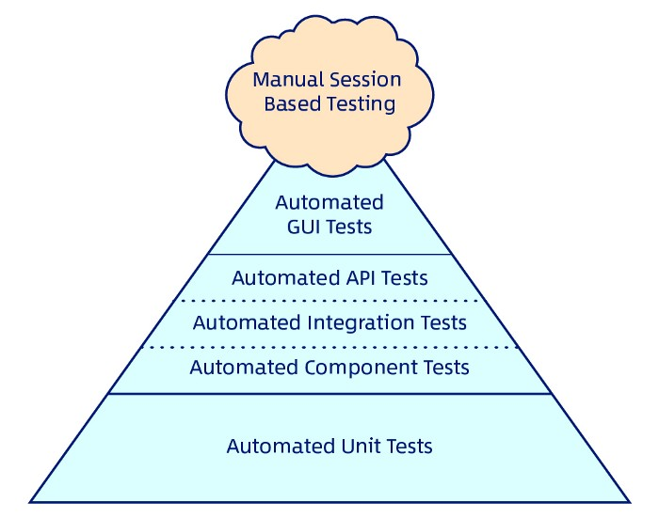
Invert the pyramid
Notes:
https://blog.reactiveconf.com/tdd-waste-of-time-7bf5a84ce9b6

Slide 26
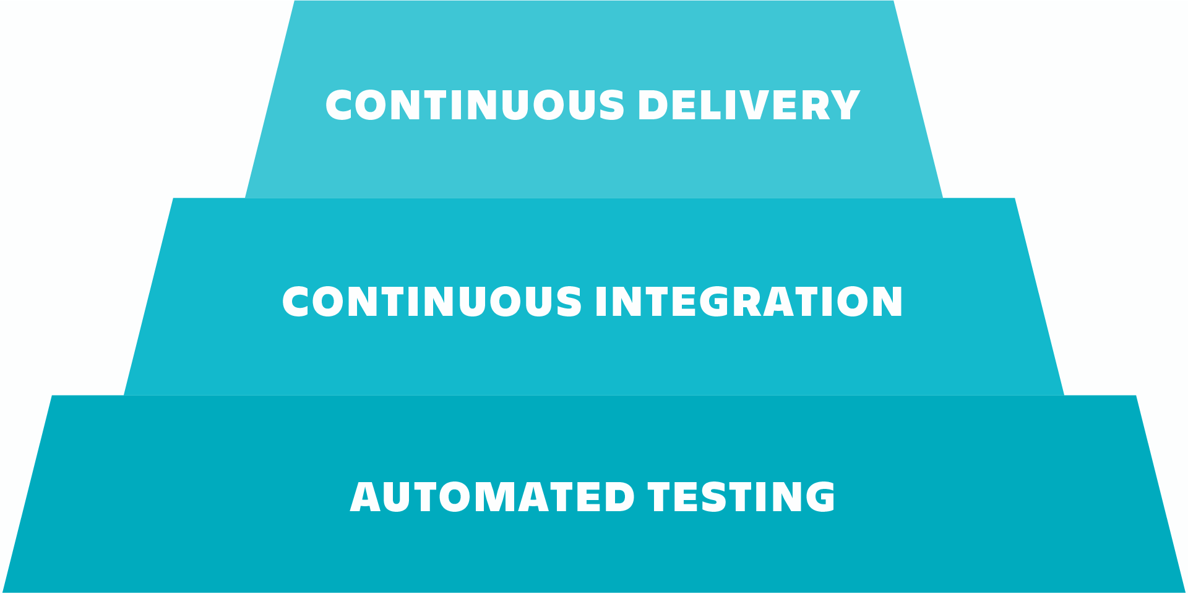
Continuous Integration
Run tests on every integration
Github actions
Cibot
Jenkins
Automated testing ensures quality at every stage of development by ensuring changes do not introduce any issues, so the software remains deployment ready at all times.

Slide 27
Our testing
Moodle LMS | Moodle App
CiBoT + Github Actions + Jenkins | Github Actions + Travis (builds)
Unit tests - PHPUnit Behaviour Tests - Behat QA Manual Cycle | Unit tests - Jest Behaviour Tests - Behat. Adapted for the App QA Manual Cycle
Notes:
Summary

Slide 28
📢 Tomorrow more with Davo!!

Slide 29
Pau & Sara series… What’s next?
Notes:
Headline, image and dot points slide

Slide 30
Questions ?
Thanks for your attention! 😘

Slide 31
Closing slide
Pau Ferrer - @crazyserver
pau@moodle.com
Sara Arjona - @sara_arjona
sara@moodle.com

