Slide 1
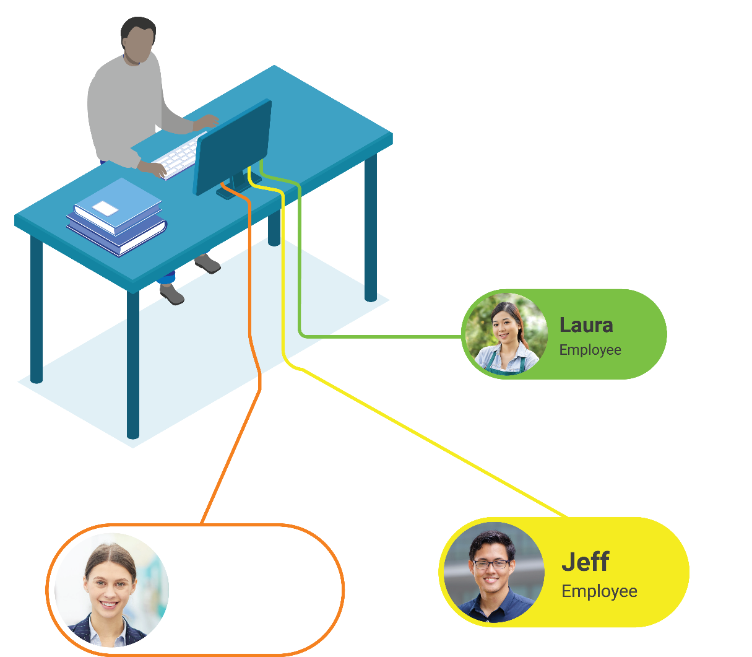


Introducing
Moodle Workplace 4
Presented by Emilio Lozano
Head of Workplace Solutions
#mootglobal22

Slide 2











Kudos to the Workplace team!

Slide 3














Multi-tenancy
Dynamic Rules
Organisation Structure
Moodle Workplace is a flexible enterprise learning management platform that streamlines employee learning, onboarding, and compliance training.
Programs
Certifications
Certificates
moodle.com/workplace4
Custom Pages
Appointments Booking
Migration
Available through

Slide 4


Contribution to
open source Moodle LMS
Moodle Workplace helps improve Moodle LMS in two ways: by contributing to the whole platform’s sustainability and also by rolling our features into Moodle LMS from time to time.

Slide 5
Moodle Workplace 4

Slide 6
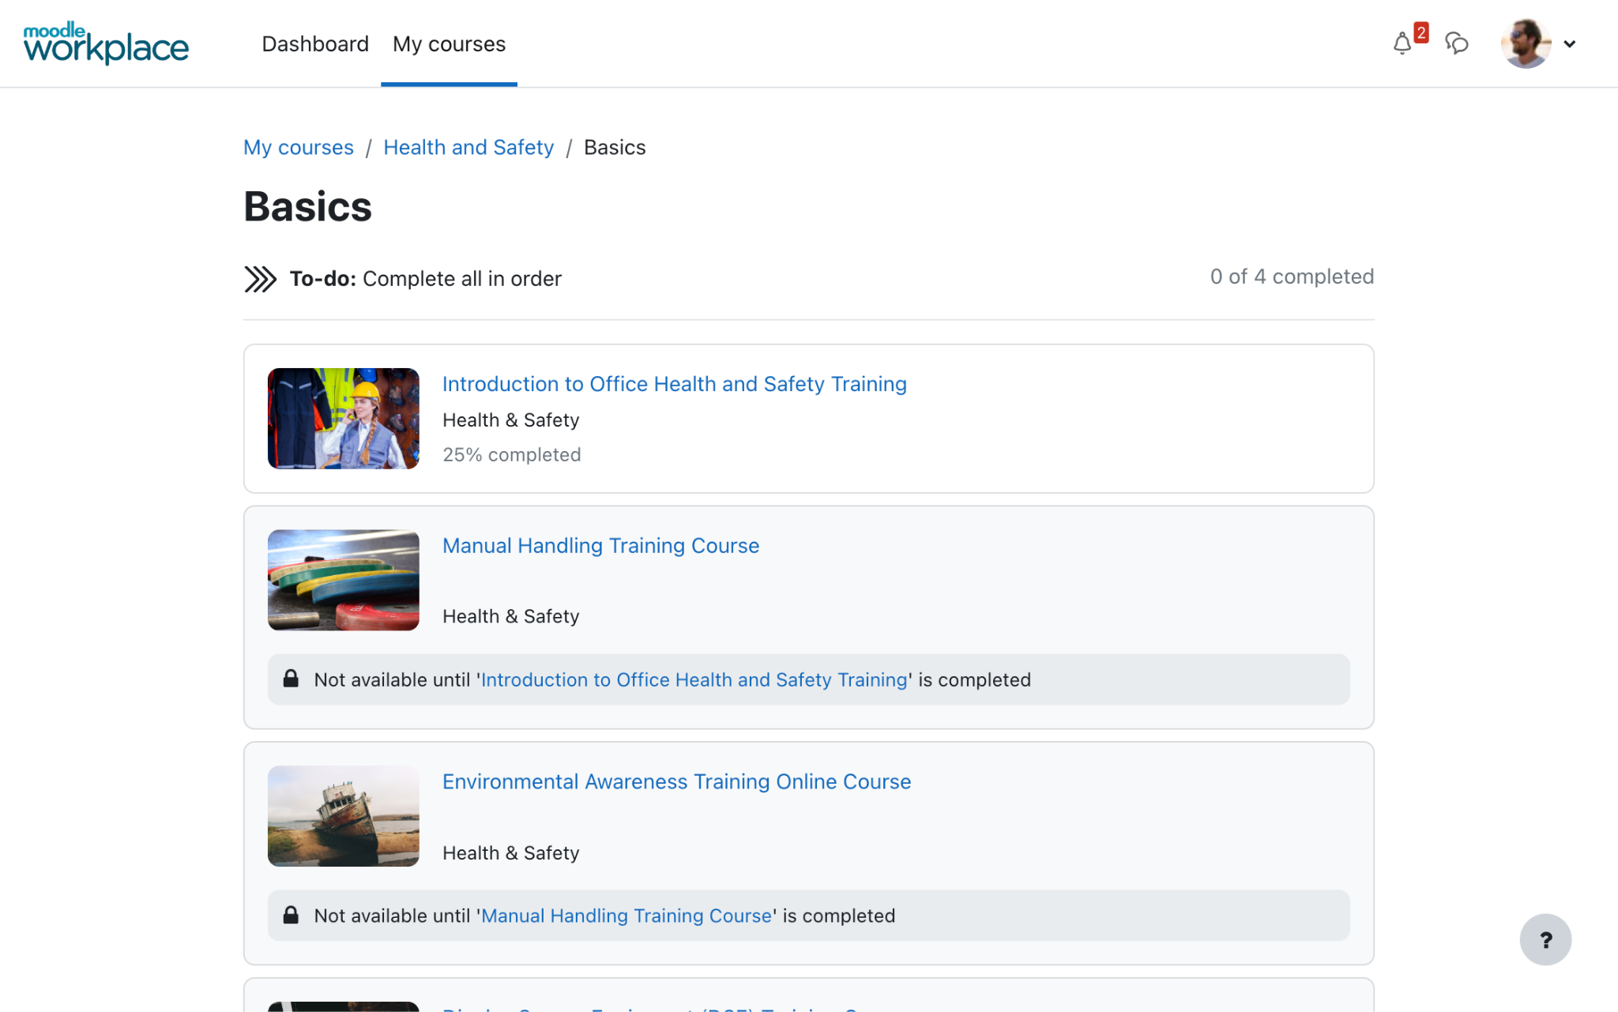
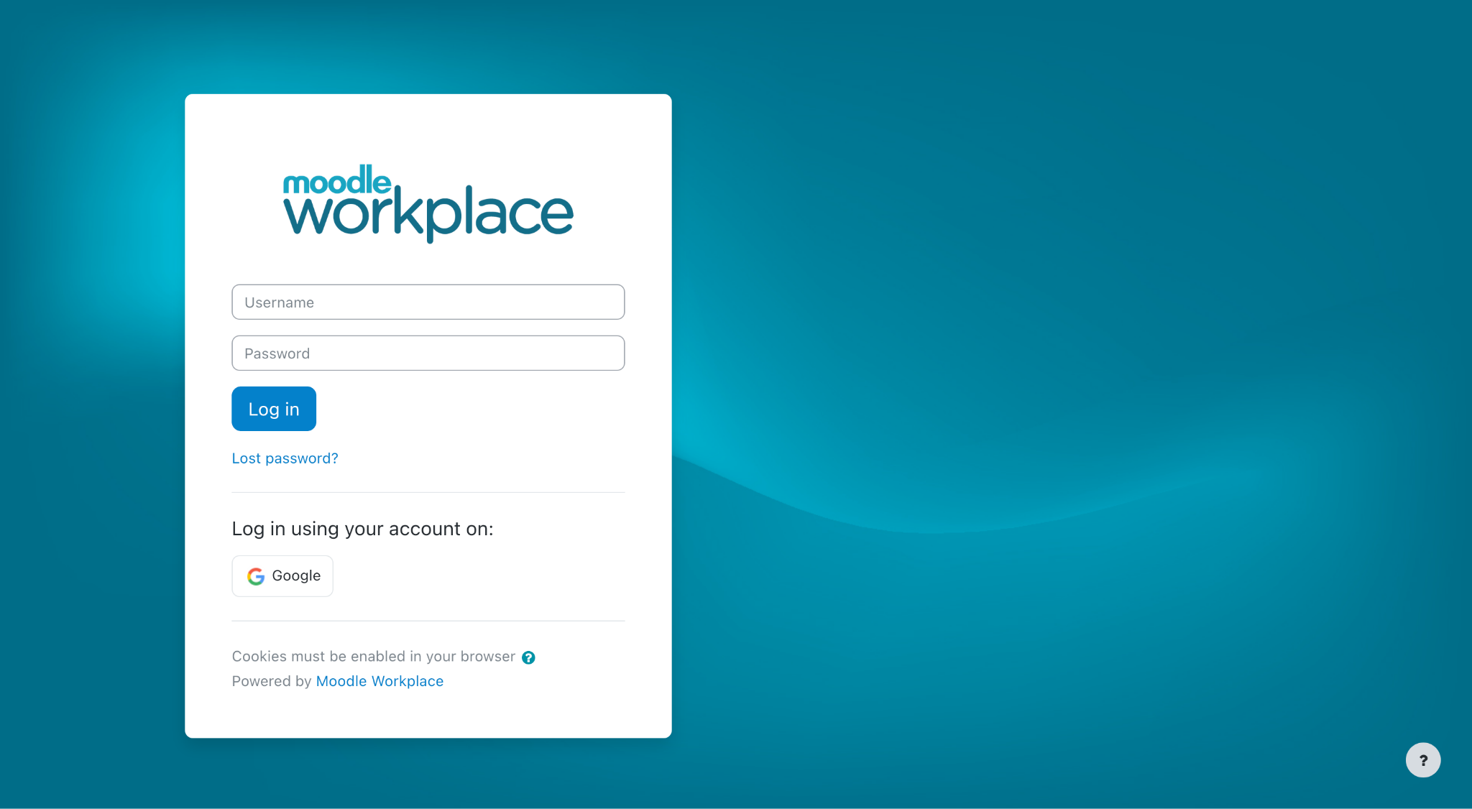
Fresh and intuitive interface and navigation
Moodle Workplace 4.0 is fresh and intuitive in line with Moodle LMS 4.0
Access to the most commonly used items is simplified through tabbed navigation and consistent sitewide

Slide 7
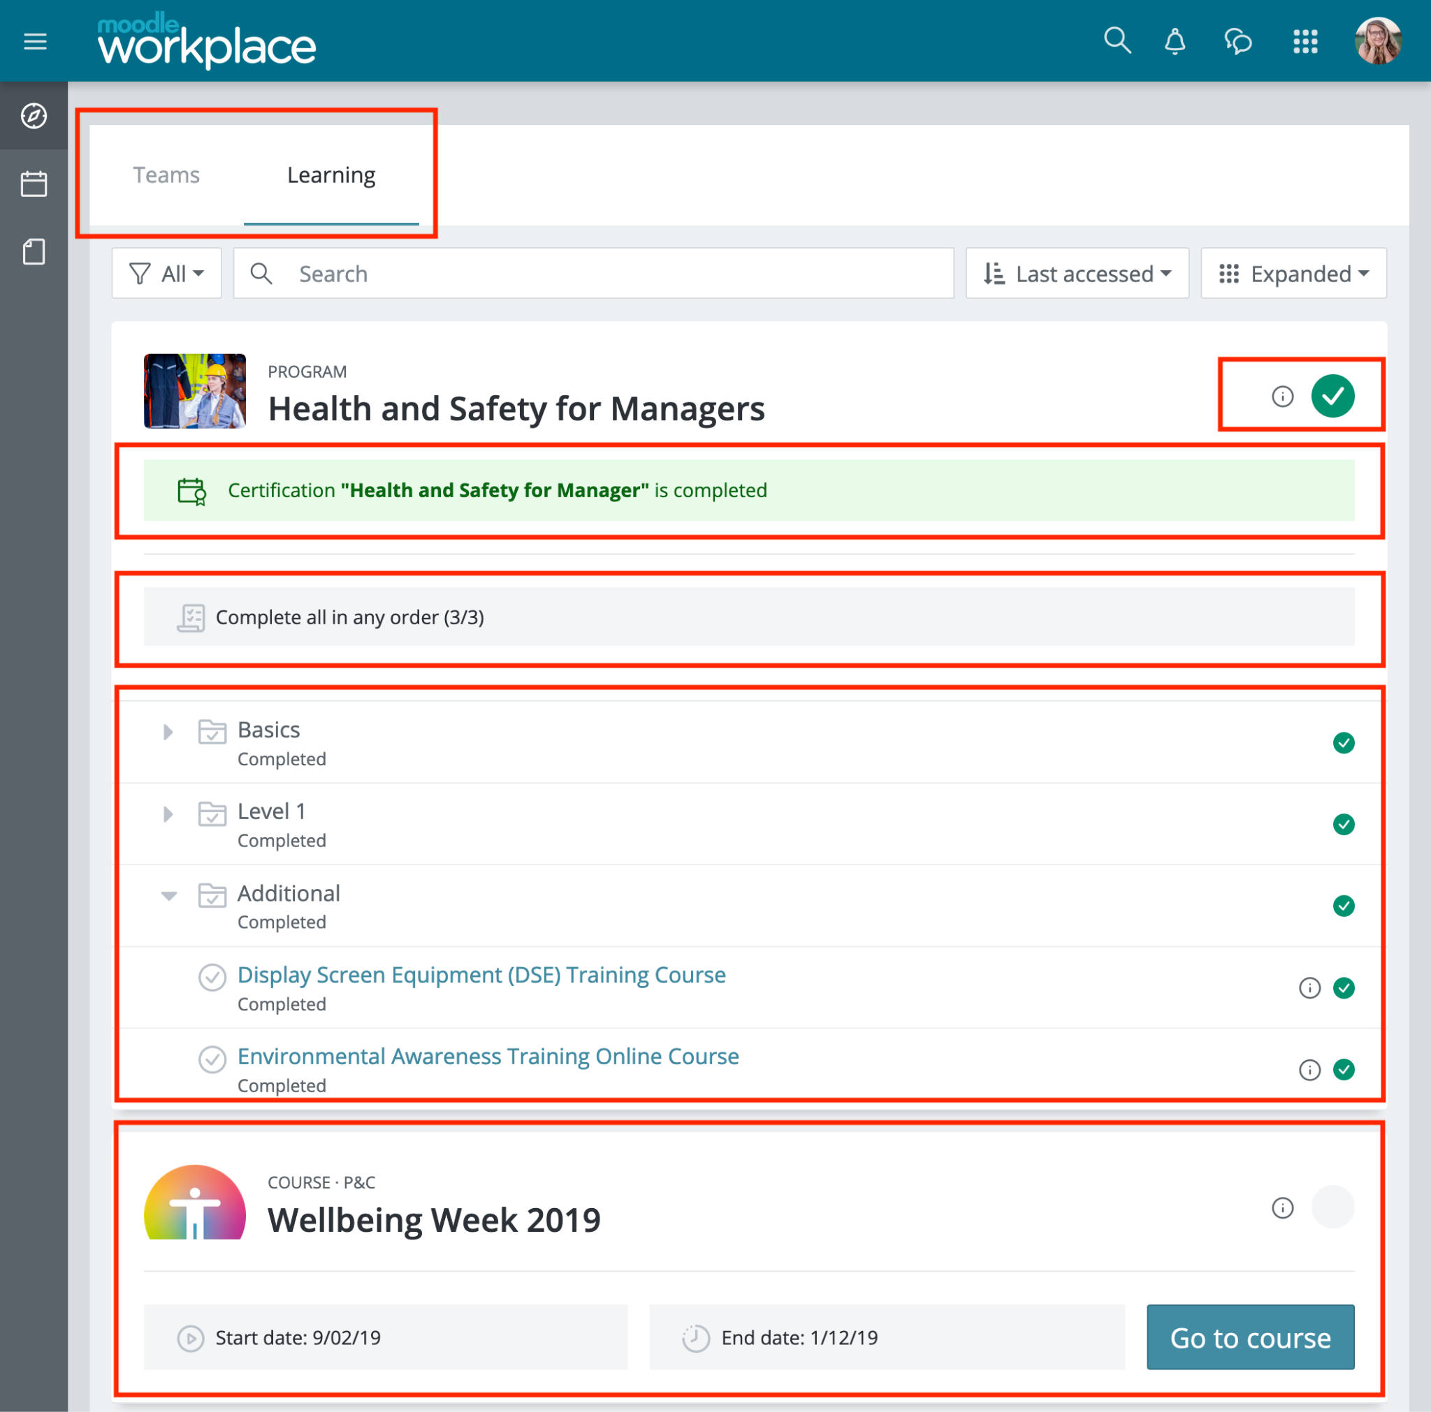
A journey through dashboard design
Workplace 3.11 dashboard, the starting point

Slide 8
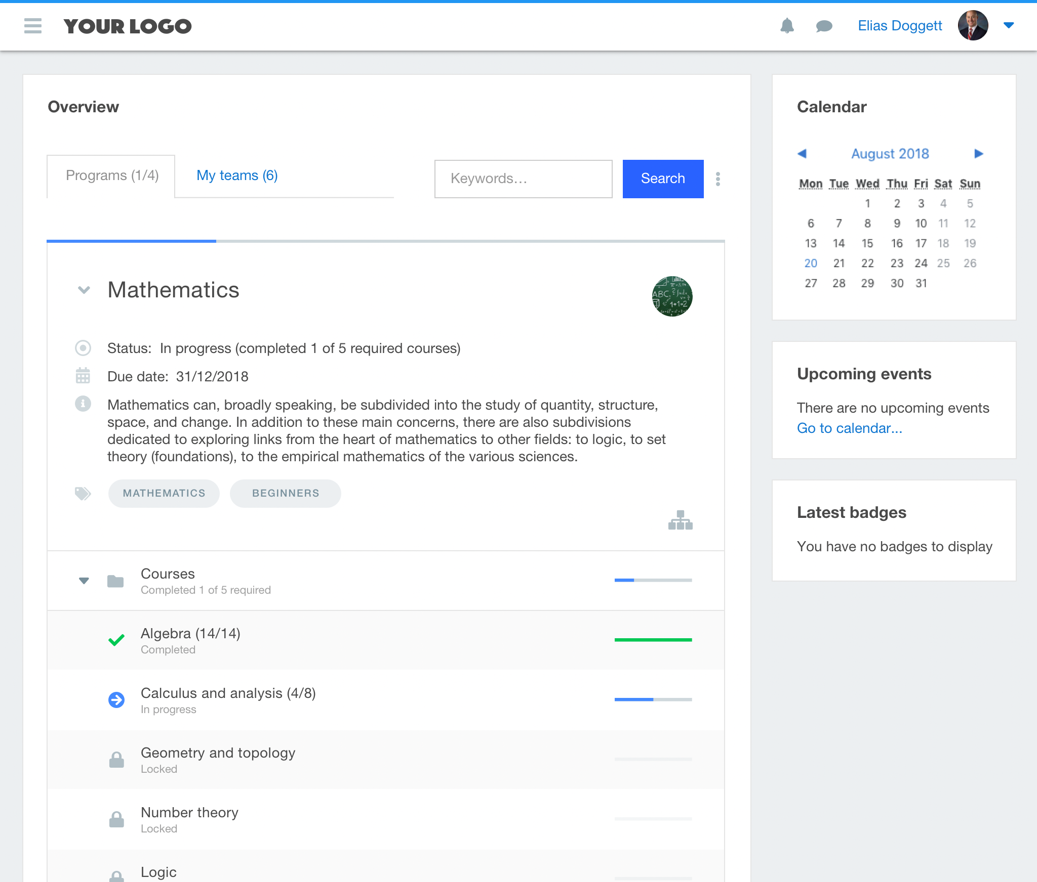
A journey through dashboard design
One of the first Workplace 4 prototypes

Slide 9
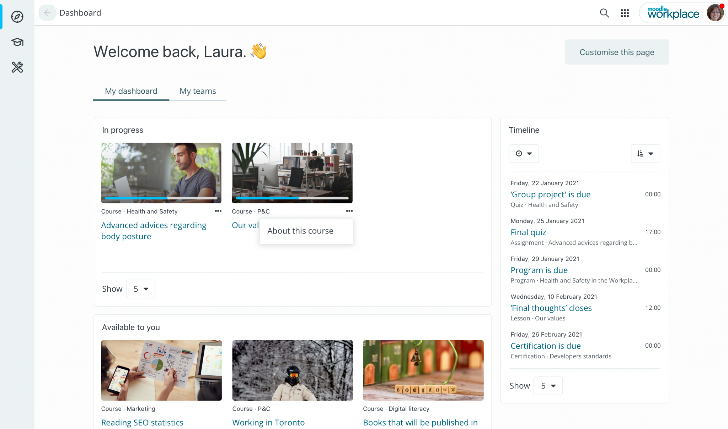
A journey through dashboard design
This is when it started to become less busy

Slide 10
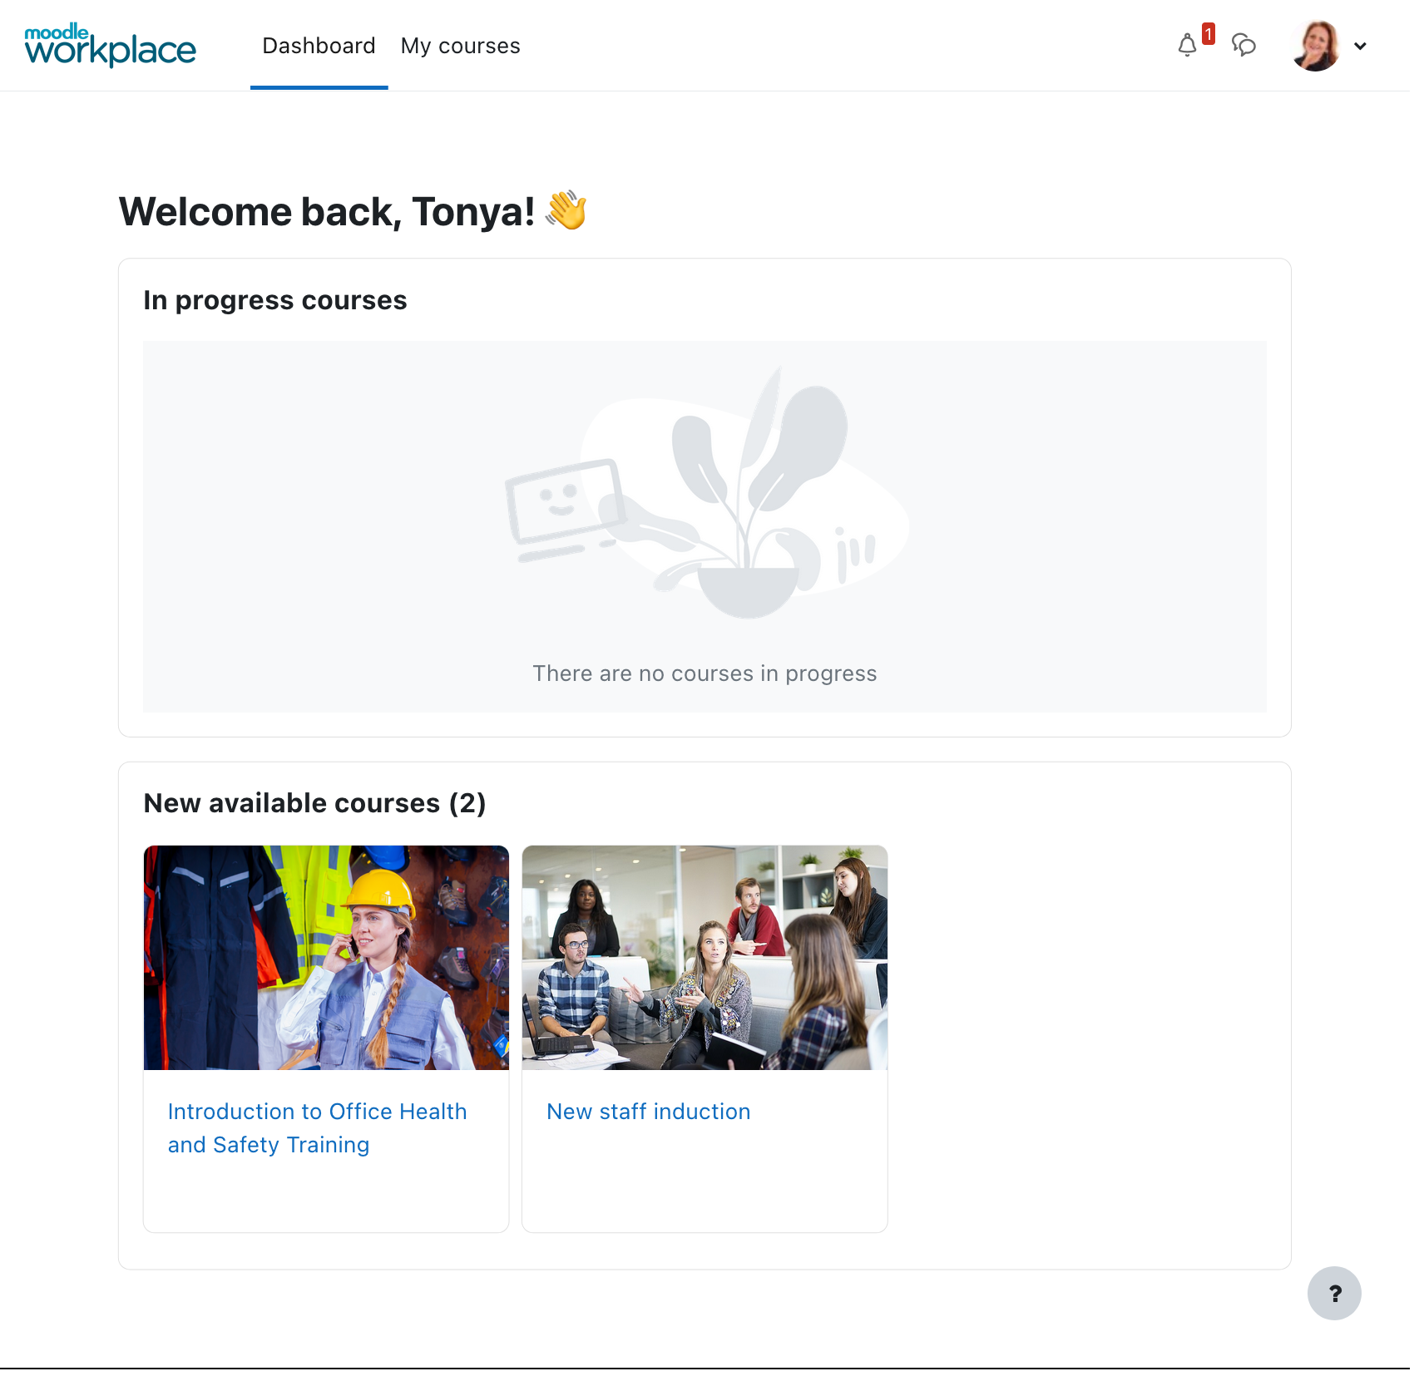
A journey through dashboard design
Final version

Slide 11
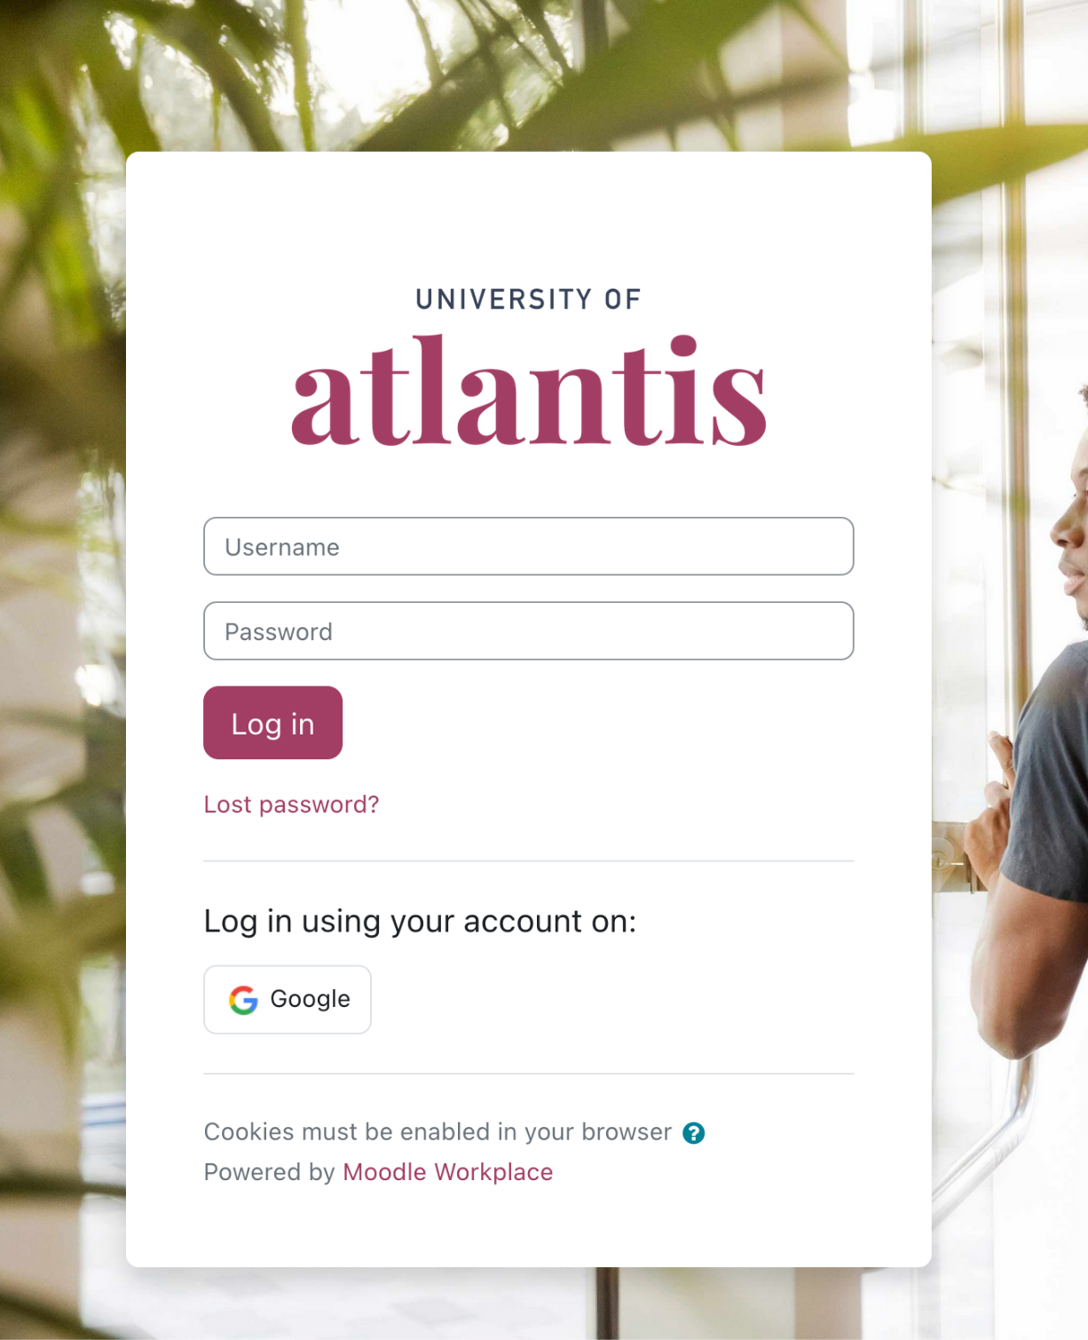
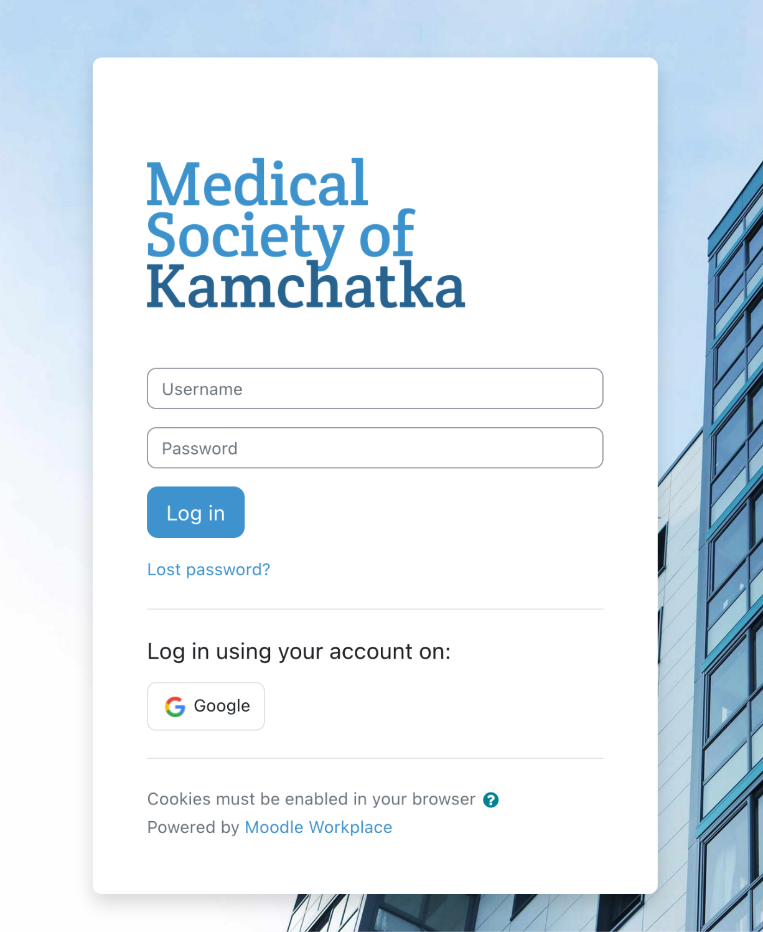
Streamlined
login page
From the first sign-in, the Moodle Workplace new design language is established through spacing, images, graphics, and colours
Fully multi-tenant support, including authentication

Slide 12
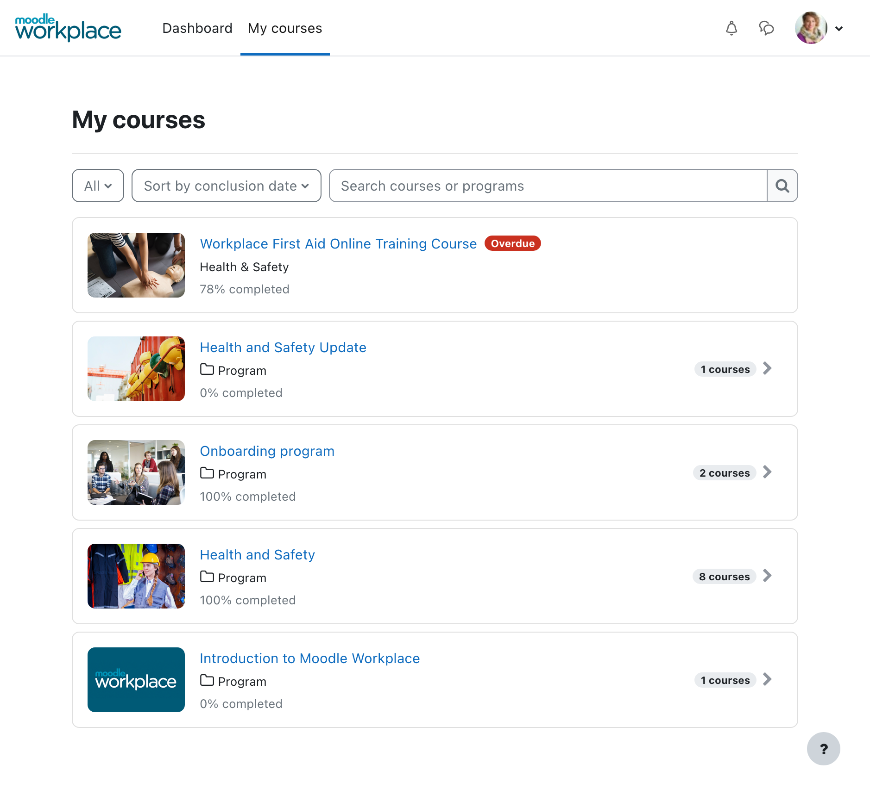
My Courses
page
Revamped My Courses page that summarises all the learning assigned to a user in a learning hub, including enrolled, available or past courses and programs.
It allows us to simplify the Dashboard by reducing the cognitive load for the learners

Slide 13
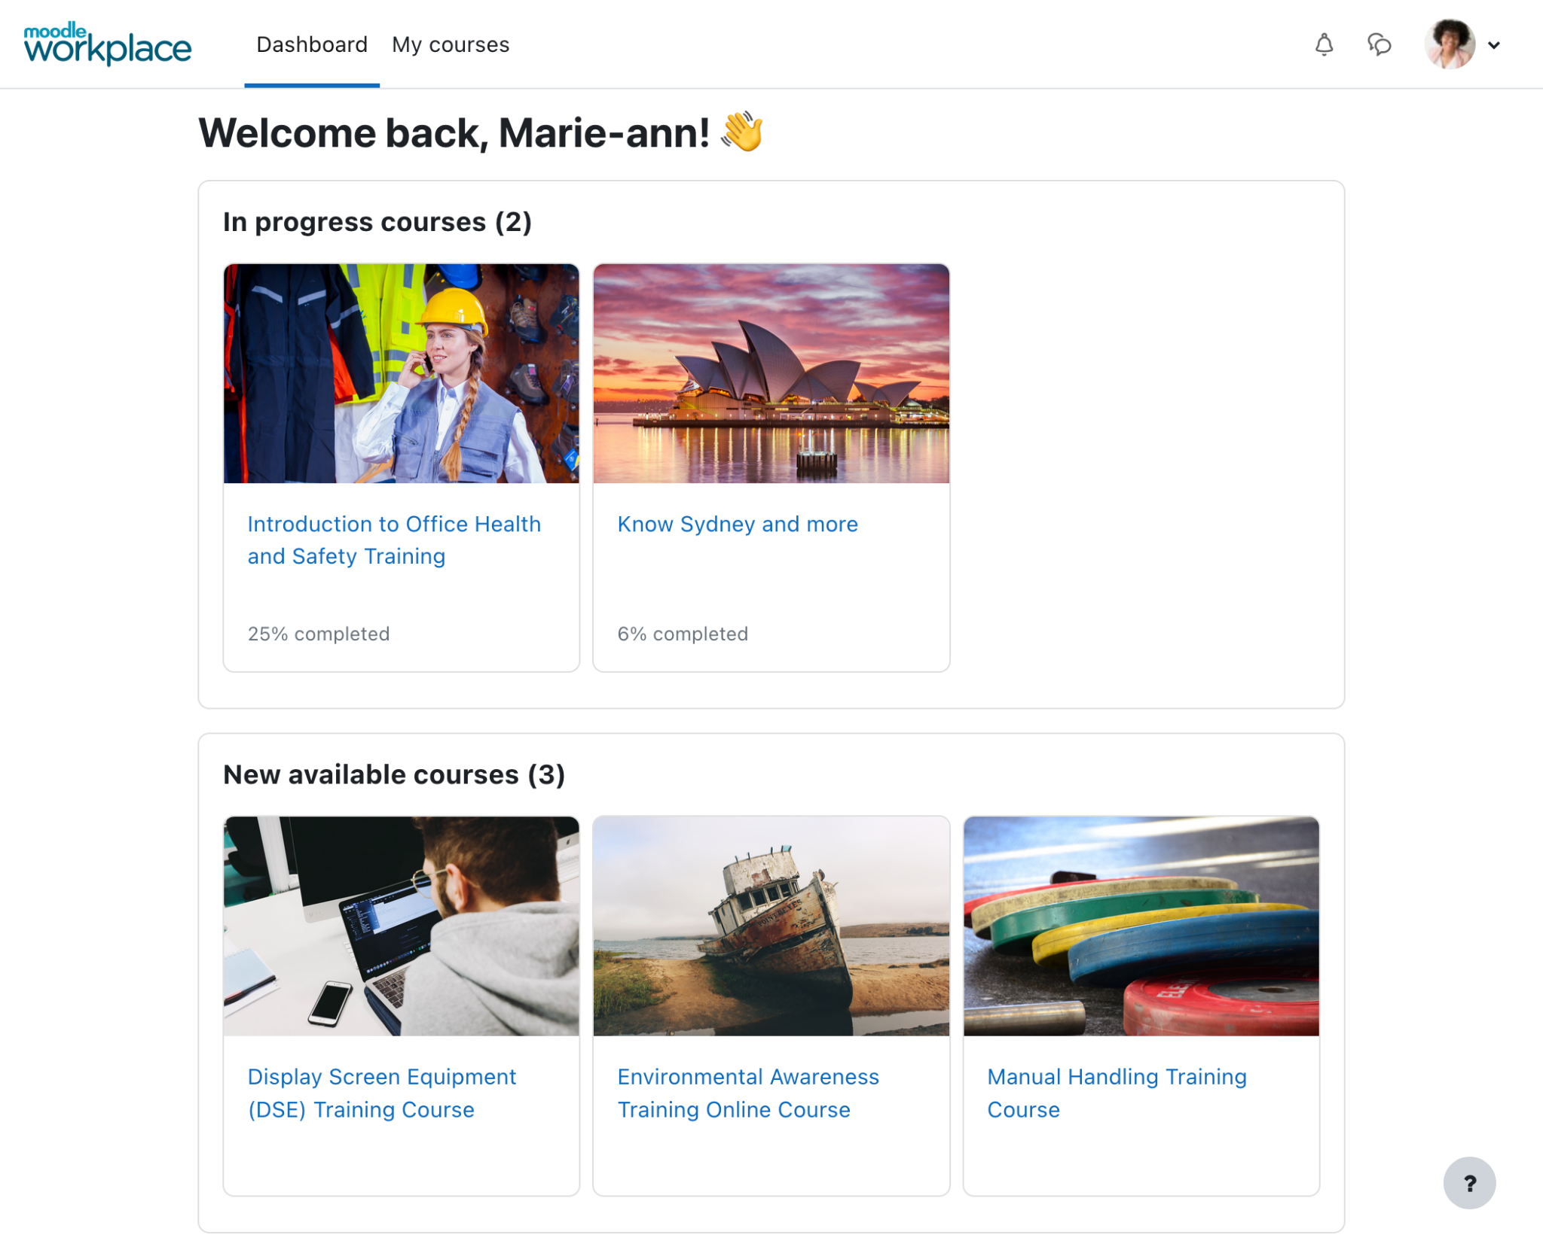
New
dashboard
Simplified to show Learners completion status at a glance.
Improved to make it easier for employees to prioritise their learning with the “In progress courses” and “New available courses” blocks.
Fully multi-tenant

Slide 14
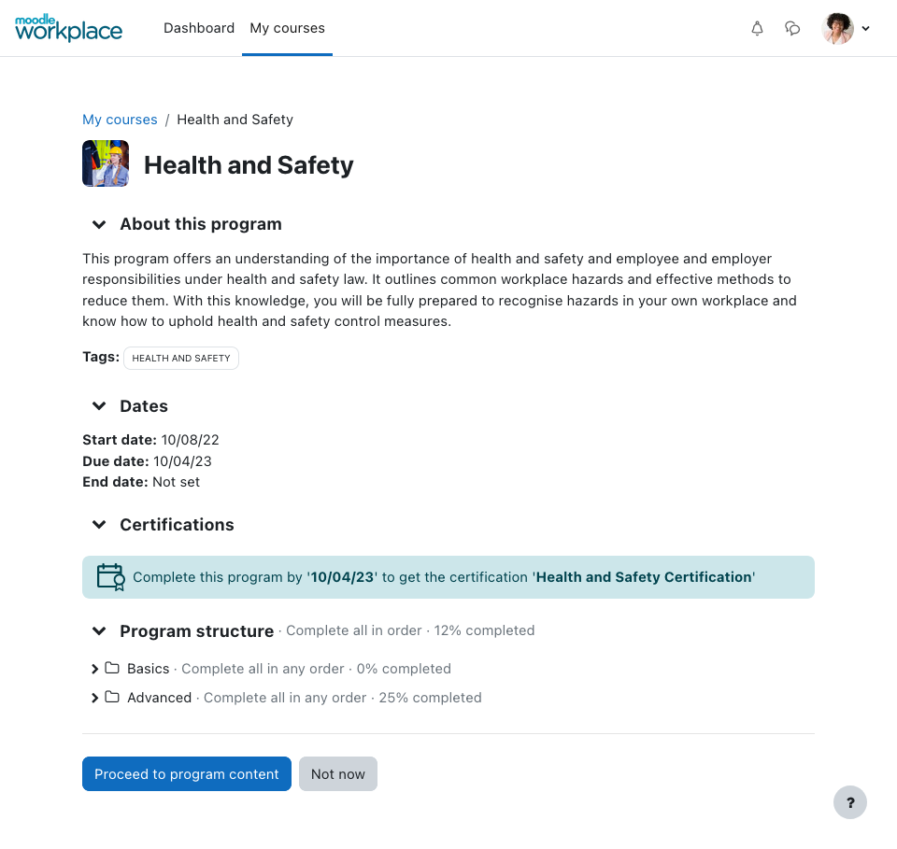
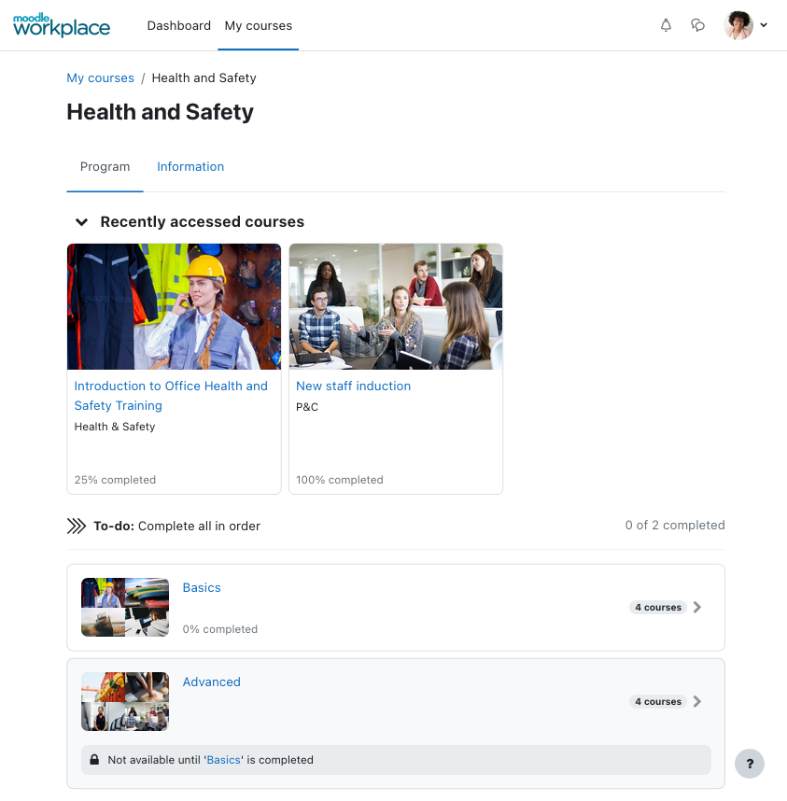
Program
page
Programs now have their own place in the learner workflow in Workplace: the Program page

Slide 15
Program cover page
Program cover page shows the user the information they need to know before they get into the program.

Slide 16
Program
page
Program page focus on the navigation through the sets and courses within the Program
Navigation though sets and courses is quick and intuitive

Slide 17
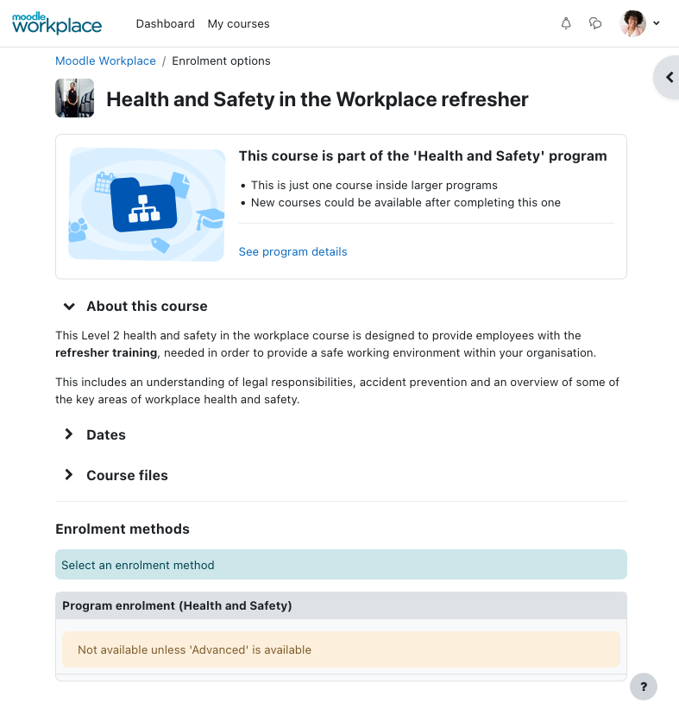
Course cover
page
Course cover is responsible of showing the user all the relevant information about the course before they get into it.
Later on, this information will be available in the “Information” tab.

Slide 18
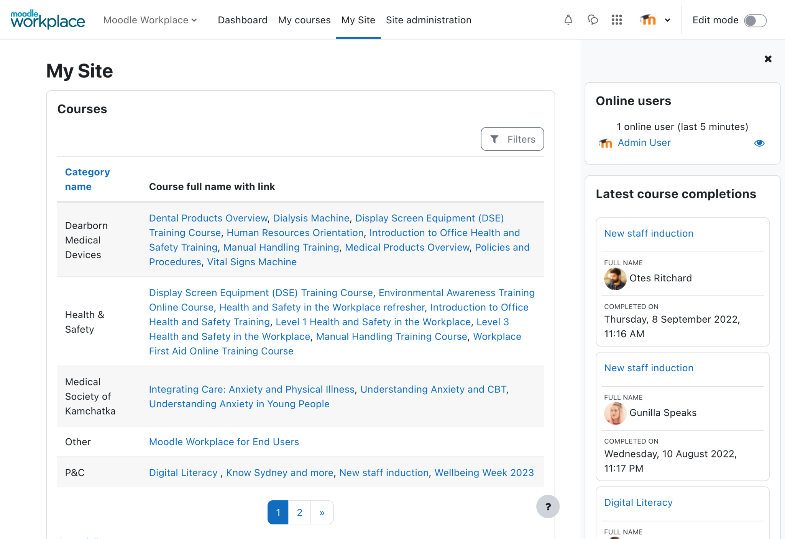
Custom
pages
Admins can create pages that work like extra dashboards where they can add blocks, and then make them available to specific audiences.
Report block helps maximise Custom pages’ flexibility

Slide 19
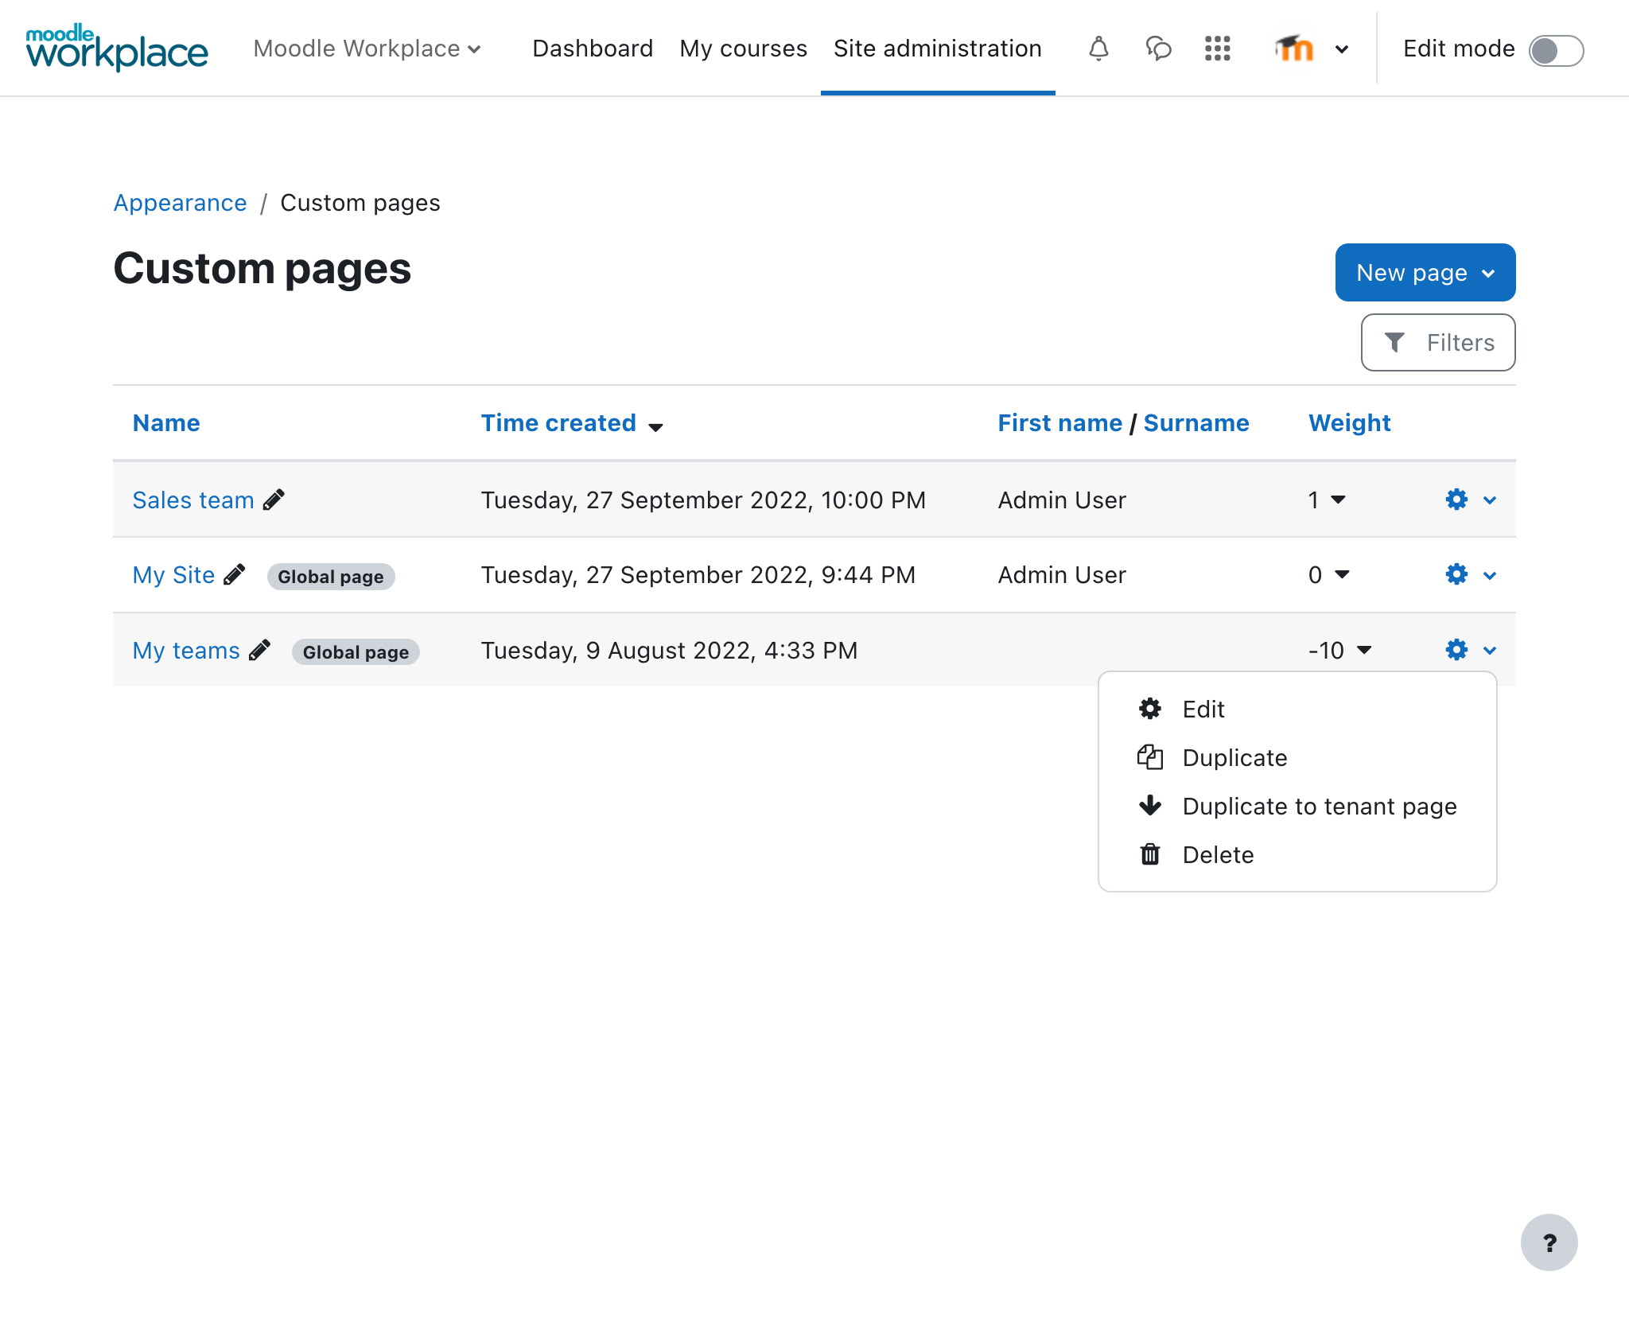
Global and tenant pages
Admins can create custom pages at a site level or for a tenant only.

Slide 20
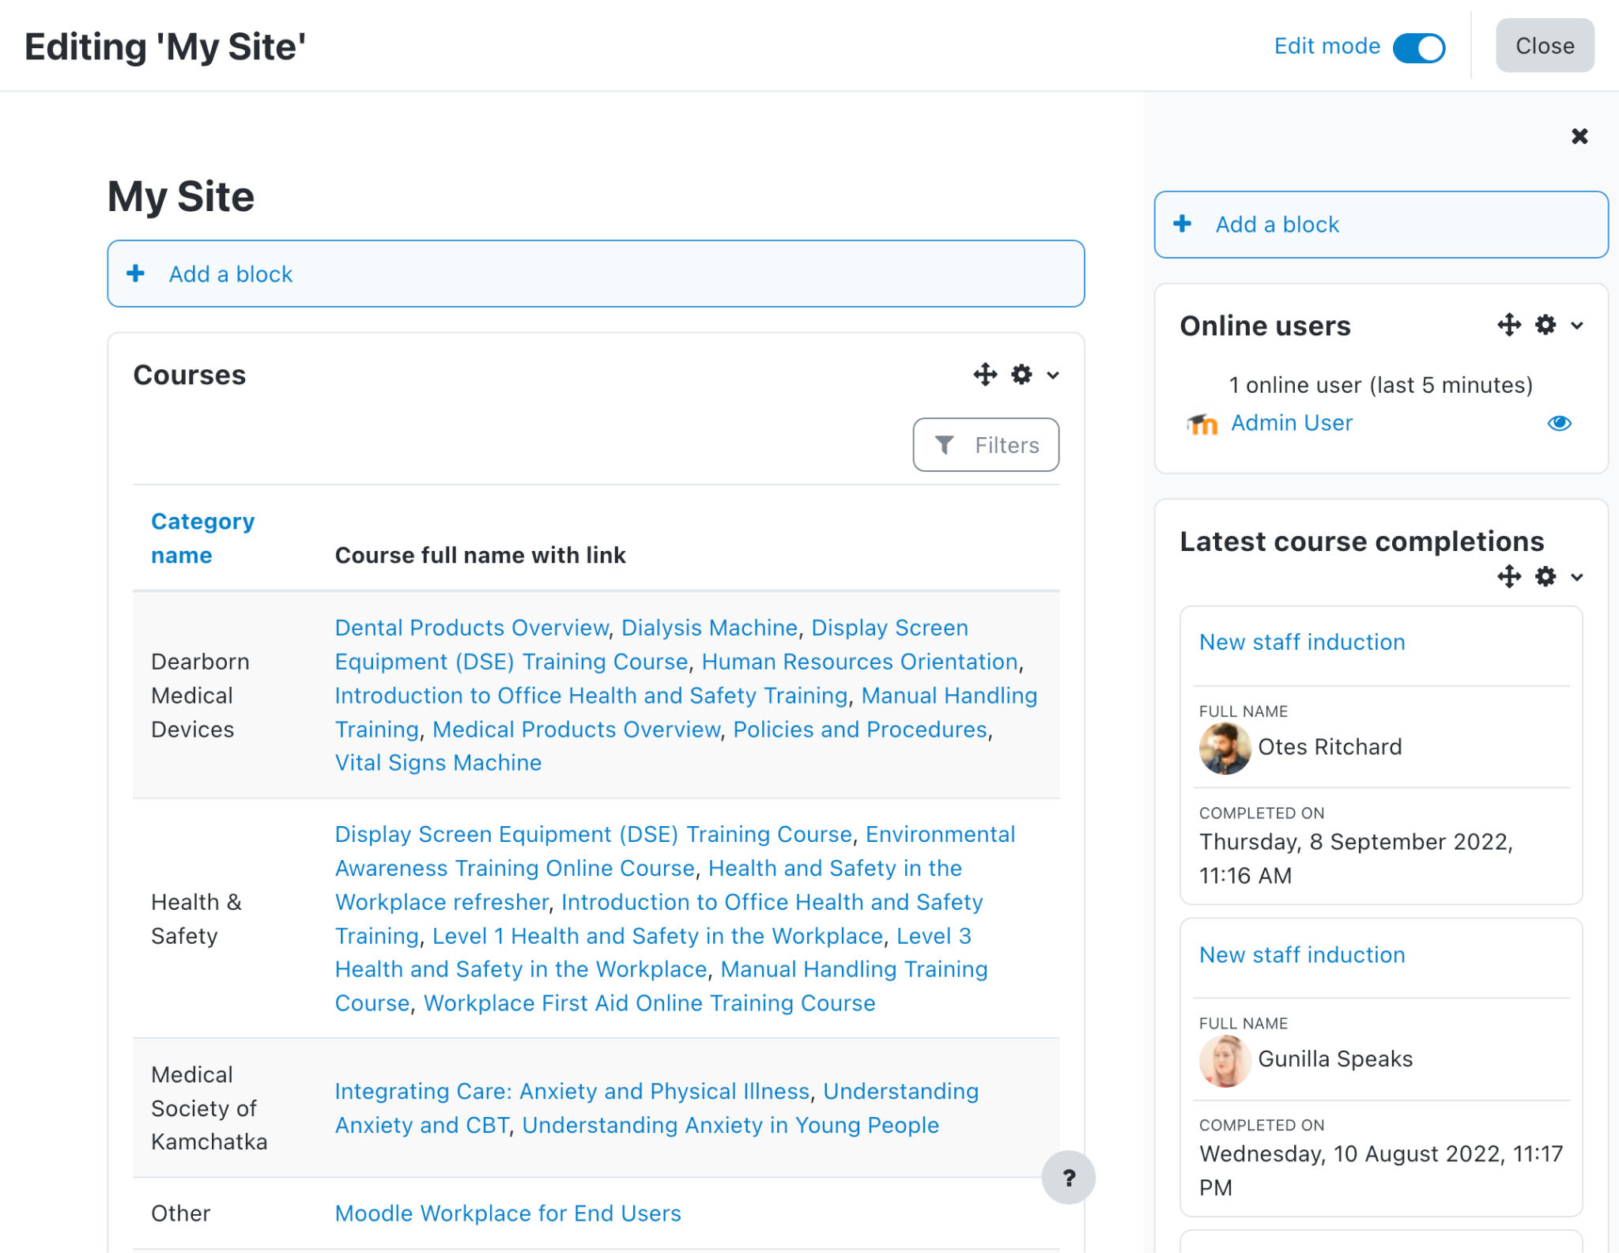
Adding
blocks
The blocks are added to Custom pages just like in the Dashboards. Just turn the edit more on and select the block to add.

Slide 21
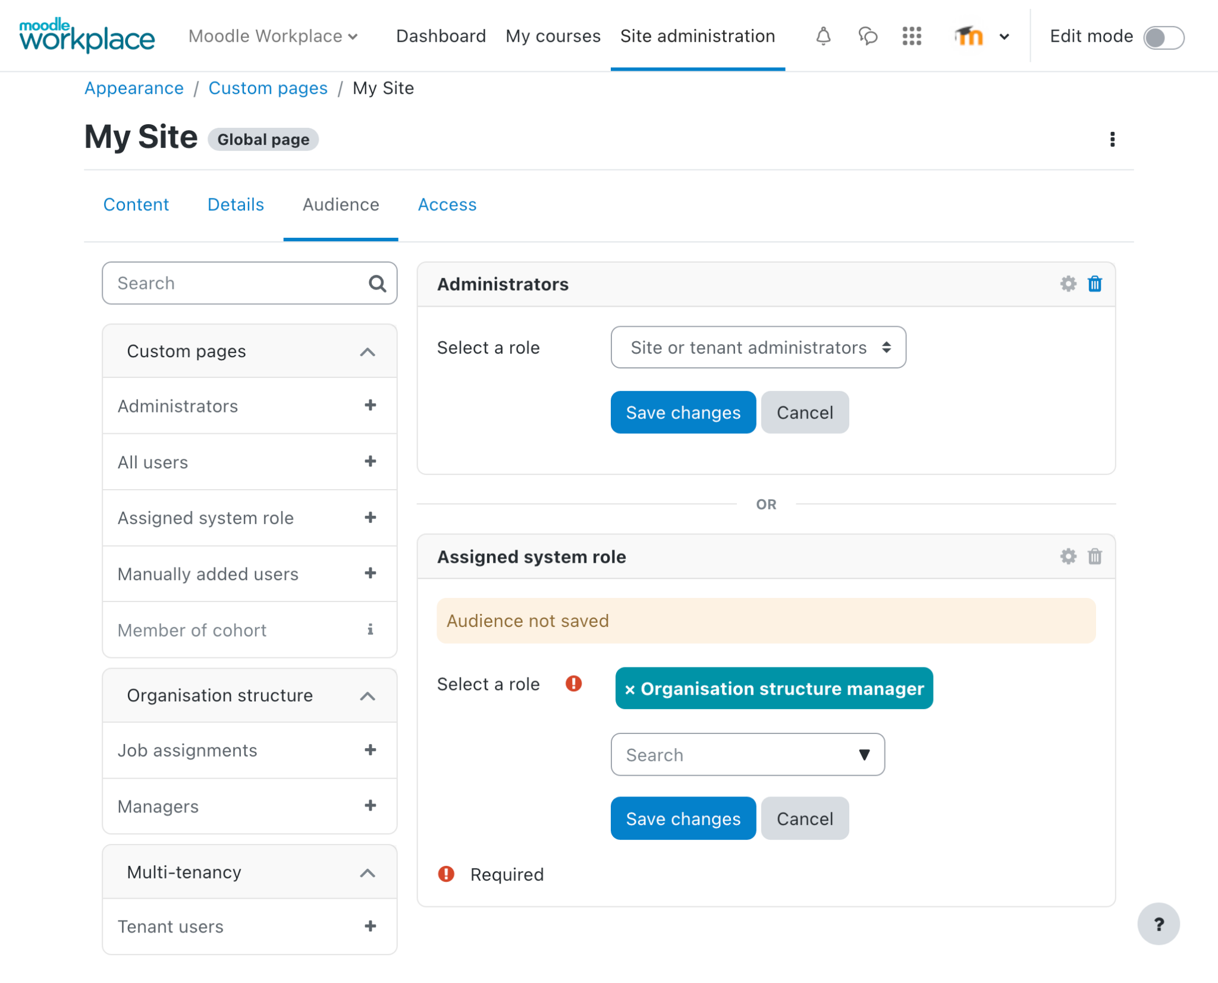
Custom page
audiences
Using audiences Custom pages can be targeted to specific groups of users.

Slide 22
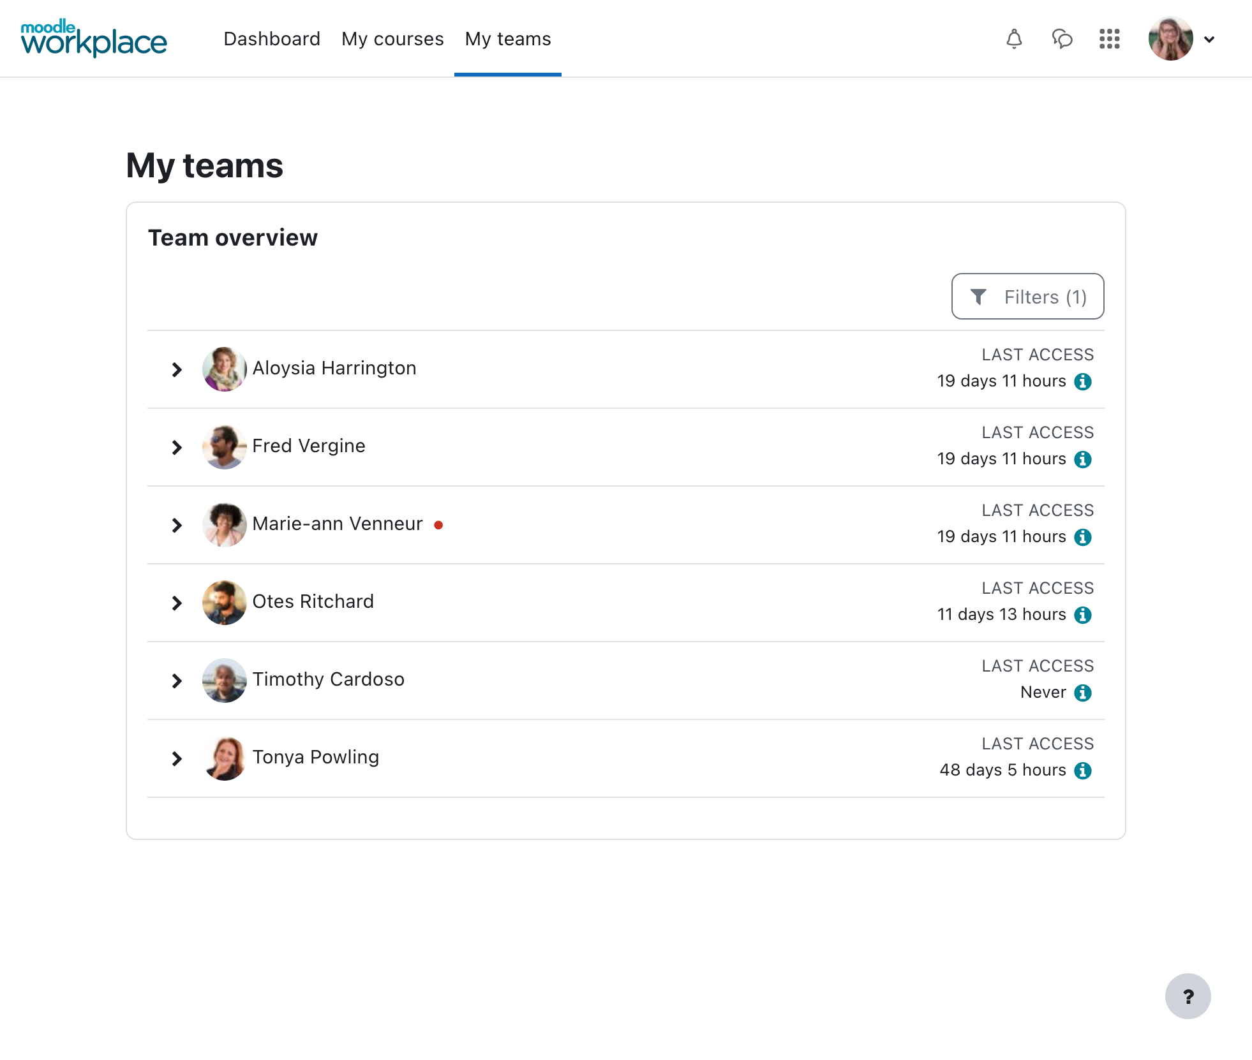
My Teams
page
It is the best example of what Custom pages are for.
My teams page provides managers visibility into team members, including tracking employee roles, learning path progress, course completion status and certifications.

Slide 23
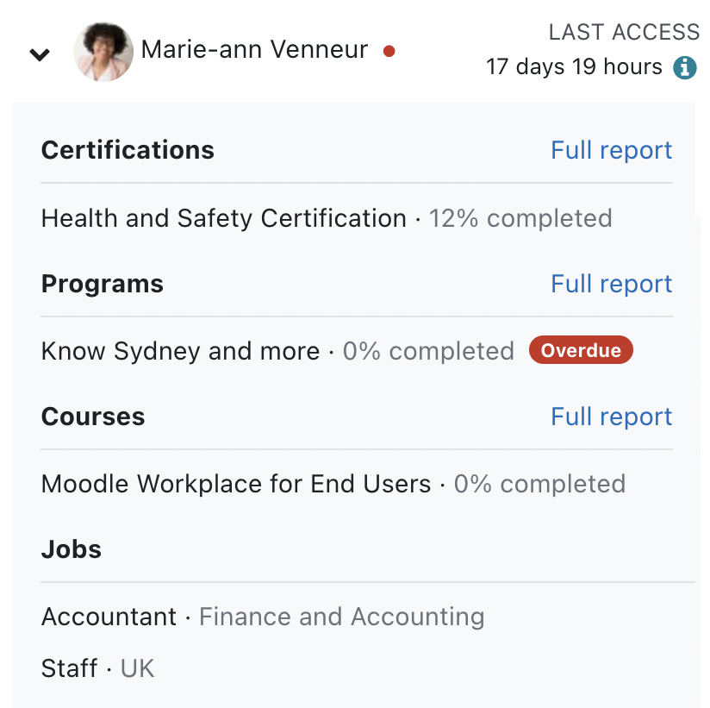
Team Overview
block
This block has been completely redesigned to focus on learning path progress and course completion status
For managers now it is easy to see if any of their team members has overdue learning, at a glance

Slide 24
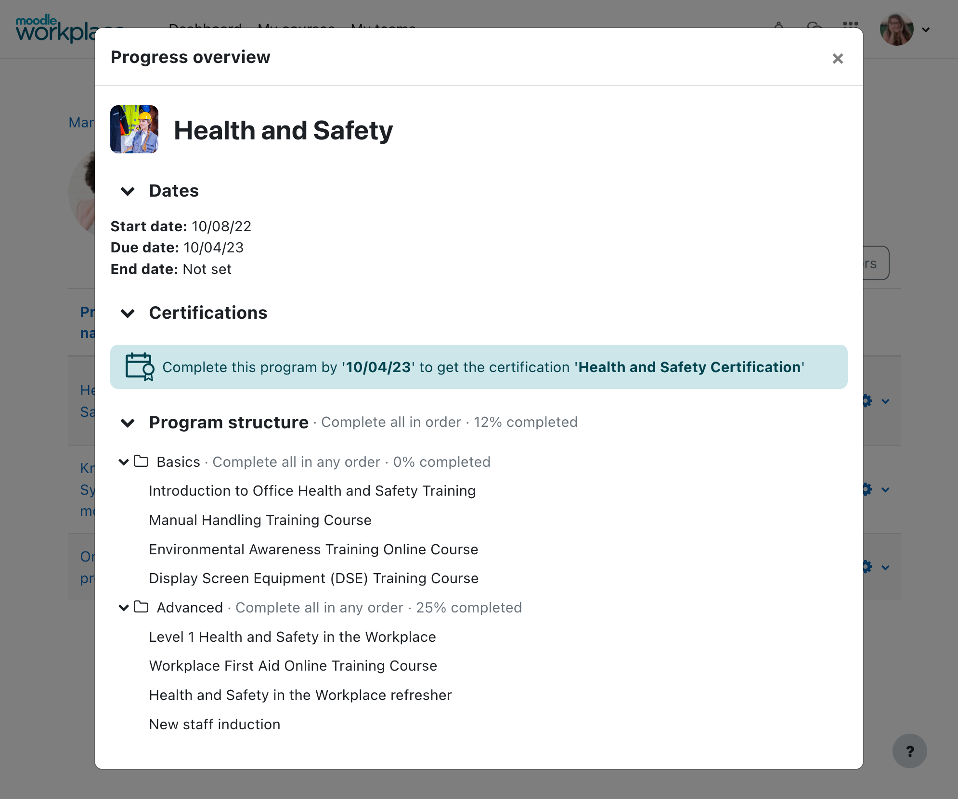
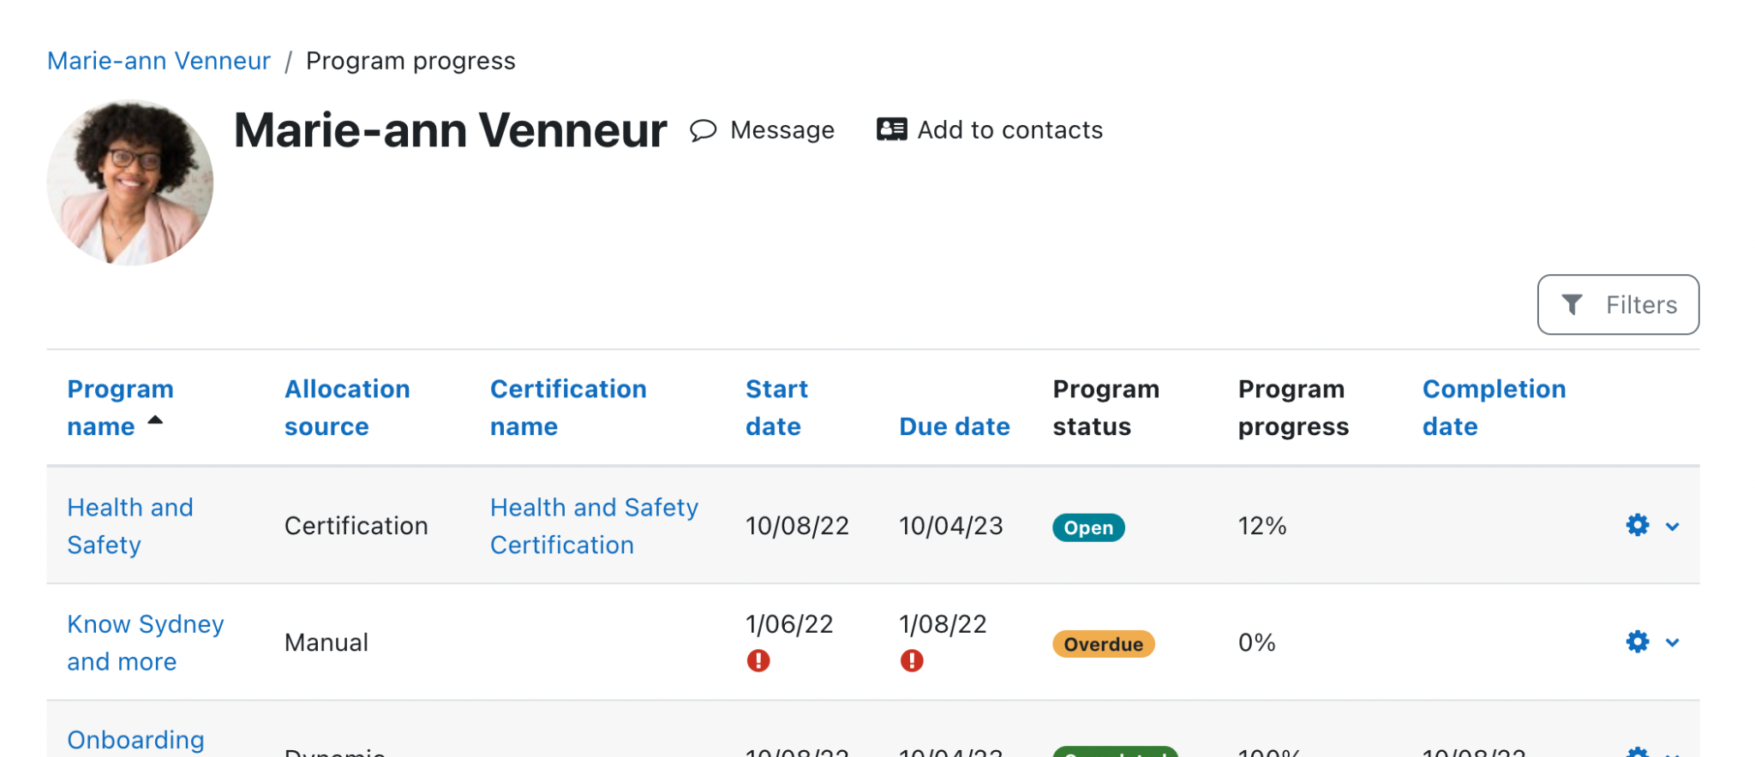
New progress reports
We have added a brand new Course progress reports and completely redesigned the Programs and Certifications progress reports

Slide 25
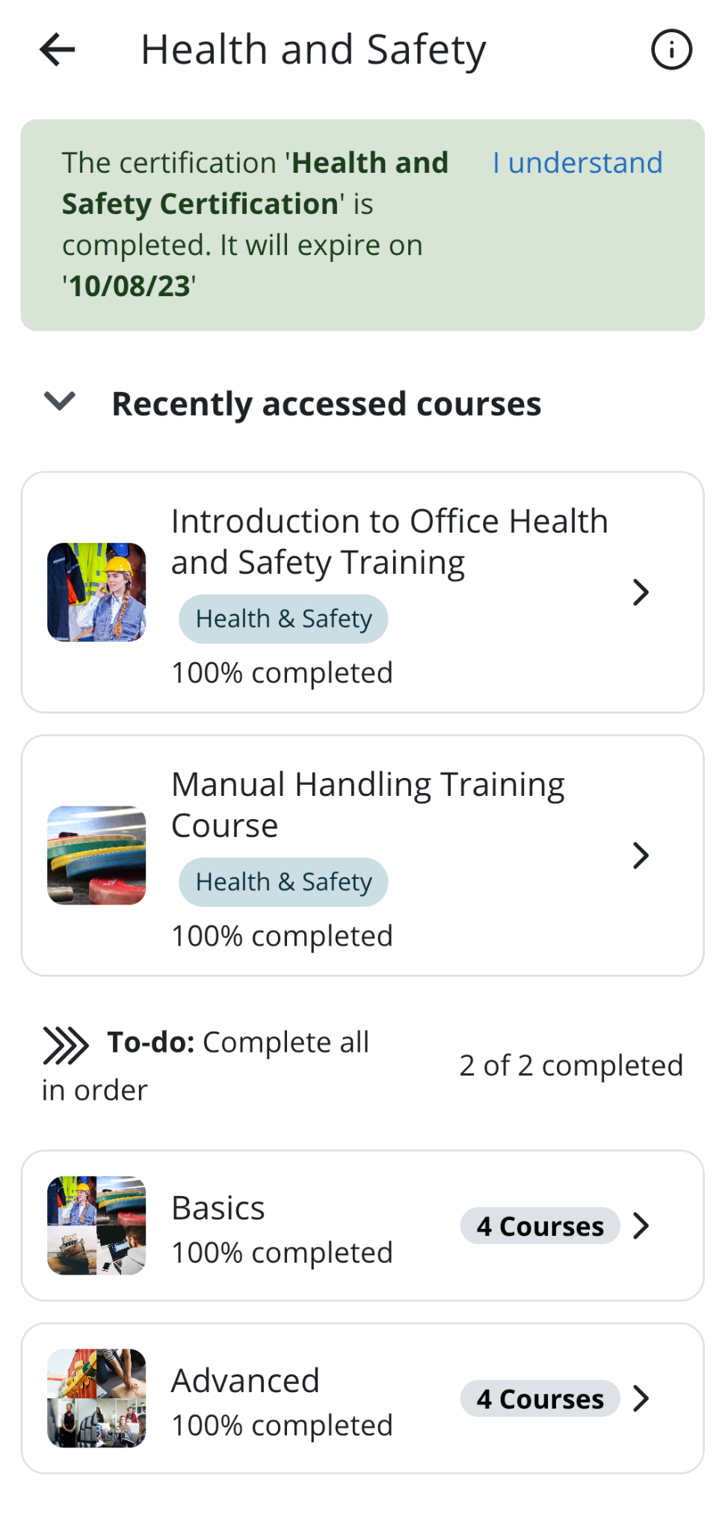
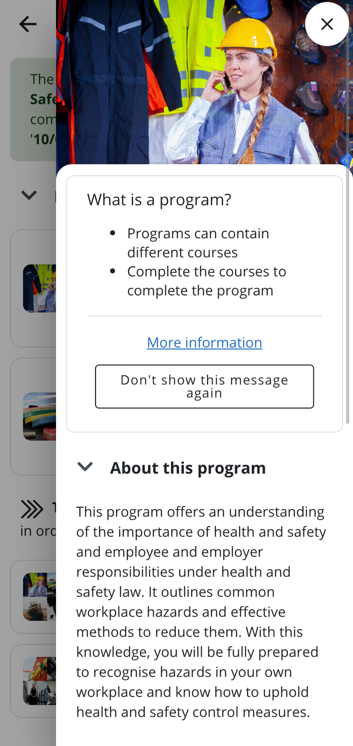
Per-tenant Apps
Support for multi-tenancy has been improved in the Workplace App
Not it is possible to have a branded App for a specific tenant within a multi-tenant site

Slide 26
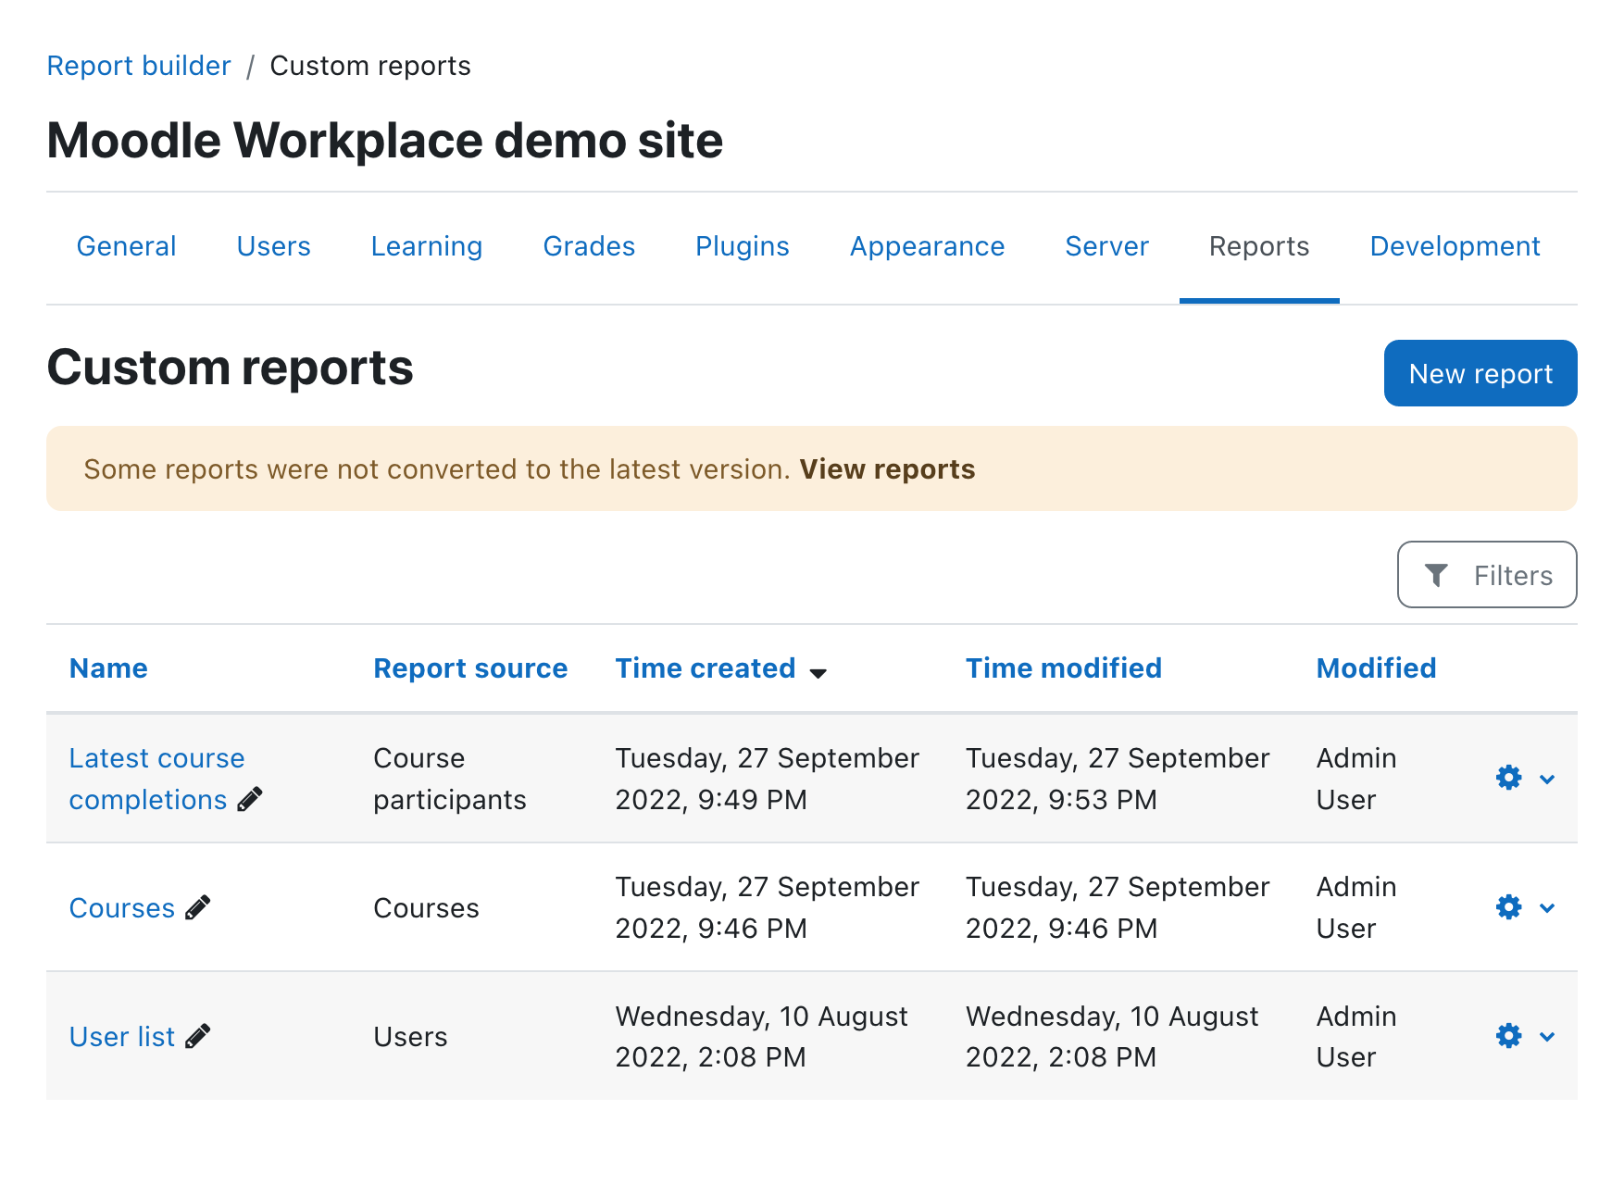
Report Builder in Moodle LMS
We rolled it out to Moodle LMS to make reporting more consistent across Moodle
Developers can use system reports to add more reports into their plugins

Slide 27
What’s next

Slide 28
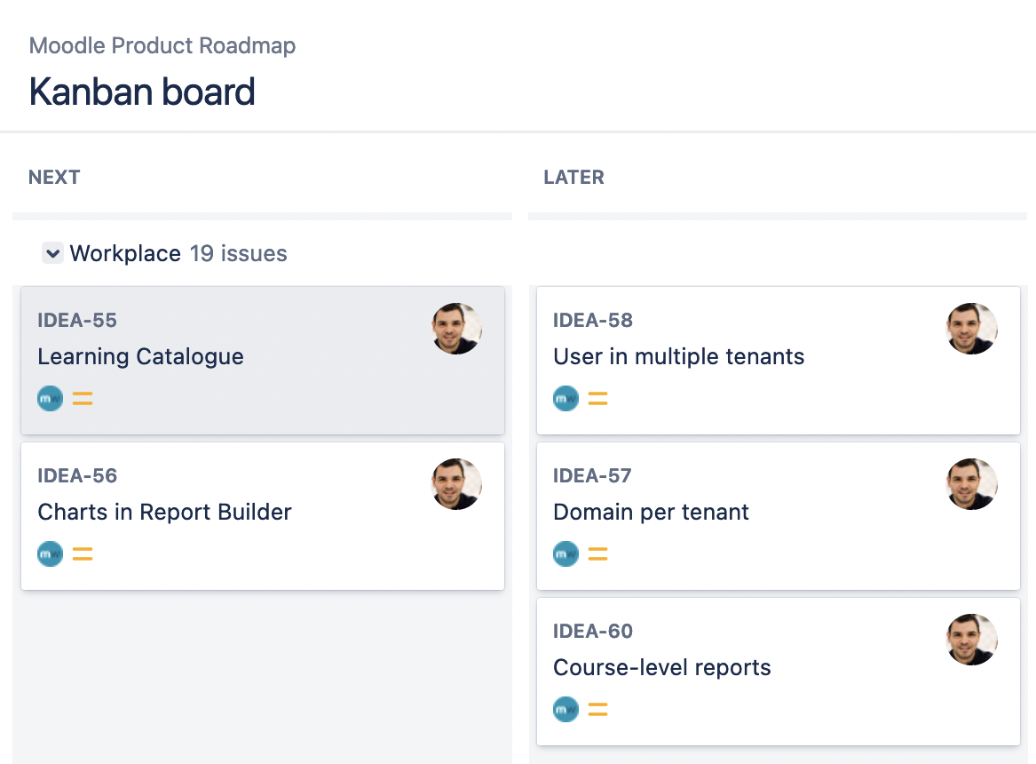

Slide 29
Get a demo
Get in touch with a Moodle Certified Service Provider to access Moodle Workplace and get a demo of our latest release.
moodle.com/workplace4

Slide 30
Closing slide
Emilio Lozano
emilio@moodle.com

