Slide 1
Using Moodle to Empower Learners through a Hybrid Learner-Centred Course at Maseno University
Maxwell Fundi
Director, Edutab Africa
MSc IT, Maseno University
Kenya.

Slide 2
Background
Lies on the Equator
Notes:
Start reflecting about first use of moodle as a student taking PHT 112, user emails for use at the, PGDE
Reflect about being a moodle administrator at AMI - Setting up moodle for low resource areas using PIs
Reflect about ID at Edutab while offering support to Inclusiv education and save the children, HE - AAU, Maseno, Kisii, RIAT - Working with SMEs
Leveraged on above experience to work with learners as a tutor

Slide 3
Background
Enabler of better use technology
Moodle service provider.
Notes:
Start reflecting about first use of moodle as a student taking PHT 112, user emails for use at the, PGDE
Reflect about being a moodle administrator at AMI - Setting up moodle for low resource areas using PIs
Reflect about ID at Edutab while offering support to Inclusiv education and save the children, HE - AAU, Maseno, Kisii, RIAT - Working with SMEs
Leveraged on above experience to work with learners as a tutor

Slide 4
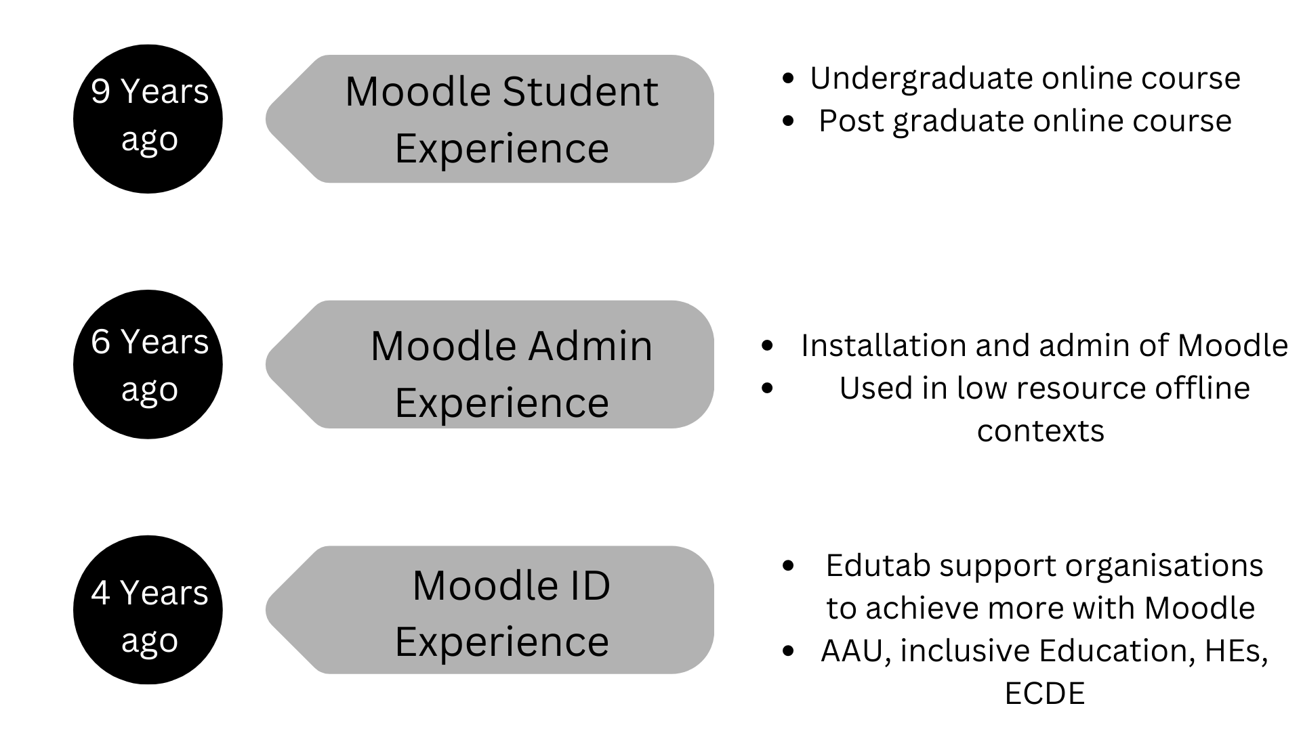
Background
Notes:
Start reflecting about first use of moodle as a student taking PHT 112, user emails for use at the, PGDE
Reflect about being a moodle administrator at AMI - Setting up moodle for low resource areas using PIs
Reflect about ID at Edutab while offering support to Inclusiv education and save the children, HE - AAU, Maseno, Kisii, RIAT - Working with SMEs
Leveraged on above experience to work with learners as a tutor

Slide 5
Background
Notes:
Start reflecting about first use of moodle as a student taking PHT 112, user emails for use at the, PGDE
Reflect about being a moodle administrator at AMI - Setting up moodle for low resource areas using PIs
Reflect about ID at Edutab while offering support to Inclusiv education and save the children, HE - AAU, Maseno, Kisii, RIAT - Working with SMEs
Leveraged on above experience to work with learners as a tutor

Slide 6
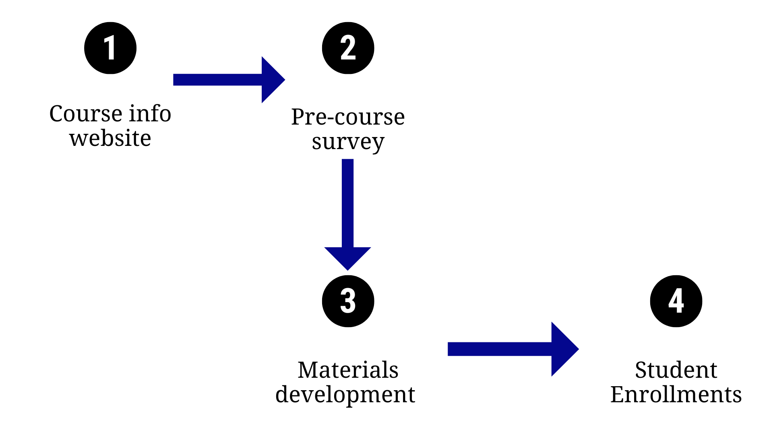
Pre course activities
Notes:
Precourse survey - To assess online learning readiness for the learners, done prior to
Materials development - Rise, videos - Edutab supported in development and delivery of the course materials
Website - info about the course even before it starts, and after the course - Linked to edutabs

Slide 7
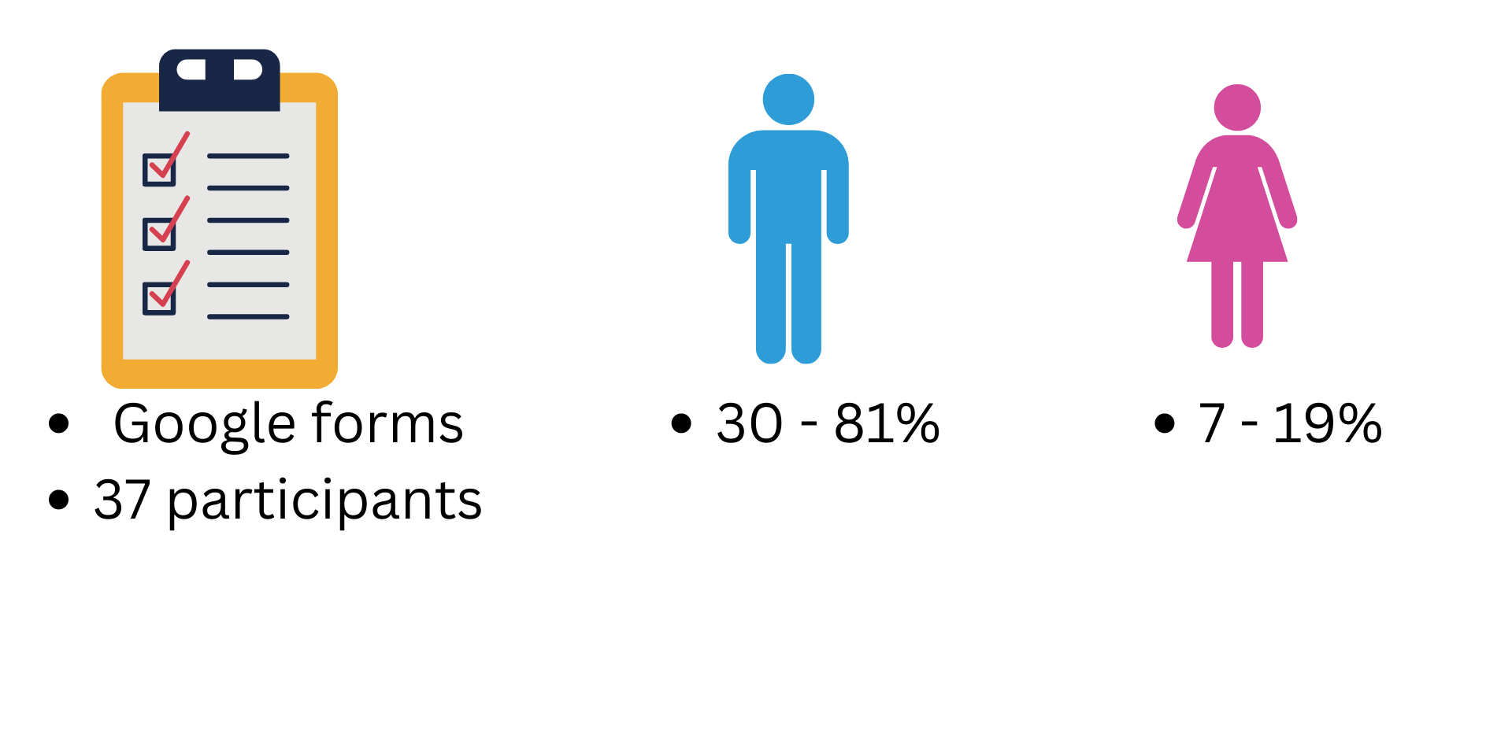
Pre course survey
Notes:
The pre course survey was on the course website, 37 students took part in survey, 30 male and 7 female.

Slide 8
Device ownership
All the course participants had a smartphone
94.6 % - Had a laptop/desktop computer
Notes:
Sort to find out what devices they owned to inform how the course is delivered.
While they had phones they didn't have like high end phones - not high end phones but still good enough for use. I remember some students had to delete some course materials to update their courses weekly
Desktops and laptops available - second hand making them affordable

Slide 9
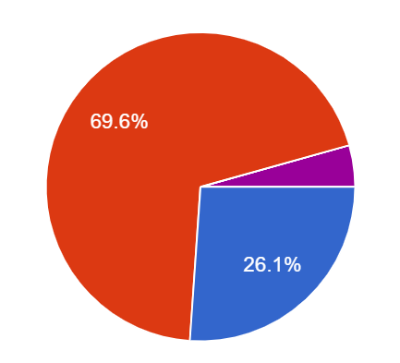
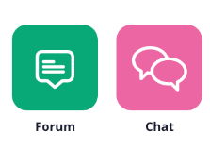
Communication in the course
Preferred mode of communication
Devices used in the course
Mobile Phones
Whatsapp - 91.9%
eMail - 8.1 %
Laptops
Other tools used
Notes:
Most chose whatsapp as a means of communication - Can be attributed to behaviour + not engaged in elearning previously so not being aware of communication tools in moodle
Whatsapp group was created for the class
Whatsapp used moodle communication tools to support during the course - messagings, forums, announcements etc

Slide 10
Previous online learning experience
81.1 % not taken online course previously.
Notes:
it was a first time for many taking an online course
Covid brought opportunities for edutab to support development of these courses

Slide 11
Internet Access
86.5 % used > 50MB
51% used > 1GB
72% no access to Public Wifi
Dropping cost of internet in Kenya
Subsidized offers by telcos for this demographic
Notes:
Saying about the costs of the the internet??? - investment in infrastructure by the govt and private institutions - govt providing environment for this growth
Internet connectivity and infrastructure in Kenya.

Slide 12
The Course delivery
10 weeks hybrid course
2 physical meetings
Interactive learning content in
and
Notes:
Why scorm and pdf - provide diversity for people who would like to print etc

Slide 13
Enrolment and Orientation to elearning
Bulk student enrollment
Logging in to the LMS
Downloading, setting up, navigating the app
Downloading content for offline use
Navigating the web version
Notes:
While most of the learners were new to elearning I made a video to demonstrate

Slide 14
The Course delivery
Weekly mixed assessment included - Mastery Quizzes, Timed Quizzes, Forums, groupworks/peer to peer assessments, presentations, case studies.
Feedback was anonymously collected on Padlets
“Then just wanted an improvement on the chapter update.It doesn't reflect on everyone's immediately” - Student
Notes:
Mastery quizzes - could be made out of random questions, done multiple times, highest grade recorded
Anonymous feedback to improve honesty.

Slide 15
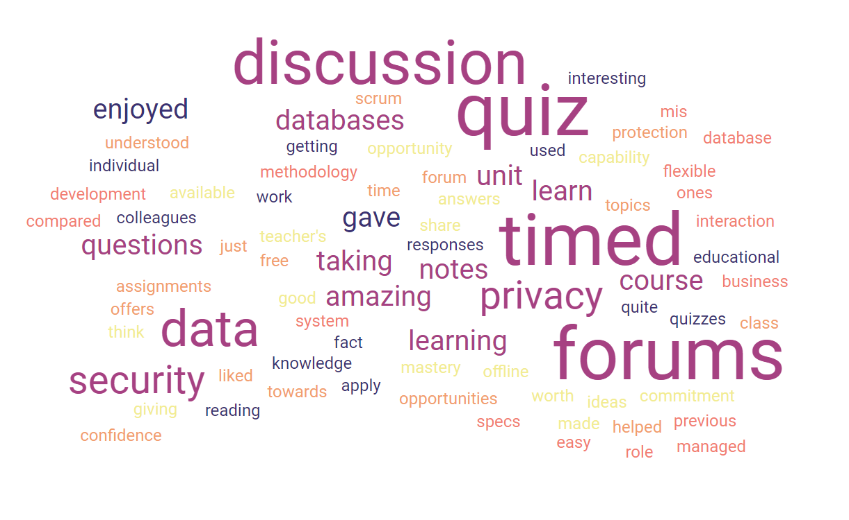
What was enjoyed most
Discussion forums
“I liked the discussion forum because of the activeness from fellow students who mentioned the errors and commented on my work” - Student
“Discussion forum because it gave us opportunity to share ideas” - Student
Timed quizzes
“I liked the timed quiz because it helped me and gave me confidence that I understood the topics”
Data security, privacy and protection
Had comics as a teaching material
Notes:
Comics - teaching with relatable material

Slide 16
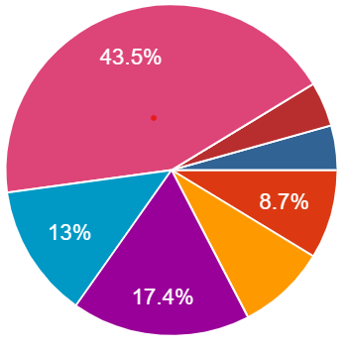
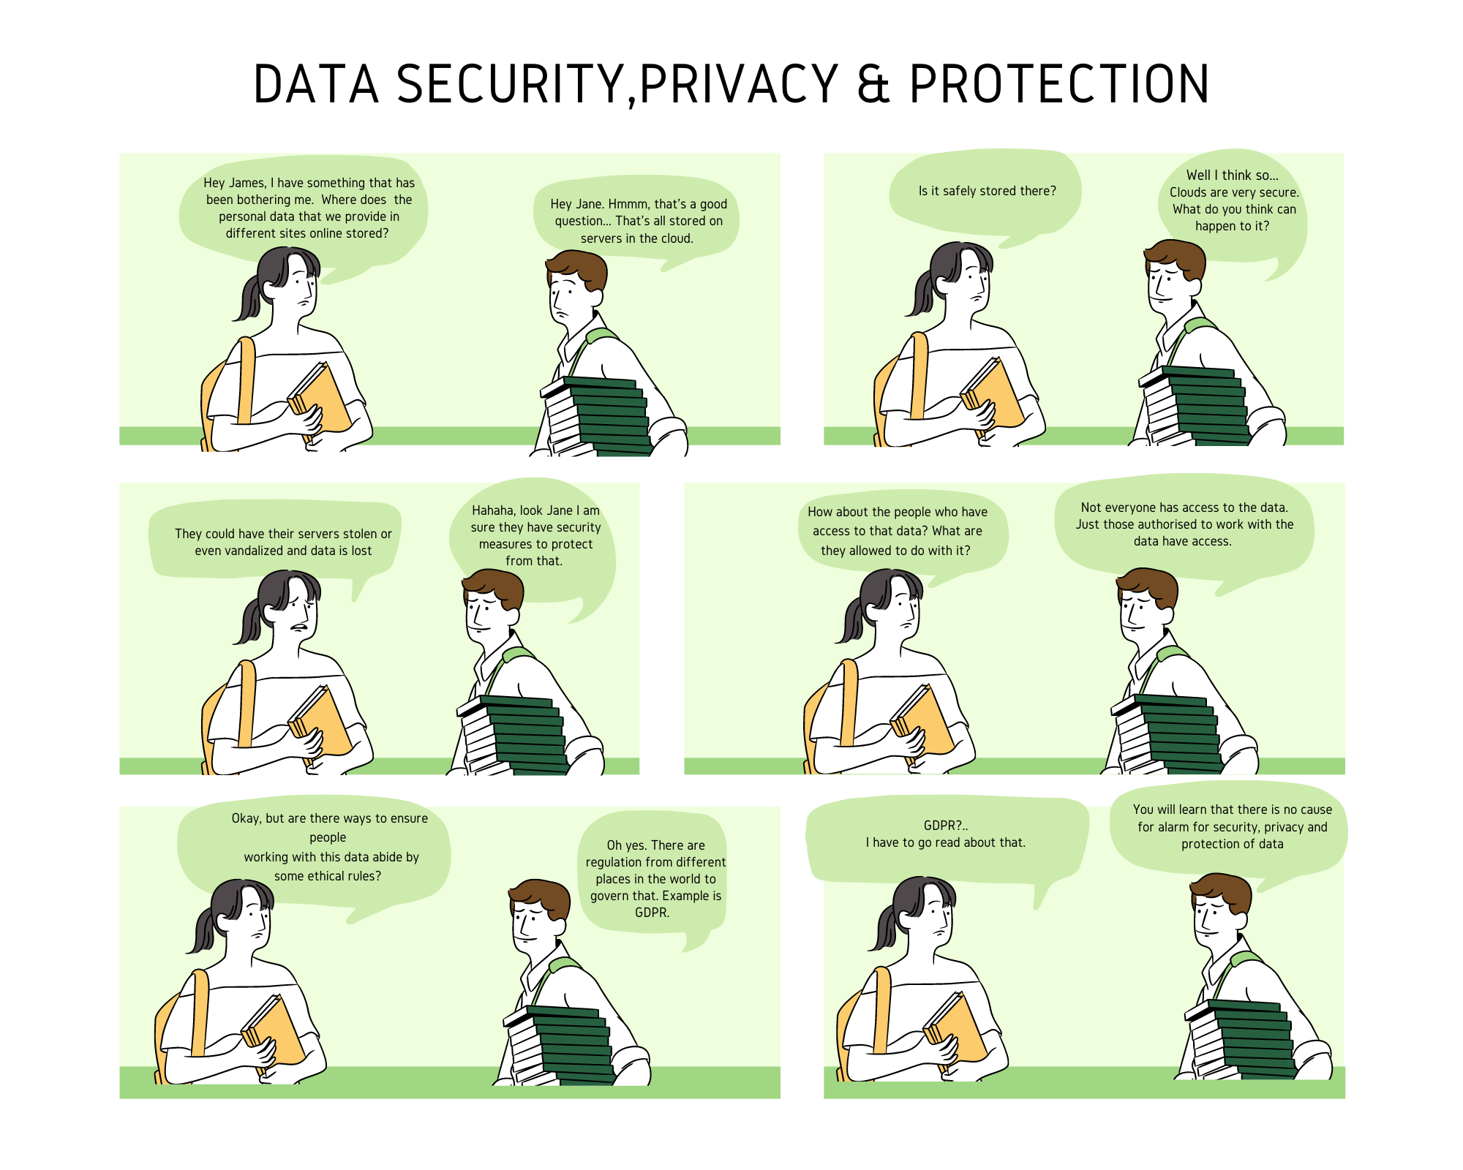
What topic was meaningful
43.5% - Data security, privacy, protection was most meaningful topic

Slide 17
Would you take another online course?
Flexibility
“It was a very flexible course compared to previous ones” - Student
“I'd prefer online because of the easy time to access the notes and even read freely. Mobility available” - Student
“You can pursue other things as you learn..it also enables flexibility of learning anywhere” - Student
“It's flexible and does not restrict you from doing your business and also saves money on transport to the school for face to face learning” - Student
“Due to its flexibility and time efficiency”- Student
“One is able to balance academic and work” - Student
Everyone said

Slide 18
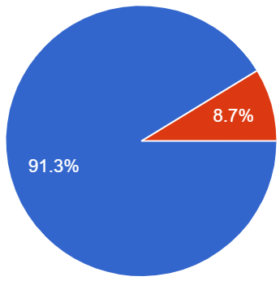
Use of Moodle App
What was useful?
Free, easy to use
“It provides easy to use menu interface and less data costly”
“You can download notes while online and study offline”
“It made work easier by accessing notes offline”
“The resources were readily available when one wanted to study”
“........and also good notes that are available offline”
91.3% Used Moodle App

Slide 19
Challenges
Initial weeks were challenging
Most students had devices
Notes:
Headline, image and dot points slide

Slide 20
Notes:
Headline, image and dot points slide

Slide 21
Closing slide
Maxwell Fundi
maxwell@edutab.africa

