Slide 1
What is automated testing?
Why should non-developers be interested?
Davo Smith - @davosmith

Slide 2
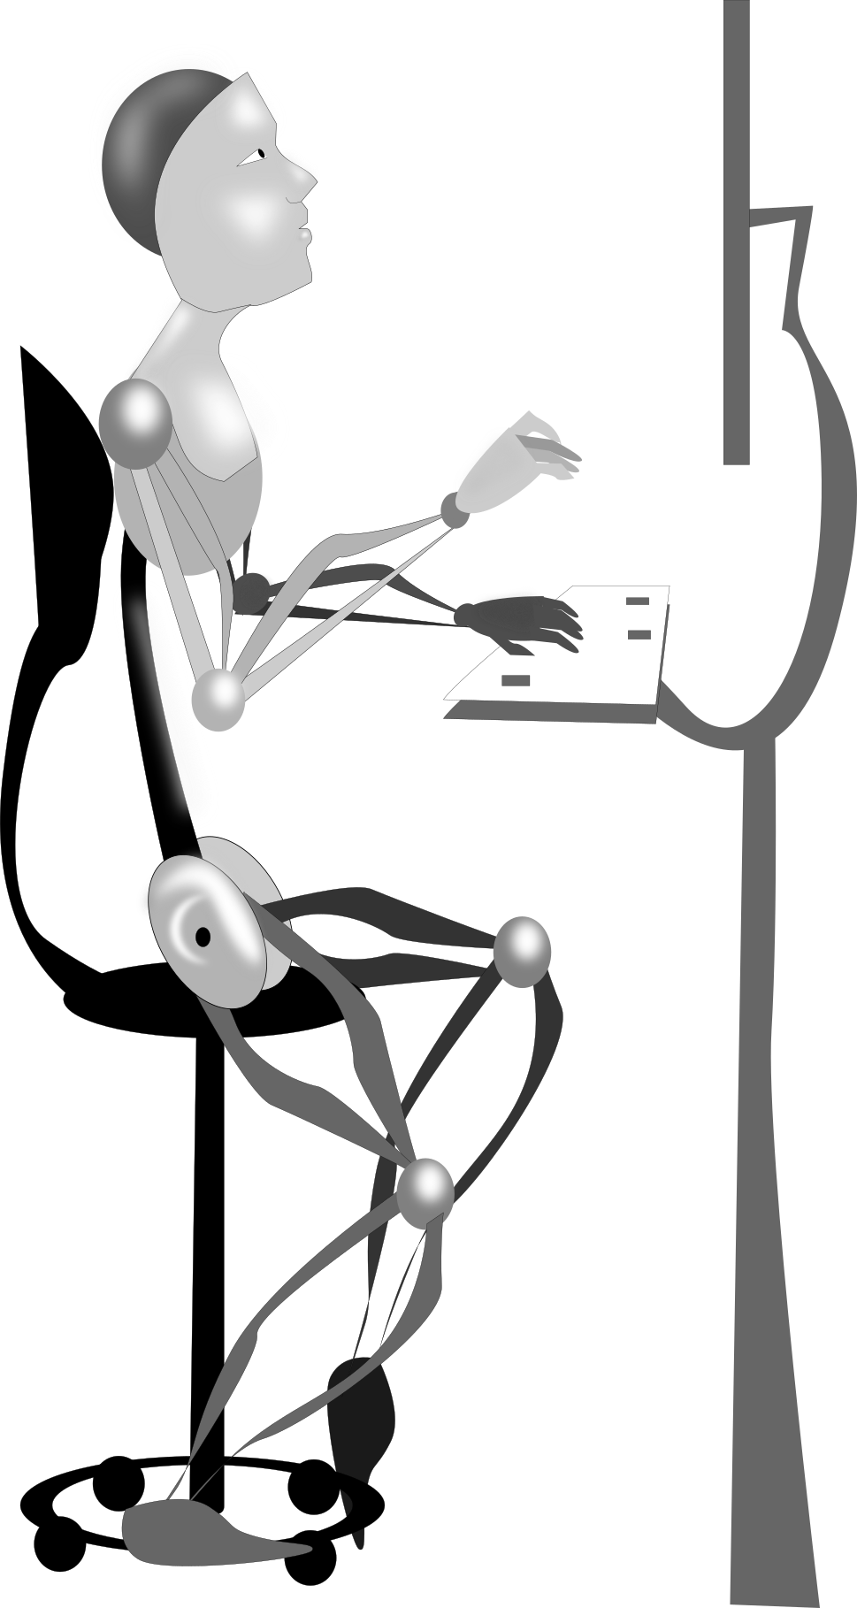
What is automated testing?

Slide 3
Why does it matter?
During initial development
Adding new features
During upgrades
Combining different custom code

Slide 4
Limitations?
Only test what you think of testing
Can't spot "obvious" problems
Nam at tortor in tellus interdum sagittis. Donec orci lectus, aliquam ut, faucibus non, euismod id, nulla. Quisque ut nisi. Curabitur suscipit suscipit tellus. Vestibulum turpis sem, aliquet eget, lobortis pellentesque, rutrum eu, nisl.
Vestibulum turpis sem, aliquet eget, lobortis pellentesque, rutrum eu, nisl. Fusce commodo aliquam arcu. Fusce commodo aliquam arcu. Cras dapibus. Suspendisse potenti.
The test worked!

Slide 5
Types
Unit testing - PHPUnit
User acceptance testing - Behat

Slide 6
Steps
Set up a scenario
Do something
Check the results

Slide 7
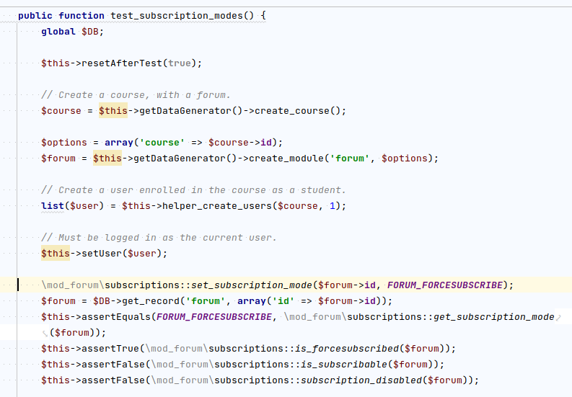
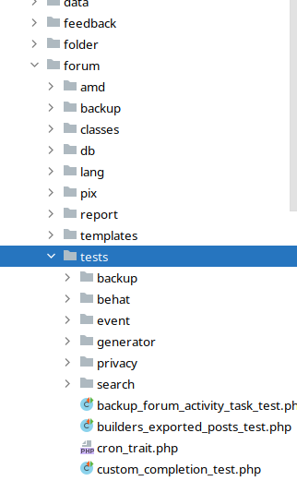
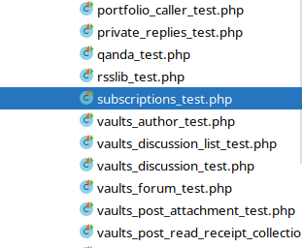
PHPUnit

Slide 8
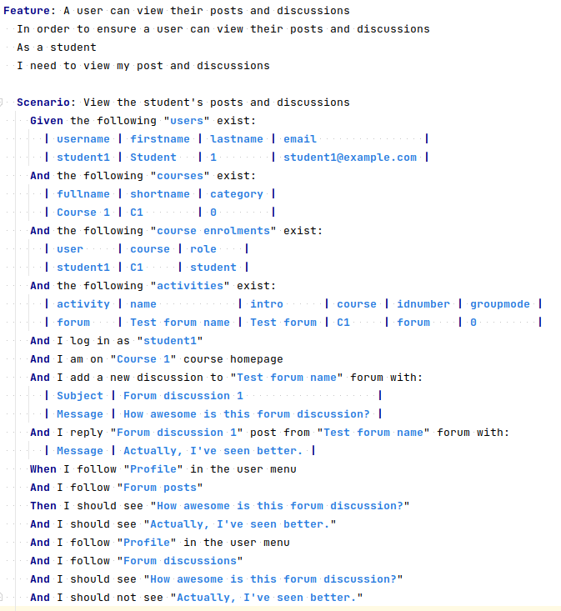
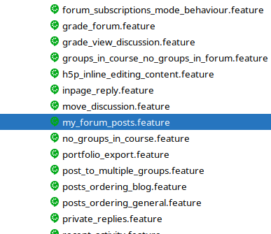
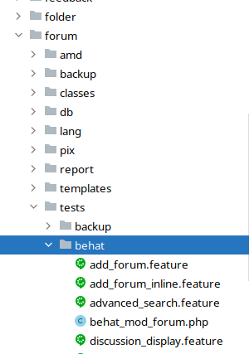
Behat

Slide 10
Why should you care?
Quality of core Moodle code
Evaluating 3rd-party plugins
Paying for custom code

Slide 11
Any Questions?
Davo Smith
@davosmith

