Slide 1
Verbal feedback – Oral presentation structured assignment throughout all classes and the whole curriculum
Luca Bösch
Bern University of Applied
Sciences

Slide 2
Verbal feedback – Oral presentation structured assignment throughout all classes and the whole curriculum
Luca Bösch
Bern University of Applied
Sciences
Notes:
((( Mikrofone richten )))
Hi.
I want to talk to you about our aim two give students more consistent feedback.
how do we do this?
by using verbal feedback.

Slide 3
Verbal feedback
Notes:
“Verbal feedback” is kind of a pun.
it means feedback to verbal presentations but also feedback that not just consists of keywords but is explained in whole phrases and structured text.

Slide 4
The challenge
Criteria for verbal presentations vary too much
Cumbersome to write criteria, grades and feedback for presentations
Aim to have students get comparable feedback throughout classes during the whole curriculum
Inconsistent feedback does not help much in learning
Notes:
The authors of this tool at our university of applied sciences analyzed that oftentimes students do presentation throughout their curricula. They are graded by different lectures and each and every lecturer has his or her own criteria. That isn't good in the student’s point of view because it's hard then to track on which aspects you progress and on which your remain stuck. So, the aim is to have as much lecturers and as much classes use the same feedback criteria for presentations. With this in mind a criteria scheme was developed and reviewed and a Moodle activity was programmed. Here’s Verbal feedback.

Slide 5
Verbal feedback
Notes:
With verbal feedback after his or her presentation a student gets rated and commented feedback on the set criteria. She or he can download his or her report. The feedback can be done by more than one lecturer and the resulting grade is the average and the added comments are the combination of both.
Let's look on how that feels in the user interface.

Slide 6
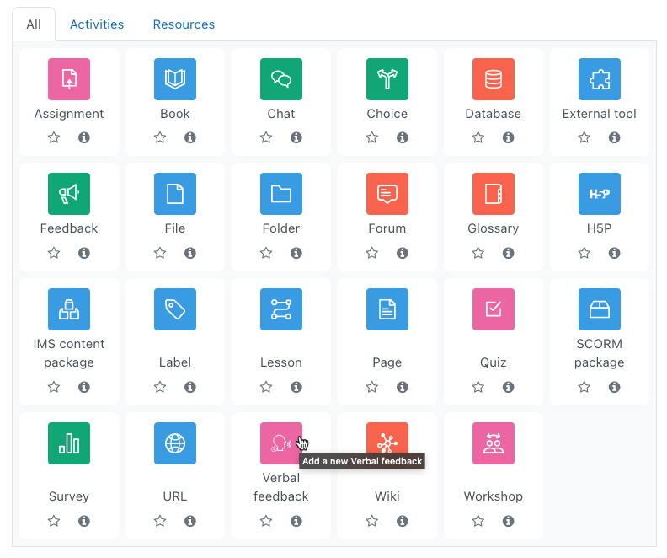
Verbal feedback
Adding the activity
Notes:
A lecturer adds a verbal feedback activity …

Slide 7
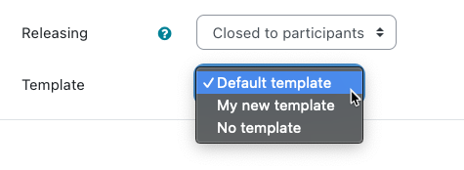
Verbal feedback
Choose the template
Select releasing mode
Notes:
… and select a template. As of now the templates come in French, German and English. Alongside the template selection they also choose whether the students see the feedbacks right away or only after they are released.

Slide 8
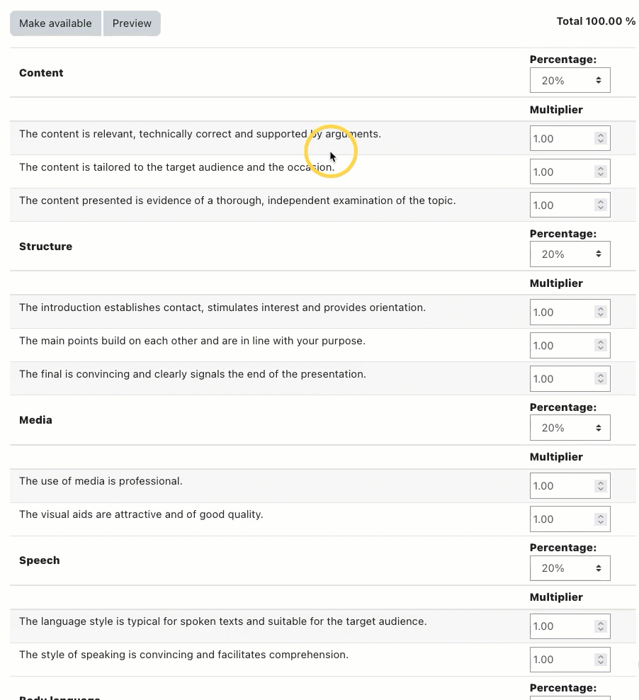
Criteria grid
Criteria are grouped to categories
Categories “Content”, “Structure”, “Media”, “Speech”, “Body language”
Scores of the categories go to a spider diagram
Notes:
This is the default criteria grid – and criteria are grouped to categories – that comes delivered with the standard verbal feedback plug in. It aims at verbal presentations and has the categories of content, structure, media, speech and body language.
How do students perform in those five categories will at the end be illustrated not only in a table but also in a spider graph.

Slide 9
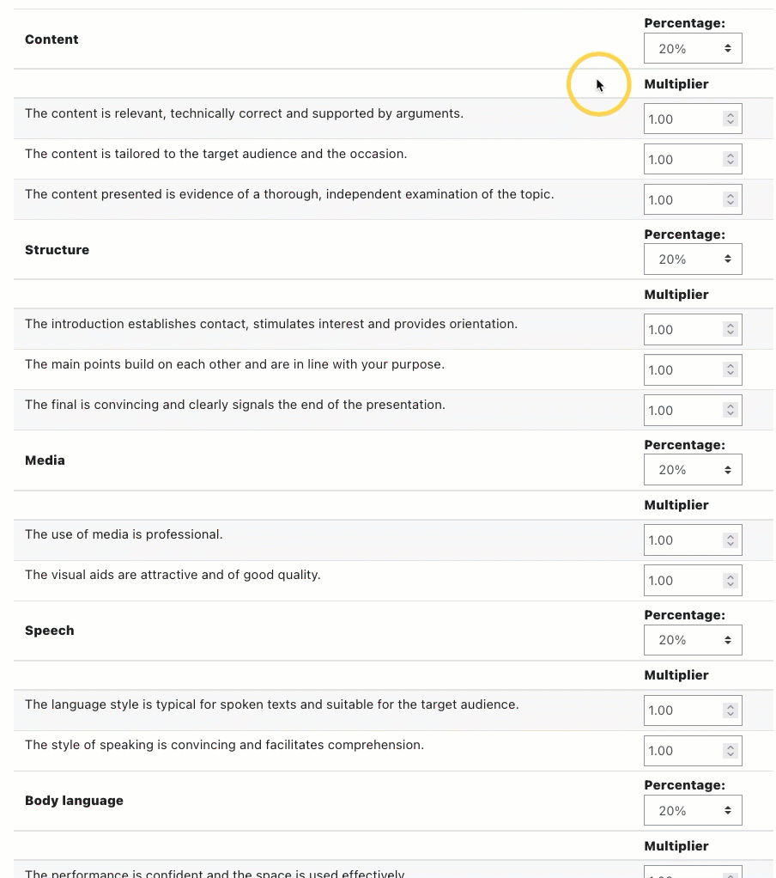
Fine tune the criteria grid (1)
Category percentage adaptable
0% percentage categories are ignored
Notes:
Now, if I just wanted four categories–for example if media isn't important because they are not allowed to be used–then I would just turn the percentage to zero and equalize in order that the other four sum up to 100%. A 0% category is not displayed neither in the grading form nor in the result sheet.

Slide 10
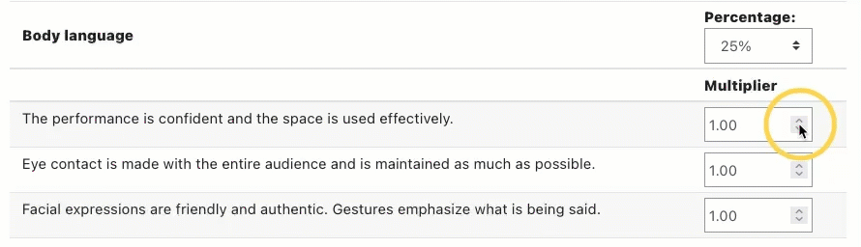
Fine tune the criteria grid (2)
Criterion weight inside a category adaptable
0 multiplier criteria are ignored
Notes:
The criteria that make up a category can be weighted between each other. If I want one to be weighed more than the other, I would just increase the multiplier. A criterion with the multiplier set to 0 isn't displayed in the sheet. Once done with my customizations, I can preview the evaluation sheet or make it available right away. Then, a lecturer or multiple lecturers can go and grade a student who does a verbal presentation.

Slide 11
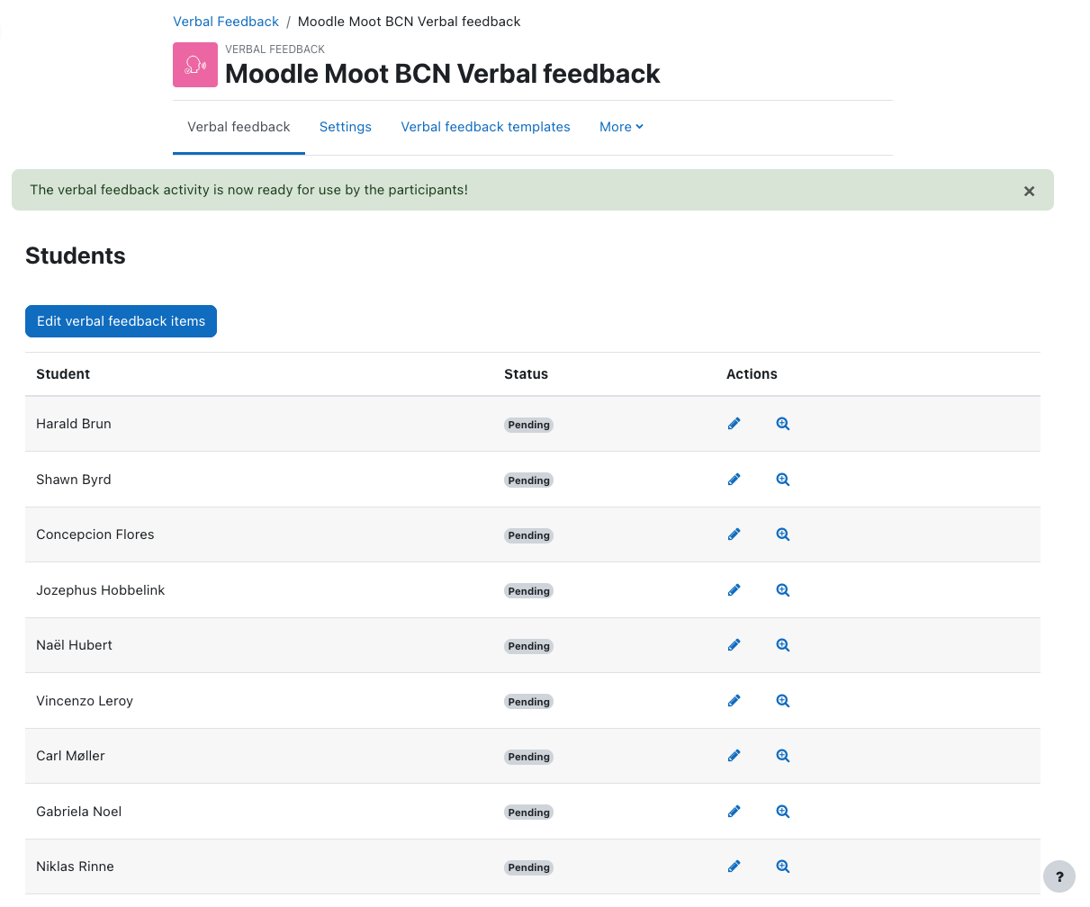
Go grade and feed back
Students overview
Start assessing from here
Notes:
This is the overview of the students about to do a presentation.

Slide 12
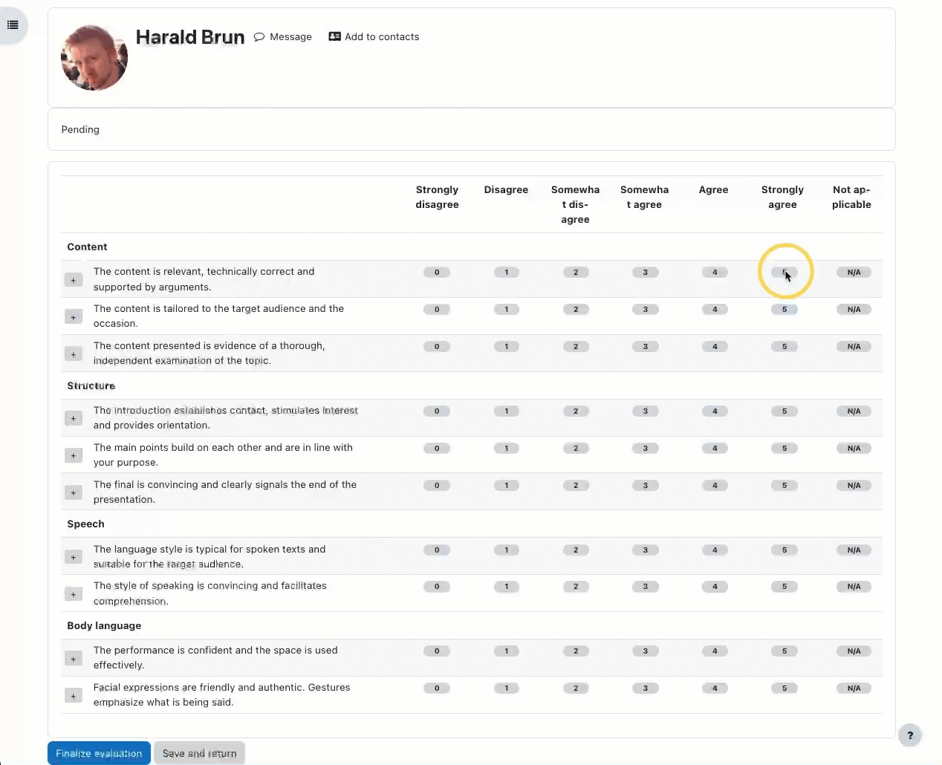
Go grade
Define the criteria numeric grade
Keep in mind what to add for the criteria
Notes:
During the presentation, a lecturer signs the grades which are on a six level scale. For the first times you do this, it is recommended to have a print out version of this evaluation sheet, too. But so far that wouldn't be very different from a usual rubric. Here's where the added value kicks in.

Slide 13
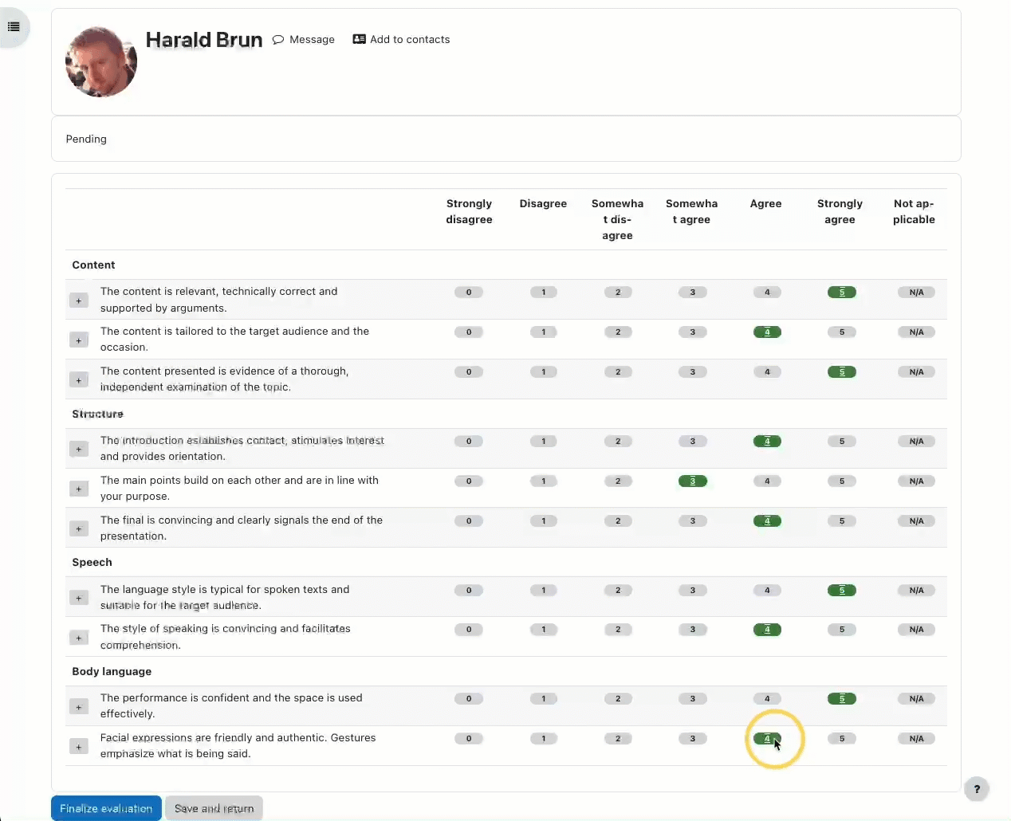
Go comment and feed back
Different four scale phrases
for the aspects of the criterion
Add them to the editable
“Structured comment” field
Additional private notes can
go in the “Private comment”
field
Notes:
This is the detail rating. For each criterion different feedback sentences are prepared. When clicking on the “Plus” button at the left hand side of criterion those sentences are presented upon hovering over the four buttons.
When clicking one of the options, the phrase is added in the Student comment field. That comment field obviously can as well be amended, but the phrases added by those button clicks are a great starting point.
There is a “Private comment” field as well which is visible only to lecturers.

Slide 14
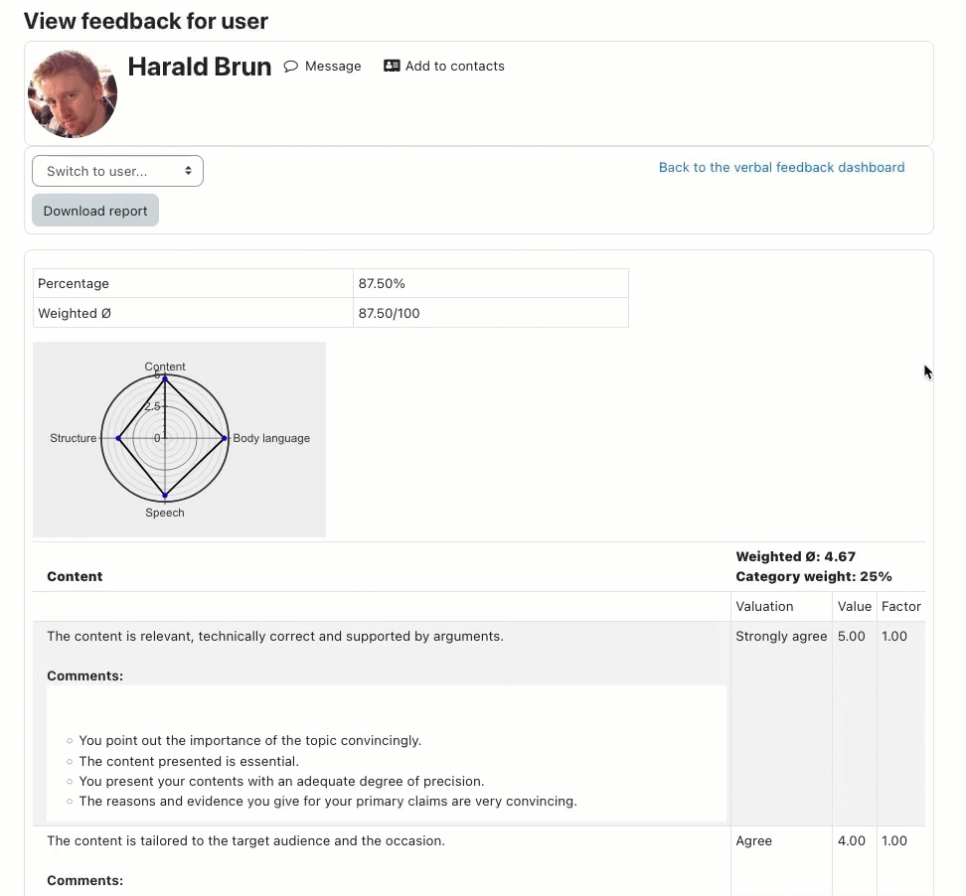
Results (1)
Combination of valuations
and feedback of multiple
lecturers combined
Values take the mean when
more than one do assess
Comments are combined
Notes:
The combined results of all grading lecturers are presented to the student who is graded.
This means, that the scores values consist of the mean of all grading lecturers. The single comments are merged together to form aggregated feedback.

Slide 15
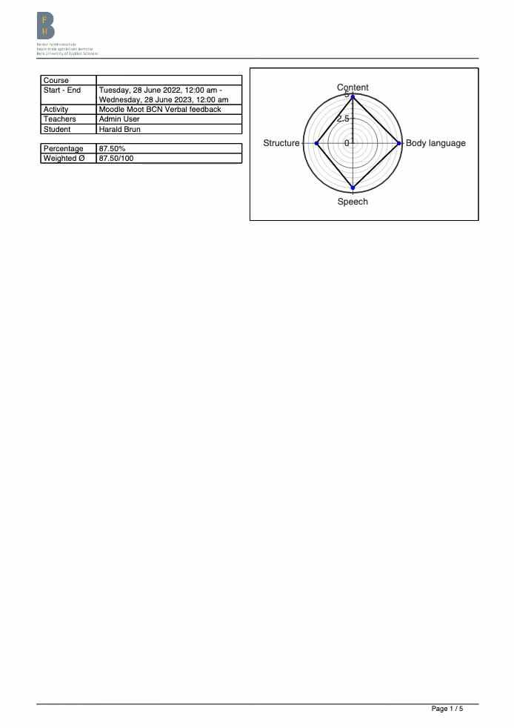
Results (2)
Downloadable PDF
Site wise configurable
first page logo
Notes:
(…)

Slide 16
Recap
1
11
2
3
4
Configure questionnaire, adjust weighting of criteria
Perform rough evaluation during presentation, with notes
Perform fine evaluation after presentation
Feedback phase: publication of results
Notes:
(…)

Slide 17
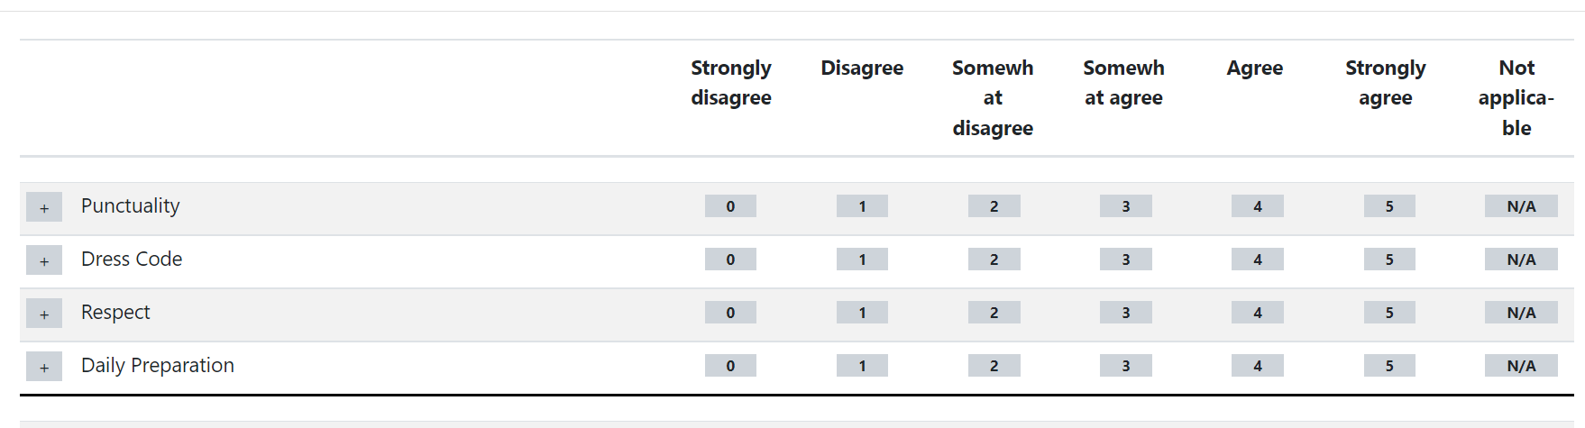
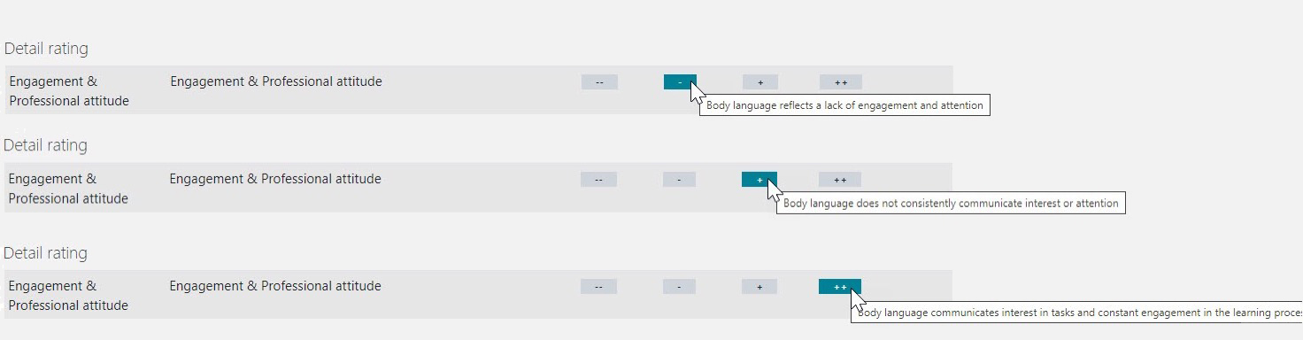
Adopters
The versatility of the tool is given
Example:
École hotelière de Lausanne
Adopt for training of Hotel managerial students
Notes:
(…)

Slide 18
Where do we go from here?
Group mode
Having peers grading peers (just assigning editingteacher role does not work)
More PHPUnit tests
Import/export functionality for criteria grids (YAML format)
Questionnaire for written assignments
Notes:
(…)

Slide 19
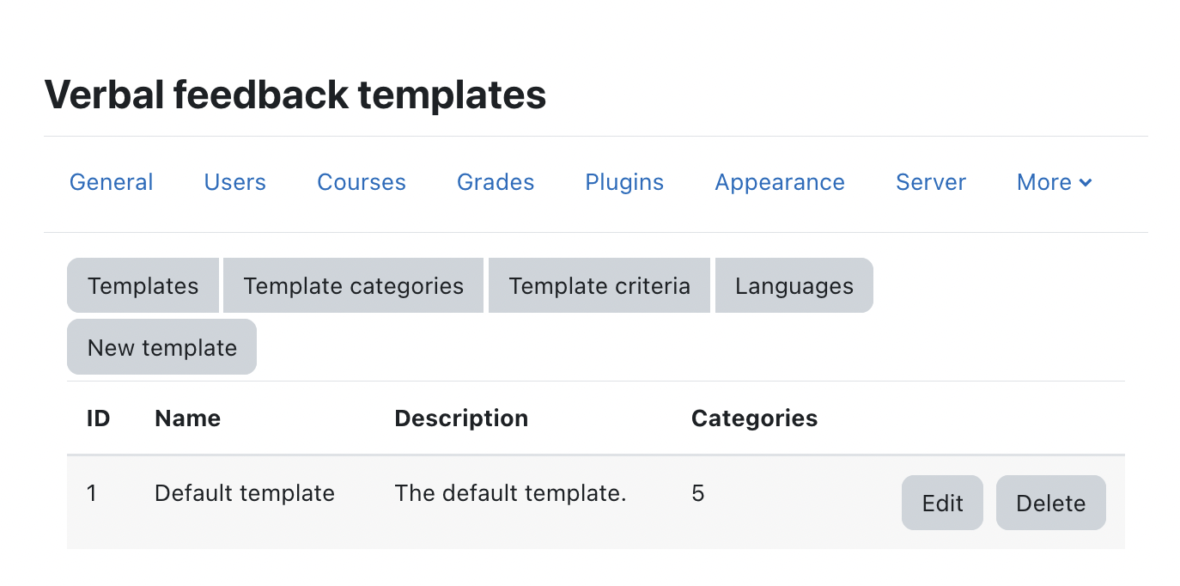
How to customize?
What’s here can be modified
Notes:
(…)

Slide 20
Questions? Remaks?
Notes:
(…)

Slide 21
Closing slide
Luca Bösch
luca.boesch@bfh.ch

Slide 22
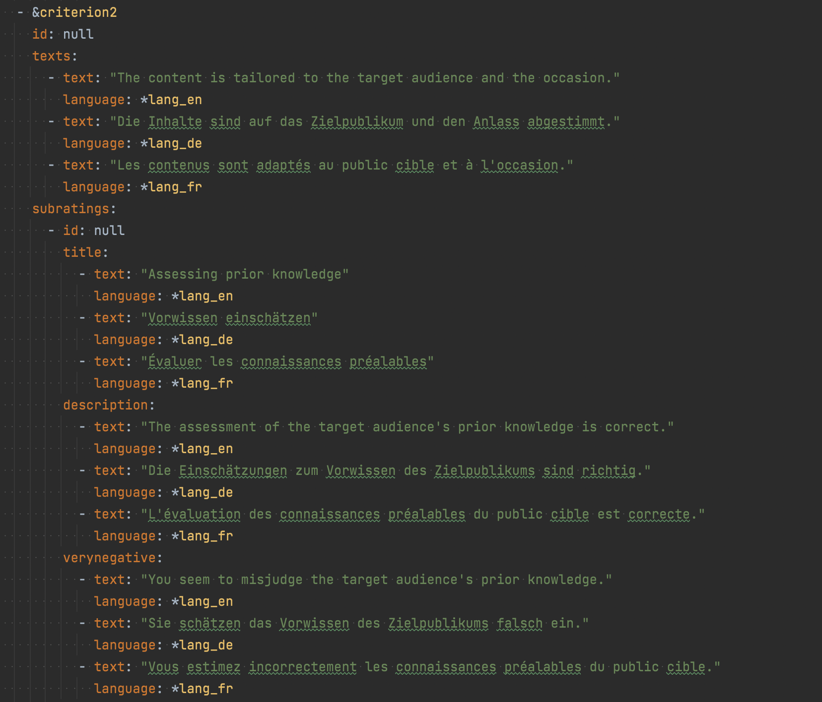
How to customize? (2)
YAML import/export format
Notes:
Headline, image and dot points slide

Slide 23
Hent, si diciend esequi que vendisIs essincte cus, consequi con providem qui oditi
tem harum qui tem. Nam ut omnimus andiciam qui arum, odit re rest, eaqui doluptatem eiur
Image goes here

