Slide 1
Using Moodle to
Bridge the Digital Divide
Building the UNESCO Institute for Lifelong Learning (UIL)
Digital Competencies for Literacy Educators Course
Lauren Goodman
@laurenfgoodman
Michelle Moore
@michelledmoore
Notes:
Lauren - Moodler since 2015 - Dean of Teaching and Learning Innovation at a community college
Michelle - Moodling since 2003; almost entire experience
Have had opportunities to work on amazing projects, learned all kinds of things from working with concrete and steel manufacturers to massage and trauma therapy programs, universities, trade schools and more. While always interesting, every once in awhile you have the chance to work on a project that
UNESCO Institute for Lifelong Learning - UIL -
course designed for educators - central audience - literacy educators who are volunteers working around the world - literacy is interpreted as broadly as possible - includes reading, writing, numeracy, and digital literacy - literacy educators could be teaching all kinds of literacies - course designed for educators
goal is to equip literacy educators to incorporate technology into their local context

Slide 2
Notes:
Moodle has had a relationship with UNESCO for quite some time given they have similar values and goals. This project developed as a result

Slide 3
UNESCO Institute for Lifelong Learning
Jian Xi Teng
Programme Specialist
ICT for Lifelong Learning
jx.teng@unesco.org

Slide 4
UIL Digital Literacies Course Team
Rakhat Zholdoshalieva: Team Leader Quality Learning Systems
Annapurna Ayyappan: Assistant Programme Specialist
Sofia Chatzigianni: Assistant Programme Specialist
Chung Qiongzhuoma: Assistant Programme Specialist
Catherine Fox: Consultant
Maria del Carmen Gomez Balleza: Intern
Zaheera Rajab: Intern
Notes:
thankful for this great team

Slide 5
Course Design Considerations
Notes:
started with content that had been written by subject matter experts - will probably aim to join the process earlier next time

Slide 6
1
Connectivity
2
Device
Learner Variables
3
Location
4
Language
5
Needs
6
Prior experience
Notes:
Needs - like all learners - will have very different needs - prioritized accessibility and universal design
all educators - any learner, anywhere,
no assumptions about the context of their learning experience

Slide 7
1
Online
2
Offline
3
Blended
Delivery Options
4
Face-to-Face
5
Synchronous
6
Asynchronous
7
Self-paced
8
Cohort-based
Notes:
Learner might be accessing course on their own using mobile app or in part of a group of learners with a facilitator in a class

Slide 8
1
Navigation
2
Deployment
Enabling
Adoption
3
Modification
4
Maintenance
5
Translation
6
Distribution
Notes:
any moodle site - formatted/built so people could make it their own - totally self-contained

Slide 9
Course Design
Features
Notes:
will walk through the examples
at the end we have lots of resources, and Guest access to the actual course

Slide 10
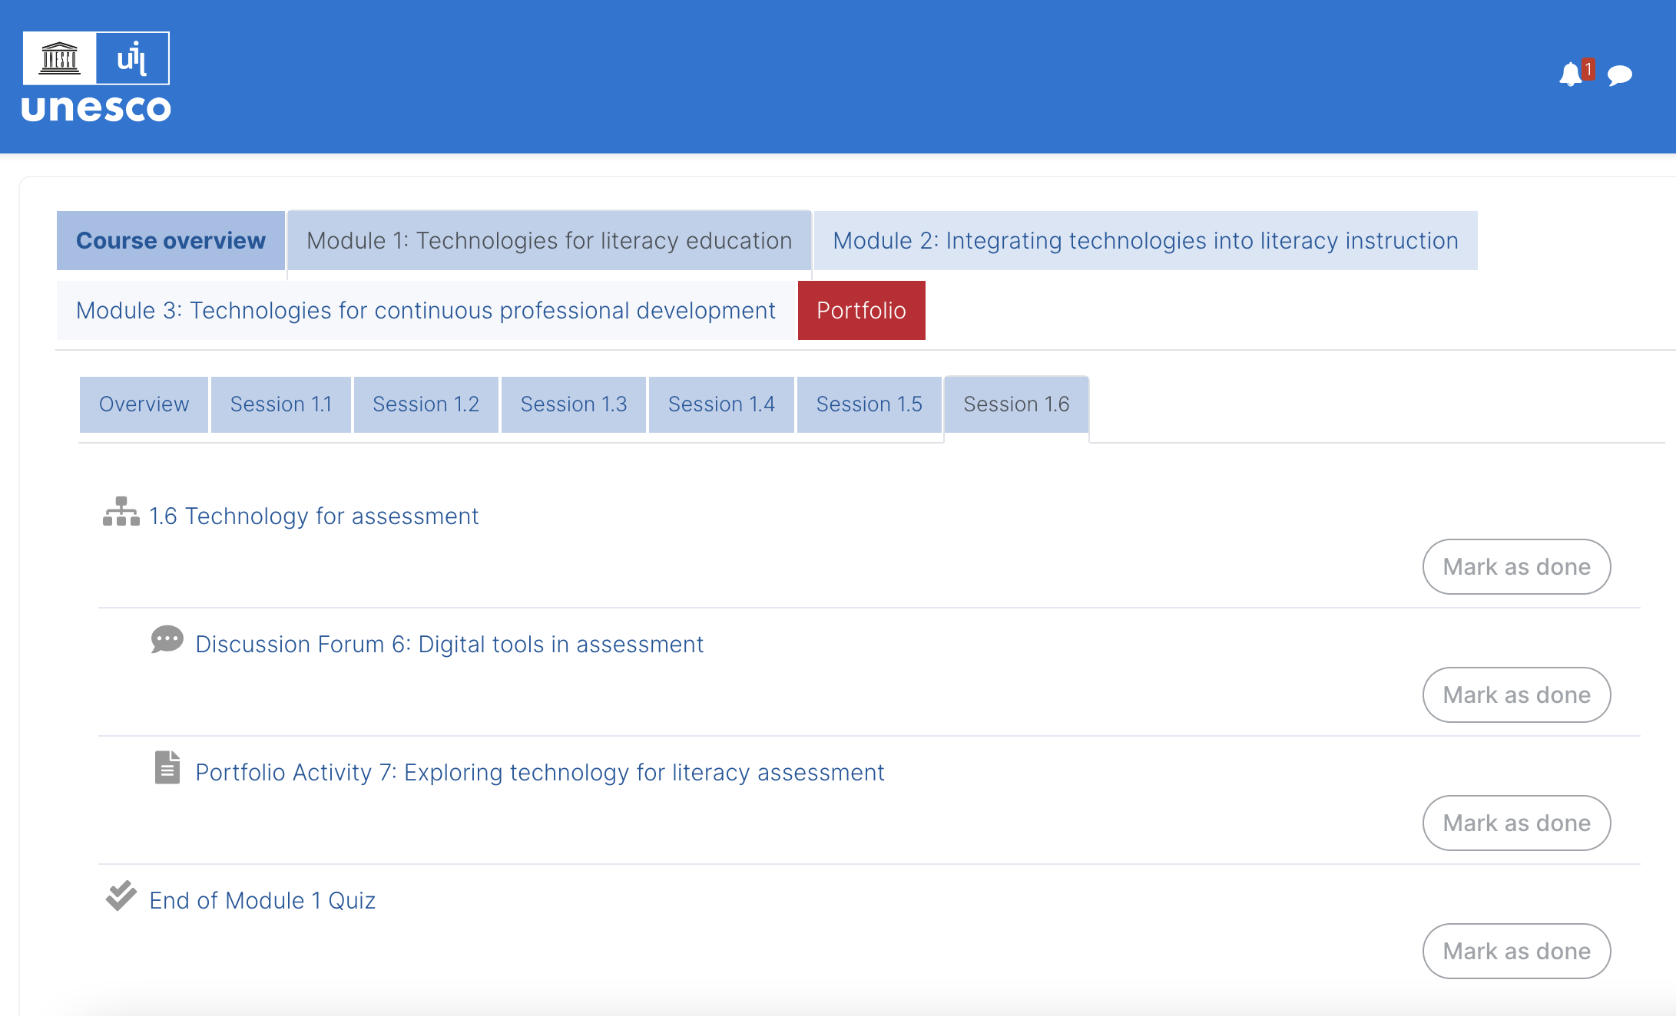
Notes:
Big Picture Course Design Features (LMS view)
OneTopic Format
Course structure - Module 1, 2, 3 and ~6 sessions per module - condense content
Naming conventions
Core Moodle tools
Lesson - provides the basic structure for all course content and navigation
Forum
Pages
Quiz
Activity completion - students manually mark as complete - wanted to give learner control
Links to activities (Forum and Portfolio prompts) both within Lesson and also on section page - intentional redundancy
Goal is to make it easy for in-person students and facilitators to navigate to activities

Slide 11
Notes:
Quick look at the course in Topics format
We made sure that all plugins (OneTopic, for example) were “nice to have,” not “need to have” - for easiest adoption

Slide 12
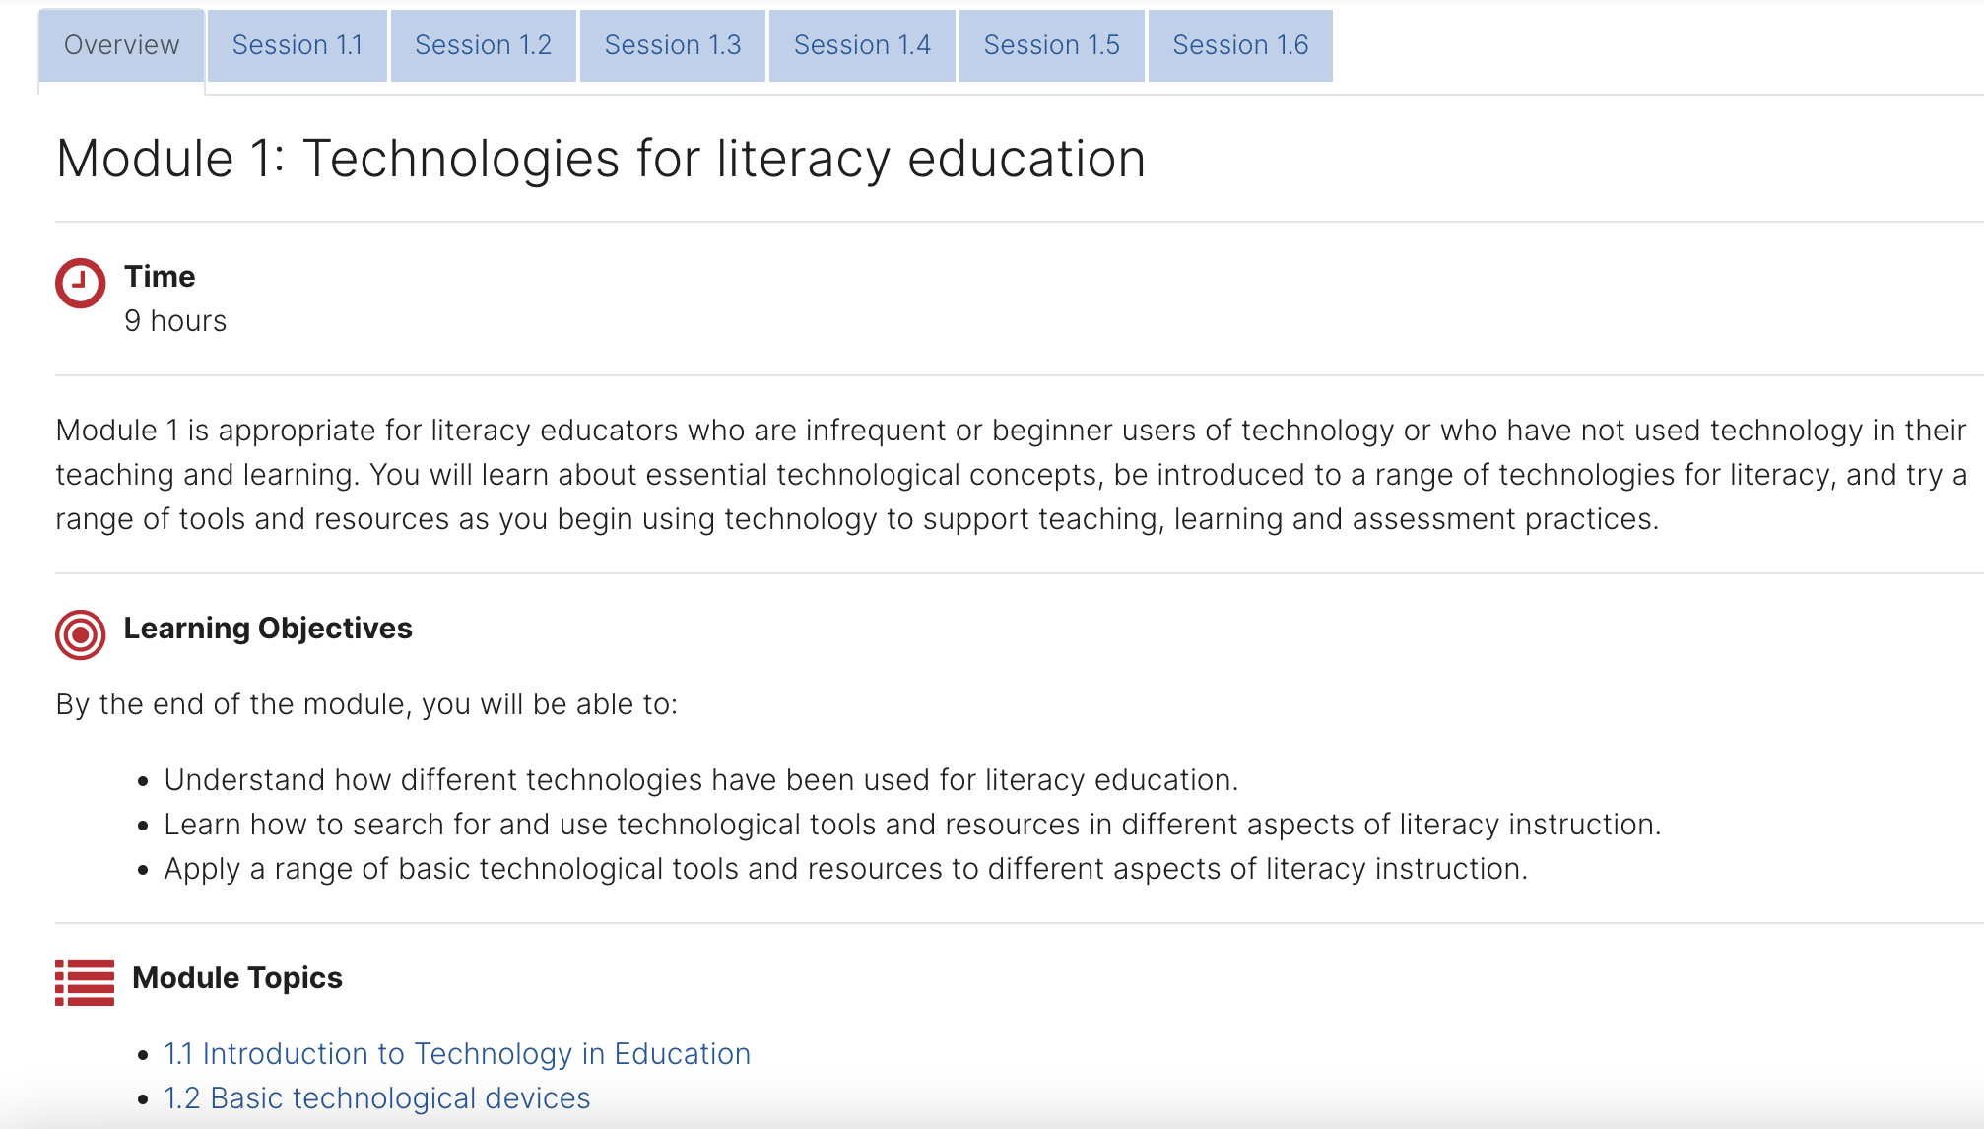
Notes:
Closer look inside a Module
Structure of Module consistent throughout course
Used Font Awesome icons to bring in simple images and break up course content without big images to increase course size
Used Activity Name Auto Linking for navigation throughout the course

Slide 13
Notes:
Closer look inside a Lesson - main structural element in the course - chose Lesson because it is:
Designed to chunk content and pace learner
Fully accessible online, online in mobile app, and offline in mobile app
Can be printed with Export to PDF plugin (will show this in a minute) - point out “Export as PDF” option
Used consistent formatting throughout course (note Font Awesome Icons)
Lesson Menu - allows for easily navigating through Lesson (show that Forums and Portfolio Activities are linked within Lesson)

Slide 14
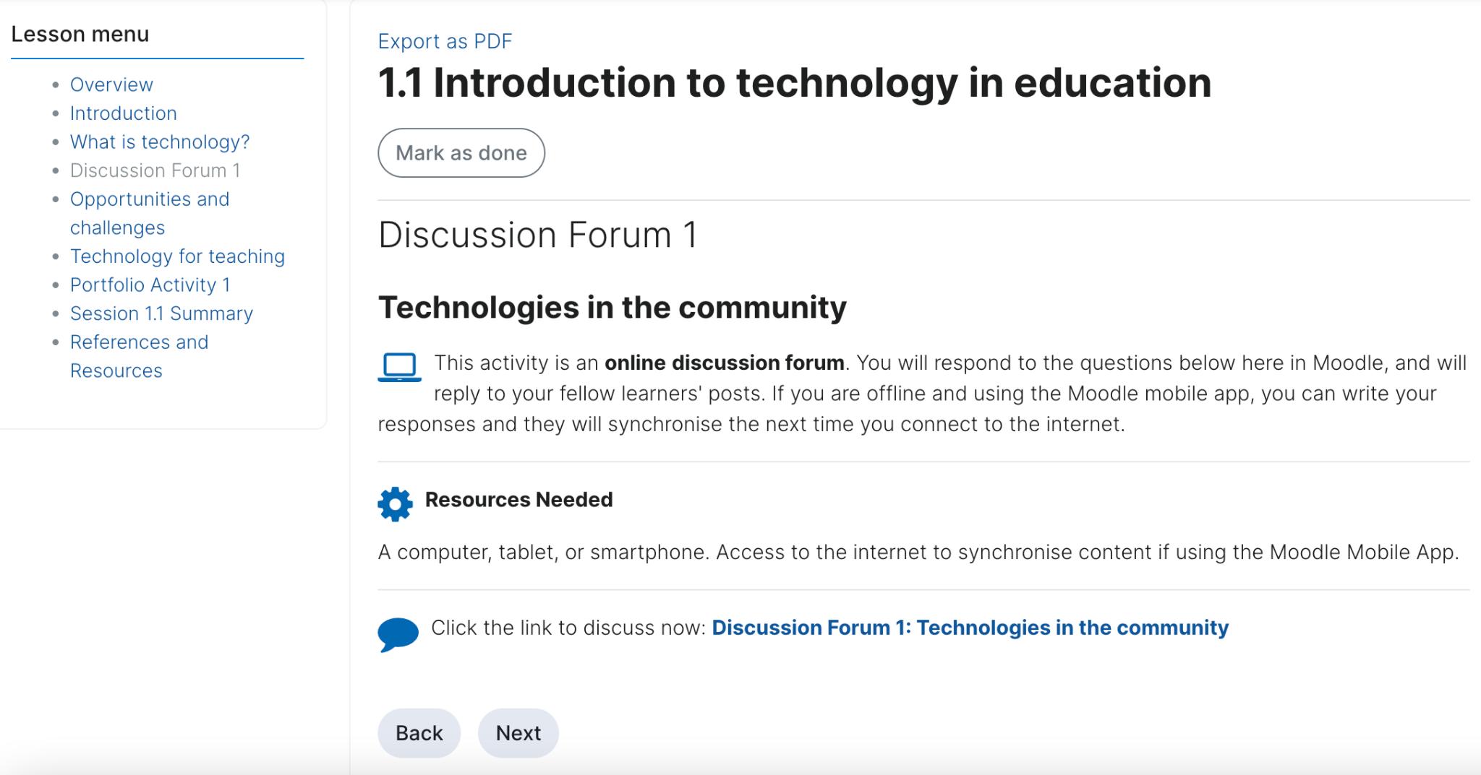
Notes:
Quick look at a Discussion Forum page in the Lesson - links learner out to the Forum activity
Forum activity then links back to Lesson (all with Activity Name Auto-Linking filter)

Slide 15
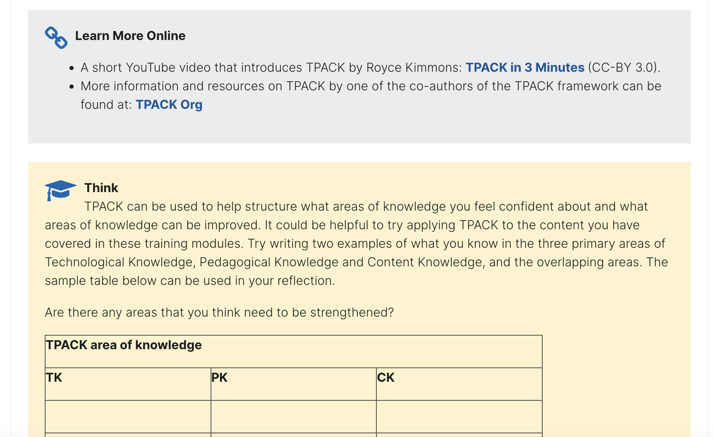
Notes:
It was important to UIL team to retain some of the “textbook-like” features of the original content, such as different colored boxes to indicate different types of content.
Examples here of “Learn More Online” and “Think” content within a Lesson page
inline CSS or HTML?

Slide 16
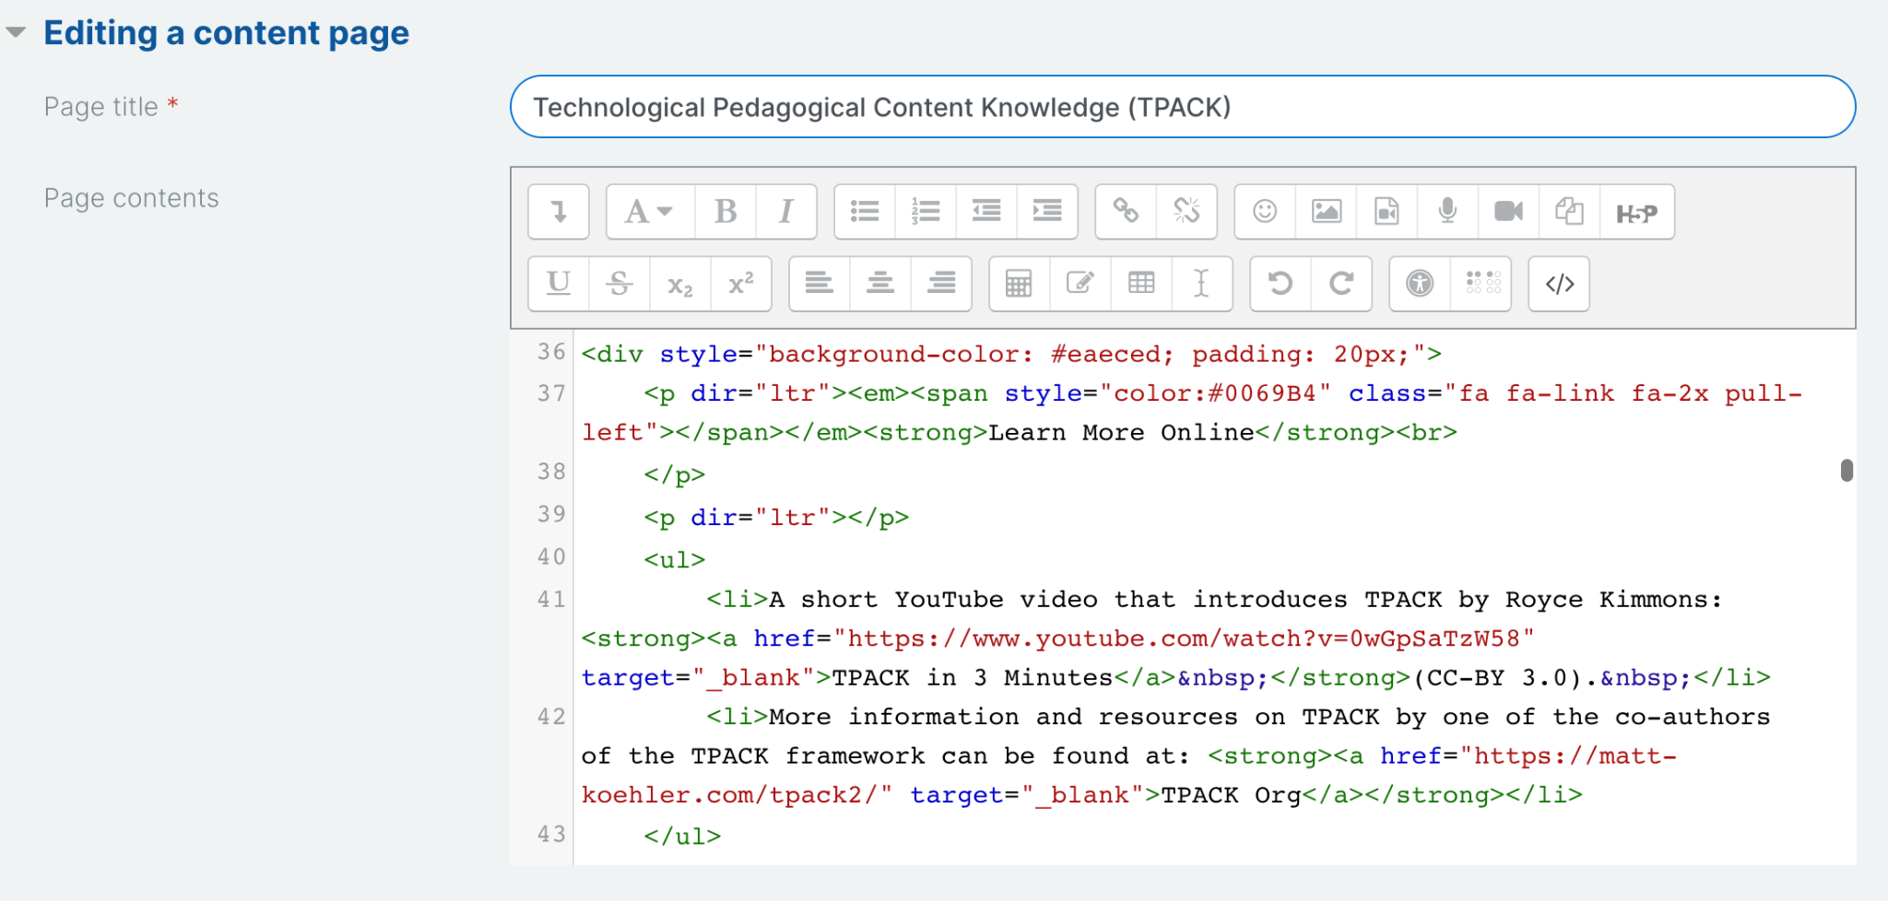
Notes:
HTML
Course needed to be self-contained, so no CSS - all HTML within Lesson pages
HTML for shaded boxes
TIP: Because of struggles with Atto editor formatting, I built most of this course directly using HTML (and I am NOT an HTML expert) - made copying-and-pasting faster and cleaner
TIP: I created a style guide with all of the HTML to make it easy to reproduce and reference (linked in Session Resources)

Slide 17
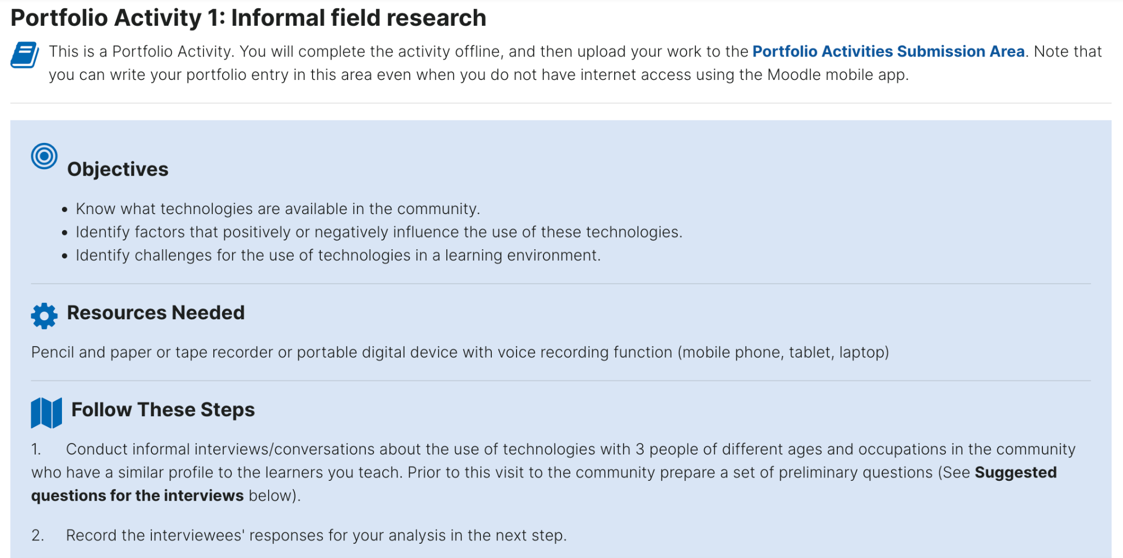
Notes:
Portfolio Activity
This evolved based on initial collaboration between UIL team and MUS
Authentic assessment
Screenshot here is of the Portfolio Activity prompt in the course

Slide 18
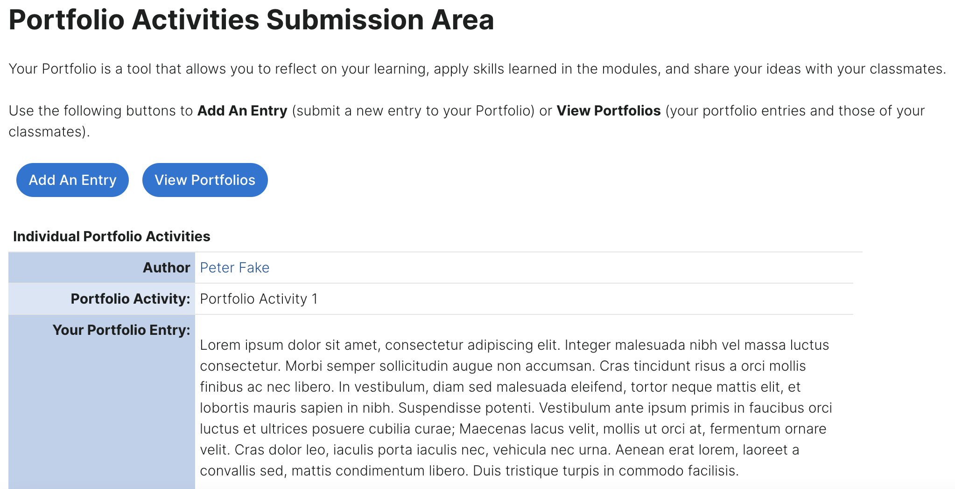
Notes:
Used the Database tool to facilitate student Portfolio submissions - Database is highly flexible and can be used fully offline in mobile app
Simplified Database menu and created these two easy buttons for students to use
THANK YOU to Sarah Ashley, MUS Team member who helped with this solution (shout out to Sarah’s session if it hasn’t happened yet)

Slide 19
Mobile App

Slide 20
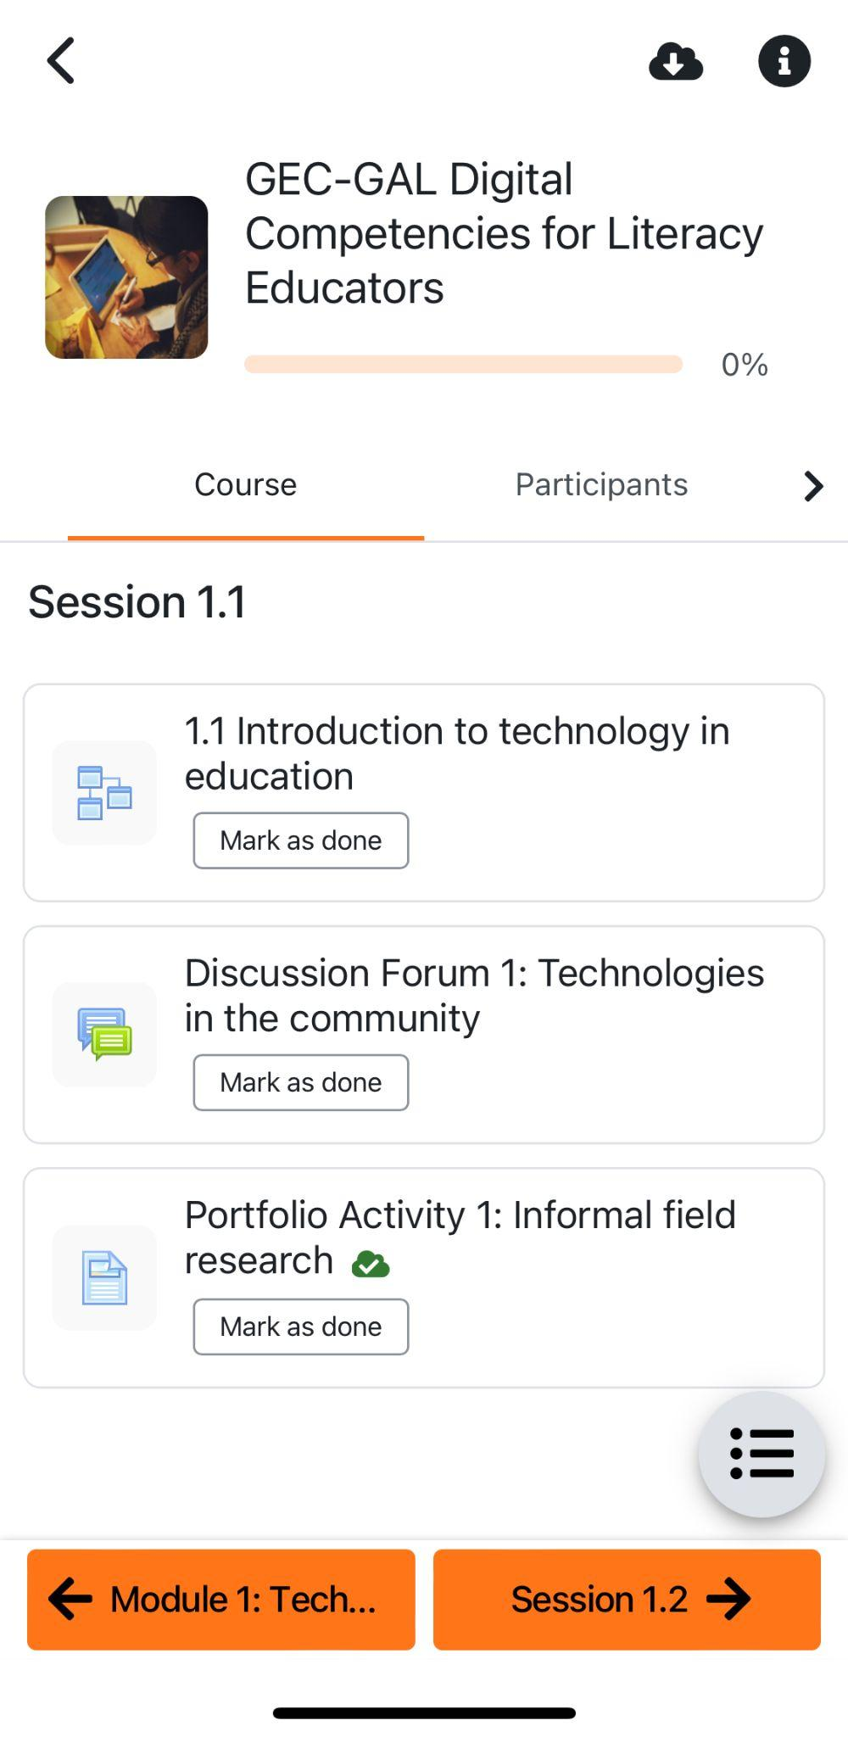
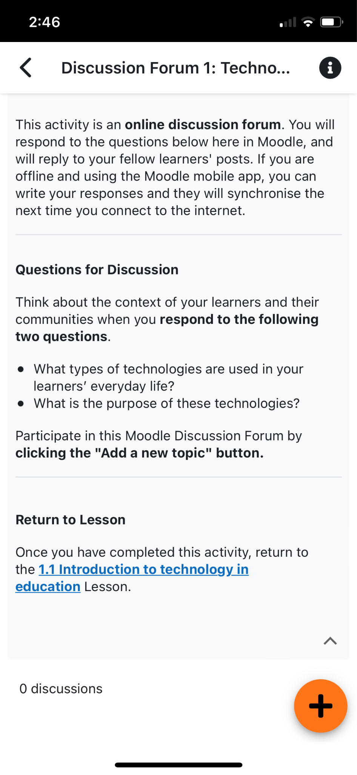
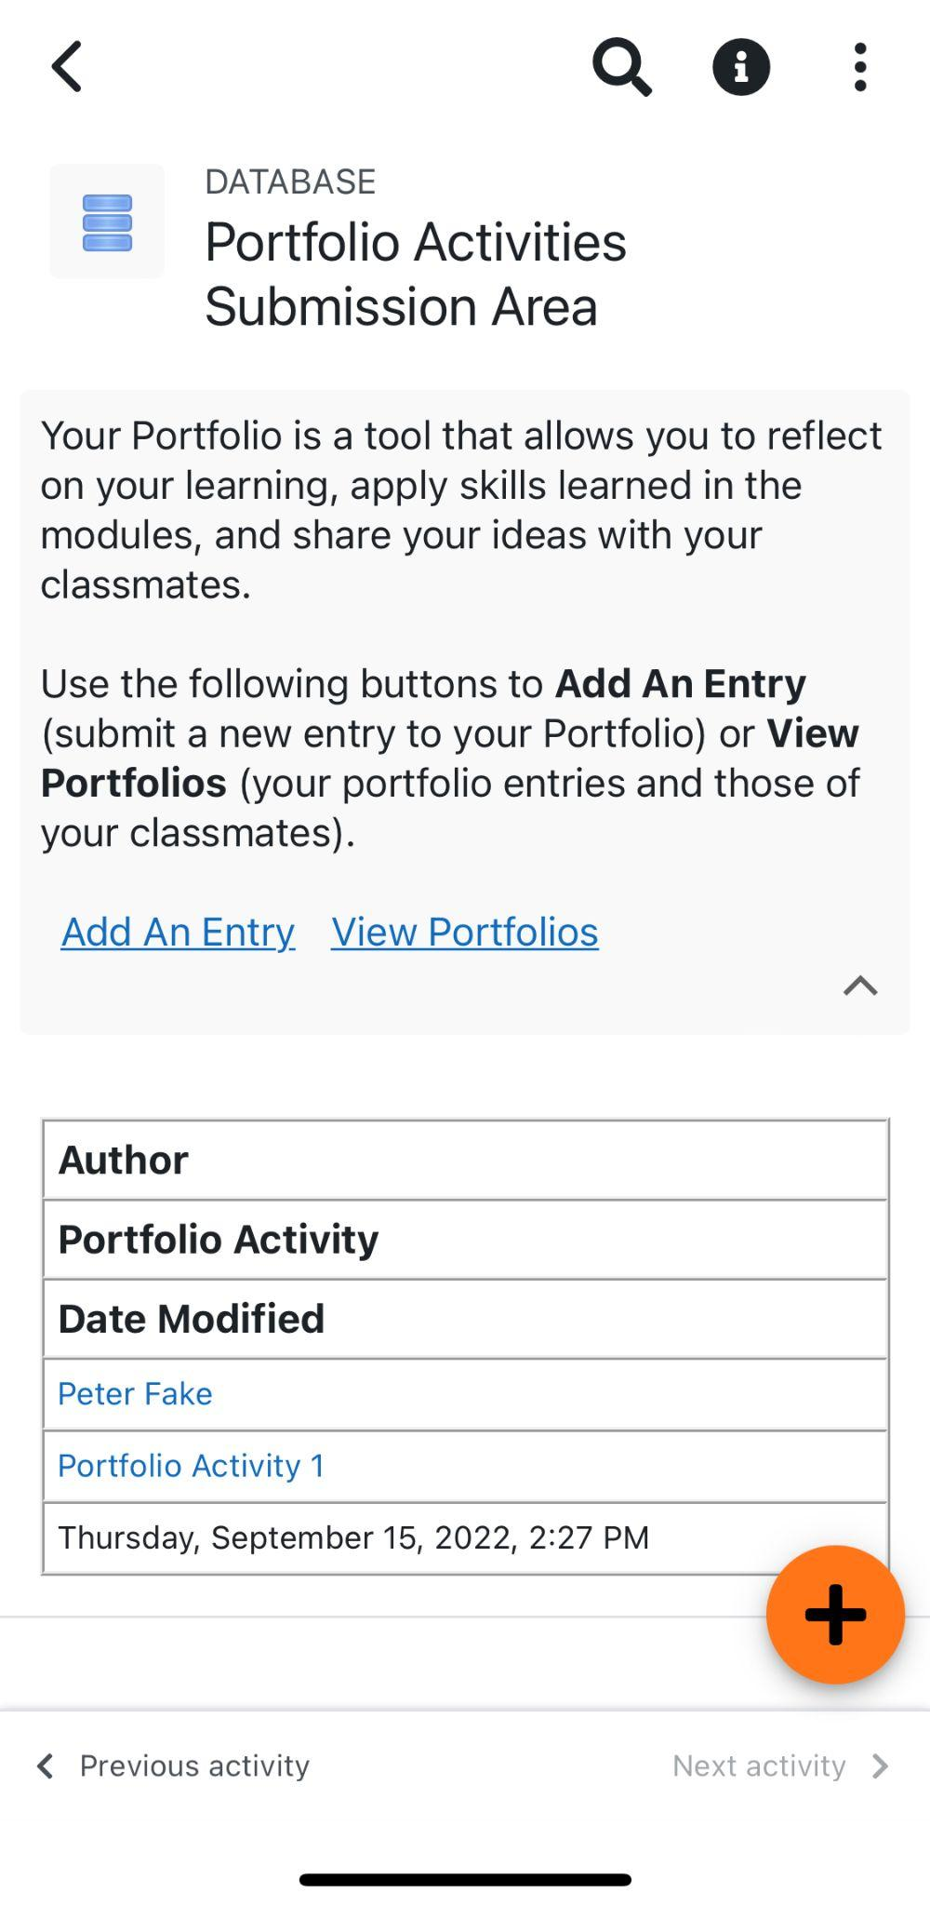
Notes:
These are screenshots from Moodle mobile app on iOS - we tested on iOS and Android, and UIL team also tested
We took a “mobile-first” design strategy with this course in the sense that, for every choice we made, we made sure that the activity could be completed not just in the app, but offline in the app

Slide 21
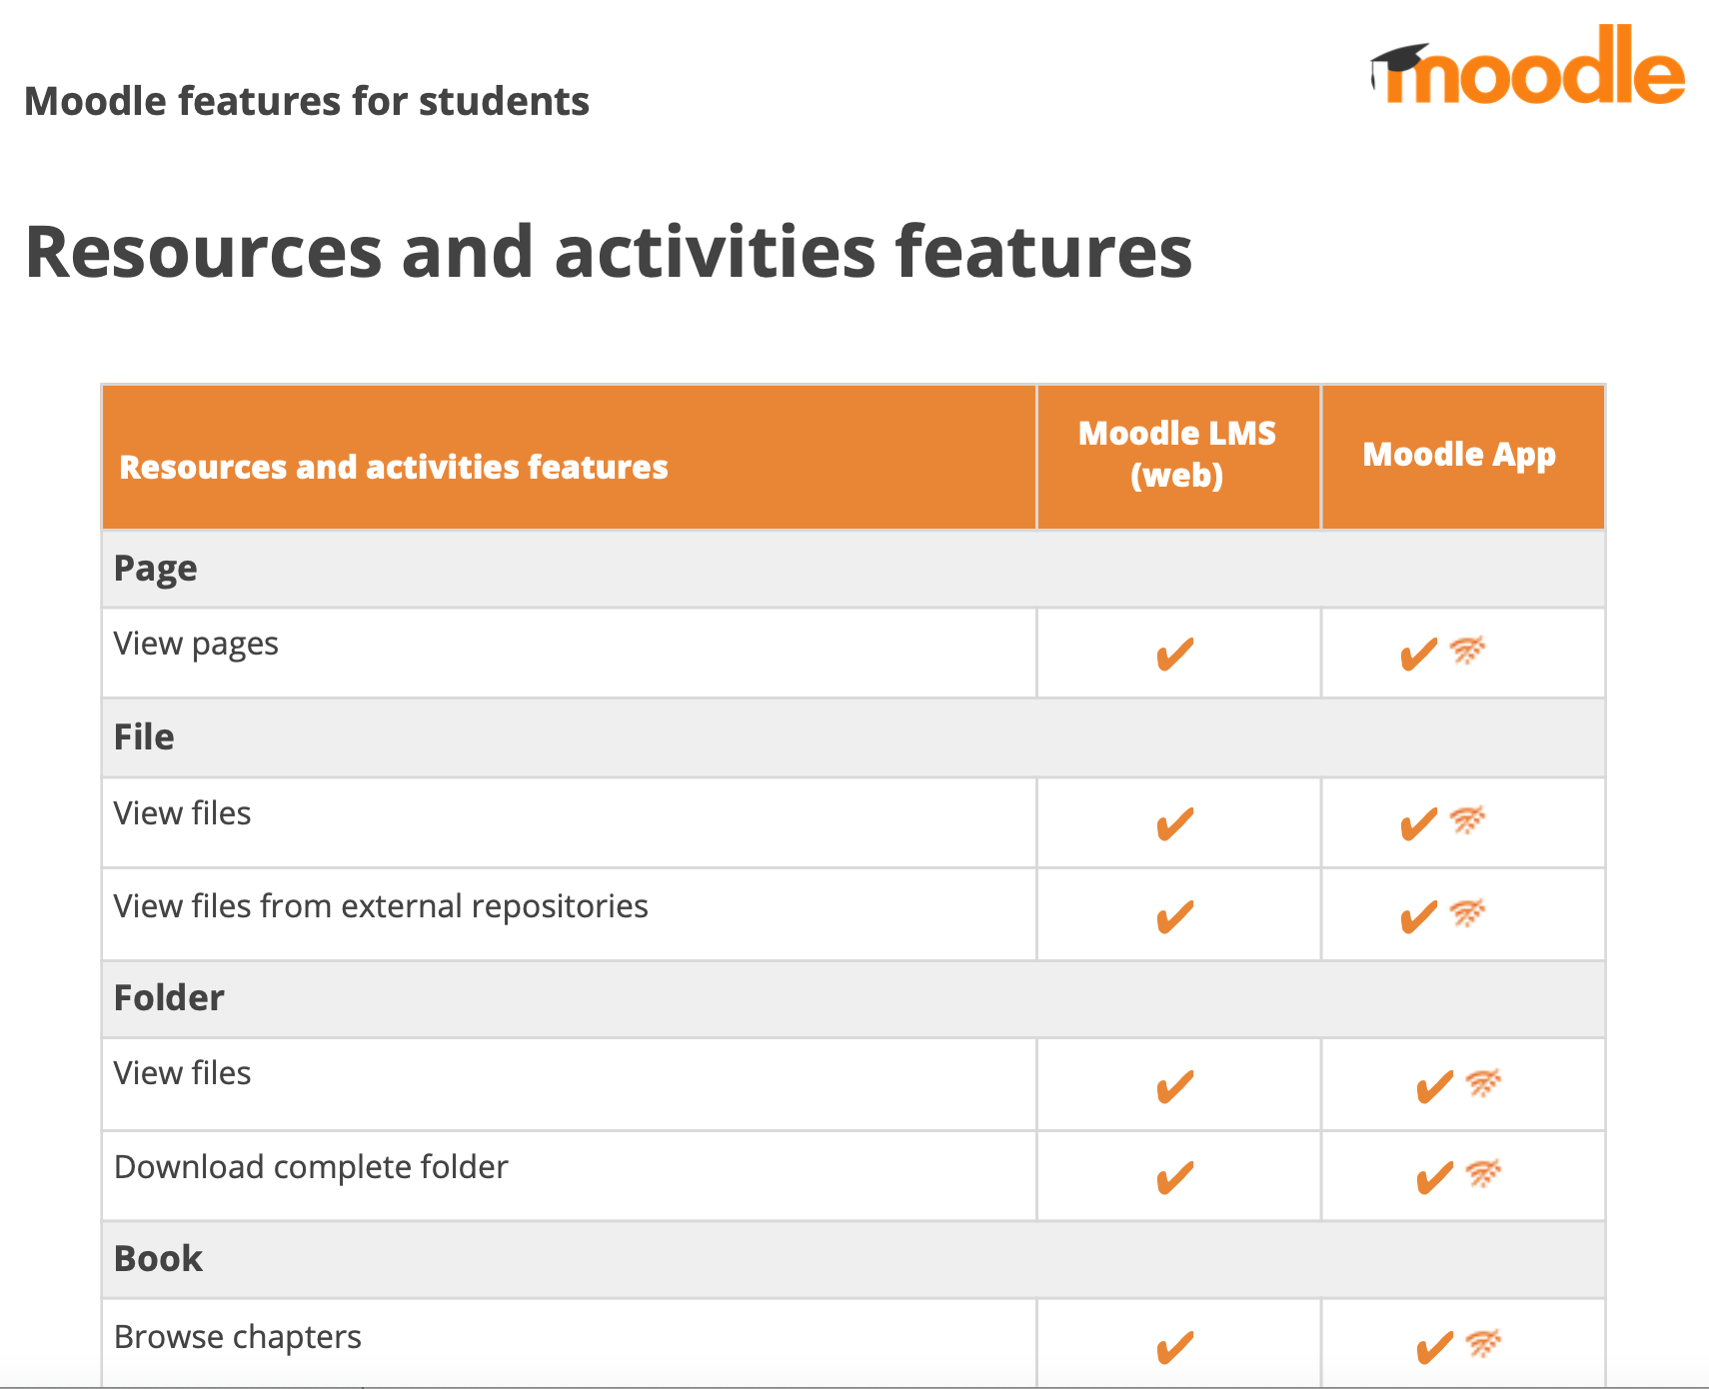
Moodle Mobile Design Resources
Moodle features for students
https://tinyurl.com/moodlestudentfeatures
Creating mobile-friendly courses
https://tinyurl.com/moodlemobilefriendly
7 tips for mobile course design
https://tinyurl.com/7moodlemobiletips
Moodle app offline features
https://tinyurl.com/moodlemobileoffline
Notes:
Examples of some resources I used as I was learning about designing for mobile - and offline use - in Moodle

Slide 22
Print

Slide 23
Notes:
Screenshot of a PDF generated by the Lesson PDF Export plugin

Slide 24
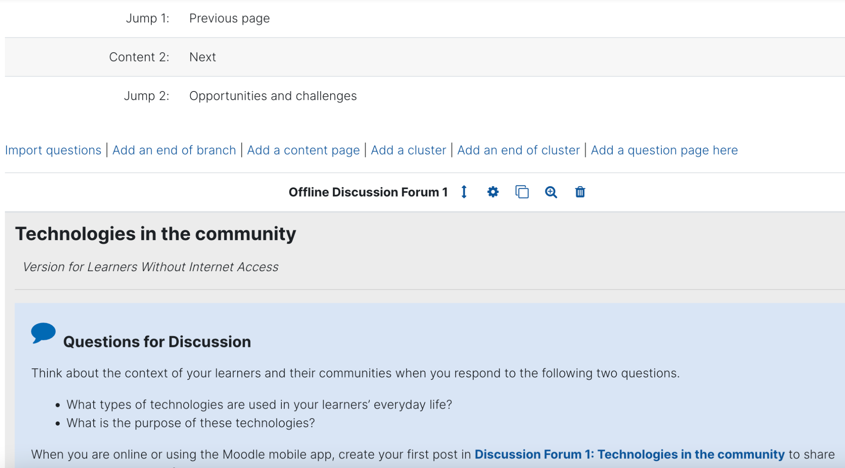
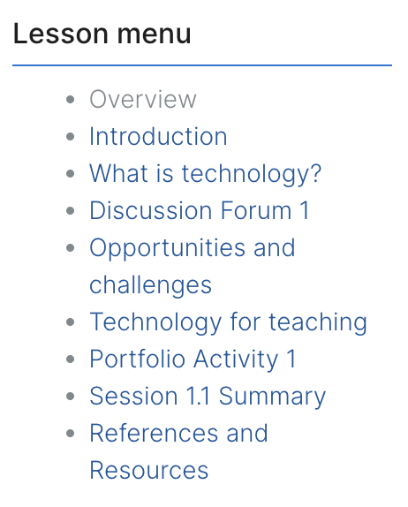
Notes:
“Offline Discussion Forum” pages in Lesson
These are skipped over
Purpose is so that the forum prompts will still print for offline learners

Slide 25
Testing, Feedback, Iteration

Slide 26
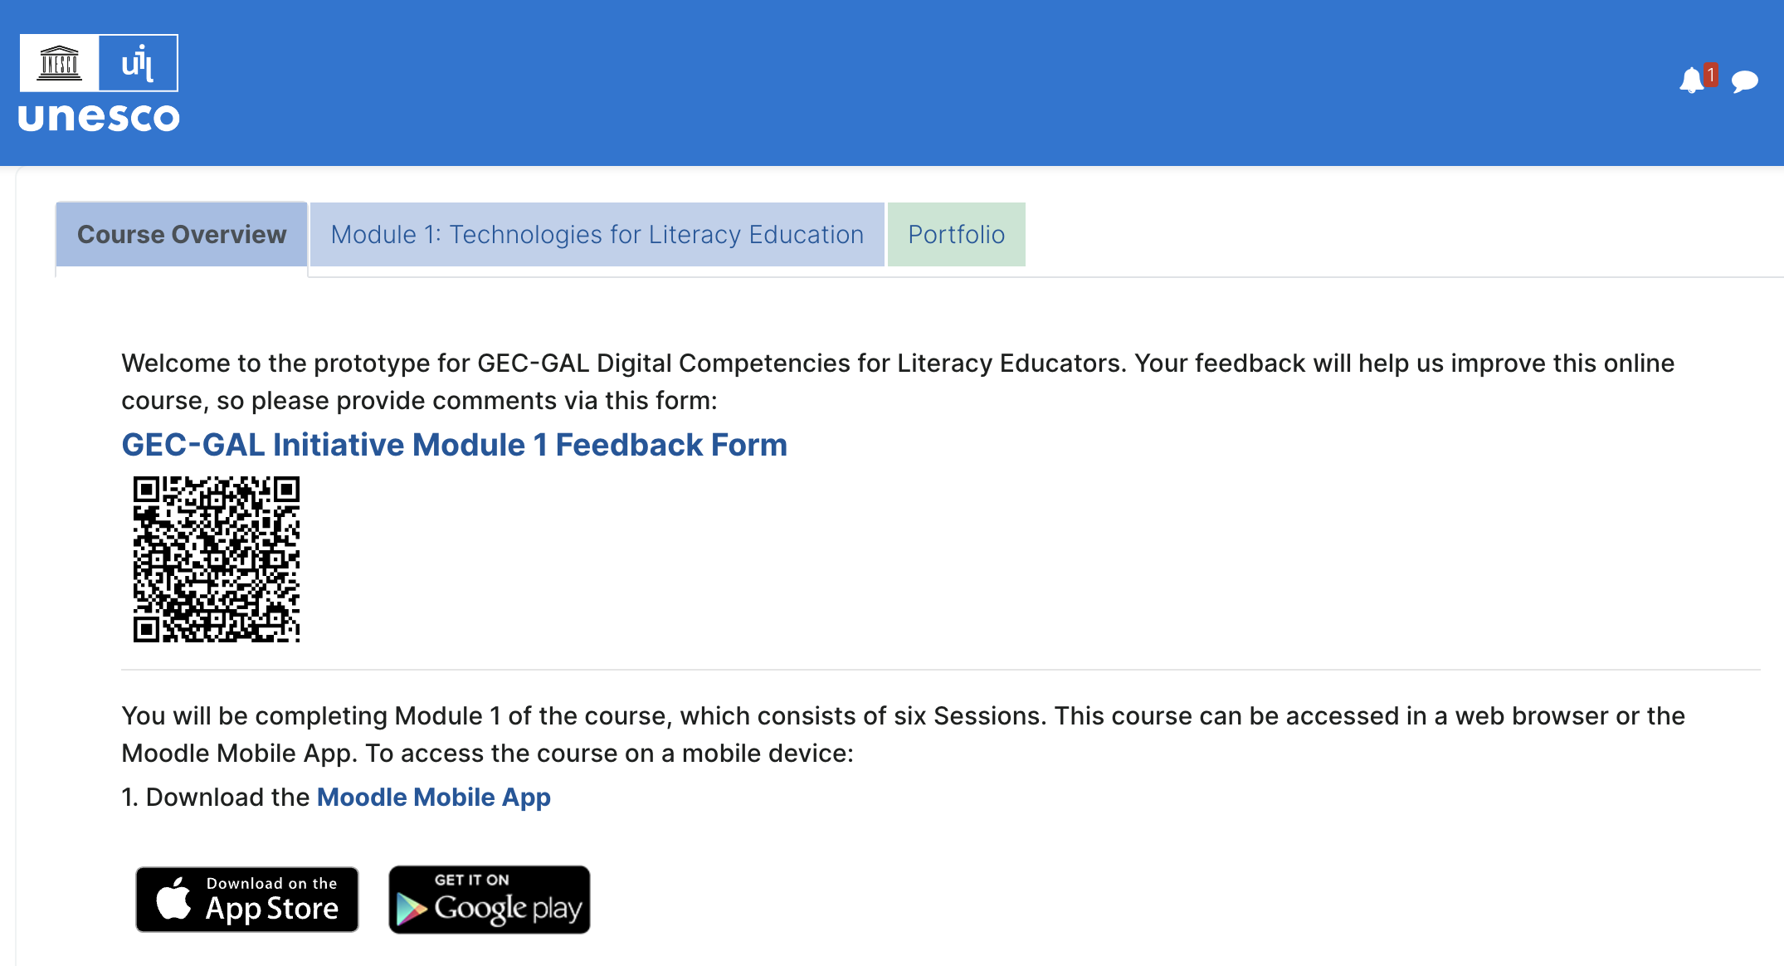
Initial Testing & Feedback
Notes:
is qr code active?

Slide 27
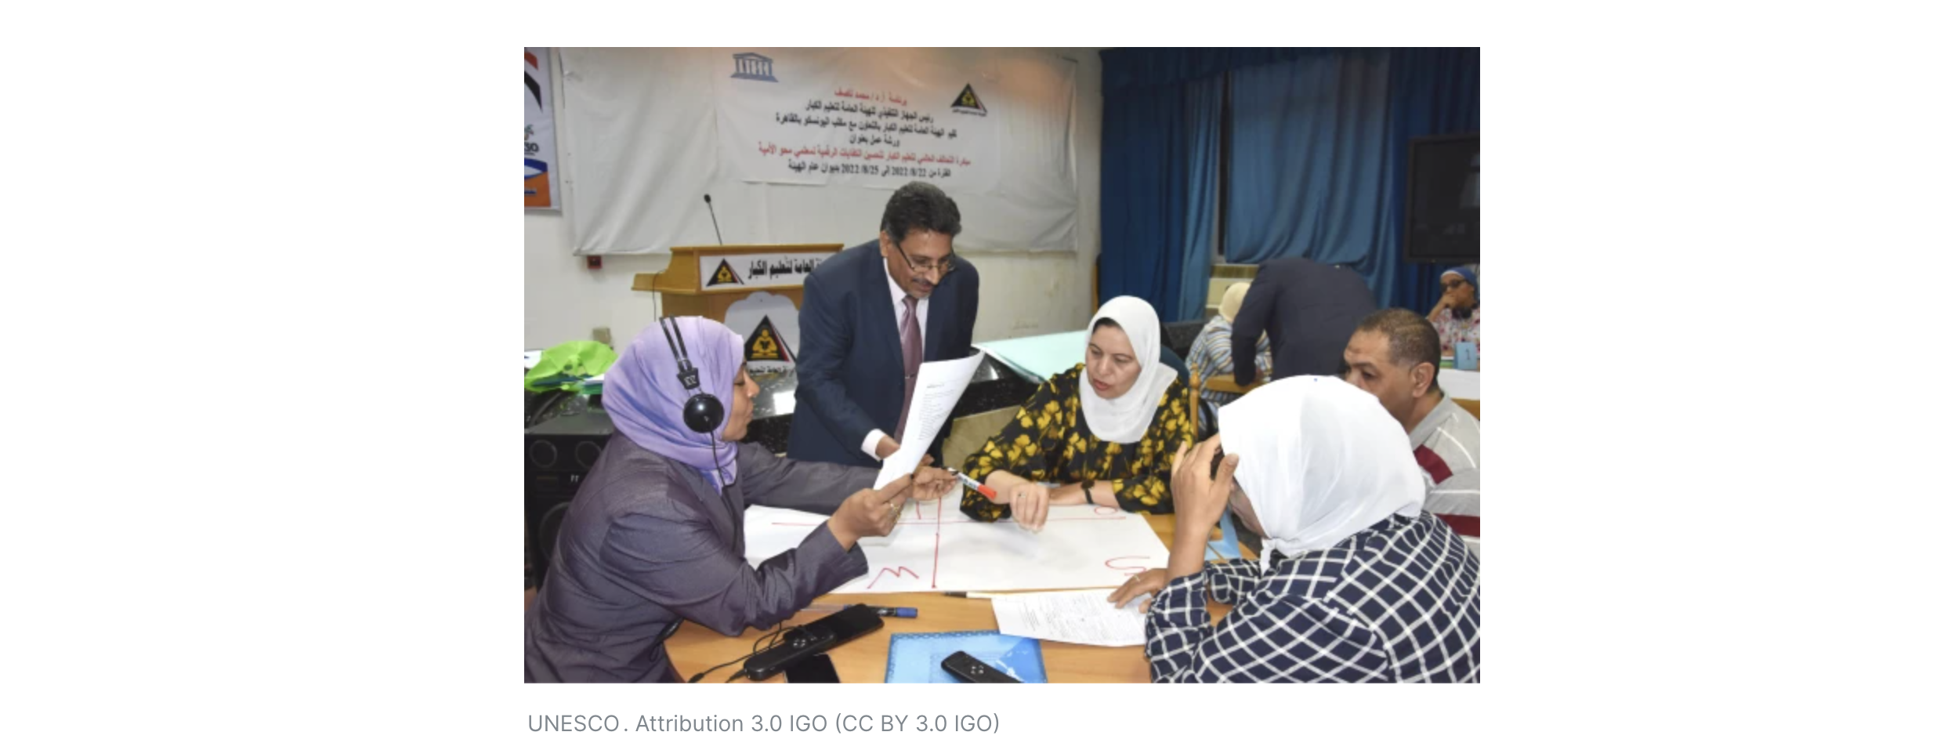
Global Distribution
Source: https://www.uil.unesco.org/en/articles/uil-launches-technology-training-literacy-educators-egypt

Slide 28
Q&A

Slide 29
Thank You!
Session Resources
Guest Access to Course
https://tinyurl.com/unescoliteracycourse
Google Drive Folder
https://tinyurl.com/literacycourseresources
Session Slides
Course Admin Guide
Moodle Features for Students
Lauren Goodman
Learning Designer
lauren.goodman@moodle.com
Michelle Moore
Head of Customer Success
michelle.moore@moodle.com
Notes:
Headline, image and dot points slide

