Slide 1
Moodle as Headless
LMS | CONTENT | MOBILE | CONSULTING | GAMIFICATION | MEC TRAINING |
IMS-LTI INTEGRATIONS | LEARNING ANALYTICS
^{ADDRESS:}
C. de València, 359 08009 Barcelona
C. de Méndez Álvaro, 20, 28045 Madrid
^{EMAIL:}
Xavier Paz - xavier@tresipunt.com
José María Tomás - jmtomas@tresipunt.com

Slide 2
WHO ARE WE?
Xavier Paz
José María Tomás
3ipunt Senior Developer
xavier@tresipunt.com
3ipunt Senior Developer
jmtomas@tresipunt.com

Slide 3
3ipunt is an official Moodle Premium Partners, members of the 1EdTech™ (Contributing Member) and AWS (Amazon Web Services) partners, as well as members of CatPL and EdutechCluster. We are focused in offering customized solutions in information and communications technology, with a high added value, a reduced cost and a close and accessible treatment.
We also identify ourselves with the concept bespoke: we like to provide a high added value to our projects, so these also provide things to us. We offer technology as a service to our customer. At 3ipunt we adapt technology to the customer needs to offer an customized integral solution for each project and scenario.
ABOUT US

Slide 4
AGENDA
Introduction & scenario
Approach
Headless system
Tokens
Services
Documentation
Roadmap
Q & A
Notes:
RRHH TIENDA
PRL
SOFTWARE DE TIENDA
ATENCIÓN CLIENTE
MARKETING
PRODUCTO
PUBLICIDAD EN TIENDA
CAMPAÑAS

Slide 5
THE TALE
Notes:
RRHH TIENDA
PRL
SOFTWARE DE TIENDA
ATENCIÓN CLIENTE
MARKETING
PRODUCTO
PUBLICIDAD EN TIENDA
CAMPAÑAS

Slide 6
Introduction
Client with Moodle Workplace and additional external apps that need to “consume” it.
Different technologies and languages (Angular and .NET)
Makes no sense to build a custom LMS from scratch.
Consume Moodle… as a service?
Users still need to use Moodle as usual.
Use famous content service as question and resources bank for courses.

Slide 7
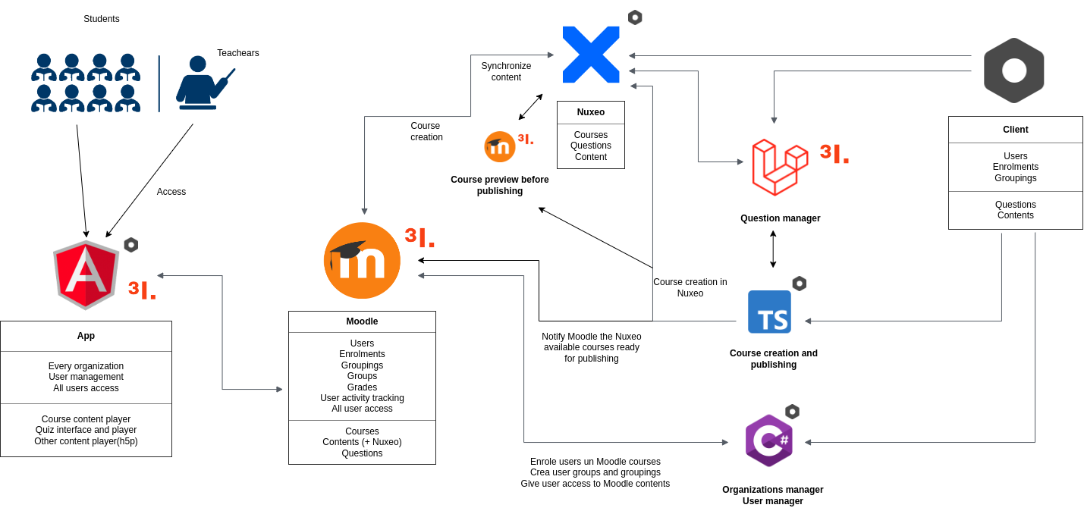
SCENARIO

Slide 8
THE SET-UP
Notes:
RRHH TIENDA
PRL
SOFTWARE DE TIENDA
ATENCIÓN CLIENTE
MARKETING
PRODUCTO
PUBLICIDAD EN TIENDA
CAMPAÑAS

Slide 9
APPROACH
Service based architecture.
Moodle can serve all its data and content to an external interface developed in any technology.
Consume moodle common services, following the standard for future coherence. Changes in apps? No problem, logic still valid.
Moodle adaptation factor.
Is Moodle ready to work as headless? Not sure, but it seems possible. Let’s check headless JSON and Restful canon.
Connect Moodle with different technologies: React, Angular, Node, Python, VUE. Using moodle does not limit you to PHP.

Slide 10
THE HOOK
Notes:
RRHH TIENDA
PRL
SOFTWARE DE TIENDA
ATENCIÓN CLIENTE
MARKETING
PRODUCTO
PUBLICIDAD EN TIENDA
CAMPAÑAS

Slide 11
HEADLESS
SYSTEM
Local plugin connects Moodle with the outside world.
Any change in Moodle is extended in any connected sources.
Use Moodle token system to operate.
Additional custom log system for each app based on Moodle standard log system, with additional tracking information for BI.
Implement the minimum necessary services. No more, no less.

Slide 12
TOKENS
Generate and user different types of tokens:
App: Login, synchronize app configuration, communicate with Moodle. Must be accessible for the app (hardcoded,endpoint, etc..)
Admin: Used for admin tasks and user management (enrolments, user uploads, course management, etc…)
Individual user: Used after login, for user actions in Moodle (grade, answers, profile, activity in course) Useful for Moodle to track user activity in the platform. Possibility to apply user profiles.

Slide 13
USERS AND
CAPABILITIES
A token for each individual user account
Get Moodle user context and capabilities.
Capabilities associated to each individual user token type.
Use Moodle capability system
After login, the app receives the user token to keep individual tracking of user activity in the platform.

Slide 14
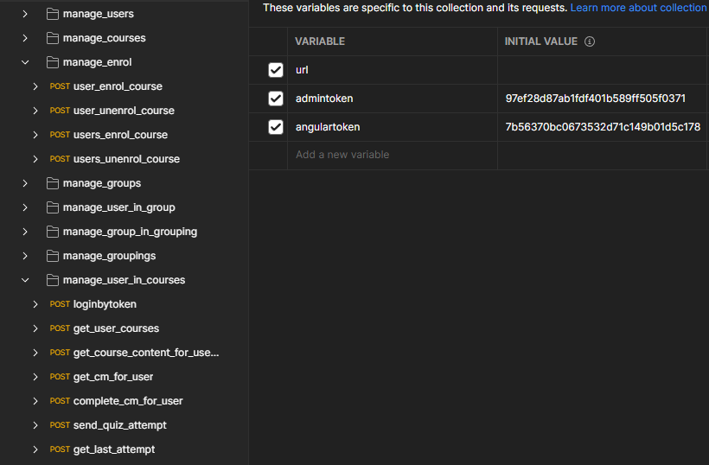
SERVICES
Goal: Simulate user activity using services.
Use moodle standard methods and workflow for each user action (submit assignment, forum post reply, etc…) to keep tracking in Moodle log.
Does Moodle already provide the service? Use it. Do not reinvent.
Most Moodle Mobile App services use token. Check it out!
Keep moodle way of working always in mind (groups, capabilities, enrolments, roles) and merge it to your workflow.

Slide 15
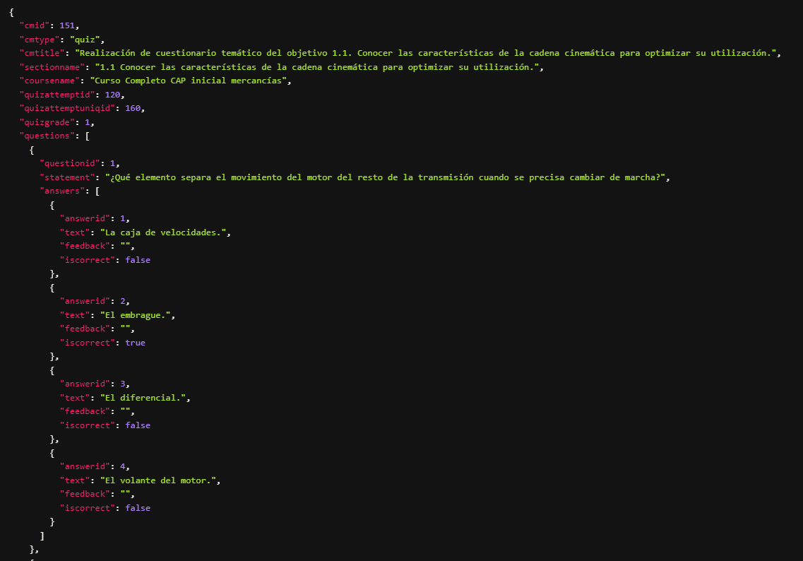
SERVICES
Course modules service example json response:

Slide 16
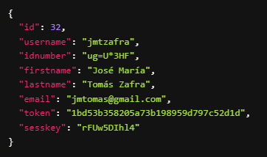
SERVICES
Login service example json response:

Slide 17
MOODLE
HELPERS
Use everything Moodle provides to ensure an easy way of life.
Use observers and ad hoc task to automate common or specific task.
Listen to Moodle events, to trigger actions on background.
Use Moodle APIs (course, user, groupings, auth, log) to deal with Moodle features and actions.
Intensive use of APIs to consume external content.

Slide 18
THE WIRE
Notes:
RRHH TIENDA
PRL
SOFTWARE DE TIENDA
ATENCIÓN CLIENTE
MARKETING
PRODUCTO
PUBLICIDAD EN TIENDA
CAMPAÑAS

Slide 19
ADDITIONAL
SERVICES
Moodle already offers services. Useful services that can be extended, but we can go further
A generic design to rule them all is not easy
Web tokens only valid to operate with a set of services. You need additional tokens for extra services
Solution: a token for each set of services
CRUDs

Slide 20
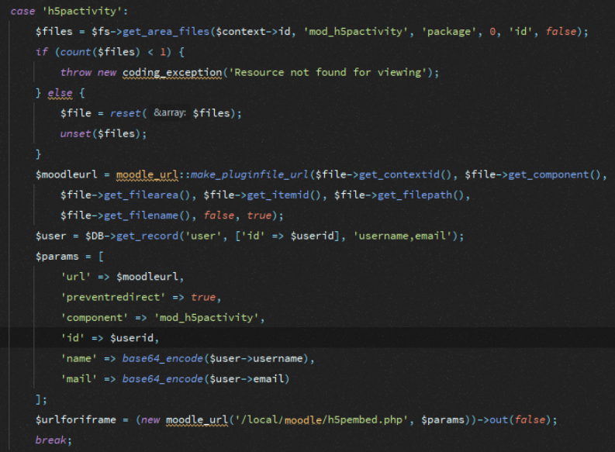
h5p CONTENT
SERVICE
Problems reproducing the content: iframes, parent window, cross domain.
Build url in custom way to allow Moodle to reproduce the h5p into an external source.
Prevent h5p redirect and user login, by tokenizing.
Moodle need user to have opened session...

Slide 21
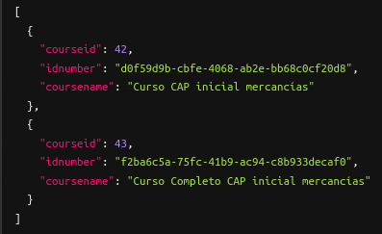
MANAGE COURSES SERVICE
Course content and data provided from external source (Nuxeo).
CRUD for course management in the Moodle platform through the Nuxeo plugin installed in Moodle, which provide.s all these services...

Slide 22
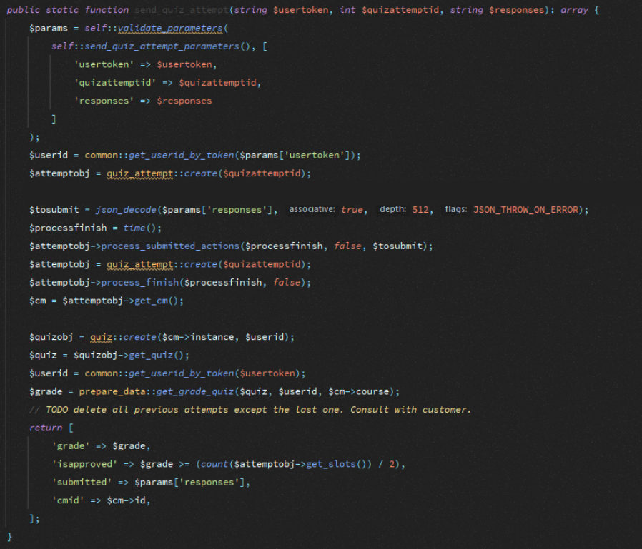
SUBMIT QUIZ
SERVICE
Moodle expects a submit action for each quiz question.
Logic in the app for each question type.
The external app developer needs to know Moodle to submit responses.
App storage to keep the preliminary responses.

Slide 23
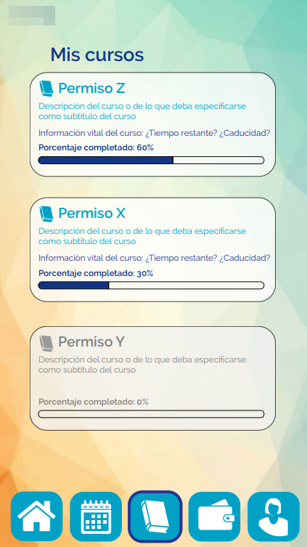
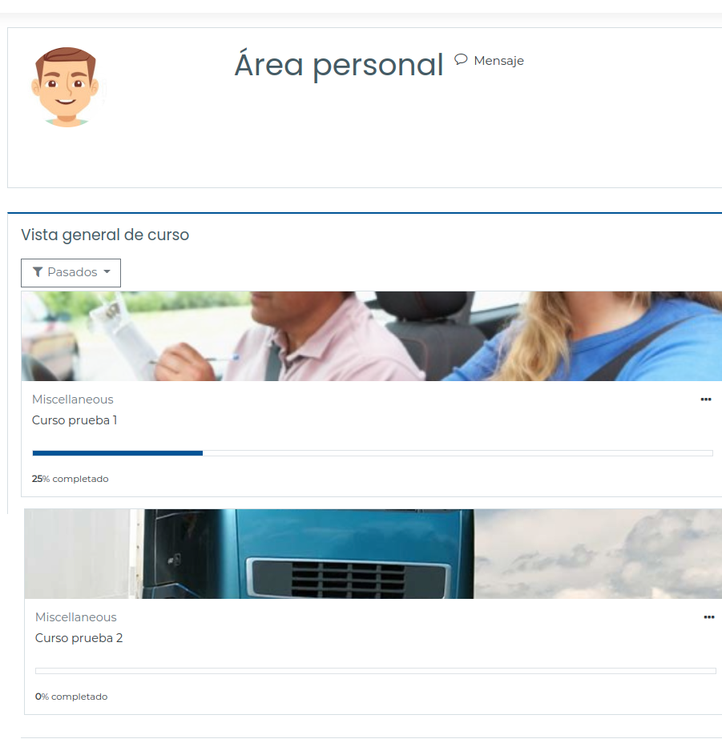
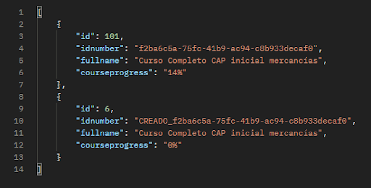
THE RESULTS
Moodle dashboard courses >> JSON response >> External app.

Slide 24
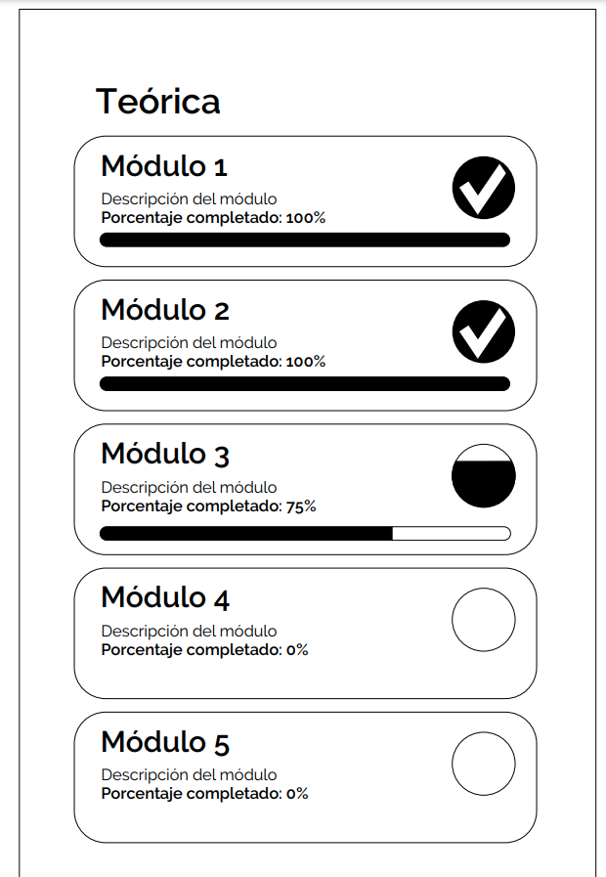
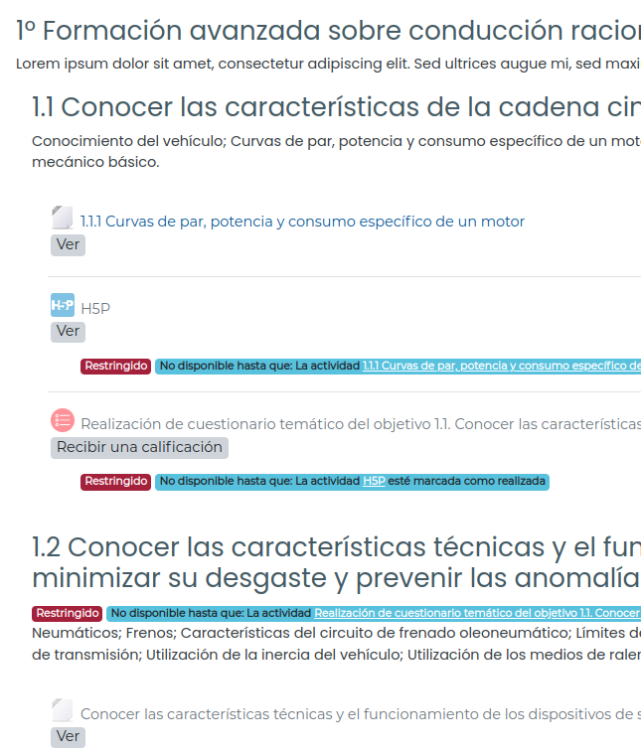
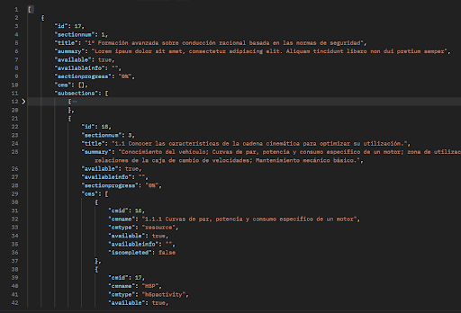
…MORE RESULTS
Moodle course sections >> JSON response >> External app

Slide 25
MOODLE
CONSUMING
A content system that storage some external resources that must be exported into Moodle.
Unidirectional communication.
Replicate courses with content into Moodle.
Use Nuxeo entities and resources.
Use of API to gather information from Nuxeo
Content synchronization between Moodle and Nuxeo.
Preview of the result in Moodle before publishing

Slide 26
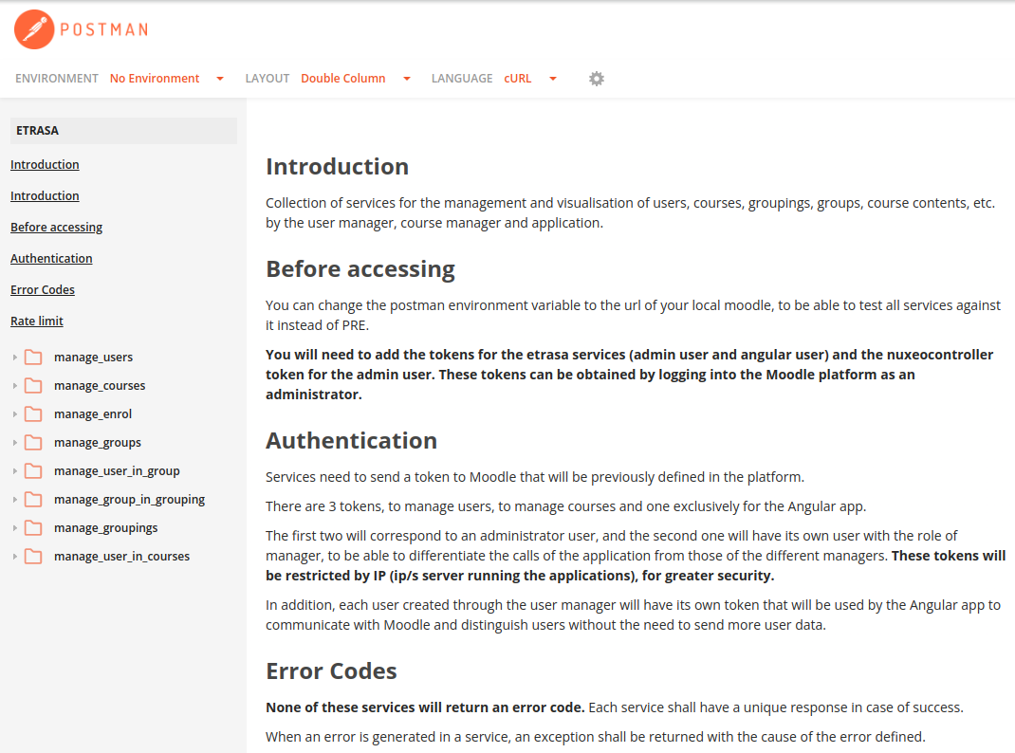
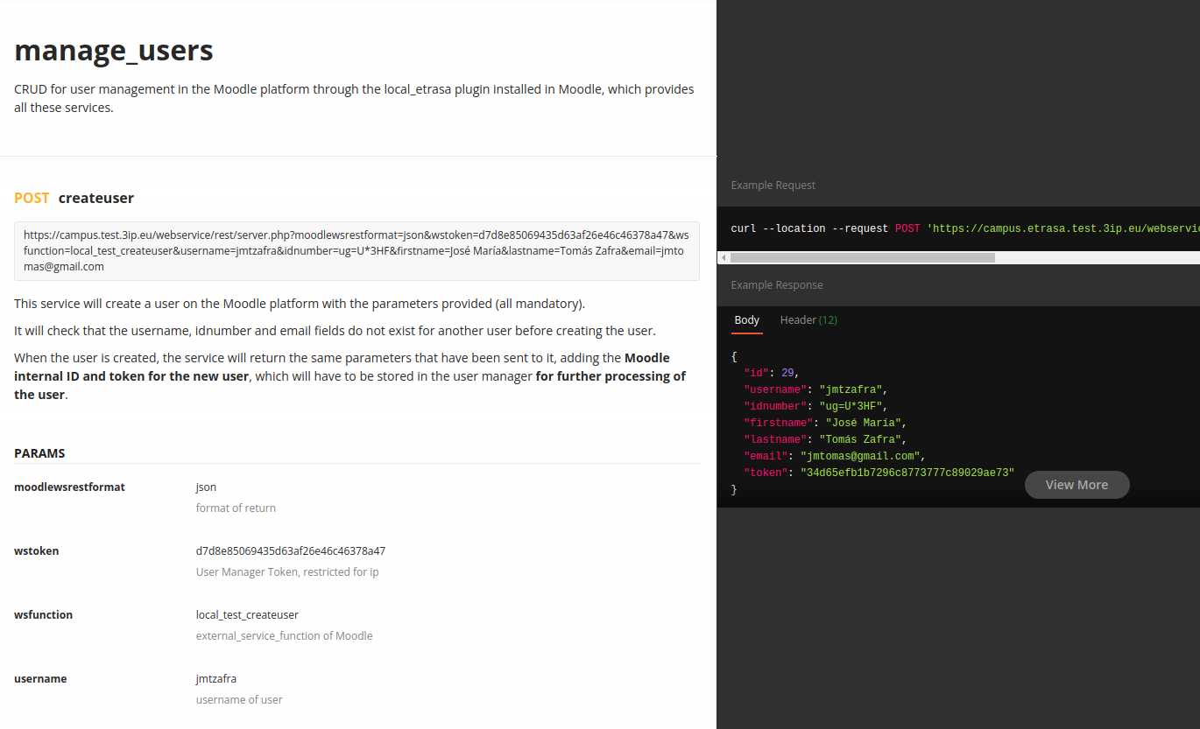
DOCUMENT IT
Use a service documentation management system for future improvements and developments.

Slide 27
THE STING
Notes:
RRHH TIENDA
PRL
SOFTWARE DE TIENDA
ATENCIÓN CLIENTE
MARKETING
PRODUCTO
PUBLICIDAD EN TIENDA
CAMPAÑAS

Slide 28
ROADMAP
Additional securitization
JWT
multi-factor authentication
SSO
Security endpoint
Use this approach to turn Moodle into a CMS or CDN.
Massive use of Restful moodle.org/plugins/webservice_restful
Scalability of the architecture.

Slide 29
THE
SHUT-OUT
Notes:
RRHH TIENDA
PRL
SOFTWARE DE TIENDA
ATENCIÓN CLIENTE
MARKETING
PRODUCTO
PUBLICIDAD EN TIENDA
CAMPAÑAS

Slide 30
ANY
QUESTION?

Slide 31
Moodle as Headless
LMS | CONTENT | MOBILE | CONSULTING | GAMIFICATION | MEC TRAINING |
IMS-LTI INTEGRATIONS | LEARNING ANALYTICS
^{ADDRESS:}
C. de València, 359 08009 Barcelona
C. de Méndez Álvaro, 20, 28045 Madrid
^{EMAIL:}
Xavier Paz - xavier@tresipunt.com
José María Tomás - jmtomas@tresipunt.com

