Slide 1
DevOps - increase quality, profitability, and stability
Anders Stenmark | Anna Elvnejd
COO COO
https://sparkfore.com

Slide 2
Background
Challenges
Time consuming maintenance for a growing number of customers
Reduced quality as security fixes and new functionality was implemented only once a year
Low profit
Goal
To scale our business and increase profitability by decreasing the cost for maintenance and development

Slide 3
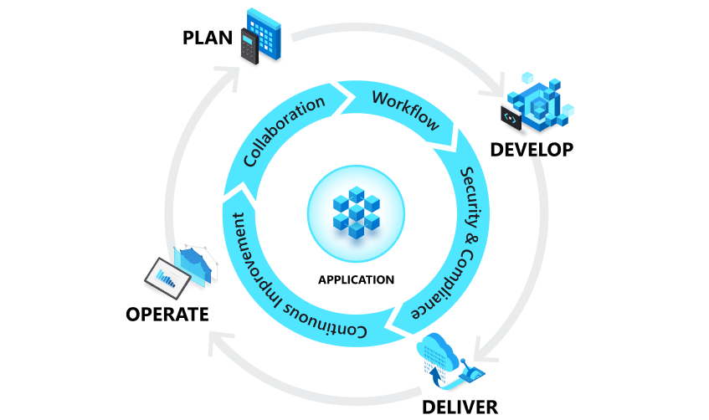
What is devops?
Development + Operations
The union of people, process and technology to provide continued added value to customers
Notes:
A combination of Dev (development) and Ops (operations)
The union of people, process and technology to provide continued added value to customers
For us, having a DevOps approach means that we have a holistic view of the Moodle services that we provide. In all key decisions, our senior IT and developers are involved to make sure that we consider every aspect of the services that we provide before doing any development – or planning any new features.

Slide 4
Overview
Discovery
Development
Staging
Unstable
Production

Slide 5
Discovery
Software Requirement Specification
Purpose and scope
Dependencies and affected roles
Functional requirements
Settings
Limitations
Entity Relations Diagram
Flowchart(s)
Wireframes
Verification (use cases, unit testing)
Delivery and operations
Resource allocation
Project planning (time plan, communication and handover)

Slide 6
Development
Developers and Operations plan the development together
All developers use the same docker-compose, but can make local modifications
Development is performed in sprints, using a simple ticket-system.
The entire DevOps team have a 15-minute meeting every morning to check on progress and discuss issues
Completed (and dev-tested) development is pushed to dev, where it’s further tested

Slide 7
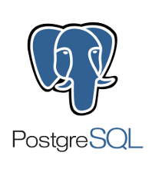
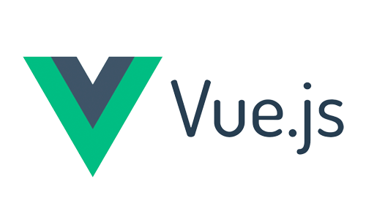
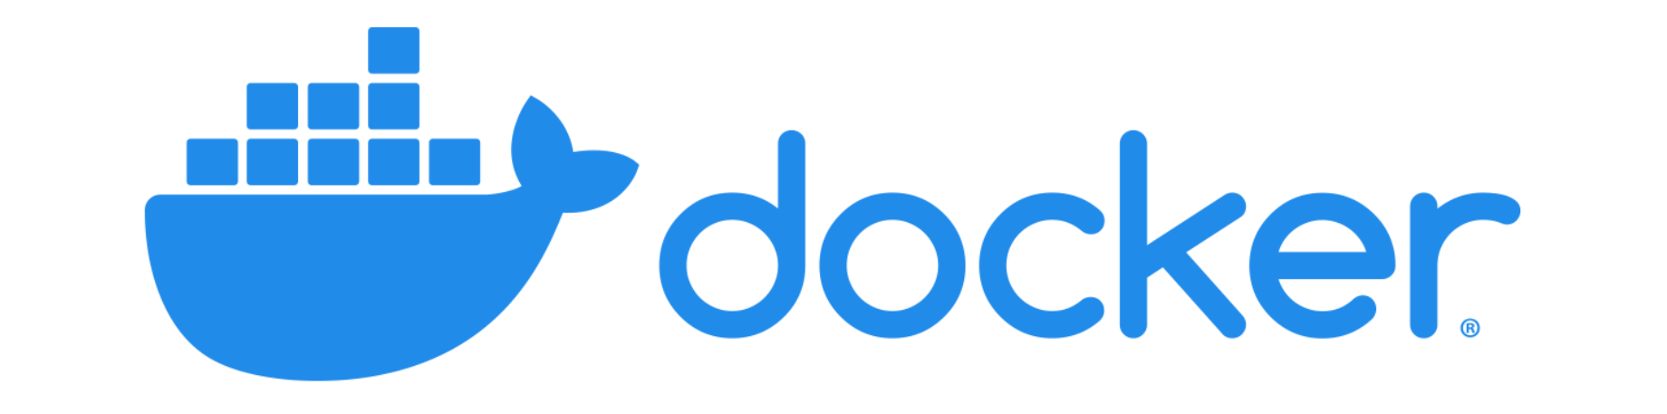
Delivery
A continuous delivery philosophy where pushed changes are automatically built and pushed to unstable or dev.
How we deliver:
Unstable (nightly – all updates)
Dev (nightly – all updates)
Staging (twice a month – selected updates)
Production (once a month - validated updates)

Slide 8
Operations
Operations are responsible for ensuring and improving efficiency and security in our services
Production nodes are automatically restarted once a month to fetch the newest production build
An uptime-robot monitors each installation and posts a message to the entire team

Slide 9
Result
Shorter time to market (new Moodle LMS up and running in 30 minutes, soon automated)
Easier to adapt to market and competition
Continuously improved stability and reliability for all Moodle LMS:es (testing, staging and production are technically identical)

Slide 10
What challenges and opportunities do you see with a DevOps approach?

Slide 11
Closing slide
Jonathan Smith
info@emailaddress.com

