Slide 1
UCL's - Development of a Course Life Cycle Tool or “One Moodle to Rule Them All” (eventually..)
Jason Norton
Head of Virtual Learning Environments
University College London

Slide 2
Who we are:
Jason Norton
Head of Virtual Learning Environments and Moodle Product Owner
Alistair Spark
Moodle Technical Lead and Service Operations Manager
Aurelie Soulier
Learning Technologist (Recently ex-UCL ☹)

Slide 3
University College London - UCL
UCL Rankings
8th in the world (QS World University Rankings 2022)
4th in Europe
4th in the UK
Institutional Statistics
11 academic faculties
48,000 students
14,300 employees
2nd in UK for research power (REF 2021)
440 undergraduate programmes
150+ nationalities represented by student body
675 postgraduate programmes
We are largest campus based university in the United Kingdom and second-largest university by total enrolment and the largest by postgraduate enrolment.
Notes:
Headline, image and dot points slide

Slide 4
UCL Moodle 21/22
Average number of Active courses per year: 6000+
Average term time peak consecutive users: 3500-4000
Average unique users per day: 50,000+
Average sessions per day: 140,000+
Approx. sessions 21/22 : 20.5 million
Approx. Pageviews 21/22: 140 million
Average number of transactions per min : 15,000-20,000
Turnitin Submissions 21/22 : 540,000+
Moodle Assignment Submissions 21/22 : 400,000+
Quiz’s Completed 21/22: 6,000+
Quiz Submissions: 280,000+

Slide 5
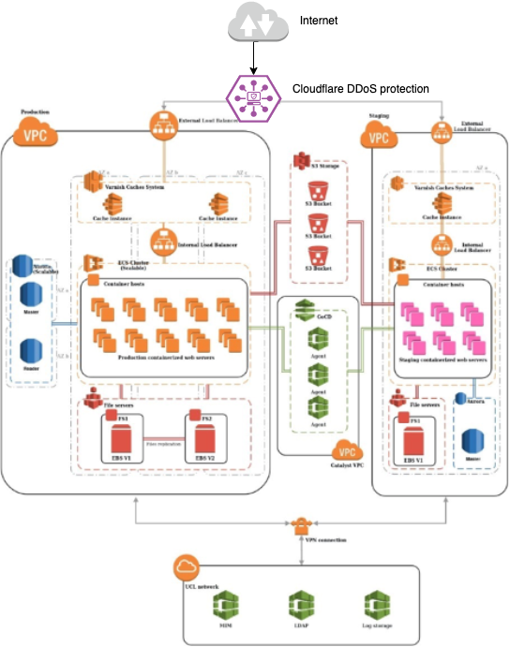
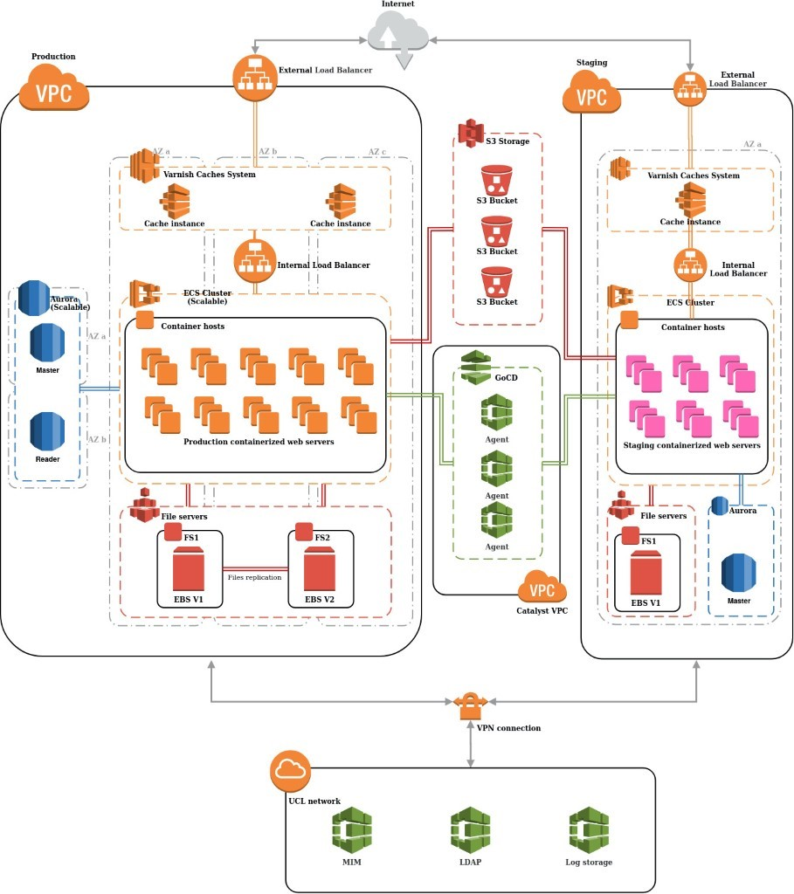
What does the UCL infrastructure look like 2022
3 availability zones in AWS UK/London region
Varnish caching layer
Dockerized web servers
AWS Aurora MySQL database
AWS Elasticache Redis instance
Cloudflare DDoS protection
AWS Native services with automated failover
VPN link between on-prem and AWS tenancy
Run in UCL’s AWS account, managed by Catalyst IT our Moodle Partner

Slide 6
A little bit of history…
Pre-2018
1 Production Moodle
Annual Snapshot taken every July (Read-Only Archive)
Maintaining 5 Snapshot instances
Key Drivers
Retention Policy – Required to keep 5 years + current of any digital assessments
Keeping student material accessible for the life of their course
Notes:
Headline, image and dot points slide

Slide 7
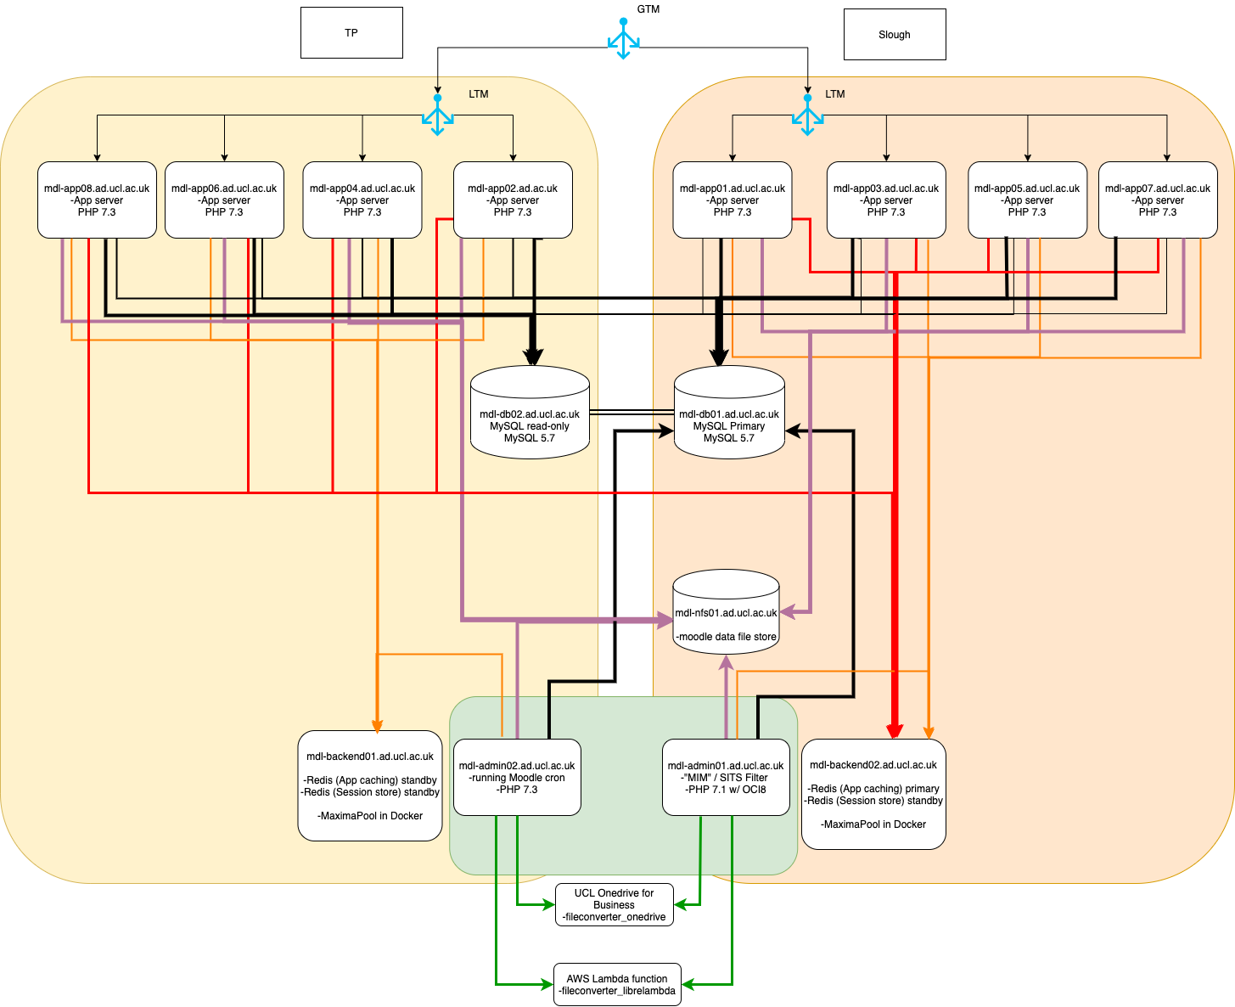
UCL – Moodle
Pre-2020
All on premise

Slide 8
A little bit of history Cont…
2018-2021
1 Production Moodle
Annual Snapshot taken every July
Annual Snapshot then runs as a late summer assessment environment
Snapshot becomes Read-Only November 30th
Still Maintaining 5 Snapshot instances and 2 Production instances!!
Key Drivers
Retention Policy – Required to keep 5 years + current of any digital assessments
Late Summer Assessment Courses available using previous academic years courses
Keeping student material accessible for the life of their course
Notes:
Headline, image and dot points slide

Slide 9
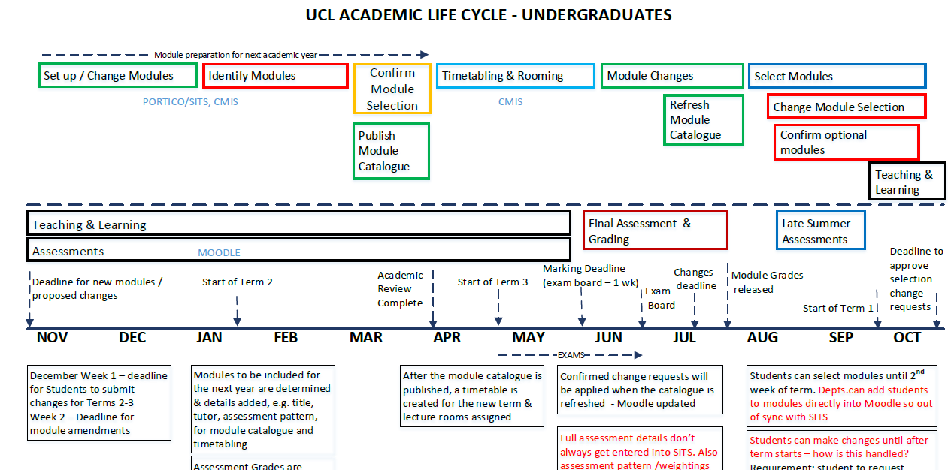
The idea of an Academic Year…
Does not exist in our world!!!
Notes:
Headline, image and dot points slide

Slide 10
Late 2019 Early 2020-The Idea/Goal
To remove the need for Snapshots
Move to one single Moodle Instance
The idea of Past > In Progress > Future to have real meaning
Empower tutors and course teams while reducing support burdens
Grow our integration with SITS (student records system)
Automation
Notes:
Headline, image and dot points slide

Slide 11
2020/21 – The Lost Year
Yet another snapshot… More confusion… More stress
But big changes
Moodle to the Cloud
Partnership with Catalyst IT
Rebuild the team
Move to Agile
Notes:
Headline, image and dot points slide

Slide 12
2021/22
Build a team and processes
Work with our Moodle partner – Catalyst IT
Develop a series of plugins (Course Life Cycle or CLC for short)
Remove Course Resets
Category building
Course Rollover Tool
Notes:
Headline, image and dot points slide

Slide 13
UCL – CLC Timeline
Brainstormed - November 2019 – February 2020
End User requirements Research - April 2021 - July 2021
Key piece of value - Date Manager implemented July 2021
SITS integration for category generation October 2021 – May 2022
Course Rollover tool development February 2022(start) – June 2022 (go-live) – ongoing

Slide 14
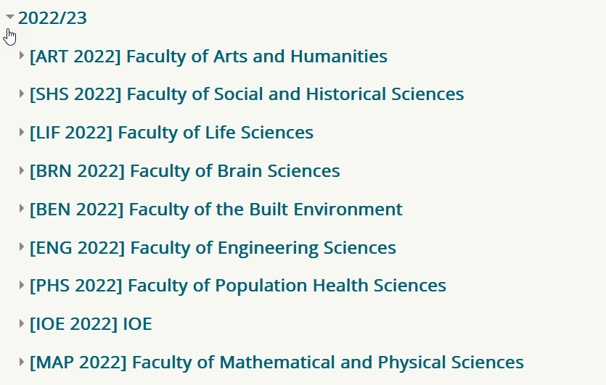
Category Creation– April 2022
New Annual Category Creation tool implemented
New annual category structure created within UCL Moodle
Created from and aligned to SITS category structure
Category level permissions implemented
Notes:
Headline, image and dot points slide

Slide 15
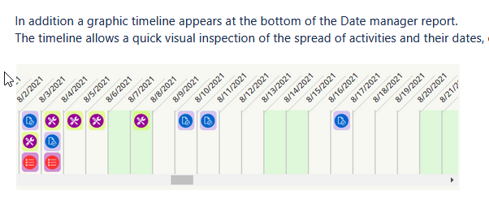
Date Manger – July 2021
Date manager provides the ability to amend the dates and names of UCL’s Moodle’s most used date-sensitive activities all in one place .
Moodle assignments
Turnitin assignments
Databases
Forums
Lessons
Quizzes
Workshops
Notes:
Headline, image and dot points slide

Slide 16
Course Rollover – May 2022
The Course Life Cycle (CLC) rollover tool creates a duplicate Moodle course based on an existing one, without any student content such as posts, assignment submissions, etc.
Courses are moved to a new category structure
It allows enrolment alignment with the next iteration of that courses Module Deliveries in SITS (our student record system)
Course teams in control
Notes:
Headline, image and dot points slide

Slide 17
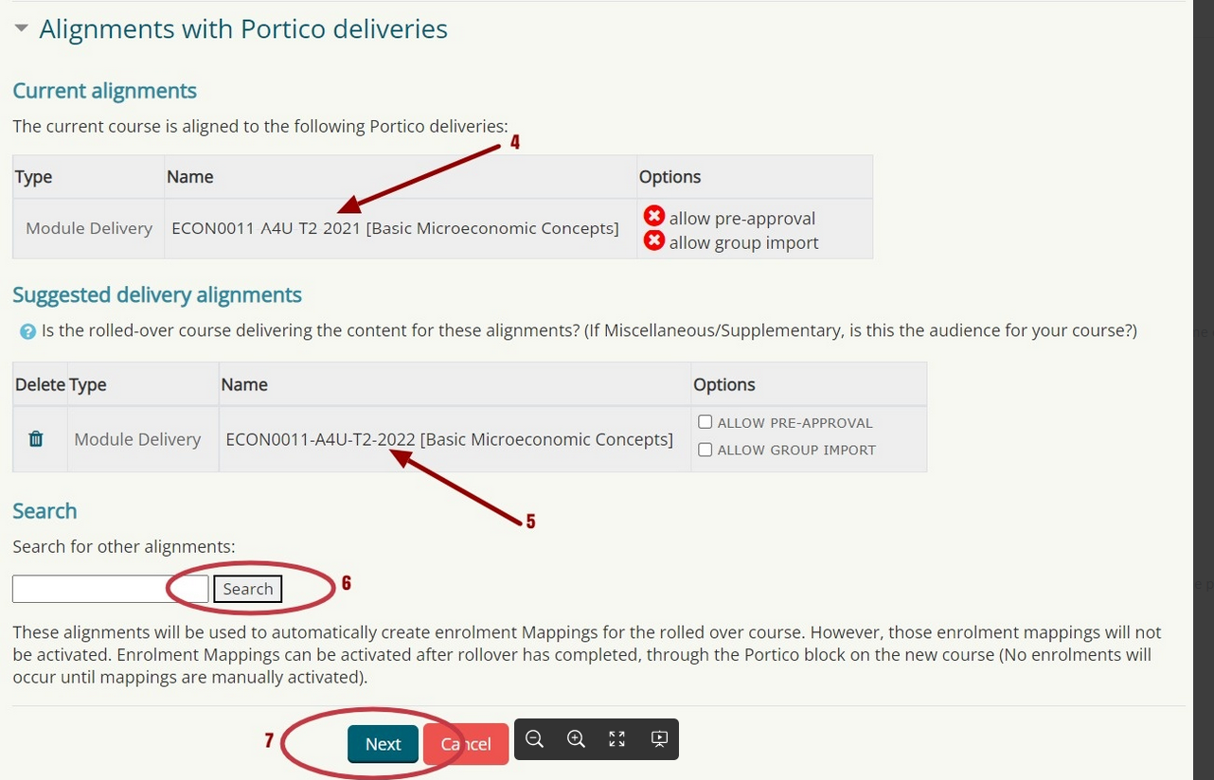
Course Rollover – Part 1
Notes:
Headline, image and dot points slide

Slide 18
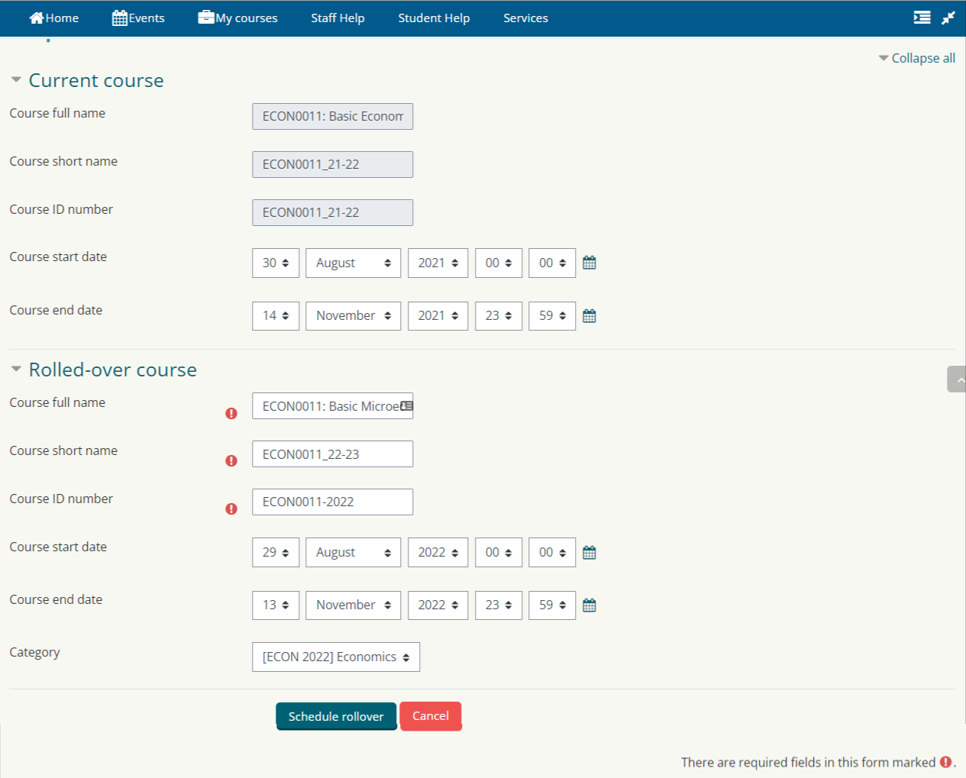
Course Rollover – Part 2
Notes:
Headline, image and dot points slide

Slide 19
DEMO

Slide 20
CLC – Progress So Far
5000+ rollovers complete
Expecting growth to between 7,000 and 14,000
12,335 active module occurrences currently planned for 2022/23

Slide 21
Key Benefits - Realised
Better Student experience -> No more URL changes mid-course (especially for Late Summer Assessment)
Better Staff experience -> Course rollover taking care of everything in one place
Risk and Disaster reduction -> standardised process, no more deleting data in prod. Less recovery requests.
Better alignment with the institution -> New category tree each academic year reflecting UCL’s structure for that year

Slide 22
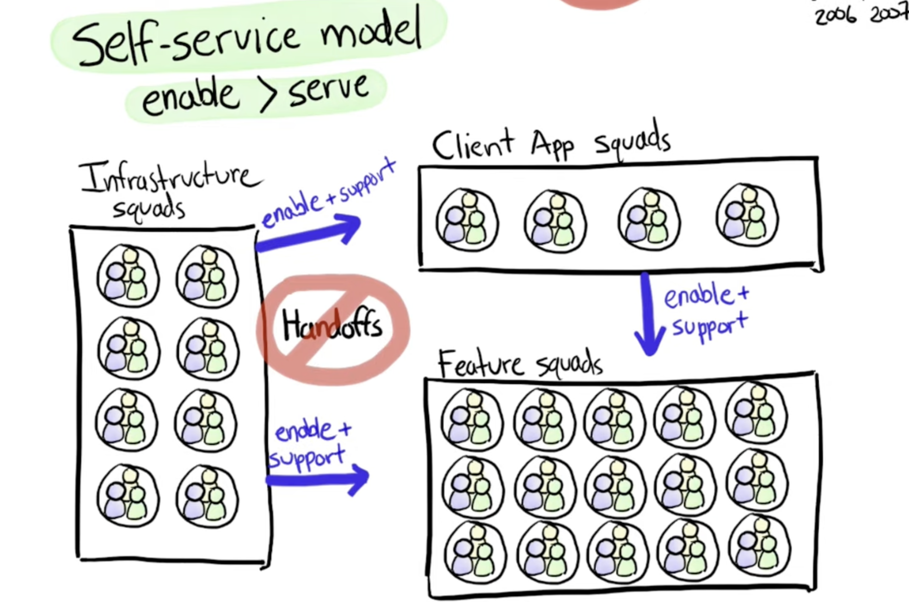
Ways of Working
Established our first “Feature Team”
Notes:
Headline, image and dot points slide

Slide 23
Minimalism & Iteration
Team used to keeping Features minimal
Small stories -> focus on higher value, delay lower value-> prioritise
Prevent Story scope creep
Going live with our MVP was a cultural shock – truly was Minimal.
Release & Iterate
Notes:
Headline, image and dot points slide

Slide 24
Ways of Working Outcomes
Building upon our continuous release process we had over 150 deployments to our testing environment with full test suite run catching issues early.
Adopted Github, Github Actions & Code Peer Reviews practices
Building upon this for new features we are starting e.g. increasing staff & student feedback loops on this and other features such as Moodle 4 theme design
Notes:
Headline, image and dot points slide

Slide 25
Go Live Approach
Go-live with Minimum Viable Product (MVP)
Iterate quickly and deploy improvements at the end of each sprint
Prod release every 2 weeks instead of usual cycle every 2 months (+some “hotfix” releases –> weekly)
Listen to user feedback & incorporate as soon as possible
Strong training & documentation package of support
Pro-actively monitor for errors and fix them -> don’t wait for tickets. Reach out to users.
Developed reporting tools & re-run functionality to support ourselves with this
Notes:
Headline, image and dot points slide

Slide 26
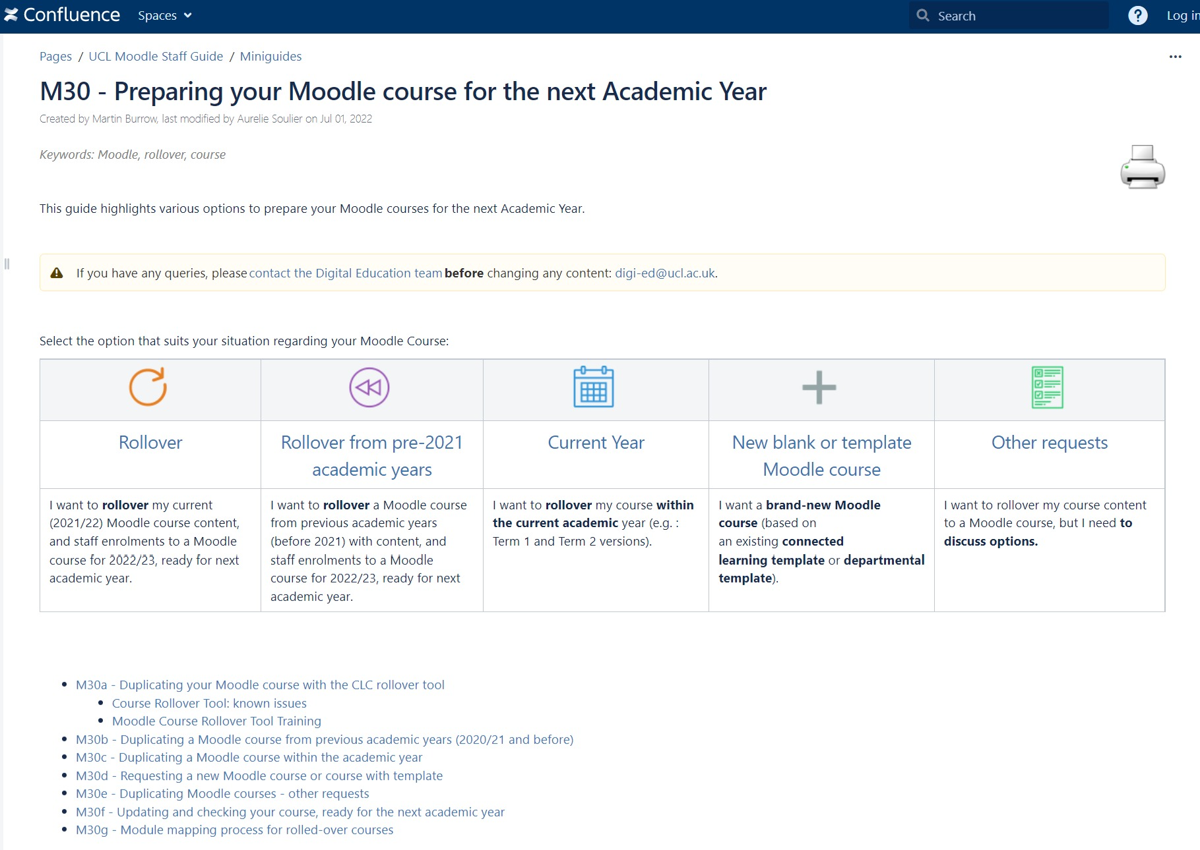
Training and Documentation
M30 guides: a series of wiki pages based on user-driven scenarios with guides, FAQs and a 'known issues' page.
Training started on 6th June to support the release on 1st June.
Two or three 30-minute sessions per week via Teams.
Three trainers.
One well-attended weekly drop-in session.
Notes:
Headline, image and dot points slide

Slide 27
What Next for CLC at UCL
Bulk rollover
In instance Read-Only functionality using context freezing
Auto-rollover
Deeper integrations with SITS and refactoring of existing tools
Community release
Joint development with other community members/partners
Notes:
Headline, image and dot points slide

Slide 28
Thank you for Listening
Questions?
*Huge shoutout to all the UCL Digital Education Team, the VLE Product Team and our partner Catalyst IT.
Notes:
Headline, image and dot points slide

Slide 29
Links to UCL’s Moodle Documentation
UCL Moodle Resource Centre
https://wiki.ucl.ac.uk/x/-xliAQ
UCL Course Rollover Tool
https://wiki.ucl.ac.uk/x/URUVAw
UCL Date Manger
https://wiki.ucl.ac.uk/x/5IxoCg
UCL Digital Education Blog
https://blogs.ucl.ac.uk/digital-education/
Notes:
Headline, image and dot points slide

Slide 30
Closing slide
Jonathan Smith
info@emailaddress.com

