Slide 1
Using Moodle in unique and unexpected ways
Kepa Urzelai
SuperMoodler
Iñigo Zendegi
SuperMoodler

Slide 2
Human Centered Design
Facility Tool

Slide 3
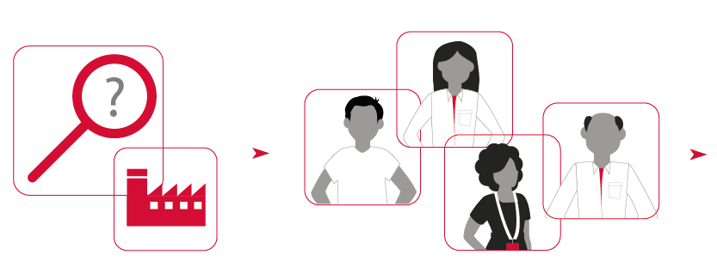
Human Centered Design
Providers
Employees
Policies and administration
Clients
Potential customers
Society
Identified problem…
…solved with the people involved
company ecosystem

Slide 4
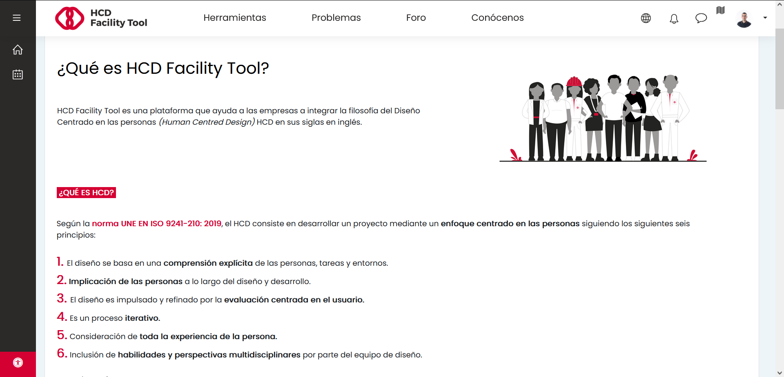
First steps
Navbar menu
Moodle 3.11
Theme: Moove
filter_multilang2
+
Moodle homepage + label modules
HTML + CSS
local_boostnavigation

Slide 5
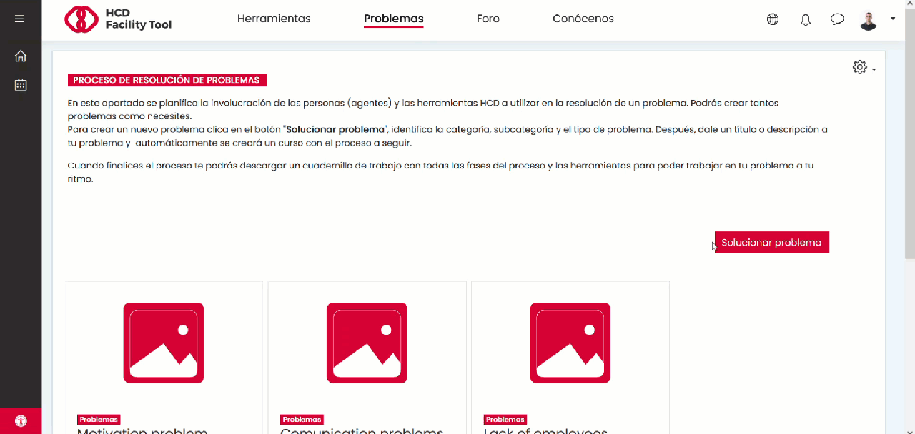
Solving a problem
Courses on demand:
local_course_templates

Slide 6
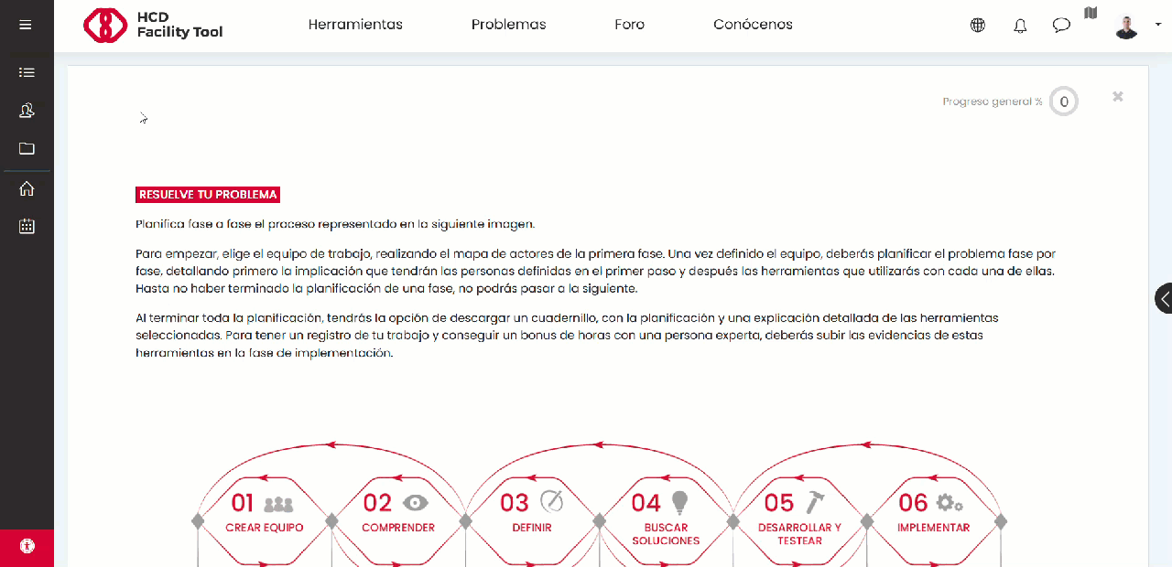
Solving a problem
block_html
+
filter_generico
Custom fields
format_tiles

Slide 7
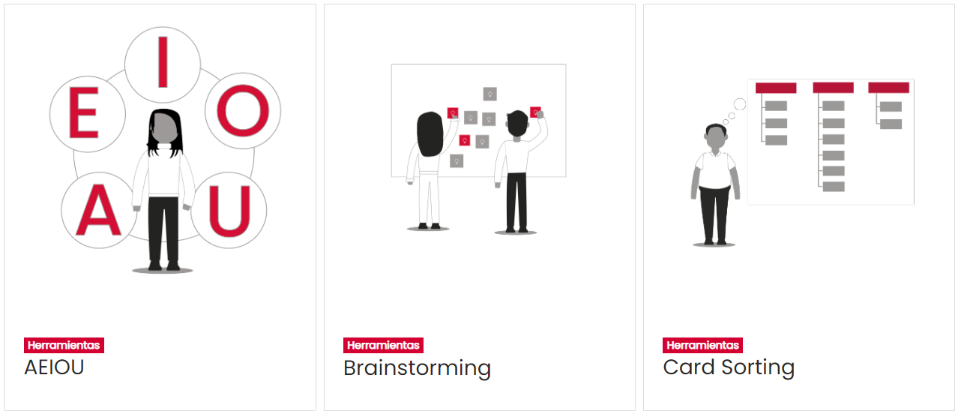
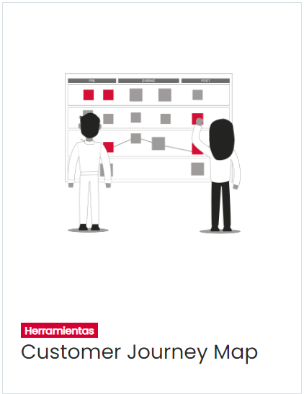
Self-paced assistant
1.
Build the team
2.
Understand
3.
Define
4.
Design solution
5.
Develop & test
6.
Implement
Planning
report
Download content
… .pdf
+
… .pdf
+
… .pdf
+
… .pdf

Slide 8
Self-paced assistant
Inputs:
Process stage
Agent involvement
Agent involvement
1. Define stakeholders
2. Choose involvement level
3. Select HCD tools
HCD tool
Group access restriction
mod_page
mod_data
mod_feedback
mod_choicegroup
+
filter_generico
Event: record created or updated
Event: response submitted

Slide 9
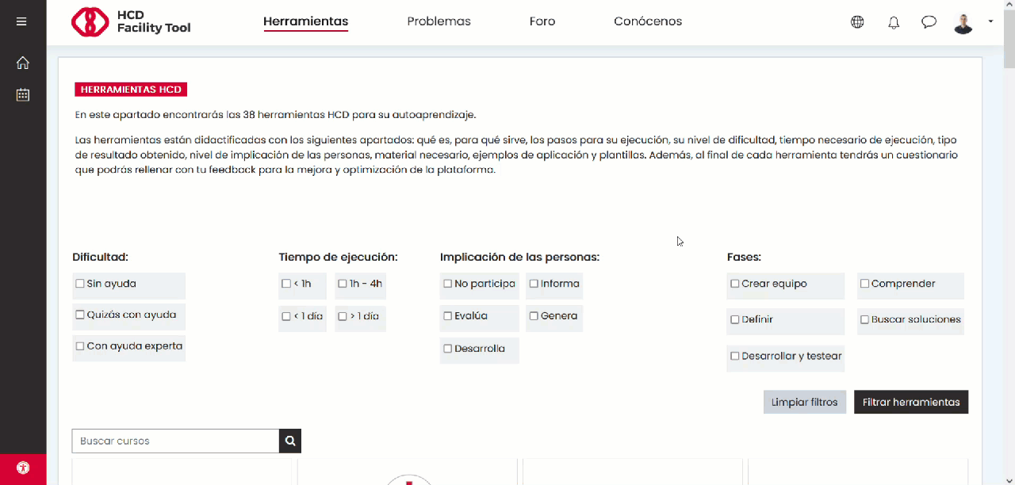
HCD tools library

Slide 10
Plugins overview
Patched
theme_moove
local_course_templates
mod_data
mod_feedback
mod_choicegroup
mod_quiz
downloadcontent
Used
filter_multilang2
atto_multilang2
filter_generico
local_autogroup
profilefield_multiselect
format_tiles
local_boostnavigation
Thank you to all of you, contributors!

Slide 11
Closing slide
Kepa Urzelai Vicente
kurzelai@mondragon.edu

