Slide 2
Translating Moodle
with Moodle Academy
Presented by Richard Lefroy
Moodle Academy
Notes:
Thankyou so much for joining us, and welcome to this presentation “Translating Moodle with Moodle Academy”

Slide 3
Richard Lefroy
Moodle Academy
Learning & Media Technologist
Notes:
I am Richard Lefroy, Learning and Media technologist with Moodle Academy, and today I’ll be talking to you about translating content in Moodle courses and sites.
Specifically we’re going to be looking at a course that we’ve released on Moodle Academy all about translations, and we’ll also be looking at a newly developed plugin that allows the collaborative translation of our online courses.

Slide 4
Overview
Creating inclusive and accessible content
Translate Moodle Academy course
Translation plugin
Questions/comments/wrap-up
Notes:
A quick rundown of the session today -
I’ll just touch briefly on goal to create inclusive and accessible content at Moodle Academy.
We’ll run through our ‘Translate Moodle Academy’ course to show you it’s features and explain the purpose behind it.
We’ll have a look at the content translation plugin to get an understanding of how it works and how it is used.
Questions, comments and wrap-up.

Slide 5
Inclusive and Accessible
The learning hub for the global Moodle community
Notes:
So first off - If you were here for the presentation immediately before this one, you will have just heard a bit about what Moodle Academy is all about.
One of the goals of Moodle Academy has always been to make our courses and content inclusive and accessible to as many people as possible. And as part of that, we need to have our courses and content available in multiple languages.
From its inception, Moodle Academy has invited the community to help us develop our courses and present online webinars, and now with the launch of our Translate Moodle Academy course and content translation plugin, our community members are getting involved even further to make Moodle Academy as Inclusive and Accessible as it can be.

Slide 6
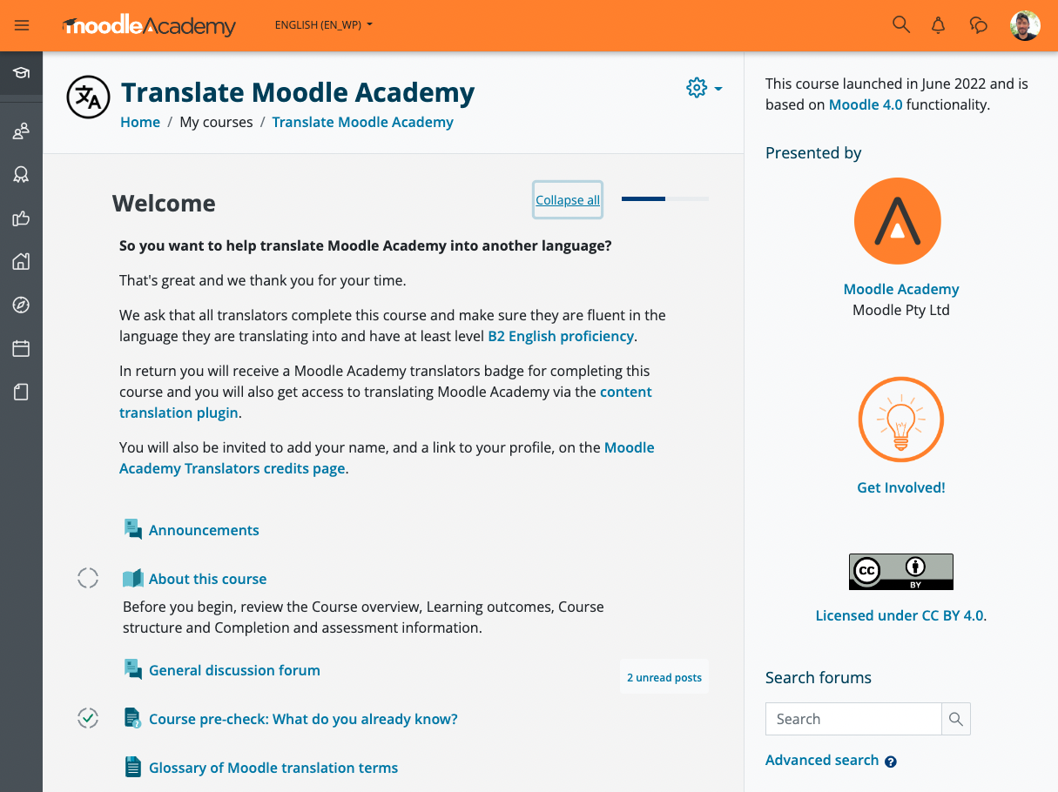
Translate Moodle Academy course
Launched June 2022.
Free and open.
Teach the background knowledge and skills necessary to translate Moodle Academy content.
Notes:
Translate Moodle Academy course:
Launched at the beginning of June 2022
Launched in conjunction with the content translation plugin (which we’ll be looking at shortly)
As with all Moodle Academy courses, it is free and open for anyone to access and participate in.
The ultimate goal of this course is to give those in our community who wish to help translate Moodle Academy content, the background knowledge and the skills necessary to do so.
Once a participant completes the course, they are given permissions on the Moodle Academy site to translate content.

Slide 7
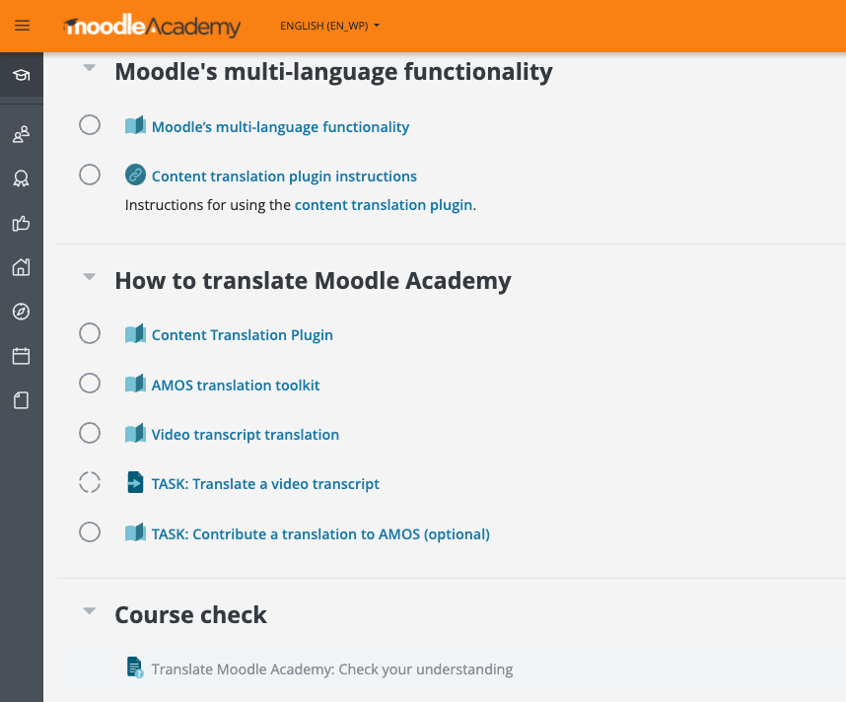
Translate Moodle Academy course
Moodle’s multi-language functionality.
Content translation plugin.
AMOS translation toolkit.
Video transcript translation.
Tasks.
Quiz.
Notes:
Course covers
Some general background information about Moodle’s multi-language functionality
Information on the content translation plugin
Information on the AMOS translation toolkit - which is Moodle’s translation site
Information on video transcript translation
Several tasks for participants to get hands on and put their knowledge into practice
Quiz to check their understanding
I won’t go into too much more detail on the contents of the course, but I will touch briefly on some of the features and requirements of this course that make it slightly different to our other Academy courses.

Slide 8
Translate Moodle Academy course
Translators must be bilingual:
Fluent in their language and have at least level B2 English proficiency.
Notes:
In this course, we are upskilling members of our community to take on the role of translating content, so there are a few tasks and requirements that we ask learners to complete to demonstrate their competence in translating.
We ask that anyone wanting to complete this course and become a translator is bilingual - they must be fluent in the language they are translating into and have at least level B2 English proficiency, so the very nature of this course means that not all members of the community will be able to undertake all of the required tasks to complete the course.

Slide 9
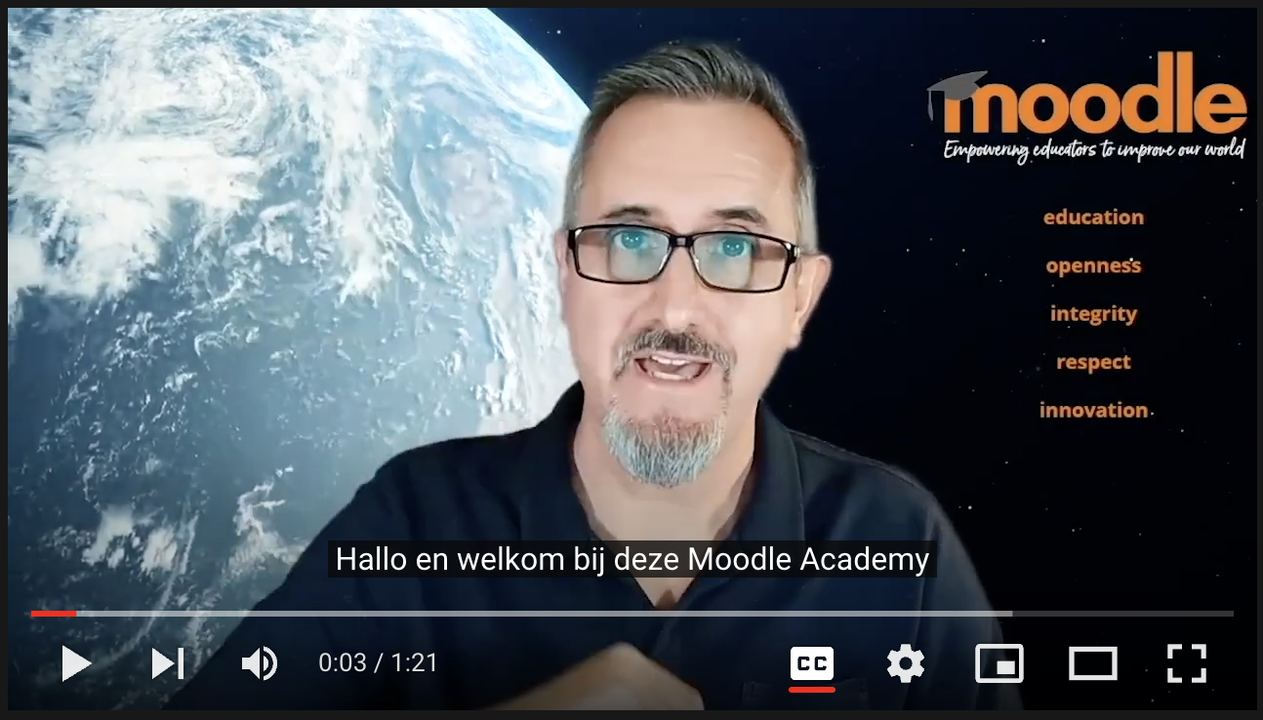
Translate Moodle Academy course
TASK: Translate a
video transcript
Notes:
Video is a large part of the content that we develop for Moodle Academy, so translation of video transcripts is another important part of making all of our content inclusive and accessible.
One of the required tasks we ask participants to complete is to translate a transcript of a video in to their language and submit it to be reviewed by the Moodle Academy team.
The video is a short introduction and welcome from Martin in one of our other courses - Introduction to Moodle. Participants watch the video, then download the English transcript and translate it, before submitting it to be reviewed by the Moodle Academy team. We then run an automated check on the translation and then essentially sign-off on it, meaning participants can complete the course and gain the necessary permissions to begin translating content.

Slide 10
Translate Moodle Academy course
36 participants completed course.
17 languages:
Arabic
Catalan
Czech
Dutch
Euskara
French
German
Greek
Hungarian
Italian
Lithuanian
Portuguese
Portuguese (Brazil)
Russian
Spanish
Spanish (Mexico)
Ukrainian
* As at September 15, 2022
Notes:
Since the course launched at the beginning of June 2022, we’ve had 35 participants representing 16 different languages complete the course and earn their badge, and who now have the translator role in our Moodle Academy site.

Slide 11
Content Translation plugin
Notes:
So - that’s a little about our translation course.
Let’s move on now to look at the newly developed Content translation plugin.

Slide 12
Content Translation plugin
Developed by Andrew Hancox in conjunction with Moodle Academy.
Launched in June 2022
Available in the Moodle plugins directory.
Enables users to provide inline translation of content in a Moodle site or course.
Notes:
The plugin was developed by Andrew Hancox in conjunction with Moodle Academy specifically for the purposes of allowing our community to contribute to translating our content.
As mentioned earlier, it was launched in June 2022 in conjunction with our Translate Moodle Academy course.
As with all plugins, it’s now open and available for anyone to install on their own Moodle sites, and it can be found on the Moodle plugins directory - I’ll share more details about that at the end of this session.
The plugin enables users with appropriate permissions to provide in-line translation of content in a Moodle site or course for text that is not translated by language packs.

Slide 13
Content Translation plugin
“Enables users to provide inline translation of content in a Moodle site or course.”
Language pack
Provides translations of Moodle user interface words (strings) that appear in settings and menus.
Translations created and managed centrally using AMOS (Automated Manipulation of Strings) and applied across all sites that install them.
Translation plugin
Allows for local translation of individual course & site content.
Translations created and managed within an individual site.
Notes:
Before we jump in to see how the plugin actually works, I just want to expand on that last point briefly and make a distinction about exactly where the plugin fits in to the ecosystem of translation options in Moodle.
As some of you will be already aware, Moodle uses language packs to translate its interface in to other languages. I won’t go into too much detail on language packs - but essentially this covers standard phrases and words which are included in Moodle core code - things like menu items, buttons, settings - basically all terminology that is included in a standard installation of Moodle. These translations are handled centrally by a system called AMOS using language packs - and are then applied across all sites that install those language packs.
In contrast, the translation plugin is built to translate content which is not part of a standard installation of Moodle - that is, content which is created or added within an individual Moodle site. Translations therefore exist only in the context of that individual site.

Slide 14
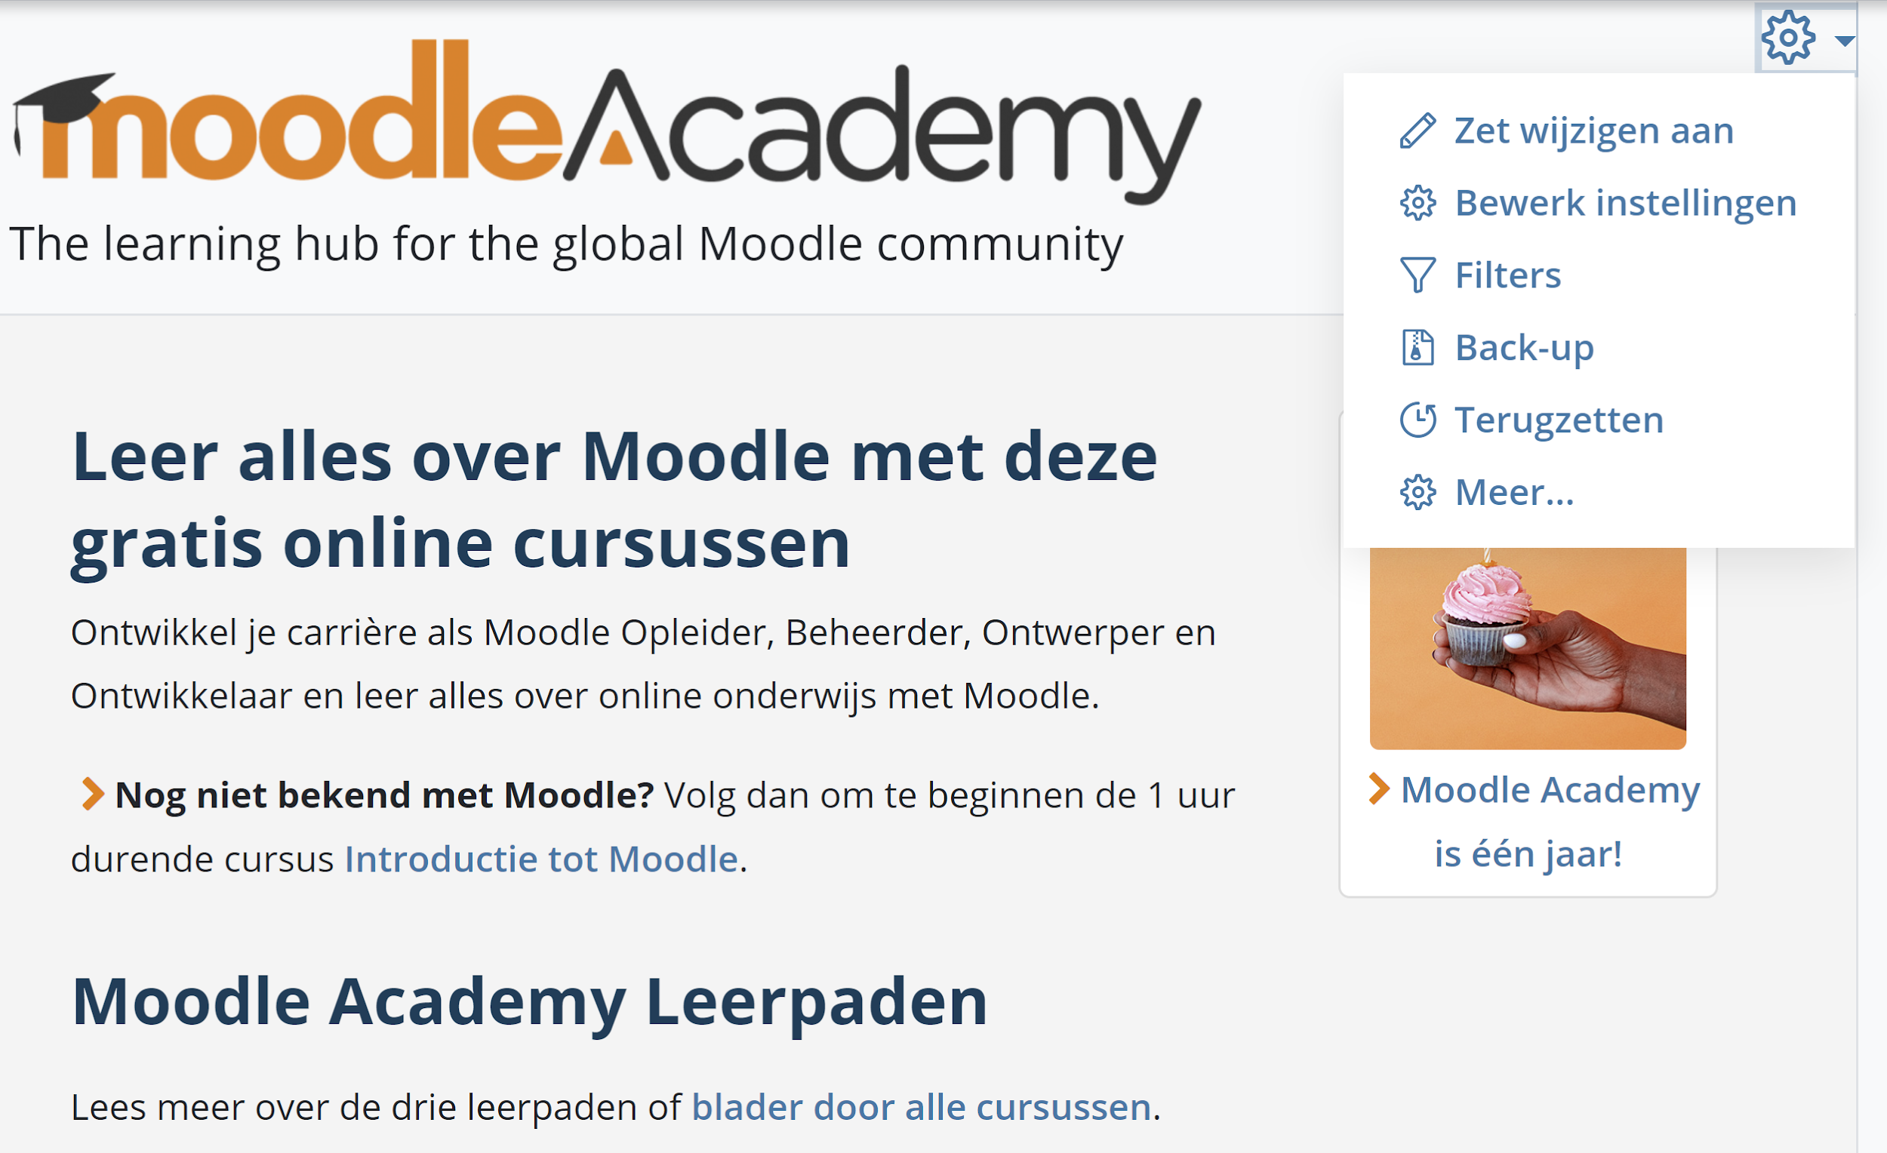
Content Translation plugin
Language pack
Content translation plugin
Notes:
So just to demonstrate that - as you can see in this example, we have some elements of the Moodle user interface - in this case a drop-down menu of options - where the translations have been provided by a language pack, and we have some site content which has been translated within this individual site using the content translation plugin.

Slide 15
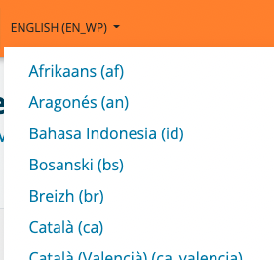
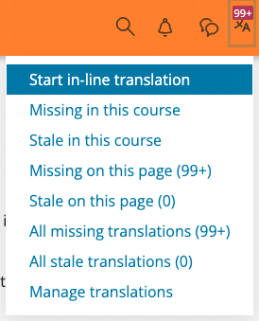
Content Translation plugin
Choose language Start in-line translation
Notes:
So let’s jump in to have a quick look at how the plugin actually works within the context of our Moodle Academy site.
Once a user has passed our Translate Moodle Academy course, they are given the appropriate site permissions to use the translation plugin.
They can start by choosing their language from the language menu, and then enabling content translation by choosing “Start in-line translation” from the plugin menu.

Slide 16
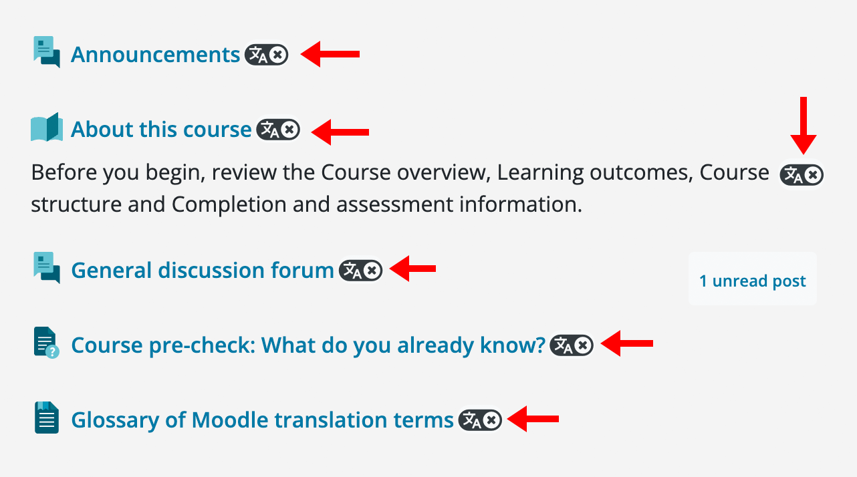
Content Translation plugin
Missing
Stale
Translated
Notes:
Once this option has been enabled, all translatable text on the page will have an icon displayed next to it to show its current status and allow it to be translated.
There are three different icons which indicate the translation status for any piece of content:
Missing - Content has not yet been translated.
Stale - Translation is out of date. This occurs when the original (English language) content has been modified after a translation was provided.
Translated - Content has been translated and is up to date.
As you can see in this example screenshot, none of this content has been translated yet, so the missing icon is displayed for each piece of translatable content.

Slide 17
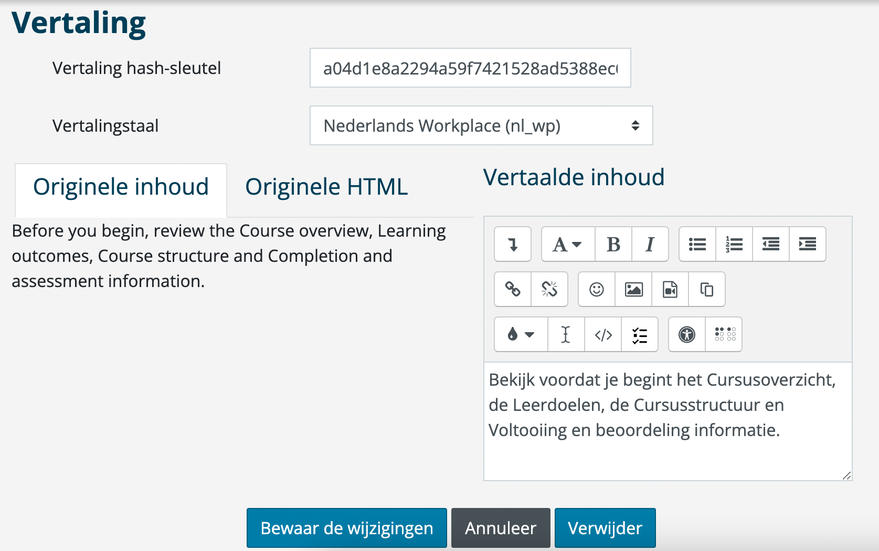
Content Translation plugin
Notes:
Clicking on a translate icon will allow you to add or update a translation.
You can see that on the left we have the original content as it was written in English, and on the right you can provide a translation in to your language.

Slide 18
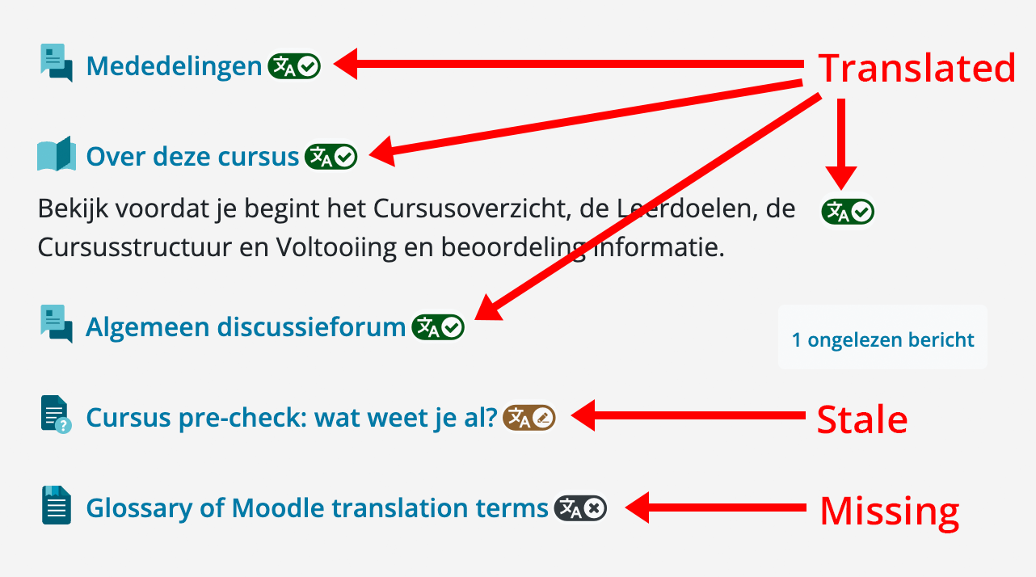
Content Translation plugin
Notes:
Once saved, the translated content will be displayed on the page, and you’ll notice the translation icon indicating the status of the translation has changed.
The translation will now be visible to all users viewing that content with the specific language set.
You can see here that most of the content has been translated, as indicated by the “translated” icon, while we also have one stale translation, and one missing translation.

Slide 19
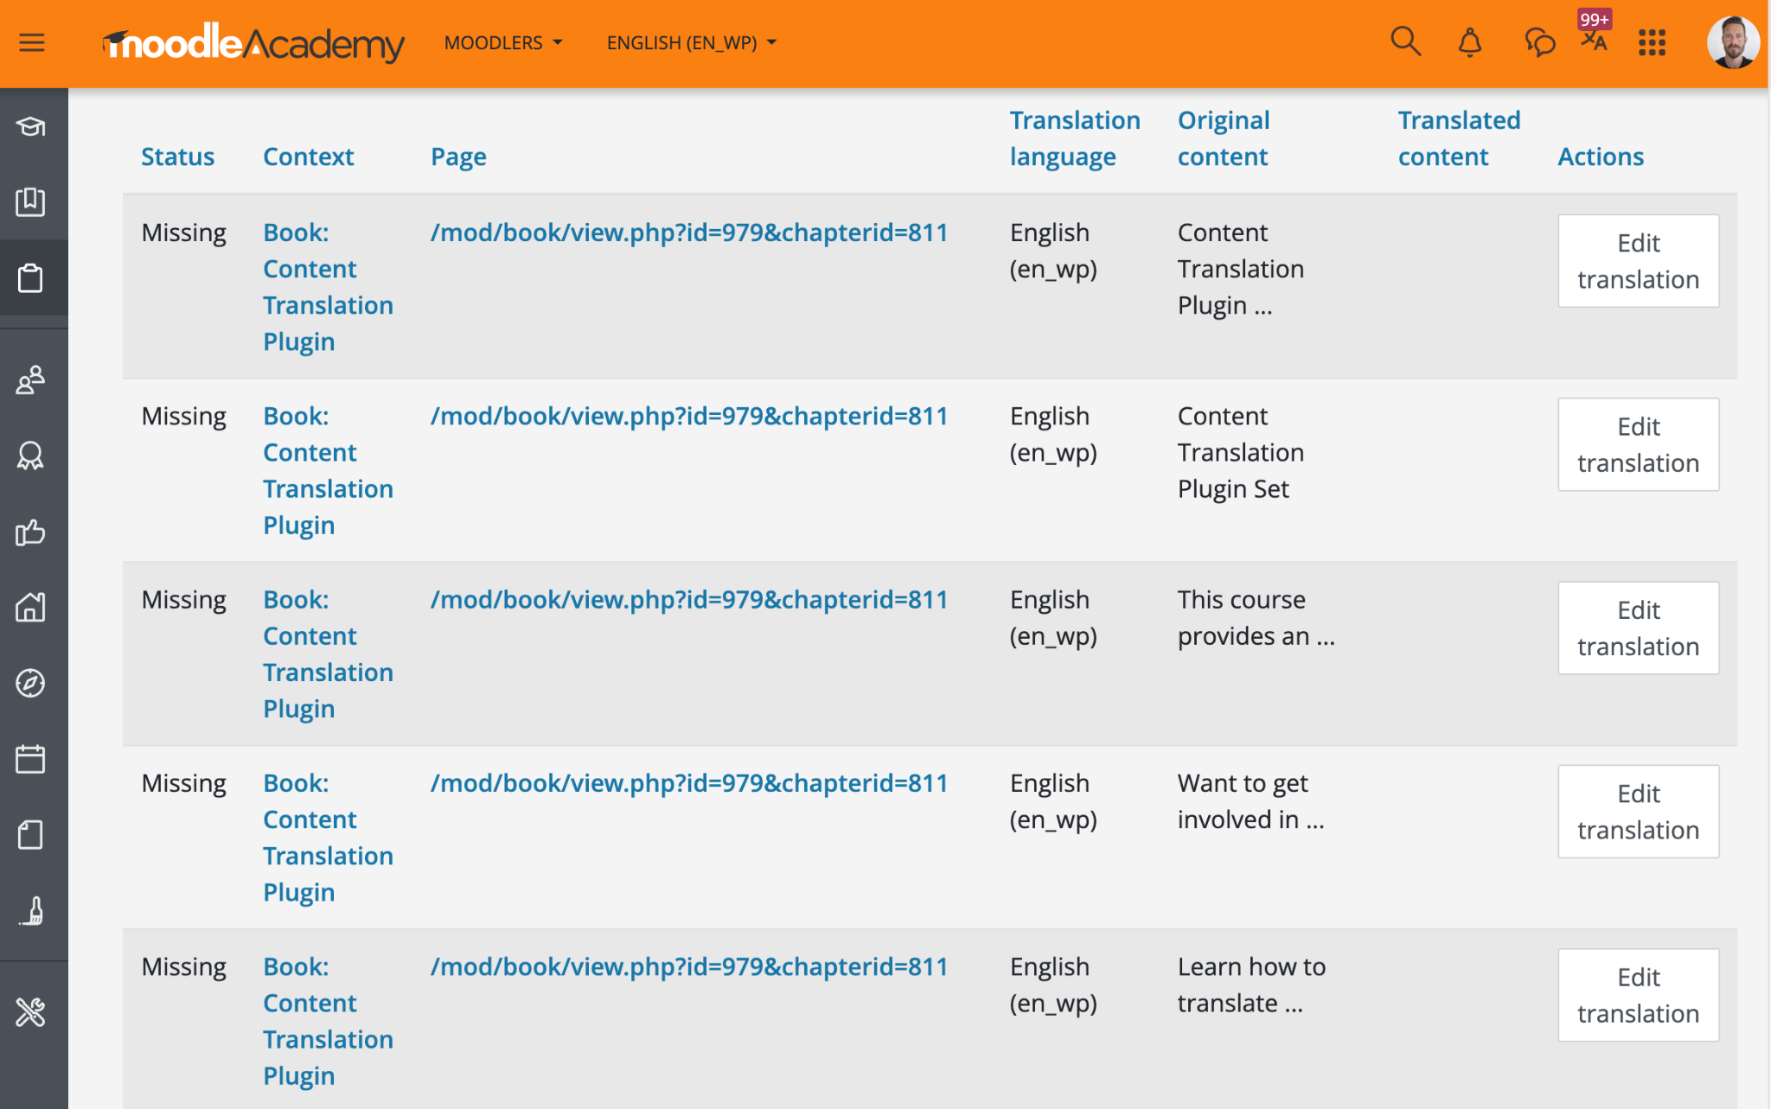
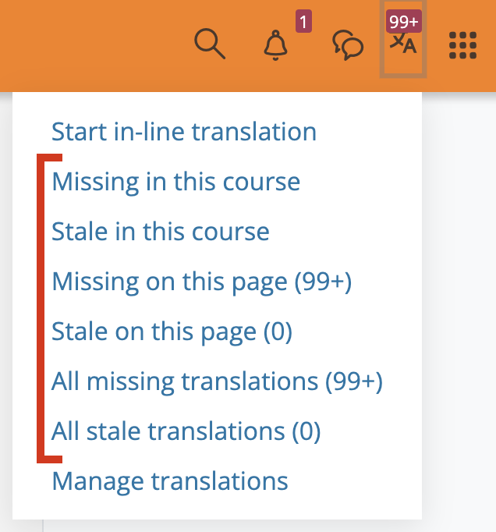
Content Translation plugin
Notes:
As well as providing translations on any page using the in-line translation option, you can also view and manage translations for the current language across a page, course or whole site by choosing from the other options in the content translation menu.
Selecting one of these options will display a report of translatable content, and you can provide translations from here rather than visiting individual pages to translate inline.

Slide 20
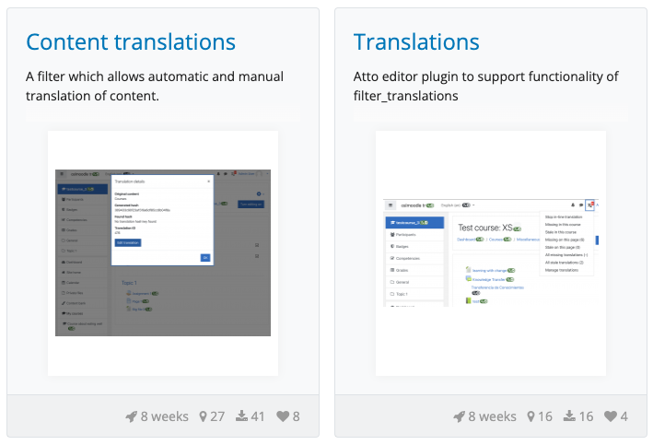
Content Translation plugin
Moodle plugins directory:
“Content Translations” https://moodle.org/plugins/ filter_translations
“Translations” https://moodle.org/plugins/ atto_translations
https://docs.moodle.org/en/Content_translation_plugin_set
Notes:
As I mentioned earlier, the plugin is open and available for anyone to install on their own Moodle sites, and you can find it on the Moodle plugins directory.
It is actually a set of plugins - you can search for “Content Translations” and “Translations” to find them, and of course there is further information available on the Moodle docs pages by searching for “Content translation plugin set”

Slide 21
Questions?
Notes:
Thankyou so much for your time today.
Questions

Slide 22
richard.lefroy@moodle.com | moodle.academy

