Slide 1
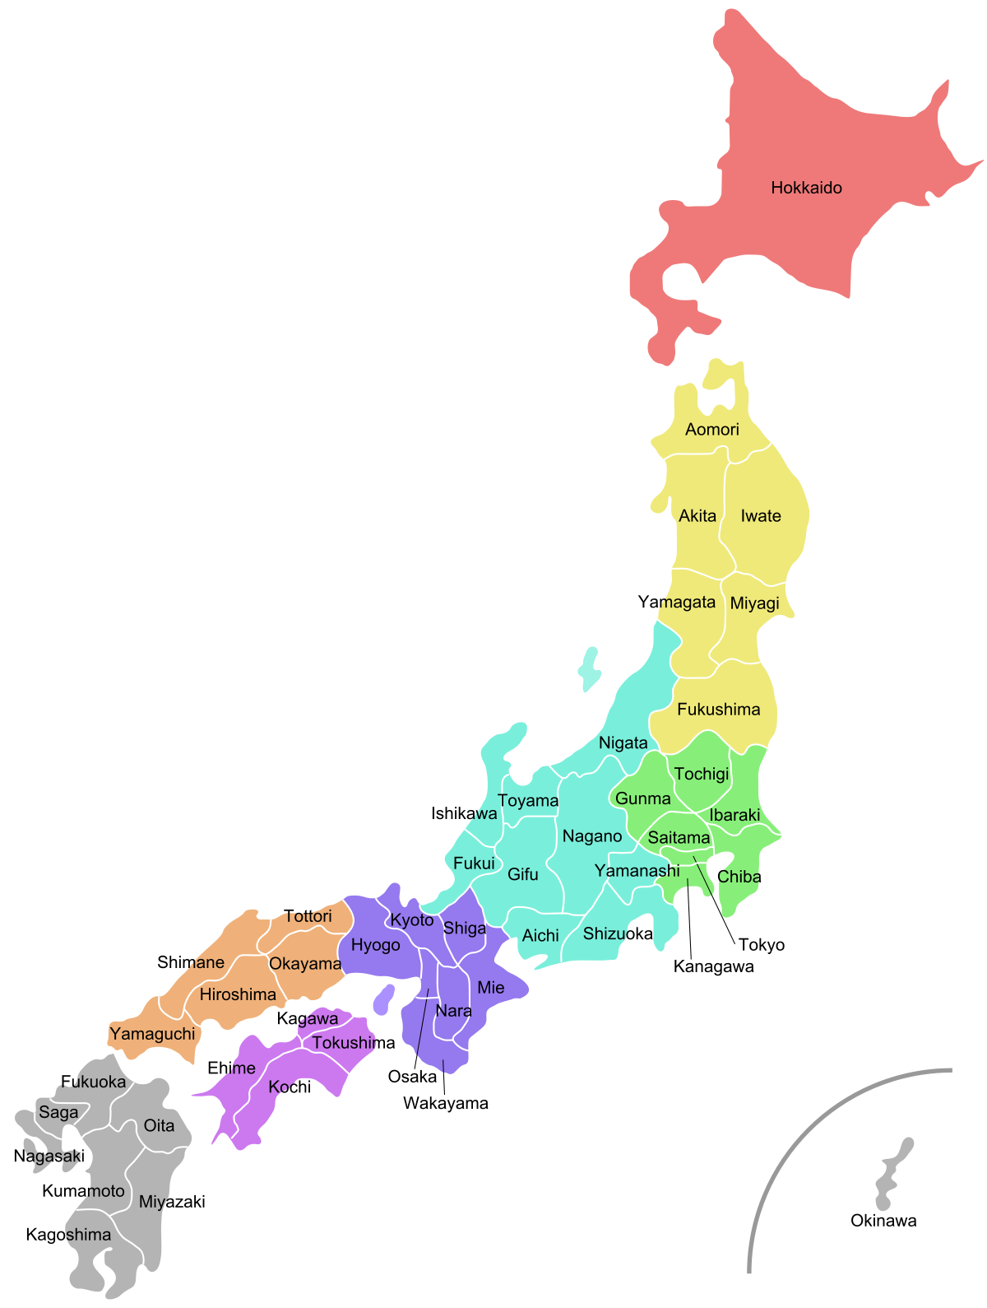
Transforming a Moodle course into a University-wide class-organization platform for online and blended Foreign Language Education
Nicholas Bovee, PhD
Associate Professor
Language Education & Research Center
Kyushu Sangyo University (Fukuoka, Japan)
Notes:
Student view
Assignments forum

Slide 2
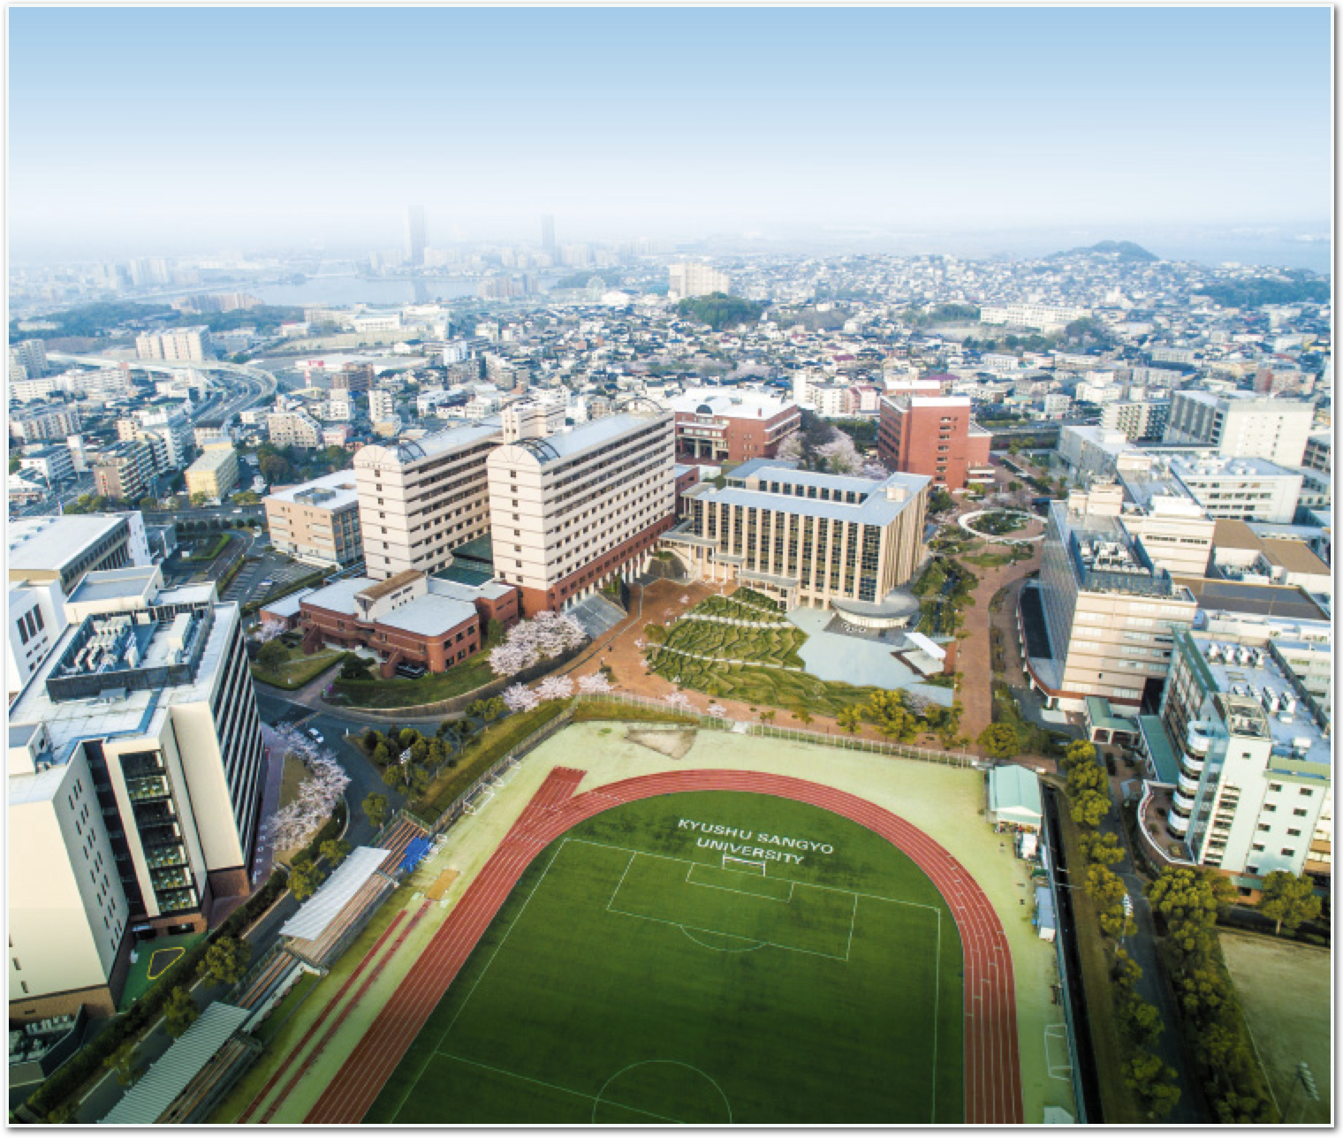
About the LERC
5,000 students enrolled in language courses
No English major
Compulsory language courses for first 2 years
6 languages on offer
200 language teachers
700 language courses

Slide 3
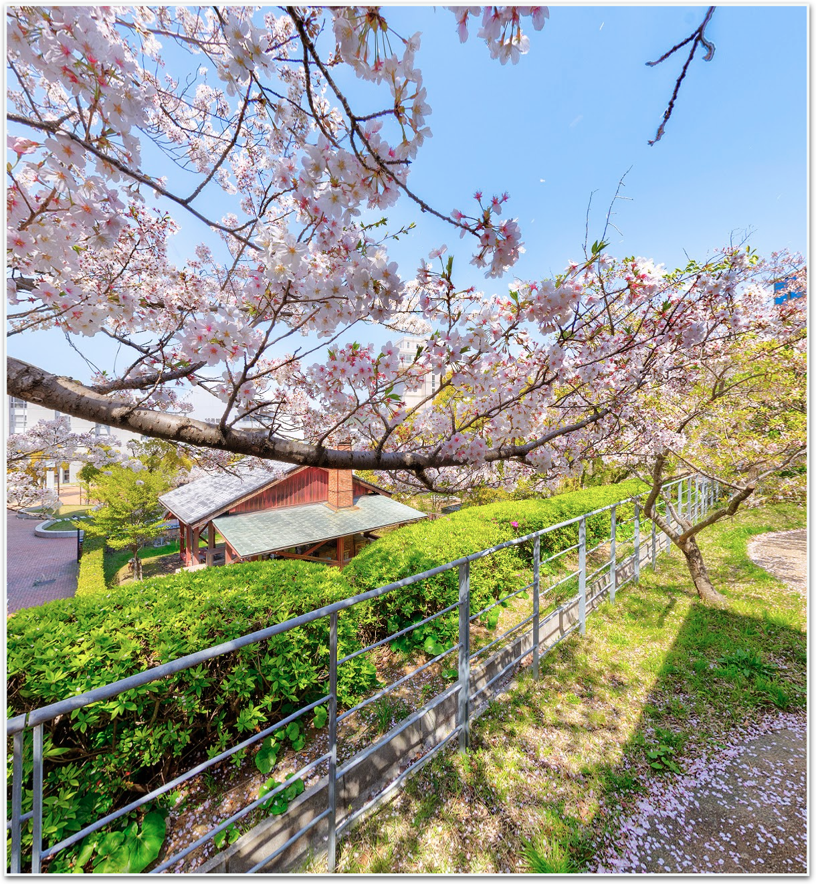
Needs assessment
Administrative oversight
Assignment submission in the form of text, images, audio, and video
Display, grade, and provide feedback on submissions on a single screen (no need to download files)
As simple as possible to use

Slide 4
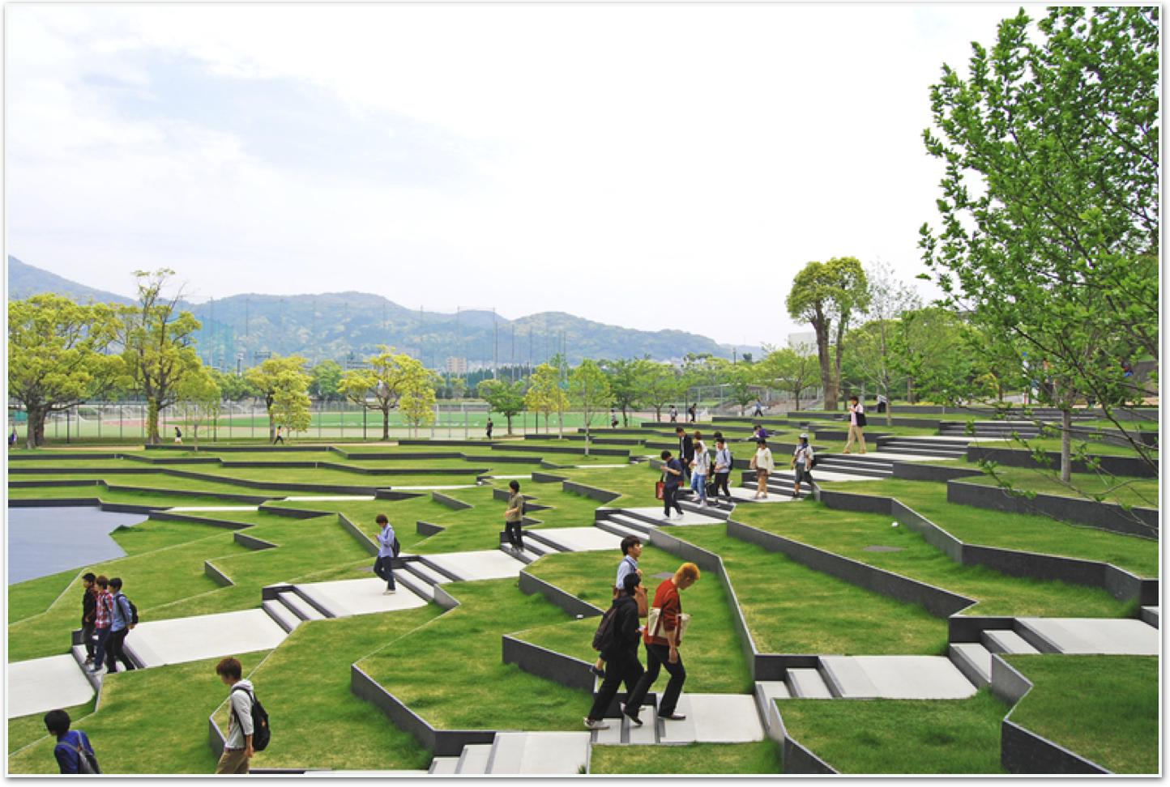
Moodle course format
Single course containing 700 groups (group mode: separate groups)
Teachers bulk enrolled as non-editing teachers
Students self-enroll using the Easy Enrollments plugin (Fordson theme)

Slide 5
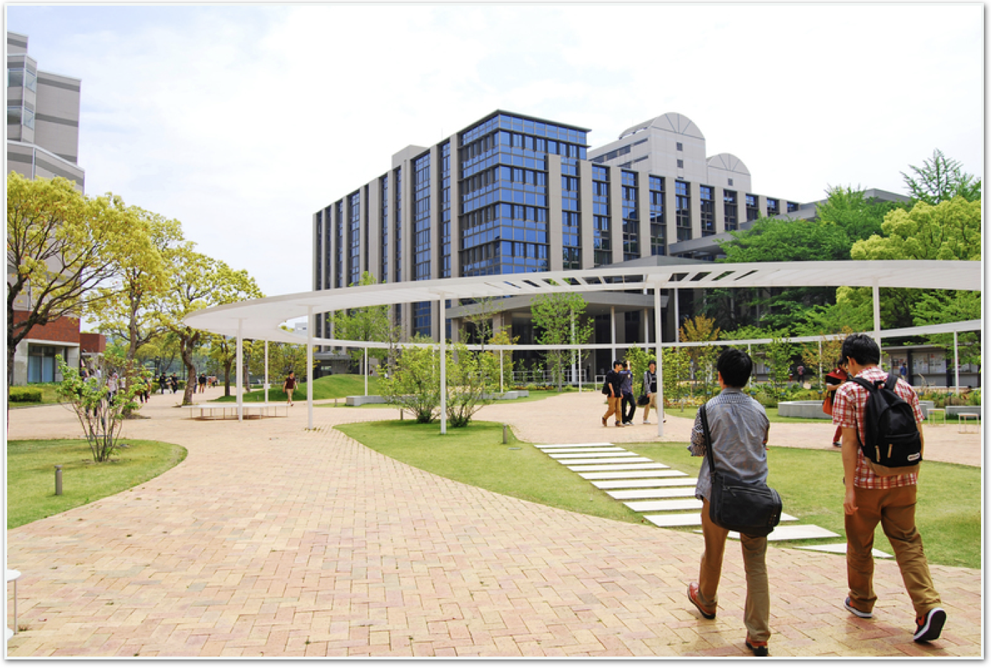
Moodle course format
6 sets of Q&A forums (A to F), each containing 14 separate forums (e.g., Task A1, Task A2…Task A14)
Each forum contains 700 separate discussions (one for each group)
A single announcements forum to which teachers post their class assignments which include links to the appropriate homework submission forums (auto-linked, e.g. “Task A1”)

Slide 6
Moodle course format
6 sets of Q&A forums (A to F), each containing 14 separate forums (e.g., Task A1, Task A2…Task A14)
Each forum contains 700 separate discussions (one for each group)
A single announcements forum to which teachers post their class assignments which include links to the appropriate homework submission forums (auto-linked, e.g. “Task A1”)
Sample forum allocation in a “four skills” course
Task A1 to A14 - Vocabulary homework
Task B1 to B14 - Speaking (videos)
Task C1 to C14 - Writing (journal)
Task D1 to D14 - Textbook (in-class tasks)
Task E1 to E14 - Reading (progress screenshots)
Task F1 to F14 - Desk number

Slide 7
Live Demo
Notes:
Student view
Assignments forum: post something, check grades, recording…
Teacher view: sidebar, gradebook, various functions…

Slide 8
Closing slide
Thank you!
Nicholas Bovee
bovee@mail.kyusan-u.ac.jp

