Slide 1
The Moodle Community What it is and why you should join it
Mary Cooch
Education Manager, Moodle HQ

Slide 2
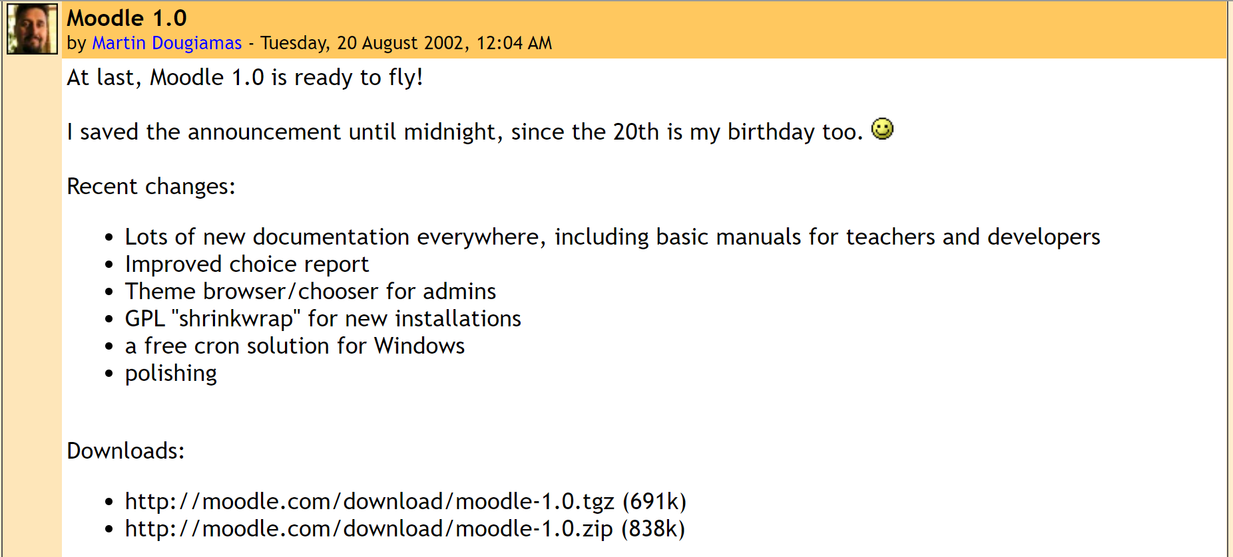
20 years of Moodle…

Slide 3
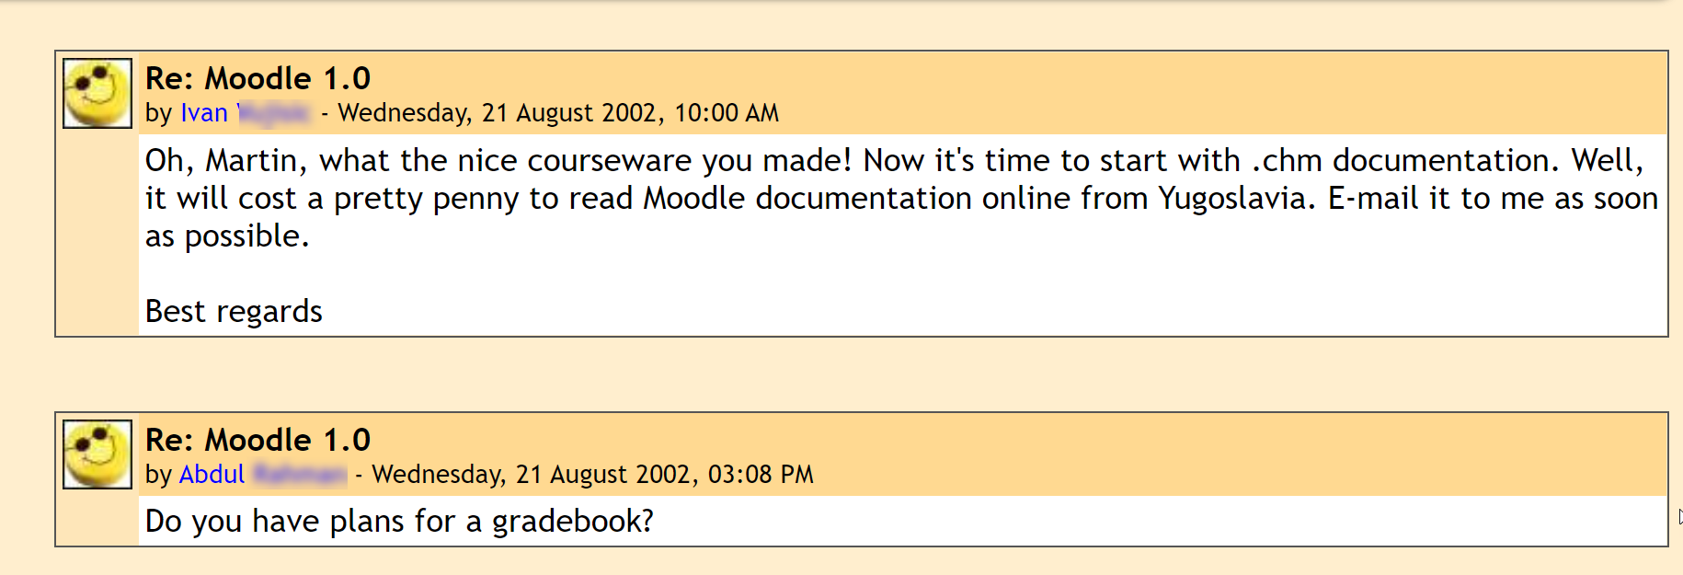
20 years of Community…

Slide 4
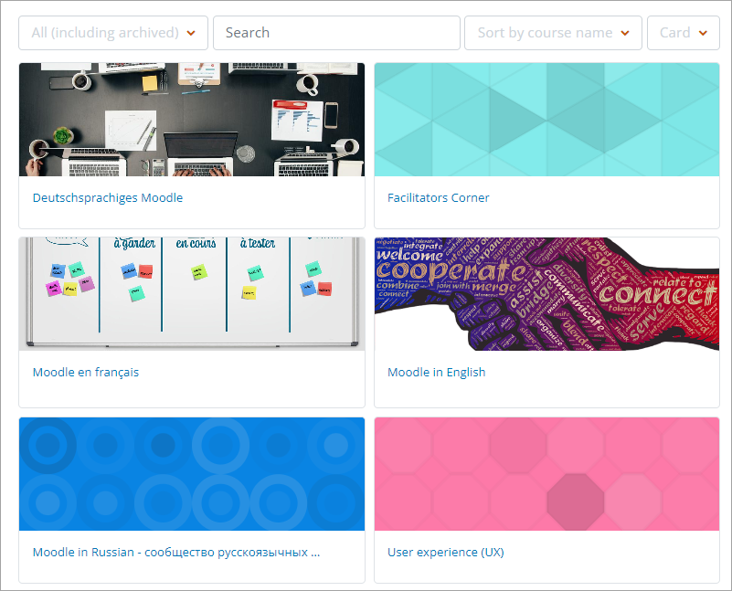
Global support…
Share your experiences in our forums – in 30 different languages
Notes:
Headline, image and dot points slide

Slide 5
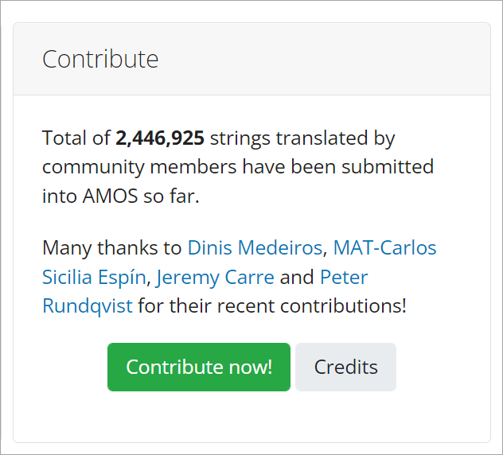
Moodle in other languages…
Improve our language packs
lang.moodle.org
Notes:
Headline, image and dot points slide

Slide 6
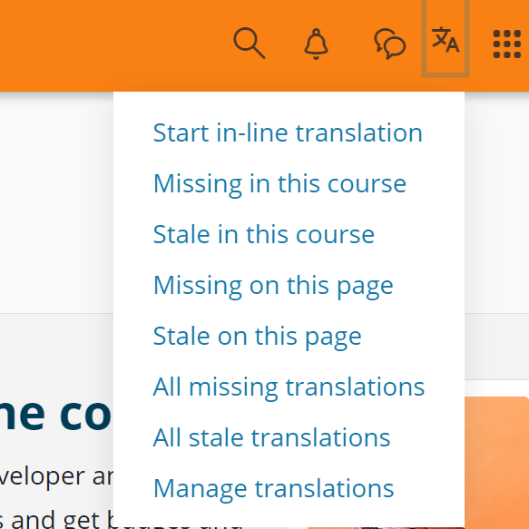
Moodle in other languages…
Translate our courses.
moodle.academy
Notes:
Headline, image and dot points slide

Slide 7
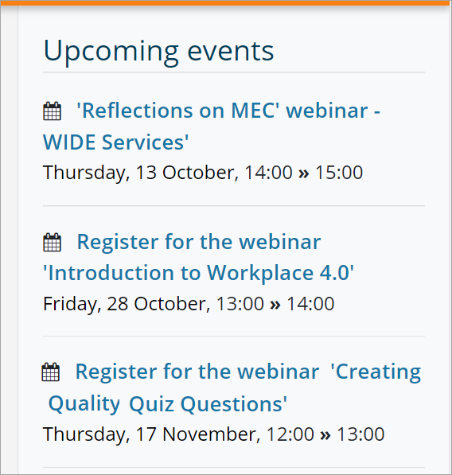
Moodle Academy…
Collaborate in ongoing professional development.
Notes:
Headline, image and dot points slide

Slide 8
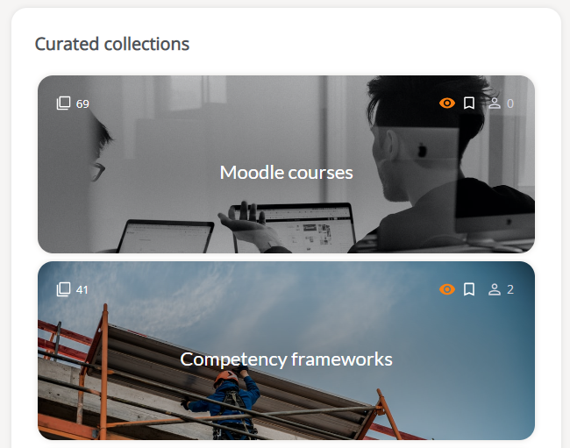
MoodleNet (OER)…
Find, share and curate open educational resources.
Notes:
Headline, image and dot points slide

Slide 9
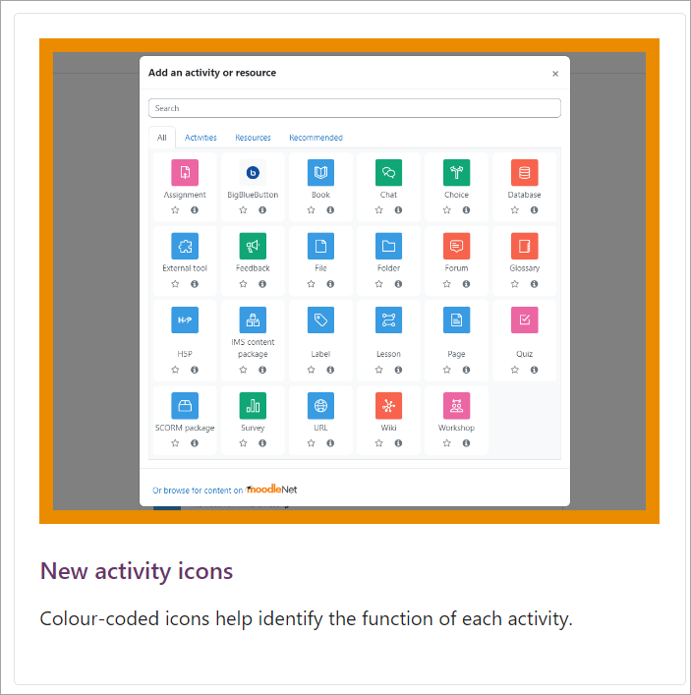
User documentation…
Contribute to the user docs*
docs.moodle.org
*yes it’s a wiki!
Notes:
Headline, image and dot points slide

Slide 10
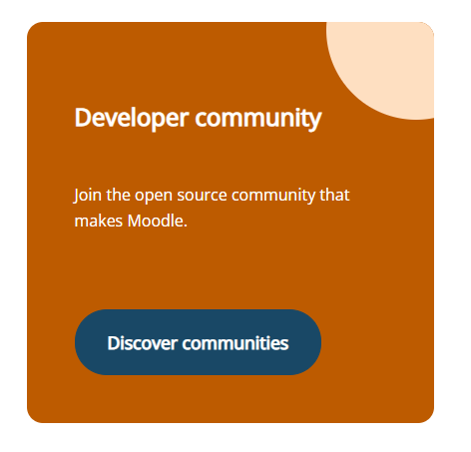
Developer resources…
Help migrate dev docs to the new developer area.
moodledev.io
Notes:
Headline, image and dot points slide

Slide 11
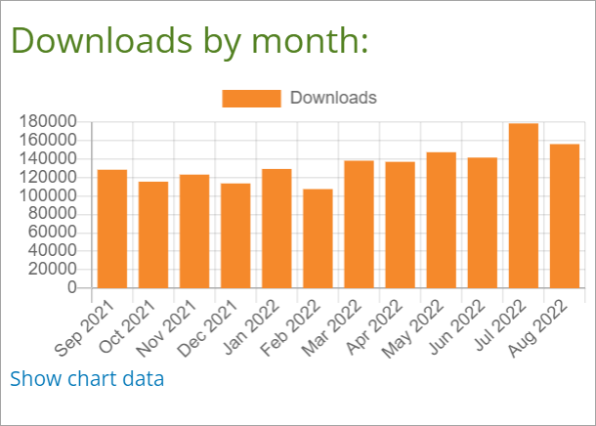
Plugins…
Share, maintain, review contributed plugins.
moodle.org/plugins
Notes:
Headline, image and dot points slide

Slide 12
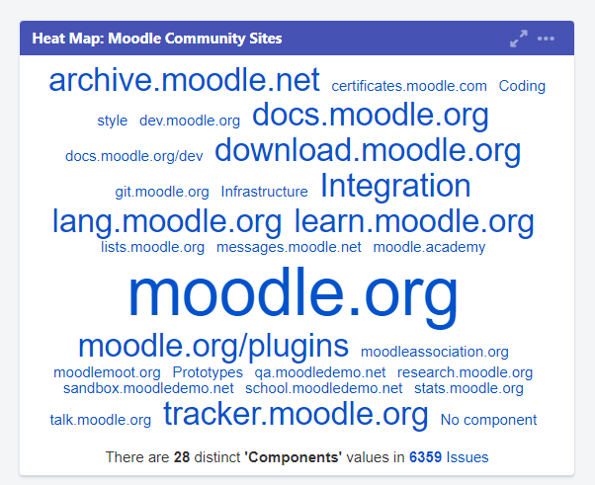
Report a bug!…
Report (and fix!) bugs on the tracker.
tracker.moodle.org
Notes:
Headline, image and dot points slide

Slide 13
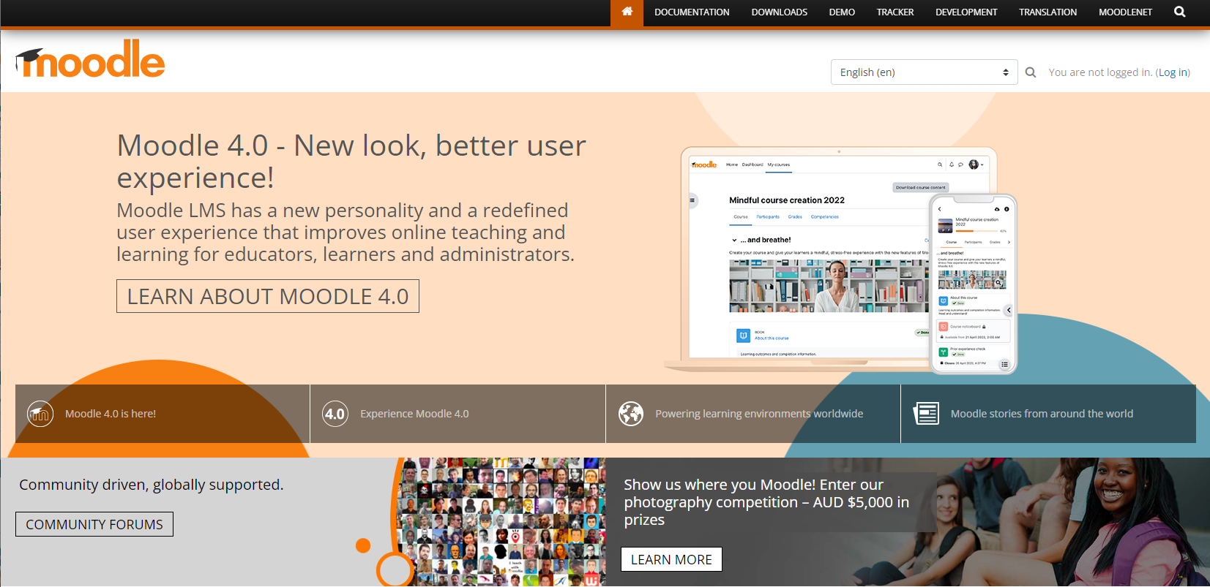
Moodle.org...

Slide 14
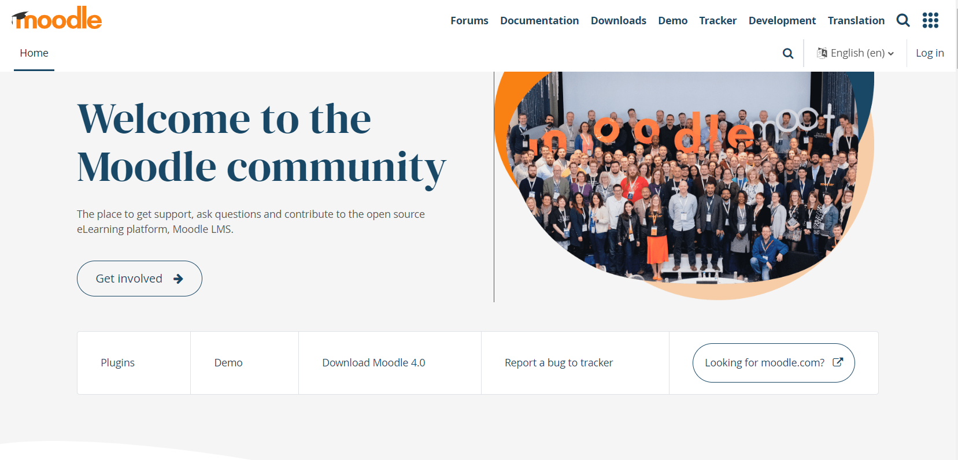
Coming soon….

Slide 15
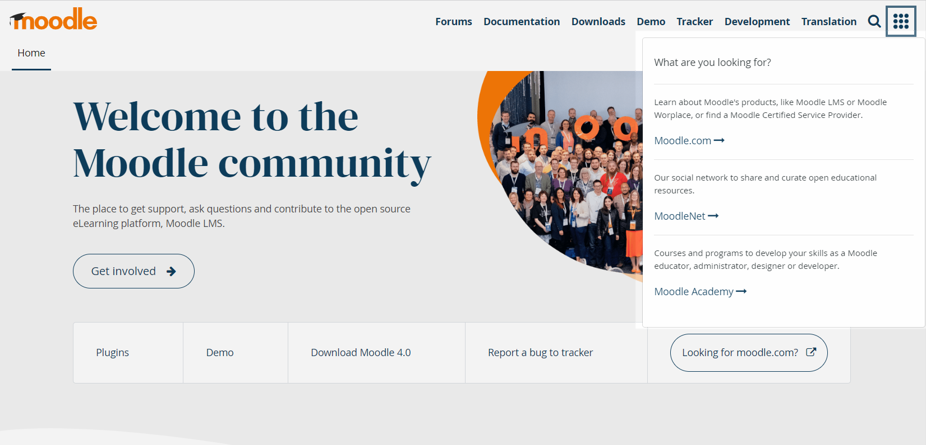
Coming soon….

Slide 16
Community Engagement Lead
Aurélie Soulier, Moodle Community Engagement Lead, started this week☺

Slide 17
Closing slide

