Slide 1
Moodle Moot 2022
tandemMOOC Practice Spanish and English!
Christine Appel
Antoni Bertran

Slide 2
WHO AM I? Christine Appel
Senior Lecturer in the Centre for Modern Languages at the Universitat Oberta de Catalunya (UOC) in Barcelona, Spain
Coordinator of European projects, amongst them, LLP project SpeakApps
mappel@uoc.edu

Slide 3
WHO AM I? Antoni Bertran
CTO 3ipunt (2004)
European LTI Co-chair
Edutech Cluster
Aws Solutions architect
@tunyafix
@tresipunt
antoni@tresipunt.com
moodle@tresipunt.com

Slide 4
tandemMooc

Slide 5
What is tandemMooc?
Improve foreign language learners’ opportunities to practice their English and Spanish conversation skills in e-tandem
Tandem language learning principles: Native speakers (or advanced learners) of each others’ target language help each other
Tandem conversations are guided by tasks
Mooc (6th edition)
From October 26 to December 7
Research carried out in tandemMOOC has mostly focused on learners’ emotions and experience within the course, their intercultural communication competence and speaking abilities, and in course and task design. Such as foreign language anxiety, although it tends to decrease as learners’ practice within the course goes on.

Slide 6
How does it work?
Each week you will have a different topic and tasks to do on e-tandem
Preparation materials and video tutorials for tandem learning strategies
Learners are can choose to be matched or select a native tandem partner
Auto video recording
Self and Pair assessment
Points and Badges for tandems, feedback and course completion

Slide 8
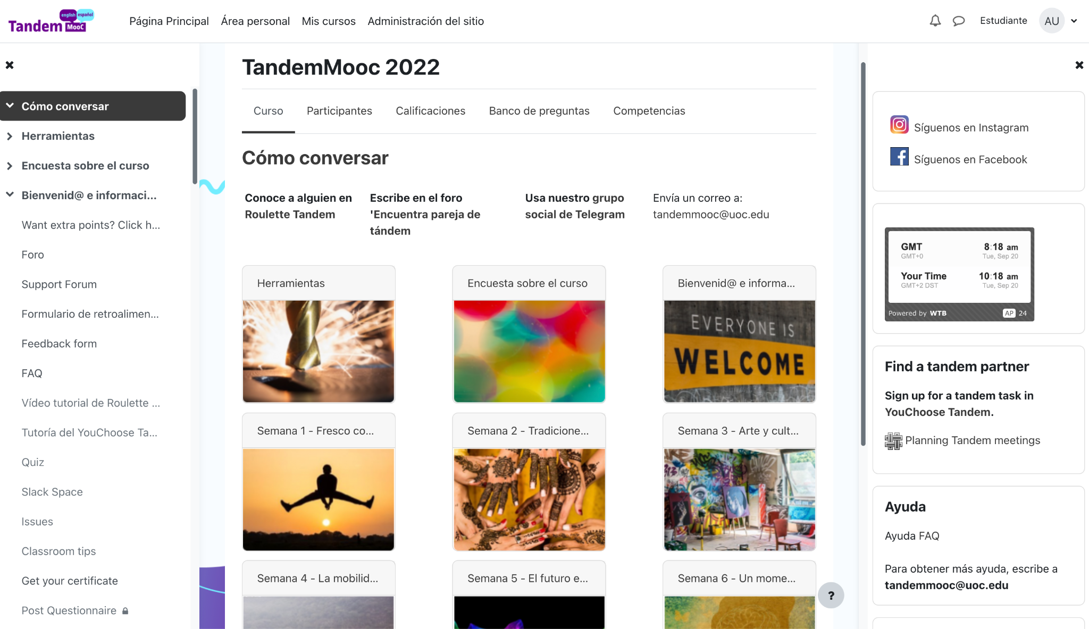

Slide 9
Main tools
Roulette Tandem matches you with a random partner who is also online
YouChoose Tandem is where you meet people you have arranged to meet beforehand
Videorecording and Feedback, review your Tandem session after your partner feedback
Portfolio information about your tandems, feedback and rating
Video Forum practice long monologues, publish as text, video or audio
Quiz activities, these activities will help to practice some aspects on language
Gamification, ranks of points , prizes, badges and reputation stars as good tandem helper

Slide 11
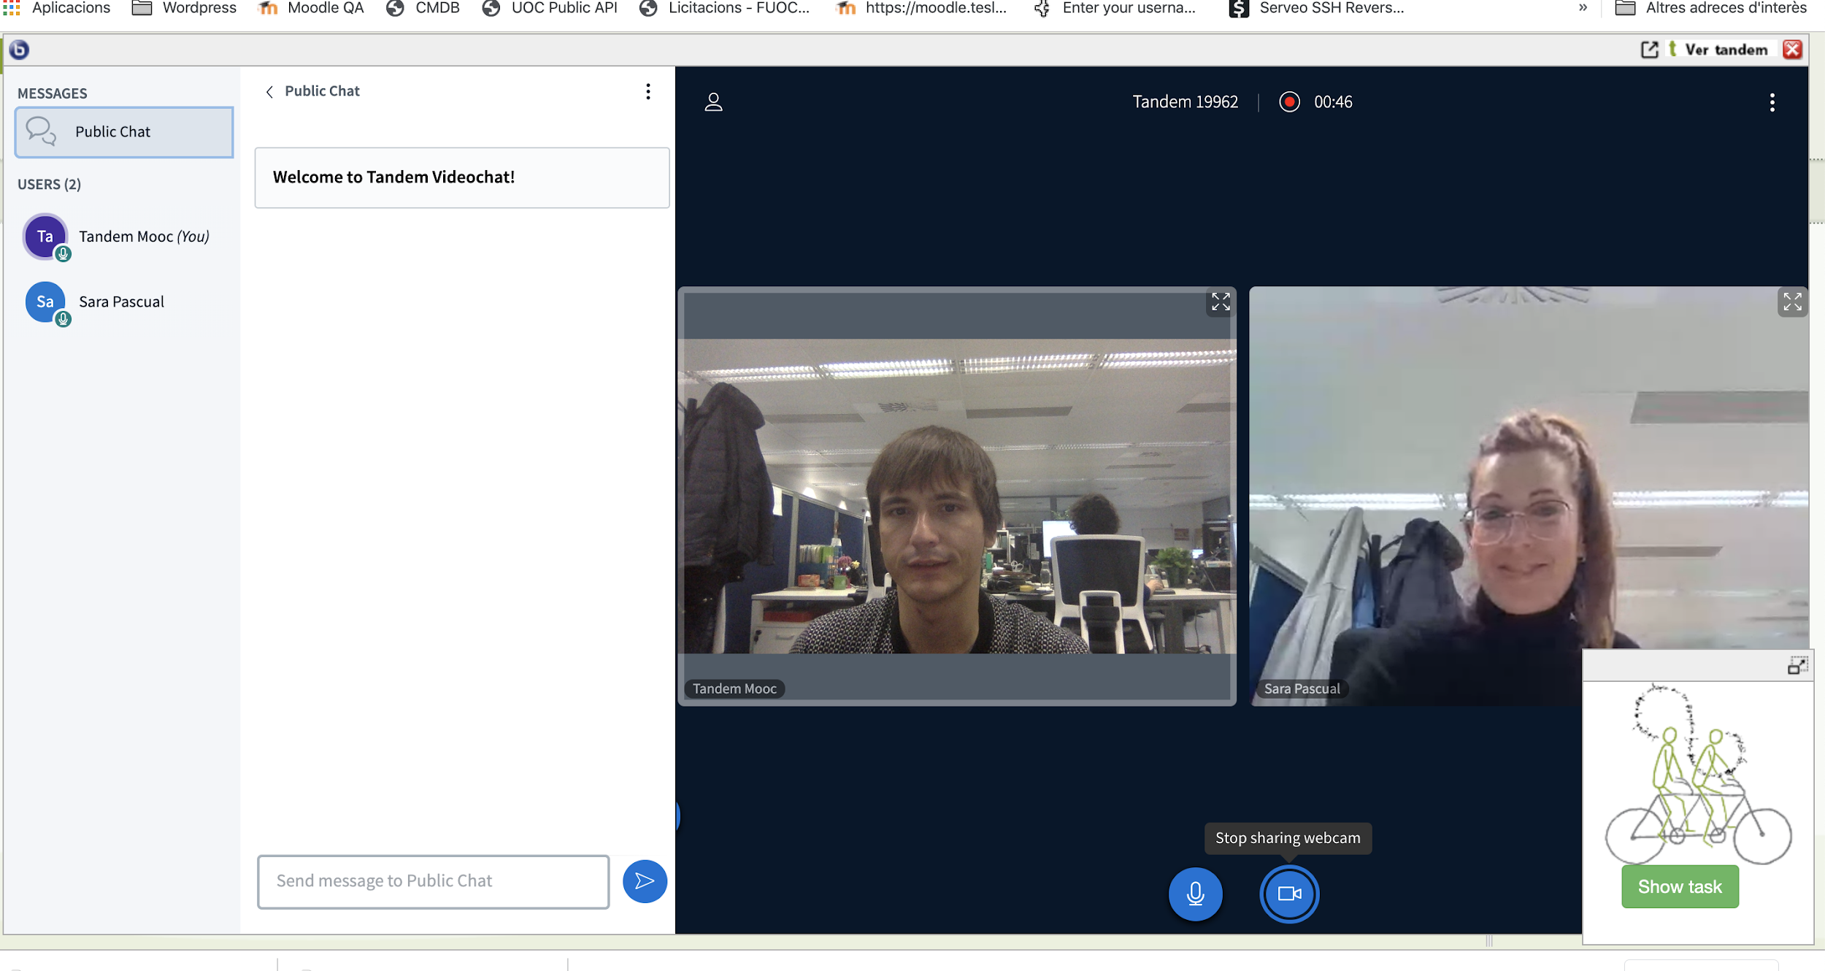

Slide 12
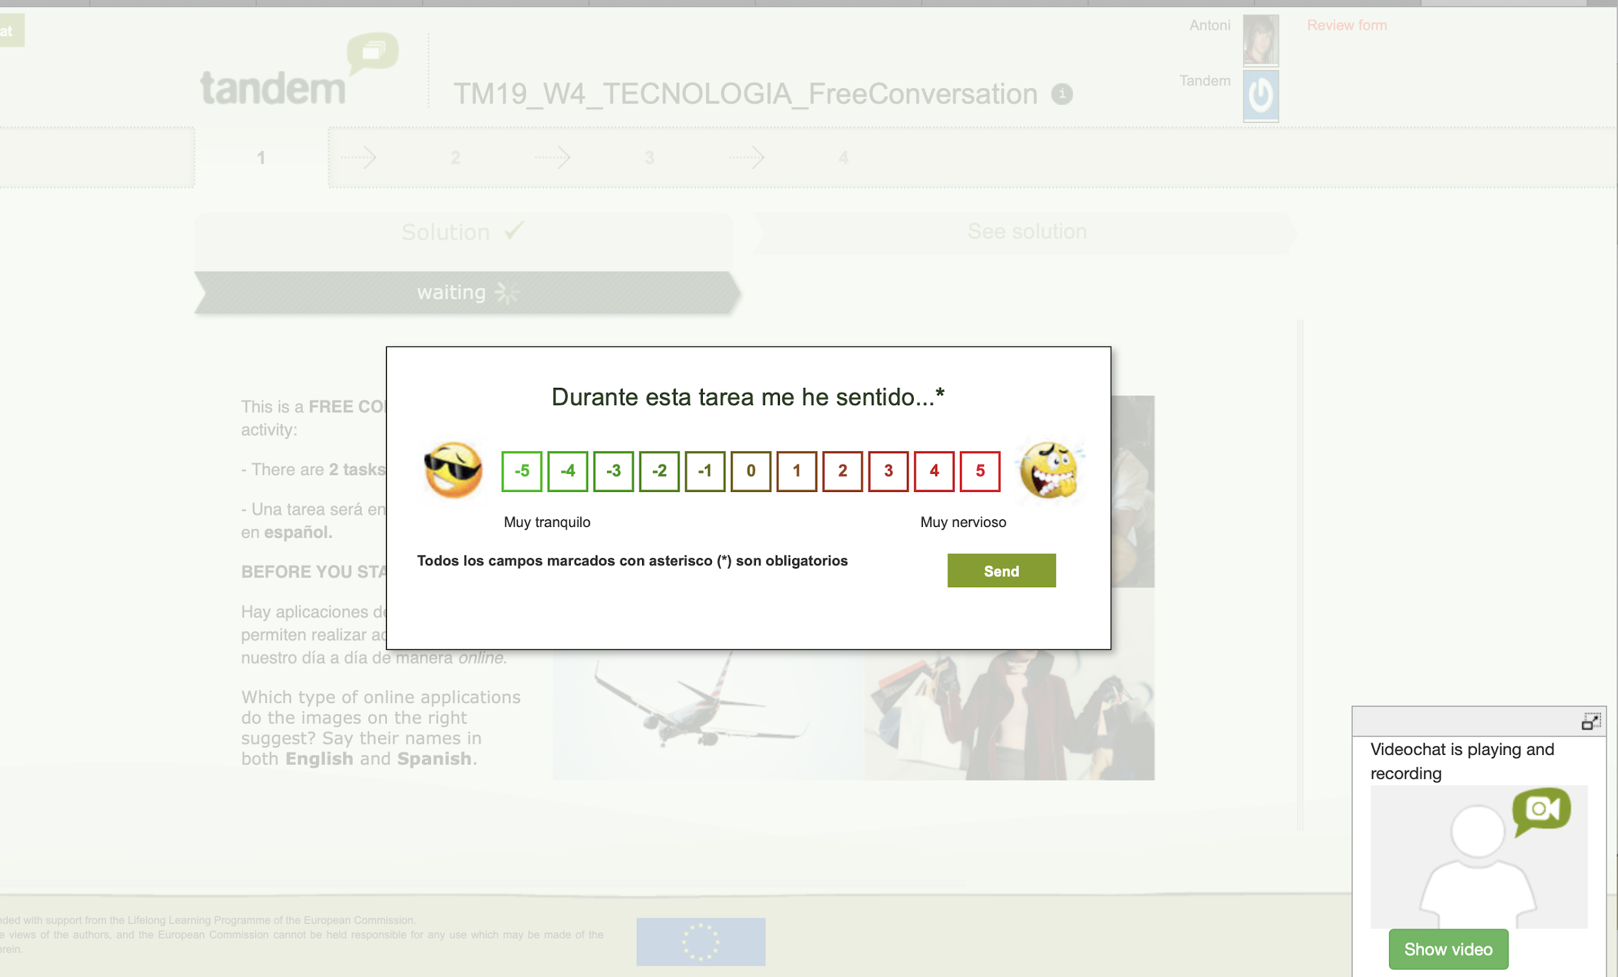

Slide 13
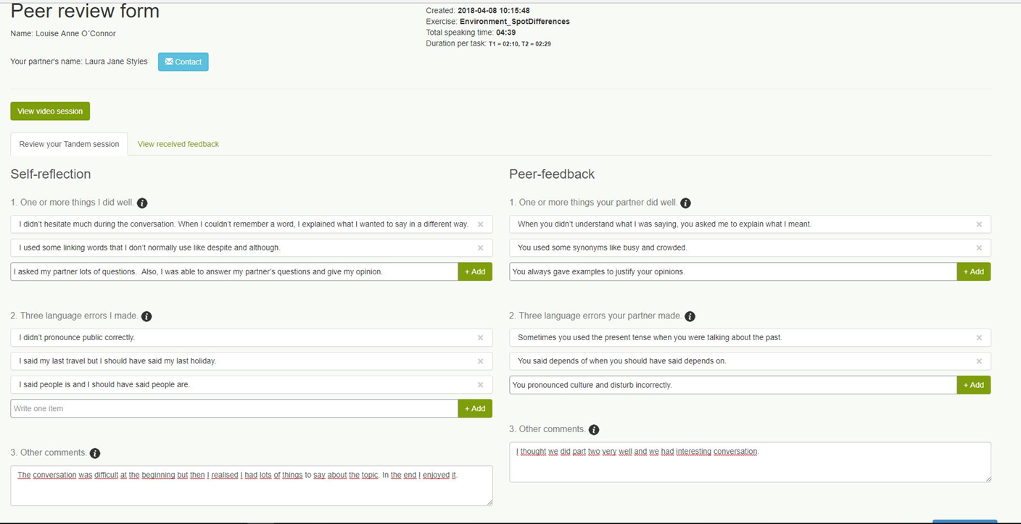

Slide 14
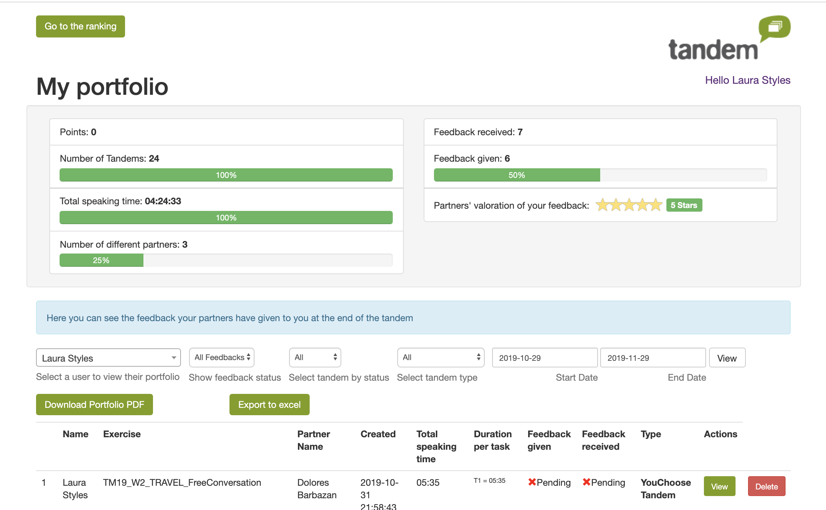

Slide 15
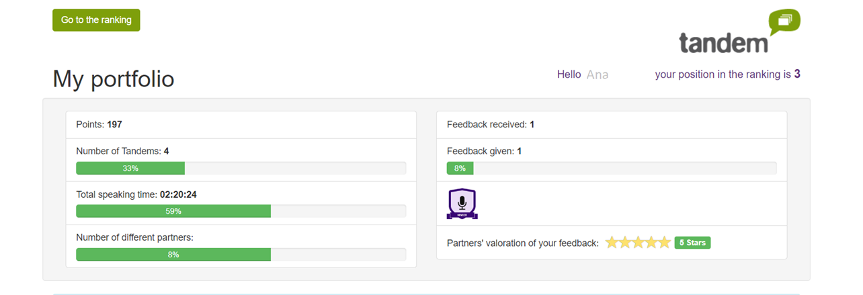

Slide 16
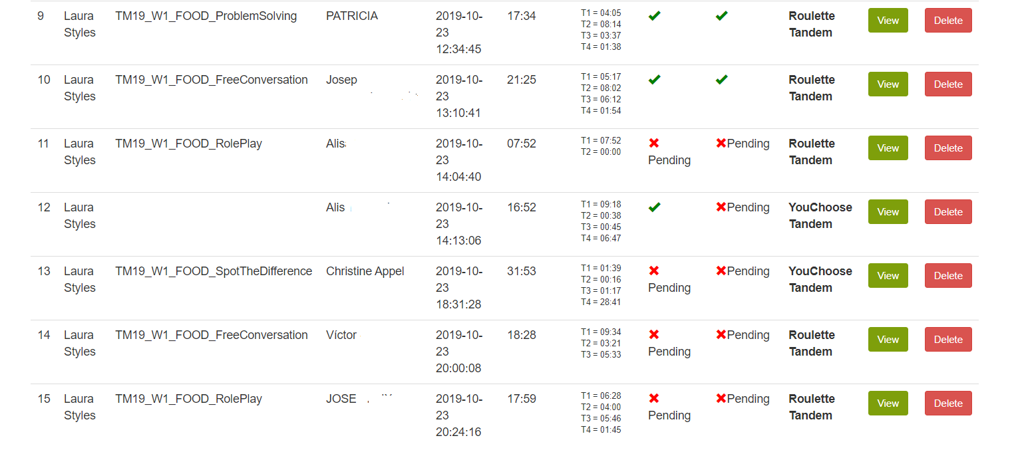

Slide 17
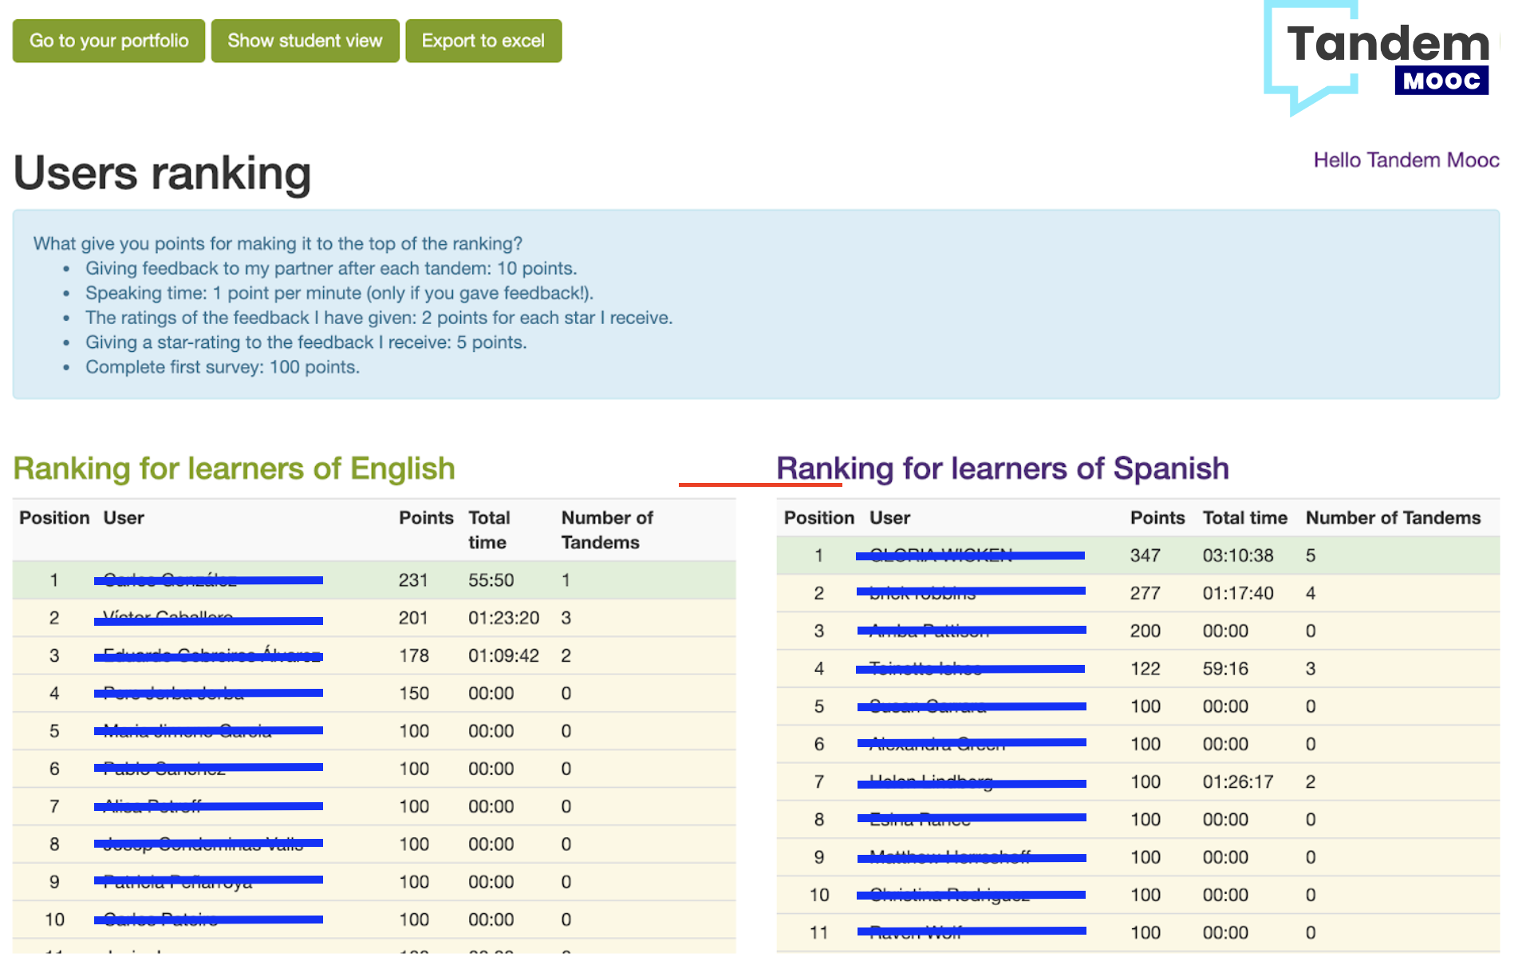

Slide 18
What gives points for the ranking?
Completing the first course questionnaire
Speaking time: 1 point per minute
Completing all activities in the tandem task
Leaving constructive feedback for your partner
The ratings of the feedback
You only get the points if you give your tandem partner feedback!

Slide 19
Architecture

Slide 20
Using 4 main OpenSource components:
WordPress as a registration platform
Moodle to perform activities
BigBlueButton to record sessions
Tandem to link pairs, show activities, ranking (https://github.com/UOC/Tandem/tree/tandem_mooc)

Slide 21
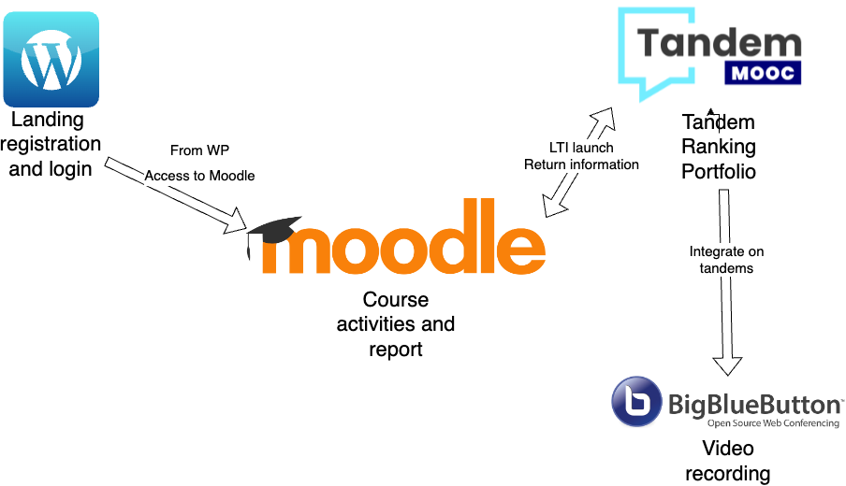

Slide 22
Let’s practice!
https://mooc.speakapps.org/

Slide 23
Questions?
Thanks

