Slide 1
StudentQuiz: An activity that gamifies the generation of quiz questions by (and for) students
Chris Nelson
Senior Product Manager, Learning Systems, The Open University (UK)
chris.nelson@open.ac.uk
1

Slide 2
CONTENTS
1
2
3
4
A brief history
What it is
What we’re working on
Q&A and links
2

Slide 3
1 A brief history

Slide 4
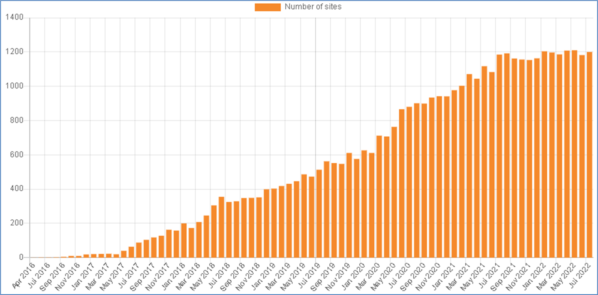
StudentQuiz history
StudentQuiz allows students to create quiz questions, and for the group/cohort to take those questions, rate/comment on them, and earn points.
Designed by Professor Frank Koch (pictured) of The University of Applied Sciences Rapperswil, Switzerland.
First released in November 2016.
Notes:
The Open University saw the plugin’s potential and we began helping its development in April 2019.
Frank retired in August 2021, but is still involved in StudentQuiz.

Slide 5
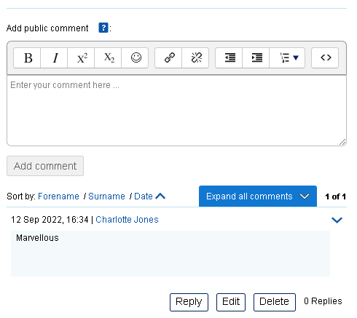
StudentQuiz history
Recent OU enhancements:
We rewrote the question commenting.
There’s private commenting when using the tutor-approval workflow.
Optional notification settings.
Additional question filtering.
We added support for ‘separate groups’ mode.
Notes:
However, Moodle 4.0’s introduction of question versioning, as well as the question bank redesign, meant that we have had to rewrite a significant portion of StudentQuiz.
Consequently have been working on compatibility issues for the last nine months :-/
But as Moodle 4.0 introduces question versioning, this is very welcome.
Early August 2022 saw the last release of StudentQuiz in the M3.x branch as it is too complicated to maintain separate branches with our move to M4.x in November 2022.

Slide 6
2 StudentQuiz: What it is

Slide 7
What it is
StudentQuiz’s core pedagogical point is: “You can only understand something if you can explain it to others” (Albert Einstein/active learning/Richard Feynman technique).
Emphasis is not on just designing the question, answer(s), and distractor(s), but also using feedback to explain why the responses are correct or incorrect.
StudentQuiz aligns well with Moodle’s constructivist principles – could be Core in a few years(?).

Slide 8
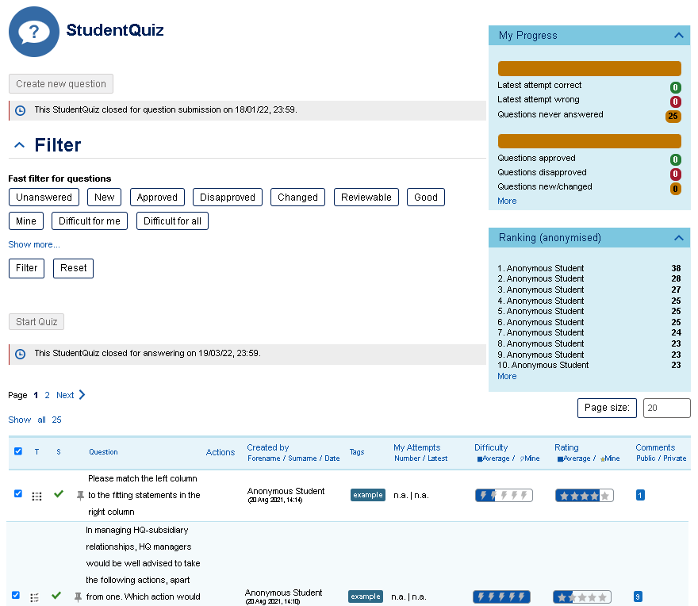
Notes:
Lots of question filtering options.
Students who participate the most will make it into the “top 10 list”.
Points are given for creating question, taking them, responding correctly etc.
Really good student questions from previous classes/years can be reused.
Much like the ‘playground revision group’, StudentQuiz can be especially useful when students are revising for tests.

Slide 9
An OU case study
Annual November presentation, postgraduate, 15 credits, popular course in the OU MBA/MBA (Technology Management).
A StudentQuiz is woven into the January-February study weeks as a learning activity.
Participation is not linked to the assessments or course pass criteria.
Notes:
Last time I presented about StudentQuiz at a MoodleMoot, I was asked if I could share any case studies. Today, I will talk about what we learnt from BB853.

Slide 10
An OU case study
Clear explanation of the entire activity and process, and emphasis on learning value. The scaffolding was introduced over a few weeks in advance.
Three exemplar (‘seed’) questions from the module team as an ice-breaker.
60 students (five tutor groups), cohort-wide StudentQuiz.
22 students (37%) created at least one question.
37 took (62%) one or more questions.
Unsurprisingly, those who created the questions also more likely to take more questions.
Image © Google Maps.

Slide 11
An OU case study
Feedback from students (I):
“Fascinating” activity.
Became clear that we need more scaffolding around Moodle question creation.
Led to improvements in our student-facing guidance.
We have removed the True/False question type.
Explore User Tours?
Several comments relating to Moodle Core:
The Moodle question forms need to be friendlier.
Confusion with the ‘shuffling’ feature in the Matching question type.

Slide 12
An OU case study
Feedback from students (II):
Several feature suggestions:
Make the question production workflow more obvious.
Posting a comment should score points.
New ‘Review’ phase, where you can still view all of the questions and comments etc., but cannot otherwise affect the activity.
Image © Google Maps.

Slide 13
3 What we’re working on

Slide 14
Future StudentQuiz developments
These are feature ideas for the next two to three years.
OU business needs often overlap with community requests.
Defect-fixing usually takes priority over adding new features.
Poyraz 72, https://commons.wikimedia.org/wiki/File:Table_salt_with_salt_shaker_V1.jpg

Slide 15
Future StudentQuiz developments
New tabbed navigation.
Rename the existing single screen the ‘Question pool’.
Introduction of the ‘My questions’ screen if the approval workflow is set.
The detailed Ranking and Statistics pages would also be tabs.
Make the question approval workflow more obvious.
A new question pool ‘Quick start’ button.
More completion criteria, add pass criteria.

Slide 16
Future StudentQuiz developments
Allow commenting on a question to earn points.
A way to reset all of the content, or duplicate-activity-without-user-content.
Better server/website-level admin controls to hide question types from being selectable at the course-level.
While an excellent feature, not every activity designer wants the gamified rankings block, so we will introduce an option to hide that aspect.

Slide 17
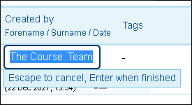
Future StudentQuiz developments
Improvements to the user notifications.
Ability for staff to over-ride the user name e.g. for seeded exemplar questions, to make it clear that the author is “The Course Team”.
A new ‘Review phase’.
Core changes(?): simplify the question forms or be able to hide certain parts in StudentQuiz, e.g. draft/ready, ID number, show standard instructions, multiple tries....
Lots to do!

Slide 18
5 Q&A and link

Slide 19
Q&A and link
The StudentQuiz plugin:

Slide 20
THANK YOU
@GoTeamOU
https://medium.com/@GoTeamOU/
Chris Nelson
Senior Product Manager, Learning Systems, The Open University (UK)
chris.nelson@open.ac.uk
68

