Slide 1
Performance testing of a Moodle system exclusively dedicated to massive online evaluations: determining its limits
José Fager
Emilio Penna
Universidad de la República - Uruguay

Slide 2
Performance testing of a Moodle system exclusively dedicated to massive online evaluations: determining its limits
José Fager
Emilio Penna
Servicio Central de Informática
Universidad de la República - Uruguay

Slide 3
About Udelar
Udelar: University of the Republic (Udelar)
Main university institution in Uruguay
100,000 students
11,500 teachers
450 careers
20 schools
16 centralized Moodle installations
9 decentralized Moodle installations
Centralized (shibboleth) login

Slide 4
During the pandemic
Year 2020: Use of technologies for education intensified
All university activities were 100% online
It is common practice at Udelar for thousands of users to participate simultaneously in evaluations

Slide 5
Requirements
Due to the large number of users, it was necessary to set up a Moodle-based system dedicated exclusively to carry out online evaluations.
Someone asked:
How many students does it support?… at the SAME time? 🤔
Looking for an answer, we decided to run a load test. We used Apache Jmeter – with this tool, we can develop a script that makes the same HTTP requests tha the real users make from their web browsers.

Slide 6
Simulation design
We configured a Moodle quiz with different type of questions (16) and some (small) images.
Test data was generated, including 5000 test users enrolled in the test course.
What does it mean that the users enter “at the same time”?
Critical moment: quiz start
It is not the same:
1000 users start the quiz attempt in 10 seconds
1000 users start the quiz attempt in 2 minutes

Slide 7
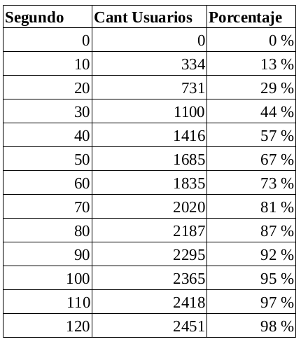
Timing
We analyzed real Apache logs, looking at the distribution of the time of the request to the start of the quiz attempts (startattempt.php). We observed, for example:
In the first 10 seconds, 13% of users started the attempt
In the first minute, 73% of users started the attempt

Slide 8
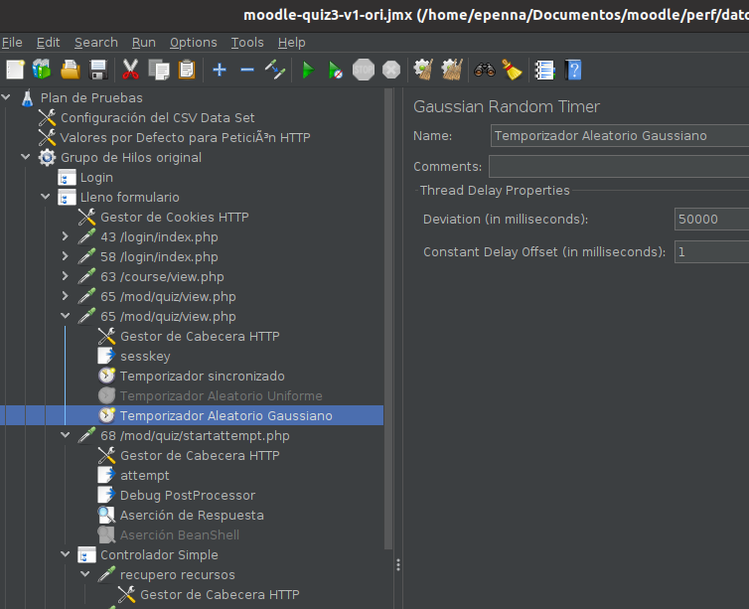
Simulation desing in jmeter
Users logged in, in the 10 previous minutes to the quiz start time (10 min ramp up)
Synchronized Timer, that waits until all Virtual Users are logged in, then the quiz starts
A good aproximation to the “start attempt” distribution was achieved using a “Gaussian Random Timer” (with a 50s deviation)

Slide 9
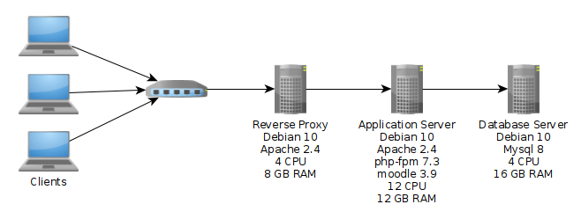
Infrastructure (test=prod)

Slide 10
Bottlenecks and adjustments
Bottlenecks detected in the load tests:
Reached max DB connections
Reached max Apache (prefork) workers
Too high CPU load in app server
Main adjustments to enhance performance:
Raised max DB connections
Changed to Apache event mpm and php-fpm and raised apache workers
Enabling and configuring opcache
More CPU for application server (8 to 12 CPU)

Slide 11
Main results
We ran tests with 2500 virtual users (VU) with no errors and good response times (560ms avg, 800ms std dev)
With 3000 VU the response time got worse and the CPU load were too high (200%) during most of the test time.

Slide 12
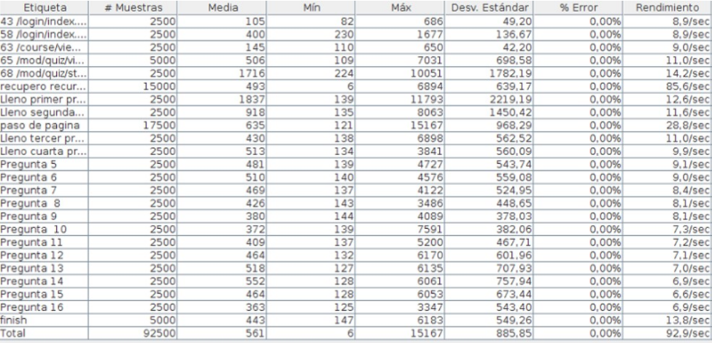
Results – 2500 VU

Slide 13
App server performance (2500 vu)
Max CPU usage: load average between 12 and 13 (110%) during 3 peak minutes (with 12 cores)
Max Apache processes: 14 (150 threads each)
Max php-fpm processes: 28
Memory (no swap was used):
Total | used | free | shared | buff/cache | available
11Gi | 1,7Gi | 2,4 Gi | 111Mi | 7,7Gi | 9,9Gi

Slide 14
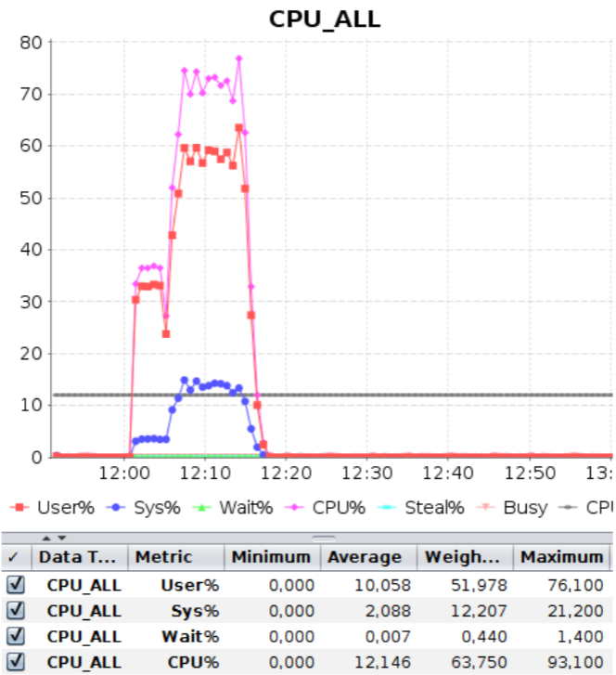
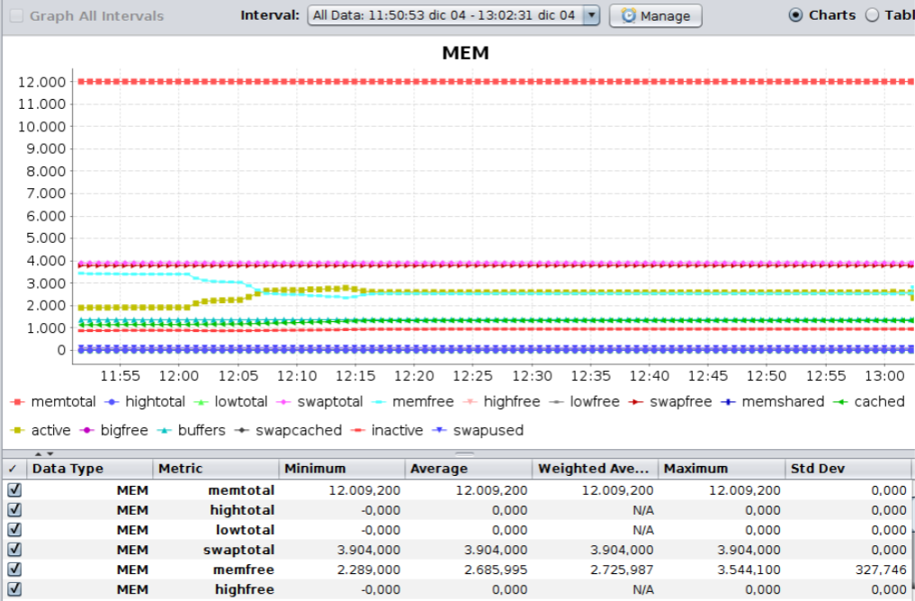
Monitoring with NMon

Slide 15
Other simulations using jmeter
Cache comparision: file vs memcached (our file chache was better, using a dell storage solution)
Tasks - uploading files
Quiz using Quiz Access Proctoring Plugin (takes photographs with webcam during exam)

Slide 16
Conclusion
Quite good results for only one application server
Simple deployment, well known software
No need for more RAM
CPU intensive, maybe more CPU could give better results
The system was used in production in more than 100 online evaluations, with up to 1500 students
Scripts were useful for testing other moodle systems in other universities.

Slide 17
Resources
Jmeter script, test data, and documents:
https://www.proyectos.udelar.edu.uy/redmine/projects/moodleperf
The scritps and load tests were made by Valentina Parula (QA division of the university central IT service).

Slide 18
Questions?

Slide 19
Gracias

Slide 20
Closing slide
José Fager
Emilio Penna
soporte.eva@seciu.edu.uy

