Slide 1
Moving to an Interconnected
and Standardised ecosystem
LMS | CONTENT | MOBILE | CONSULTING | GAMIFICATION | MEC TRAINING |
IMS-LTI INTEGRATIONS | LEARNING ANALYTICS
^{ADDRESS:}
C. de Méndez Álvaro, 20, 28045 Madrid
C. de València, 359 08009 Barcelona
^{CONTACT:}
^{Antoni Bertran}
^{antoni@tresipunt.com}
^{COMPANY:}
3&Punt Solucions Informàtiques SL
C. de València, 359 08009 Barcelona
C. de Méndez Álvaro, 20, 28045 Madrid

Slide 2
WHO AM I?
Antoni Bertran
CTO 3ipunt (2004)
European LTI Co-chair
Edutech Cluster
Aws Solutions architect
@tunyafix
@tresipunt
antoni@tresipunt.com
moodle@tresipunt.com

Slide 3
3ipunt is an official Moodle Premium Partners, members of the 1EdTech™ (Contributing Member) and AWS (Amazon Web Services) partners, as well as members of CatPL and EdutechCluster. We are focused in offering customized solutions in information and communications technology, with a high added value, a reduced cost and a close and accessible treatment.
We also identify ourselves with the concept bespoke: we like to provide a high added value to our projects, so these also provide things to us. We offer technology as a service to our customer. At 3ipunt we adapt technology to the customer needs to offer an customized integral solution for each project and scenario.
ABOUT US

Slide 4
WE AREN’T
ALONE
Notes:
RRHH TIENDA
PRL
SOFTWARE DE TIENDA
ATENCIÓN CLIENTE
MARKETING
PRODUCTO
PUBLICIDAD EN TIENDA
CAMPAÑAS

Slide 5
ECOSYSTEM REAL WORLD

Slide 6
ECOSYSTEM SYSTEMS
System A
More and more information flows between our systems.
Most unspecified.
System B
System C
System D

Slide 7
ECOSYSTEM SYSTEMS
How can I extract/enter from/into the system the information required/provided by system E?
?
System A
?
?
?
System B
System C
System E
?
?
Is there an information flow already defined that I could reuse?
System D

Slide 8
ECOSYSTEM SYSTEMS
Information to authenticate and authorize
Academic information
Analytical information
Information for tests and exams
IMS LTI
IMS OneRoster
IMS Caliper
IMS QTI
System A
System B
System C
System D

Slide 9
Introduction to
1EdTech
The IMS Global Learning Consortium is now the 1EdTech Consortium
Notes:
RRHH TIENDA
PRL
SOFTWARE DE TIENDA
ATENCIÓN CLIENTE
MARKETING
PRODUCTO
PUBLICIDAD EN TIENDA
CAMPAÑAS

Slide 10
Why
Open Standards?
Seamless access to resources
Improved product choice
Greater agility
Make tech connections effortless
Reduce the cost of connectivity and data exchange for all
No vendor lock-in
Greater choice of tech partners
https://www.1edtech.org/

Slide 11
Why
1EdTech Community?
Non-profit consortium
Owned and driven by members
Coherent ecosystem
Trusted, reliable, responsive
Represents all stakeholders
27 Countries
740 Member Organizations
Global Impact
Image: Freepik - Flaticon.com

Slide 12
1EdTech
The Power to Build a Flexible Ecosystem
Student Information System
Learning Objectives
Learning Management System
Learning Resources
Portal
Access & Data
Learning/Assessment Resources
Assessment

Slide 13
Standard | Benefit
OneRoster/Edu API | A simple, safe way of providing access and authentication while saving staff time and money.
LTI 1.3 | Direct, safe links to various discrete learning resources for each lesson, to address learner variability.
LTI Advantage | Deep linking, Users & Roles, and Grade/feedback Pass back.
LTI Resource Search | Direct link to a discrete source based on meta tags.
Common Cartridge & Thin Common Cartridge (CC/TCC) | A complete scope and sequence package, including multimedia, activities and assessments. TCC provides one doc. with the links to the resources.
CASE | A standard data format for publishing and exchanging course learning objectives.
Caliper | A data tracker to pass raw data about learner usage.
Open Badges (OB) | Describes a method for packaging information about accomplishments, embedding it into portable image files, including resources for web-based validation and verification.
Comprehensive Learner Record (CLR) | A record with secure and verifiable learning and employment records supporting academic and workplace recognition and achievements.

Slide 14
WHAT IS LTI?
A consistent format to integrate learning resources in the digital environment
LTI 1.3
Simplified, safe access, and authentication with an anonymized user ID
Host learning resources from many suppliers
Suppliers embed resources in any platform with little custom work– (less effort and cost)
Feedback and data across tools and systems
OpenID Connect

Slide 15
INFORMATION ON AN LTI LAUNCH
Learning environment,-- School, Course
User information
Consistent ID
Role: student, teacher, designer, admin
Optional: Name & Email
Message indicating purpose: Load content, discover content, etc.
LTI 1.3
OpenID Connect

Slide 16
LTI ADVANTAGE
Deep Linking
1
LTI 1.3
2
Names and Roles
OpenID Connect
3
Assignments and Grades

Slide 17
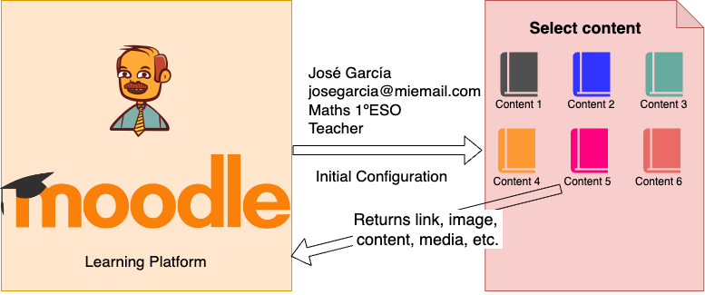
DEEP LINKING

Slide 18
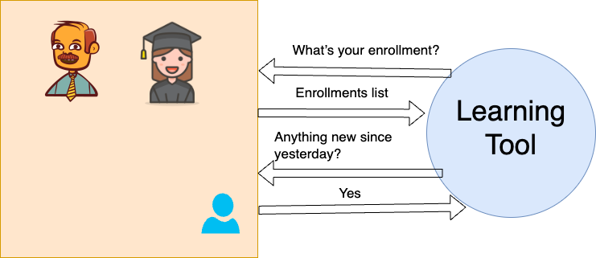
NAMES AND ROLES

Slide 19
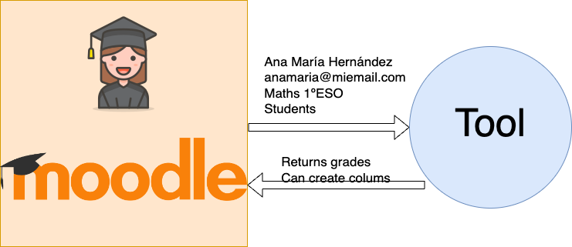
ASSIGNMENTS AND GRADES SERVICE

Slide 20
MAIN MARSUPIAL AND LTI
LTI 1.3 uses secure and modern protocols
Built on top of industry standards:
Asymmetric keys (JWSK)
OpenId idtokens (iss, sub, kid, etc)
Oauth2
Multi-tenant (deployment_id)
LTI 1.3
IMS Security Spec
OpenID Connect
OAuth 2.0
LTI Advantage

Slide 21
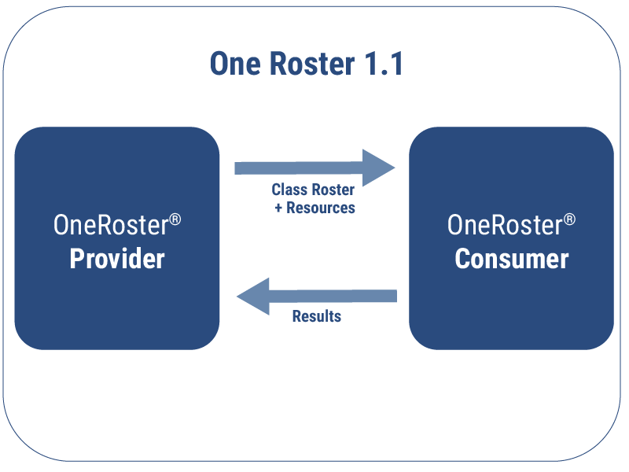
ONE ROSTER
Provision key roster related data including student, course and related enrollment information between various platforms (ex SIS and LMS)
Flexible implementation options to align with an institution’s needs and capabilities, supporting simple spreadsheet-style (CSV) exchanges as well as system-to-system exchanges using REST API’s

Slide 22
ONE ROSTER
Improves data exchange among multiple systems with roster and gradebook information, thus eliminating problems before they happen
Transmit scored results between applications, such as student scores from the LMS back to the SIS.

Slide 23
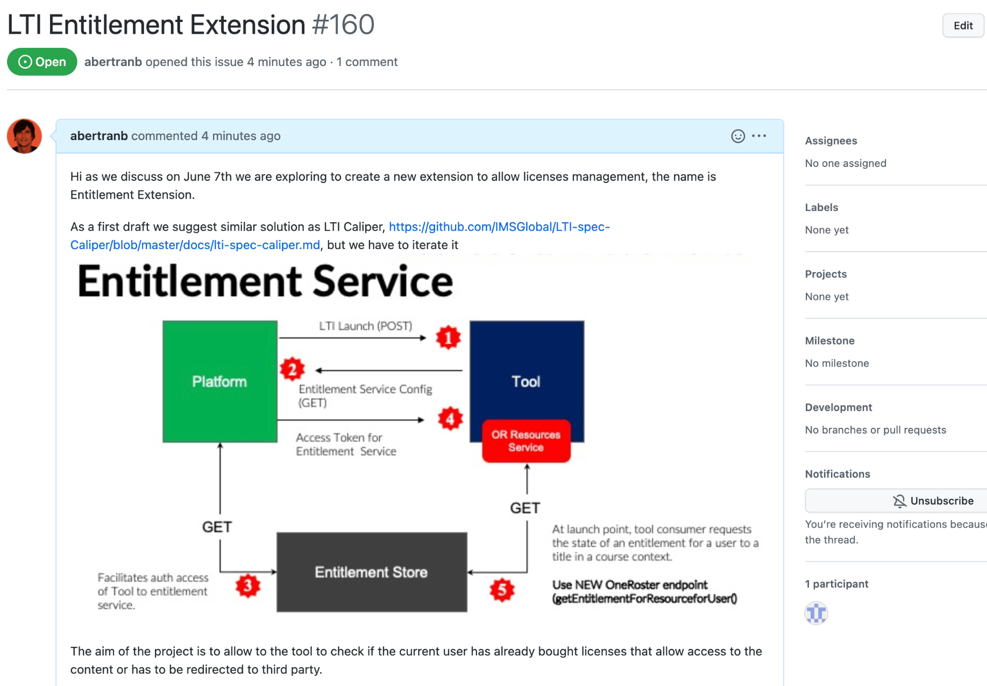
1EdTech LISTEN TO THE COMMUNITY
1EdTech allows to share proposals
The community drives
7th June we shared
Add the formal proposal
We will discuss
Create a draft
Validate

Slide 24
APPLYING TO
MOODLE
Notes:
RRHH TIENDA
PRL
SOFTWARE DE TIENDA
ATENCIÓN CLIENTE
MARKETING
PRODUCTO
PUBLICIDAD EN TIENDA
CAMPAÑAS

Slide 25
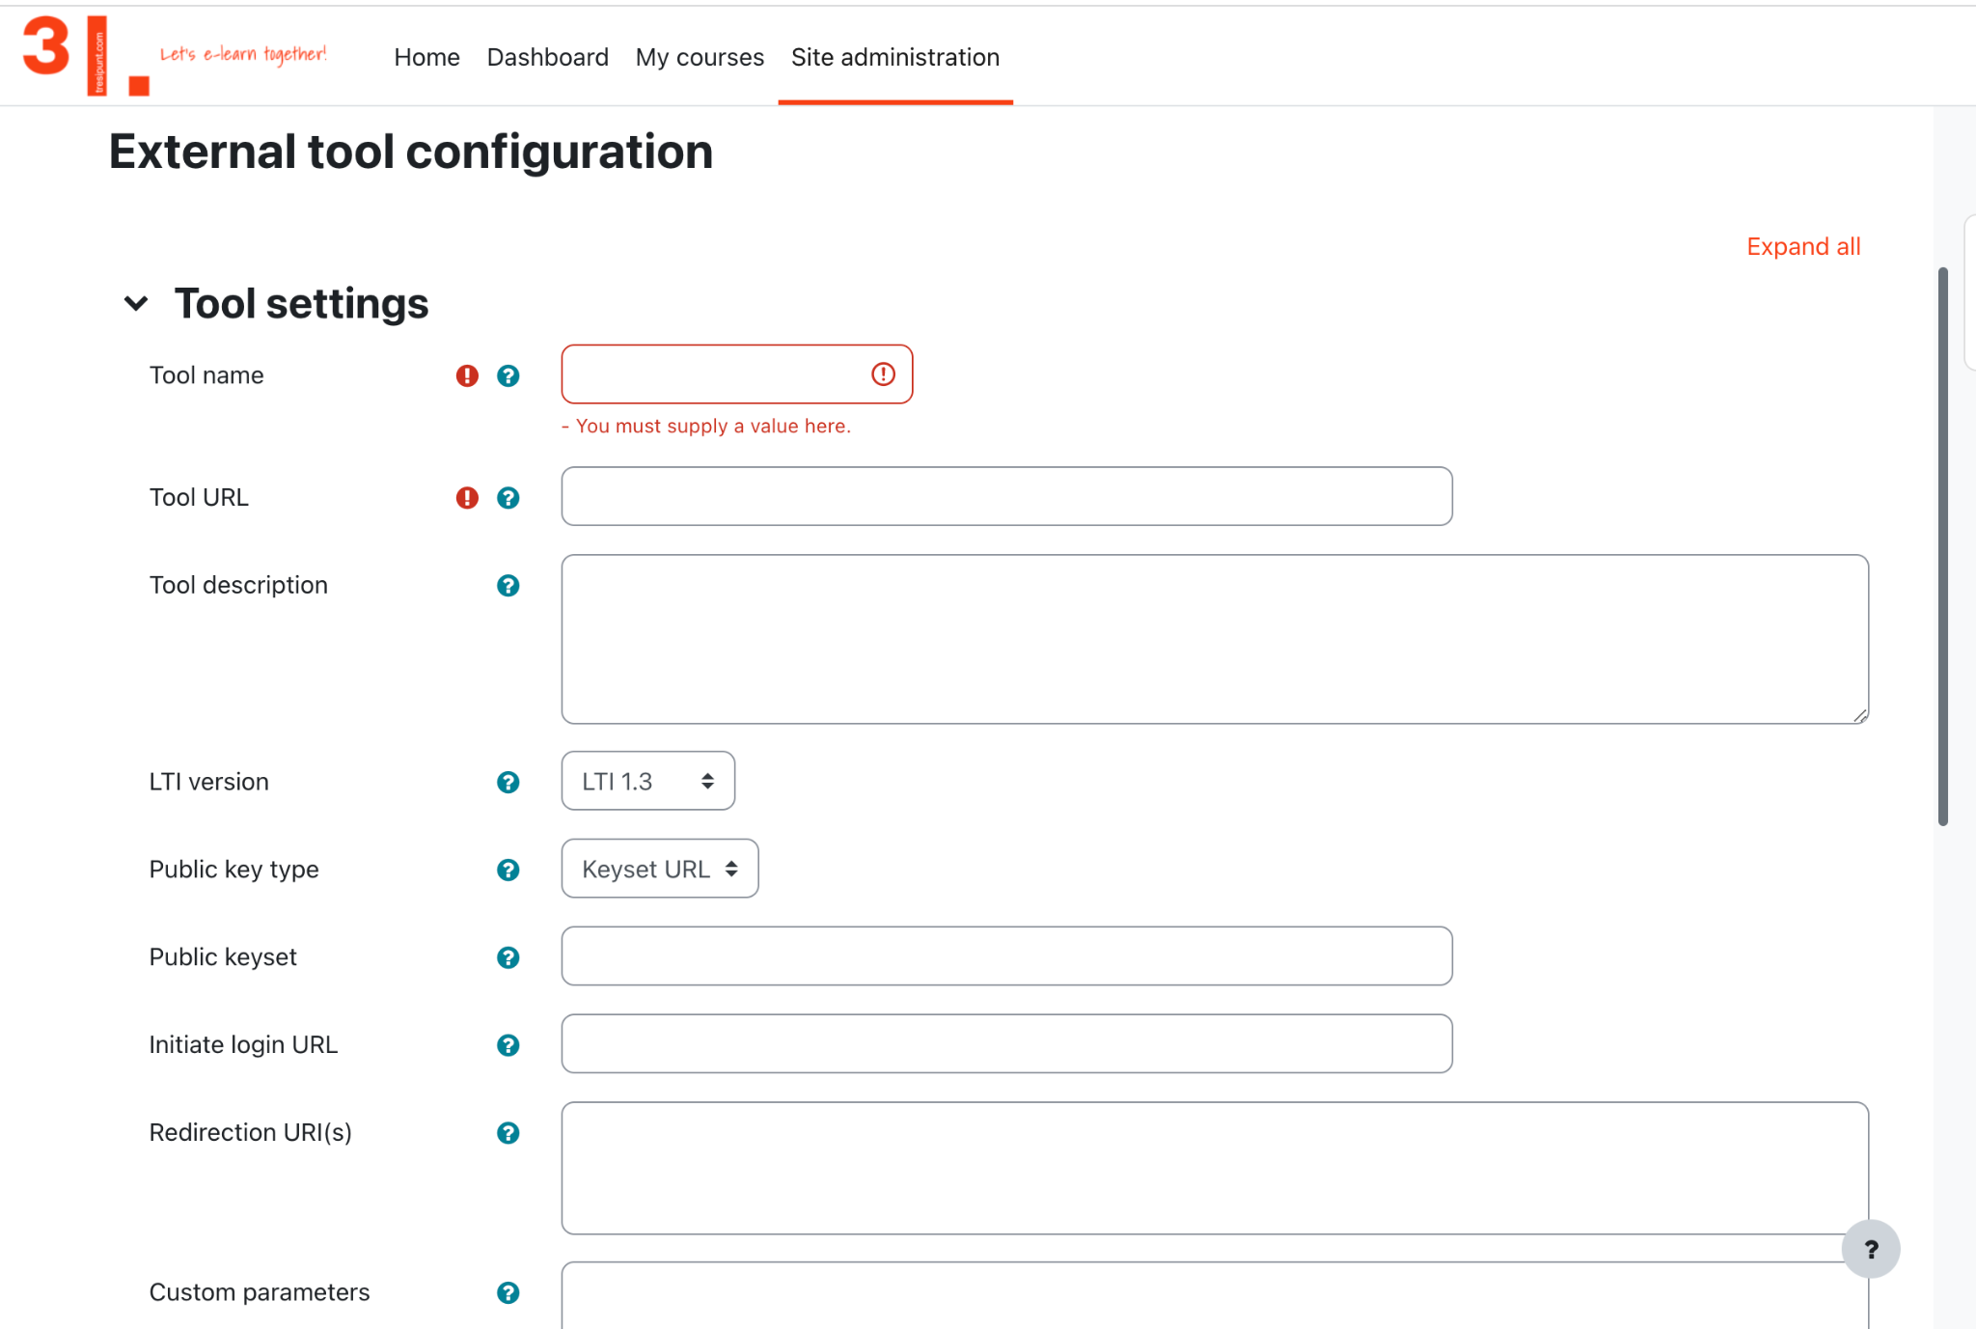
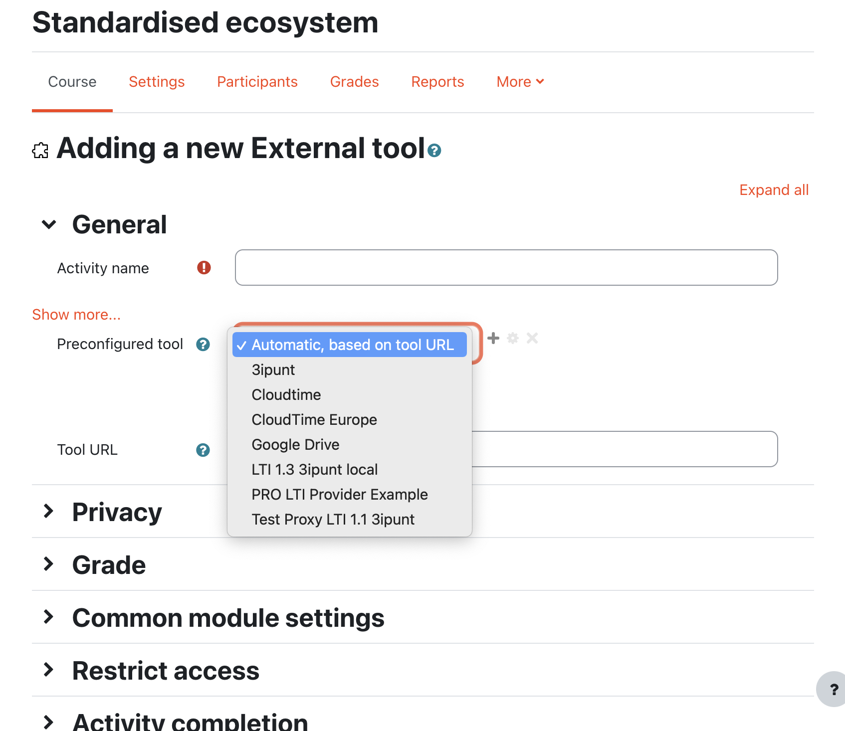
LTI PLUGIN - Activity (External tool)
Support to LTI 1.1 and 1.3
Certified
Focus on LTI 1.3
Core
Deeplink (copying courses with history, selecting multiple content items at once)
Assignment and Grade Services
Names and Role Provisioning Services
Dynamic registration

Slide 26
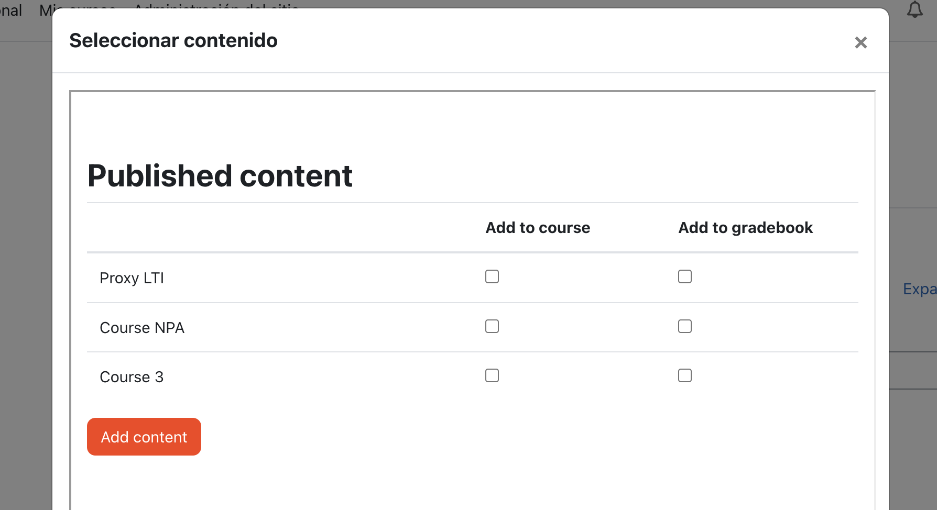
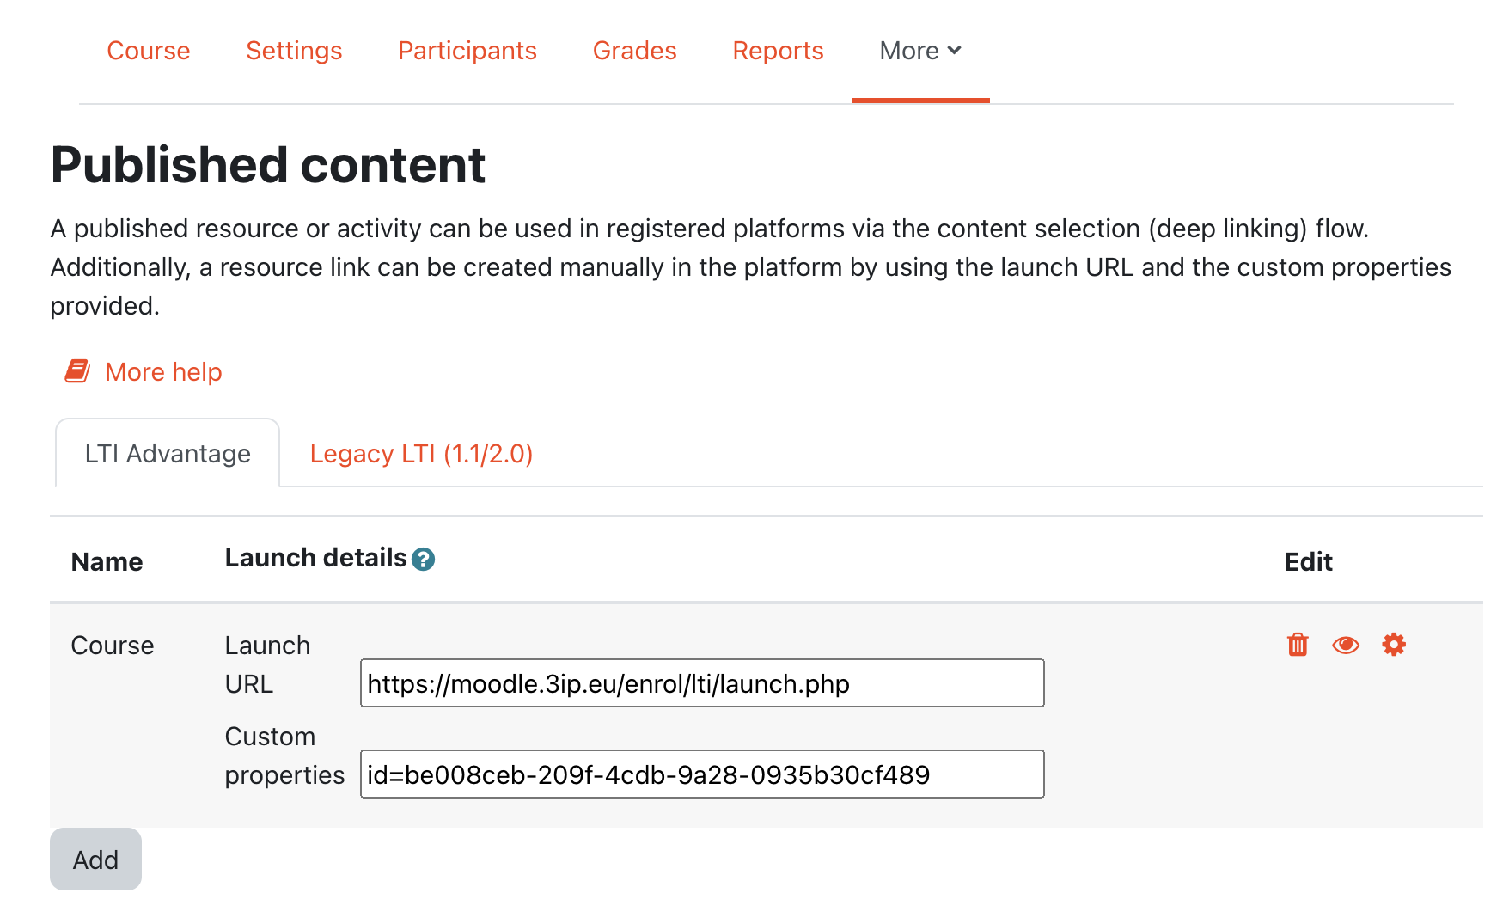
LTI PLUGIN - Authentication and Enrolment
Support to LTI 1.1 and 1.3
Focus on LTI 1.3
User account provisioning
Link creation via content selection
Deeplink
AGS Assignment and Grade Services
NRPS Names and Role Provisioning Services
Dynamic registration

Slide 27
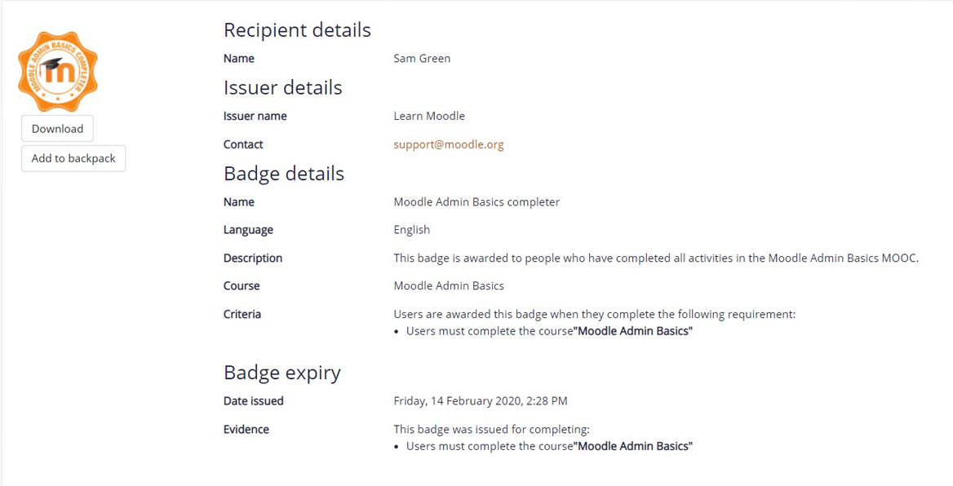
OPEN BADGES
Support Open Badges 2.0 and 2.1
Certified
Type of digital badge that is verifiable, portable, and packed with information about skills and achievements
Site badges - available to users site-wide and related to the site wide activities, like finishing a set of courses.
Course badges - available to users enrolled in the course and related to the activities that happen inside the course.

Slide 28
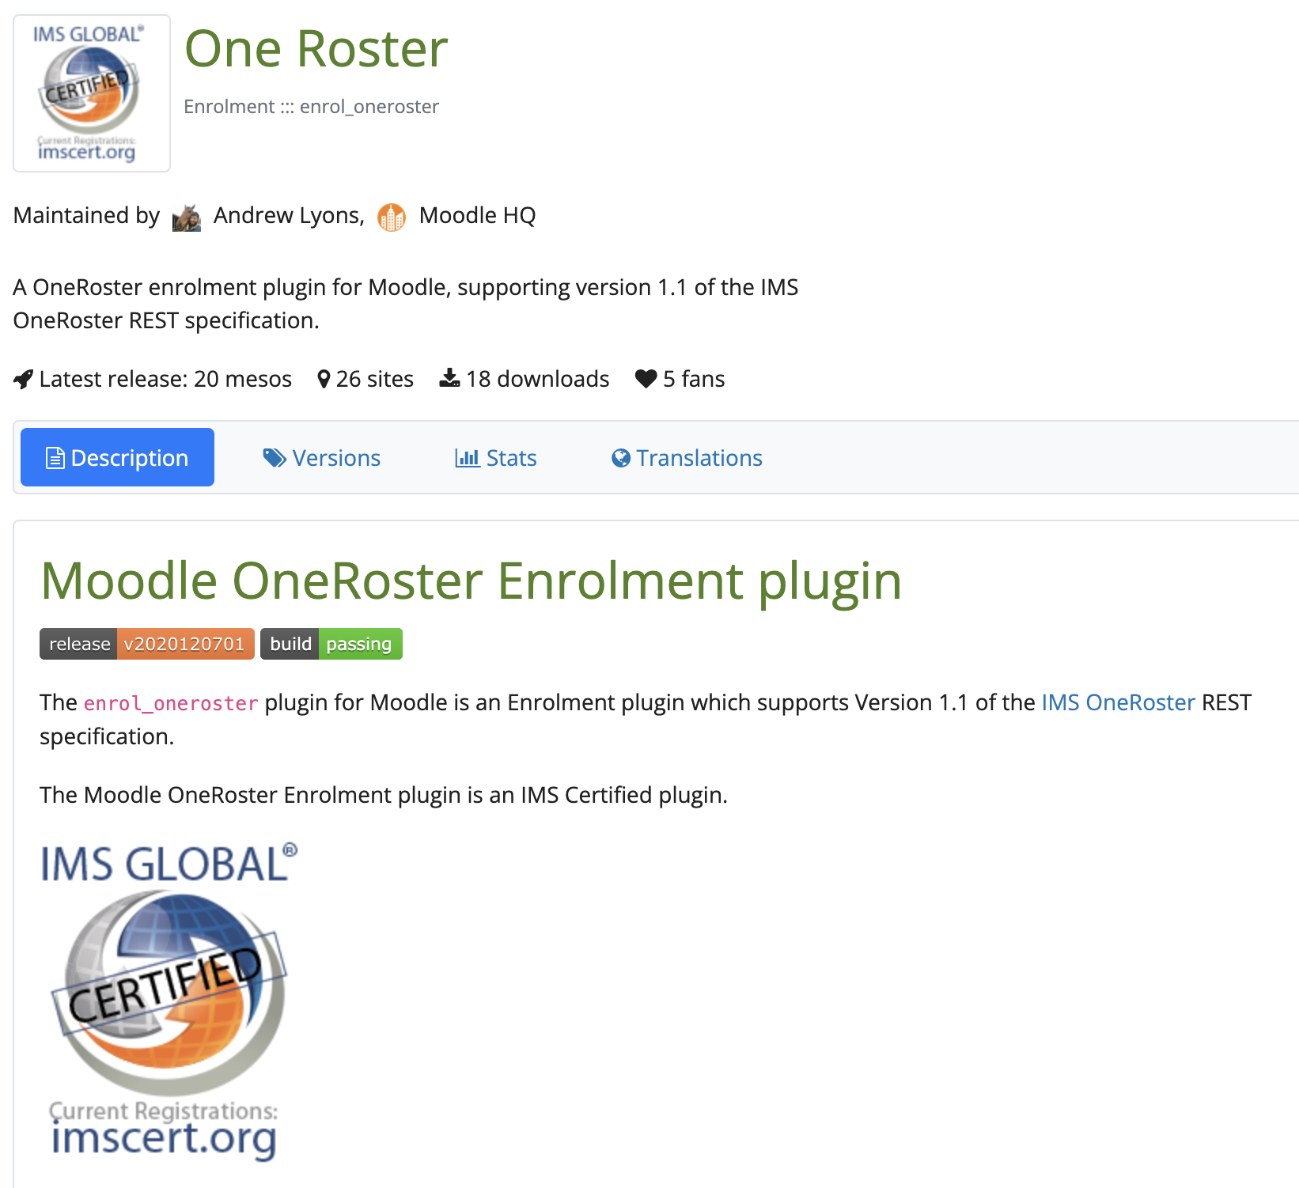
One Roster PLUGIN - Enrolment
Andrew Lyons and Moodle HQ
Certified
Creation of users associated with a School
Assignation of Parent roles to individual students
Creation, and Update of Moodle courses from OneRoster Class data, including provision of: Start and End date
Creation, Update, and Removal of Enrolment records for students, and teachers to each course
https://moodle.org/plugins/enrol_oneroster

Slide 29
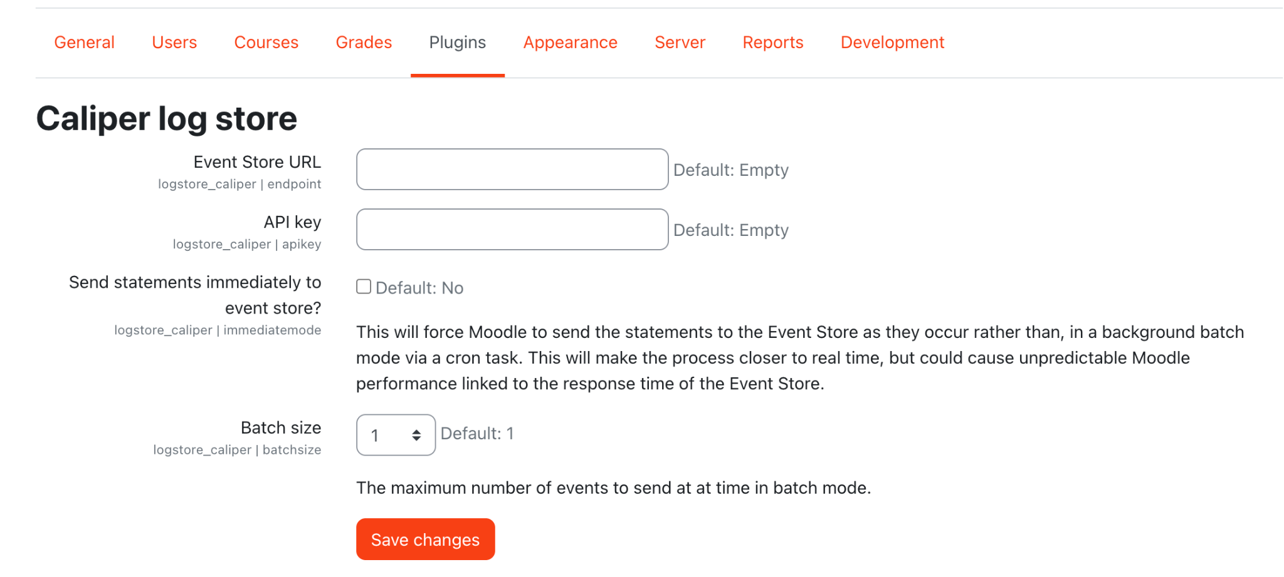
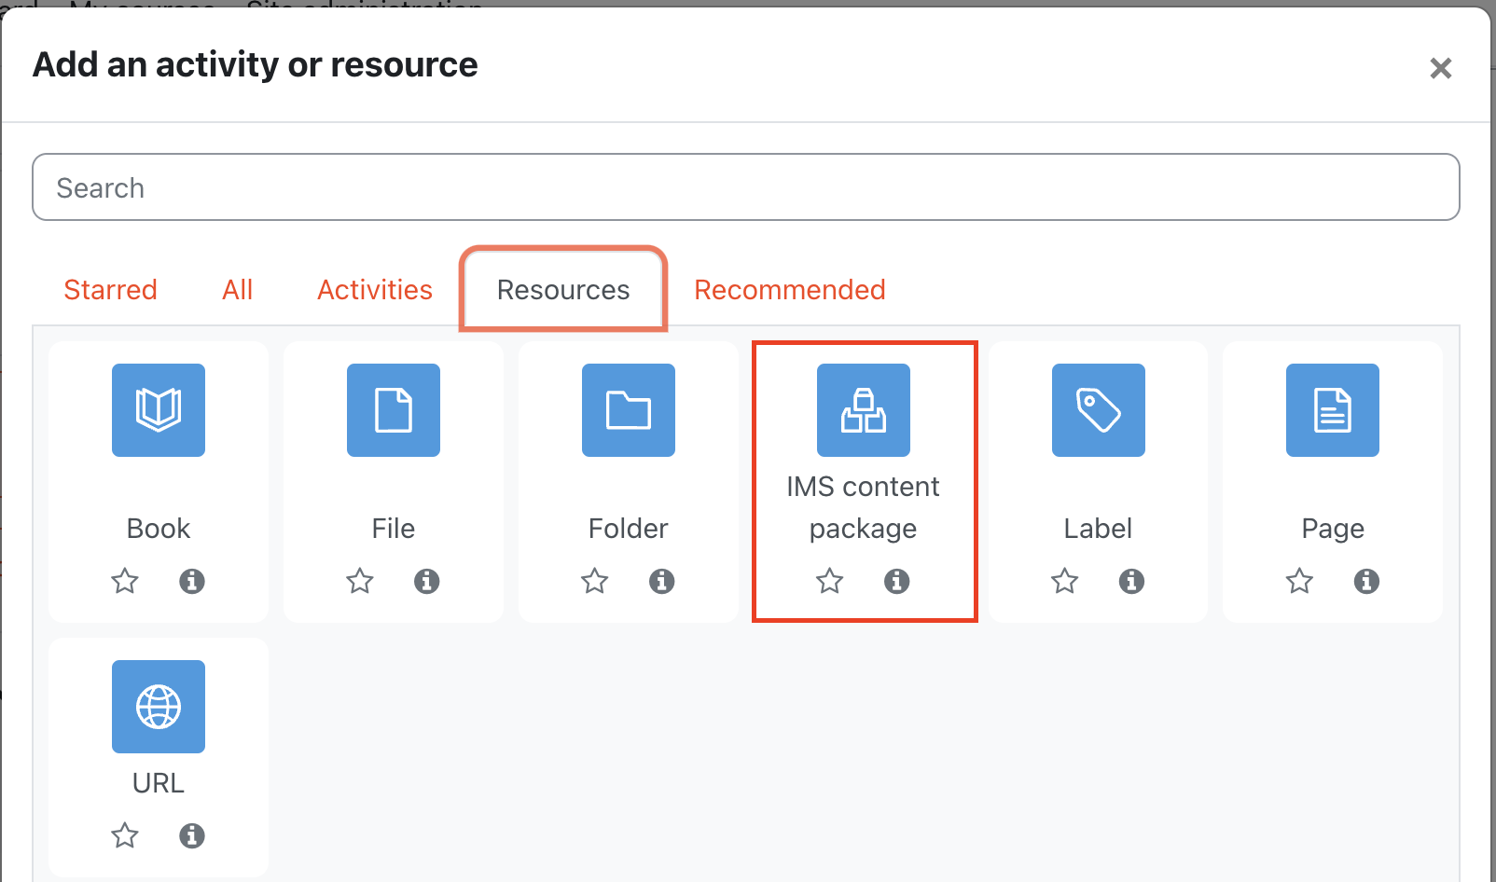
OTHER PLUGINS
Caliper logstore
https://moodle.org/plugins/logstore_caliper
You will need an LRS like LearningLocker
IMS Content package
Import packaged content using IMS CC
CASE for Moodle
Vote for it https://tracker.moodle.org/browse/MDL-74008

Slide 30
Let's see!
Moodle

Slide 31
ANY
QUESTION?

Slide 32
CREDITS
THANKS
Beatriz Arnillas (1EdTech)
Francesc Santanach (UOC)

Slide 33
Moving to an Interconnected
and Standardised ecosystem
LMS | CONTENT | MOBILE | CONSULTING | GAMIFICATION | MEC TRAINING |
IMS-LTI INTEGRATIONS | LEARNING ANALYTICS
^{ADDRESS:}
C. de Méndez Álvaro, 20, 28045 Madrid
C. de València, 359 08009 Barcelona

