Slide 1
Opening slide

Slide 2
MoodleCloud on 4.0
Presented by Frances Le Page
MoodleCloud Product Manager
Notes:
Hello, my name is Frances Le Page and I am the Product Manager for MoodleCloud.

Slide 3
What we provide?
Hosting
Moodle Upgrades
Security
Stability
Reliable
Notes:
MoodleCloud is the Software-as-a-Service version of the Moodle LMS, built, managed and maintained by Moodle HQ. MoodleCloud provides its Customers with the latest version of Moodle by upgrading their sites soon after each release. SaaS to MoodleCloud means offering a quick, reliable, stable and secure hosting solution for educators around the world at a smaller scale.

Slide 4
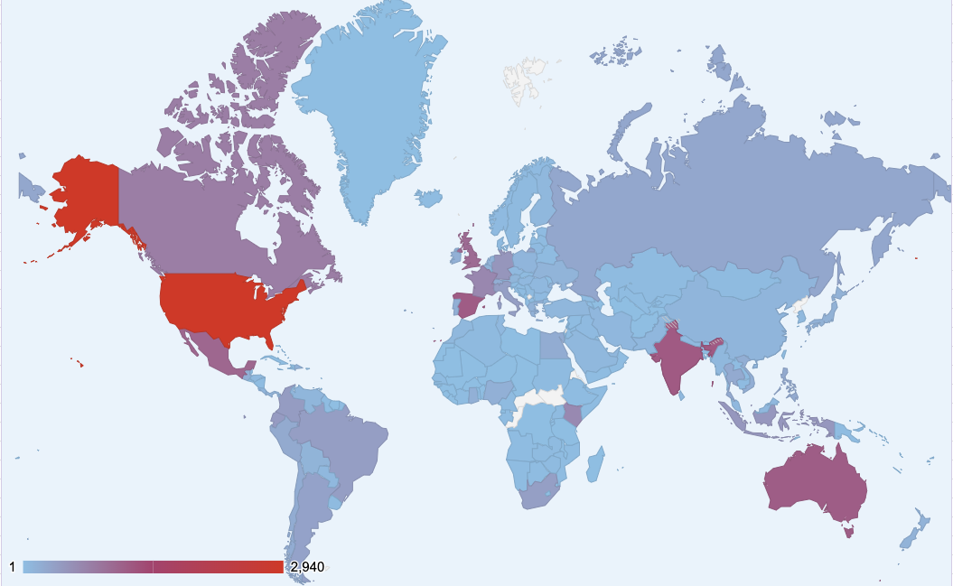
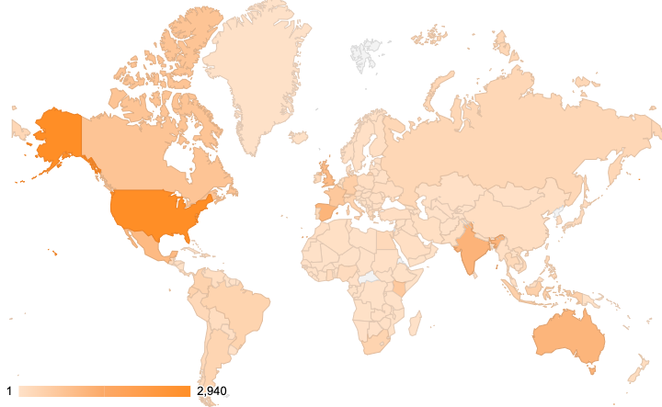
Who we serve?
Image goes here
Notes:
MoodleCloud currently services 213 regions with over 20,000 sites. The top 5 countries using MoodleCloud services at the moment are the United states of America, India, Spain, Australia and Mexico.

Slide 5
Our Customers
Staff
Training
(25%)
Notes:
We have conducted market research over the past two years which has helped our team understand who our customers are. We found three common segments for our Customers having 25% of them training their staff.

Slide 6
Our Customers
eCommerce (30%)
Staff
Training
(25%)
Notes:
30% of them using MoodleCloud in an eCommerce setting, for example selling courses to educators or businesses.

Slide 7
Our Customers
School, College & University Teaching
(45%)
eCommerce (30%)
Staff
Training
(25%)
Notes:
And 45% of them teaching in schools, colleges or universities. We were then able to develop our persona types and understand who these three segments were.
We use these persona’s to help our team make decisions about what our users needs and requirements are. Our main focus is on individual educators, these include..

Slide 8
Teaching
Notes:
Educators teaching learners - We have Sarah here, who is an individual educator at a small business teaching Vocational students. She needs an LMS that is reliable and easy to set up without all the technical skills to host and maintain her site.

Slide 9
Training
Notes:
Educators and businesses who are training their staff - Matara here needs to train her staff with an LMS that’s secure and stable to ensure her staff has access to the organisational learning information.

Slide 10
Selling courses
Notes:
And educators who are selling their courses to different types of businesses - Wally, who is another example of our individual educators but in his case, he wants to sell his courses to vocational individuals. He requires the same as Sarah and Matara but requires the ability to offer payments for his courses he is selling.

Slide 11
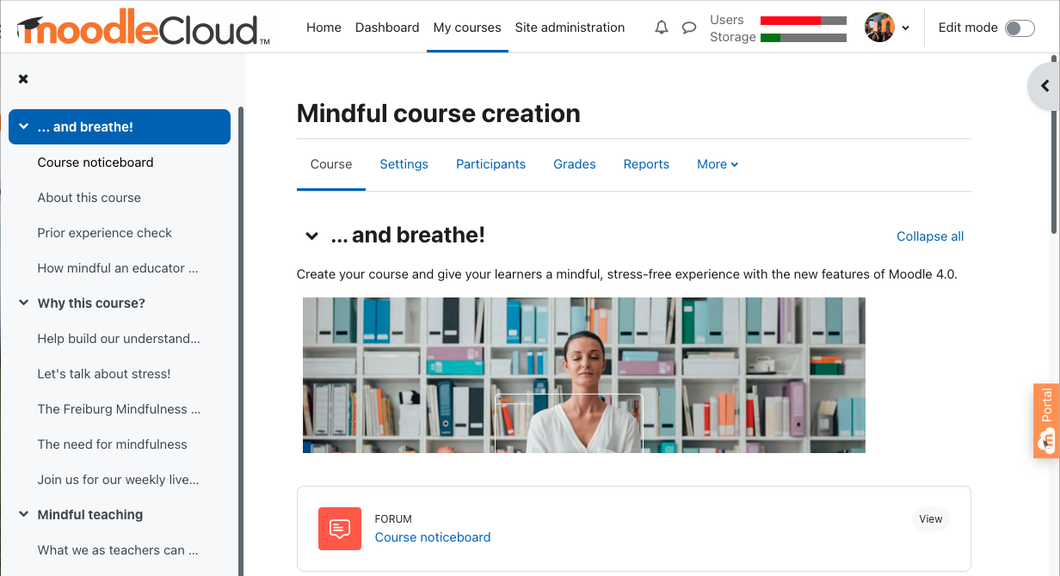
What can you do with MoodleCloud?
Image goes here
Notes:
As MoodleCloud is the Moodle LMS, you can utilise all the inbuilt tools and activities that Moodle has to offer. So how can you make the most of MoodleCloud? With MoodleCloud, all the technical hosting is taken care of so you can focus on building your courses and what your learners needs are. To keep things simple and safe (of course), we don’t allow our customers to have direct database access which means we have disabled the ability to install their own plugins or themes. But that doesn’t stop you being able to make the most of your MoodleCloud site.

Slide 12
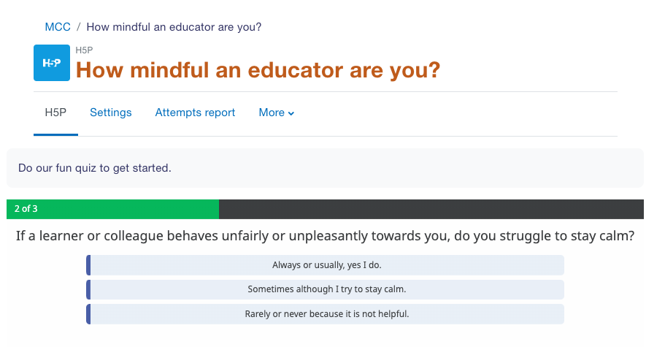
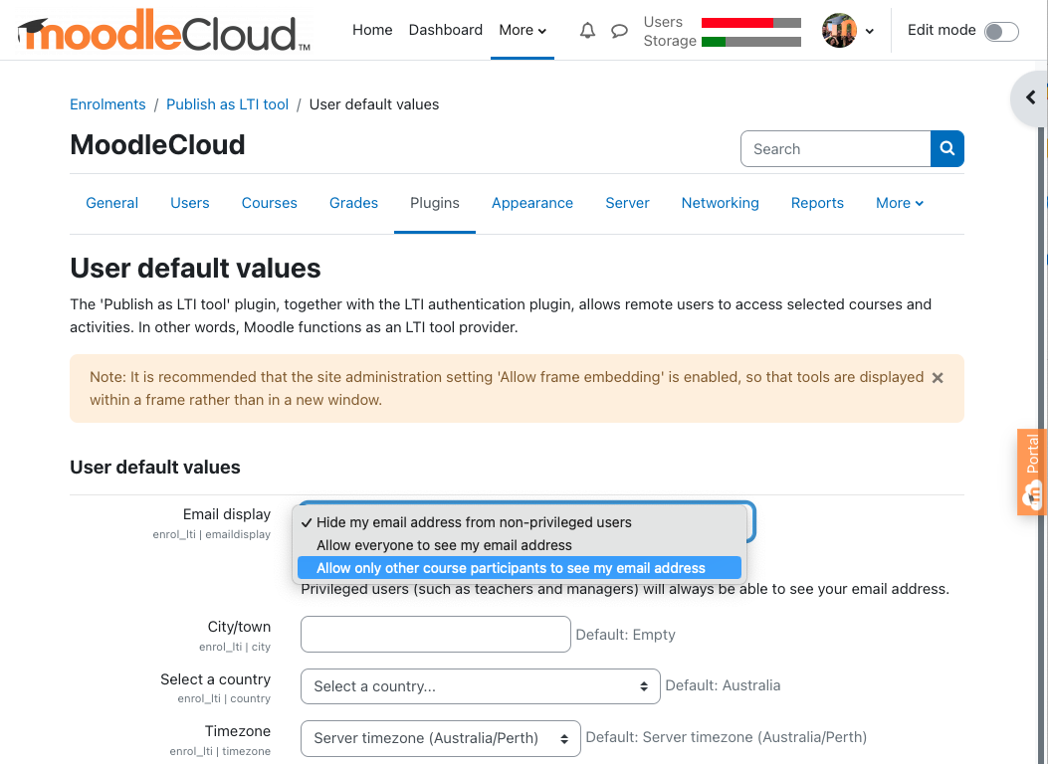
Build great courses
H5P
LTI
Moodle Activities:
Assignment
Forums
Quiz
Image goes here
Notes:
You can utilise all of Moodle’s great features and build great courses within your MoodleCloud site having access to tools such as H5P, LTI and Moodle activities such as our most commonly used activities including Assignment, Forums and Quiz.

Slide 13
Got lots of files?
Connect to G-Drive
Notes:
If you have lots of files you want to share with your learners from your MoodeCloud site, you can link your MoodleCloud site to a repository such as Google Drive. You can create a new project within your Google developer console, add that to your MoodleCloud site under OAuth services. Once you have added your Google Drive you can enable it to be used under manage authentications.

Slide 14
Notes:
Now that MoodleCloud is one Moodle 4.0, you are able directly link up your site to MoodleNet. You simply go into your activity finder and click on the MoodleNet link at the bottom to brown for content. You will be able to browse through and find resources relevant to your course.

Slide 15
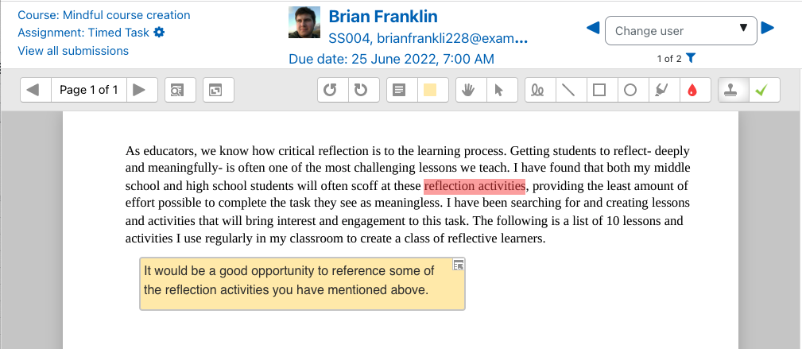
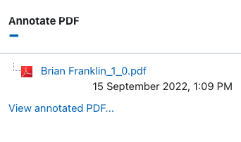
Make grading easier
Notes:
Another cool feature MoodleCloud has (if I may say myself) is our ready-installed Document Converter plugin. It enables you to automatically convert an uploaded assignment submission to PDF format for teachers to grade and annotate. The Teacher can click on the Grade button which will allow the Teacher or Administrator to add a grade, feedback, comments, stamps, highlights or freehand drawing directly onto the PDF file.

Slide 16
MoodleCloud plans has access to the Premium plan
Notes:
MoodleCloud Customers have access to the Moodle Mobile App Premium plan. This plan includes unlimited active devices for push notifications,unlimited access to offline courses and unlimited customised app features. It gives you access to course content and activities, in-app messaging, calendar, gradebook and loads more.

Slide 17
I need help with learning Moodle..
Notes:
Moodle Academy is our learning hub for the global Moodle community. You can learn all about Moodle with it’s free online courses with their learning pathways including Moodle Educator, Moodle Administrator and Moodle Developer courses. They also run many different webinars throughout the year on many different topics including learning Moodle basics which is perfect if you’re a MoodleCloud newbie just starting out.

Slide 18
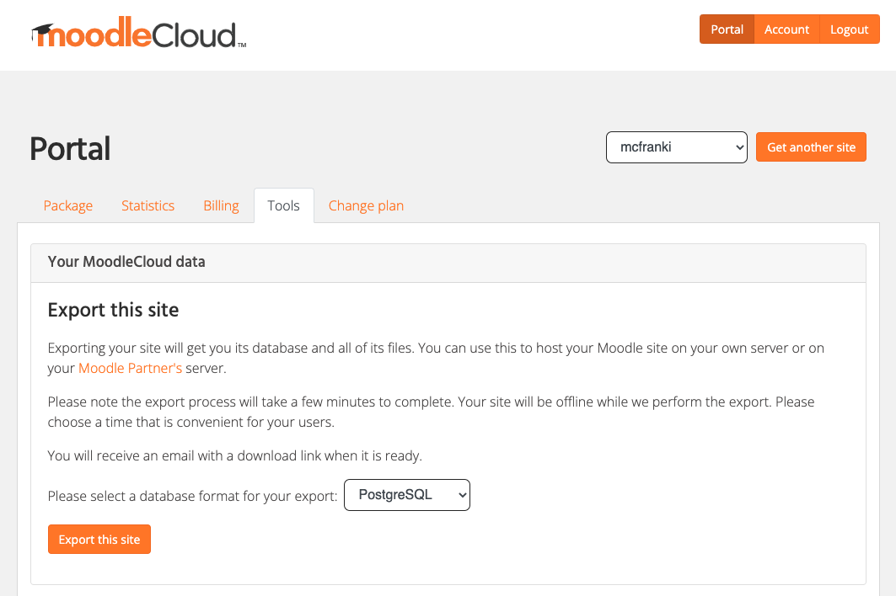
Need something bigger?
Notes:
If you’ve outgrown your MoodleCloud site or you just need some extra services and features that aren’t available on our plans, you can easily export your MoodleCloud site from within your MoodleCloud Portal which just a click. You can then give this file to one of our Moodle Partner’s or Moodle Services Providers for a more Customisable version of Moodle with all your hard work ready to be imported to your new site.

Slide 19
What’s next?
Course templates
Custom Domain Hosting
Notes:
What’s next for MoodleCloud? We’re focusing on researching our users needs and dive deeper into understanding what the individual educators require for each of our Persona types. We’ll be diving into Course templates, we want to understand what each Persona type and user case will benefit from. How can we help them getting started when they first start out with MoodleCloud in their LMS journey to make it as smooth as possible and be able to focus on their content. We will also be focusing on giving our Customers the ability to choose their own Custom domain further down the line.

Slide 20
Closing slide
Frances Le Page
E: frances@moodle.com
W: moodle.com/moodlecloud
Notes:
Thank you for your time today. Any questions?

