Slide 1
Digital Inclusion
The right to learn, anywhere
We are committed to bridging the digital divide in education and create lasting change for communities around the world
Natalie Denmeade
Tina Nassr

Slide 2
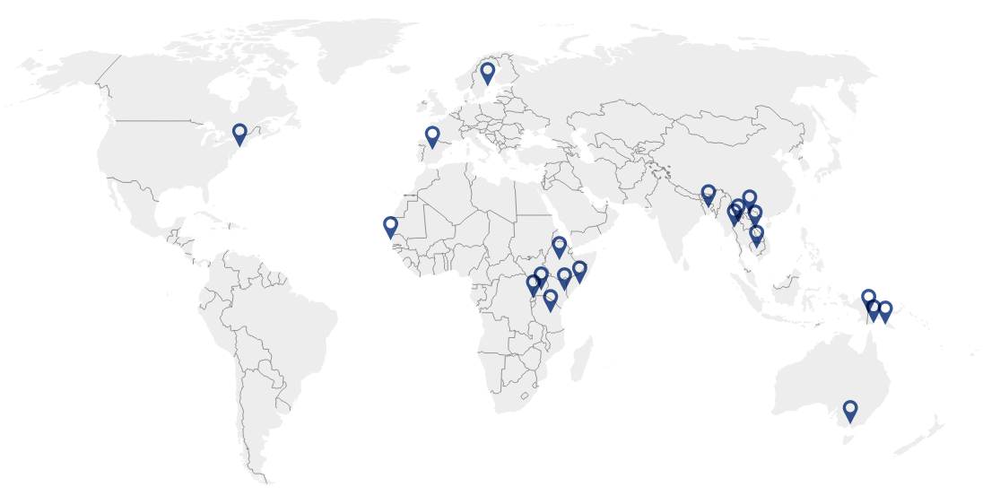
eLearning in low-resource settings

Slide 3
Our ability to make education technology work where others can’t sets us apart

Slide 4
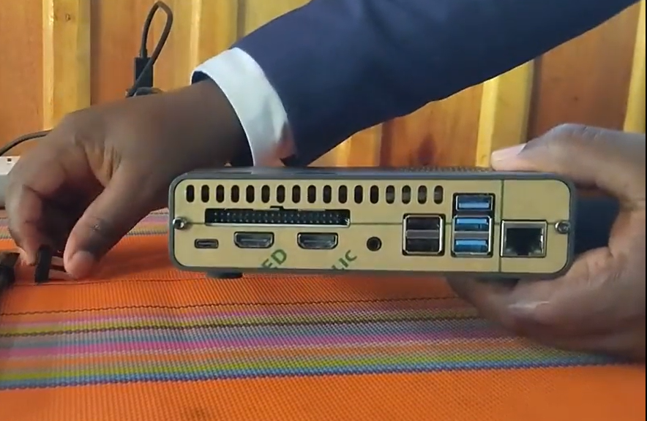
iLP Box
No Internet (Offline)
Reach more learners and provide continuity of education
Large Internal Storage (2 TB)
Power Bank /Solar

Slide 5
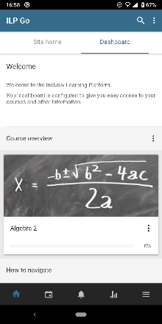
The Inclusiv eLearning Platform (iLP)
A Learning Management System as-a-service for formal or informal learning and Teacher capacity building in low and middle income countries
Moodle Mobile App supporting Digital Inclusion for marginalised learners
Teacher-created local content
Training & Mentoring Support
Sustainability through Content Portability
Real time data supporting Monitoring and Evaluation (MEAL)

Slide 6
Our Vision - iLP Box Roadmap
Explore an offline Moodle Learning Management System on a local server with WiFi Hotspot
Jan 22
Sep. 22
Dec. 22
2023
Cambodia Beta iLP Box 1 2 TB Internal SSD 30 concurrent users
Cambodia Beta
Kenya Beta
iLP Box 1
+ Cloud synch of user analytics and course copy
Tanzania Beta
iLP Box 2
4TB Internal Storage + 50 concurrent users
Tanzania
iLP Box 3 What do you need next? Please tell us

Slide 7
Urgent need to build Teacher capacity
700+ million children out of school in Jan 2021 due to COVID
10-16 million at risk of not returning due to pandemic's economic effects
Climate hazards driving attendance down even further
Learning loss disproportionate for girls, children with disability, migrating, displaced

Slide 8
Urgent need to build Teacher capacity
700+ million children out of school in Jan 2021 due to COVID
10-16 million at risk of not returning due to pandemic's economic effects
Climate hazards driving attendance down even further
Learning loss disproportionate for girls, children with disability, migrating, displaced

Slide 9
Challenges we faced
During COVID remote training on how to use and configure the iLP Box was exceptionally difficult in some cases due to unmatching role skills
Purchasing good quality powerbanks
Delays in supply
Poor internet makes downloading of large files and image of the SSD difficult
Motivate and empower people to create their own content
Explaining good practices of eLearning

Slide 10
Summary
The iLP Box can provide marginalised communities with access to education without relying on internet or constant electricity
Helps boosting digital literacy
Further improvement of the iLP box and the development of additional plugins will increase possibilities and ease the use in the future even more

Slide 11
Contact us: Email: tina.nassr@inclusiveducation.com Twitter: @tina_nassr Email: natalie.denmeade@inclusiveducation.com Twitter: @moodlemuse

