Slide 1
Moodle for Government: Unleash Your Government Learning Innovation!
Michael Maloney
Partner, Talent Development and Talent Acquisition IBM US Federal

Slide 2
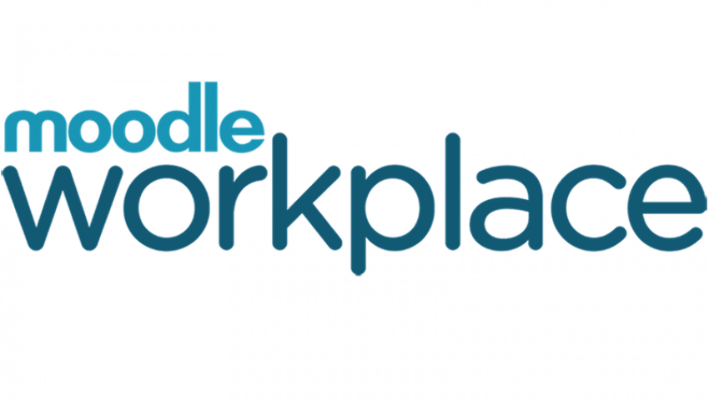
Government Learning and Innovation Can Be Challenging
At a High Level:
Many Government Agencies are large and complex
Multiple Stakeholders / Charters are wide reaching
Incombered by Multiple Rule and Regulations
Public Trust dictates cautious movement
Training / Learning can be imperative to Safety / Security
We Cannot Allow Government Organizations
To Fall Behind Innovation!

Slide 3
Why do Governments Distance Themselves from Open Source and Innovation?
Complexity
Multiple Components
Scalability
In Thousands or Millions
Interoperability
Interact with external systems
Mission Achievement
Safety & Security Issues
Security
Governmental Requirements
RMF, FedRAMP
Governance
Control and Direction

Slide 4
The Time is Right Moodle Workplace can now fulfill the needs of Government
Open Standards provide Flexibility
Plug-ins Provide ease of Integration with tools
Ease of Installation in the Cloud or on-Prem
Security is not an Issue
Scalability is all in the Set-up
Configuration and Customization
Multi-Tenancy
Synchronous and Asynchronous training capability
Great Partner - Supportive
Moodle is supportive every step of the process
Worldwide Event in support

Slide 5
Provides the Flexibility for TLAs
Open Source, Open Standards is a way to allow your LMS to be a vital part of any Government’s Total Learning Architecture
Even beyond the TLA to larger Ecosystems
Complex is made Simple with Moodle Workplace as the foundation

Slide 6
Steps for Success
DESIGN
TESTING
Design the system to include data, content
Unit, Functional Integration Performance
REQUIREMENTS
DEVELOPMENT
DEPLOYMENT
Define the Requirements with all Stakeholders
Waterfall or Agile
Solid Development Cycle
Progress Reviews
Training
Data
Content
Roll-out Support

Slide 7
Skills and Expertise Required
Program Management
Application Development and Integration
Application Configuration
Content Management
Roles and Permissions
Interface Partner Support
Data Management
Coordination of Change and Configuration
Service Desk Support
Strong Vendor Relationships
Strong Client Relationships

Slide 8
Before
After
Disparate Systems to achieve Training Objectives
Manual Configuration
Data Siloed/Inaccessible
No Longer Supported
Manual Maintenance
Limited Content/Data Flexibility
Security Issues
New System
In The Cloud
Multi-Tenancy
Interoperable with Systems via Plug-ins
Synchronous and Asynchronous Training in a single system
Elastic Infrastructure
Meeting all needs

Slide 9
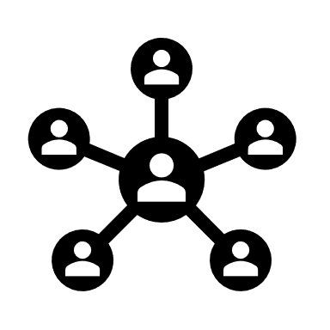
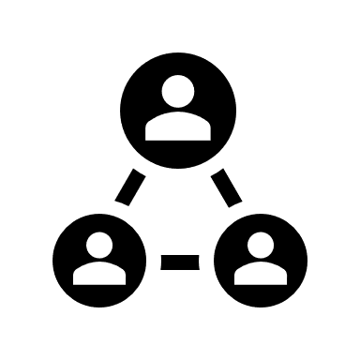
Defining Success
1250
active courses
5M+
course enrollments
3M+
course completions
756K+
active users
8
integrated applications
3
custom code efforts to scrub PII
16K
managed org units
10
cloud instances
1000+ locations worldwide
40K
resolved service desk tickets
100+
end user trainings
10
customized roles
3+
years of migrated user data
1
ATO- cloud open-source software
A top visited site for Organization
2
cloud environments
10 established interfaces
1
custom org management tool
13+
custom workflow eForms
25
completed ASIs

Slide 10
Thank You
Bringing Open Source, Open Standards LMS to Government Agencies
Always ready to discuss:
A Successful Implementation
1M Users, Cloud, 7 Applications
User Satisfaction High
Another Implementation Underway
2M Users, Cloud, 3 Applications
Driving towards a 2023 Go-Live
Future Steps
Complete TLA Stacks
Infuse new Methods to teach
Program Management
Interface
Security
DEVOPS
Cloud Architecture
Vendor Coordination
Client Engagement
Data Management & Migration
Moodle Workplace can bring innovation to your Governmental Organization

Slide 11
Questions / Discussion

Slide 12
Closing slide
Michael Maloney
Michael.maloney@us.ibm.com

