Slide 1
Moodle for firefighters’ association
Robert Manthey
Research Assistant

Slide 2
Moodle for firefighters’ association
Robert Manthey
Research Assistant

Slide 3
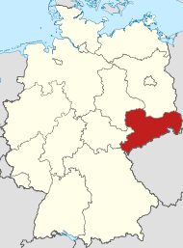
LFV Sachsen e.V.
Non-profit Firefighters’ association
State of Saxony, Germany
~ 45.000 firefighters
Promotion & Representing the interests of the fire departments
Coordination and organization
Training and further education of members
Teaching citizens and children about fire safety
Grant applications for youth & kids fire departments ( > 600 appl./year)

Slide 4
LFVS Moodle
Training courses with videos, questionnaires and certificates for self-study
(Hybrid) Seminars with online & offline components
Video conferencing with
Would like to management support applications

Slide 5
Application management
Initial situation:
Fire departments would like to organize a special training, competition etc.
Want (financial) support from association
Submit (paper) application with description etc.
Association manage applications manually by means of extensive spreadsheet, paper mail, phone and handwork
Limited resources for improvements

Slide 6
Application management
Goal:
Digital application submission
(Semi-) automatic review
Communication with applicant
Sending approvals
Billing submission
Finance calculations
Integration into existing systems
Useable without extensive training

Slide 7
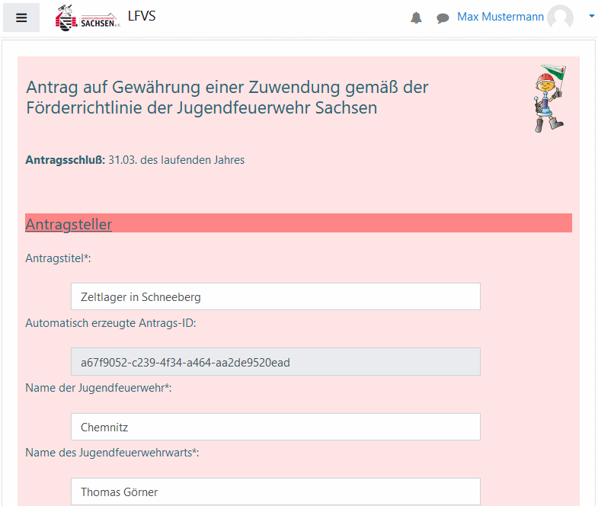
Application form (I)
Moodle is known and thus reused
Course with quiz = application
Course-specific language for custom wording
Modified overview for reviewer
Notes:
Headline, image and dot points slide

Slide 8
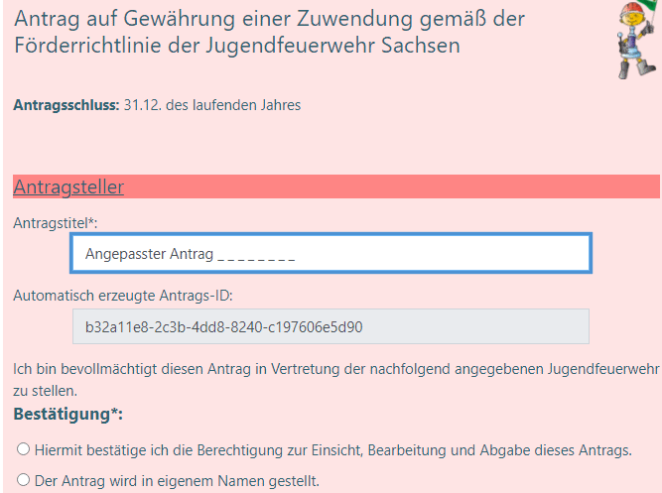
Application form (II)
Grouping with descriptions
Form input consists of short answer and multiple choise questions
Custom design with embedded CSS based style modifications
Notes:
Headline, image and dot points slide

Slide 9
Application form (III)
Input checks and question logic with embedded Javascript (last question)
Notes:
Headline, image and dot points slide

Slide 10
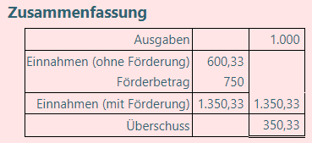
Application form (IV)
Calculate values for information (Deadlines) and first plausibility checks
ReadOnly fields for calculated values to be stored
Notes:
Headline, image and dot points slide

Slide 11
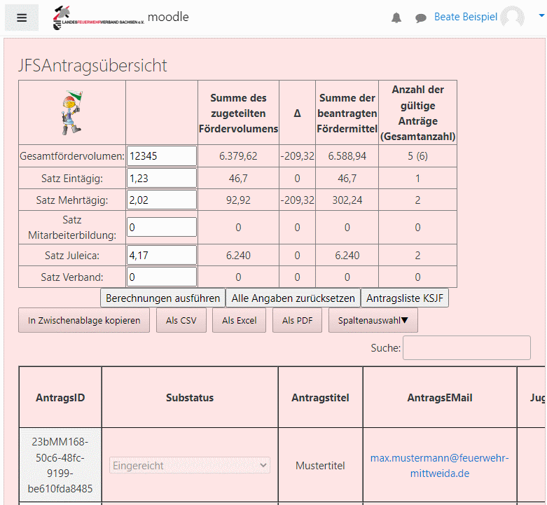
Applications review
Application review and accounting by means of modified overview-plugin
Allow setting of funding values and processing status
Allow communication with applicant
Automatic version logging
Notes:
Headline, image and dot points slide

Slide 12
Approval
Controlled by review
Approval automatically generate PDF
Automatic sending per EMail to applicant
QR-Code added for electronic workflow (with signature)
Notes:
Headline, image and dot points slide

Slide 13
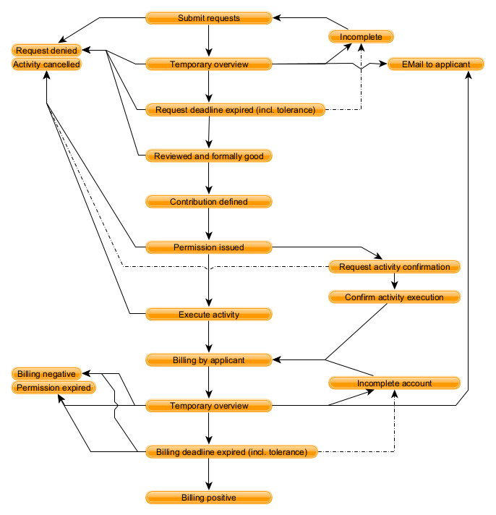
Application workflow
Evolution over time
Several states were initially hidden, undetected or later added for optimization
Notes:
Headline, image and dot points slide

Slide 14
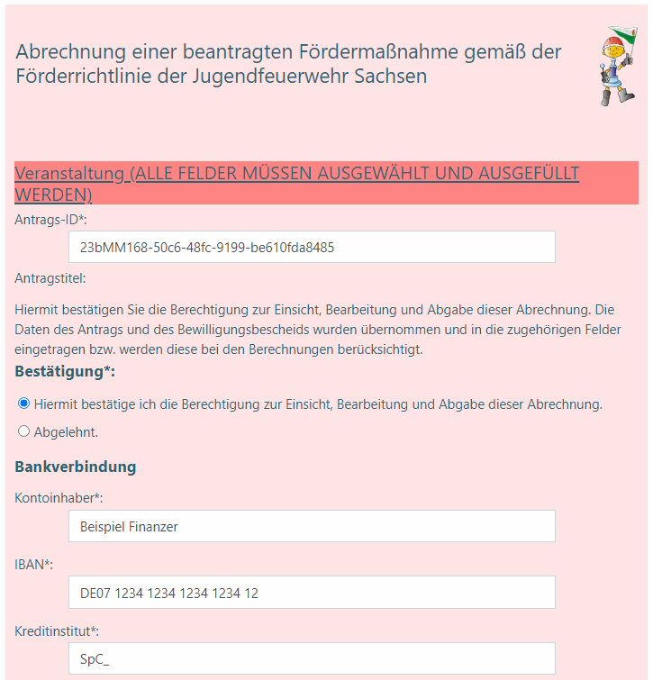
Billing form
Similar to application form
Take values from application and review
Take bills and evidence from applicant
First plausibility check
Notes:
Headline, image and dot points slide

Slide 15
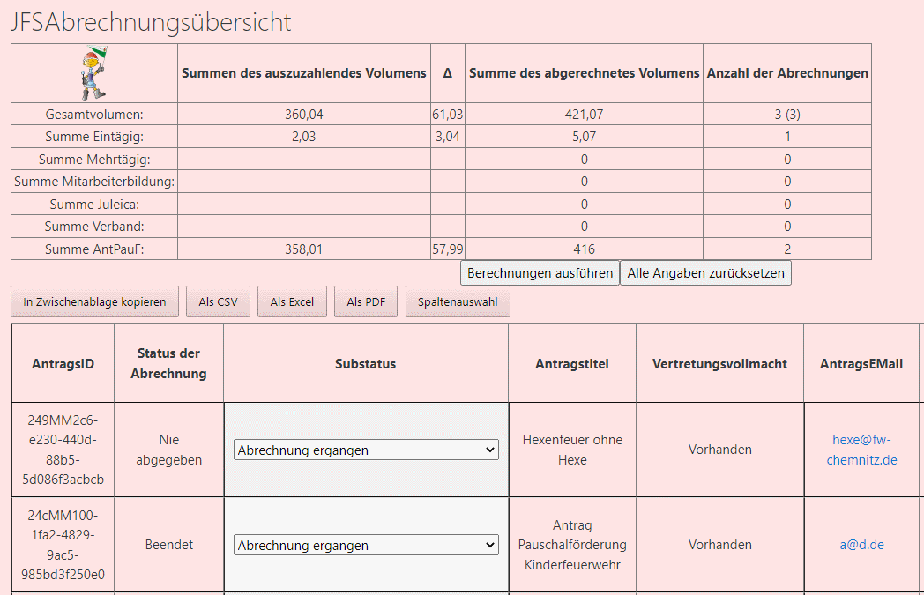
Final review
Billing review
Finalize support based on accepted bills
Notes:
Headline, image and dot points slide

Slide 16
Final decision
Controlled by review
Automatically generated
Automatic sending per EMail to applicant
QR-Code added for electronic workflow (with signature)
Notes:
Headline, image and dot points slide

Slide 17
Conclusion
Moodle reusable for non-teaching tasks
Only minor training needed
Quiz & JS usable for complex forms
Thank you for your attention!

Slide 18
Closing slide
Robert Manthey
robert.manthey@hs-mittweida.de

