Slide 1
Moodle as a tool to deliver, promote and reinforce UNIVERSEH – ‘European Universities’ teaching and learning culture
https://edu.universeh.eu
Carolina Sandoval Durazo
E-Learning Specialist and
Marc El Alami
Moodle Administrator
at UNIVERSEH

Slide 2
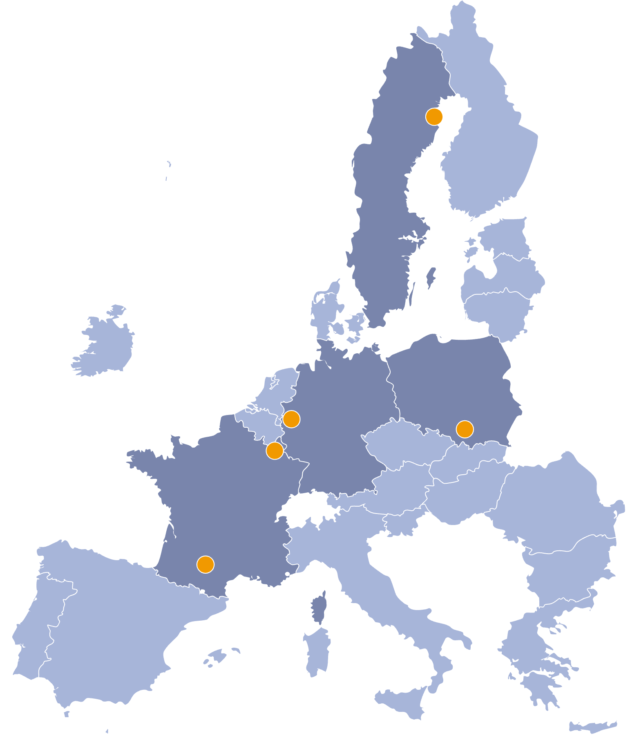
European Universities
Context
Transnational alliances
Lead the way for universities of the future
Promote European values and identity
Revolutionise quality and competitiveness of European higher education
UNIVERSEH
An alliance of five universities with a focus on Space and New Space in Europe.
https://edu.universeh.eu

Slide 3
520
Learning Communities in Distance Education
13% of
Over 50% of Students
taking online courses with no face-to-face interactions report feeling isolated from the institution, faculty and peers³
Students would not enrol in online courses because of fear of feeling isolated²
Dropout Rates for MOOC courses vary
between
91-93%¹
Over 40% of Students
30% of
taking online courses with no face-to-face interactions believe that others are not concerned about their well-being³
Students would not enrol in online courses because of difficulties interacting with peers²
¹Goel, Y and Goyal, R. (2020) On the Effectiveness of Self-Training in MOOC Dropout Prediction" Open Computer Science, vol. 10, no. 1, 2020, pp. 246-258. [Online] Available at: https://doi.org/10.1515/comp-2020-0153
²Fidalgo, P., Thormann, J., Kulyk, O. and Lencastre, J. (2020) Students’ perceptions on distance education: A multinational study. International Journal of Educational Technology in Higher Education, 17(18) (pp. 1-18) [Online] Available at: https://educationaltechnologyjournal.springeropen.com/articles/10.1186/s41239-020-00194-2
³Pilcher, A.J. (2017) Virtual learning community: Utilizing learning communities in hybrid and online graduate programs. Graduate Theses and Dissertations. 15604. [Online] Available at: https://lib.dr.iastate.edu/etd/15604

Slide 4
Pedagogical Objectives
Conceptualization
Learning Community Focus
Reduce Digital Divide
Improved Channels of Communication between Members
Centralization of Resources
Teaching and Learning Training
Innovative pedagogical approaches
Interactive learning
Student-centred learning
Peer-to-peer
Collaborative learning
https://edu.universeh.eu

Slide 5
Technological Objectives
Conceptualization
Digital mobility
Combine in-person, distance/blended, synchronous and asynchronous learning
Scalability
Shared Repository
Wide range of technological tools and solutions:
user roles
plugins
SSO
cohorts, etc…
Tech and Web Accessibility
GDPR compliance with Privacy by Design
https://edu.universeh.eu

Slide 6
A Glimpse
Implementation
Frontpage
Announcements: Space related events and useful information
The Dictionary of Space Concepts: developed by students and accessible by anyone.
Course catalogue: visible to everyone.
Language courses: available for everyone in the community.
MOOC-like courses: accessible to everyone in the community
https://edu.universeh.eu

Slide 7
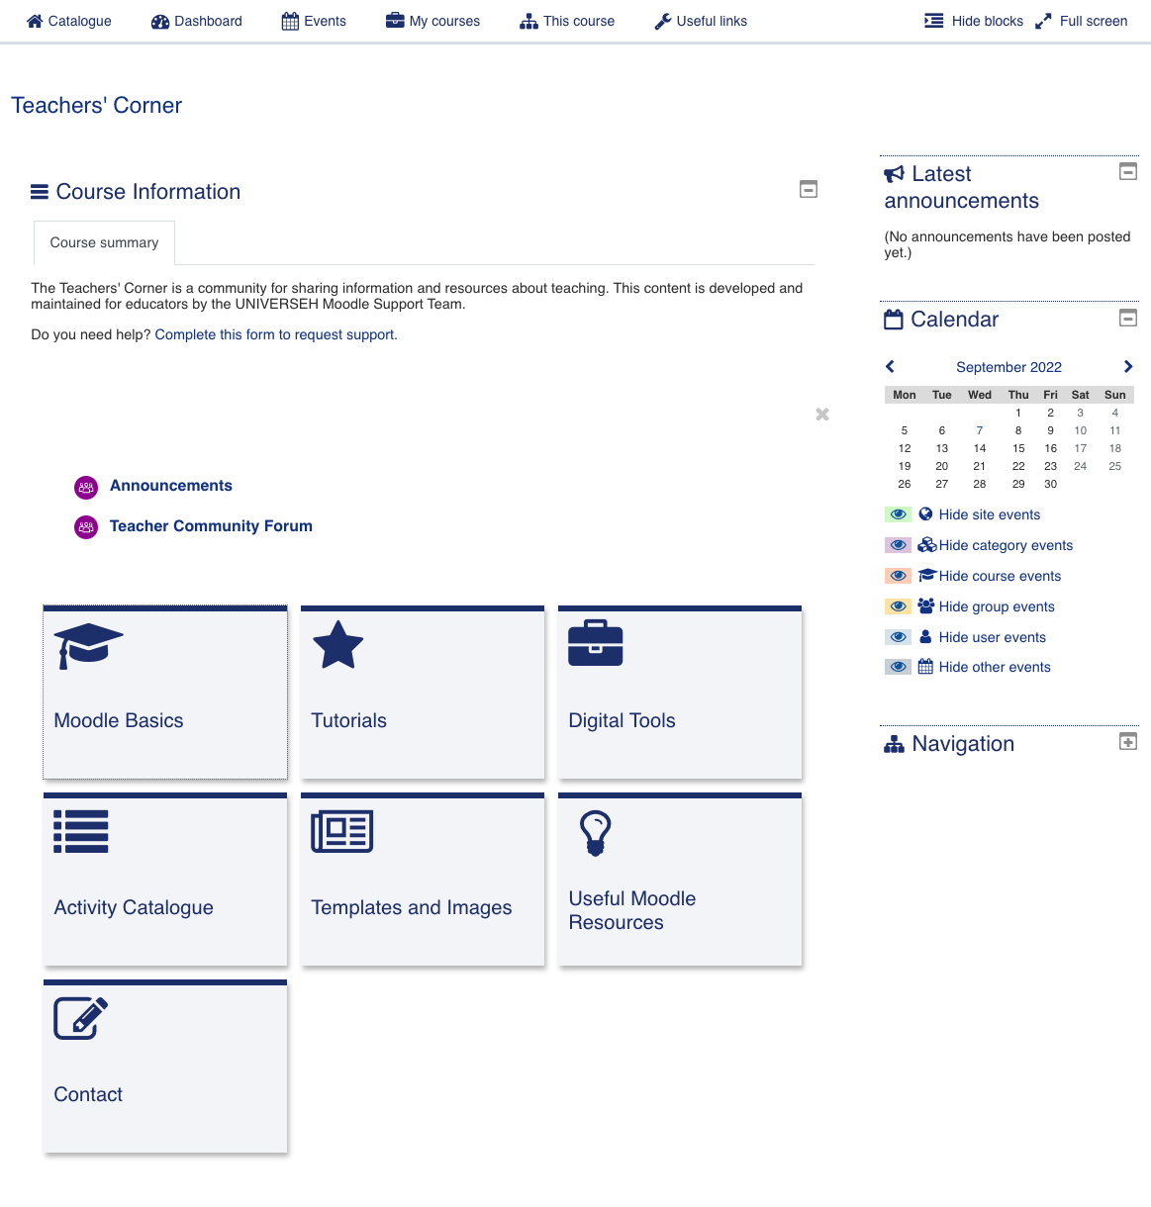
A Glimpse
Implementation
Teacher’s Corner:
On-boarding​ for educators
Teacher’ community forum
Moodle basics and tutorials
Repository of relevant Digital Tools
Activity Catalogue with examples to try
Repository of Templates for lectures and space-related Images
Additional resources on Teaching and Learning with Moodle
Tech and Community Support​
https://edu.universeh.eu

