Slide 1
Opening slide

Slide 2
A preview of Moodle 4.1 & Beyond
Presented by Barry van Oudtshoorn
Moodle Platform Manager
Prepared together with Sander Bangma
Head of Educational Solutions

Slide 3
What we’ll cover
Barry van who?
Moodle 4.0 highlights
Moodle 4.1: what’s coming in November?
Changes to our roadmap approach
Looking to the future

Slide 4
Barry van who?
van Oudtshoorn ≈ fun oats horn
Notes:
Platform Manager at Moodle
Still new, still learning
Ed-tech background; 14 years in K12 LMS before Moodle
Work alongside Sander Bangma on LMS
Sander not here; co-prepared presentation

Slide 5
Now: Moodle 4.0
Notes:
Recently released 4.0
Huge release; lots of functionality and improvements

Slide 6
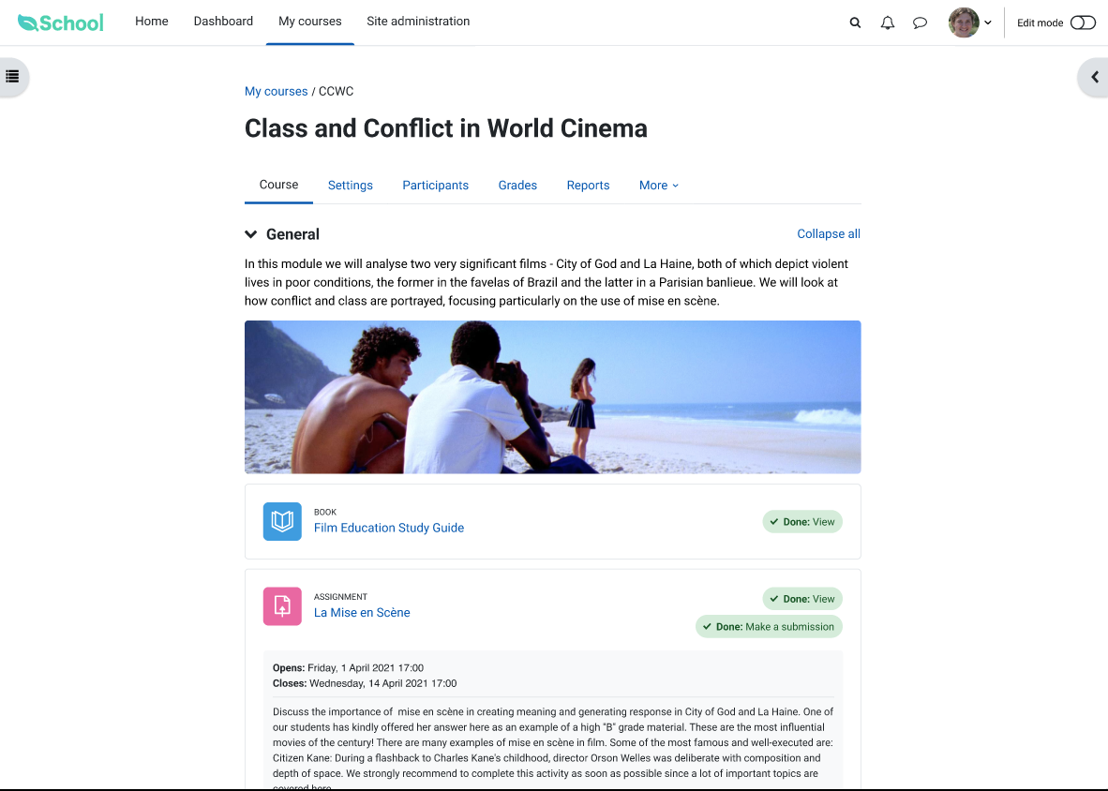
Highlights from Moodle 4.0
Navigation reimagined
Easy, intuitive, quick
Redefined course experience
Easy to edit
Know what to do next
Notes:
Beautiful new default theme
Easy to customise and build on
Significantly improved navigation throughout
Streamlined course experience making editing and navigating easier

Slide 7
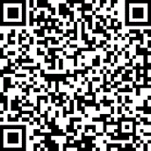
More 4.0 highlights
…and more!
Report Builder
BigBlueButton
LTI 1.3 Advantage tool provider
Quiz and question improvements
Notes:
Ported Workplace’s Report Builder to Moodle
Out-of-the-box BigBlueButton integration
Better LTI support as tool and consumer
Lots of improvements to quiz and question management

Slide 8
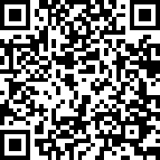
Better: Accessibility: WCAG 2.1 AA
BETTER
Accessibility: WCAG 2.1 AA
Accessibility fixes from 4.1 being backported to 4.0
Accessibility needs are not binary: people have changing needs
MDL-74624
Notes:
Understand that accessibility is a core part of Moodle
People’s accessibility needs change over time
Can’t be a “tick-box” exercise
Working hard to improve accessibility in Moodle, including backporting

Slide 9
Next: Moodle 4.1

Slide 10
4.1 by the numbers (so far!)
390+ issues integrated
130+ community patches
230+ bugs squashed
70+ bugs squashed
140+ improvements
50+ improvements
Notes:
Numbers far lower than what they’ll eventually reach
Amazing community that contributes to Moodle and helps shape it

Slide 11
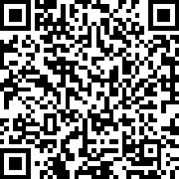
Coming in 4.1
NEW
Report Builder reports
BETTER
Database activity UX
NEW
TinyMCE 6 available
BETTER
Gradebook UX
NEW
Share to MoodleNet (stretch)
BETTER
BigBlueButton integration
BETTER
Questions and bank
BETTER
Accessibility

Slide 12
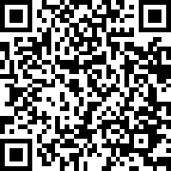
New: TinyMCE 6 available
NEW
TinyMCE 6 available
Fewer bugs, better behaviour, easier development
Will ultimately replace Atto
Available as an alternative for now
Plugin authors: time to start developing!
MDL-75071
Notes:
Why replace Atto
Timeline
Plugins need to be ported/reworked for new editor

Slide 13
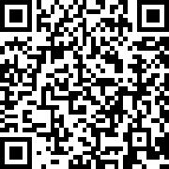
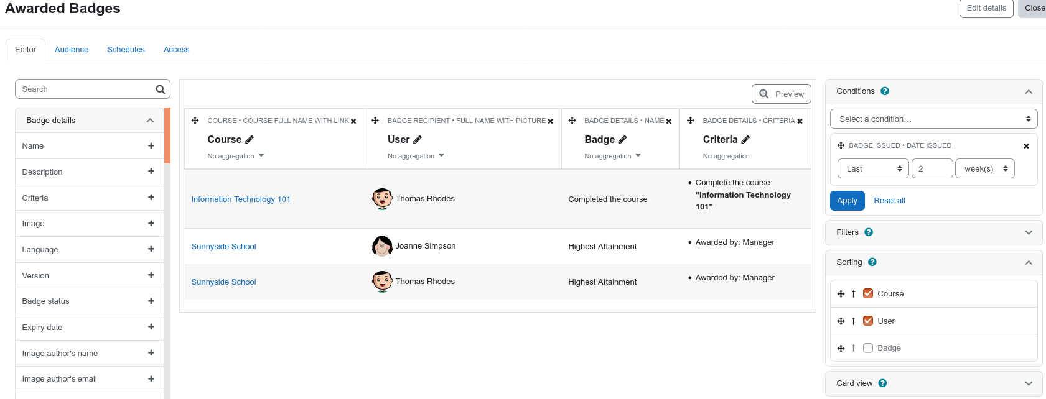
New: Report Builder reports
NEW
Report Builder reports
MDL-73987
Badges, notes, blogs, task logs, tags, groups, comments, and files
Course reports: participants, enrolment, completion status, and the last course access date
Easily build beautiful, useful reports without code
Notes:
NB completion status: highly-requested and very useful report
MDL-74364

Slide 14
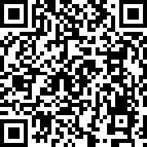
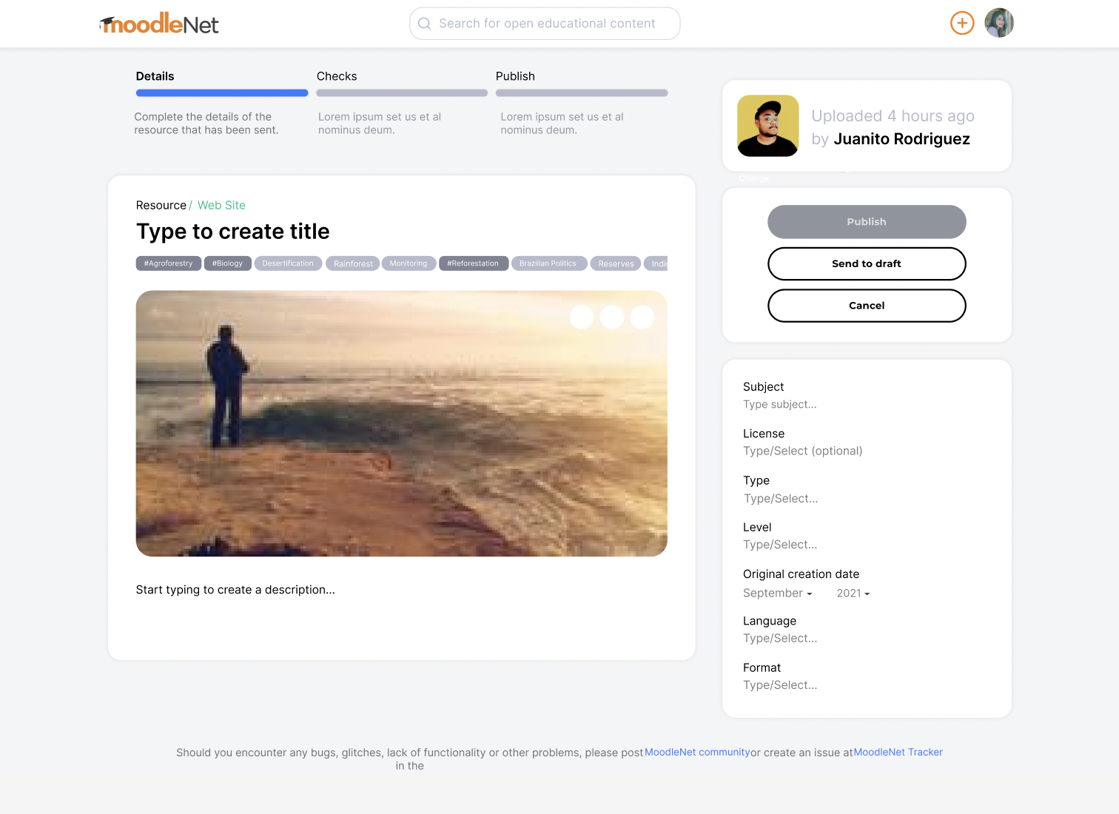
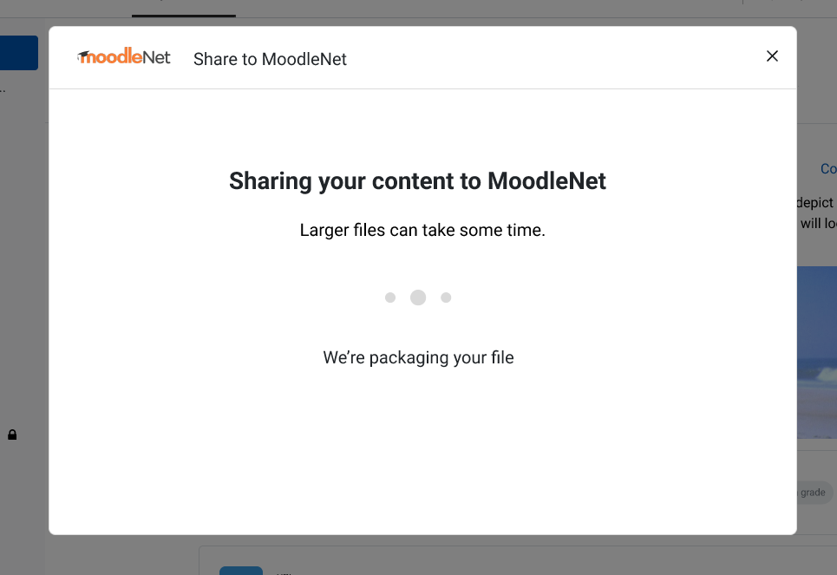
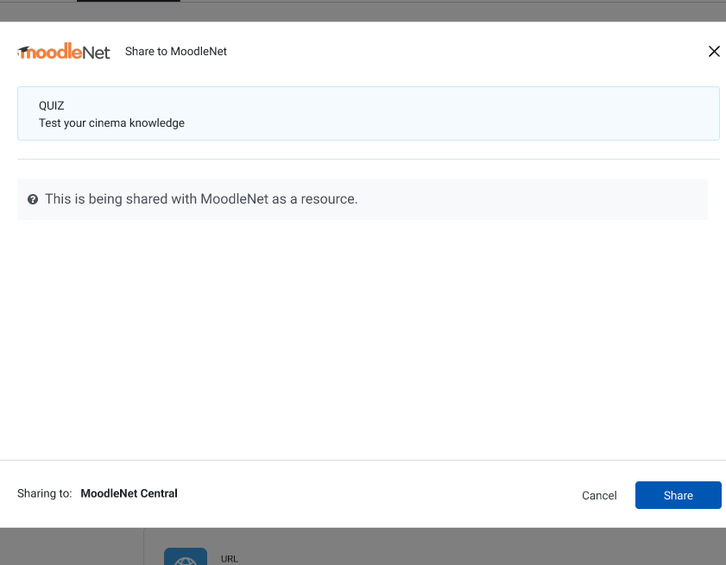
New: Share to MoodleNet
NEW
Share to MoodleNet (stretch)
Easily share activities to MoodleNet
Support educators and education globally
MDL-75207
This is a stretch goal. We hope to have it ready for 4.1, but it may land later.
Notes:
Stretch goal, may not make it

Slide 15
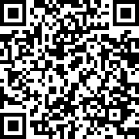
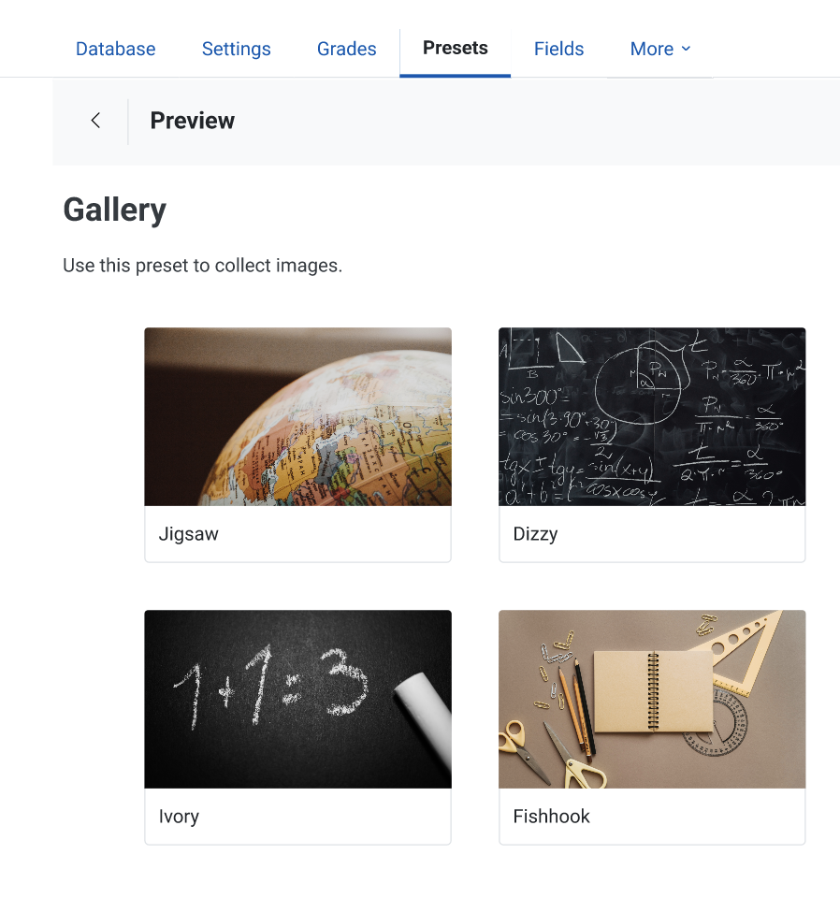
Better: Database activity UX
BETTER
Database activity UX
Project supported & funded by MUA
Multiple presets with gallery preview
Make it easier to get started with the database activity
Better experience for end users
MDL-75059
Notes:
https://tracker.moodle.org/browse/MDL-75059
Modernise Moodle’s database interface, improve the existing workflows and make its usage a more intuitive and user-friendly experience.
Two main goals
Make it easier for teachers to create new database activities, providing a new set of presets and preview mode.
Improve the student experience by providing a better experience with the existing views in his course activity.

Slide 16
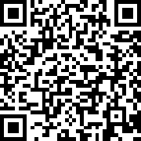
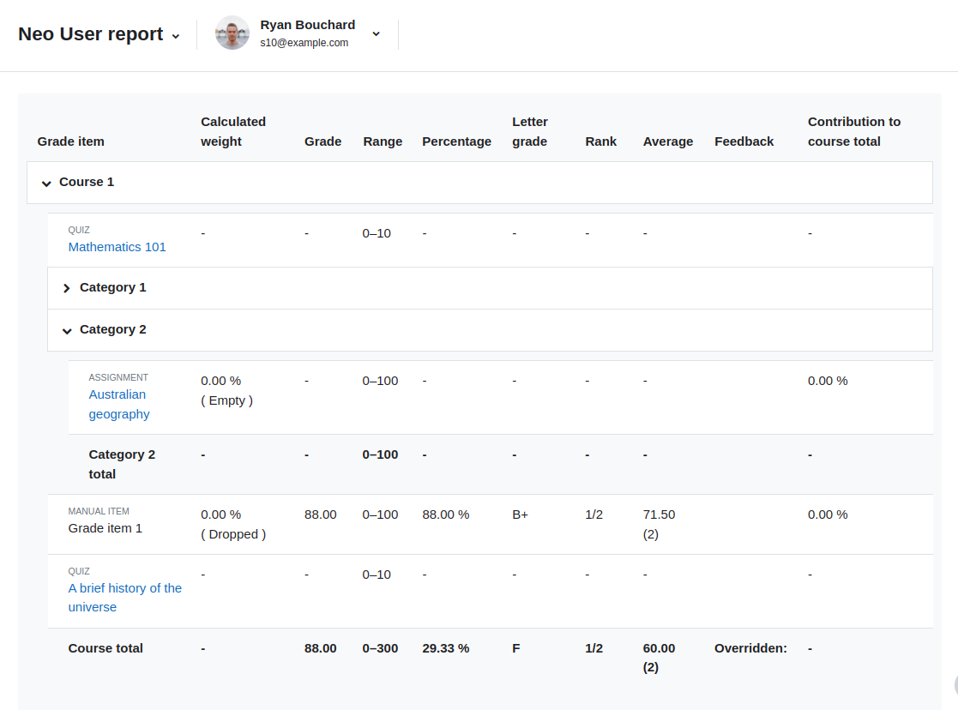
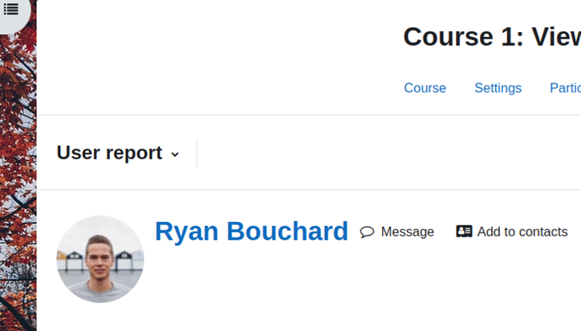
Better: Gradebook UX
BETTER
Gradebook UX
Clearer navigation
New grade summary report
Improved UI/UX on the “User report” and “Single view” page to make these easier to understand & use
Various UX enhancements throughout
MDL-74953
Notes:
Grader report page will be worked on for Moodle 4.2

Slide 17
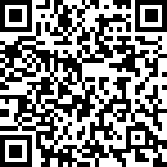
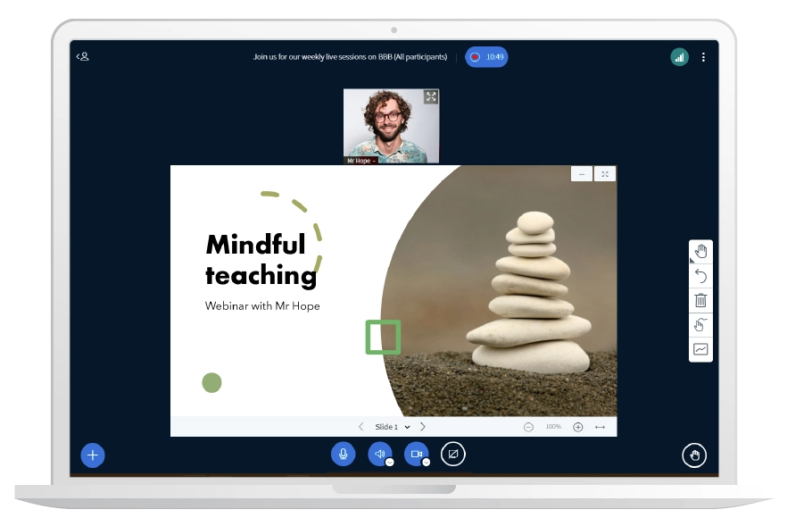
Better: BigBlueButton integration
BETTER
BigBlueButton integration
Building on 4.0
Contributed by the BBB team
Working towards
Invite external participants
BBB language based on Moodle user language
Bug fixes
And more!
MDL-74662
Notes:
* BBB team working towards this for 4.1, but otherwise 4.2

Slide 18
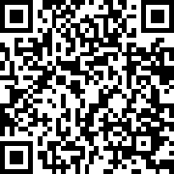
Better: Questions and question bank
BETTER
Questions and question bank
Community-driven initiative!
Working towards
Improved management & sharing of questions
Question bank as an activity
Question filtering
Further UX improvements
TODO
Replace image
MDL-72752
Notes:
* Working towards; otherwise will land 4.2

Slide 19
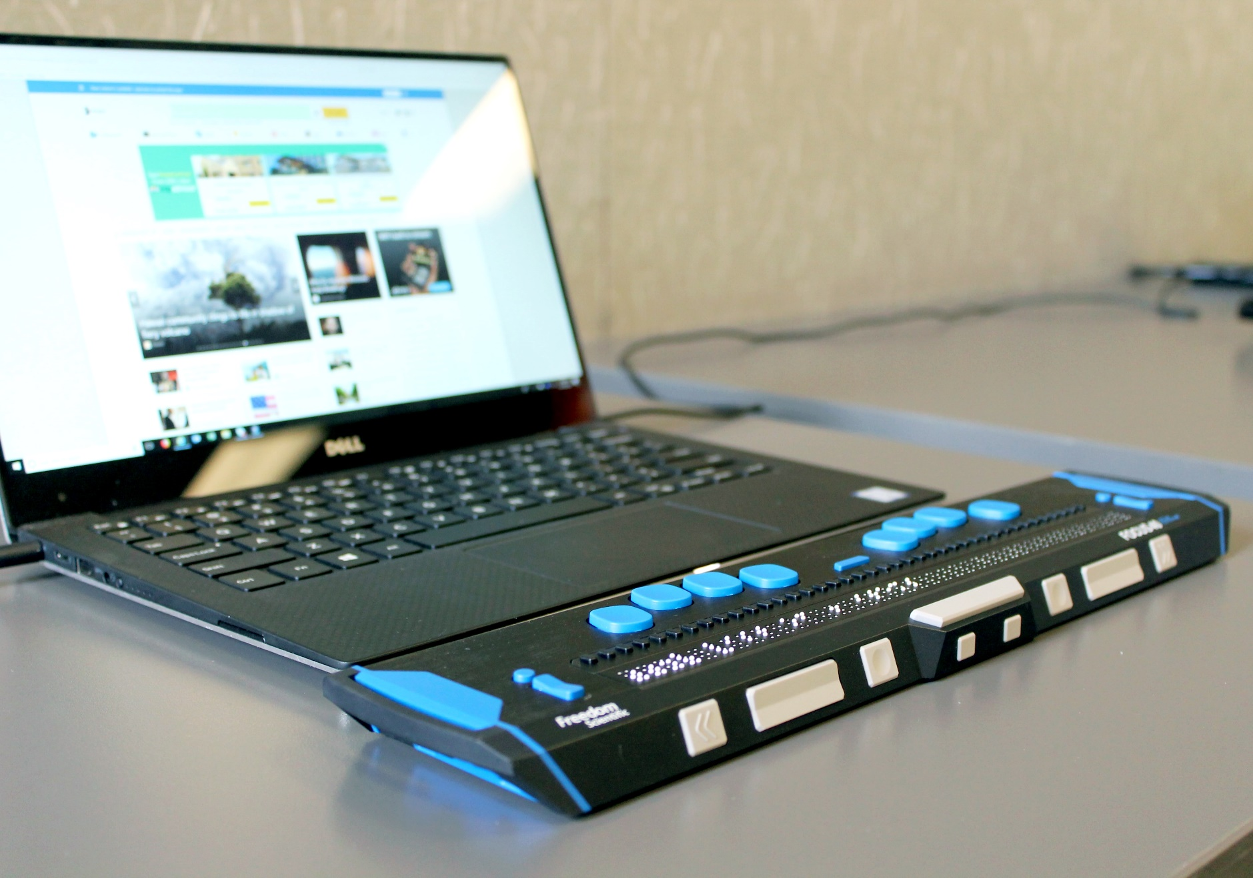
Better: Accessibility
BETTER
Accessibility
Education is for everyone: accessibility is a core concern
Markup and nav improvements for screenreaders
Colour contrast issues resolved
WCAG 2.1 AA achieved in 3.10 & 3.11 and underway for 4.0 & 4.1
MDL-74642

Slide 20
Roadmap process changes

Slide 21
A simpler roadmap
Now
Next
Later
Later still
Moodle: contextual complexity
Transparency and clarity
Input from idea to implementation
Not just MDL: new IDEA project for all Moodle products
Want to be part of this right now?
Join Marie and the Product team in the Workshop Room at 2pm tomorrow!
Notes:
Full SDLC

Slide 22
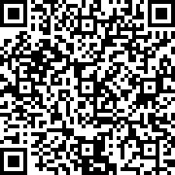
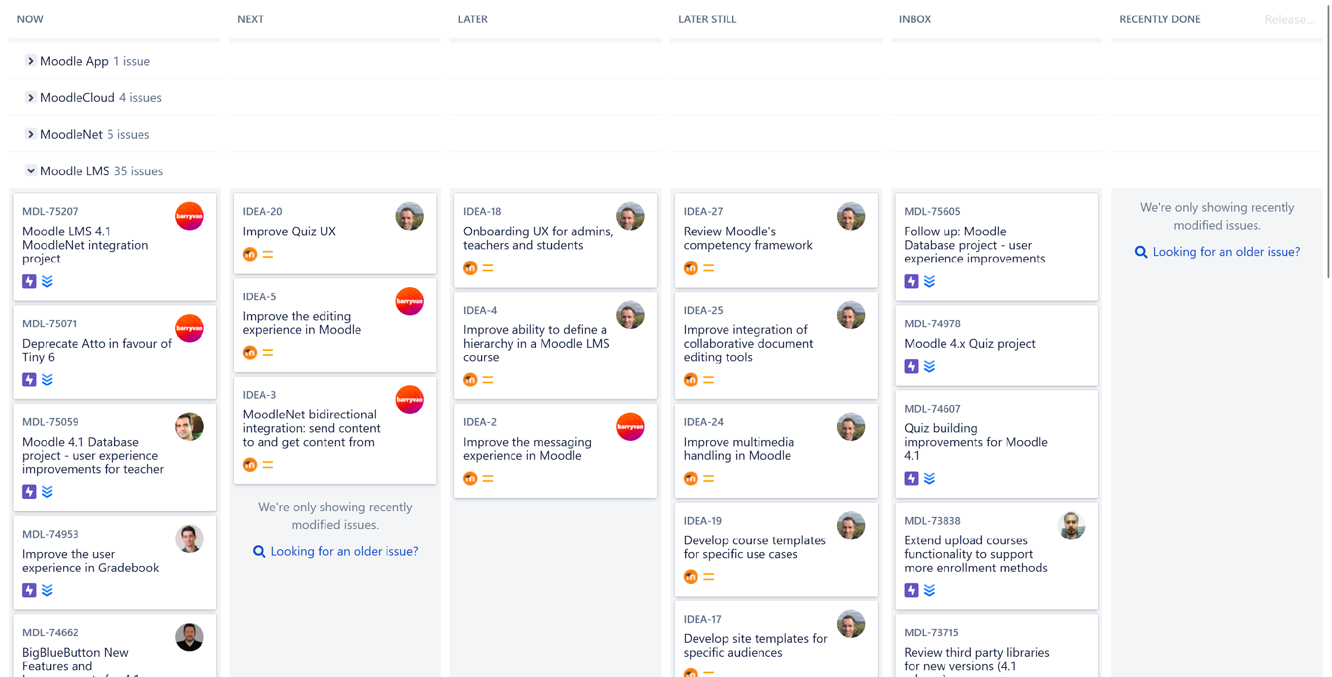
In Tracker
Note: this is still in flux and is subject to change!

Slide 23
Contributing to the roadmap
For now, no change: keep using MDL and support
IDEAs = large projects, triaged by Product team
But always open for discussion and advocacy!
Comment and vote on issues
Volunteer for research to help us understand your needs
Become a member of the MUA: propose & vote on a release project

Slide 24
Moodle 4.2 and beyond

Slide 25
Likely in 4.2
NEW
Matrix integration
BETTER
TinyMCE 6 integration
NEW
Instant messaging framework
BETTER
Gradebook UX
NEW
Research on course hierarchy
BETTER
Quiz UX
BETTER
MoodleNet integration
BETTER
Bulk editing course activities
Notes:
Activity indentation likely to be asked about
Research starting soon

Slide 26
Later still: Moodle 4.x
Ongoing discovery and exploration
Site and course templates
Improved onboarding and first-run experience
More messaging integrations via plugins
TinyMCE the default editor

Slide 27
Thank you
Notes:
And special thanks to Sander Bangma

Slide 28
Closing slide

