Slide 1
Learning Analytics for Academic Leaders “ten miles behind me and ten thousand more to go”
Stephen Clarke
Head of Digitally Enhanced Learning
London South Bank
University

Slide 3
Ten Miles

Slide 4
Ten Miles Behind Me

Slide 5
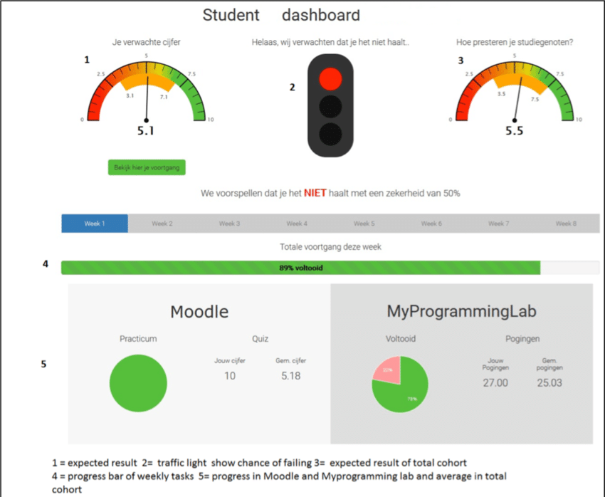
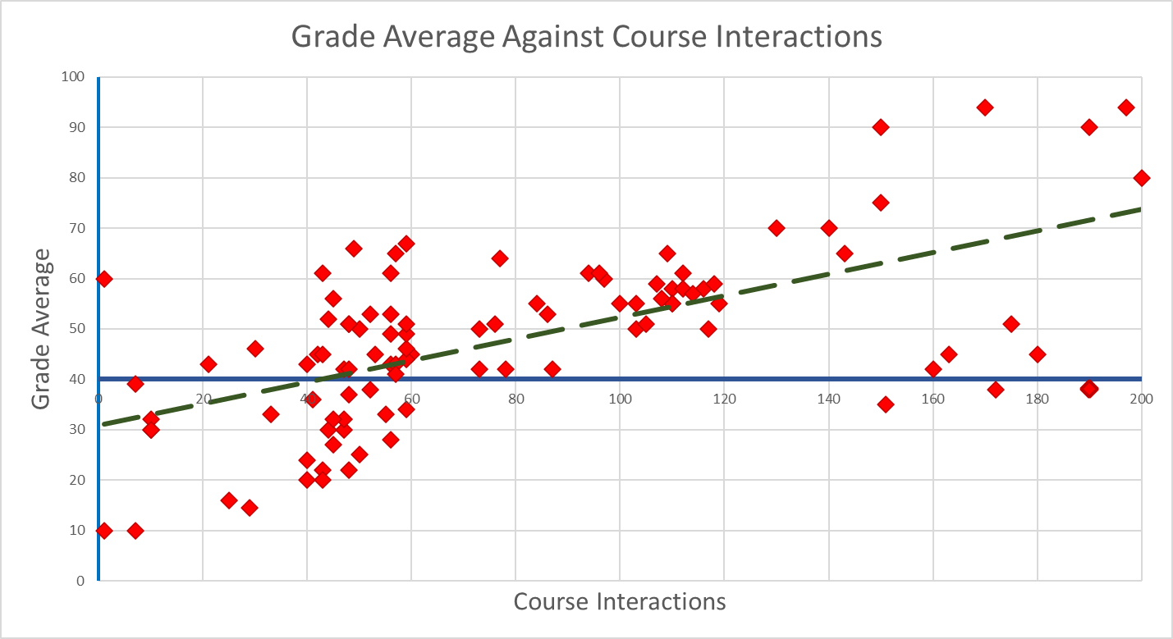
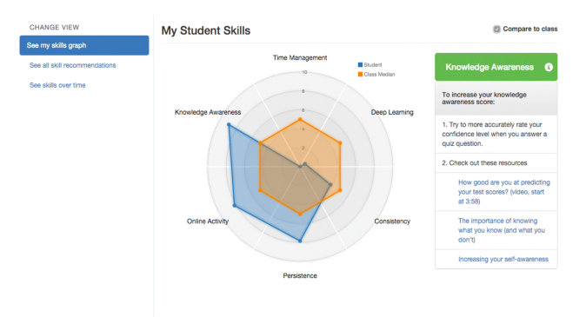

Slide 6
How Do We Take the Next Steps?

Slide 7
Survivability

Slide 8
Need was clear
Awareness of the need was High and Wide
What did the Data show?

Slide 9
The Data

Slide 10
The Analysis
Aircraft would come back from battle with bullet holes.
The Allies sought to strengthen the planes to increase combat survivability, but also maintain performance.
A mathematician, Abraham Wald, pointed out that perhaps the reason certain areas of the planes weren’t covered in bullet holes was that planes that were shot in certain critical areas did not return.
This insight led to the armour being re-enforced on the parts of returning planes where there were no bullet holes.
This shows that the analysis of the data, if done well, provides meaningful and actionable insights.
Acting on the insights can have a transformational impact.

Slide 11
Transformation
Transformation
Transformation
Transformacion
Trasformazione
Transformatie
Трансформація (Transformatsiya)
Trawsnewid
Transformació
Transformación
Transformo
تحويل (tahwil)
טרנספורמציה (transformatsiya)
Transformação
N
eed
A
wareness
=
de
D
ata
A
nalysis

Slide 12
Need and Awarenes in Higher Education
?

Slide 13
HEPI

Slide 14
UUK

Slide 15
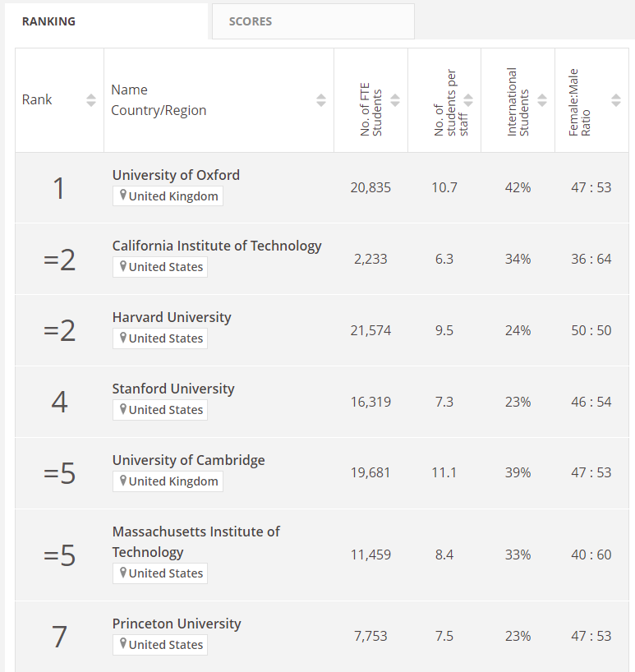
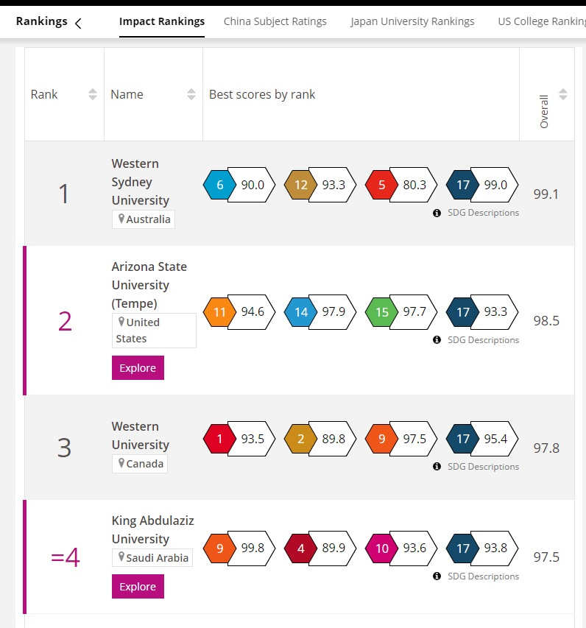
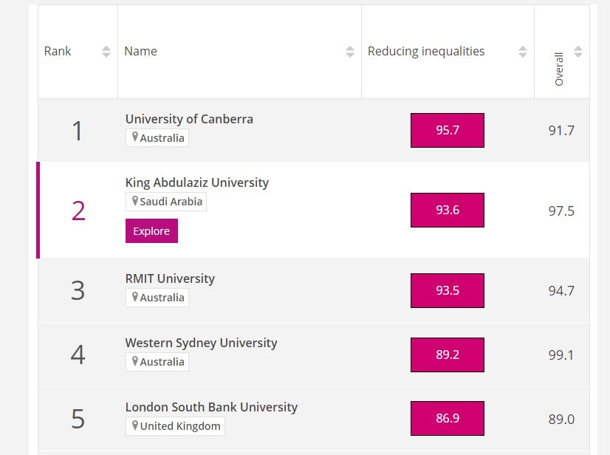
World University Rankings

Slide 16
Other Potential Sources
Conferences
Forums
Academic Networks - WUN, Universitas 21
EUNIS Rectors Conference

Slide 17
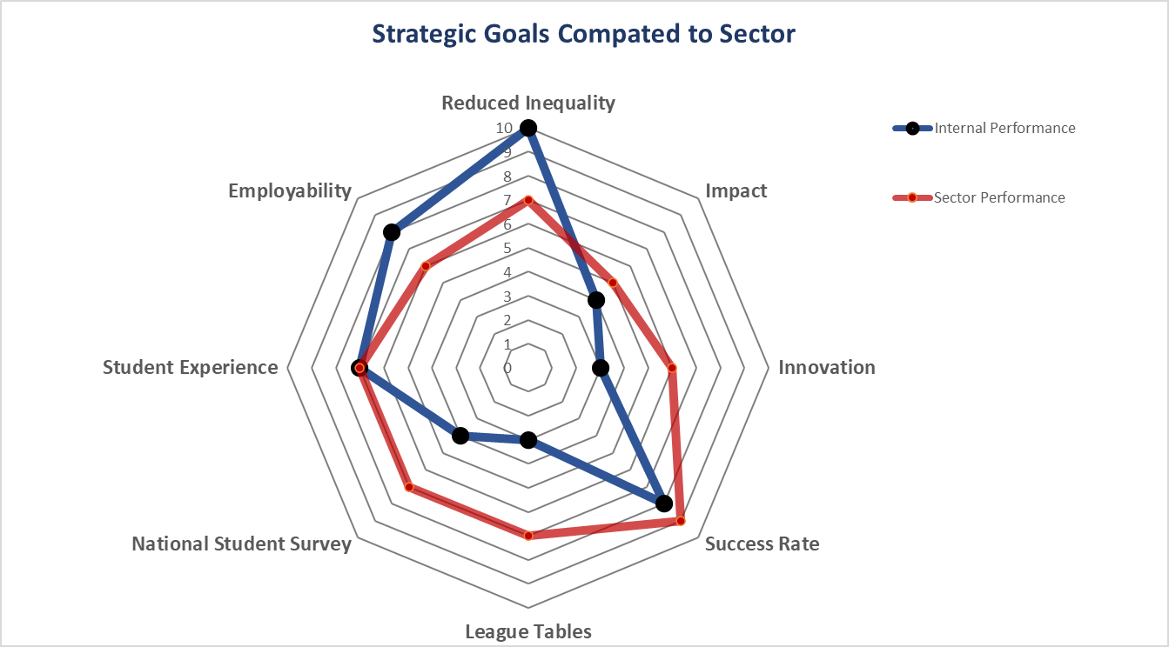
Information for Leadership

Slide 18
Feedback
What are the leadership themes?
Where are organisations on the journey?
What are the barriers?
Are we pushing at an open door?

Slide 19
Closing slide
Stephen Clarke
clarks49@lsbu.ac.uk

