Slide 1
Learning Analytics “Coat of Many Colors”
Stephen Clarke
Head of Digitally Enhanced Learning
London South Bank
University

Slide 2
https://lsbu-lecturecast.cloud.panopto.eu/Panopto/Pages/Viewer.aspx?id=a859c1a0-4414-4221-b279-aefc00efb7e3

Slide 3
Coat of Many Colors

Slide 4
What are the pieces to make our analytics coat of many colours?

Slide 5
Data Retention Policy
Probably Exists
May Already Reference Learning Data
Multiple Parts May Impact
Need to Keep Data
Need to Destroy Data
Point of Anonymity
Data Retention

Slide 6
Reporting Servers
May Exist
Synchronisation
Hierarchical File Storage
Not Data Warehouse
Reporting Server
Data Retention

Slide 7
Database Table Management
Reasons to Keep Data
Data Retention Policy
GDPR
Appeals
Learning Analytics
Reporting Server
Database Management
Reasons to Remove Data
Data Retention Policy
GDPR
Performance
Data Retention
Reasons to Process Data
Learning Analytics
GDPR
Business Intelligence

Slide 8
Data Warehouse
Data Warehouse
Reporting Server
Database Management
Multi Dimensional Data Storage
Compares Data Change Over Time
Essential
Data Retention

Slide 9
Enterprise Platform Integrations
Data Warehouse
Reporting Server
Student Records System
Identity Management
HR System
CRM
Finance
Database Management
Data Retention
Enterprise Platform
Integrations

Slide 10
Data Analysis
Data Warehouse
Reporting Server
Data Analysis
Database Management
Data Preparation
Look for Patterns
Look for Correlations
Challenge Assumptions
Data Retention
Enterprise Platform
Integrations

Slide 11
Data Reporting
Data Warehouse
Reporting Server
Data Analysis
Database Management
Summary
Diagrams
Dashboards
Audiences
Alignment to Goals
Data Retention
Data Reporting
Other Enterprise Platforms

Slide 12
Consuming the Data

Slide 13
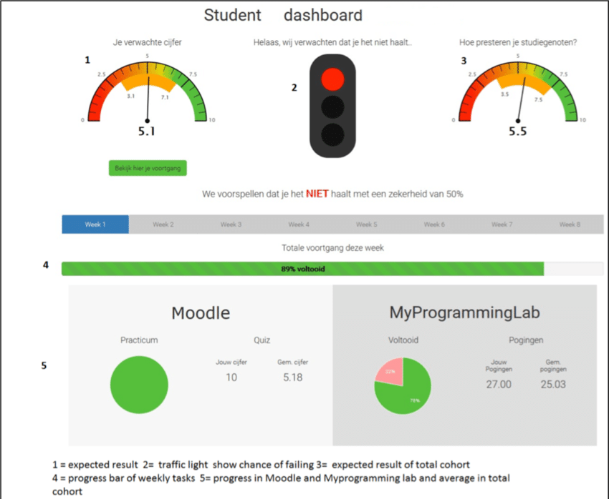
Information for Learners

Slide 14
Information for Learners

Slide 15
Information for Academics

Slide 16
Information for Academics

Slide 17
Information for Leadership

Slide 18
Information for Leadership

Slide 19
Feedback
What have I missed?
Where are organisations on the journey?
What are the barriers?
Do we share the vision?

Slide 20
Closing slide
Stephen Clarke
clarks49@lsbu.ac.uk

