Slide 1
Is your phone still a useful study tool if you’re studying at home?
Davina Beegoo-Price – Head of Digital Student Experience
James Reed – Product Development Manager
Online Student Experience Team
Open University - UK
MoodleMoot Global 2022

Slide 2
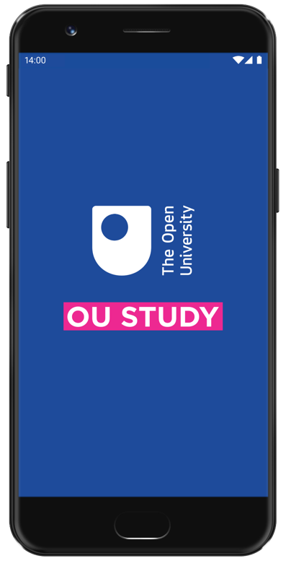

Slide 4
Laptops for deep study and writing assignments
Companion app to support their study and stay connected to the OU
Check study planner, tutorial dates and assessment scores
Read and respond to forum posts

Slide 5
Micro study sessions
Pre-reading materials
Re-engaging with materials
Downloading for offline use

Slide 8
1 Carried on as ‘normal’

Slide 9
2 Similar habits, but new location

Slide 10
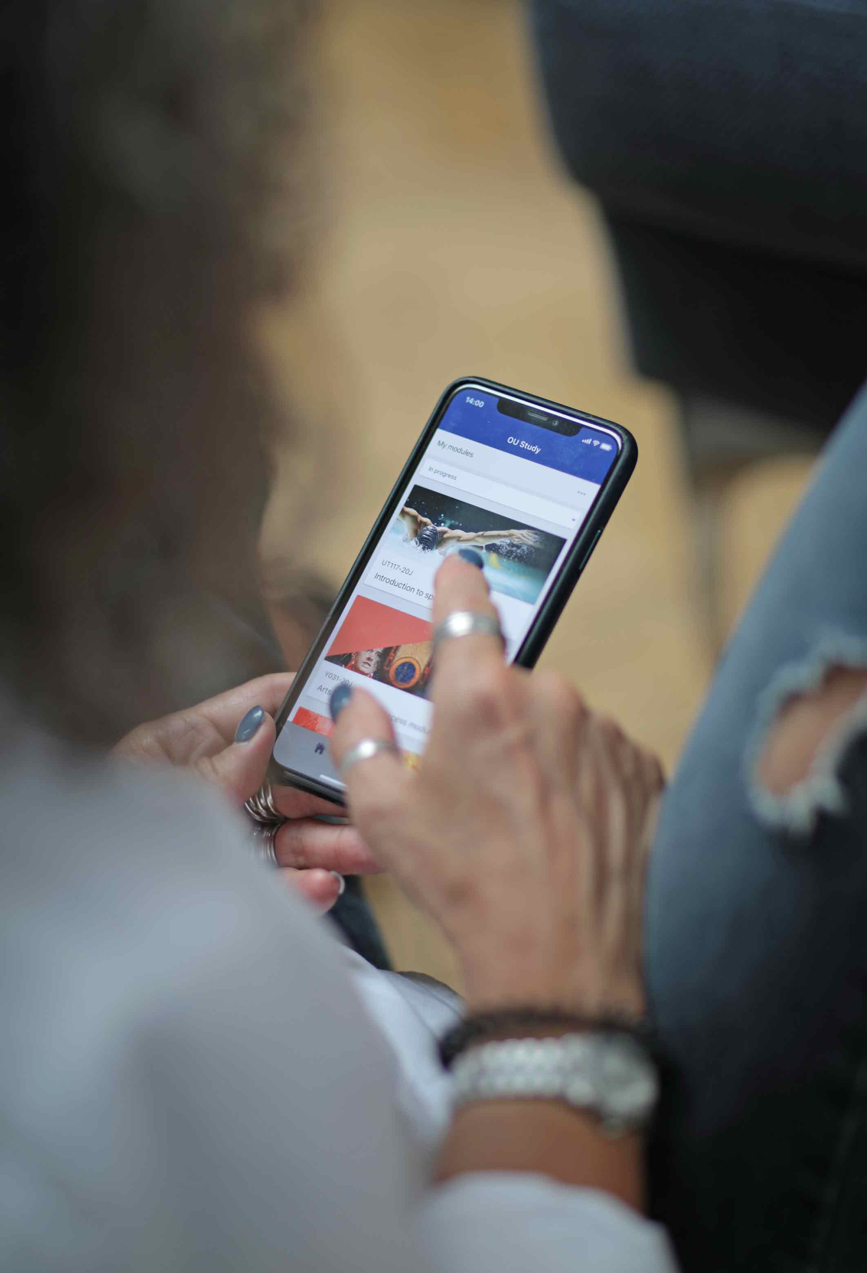
3 More app please!

Slide 11
4 Nah, no app for me thanks!

Slide 14
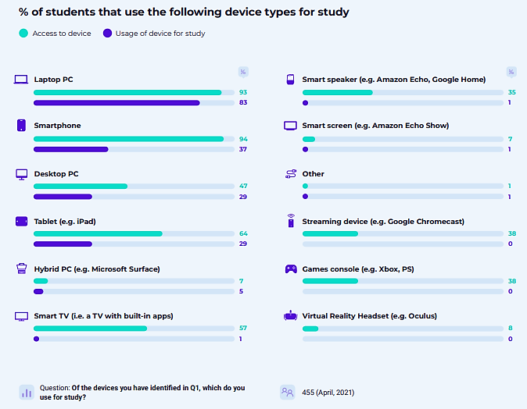
Collins, D. (2021) Student Device Usage Report 2021, Milton Keynes, The Open University.

Slide 15
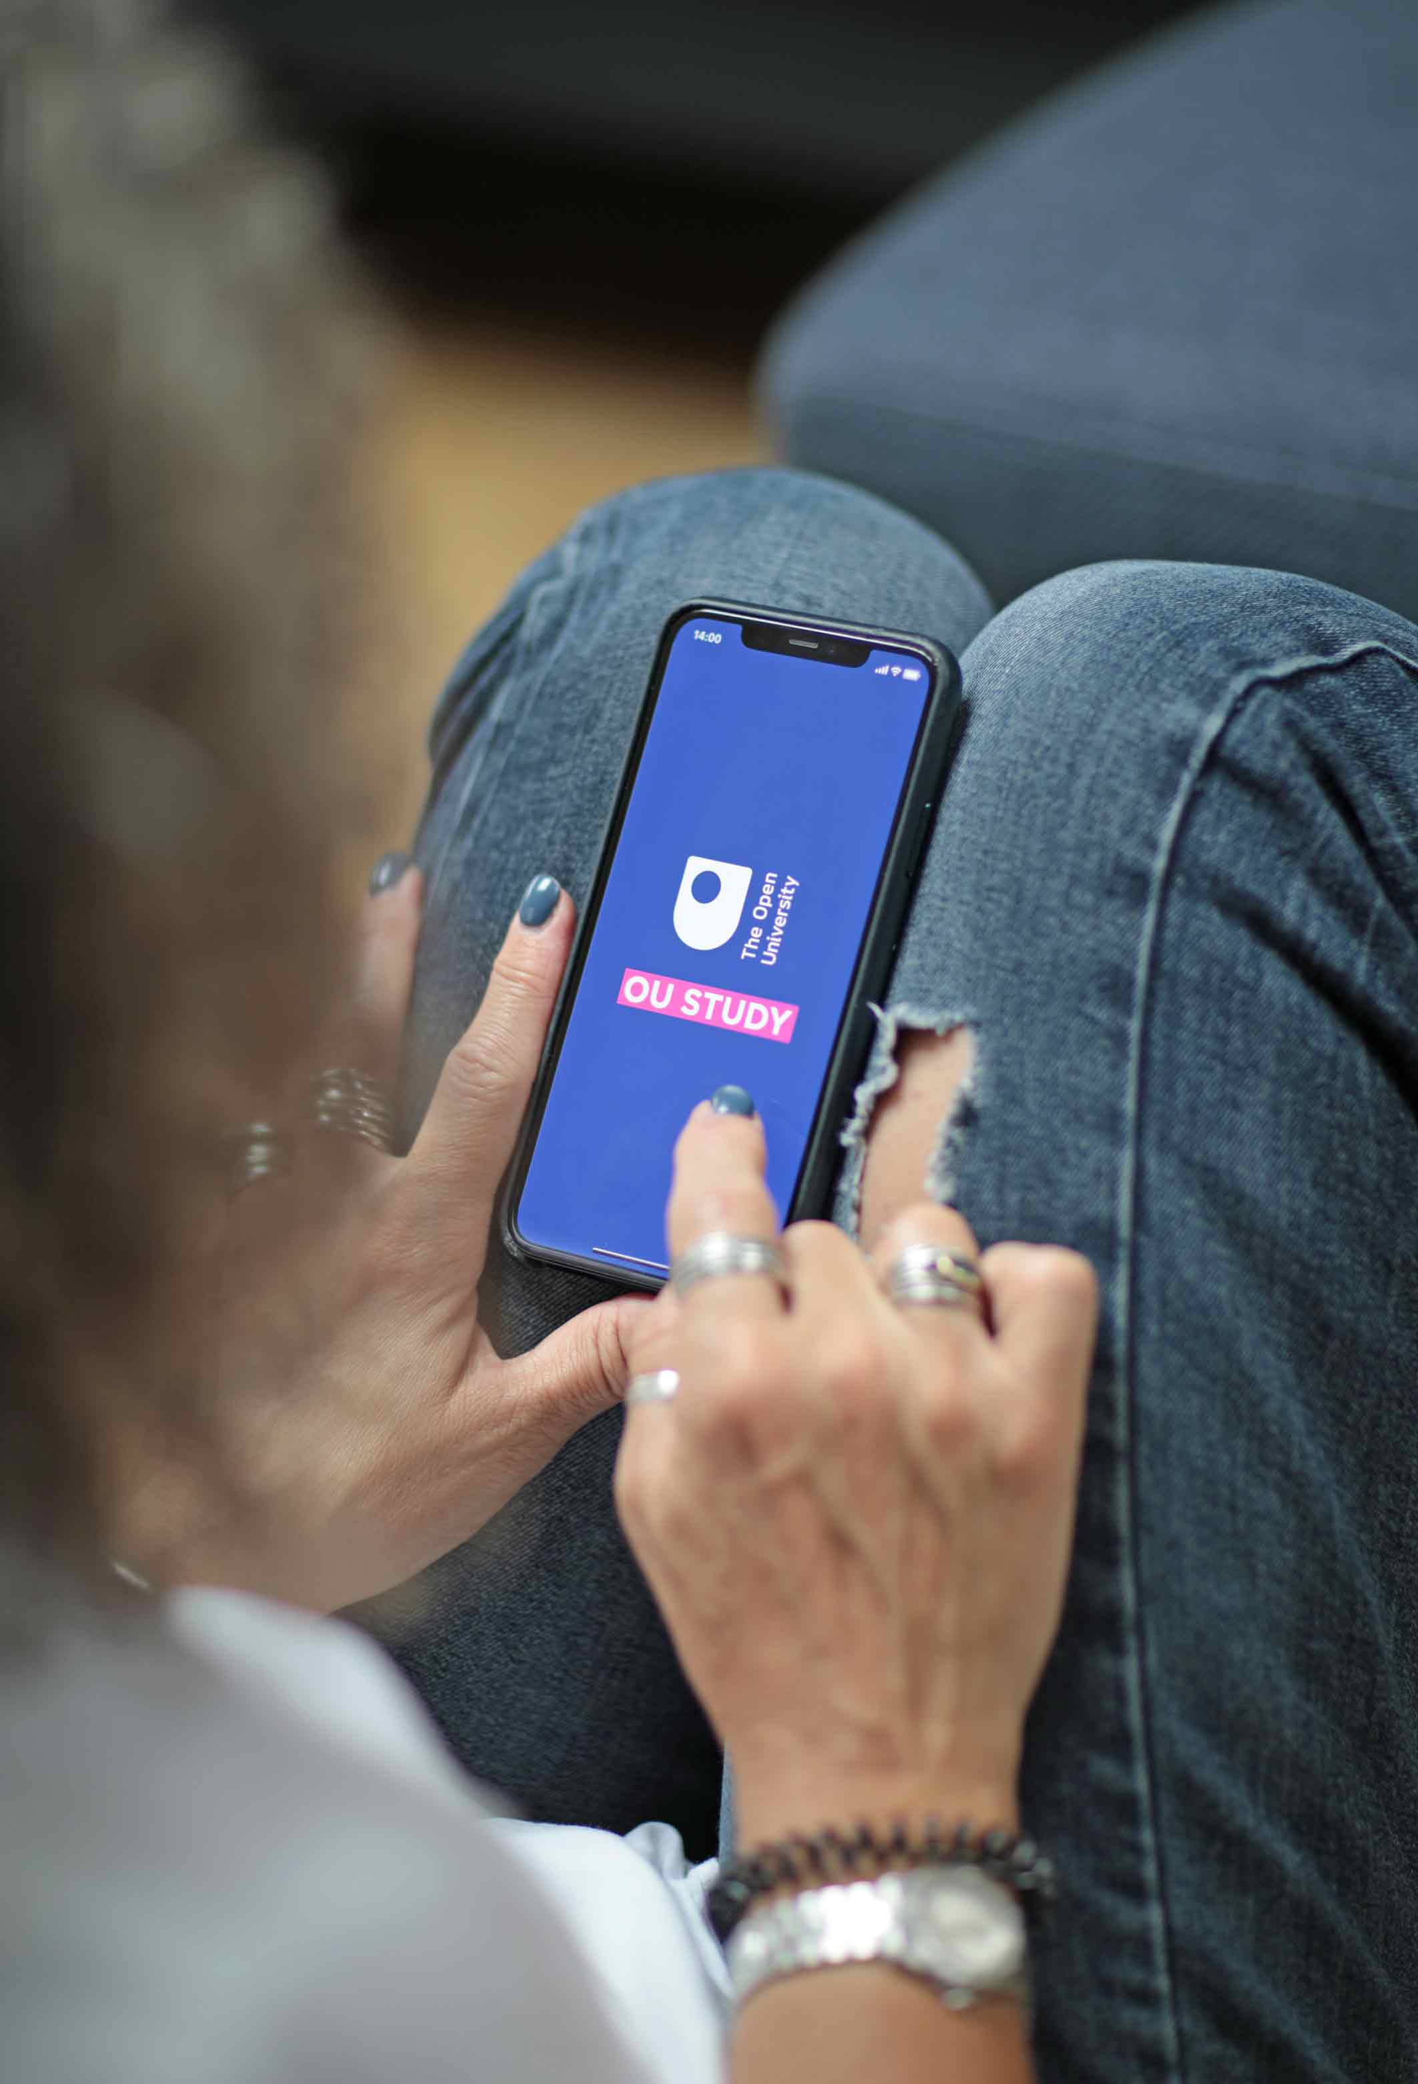
Learning materials not optimised for mobile delivery
Too much push-to-browser
Lack of understanding
Sign-in issues
Pre-established study habits.

Slide 16
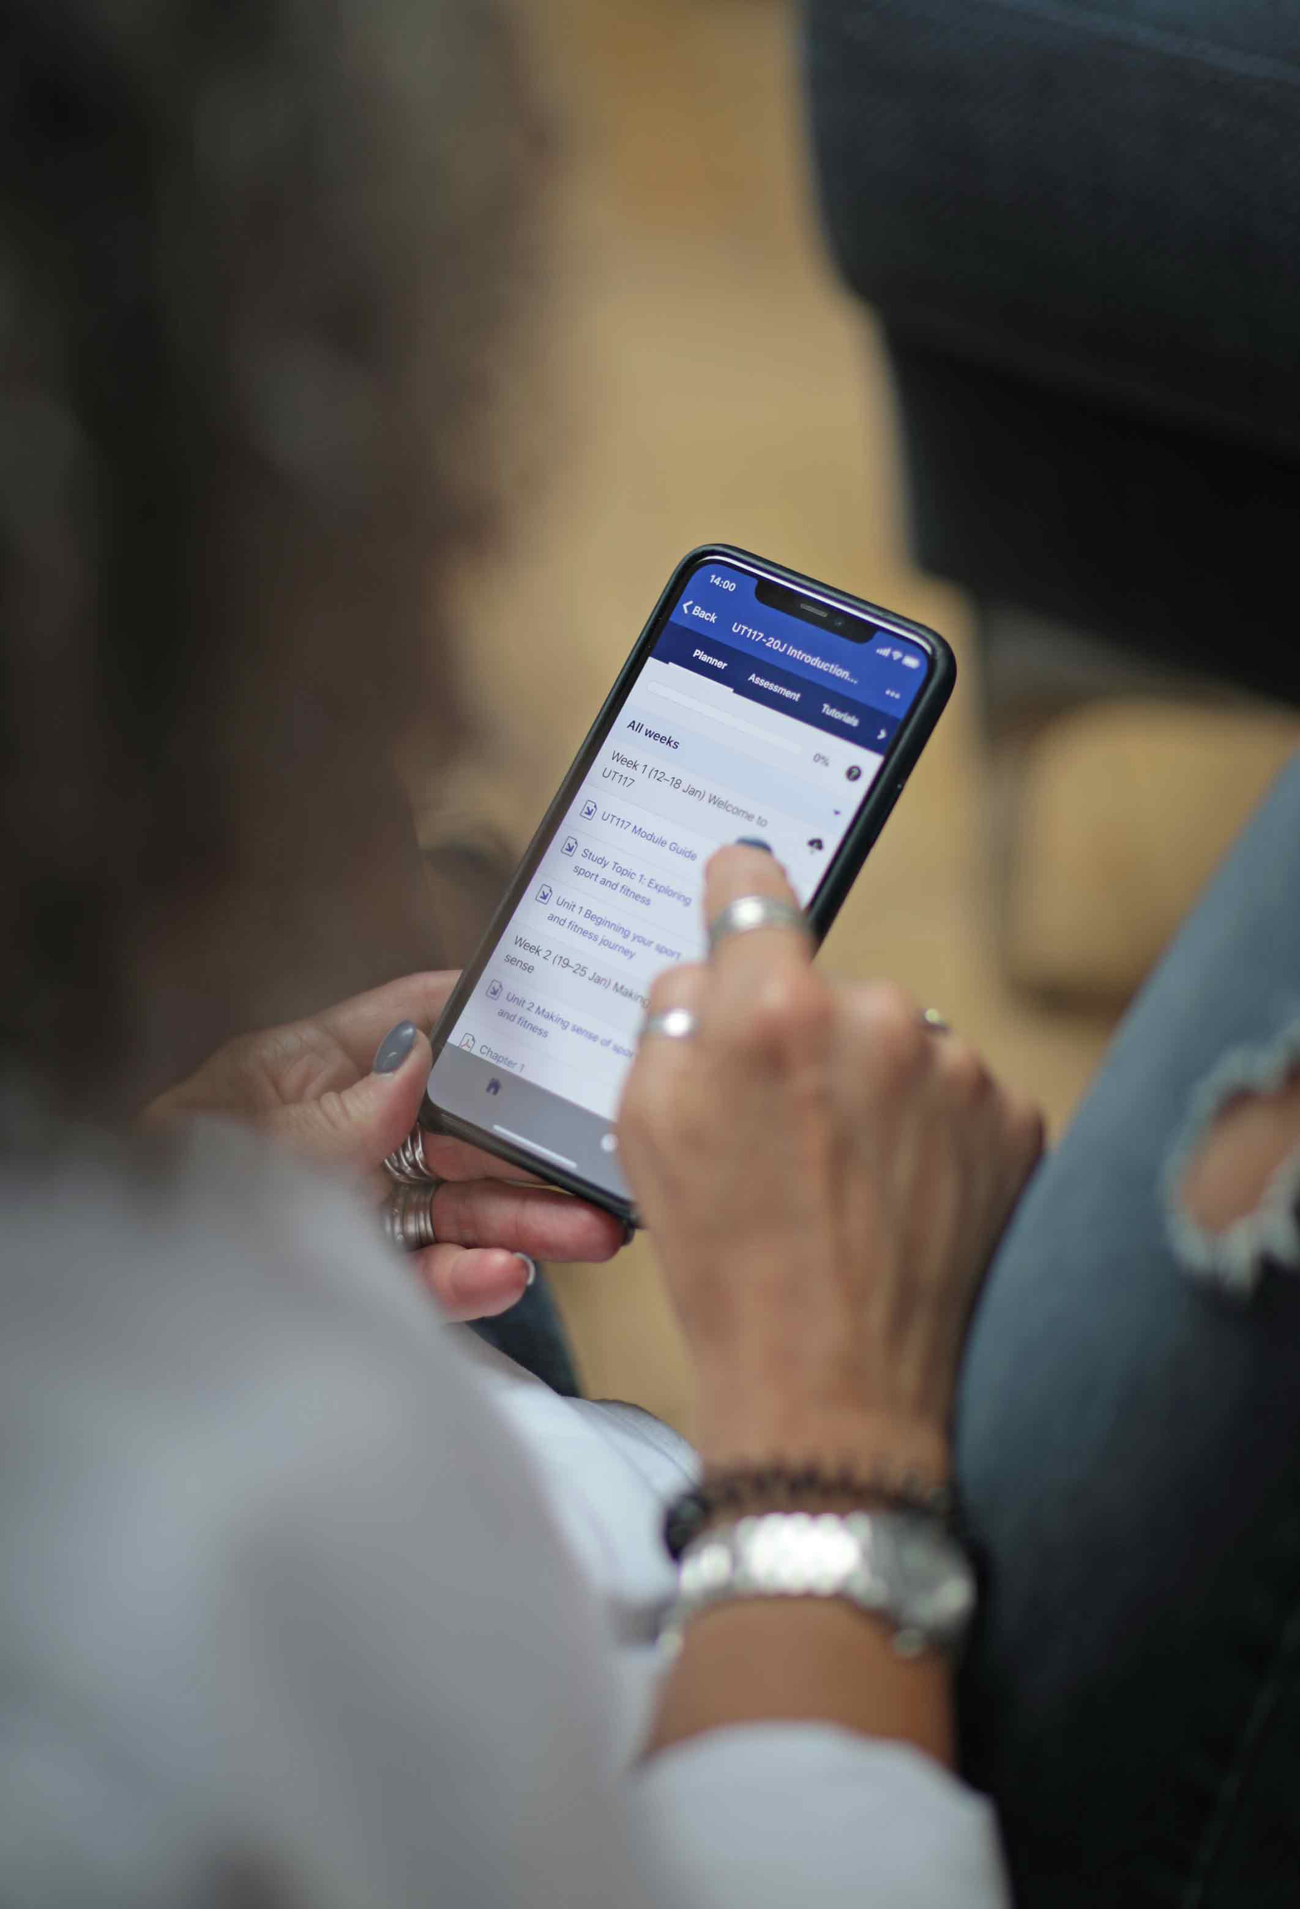
Study behaviours remained similar despite Covid
Lack of app uptake often due to pre-established study habits or content not being optimised for mobile
Listening to content

Slide 17
THANK YOU
Online Student Experience Team
Open University - UK
MoodleMoot Global 2022

