Slide 1






27-29th of September
Theme: Supporting an international and diverse community
By Renaldi Prinsloo & Melanie Julie
Integrating Zoom, WhatsApp and Google translate with Moodle courses to provide flexible and equal online learning opportunities to worker educators globally

Slide 2
The International
Federation of Workers’ Education Associations
Who is IFWEA? Global federation of worker educators
IFWEA is the only international organization for worker educator associations
Promote and advance education of the democratic labor movement
Our affiliates are worker associations from many countries
Secretariate based in Cape Town, South Africa

Slide 3

Who are our participants?
We focus on adult education opportunities for worker educators
Provide education to
trade unions and
member-based associations
on a national, regional and global level
They provide education to worker communities using the our IFWEA Moodle Platform

Slide 4

How is digital learning different when it comes to Workers Education ?
Its digital learning opportunities that we are offering but its also a tool for deepening to help us bridging the digital divide

Slide 5
Challenges we had with running courses on Moodle
Limited access to computers
Bandwidth
Low level of digital literacy
Poor level of English
Fear of the unknown

Slide 6
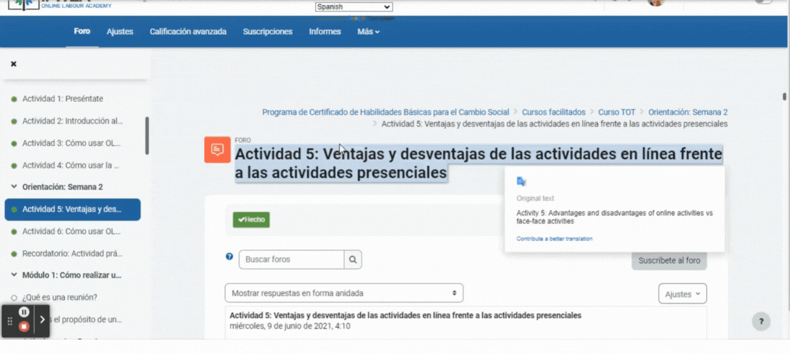

Adding Google translate as a plugin and how it has changed how we conduct courses on Moodle

Slide 7
Adding Google translate as a plugin had helped us:
An inclusive environment:
Including more participants with different levels of English proficiency
Accommodate
participants from our
vast global community

Slide 8
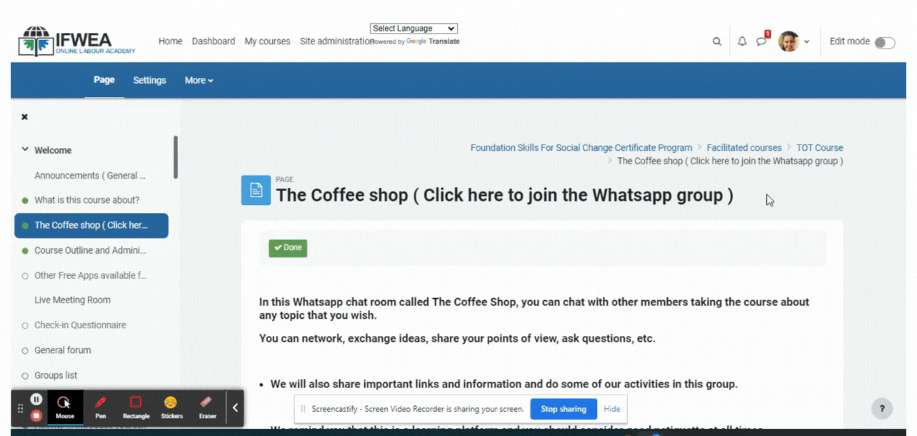
The use of WhatsApp as an external tool when conducting Moodle courses

Slide 9
The use of WhatsApp as an external tool when conducting Moodle courses
Helps us to overcome some of our challenges
- Initial communication and introductions
- More accessible
- Quicker for everyone to engage
- Open channel for duration of course
Some Examples of what is shared in Course WhatsApp groups
Pictures
Screenshots of sections in course
Screen recordings
Summaries of the weekly workshops
Homework for the upcoming week
Voice note feedback from participants
Study circles presentations

Slide 10
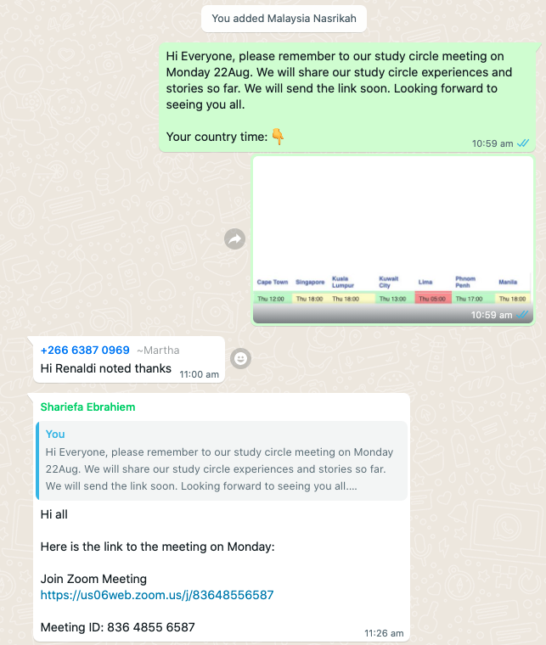

Slide 11
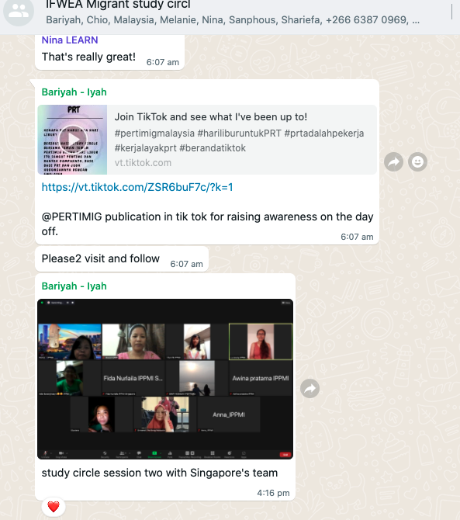

Slide 12
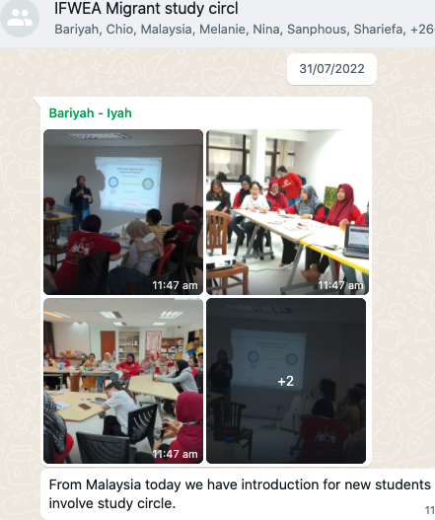

Slide 13
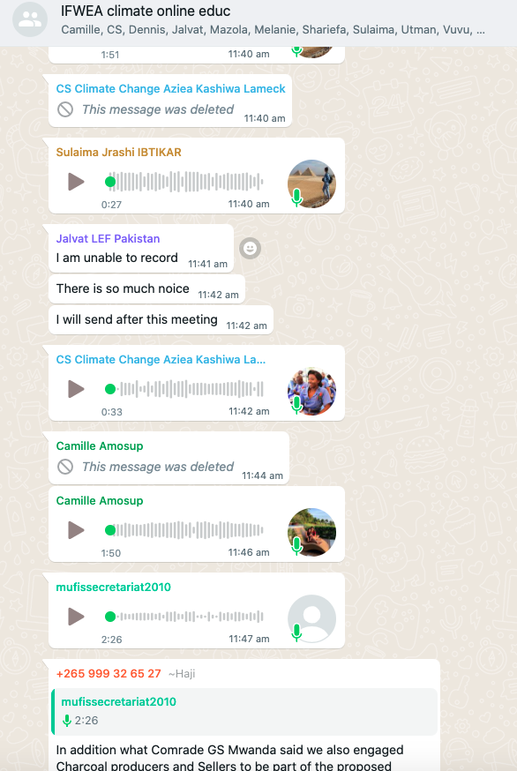

Slide 14
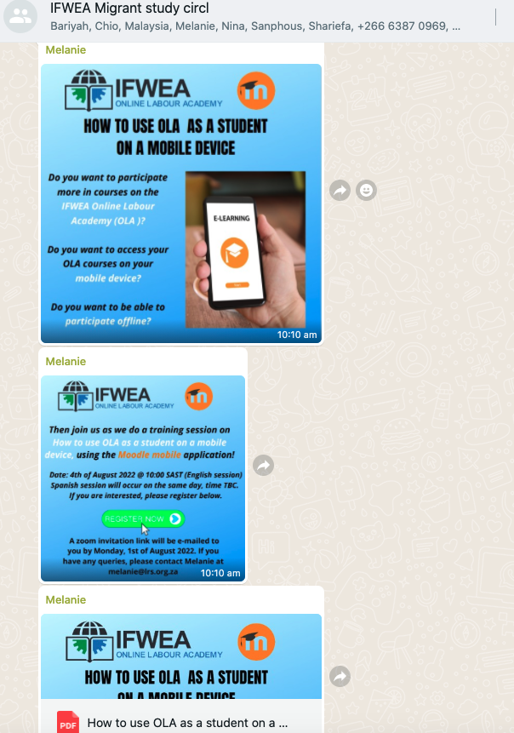

Slide 15
Strengthening the human aspect of our courses
Personal engagement with other participants
Relationship building and networking
The use of ZOOM as an external tool when conducting Moodle courses
Create an atmosphere of participatory learning
Assessing the expectations of the course

Slide 16
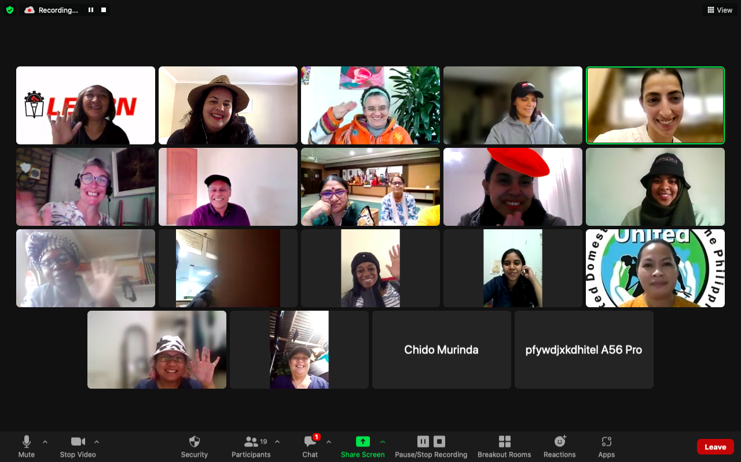

Slide 17
Gage the level of understanding from participants on a topic
Conduct basic introduction to Moodle (orientation)
Conducting weekly workshops
The use of ZOOM as an external tool when conducting Moodle courses
Technique over technology
Zoom study circles, zoom as main education platform and
Moodle as a secondary tool

Slide 18
“Online education creates access to knowledge, builds confidence, and breaks down barriers to opportunity for workers.”
“It is the combination of tools that IFWEA uses that helps us make the transition to online education and especially their patience.”
“Digital education should be available to the masses; this will increase the power of the people.”

Slide 19

Doodly video

Slide 20
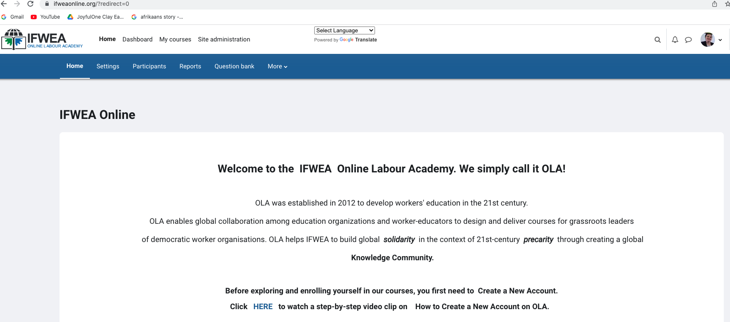
We invite you to our Moodle platform
ifweaonline.org
Thank you

Slide 21


How we support our affiliates to use OLA :
We train educators from our affiliates to design and run online courses on Moodle OLA
Advising organizations to transition to online Education
Design and run courses for them
Train organizations to run courses

Slide 22
Why digital
education for
worker educators?
Trade union education is the vehicle upon on which workers’ organizations have built their capacities and influence in the ever-changing world of work.
It is through grassroots education and mobilization of their members and community allies that unions have won victories on many challenging issues, including membership recruitment and organizing.
It is important for union organizers, negotiators and educators, to be continuously be aware of newer ways of tackling new challenges of work conditions and emerging issues affecting the function of unions.
We are continuously exploring how this could be done through online education programmes.

