Slide 1
Opening slide

Slide 2
Ideate with the Moodle Product Team
Presented by Marie Achour
Global Head of Product
Supported by the Product Leadership team @ MoodleHQ

Slide 3
Are you ready to become Moodle Product Team member?
Notes:
Welcome and thank you for joining us this afternoon.
My name is Marie Achour and I am the Global Head of Product at MoodleHQ. This is my first Moot and it has been a true pleasure meeting so many of you so far and can’t wait to get to know each of you more during our session today.
During our 90-minute workshop, I hope to recruit you all as Moodle Product Team members!
Myself and the Moodle Products Leadership group, who is also here today, are really looking forward to welcoming you to the team :)
To help onboard you, we will start today’s session by giving you an overview of how we do what we do at Moodle Products and why it matters.
We then want to take the opportunity to do what we do with all our team members and get your input on the information we need to build our products.
We also want to share our ideas and collect your ideas on our next areas of focus in Moodle’s product development.
And finally, to make sure you can feel like a Moodle Products Team member long after this workshop ends, we want to show you how you can continue to contribute and stay connected to our product development process.

Slide 4
Our Approach
Notes:
Let’s start with your induction into our approach!

Slide 5
1
2
3
4
User-focused
Outcome driven development
Collaborative prioritisation
Visible progress
Notes:
At Moodle Products we apply four key principles to our product discovery and delivery processes.
Everything starts and ends with our users.
Understanding their needs and building solutions that meet those needs is our primary purpose.
That’s why we have recently reorganised our teams to make them more aligned with the different groups of users who use our products.
By aligning our teams to user needs, we ensure user-centricity;
This gives our teams the focus they need to really take the time to understand our users;
And they can leverage that insight to create the functionality those users need to enhance their experience with our products.

Slide 6
User-focused
Learners
Educators
Trainers
Administrators
Open Source Collaborators
Notes:
At their heart, all Moodle Products serve one ultimate user group, learners (or students), but if you take a step back, these learners are served by other groups of individuals.
These are the people who use Moodle as the tool to engage with their learners - they are our key users and fall into four broad categories:
Educators who work either as individuals or as part of educational institutions: Teachers, Instructional Designers, Professors, Coaches, Roving Academics or even Volunteering Group Leaders are good examples of this segment.
Trainers and HR L&D reps who work in workplace settings e.g. corporate, health, not for profit, government organisations, etc: Learning & Development Leads, Organisational Development Managers or Training Specialists are typical titles used by people in this group.
Administrators of LMS solutions: EdTech specialists, Instructional Technologists and members of the IT department in both educational and corporate institutions fall in this category.
Open Source Collaborators, a subset of our broader community which includes people in the groups above as well as our partners and developers: This is a special group that exists at Moodle thanks to our OpenSource ethos.
Can I check with this crowd - if you identify as an Educator, please put your hand up?
Wow - lots of you!
What about Workplace Trainers or Learning & Development professionals, anyone out there?
Ok - so what about Admins and EdTech specialists?? Ok - a good group
And finally - who puts their hand up to Open Source Collaborators? I bet it’s most of you!
Now as you can see, these are some pretty broad categories of users and the definitions I’ve given you really don’t say a lot about the individual needs of each type of user.

Slide 7
User Profile Example
Notes:
That’s why, as a Moodle Product Management team, we take the time to define each of our users groups into smaller groups with more detailed definitions.
We use a process called user profiling or persona mapping to do that.
What you see behind me is an example of one of our user personas.
As you can see the profile is designed to paint a picture in our team members minds of the people we build our products for. It details what they need, what they care about, things that they find difficult to deal with in their day-to-day work and what their goals are when they are doing that work.

Slide 8
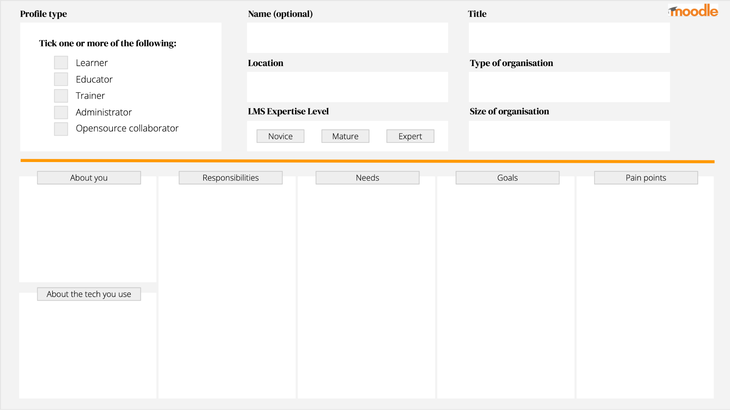
Activity Breakout
Notes:
We’ve only really just started scratching the surface of creating the wide range of user personas for the different types of users that use our products - we have 300 million users, so it’s big task :)
That’s why, in a few minutes, we are hoping to ask for your help.
We would like to ask you to fill out one of these persona canvases for the user type that you feel best represents you.
Tell us a little bit about you, what your responsibilities at work are, what are your needs in delivering to those responsibilities, what are the key goals you want to achieve in your job and what are some of the things that make those goals hard to achieve?
We will use this information to help create more user profiles like the one I showed you on the previous slide and - with them - help our team better understand our users and stay focused on the things that matter to you!

Slide 9
1
2
3
4
User-focused
Outcome driven development
Collaborative prioritisation
Visible progress
Notes:
Now to the second key principle, outcome-driven development.
Software development is a complex process. From idea validation through product design, development, testing, and features deployment to releasing the product to the market, getting yet another users’ feedback, and iterating. It’s a lot.
And because it’s such a demanding process, it’s easy to lose sight of what really matters – to give real value to the users.
That’s why at Moodle Products we are embarking on a journey to become an outcome-driven software development team.
So what does that mean?

Slide 10
Outcome driven development
Hypothesise
Ideate
Implement
Adapt
Did it work?
Notes:
The process you see up on the slide pretty much sums it up.
It starts with a hypothesis - this is when you articulate a theory on what outcome will be achieved if you solve a problem you’ve identified needs addressing.
Outcome-driven development starts with getting a team to think about the outcomes their work will help achieve. And those outcomes will usually be something that we deliver that either fixes a real problem that our users have or a real problem that our business has. Because when you fix problems, you deliver value!
Then, onto ideation - this is when you throw up all the potential solutions that might best solve the problem you are trying to fix… and pick the best one
Then, you implement that solution and deploy it out there in the world… if it drives the outcome you were hoping for, good stuff… if not, you adapt and keep at it until you solve the issue!
It's a big topic… and we wouldn’t have the time to cover all of it together today…

Slide 11
Hypothesis Example
We believe that:
[doing this]
for [these people]
will achieve [this outcome]
We’ll know this is true when we see:
[this result]
We believe that:
Providing database presets
for Educators
Will make it easier for them to use the activity
We’ll know this is true when we see:
Increased use of database activities in Moodle implementations
Better feedback on the database activity usability in surveys
Notes:
So I thought we would focus our efforts on the first step of the process - hypothesising!
It’s the most important one because it’s the one that helps teams identify real problems that our users have or maybe a real problem our business has that we need to address.
The little statement template above is the simplest form of a hypothesis statement - it’s not a full scientific hypothesis, like those that I am sure many of you use in your day-to-day professions… it’s a version of hypothesis testing that is used in LEAN UX development - it’s meant to be simple and fast to use.
It starts with an idea, confirms whom this idea will help, and states what outcome that idea will achieve.
Very importantly, it also spells out how we will see if our idea had the outcome we were hoping it would achieve.
If we have members of the MUA in the room, the example I use on database presets will probably look very familiar to you.
And for those of you who didn’t get to see Barry’s presentation earlier in the Moot, you’ll probably be happy to learn that we are working on this hypothesis as we speak, and will be testing our solution for it in our 4.1 release!

Slide 12
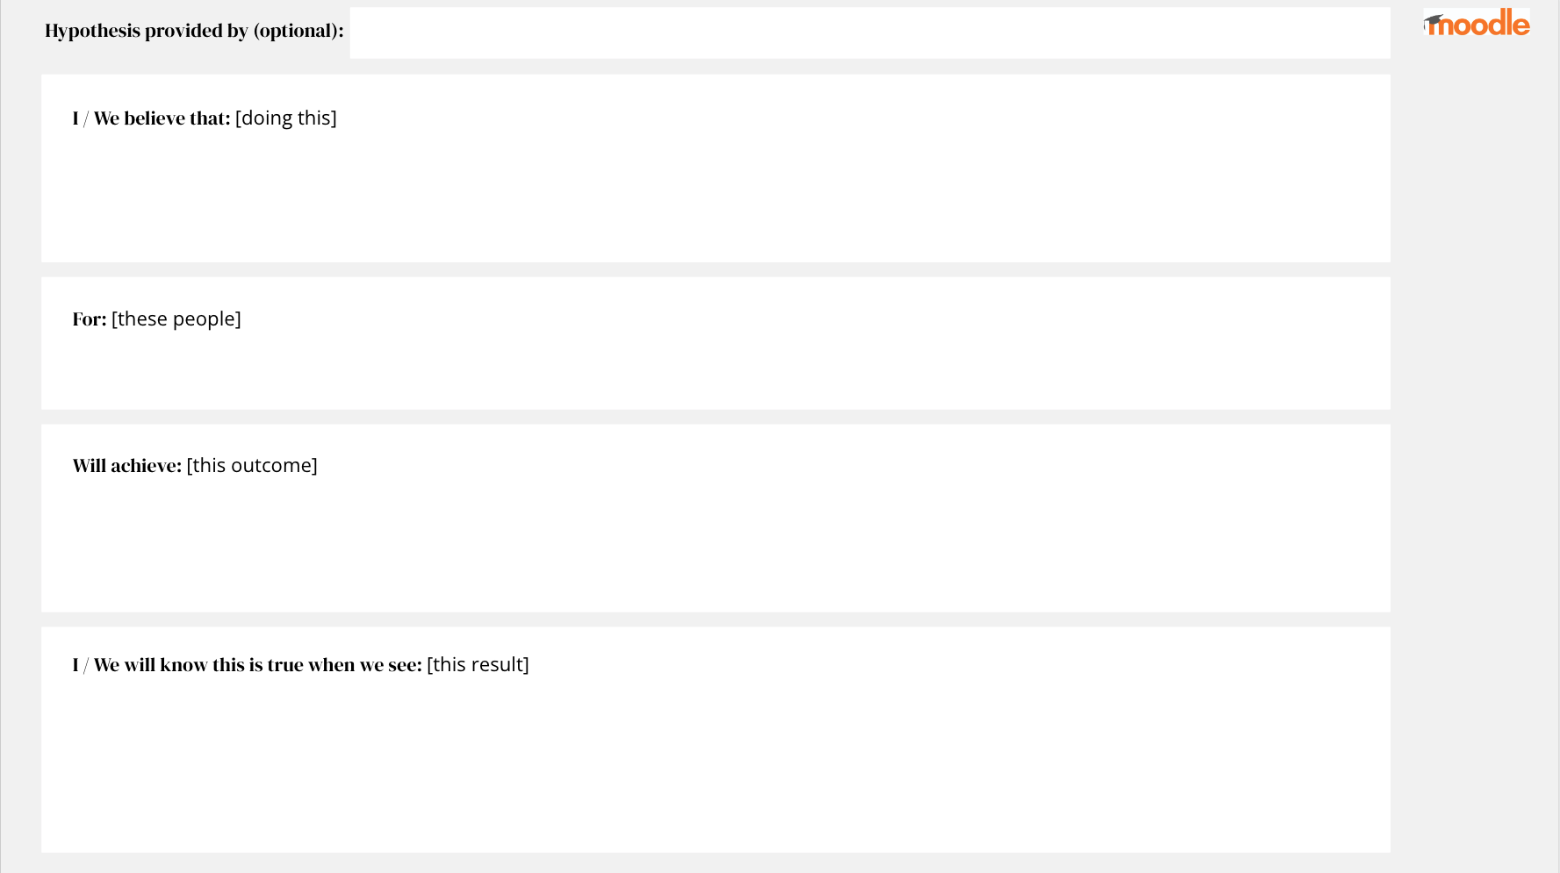
Activity Breakout
Notes:
In a few minutes, we want to ask you to have a go at creating a hypothesis.
What problems do you think we should be looking into at Moodle Products, whom do these problems affect, what benefit will they get if we solve those problems for them and how will we know if we’ve succeeded?
I’m sure there are a ton of great hypotheses in your minds and I can’t wait to see what you have to share.

Slide 13
1
2
3
4
User-focused
Outcome driven development
Collaborative prioritisation
Visible progress
Notes:
Our third principle is by far the easiest one to explain to a new starter.
It's all about prioritisation.

Slide 14
Collaborative prioritisation
“
Our priorities are determined & agreed upon through engagement
Our stakeholders are varied; from our community to our partners, to our service teams and our senior leaders - every one of them cares about Moodle as much as we do - we respect that and proactively work to understand their priorities before we determine what ours are.
.”
Quote from our Moodle Products Playbook
Notes:
To help all our new starters at Moodle, we’ve created a Moodle Products Playbook - in this playbook we articulate the big things you need to know about working at Moodle in the products team.
Importantly, the playbook lists our core principles, those that we apply to everything that we do.
I’ve pasted in the slide behind me a direct quote from our playbook. It explains one of our key principles which is that our priorities are set through engagement.
Prioritising what to work on can be subjective so it’s really important to us that we apply a process that helps ensure we can clearly explain why we did or did not choose to focus on something to all the people who will have an opinion about it.
That means that when we do our prioritisation in the future, we are going to work hard to ensure we take the views of our users, our stakeholders and our team members into consideration and give each of those groups a voice in our decision process.
By the way, we will be publishing our playbook for our community in the months to come - keep an eye out for it if you are interested reading through it!

Slide 15
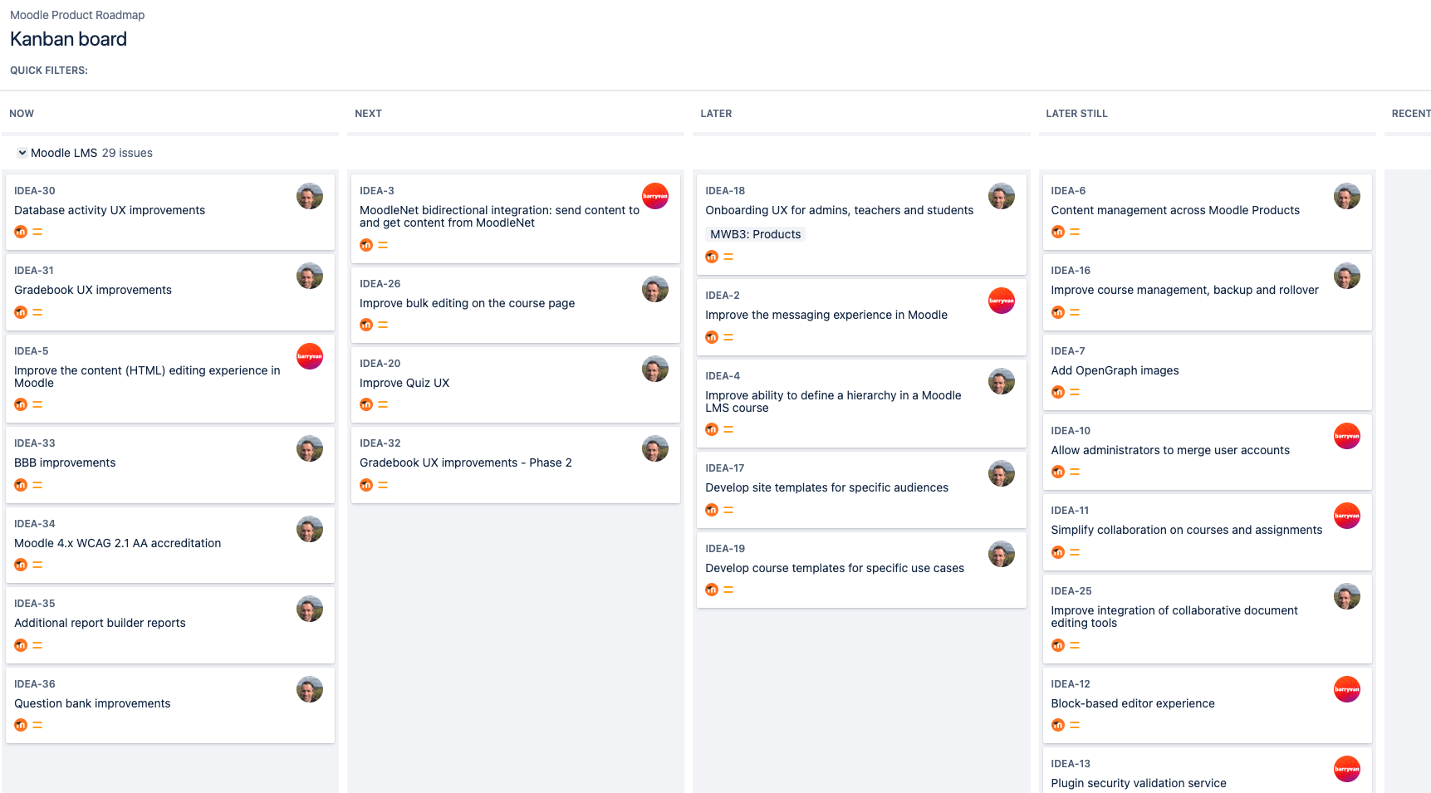
Activity Breakout
Notes:
To help us achieve that goal, we’ve been hard at work before your arrival in our team at creating a brand new Moodle Products Roadmap.
By accessing Moodle’s tracker, anyone who is interested will be able to go to our new Kanban board anytime they like to see all of the ideas we are working on, add new ones and comment on the ones that are already there.
This is not unlike our approach for the MDL project today, but it’s expanded to all our products in Moodle and it’s focused on IDEAS! Not just technical solutions.
The new Moodle Products Roadmap will be launched at the same time as our new moodle.org site and will be accessible through a dedicated section on the site.
But since you all are here today, we thought we’d give you an early view of the roadmap and an opportunity to vote for the ideas you like the most.
You will see that on the wall over there, we have printed each of the ideas on our roadmap onto A4 pieces of paper. They are in no particular order but grouped into different product categories for ease of reference.
If you like an idea, vote for it by sticking one of the 5 stickers we’ve included in the envelopes you found on your chairs.
This is also your chance to add ideas to the roadmap. Use the post its in your envelopes to write them out and stick them in the product section in which they belong.

Slide 16
Time to get to work!
Notes:
Ok - are you ready to get started as a Moodle Product Team Member? Its time!!

Slide 17
Station 1: User Profiles
Fill out your user profile canvas
You will need: Pen, canvas
Station 2: Hypotheses
Have a go at creating a hypothesis (or 2)
You will need: Pen, template
Station 3: Ideas
Vote for the ideas you like the most
Add solutions you want us to consider
You will need: Post its, pen, dot stickers
Notes:
People with an envelope on their chair that has an ORANGE dot on it. Please join Frances and Jess in the corner over there. At this station, you will help us fill out our register of user profiles by completing the canvas I showed you earlier. They will provide you a template to fill out.
People with a BLEU dot. Please join Zoe, Carles and Adrian in the front. We want to get you contributing to our list of hypotheses and problem statements using the template I presented, they will have print outs for you to use to do so at the station.
People with a GREEN dot, make your way to spend some time with Barry, Emilio, Juan and Paul to take a look at our list of ideas, vote for your favourites using the stickers provided and add to the list by writing new ones onto your post its!
We will be spending 10 minutes at each station and then, we will rotate through to the next one meaning that everyone will have a chance to visit each of the Activity Breakout areas and contribute to them!

Slide 18
1
2
3
4
User-focused
Outcome driven development
Collaborative prioritisation
Visible progress
Notes:
So, how did you go? Do you like being a Moodle Product Team member??
Thank you very much for all of your contributions! I can see we got a lot out of you on your first day :)
Before we let you go home and rest up, I want to share some information about the last key principle we apply to our work at Moodle Products, which is Visible Progress

Slide 19
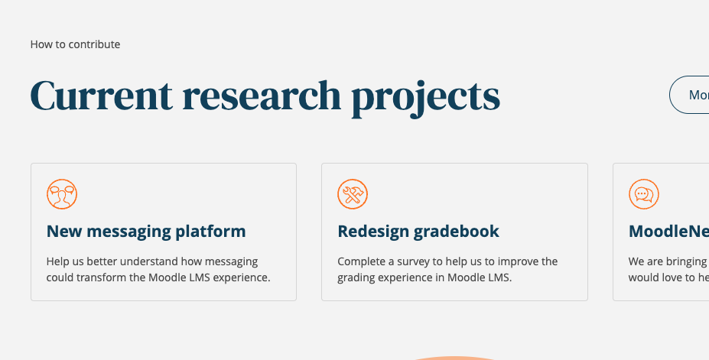
Visible progress
Roadmaps Reviews
Reaching out for Research
Sprint Showcase Shorts
Notes:
Our stakeholders deserve to know what we are up to so we’ve been updating our processes to ensure you get more opportunities to see our work on a regular basis.
Expect us to reach out more consistently to our community get feedback on our priorities.
We already do that a lot with the MUA, the Workplace Product Advisory Group, but we want to do more of it…
Every 3 months, we will be holding a planning week as a team that will see us set our priorities and plan our work for the quarter ahead - so expect us to come at you all every quarter with questions on what matters to you so that we can take that input into consideration!
We will also be setting up a new research panel, if you are interested in participating in the panel, please visit the Moodle Products Bar or register your interest with Zoe at the end of this session.
We want to make it easier for you to find out what research activities we have in progress so Research will have a dedicated section on our new look moodle.org (due out any day now!)
And finally, in a few weeks, we will be launching our new Sprint Showcase Shorts!
We now work in 3 sprints at Moodle Products, we all start them together and finish them together.
And at the end of each Sprint we hold a Showcase during which our teams share the work they have completed during the Sprint so they can see each other’s work - and we record those sessions!
So we will be creating a version of that recording that we can share with you all - so every 3 weeks, you can watch a short video that will give you a little snippet of how we are progressing.
And if any of you are developers out there (which I’m pretty there are!), if you see anything we are working on that you are particularly excited about, it will give you the chance to know more about it and choose to join in the fun if you want to contribute to it.

Slide 20
One final step…
Notes:
I forgot to share the final key principle with you at the beginning of our session… and we have one last request of you all before you finish your first day in the Moodle Products team.

Slide 21
Learn from everything we do
Notes:
When we develop a better Moodle, we try to learn from everything we do.
Our teams hold regular Sprint Retros at the end of every sprint during which they discuss what went well, what didn’t go so well and ideas for improvements.
These sessions are not focused on what we built but rather, on how we built it… how we worked together, how our processes could be improved and what we can do to become a better Products team.
So before you leave today, we’d like to ask you to share your thoughts about this workshop.
Using your post its and pens (for one last time) please create 3 post its.
One with a tick on it that tells us what you liked about the session.
One with a cross on it that tells us if there is anything you would have liked to see us do differently.
And the last one with that gives us an idea of something we could do next time we run a session like this that you think would be of value.
Once you are done, please place your post its in your envelopes and leave them and your clipboards on your chair.
We will collect them, as well as the rest of your feedback from today, collate them and use them as we continue to grow as a team!

Slide 22
Thank you!
Notes:
Thank you so much for your hard work and contributions!
It’s been a pleasure to work with you all on your first day in the team - and here’s to many more ahead!

Slide 23
Closing slide

