Slide 1
How to Engage your Learners using H5P
Ståle Hegna
Content Designer, Telemark Kompetanse
Notes:
My name is Ståle Hegna, and I am a Content Designer in Telemark Kompetanse. We are working with three different LMS’es – KS Læring for the Norwegian municipalities (more than 470,000 users), aiLæring for Work&Inclusion companies (about 10,000 users) and MERkompetanse, which is our own platform.

Slide 2
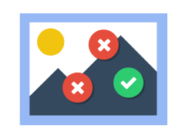
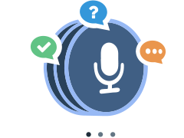
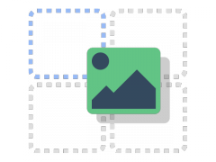
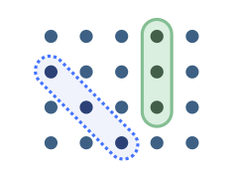
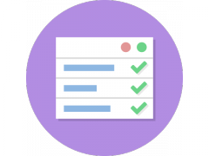
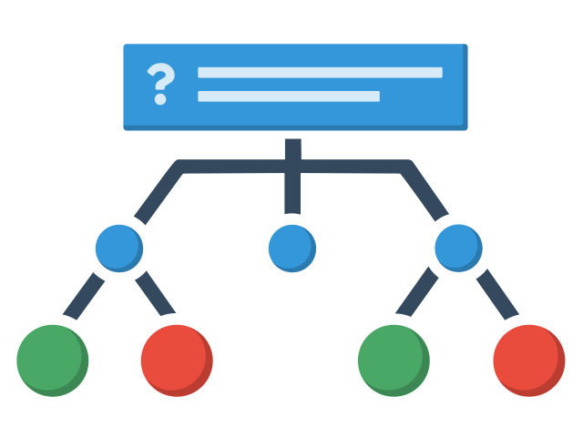
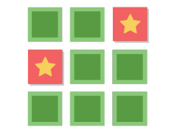
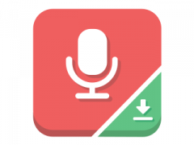
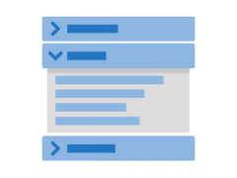
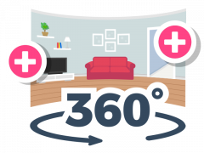
H5P Family – 52 content types
Notes:
The H5P family consists of 52 different content types.
KLIKK In some of these content types, for example Course Presentation and Column, you can include many of the other content types. And I will give you a few examples of this during this presentation. And I will also show you an example of the Personality quiz content type.

Slide 3
Content
Self Assessment (Column, Course Presentation and Accordion)
Theme: Self Assessment – Basic Digital Competence (Norwegian municipalities)
HSE campaign (Course Presentation in Active surface mode)
Theme: HSE campaign (Statkraft, Norwegian state)
Personality quiz
Theme: What are your values as a forest owner?
Notes:
Distributed on KS Læring – Moodle platform used by 210 municipalities in Norway – 470,000+ users – Basic Digital Competence Self Assessment.
Distributed on H5P.com – Statkraft is a leading company in hydropower internationally and Europe’s largest generator of renewable energy.
Distributed on a platform called Skogkurs

Slide 4
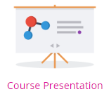
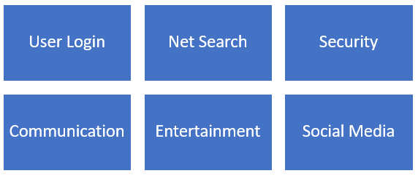
Self assessment
6 subjects (3-5 questions) H5P: Course Presentations with Summary page showing results All question types used
Course Recommendations H5P: Accordion
Link to internal Moodle courses or available free net courses
GO LIVE
Notes:
As mentioned earlier, the H5P family consists of 52 different content types, and we often use combination of content types in our learning material. In the Basic Digital Competense Self Assessment, we have used the content type Column as our main H5P content type but combined it with six Course Presentations med up of questions.
When these Course Presentations are completed one by one, the user goes the Summary page to see the result. And based on the result, the user proceeds to the Recommended Courses section. Here we have used the Accordion content type and linked to the recommended course for each subject. These courses can be internal Moodle courses on the actual platform or a link to courses published elsewhere. So let’s go live and se what this looks like.

Slide 5
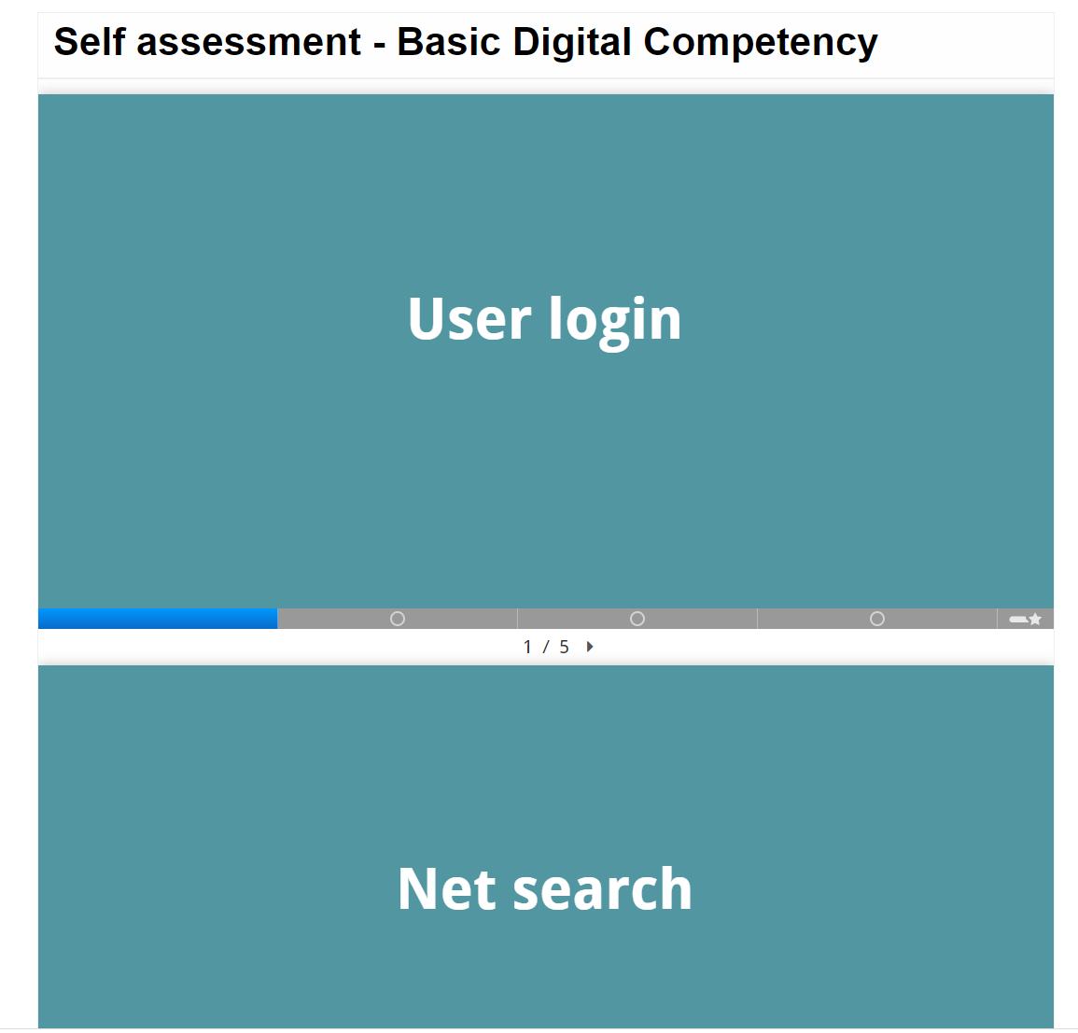

Slide 7
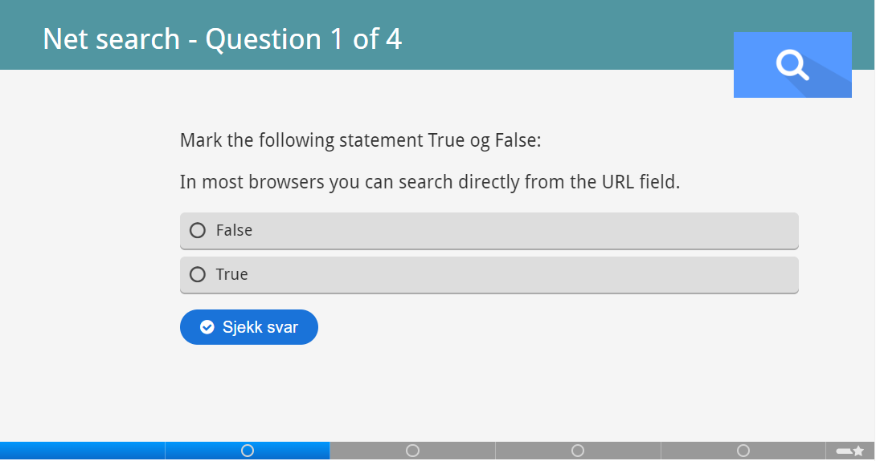

Slide 9
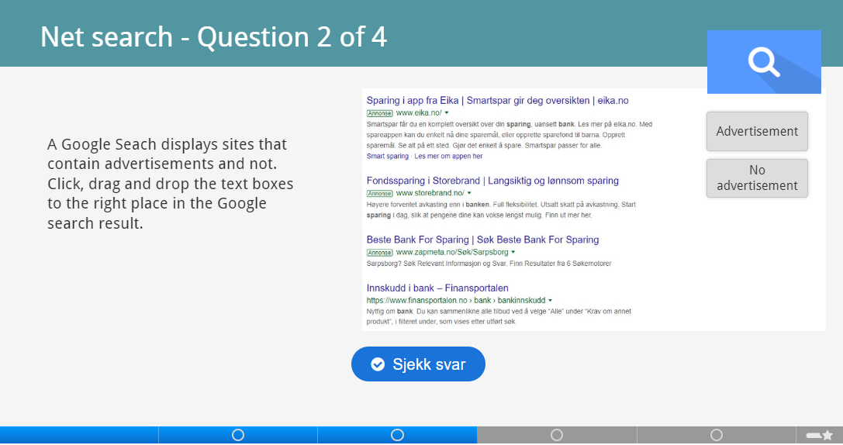

Slide 12
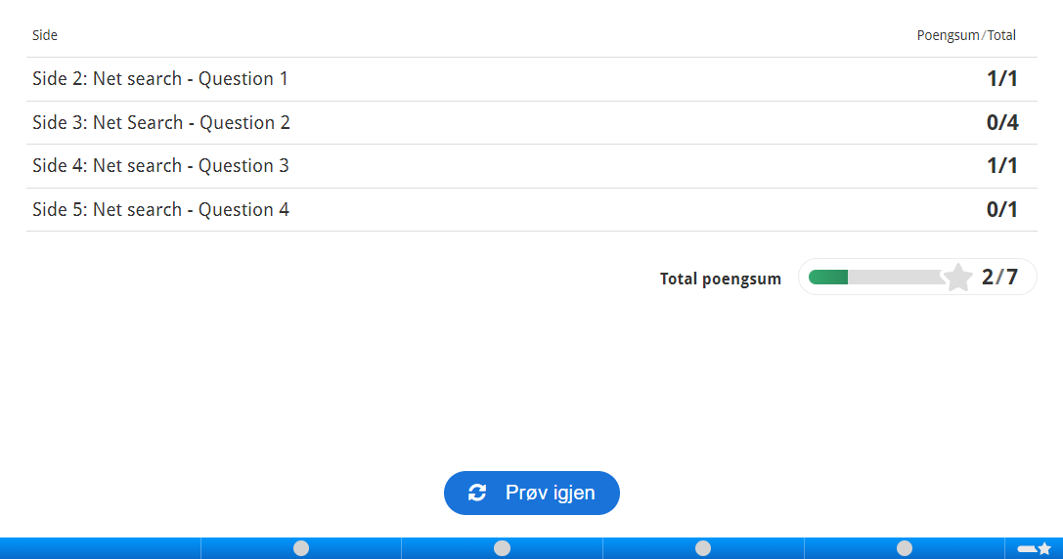

Slide 13
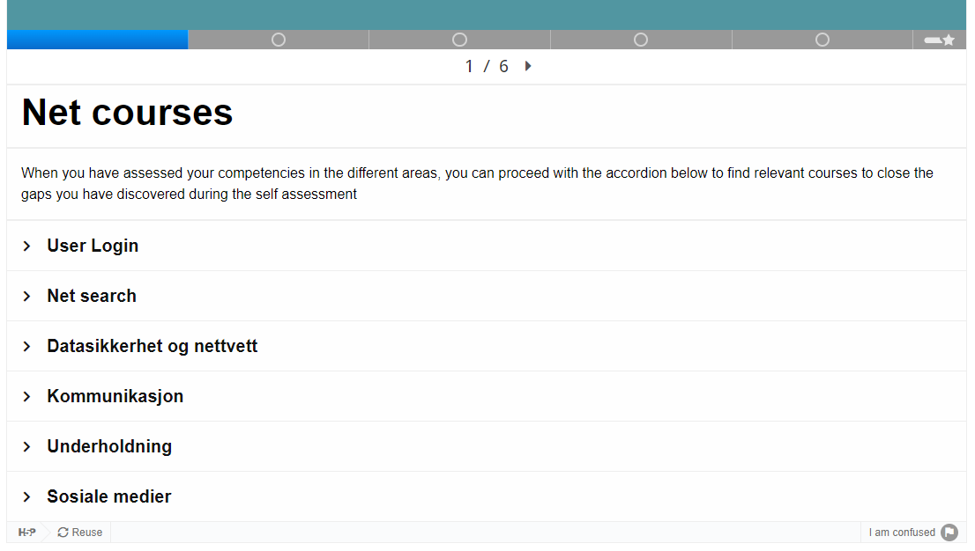

Slide 14
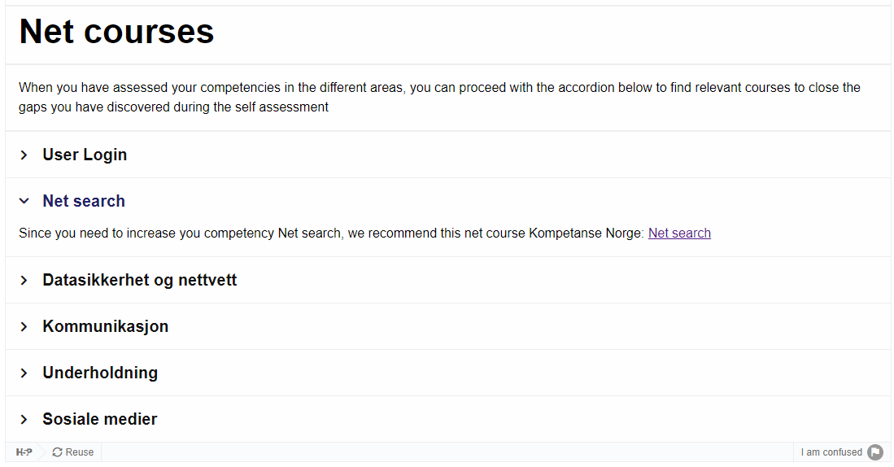

Slide 15
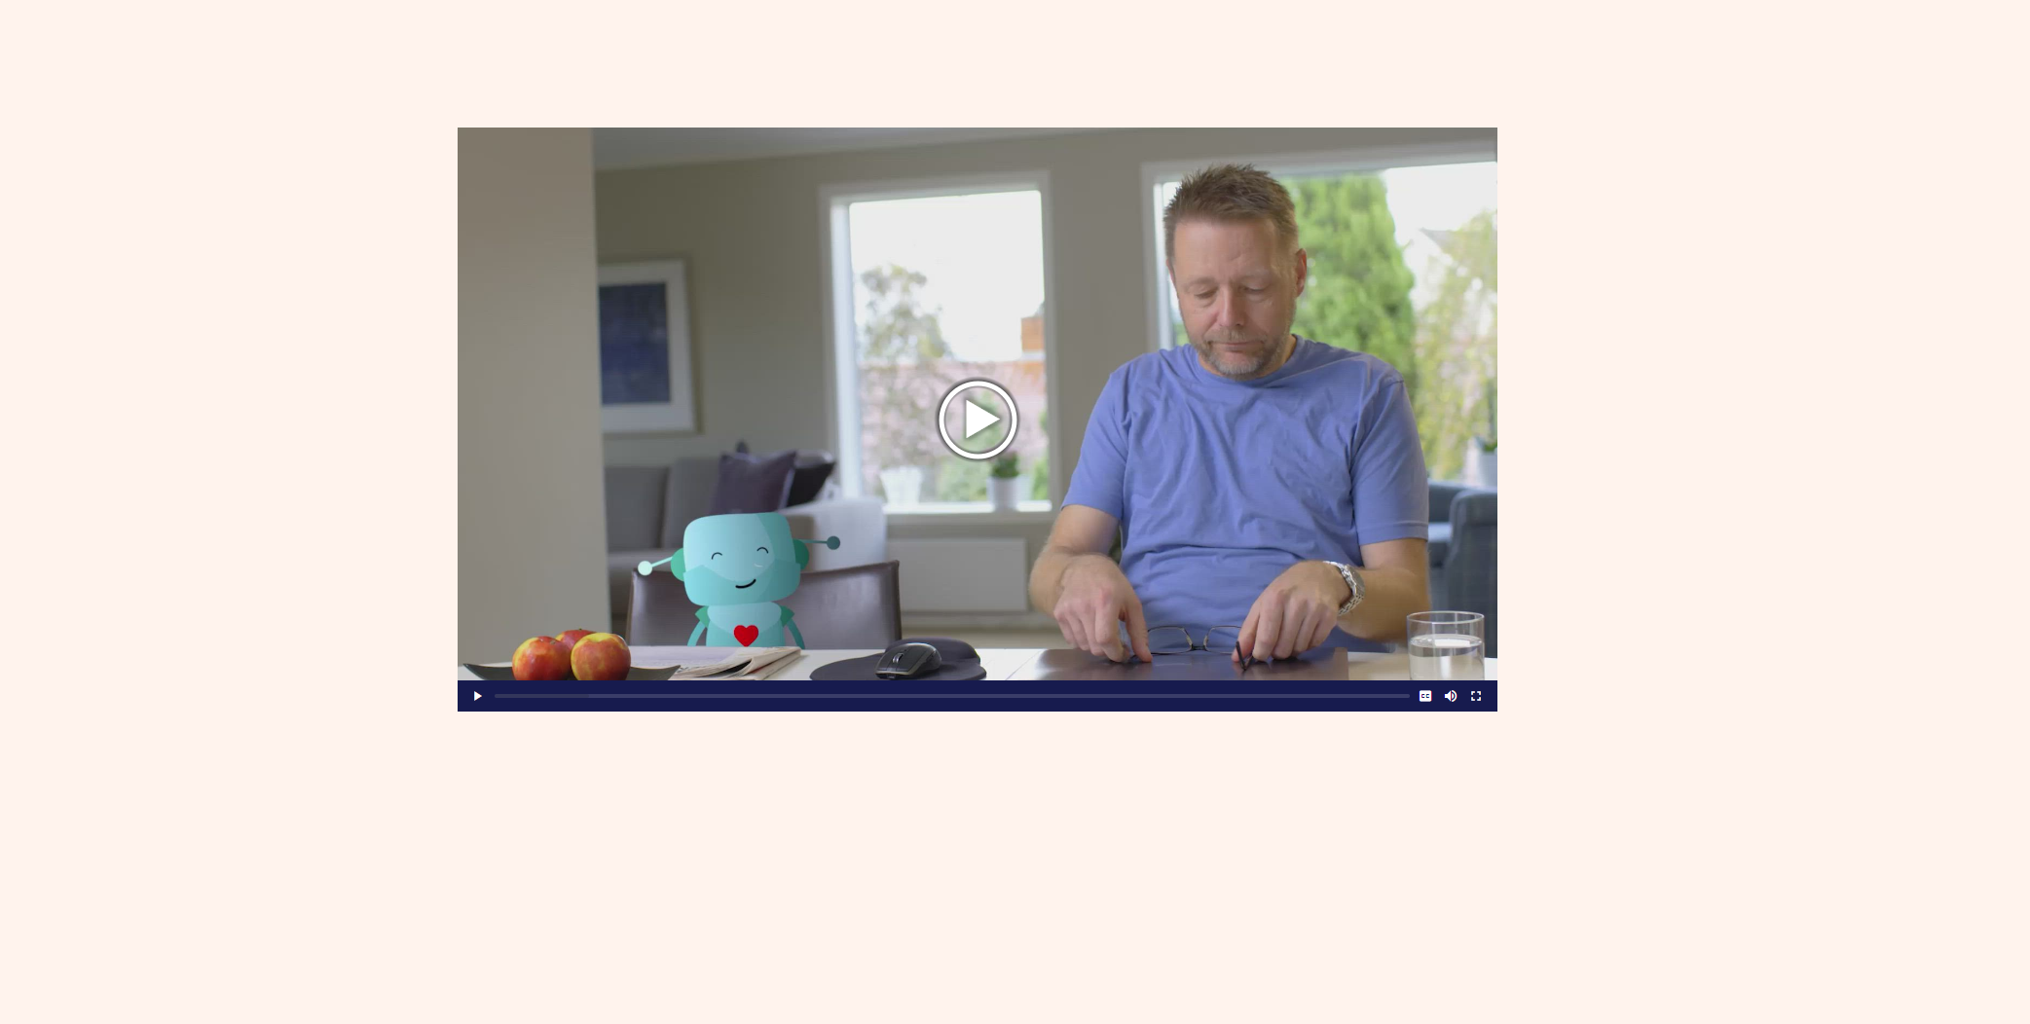

Slide 16
HSE Campaign
HSE campaign
Theme: HSE campaign (Statkraft, Energy Company Norwegian Ministry of Trade, Industry and Fisheries)
Course Presentation (Active surface)
Functionality used: Buttons, Question types, Anchor, Dialog Cards, Exportable Text Area, Video
Notes:
Distributed on H5P.com – Statkraft is a leading company in hydropower internationally and Europe’s largest generator of renewable energy. Health, Security and Environment
Here we used CP in Active Surface mode. Why? Because we wanted to guide the employees or users through the course content. R – Risk conscious
A – Responsible
U - ????
S -

Slide 17
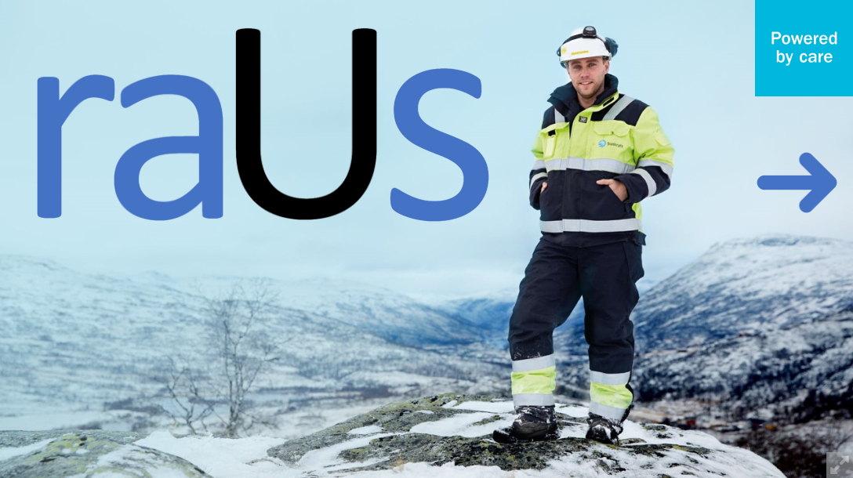

Slide 19
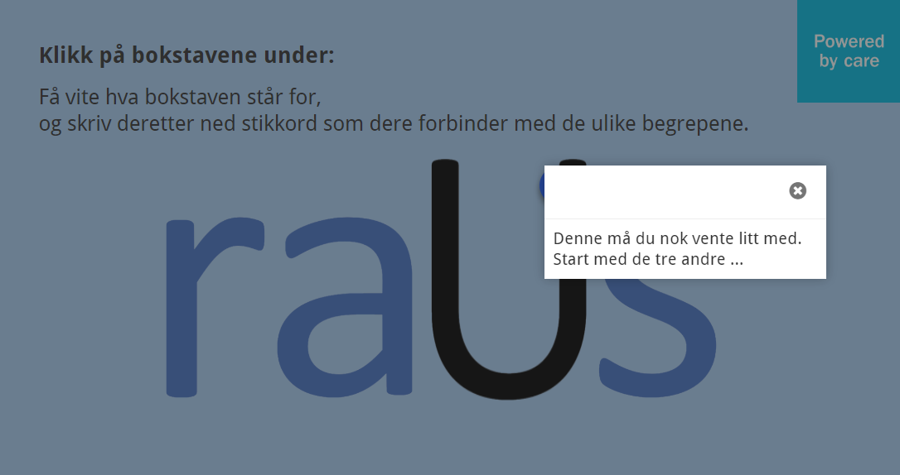

Slide 20
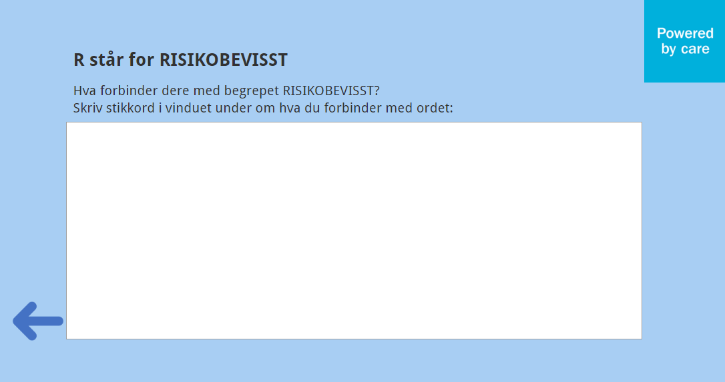

Slide 21
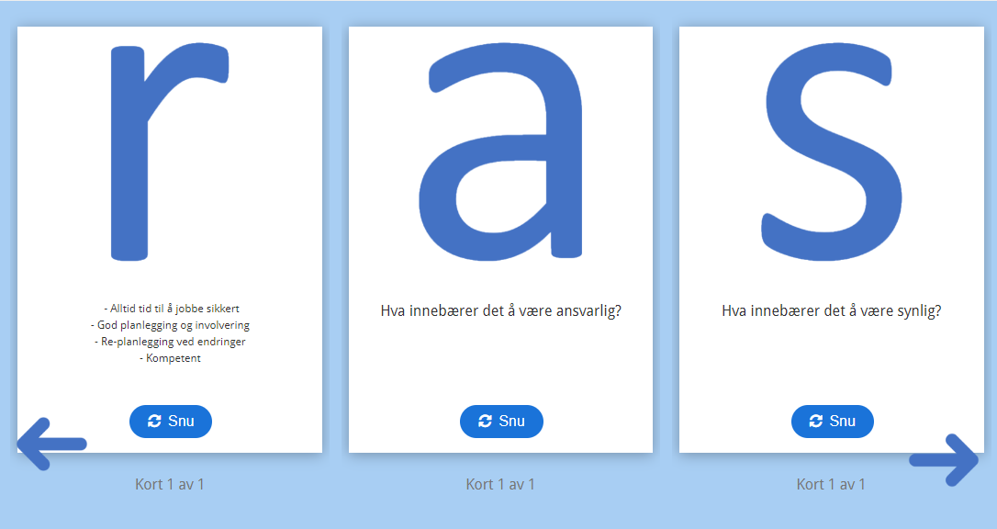

Slide 24
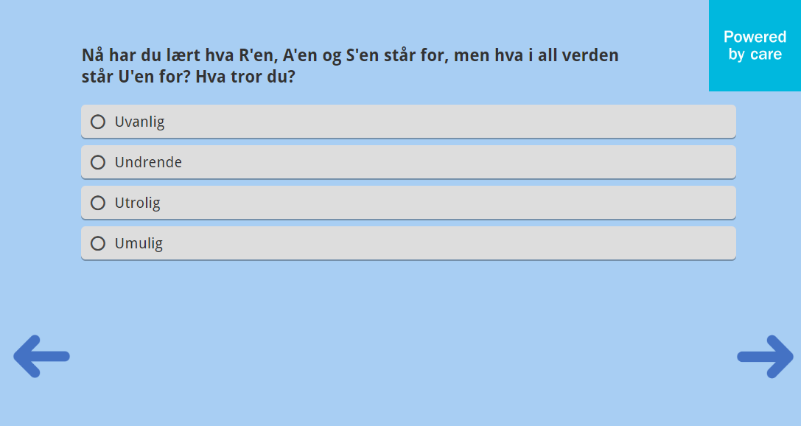

Slide 28
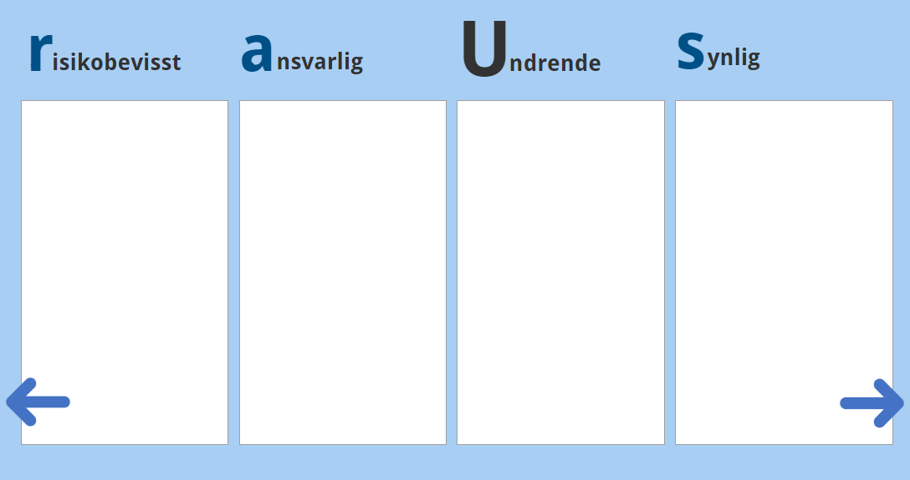

Slide 30
Personality Quiz
HSE campaign
Theme: What are your values as a forest owner? (Skogskolen)
Personality Quiz
Notes:
Distributed on KS Læring – Moodle platform used by 210 municipalities in Norway – 470,000+ users
Distributed on H5P.com – Statkraft is a leading company in hydropower internationally and Europe’s largest generator of renewable energy.

Slide 31
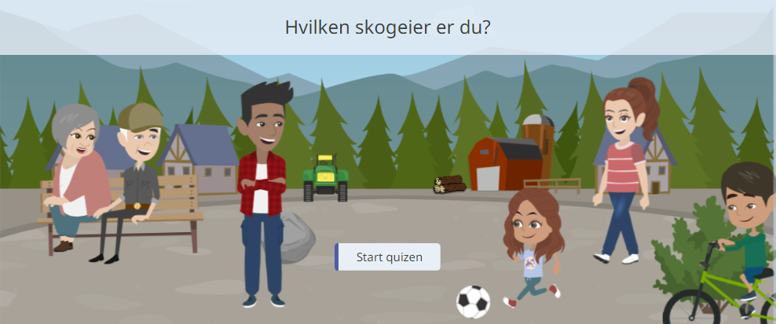

Slide 32
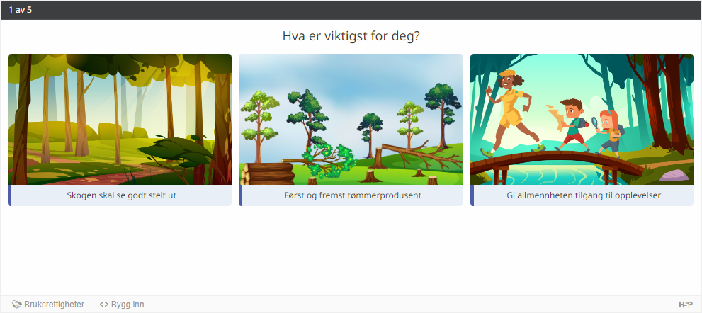

Slide 33
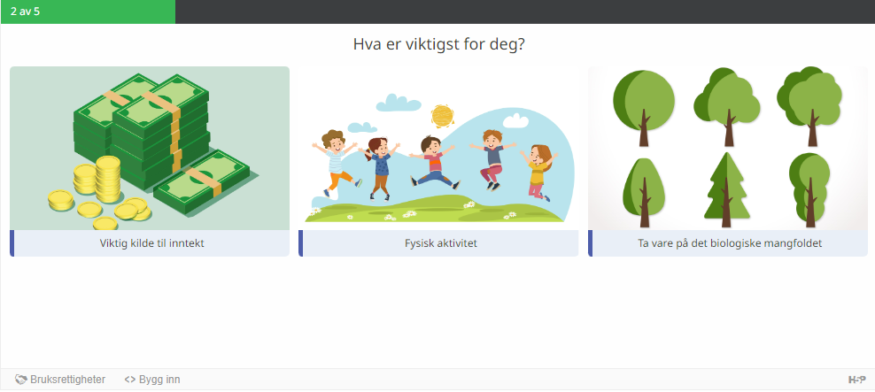

Slide 35
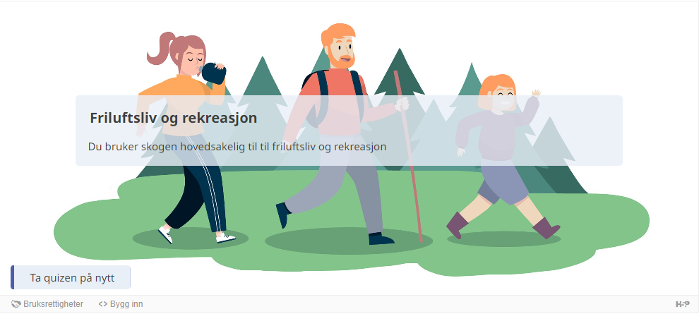

Slide 36
Closing slide
Ståle Hegna, Content Designer
stale@tkas.no

