Slide 1
H5P Advent Calendar: Sharing Moodle Tips in an Engaging way

Slide 2
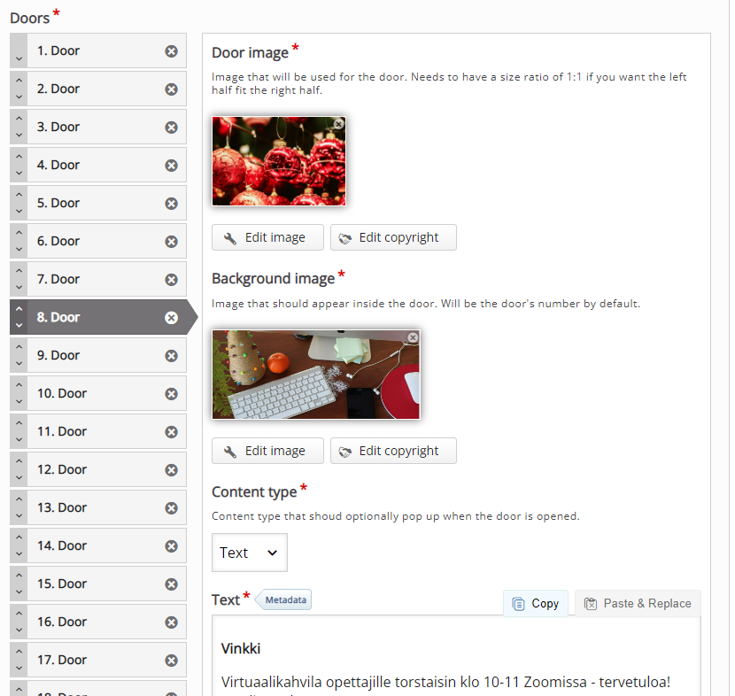
H5p ADVENT cALENDAR
Possible to add videos, audio, images, texts and links within each door
Visually customisable
Design mode enables preview of the content
Content can be updated even when the calendar is open to the public
Not fully accessible
Calendar closes after December:
open in design mode if you want users to be able to access the content later

Slide 3
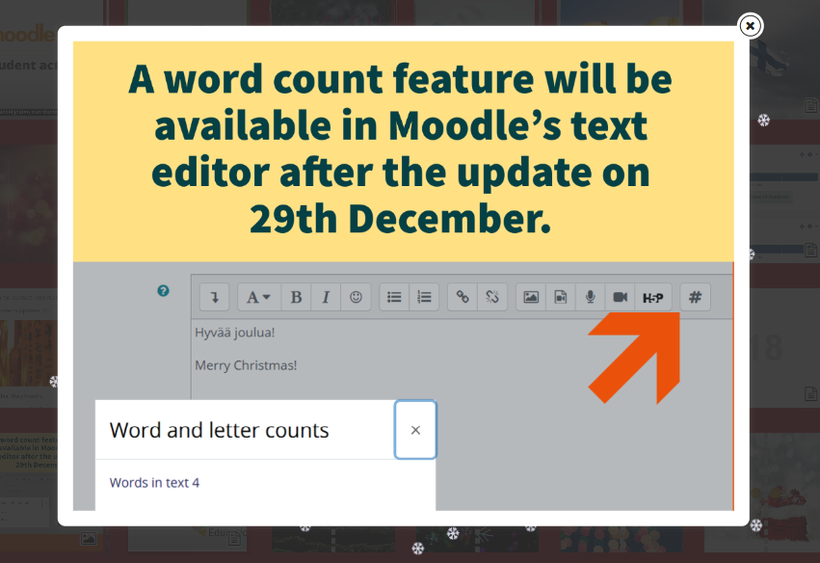
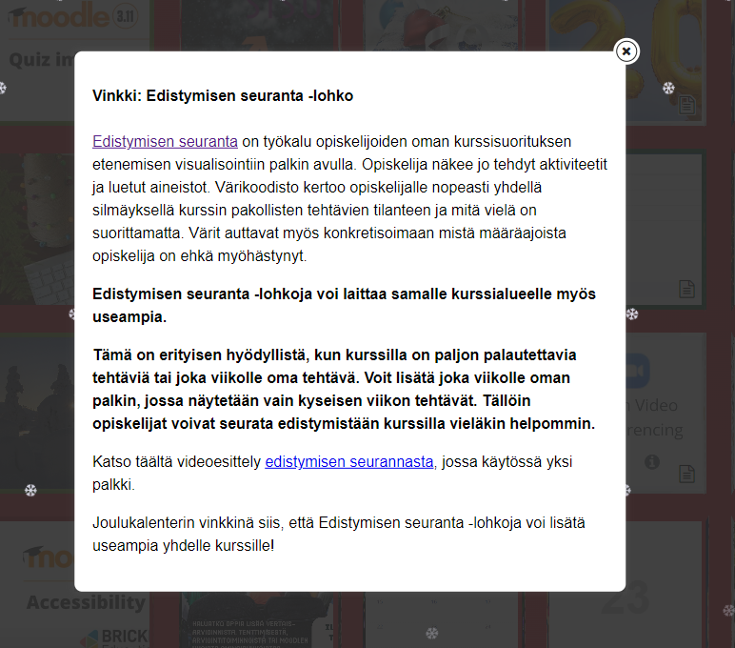
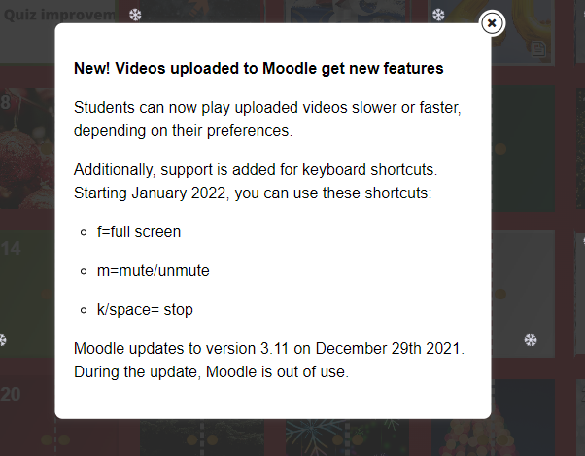
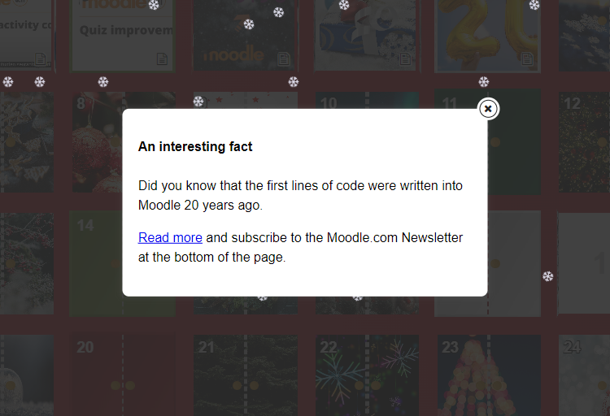

Slide 4
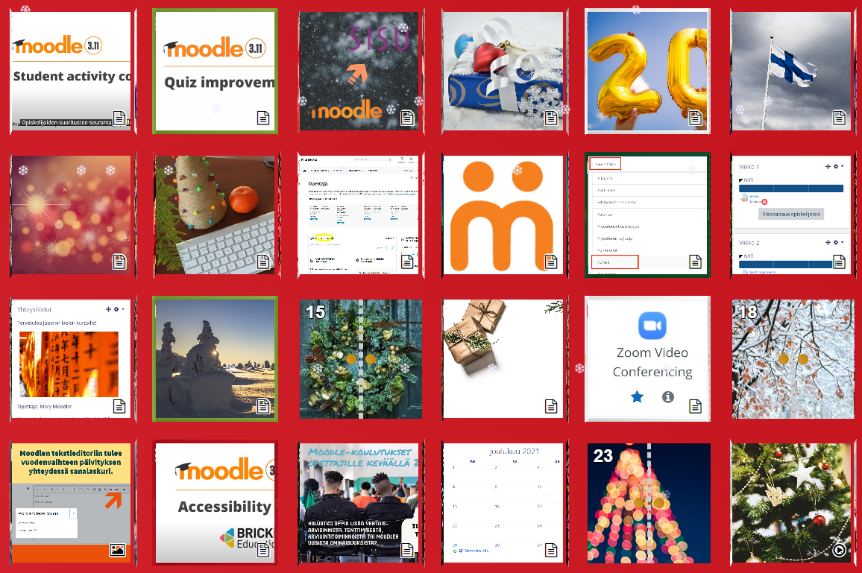
Some statistics
15 Moodle training sessions in 2021
~300 attendees total
~20 on average per session
532 teachers visited the calendar
Notes:
XX teachers at Uni (jos löydetään)

Slide 5
Some statistics
Nr. of visits
Notes:
tähän: isommalla tekstit

Slide 6
FEEDBACK FROM TEACHERS
COMMENTS FROM TEACHERS
Tidbits of information – easier to digest and look through
Activating way for teachers to learn about Moodle
”Accidental learning”: learning new things without having even known to look for them
→ better user experience
IDEAS FOR NEXT CALENDAR
Content ideas:
FAQ
New ways of using familiar activities
Do the calendar again, even if it means less doors (eg. nothing on weekends)
Tips once a day/week during the
academic year?
OTHER COMMENTS
Boosts Holiday spirit!
Pandemic has restricted informal interaction → enhances sence of community
AVOID Long texts and information overload
→ Loss of interest

Slide 7
Where to next?
Calendar returns in 2022!
Biweekly short presentations in our online Digipedacafé
First two presentations tripled the number of participating teachers
Boosted the Holiday spirit within our team, too!

