Slide 1
elearning.auth - The case of the largest university in Greece
C.Papazoglou, D. Charidimou, G. Roussos, A. Agorogianni
IT Center, Aristotle University of Thessaloniki

Slide 2
elearning.auth - The case of the largest university in Greece: Integrating external tools to assist the community and facilitate international synergies

Slide 3
Presentation outline
The University
The Challenges
The Changes
The Outcome
The Future

Slide 4
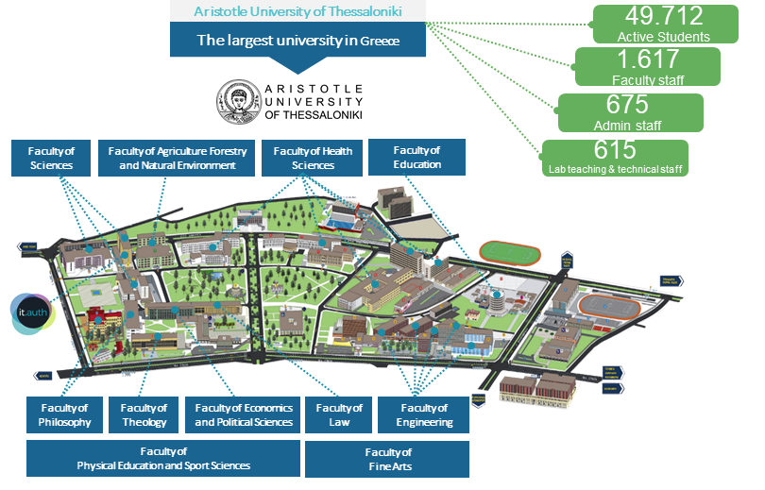
The University 1/2

Slide 5
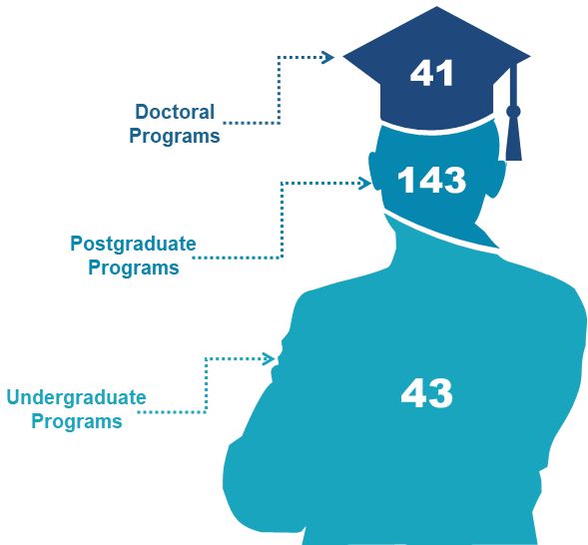
The University 2/2

Slide 6
The Challenges
Size of community and curriculum
Diversity of fields of study (different learning needs and teaching tools)
Digital skills level variance
The COVID-19 pandemic

Slide 7
The COVID-19 pandemic

Slide 8
The immediate changes
Abrupt shift to online classes (exclusively)
Online exams
The new challenges
Availability
Performance
Security & privacy issues
Procedures/Governance bodies
Usability

Slide 9
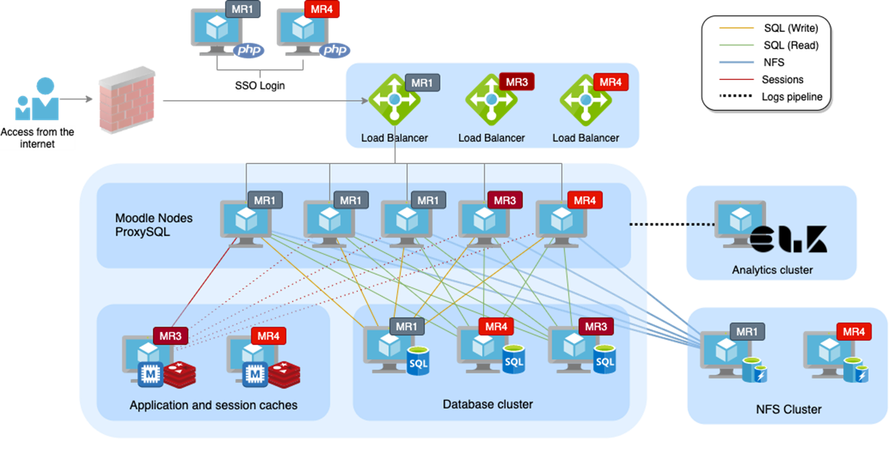
How we dealt with the challenges
Zoom integration
Content upgrades (e.g., MathType)
Moodle plugins (e.g., Safe Exam Browser, Block concurrent sessions
Server clustering
Enhancements to user support team
Exam Board/Online exams terms and conditions

Slide 10
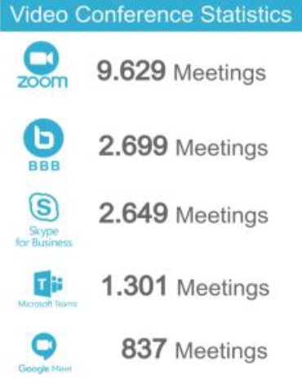
Zoom Integration
Zoom meetings dashboard configured as external tool via LTI
The university uses SSO via SAML for authentication
Zoom update for LTI pro for data privacy
Institutional e-mails are not displayed or propagated outside
Zoom by far the most popular video conferencing tool

Slide 11
The immediate outcomes
The academic community and the IT center rose to the challenge
Covid-19 pandemic accelerator for Digital skills improvement
The new server infrastructure greatly improved availability and user experience
Positive user feedback + Trust in digital tools ↑

Slide 12
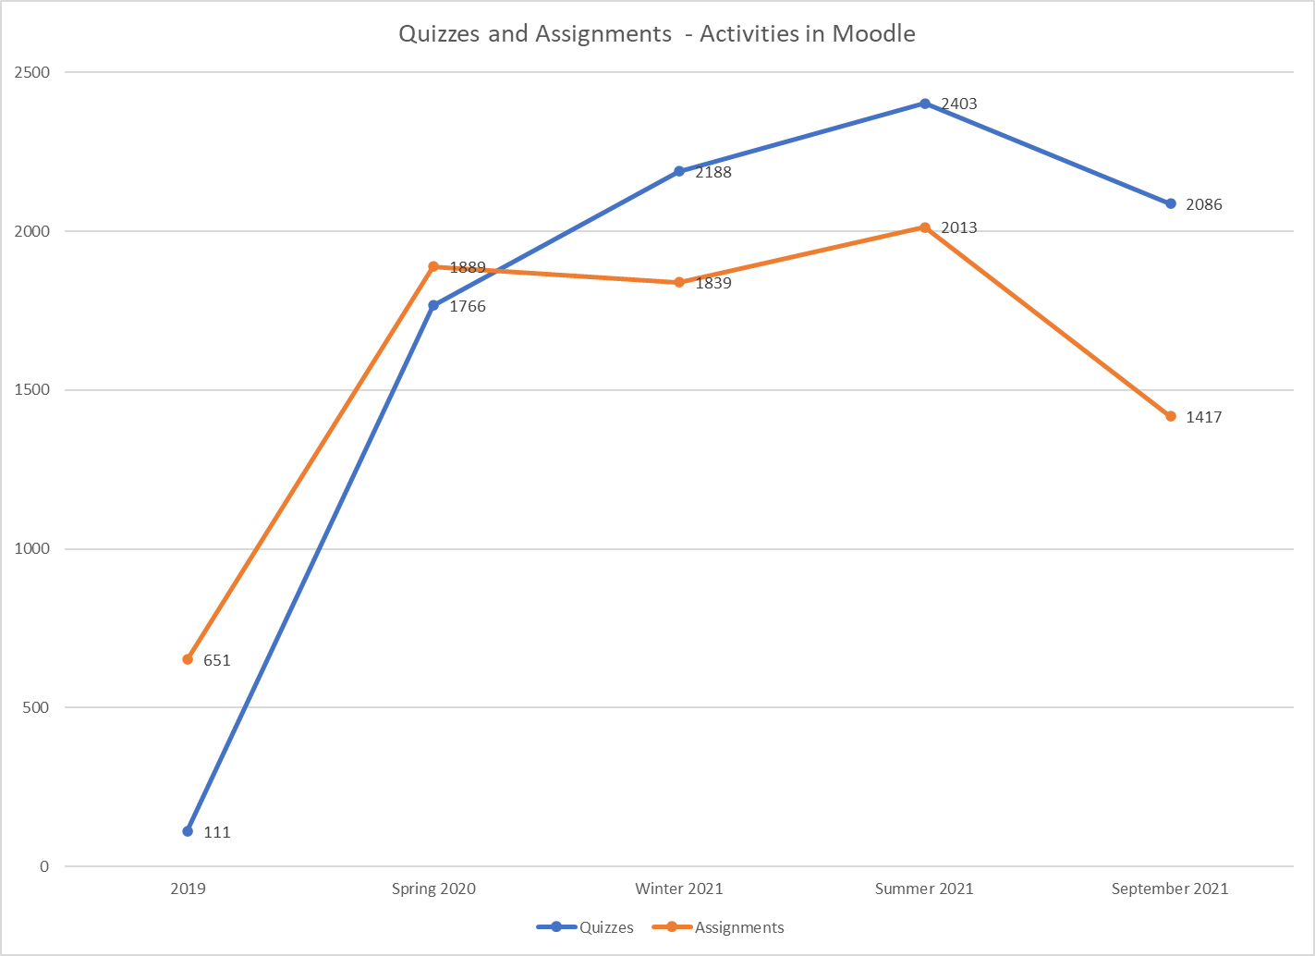

Slide 13
Other integrations

Slide 14
The Campus Management System
Student Information System – SIS
Developed in-house – Open-source solution (https://universis.gr/)
Web interfaces for School Registration Offices – Faculty – Students
Current level of integration with the LMS: automation of student enrollments/ unenrollments in courses in accordance with instructor settings
Development team working on compliance with OneRoster

Slide 15
International Synergies – Epicur
EPICUR Campus: inter university digital ecosystem
Two main modules: the Virtual Campus Learning Platform (VCLP), and the Virtual University Registrar System (VURS)
VCLP plays the role of a decentralized Learning Management System (based on ILIAS LMS)
VURS is the EPICUR centralized Campus Management System – developed in AUTh
Specific courses designated to be available to international students using their home country institutional accounts in foreign country LMS (Moodle-ILIAS interconnection using the CampusConnect plugin)

Slide 16
Post pandemic & the future

Slide 17
The changes
Major positive shift in attitudes towards online learning
Legacy in digital content (teaching and exams material)
Legal issues no longer seen as insurmountable
Exams via the LMS using university computer labs or dedicated school equipment
Restrictions on exam activities/ locations to comply with legal requirements and minimize cheating

Slide 18
Future goals in integrations
Use LTI for in-house developed code
Two-way integration with the CMS at a lower level
SIS → LMS: courses lifecycle management
SIS → LMS: improve current solution for student enrollments
LMS → SIS: update grades

Slide 19
Future goals for our LMS
Updates streamlining
Upgrade to Moodle 4
Better accommodate the needs of University Lifelong learning programs
Different timetables
Attendees have different access rights
Lack of institutional accounts for SSO

Slide 20
Thank you for your attention!

Slide 21
Closing slide
Chrysa Papazoglou
moodle@it.auth.gr, chrispa@it.auth.gr

