Slide 1
DIGITAL HEALTH SOLUTIONS
Using Moodle to empower maternal and newborn healthcare professionals in Ethiopia with blended learning programs during COVID-19
Daphne Elberse
Project Manager

Slide 2
ABOUT HEALTH[E]FOUNDATION
Since 2003, Health[e]Foundation:
Provides digital knowledge & education for healthcare professionals and community workers, and;
Shares information using digital tools with communities
to promote informed decision making and healthy self management at large scale in resource-limited settings.
20,000
HEALTHCARE
WORKERS TRAINED
34
COUNTRIES
100,000
COMMUNITY MEMBERS
REACHED
Notes:
With digital health solutions strive to educate and inform healthcare professionals and communities about topics such as maternal and child health, sexual and reproductive health and rights (SRHR) to strengthen healthcare systems and empower communities globally.
20+ year track record in digital health solutions
Strong network and presence in sub-Saharan Africa
Active in Ethiopia since 2013

Slide 3
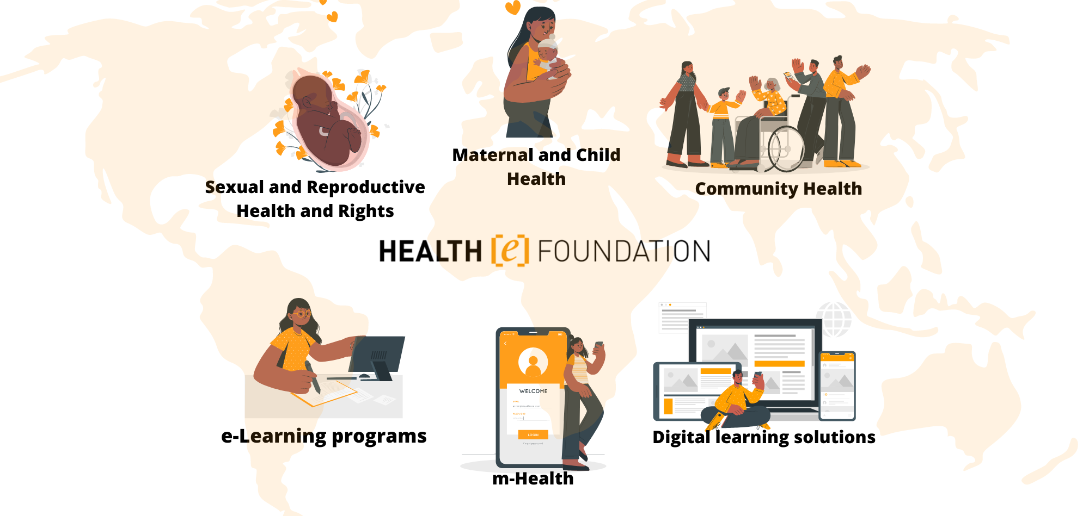
FOCUS AREAS
Notes:
Started out with one course, HIV[e]Education, broadened our scope with offering m-Health and digital learning solutions as well and expanding our thematic areas to SRHR, MCH and CH.

Slide 4
CUSTOM E-LEARNING PROGRAMS
Moodle open-source LMS
m-Health
Information provision for communities via app technology, SMS, and voice messages
Closed-source LMS is phased out
2023 & beyond
2023 & beyond
2022
2022
Locally-owned digital solutions
2020
2019
Capacity strengthening of local partners to own and maintain digital solutions on the open-source Moodle LMS
2016
2014
Digital learning solutions
2003
2003
(Blended) e-learning with a homemade / closed-source LMS and open-source LMS, co-owned digital learning solutions with partners
e-Health
Blended e-learning for healthcare workers and community health workers with a tailor-made LMS
Notes:
Start of Health[e]Foundation, history, and change of scenery. Recent developments related to COVID-19 and sustainability, resulting in minimum requirements for choosing a new LMS. Future perspective: locally-owned digital solutions.

Slide 5
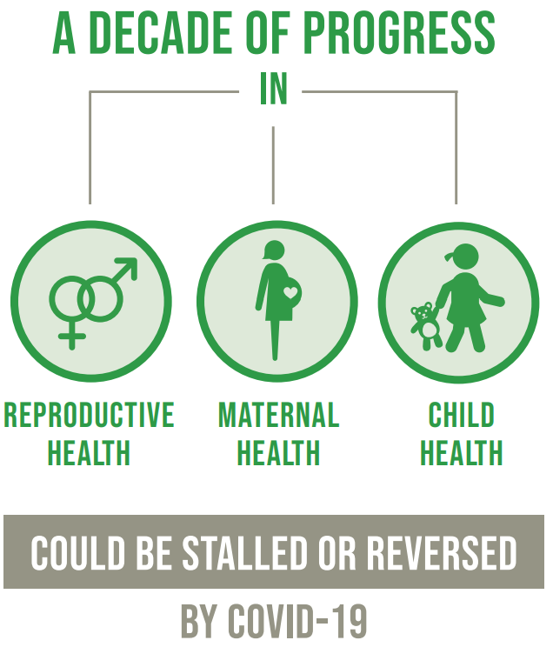
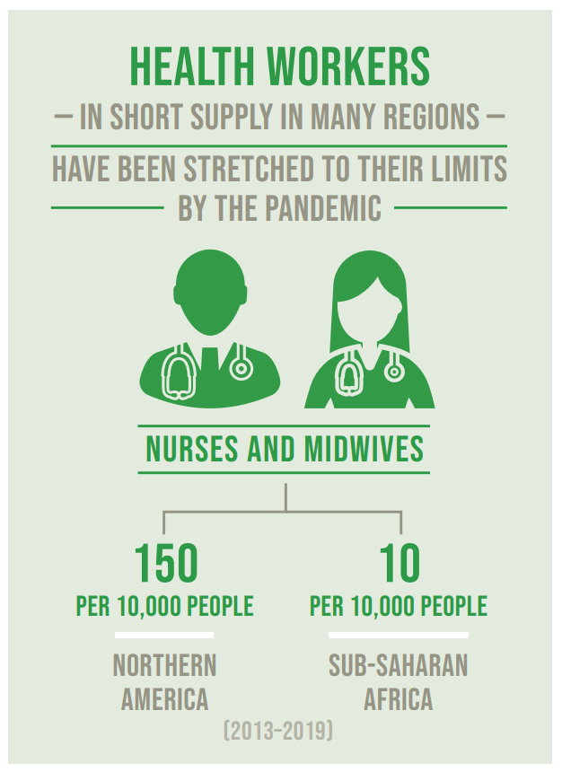
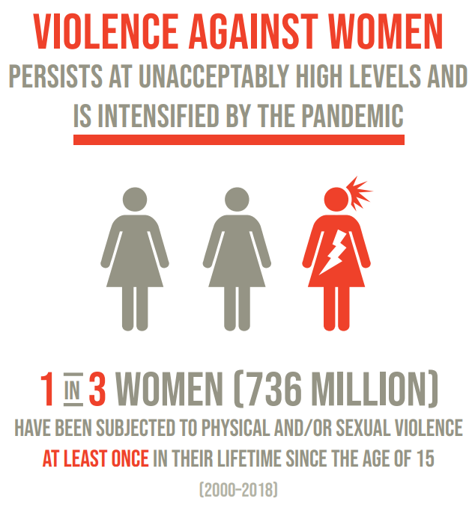
THE PANDEMIC’S INFLUENCE ON SDG 3 & 5
Source: The Sustainable Development Goals Report 2021
Notes:
COVID-19 has negatively influenced progress towards realizing SDG 3 ‘Good health and well-being’ and SDG 5 ‘Gender Equality’
Consequences for:
Reproductive health, maternal health, and child health
Availability of health workers, including nurses and midwives
Gender based violence and domestic violence

Slide 6
CONTEXT ETHIOPIA
SDG | Ethiopia | Target
MMR | 401 (2017) | 70 (2030)
NMR | 27 (2020) | 12 (2030)
There is an urgent need to strengthen health services and expand on training opportunities for health professionals.
That is why we have developed the SRHR[e]Education and Pandemic[e]Response courses for (future) midwives in Ethiopia.
Notes:
Also, or even particularly, the case for Ethiopia, where SDG targets related to reproductive, maternal, and child health are dangerously exceeded, and midwives have been stretched to their limits both because over the COVID-19 pandemic as well as due to the humanitarian conflict.
This points to a dire need to strengthen health services and training opportunities for health professionals, hereby acknowledging the great potential of digital health solutions.

Slide 7
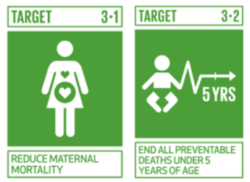
SRHR[E]EDUCATION & PANDEMIC[E]RESPONSE
Blended learning programs (2020 – 2022) for 539 (future) midwives in Ethiopia
Strengthen knowledge and skills to safely perform core tasks during the pandemic
Notes:
The SRHR[e]Education and Pandemic[e]Response courses were developed and contextualized to the Ethiopian context. They include topics of COVID-19 and maternal health, gender equality, gender-based violence, respectful maternity care, post-abortion care, family planning, sexually transmitted infections, postpartum hemorrhage, hypertensive disorders, cervical cancer, essential newborn care and SRH in humanitarian crises.

Slide 8
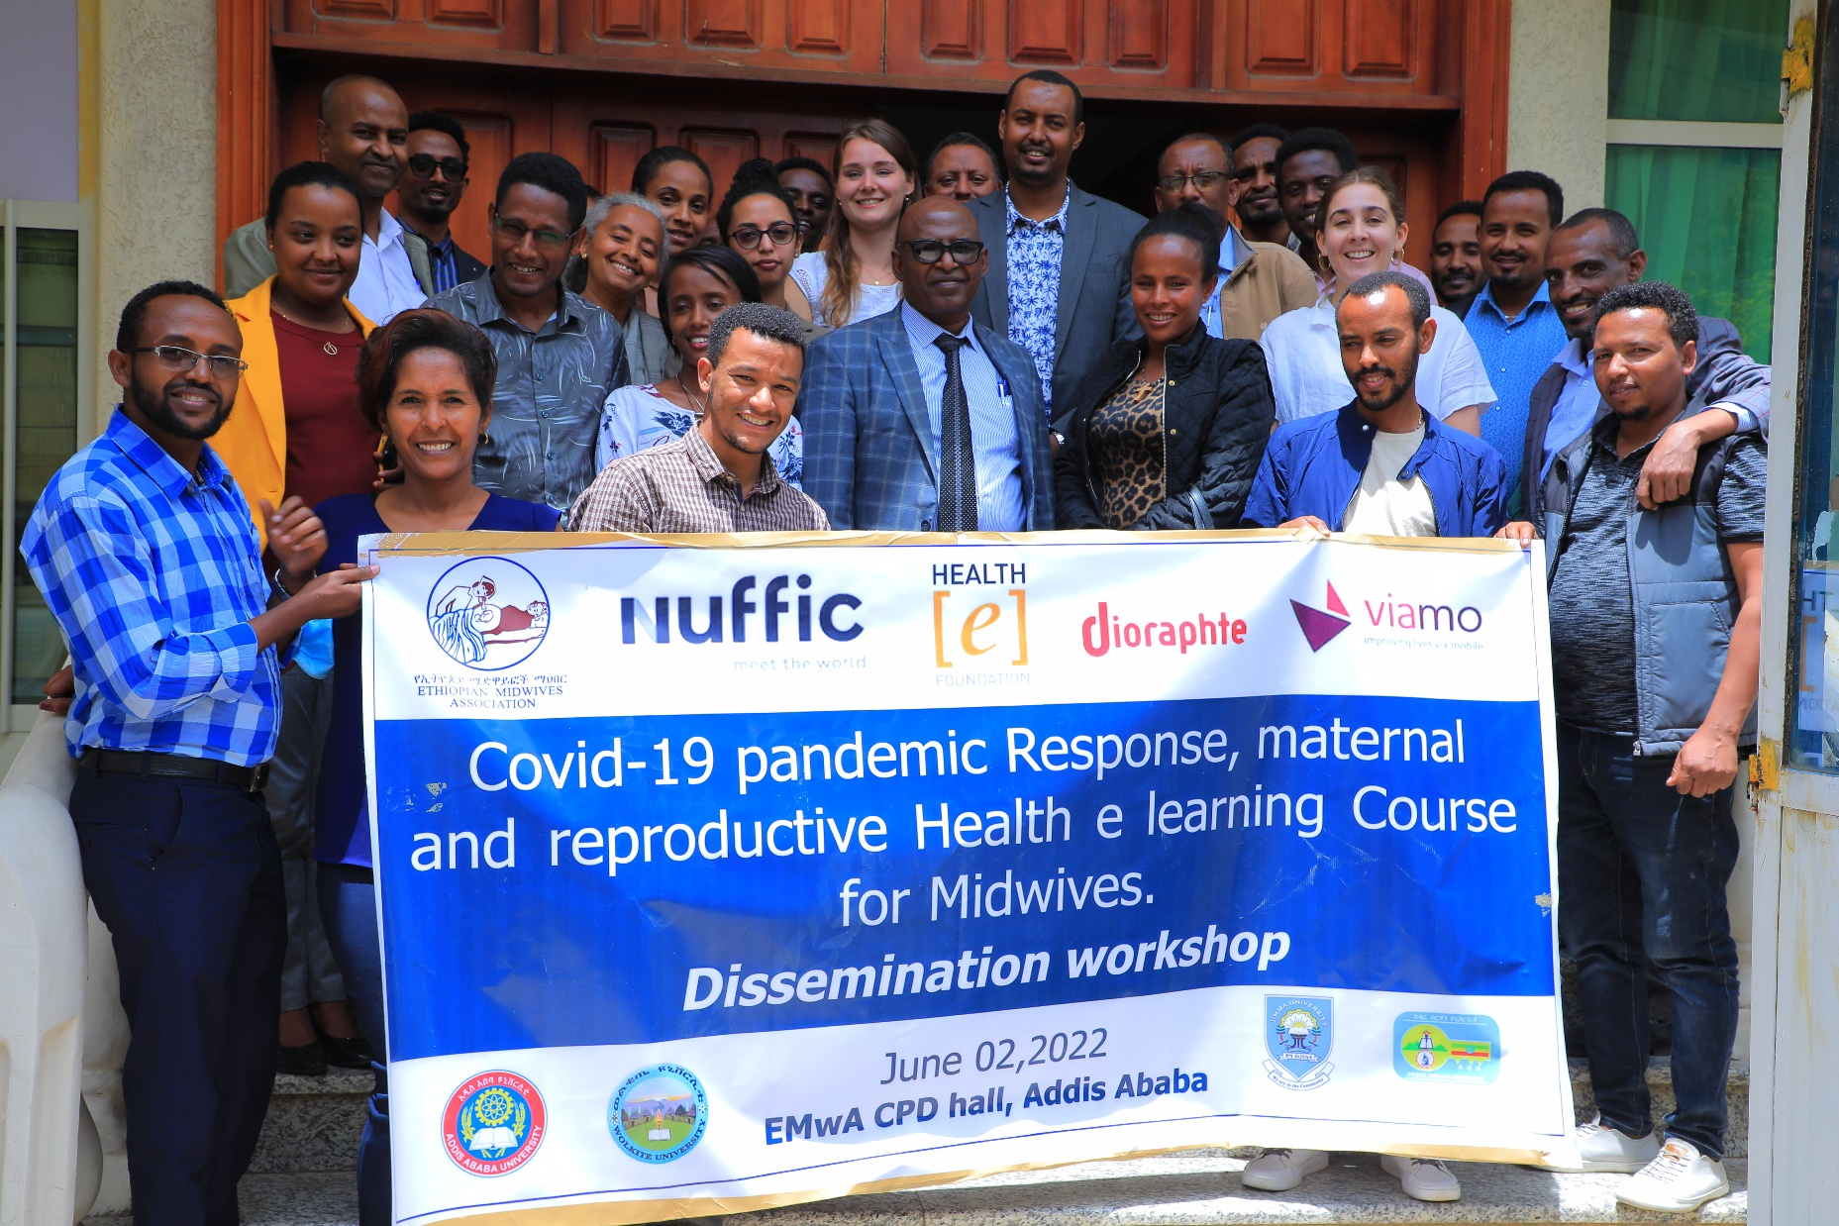
MEET OUR PARTNERS
Notes:
Introduce our partners, because a successful program is always implemented in partnership with passionate and knowledgeable national and international partners who share our mission and goals. The training was delivered via EMwA to the four collaborating Universities in Addis Ababa, Jimma, Debre Birhan and Wolkite. To develop the Pandemic[e]Response course, as well as our TENA interactive voice response service, we have collaborated with EMwA and Viamo, with financial support from Nuffic and Diorapthe.

Slide 9
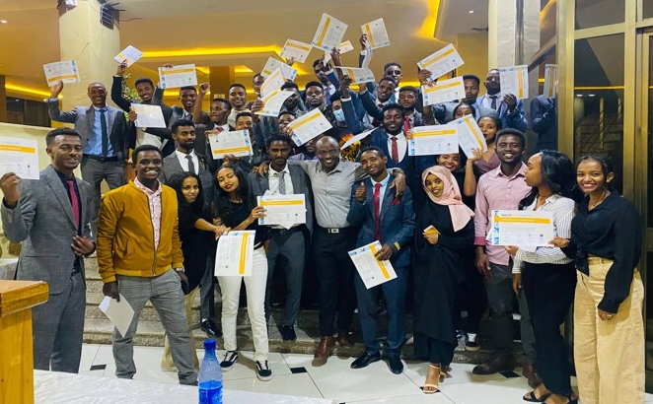
MEET OUR LEARNERS
Notes:
Introduce our learners. (future) Midwives in Ethiopia, who are motivated to update their knowledge and skills to provide quality information and care to their clients.

Slide 10
OUR E-LEARNING PRODUCT
Simple and straightforward design
Multi-device compatibility
M&E based on pre- and post tests
Interactive distance-based learning
Offline functionality
Open-access & SCORM compliant
Notes:
Selection of our authoring tool and LMS:
SCORM-compliant: content can be created one time and used in many different systems without modification.
Interactive content: content can be designed with the use of interactive elements allowing a didactical sound and engaging learning experience.
Multi-device responsive: content is automatically adjusted for various screen sizes (mobile, tablet, desktop).
Offline access: content is available both on- and offline via a web browser, desktop app, or mobile app.

Slide 11
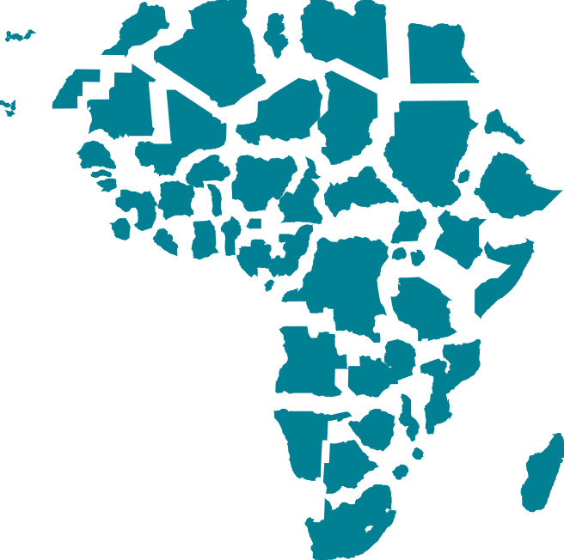
BENEFITS OF BLENDED LEARNING
Up-to-date country-specific health education in line with (inter)national guidelines
Learning anytime, anywhere, outside office hours without the need to leave clinics unattended
Available on smartphones, tablets, laptops, and desktops with offline functionality
Keeping midwives motivated to learn new knowledge and skills, put these into practice and belong to a group of learners
Gathering learning data for continuous monitoring, improvement, and results & impact measurements
Simple straightforward design
Notes:
What do we mean with a blended learning format? Why did we choose for a blended learning format?
Our learners are passionate healthcare professionals in resource-restricted settings, who are motivated to strengthen their knowledge and skills while facing the following challenges:
Limited time available during office hours
Poor internet connection
Basic proficiency in English
Limited digital literacy
Desire to stay motivated, belong to a group of learners, and put new knowledge and skills into practice
To respond to their needs we apply blended learning (see benefits slide). Personal contact is key to effective distance-based learning. The LMS should be easy and accessible.

Slide 12
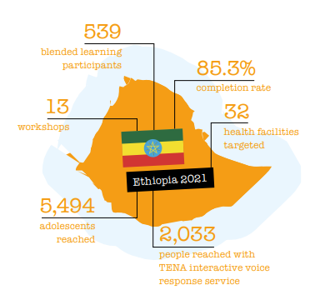
RESULTS
Survey results (n=391):
Most users access the e-course via their smartphone (73%)
Most users prefer the blended learning format compared to e-learning only or traditional classroom education (79%)
Nearly all participants (96%) apply their acquired knowledge and skills in practice

Slide 13
EVALUATION
Strengths
Smartphone access
Smooth UX journey
Interactivity
Blended learning format
Effective (digital literacy) skills transfer
Inclusive design
Weaknesses
Offline functionality
Online monitoring and evaluation
Course size
Device requirements
Online media, surveys, and forms
Notes:
Survey results (n=391) showed most users accessed the e-course via their smartphone (73%) with high appreciation for the Moodle platform, highlighting its smooth UX journey and level of interactivity, as well as the added value of the blended learning format (79%), increasing engagement and motivation to pursue learning, and foremost increase in skills crucial for performing midwifery profession. The blended model ensured digital literacy skills transfer, enhancing inclusiveness of our learning environment.
On the other hand, the Pandemic[e]Response program demonstrated that reaching out to communities and professionals in remote areas poses challenges in accessing the platform despite offering the learning content online and offline via a web browser and a mobile application. This relates to the balancing act between offline functionality for users and online monitoring of participants’ progress for e-learning providers as well as the trade-off between creating an interactive and attractive learning environment and limitations related to course size, device requirements, and internet connectivity.

Slide 14
OUR LEARNING CURVE
Features and functionalities are strongly interrelated
Solving one challenge might create another one
Effective learning is not a one-size-fits-all approach: tailored design based on the needs of each target audience is required
Notes:
Examples: interactive and engaging design with videos has consequences for offline functionality due to YouTube or SCORM size with actual videos,
M&E interacts with offline functionality when you place restrictions and people need to connect with internet to confirm that they completed tests in order to continue.

Slide 15
CONCLUSION
To ensure inclusive quality education, one should stay away from “one-size fits all” solutions and continuously improve on the user journey, finding alternative e-learning formats to respond to the specific needs of your target population.

Slide 16
PARTNERING FOR POSITIVE IMPACT
Health[e]Foundation has longstanding expertise in building and implementing digital learning solutions. We offer services for curriculum development, e-conversion, implementation, and evaluation of learning solutions.
Let's partner and contribute to realizing the SDGs.
Daphne Elberse
daphne@healthefoundation.eu www.healthefoundation.eu

