Slide 1
Developing a gamification subsystem for Moodle 4.0
Salvador Banderas Rovira
Head of Educational Technology and Translation at FUNIBER

Slide 2
Gamification – Why now?
A rising need to boost teacher and learner engagement apropos the learning process, but also towards the (digital) environment where it takes place
Image by pikisuperstar on Freepik

Slide 3
Existing plugins
Level Up XP (block_xp)
Frédéric Massart
https://moodle.org/plugins/block_xp
Stash (block_stash)
Adrian Greeve, Frédéric Massart
https://moodle.org/plugins/block_xp
Game (mod_game)
Vasilis Daloukas
https://moodle.org/plugins/mod_game
Motrain (local_mootivated)
Frédéric Massart, Jeff Campbell
https://moodle.org/plugins/local_mootivated
Block Game (block_game)
José Wilson da Costa
https://moodle.org/plugins/block_game
Quizventure (mod_quizgame)
John Okely, Stephen Bourget
https://moodle.org/plugins/mod_quizgame

Slide 4
Core components
Badges
H5P
Core gamification subsystem

Slide 5
keep it simple
Notes:
Headline, image and dot points slide

Slide 6
The basics
What?
Obtaining points
Where?
Within an active game instance
When?
Carrying out certain actions, etc.
Who?
Users with certain capabilities
Why?
That’s up to the interested users

Slide 7
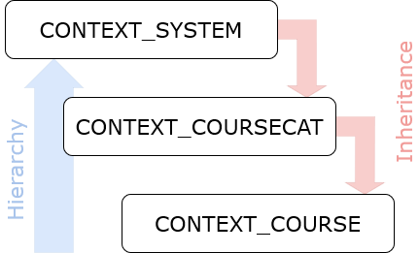
The game instance
Defined at context level
Bottom-up hierarchy
Inheritance
Points obtained by users are linked to the game instance that is active in the context where they are given

Slide 8
Notes:
Headline, image and dot points slide

Slide 9
game() and game_manager() classes
The game_manager() class is a Singleton that handles construction, destruction and management of the game instances
The game() class contains the methods (API) and the properties for the current game instance. Methods include but are not limited:
Get user points
Add points to a user
Substract points from a user
Reset game for a user

Slide 10
Global settings – settings.php
Enable gamification for the site
Enable the global game instance for CONTEXT_SYSTEM
Set defaults for local settings (completion points, event points, etc.)
$settings = new admin_settingpage(
'local_game',
new lang_string('pluginname', 'local_game'));
$ADMIN->add('localplugins', $settings);
$settings->add(new admin_setting_heading(
'local_game/general',
new lang_string('settings:general', 'local_game'),
null
));
$settings->add(new admin_setting_configcheckbox(
'local_game/enable',
new lang_string('settings:enable', 'local_game'),
new lang_string('settings:enable_desc', 'local_game'),
1
));
$settings->add(new admin_setting_configcheckbox(
'local_game/enableglobalinstance',
new lang_string('settings:enableglobalinstance', 'local_game'),
new lang_string('settings:enableglobalinstance_desc', 'local_game'),
0
));

Slide 11
Local settings (1)
User with the right capabilities should be able to manage the game instance in each context:
Site administration or site course settings (CONTEXT_SYSTEM)
Course categories (CONTEXT_COURSECAT)
Courses (CONTEXT_COURSE)
However, there are no hooks to extend the form standard modules – as opposed to coursemodule_standard_elements(). Options:
Modify edit_form.php and class editcategory_form.php directly
Develop the course_standard_elements() and coursecategory_standard_elements() hooks
Implement the Custom Field API

Slide 12
Local settings (2)
Created an static settings page (instance.php) and extended settings navigation to include it only if there’s an active game instance in the context
Settings include the management of local values (event points and frequency, completion points, etc.) and allows enabling or disabling the instance:
Disable
Inherit from parent context
Enabled
function local_game_extend_settings_navigation($settingsnav, $context) {
global $CFG;
if (($context->contextlevel === 50) &&
has_capability('local/game:manage', $context)) {
$url = new moodle_url($CFG->wwwroot . '/local/game/instance.php',
['contextid' => $context->id]);
if (!$coursesettingsnode = $settingsnav->find('courseadmin', null)) {
return false;
}
$node = $coursesettingsnode->create(
new lang_string('pluginname', 'local_game'),
$url,
navigation_node::NODETYPE_LEAF,
null,
'game',
new pix_icon('i/pad', 'game'));
$coursesettingsnode->add_node($node, 'coursereports');
}
}

Slide 13
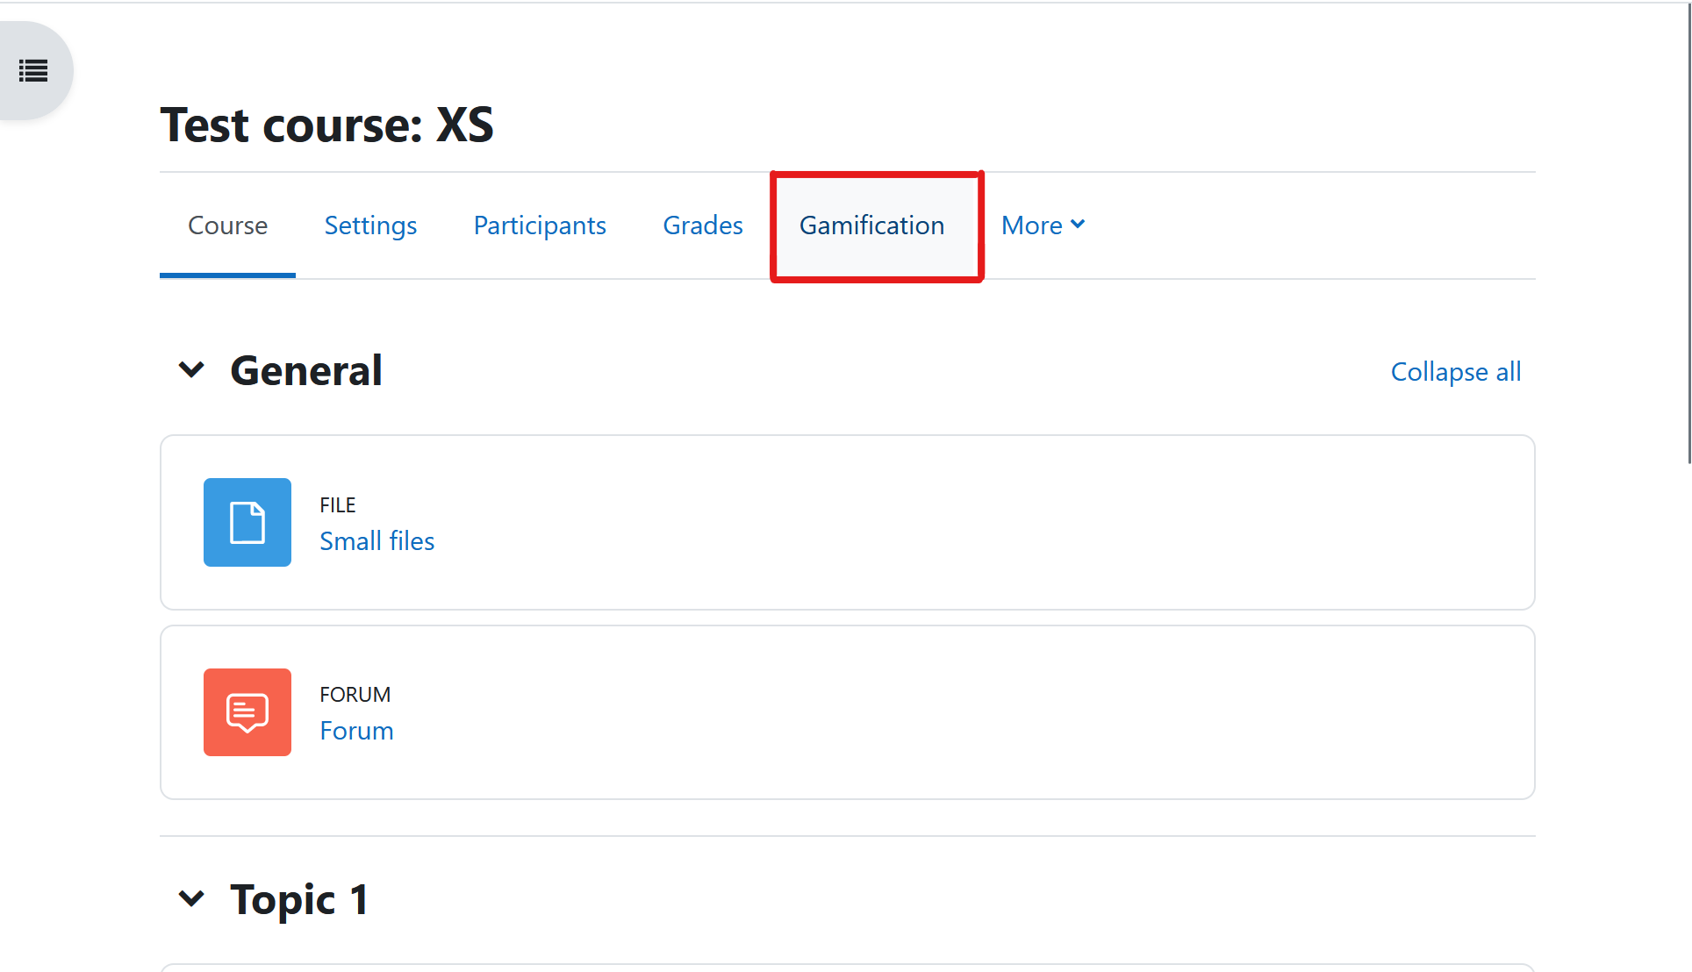
Notes:
Headline, image and dot points slide

Slide 14
Capabilities – db/access.php
Manage game instances (local/game:manage)
Participate and earn points (local/game:play)
View other user points (local/game:viewuserpoints)
Add points to user (local/game:adduserpoints)
Remove points from user (local/game:removeuserpoints)
$capabilities = [
'local/game:manage' => [
'riskbitmask' => RISK_DATALOSS,
'captype' => 'write',
'contextlevel' => CONTEXT_SYSTEM,
'archetypes' => [
'manager' => CAP_ALLOW,
'coursecreator' => CAP_ALLOW,
'editingteacher' => CAP_ALLOW
],
],
'local/game:play' => [
'captype' => 'write',
'contextlevel' => CONTEXT_SYSTEM,
'archetypes' => [
'student' => CAP_ALLOW
],
],
[...]

Slide 15
Obtaining points
A user may obtain points when:
An action is carried out within the platform
An activity or a course has been completed
Another user awards them
An action is carried out in an external application or service

Slide 16
Actions – Events
The event_manager() Singleton class handles event filtering for observers and tracking.
Inspired by Adrian’s Greeve report_event_list_generator::get_all_events_list() method.
Only LEVEL_PARTICIPATING and LEVEL_TEACHING events.
Excluded events related to completion since they are used separately by a different process.
$events = core_component::get_component_classes_in_namespace(null, 'event');
foreach (array_keys($events) as $eventname) {
if (is_a($eventname, \core\event\base::class, true)
&& !in_array($eventname, $ignoreevents)) {
$reflectionClass = new ReflectionClass($eventname);
if (!$reflectionClass->isAbstract()) {
$eventfullname = "\\${eventname}";
$event = (object) $eventfullname::get_static_info();
if (!empty($edulevel)
and !in_array($event->edulevel, $edulevel)) {
continue;
}
$event->fullname = $eventfullname::get_name();
$stringmanager = get_string_manager();
$event->componentfullname = $event->component;
if ($stringmanager->string_exists('pluginname', $event->component)) {
$event->componentfullname = get_string('pluginname', $event->component);
}
$eventlist[$eventname] = $event;
}
}
}

Slide 17
Actions – Event observers
Loop through all events returned by event_manager() and pass them to the local_game_observer::tracked_events callback.
Avoided use of ‘*’ to reduce impact on performance.
BEWARE: Event observers are cached. Luckily, if other components want to add new observers, they must bump up the version number.
$trackedevents = \local_game\event_manager::get_game_event_list();
foreach ($trackedevents as $eventname => $event) {
$observers[] = [
'eventname' => $eventname,
'callback' => 'local_game_observer::tracked_events',
];
}

Slide 18
Actions – Tracked events (1)
Tracked events are handled by the local_game_observer::tracked_events callback.
They are defined in each game instance by users with the local/game:manage capability.
To prevent abuse, a maximum excution frequency can be defined when tracking events.
public static function tracked_events($event) { $data = json_decode(json_encode($event->get_data()));
$user = \core_user::get_user($data->userid);
$context = \context::instance_by_id($data->contextid);
if (!has_capability('local/game:play', $context, $user)) {
return false;
} $game = new \local_game\game($context);
if (!$game->init()) {
return false;
} if (!array_key_exists($data->eventname, $game->events)) {
return false;
}
$gameevent = $game->events[$data->eventname]; if (!$game->check_frequency_limit($user->id, $gameevent->eventname)) {
return false;
} $game->add_points($user->id, $gameevent->points);
$game->log($user->id, $gameevent->points, $gameevent->eventname);
return true; }

Slide 19
Actions – Tracked events (2)
When tracking an event, users need to set:
The event name
The points given to the user when the event is triggered
The maximum frequency for the event to give points:
Maximum times
Interval + Type of Interval (for instance, “per 1 day”, “per 2 months”, “only once”)
Every time points are given or substracted, the action is logged in a separate table. Frequency is checked againts them to see if the limit has been reached.
The use of the Logging API was avoided to reduce any impact on performance.

Slide 20
Completion
Users with the local/game:manage capability can set how many points an activity will give when completed.
Activity settings have been extended with the coursemodule_standard_elements() hook.
Completion is handled by the local_game_observer::course_module_completion_updated callback when the appropiate event has been triggered.
function local_game_coursemodule_standard_elements($formwrapper, $mform) {
$context = $formwrapper->get_context();
$game = new \local_game\game($context);
if ($game->init()) {
$mform->addElement('header', 'gamesection', get_string('form:heading', 'local_game'));
$mform->addElement('checkbox', 'gameenabled', get_string('form:enabled', 'local_game'));
$mform->setDefault('gameenabled', $game->is_enabled());
$mform->addElement('text', 'gamepoints', get_string('form:points', 'local_game'));
$mform->setDefault('gamepoints', $CFG->defaultcompletionpoints);
$mform->setType('gamepoints', PARAM_INT);
$mform->addHelpButton('gamepoints', 'form:points', 'local_game');
}
}

Slide 21
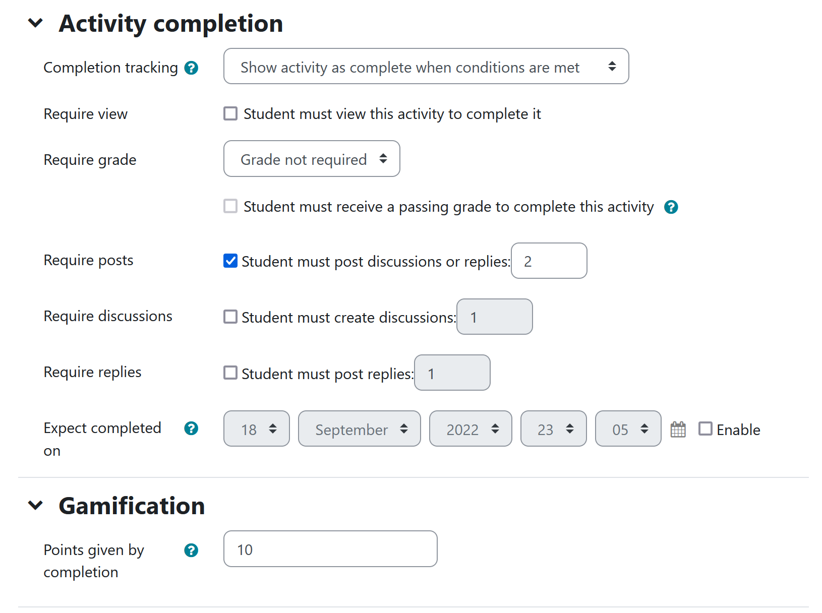
Notes:
Headline, image and dot points slide

Slide 22
Manual giveaway - Core API
As stated before, the game() class contains the methods (API) and the properties for the current game instance. Methods include:
Get user points
Add points to a user
Substract points from a user
Reset game for a user
Currently, there is no implementation for these methods.

Slide 23
External API – db/services.php
The Web Service functions available mirror the core API methods provided by the game() class, but also the ones provided by the game_manager() class regarding game instance management, creation and destruction.
When calling the add_points() method from external applications or services, the points are logged as “external” instead of being linked to an event or a user. The maximum value and frequency of external points can be configured in both the global settings and the game instance configuration.

Slide 24
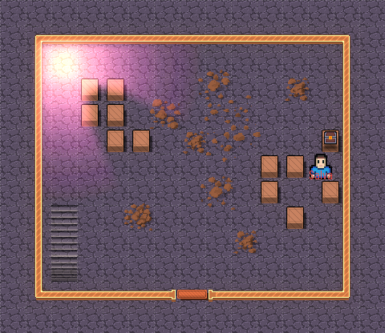
local_game_add_points()
SALVA
I found a treasure chest with 10G inside!
Notes:
Headline, image and dot points slide

Slide 25
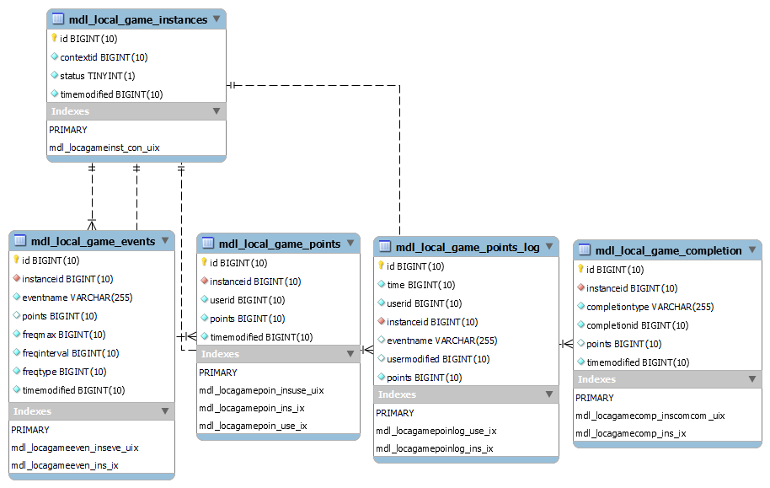
Database model – db/install.xml

Slide 26
Switching to a Core subsystem
The “game” folder needs to be at root directory.
Core subsystems (and their subplugin definition) need to be declared in lib/components.json.
Many of the callbacks, hooks and methods used previously are only available to local plugins. Instead, subsystems have more direct ways of implementing the same functionalities.
For instance, instead of creating a callback or implementing the Custom Field API to extend the course settings, the form definition may be modified directly in edit_form.php, as other core subsystems do.

Slide 27
Subplugin and plugin examples (1)
moodle-game_ladder
Providing users with a leaderboard within the game instance. Extra features include: establishing periods for the ladder to be reset, giving badges to the Top-N tier, restrict access depeding on position, etc.
moodle-game_levelup
Allowing users with the management capability to define levels and the points needed to reach each one of them. Extra features include: giving badges when reaching a certain level, restrict access, etc.
moodle-game_team
Creating teams depending on course categories, courses or groups to engage cooperatively and competitively by extending points beyond the user. In order to ensure equity, team size and composition is considered and points are given a relative value to balance big differences.
moodle-availability_game
Allowing users with the management capability to restrict access to resources and activities depending on the points of the participant user.

Slide 28
Subplugin and plugin examples (2)
moodle-aware_criteria_badge
Allowing users with the management capability to automatically give badges to participant users when reaching a certain amount of points.
moodle-atto_game + moodle-filter_game
Allowing users with the add points capability to add placeholders in textareas to give participants a certain amount of points when clicking on it.

Slide 29
Prototypes
An early version of the local_game plugin can be found at:
https://github.com/ragart/moodle-local_game
The rest of the prototypes are private for the moment. Over the next weeks, they will be available as separate repositories by the same user (ragart).
They are far from ready (and won’t anytime soon), so please don’t use them in your production settings.

Slide 30
Closing slide
Salvador Banderas Rovira
salvador.banderas@funiber.org

