Slide 1
DD
a full open source e-learning ecosystem
LMS | CONTENT | MOBILE | CONSULTING | GAMIFICATION | MEC TRAINING |
IMS-LTI INTEGRATIONS | LEARNING ANALYTICS
^{PAU PLANA i SALESAS}
3&Punt Solucions Informàtiques SL
C. de València, 359 08009 Barcelona
^{pau@tresipunt.com}

Slide 2
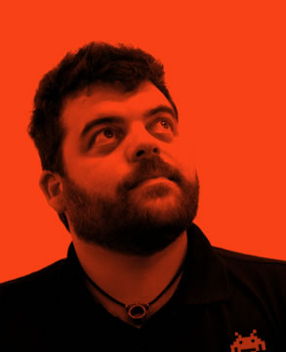
WHO AM I?
Pau Plana
CEO 3ipunt (2004)
Edutech Cluster Co-chair
@pauplana
@tresipunt
pau@tresipunt.com
moodle@tresipunt.com

Slide 3
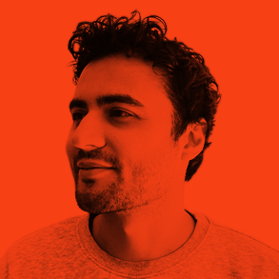
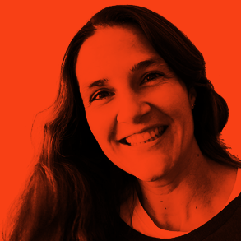
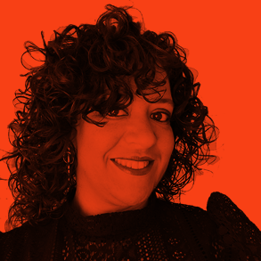
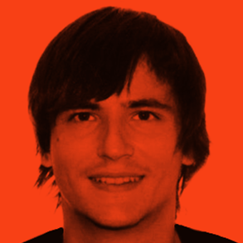
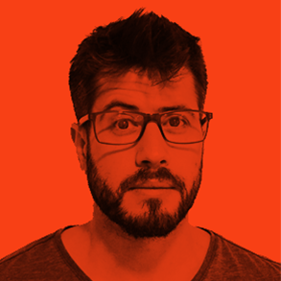
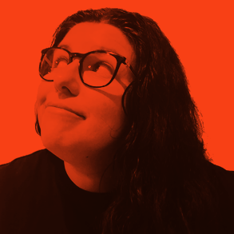
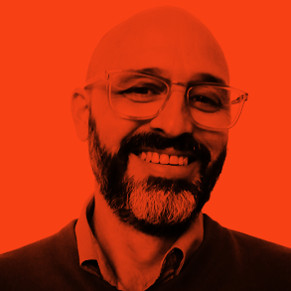
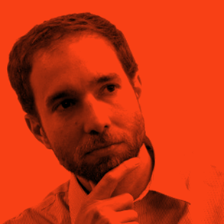
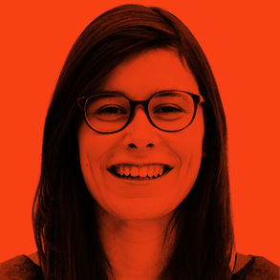
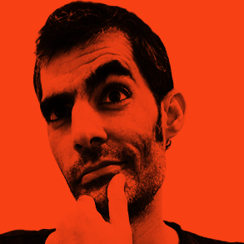
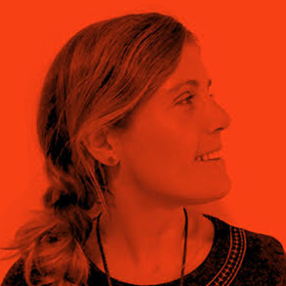
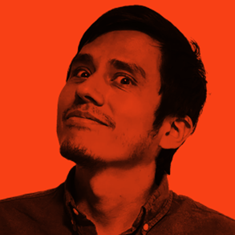
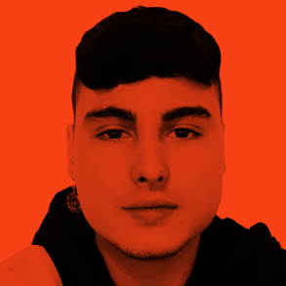
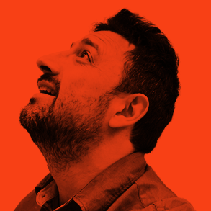
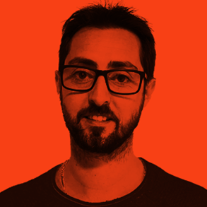
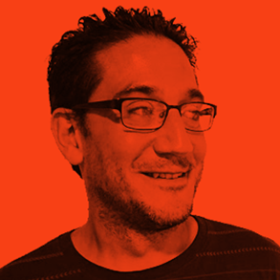
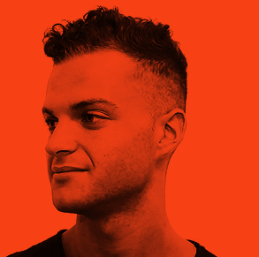
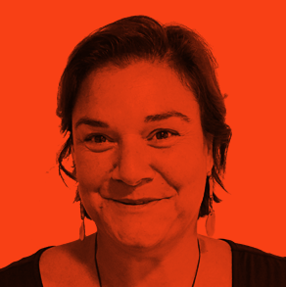
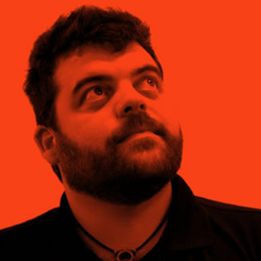
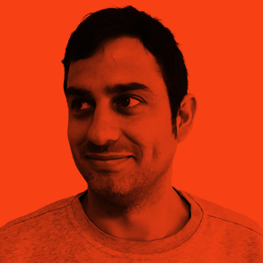
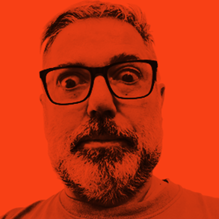
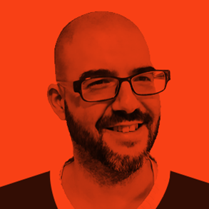
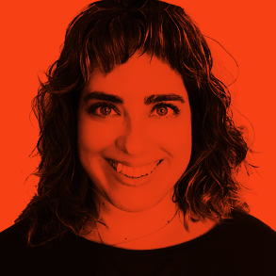
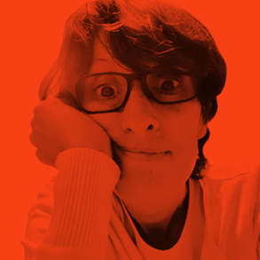
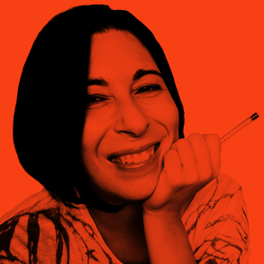
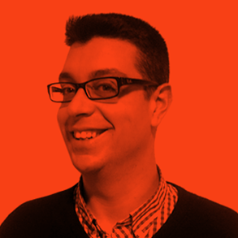
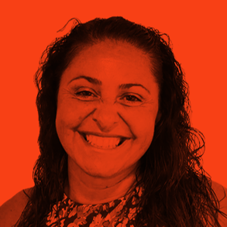
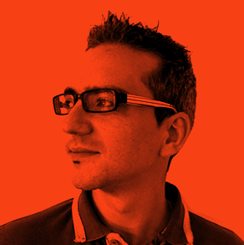
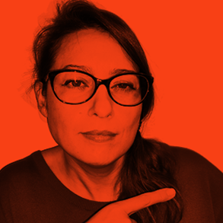
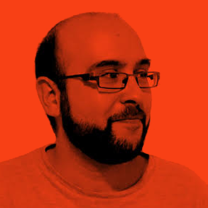
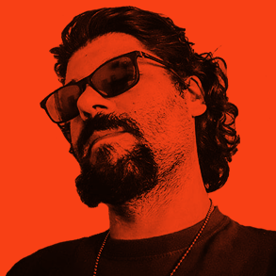
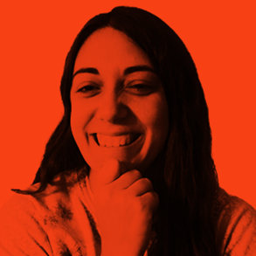
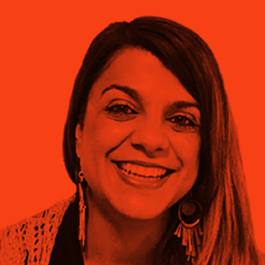
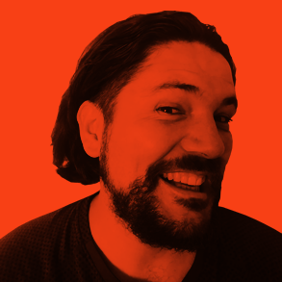
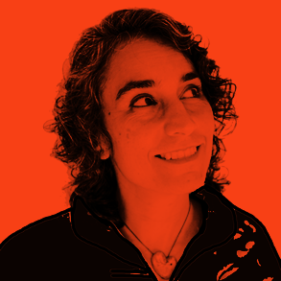
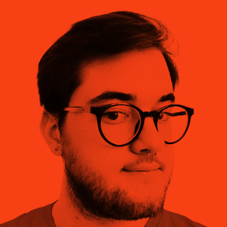
3ipunt is an official Moodle Premium Partners, members of the 1EdTech™ (Contributing Member) and AWS (Amazon Web Services) partners, as well as members of CatPL and EdutechCluster. We are focused in offering customized solutions in information and communications technology, with a high added value, a reduced cost and a close and accessible treatment.
We also identify ourselves with the concept bespoke: we like to provide a high added value to our projects, so these also provide things to us. We offer technology as a service to our customer. At 3ipunt we adapt technology to the customer needs to offer an customized integral solution for each project and scenario.
ABOUT US

Slide 4
OUR
WAY
2004
2008
2017
2022
WE START
E-LEARNING
WE ARE MEMBERS
WE CONTINUE
We are born as a technology and development company.
We entered the e-learning world with several clients with whom we are still working.
We became a Moodle Partner after more than 10 years of experience with e-learning projects.

Slide 5
AGENDA
The context of the project
What is the DD
The DEMO
ANY QUESTION?
Notes:
RRHH TIENDA
PRL
SOFTWARE DE TIENDA
ATENCIÓN CLIENTE
MARKETING
PRODUCTO
PUBLICIDAD EN TIENDA
CAMPAÑAS

Slide 6
The project CONTEXT
Notes:
RRHH TIENDA
PRL
SOFTWARE DE TIENDA
ATENCIÓN CLIENTE
MARKETING
PRODUCTO
PUBLICIDAD EN TIENDA
CAMPAÑAS

Slide 7
THE
PROBLEM
The data is the new most valuable resource in the world.
The ownership of this data is the key for the largest Tech Companies of the world. Using their products and services we are giving to them a lots of this row materia.
The coronavirus coerce all the schools in the world to close.
The Big Tech Companies took the opportunity to envy the market, even more.
All the schools had an emergency and the easy way was use the “free” software to keep the classes going.

Slide 8
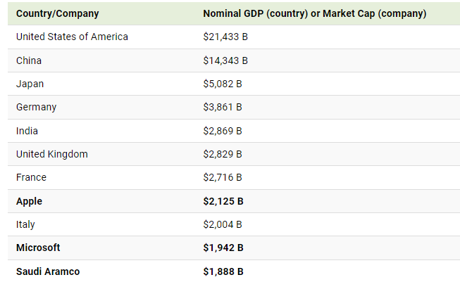
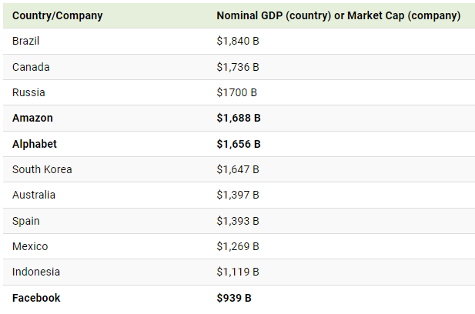
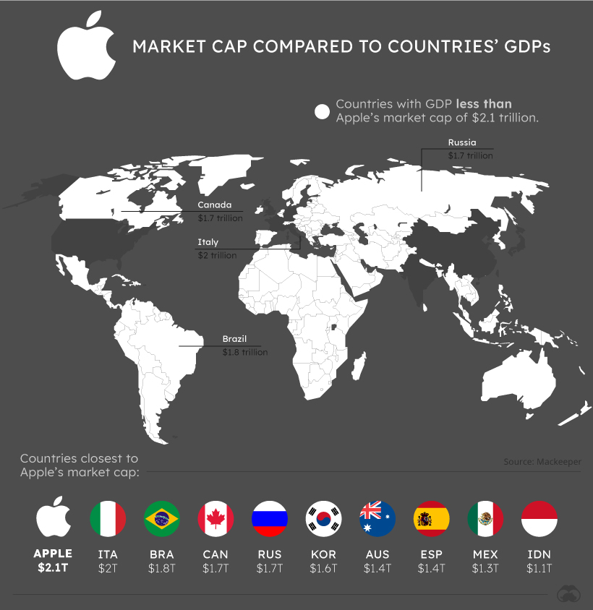
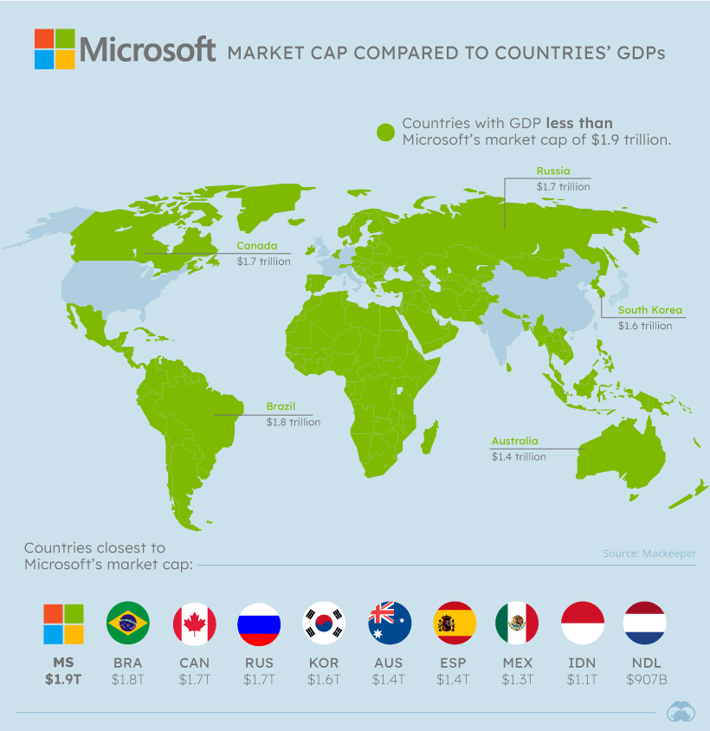
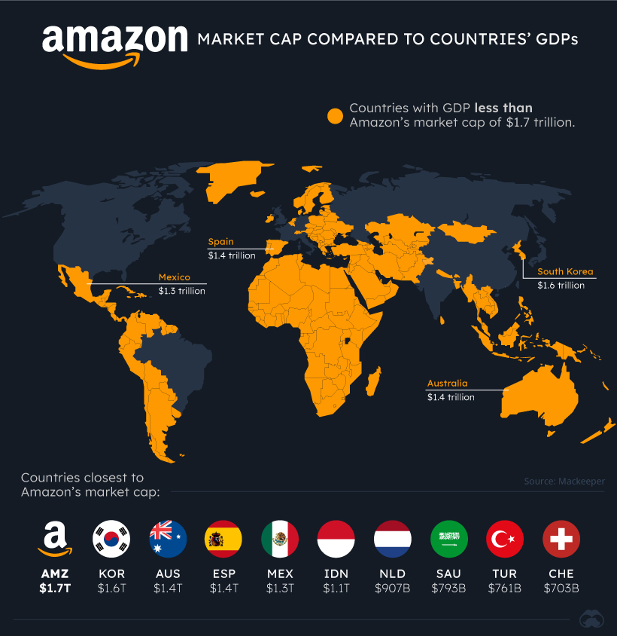
THE GLOBAL
CONTEXT

Slide 9
WHY IS A
PROBLEM
CHILDREN
DATA
The property of the data of the students is concentrated in few companies and in fact this is authorized by families and schools.
NON STOP
ADVERTISING
We are opening the doors to the penetration of advertisements in a new unexplored and week market. The children.
ACRÍTIC
EDUCATION
The school lost freedom to choose what they use to teach to their students. So the school is no longer an open an plural space for think.

Slide 10
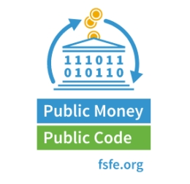
THE
SOLUTION

Slide 11
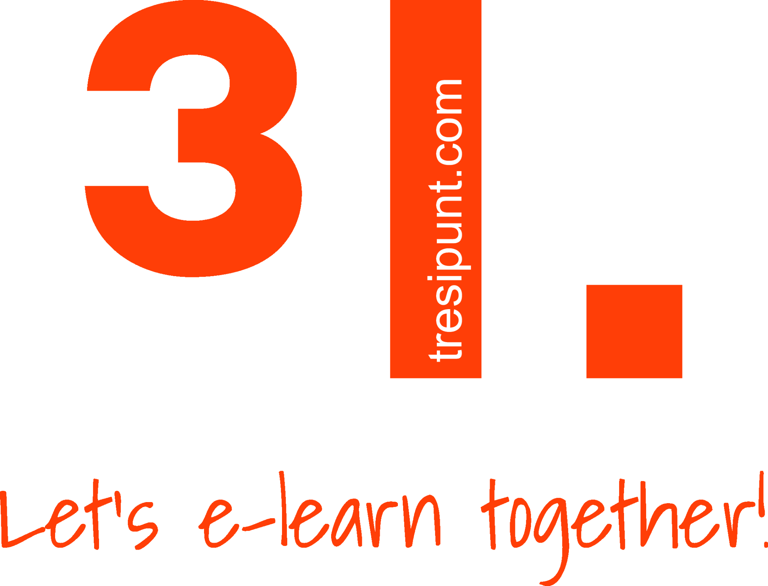
WHO WE
ARE
1
FAMILIES
In 2019 a group of concerned families had started the mobilization and contact to XNet.
3
Had won the public tender to create DD, and started to work in it in 2019.
2
4
PILOT PROJECT
We had started with 3 schools on 2021 and 10 more this year.
Had started negotiations with the public sector to find collaboration for the project. Finally we started it with the collaboration of the Barcelona City Hall and other organizations.

Slide 12
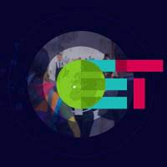
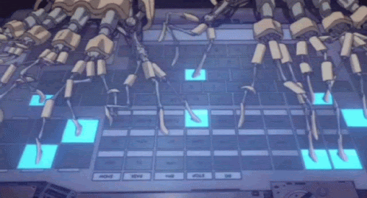
We meet
Develop!!!
Pilot
2019
2021
2022

Slide 13
What is the DD
Notes:
RRHH TIENDA
PRL
SOFTWARE DE TIENDA
ATENCIÓN CLIENTE
MARKETING
PRODUCTO
PUBLICIDAD EN TIENDA
CAMPAÑAS

Slide 14
DEMOCRATIC
DIGITALIZATION PLAN
PUBLIC
SERVERS
The infrastructure and code must be auditable and take care about the data protection
DD
SUITE
An open source based suite for education that must be easy to use and replicate.
TEACHERS
TRAINING
Offering services of support, training and maintenance, during the transition process.
THREE MAIN AXES

Slide 15
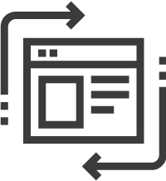
DD. Education Suite
THE
MAIN GOALS
Improved UX
Custom developments to improve the user experience in all the apps of the suite.
Single identity management
KEYCLOACK with SAML2 to unify user sessions across applications
Simple Setup
Simple automated orchestration with containers and technology DOCKER-COMPOSE.
Security and monitoring
OWASP ModSecurity firewall with customized rules. Graphical visualization of environment usage and access logs with GRAFANA .
Notes:
SAML2 es la tecnologia que ens permet unificar autentificació, la informació d’usuari, els grups i els rols.
S’utilitza HAPROXY i Modsecurity per garantir la seguretat de l’entorn
Amb la tecnologia DOCKER se hace un despliegue del entorno sencillo y automatizado.
Amb la tecnología Grafana Locki podem visualitzar de una forma atract
Podremos visualizar de una forma más gráfica y atractiva los datos del entorno gracias a Grafana Loki.

Slide 16
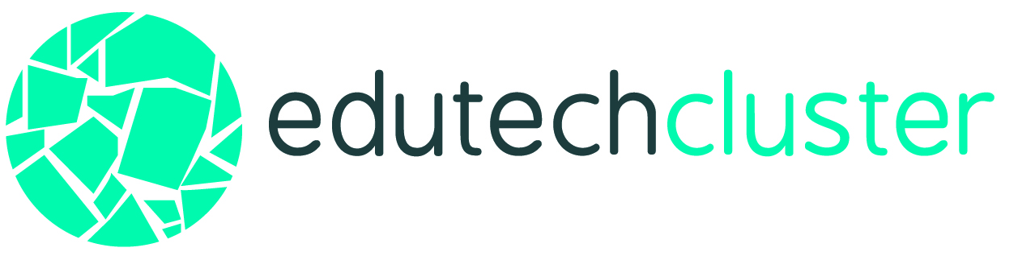
DD. Education Suite
THE
SOLUTION
Office automation
Web environments
Virtual classes
Training classrooms
Collaborative space
#letselearntogether

Slide 17
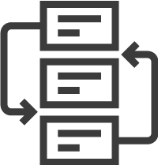
THE
FEATURES
DD. Education Suite
03
As you like
Application customizations to facilitate usability.
01
05
Single Sign - On
You login once and you have access to all applications.
02
04
Agile development
Simplify the installation, deployment and maintenance of services.
DD menu
To navigate between applications and configurable.
Easy
Centralized management of users and groups.

Slide 18
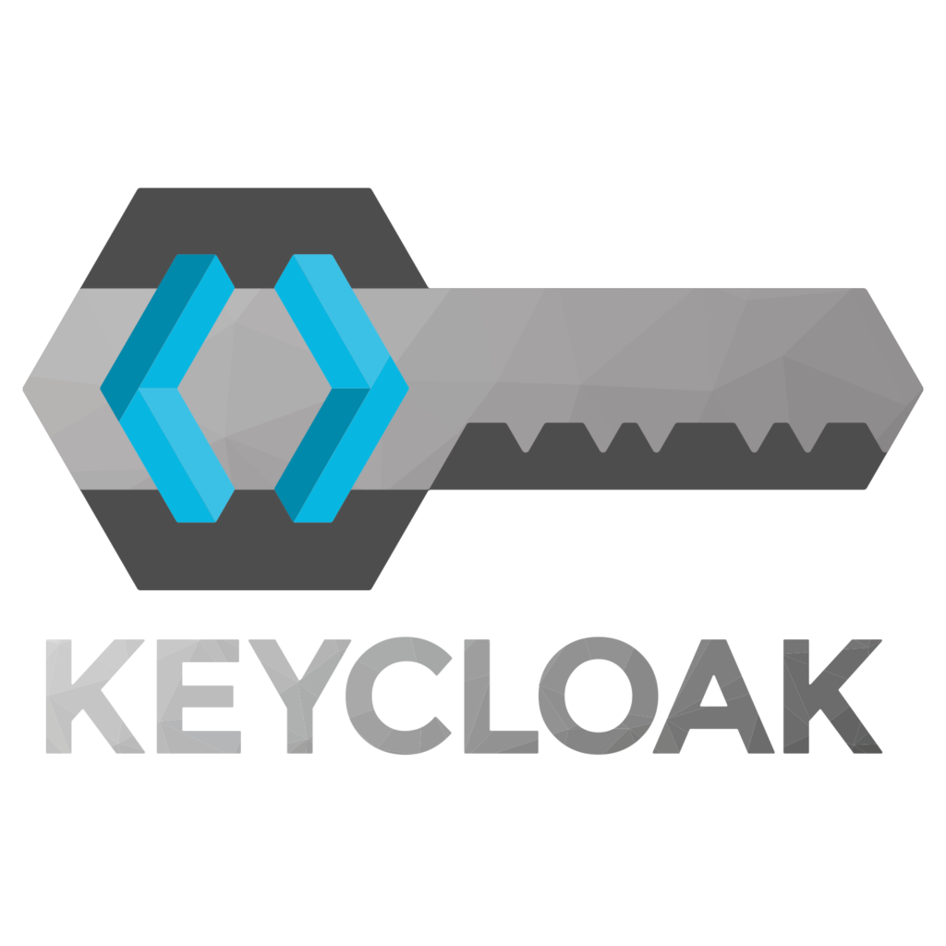
DD. Education Suite
THE
AUTHENTICATION
LOG IN
Single sign-on for access to all integrated applications.
Single Sign On
SAML2 technology that allows us to unify authentication, user information, groups and roles.
AUTHENTICATION
USER
GROUPS
ROLES
SAML2
SAML2
SAML2
SAML2
SAML2
SAML2
Notes:
SAML2 es la tecnologia que ens permet unificar autentificació, la informació d’usuari, els grups i els rols.
S’utilitza HAPROXY i Modsecurity per garantir la seguretat de l’entorn
Amb la tecnologia DOCKER se hace un despliegue del entorno sencillo y automatizado.
Amb la tecnología Grafana Locki podem visualitzar de una forma atract
Podremos visualizar de una forma más gráfica y atractiva los datos del entorno gracias a Grafana Loki.

Slide 19
DD. Education Suite
THE
MENU
USER AVATAR AND CONFIGURATION
The same navigation Menu in all the applications.
CONFIGURABLE
LOGO
SUITE
SERVICES
CUSTOMIZABLE
LINKS, TEXTS AND ICONS
Notes:
SAML2 es la tecnologia que ens permet unificar autentificació, la informació d’usuari, els grups i els rols.
S’utilitza HAPROXY i Modsecurity per garantir la seguretat de l’entorn
Amb la tecnologia DOCKER se hace un despliegue del entorno sencillo y automatizado.
Amb la tecnología Grafana Locki podem visualitzar de una forma atract
Podremos visualizar de una forma más gráfica y atractiva los datos del entorno gracias a Grafana Loki.

Slide 20
DD. Education Suite
CENTRALIZED
USER MANAGEMENT
ENVIRONMENT CUSTOMIZATION
Import from Google Suite for education and CSV:
Customization
tool for:
Group structure
Role structure
Avatars
Quota
Logo
Login background image
Company colours
Tools menu
Notes:
Gestió centralitzada
Pots importar tota la:
Estructura d’usuaris
Grups
Unitats organitzatives
Passwords
de google suite for education.
Personalització
Logo
Colors corporatius
Image background
Menú d’eines

Slide 21
DD. Education Suite
THE
CUSTOMIZATION
Notes:
SAML2 es la tecnologia que ens permet unificar autentificació, la informació d’usuari, els grups i els rols.
S’utilitza HAPROXY i Modsecurity per garantir la seguretat de l’entorn
Amb la tecnologia DOCKER se hace un despliegue del entorno sencillo y automatizado.
Amb la tecnología Grafana Locki podem visualitzar de una forma atract
Podremos visualizar de una forma más gráfica y atractiva los datos del entorno gracias a Grafana Loki.

Slide 22
DD. Education Suite
THE
USER MANAGEMENT
You can import the entire structure of users, groups and organizational units from Google Suite for Education
You can import CSV with users, passwords and groups.
The user can belong to various groups:
Student
Teacher
Manager
Also can fix the usage quota for NextCloud
Notes:
SAML2 es la tecnologia que ens permet unificar autentificació, la informació d’usuari, els grups i els rols.
S’utilitza HAPROXY i Modsecurity per garantir la seguretat de l’entorn
Amb la tecnologia DOCKER se hace un despliegue del entorno sencillo y automatizado.
Amb la tecnología Grafana Locki podem visualitzar de una forma atract
Podremos visualizar de una forma más gráfica y atractiva los datos del entorno gracias a Grafana Loki.

Slide 23
Every service is created with Docker-compose & containers
DD. Education Suite
THE
ARCHITECTURE
GITLAB
TRANSVERSAL SERVICES
SEC-HAPROXY
WAF
SERVER BBB
SERVER MAILU
SERVER GRAFANA
APPS-WORDPRESS
APPS-WORDPRESS-CLI
SSO-HAPROXY
APPS-ONLYOFFICE
APPS-MARIADB
SSO-NEXTCLOUD-NGINX
SSO-NEXTCLOUD-APP
APPS-ETHERPAD
APPS-MOODLE
SSO-KEYCLOAK
SSO-AVATARS
SSO-ADMIN
MONITORING-PROMTAIL
MONITORING-GLANCES
BACKUPS
APPS-POSTGRESQL
SSO-API
Notes:
SAML2 es la tecnologia que ens permet unificar autentificació, la informació d’usuari, els grups i els rols.
S’utilitza HAPROXY i Modsecurity per garantir la seguretat de l’entorn
Amb la tecnologia DOCKER se hace un despliegue del entorno sencillo y automatizado.
Amb la tecnología Grafana Locki podem visualitzar de una forma atract
Podremos visualizar de una forma más gráfica y atractiva los datos del entorno gracias a Grafana Loki.

Slide 24
THE DEMO
Notes:
RRHH TIENDA
PRL
SOFTWARE DE TIENDA
ATENCIÓN CLIENTE
MARKETING
PRODUCTO
PUBLICIDAD EN TIENDA
CAMPAÑAS

Slide 25
THE
DEMO
Notes:
SAML2 es la tecnologia que ens permet unificar autentificació, la informació d’usuari, els grups i els rols.
S’utilitza HAPROXY i Modsecurity per garantir la seguretat de l’entorn
Amb la tecnologia DOCKER se hace un despliegue del entorno sencillo y automatizado.
Amb la tecnología Grafana Locki podem visualitzar de una forma atract
Podremos visualizar de una forma más gráfica y atractiva los datos del entorno gracias a Grafana Loki.

Slide 26
ANY
QUESTION?

Slide 27
ANY
QUESTIONS?
CONTACT US
pau@tresipunt.com
@pauplana
@tresipunt
Notes:
SAML2 es la tecnologia que ens permet unificar autentificació, la informació d’usuari, els grups i els rols.
S’utilitza HAPROXY i Modsecurity per garantir la seguretat de l’entorn
Amb la tecnologia DOCKER se hace un despliegue del entorno sencillo y automatizado.
Amb la tecnología Grafana Locki podem visualitzar de una forma atract
Podremos visualizar de una forma más gráfica y atractiva los datos del entorno gracias a Grafana Loki.

Slide 28
DD
a full open source e-learning ecosystem
LMS | CONTENT | MOBILE | CONSULTING | GAMIFICATION | MEC TRAINING |
IMS-LTI INTEGRATIONS | LEARNING ANALYTICS
^{PAU PLANA i SALESAS}
3&Punt Solucions Informàtiques SL
C. de València, 359 08009 Barcelona
^{pau@tresipunt.com}

