Slide 1
Building the plane while it is flying: Planning for Moodle 4

Slide 2
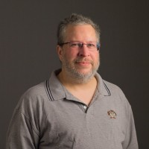
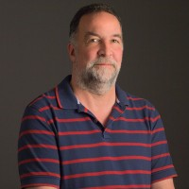
Presenters
Bethany Smith
Director, Instructional Support & Training
Jeff Webster
Director, Educational Technology Services
Martin Dulberg
Learning Technologies Coordinator

Slide 3
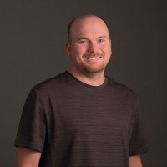
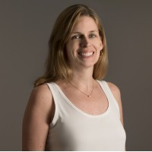
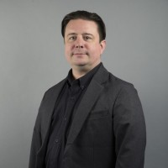
Team
Stephen Bader
Associate Director, Open Source Applications
Christine Belledin
Project Manager
Martin Dulberg
Learning Technologies Coordinator
Saras Grandhi
Software and Testing Evaluation Analyst
Bethany Smith
Director, Instructional Support & Training
Scott Watkins
Associate Director, Instructional Technology Support
Jeff Webster
Director, Educational Technology Services
Notes:
Showcase other sessions

Slide 4
Current Version
Moodle 3.9
Notes:
Marty

Slide 5
New Instance each Academic Year
Notes:
Marty

Slide 6
Three Spaces
New Instance
Academic 22-23
Update
In Place
Update
In Place
Academic 21-22
Projects
Outreach
Academic
Academic 20-21
Notes:
Marty
Alt Text: Diagram illustrating the two servers that get updated in place, our Project and Outreach Server. We stand up a new instance each academic year.

Slide 7
Upgrade Servers
Request Access
Internal Staff
Dev Staff
OTB Stock Moodle 4.0
Dev
Test
Preview
Notes:
Marty
Many instances of dev and test
Our OTB (Out of the Box) Stock Moodle 4.0 is available to all internal DELTA staff. Our Dev team sets up several dev and test servers that only they have access to. We have a preview server that all of campus can request access to.

Slide 8
Traditional Timeline
Stock, Development & Test Servers
Latest Moodle Update is posted. A new stock, dev and test server are created.
Academic 22-23 Server Goes Live
The Academic Server goes live for requests for Summer 2022
Early 2022
May 2022
Late 2021
March 2022
Preview Server
Preview server is created, at first for training and support team to provide feedback, but will eventually be released to NC State
Project & Outreach Servers Upgraded
The Project and Outreach servers are upgraded in place
Notes:
Marty

Slide 9
But we knew Moodle 4 was a BIG Update
Notes:
Marty

Slide 10
Updated Timeline
Stock, Development & Test Servers
Latest Moodle Update is posted. A new stock, dev and test server are created.
Academic 22-23 Server Goes Live
The Academic Server goes live for requests for Summer 2022
Kick-off
Project Team kick-off
September 2021
Early 2022
May 2022
August 2021
Late 2021
March 2022
Review
Review and Comment on 3.10, 3.11 features. Catalog existing Support Resources
Preview Server
Preview server is created, at first for training and support team to provide feedback, but will eventually be released to NC State
Project & Outreach Servers Upgraded
The Project and Outreach servers are upgraded in place
Notes:
Marty

Slide 11
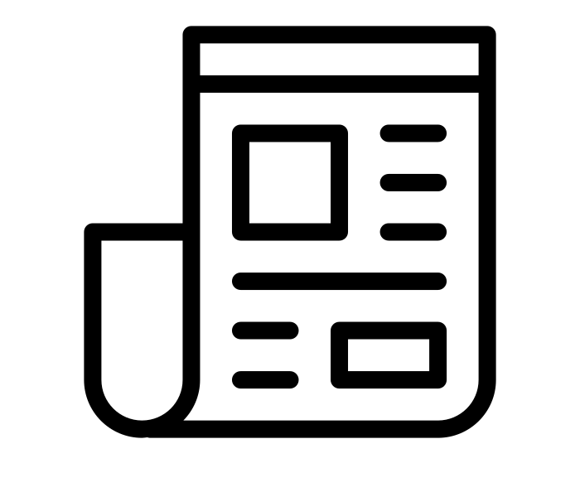
Communication Plan
Moodle 4 Coming next year
First official announcement of our upgrade plans.
DELTA Connections Newsletter
Announce Availability of Academic Server
December 2021
May 2022
August 2021
March 2022
DELTA Connections Newsletter Announce new version of Moodle with series of articles
DELTA Connections Newsletter
Announce Upgrade of Projects & Outreach
Notes:
Bethany

Slide 12
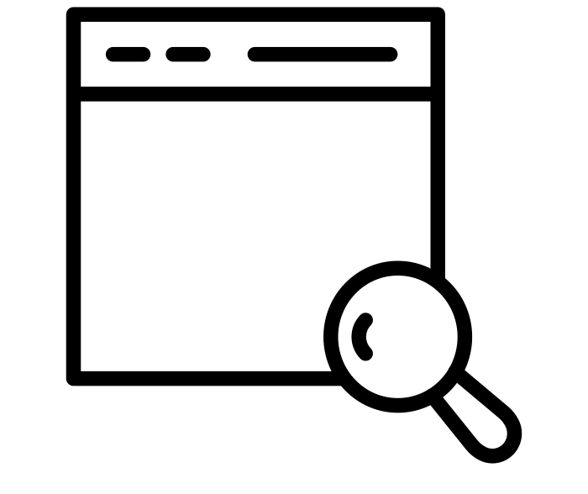
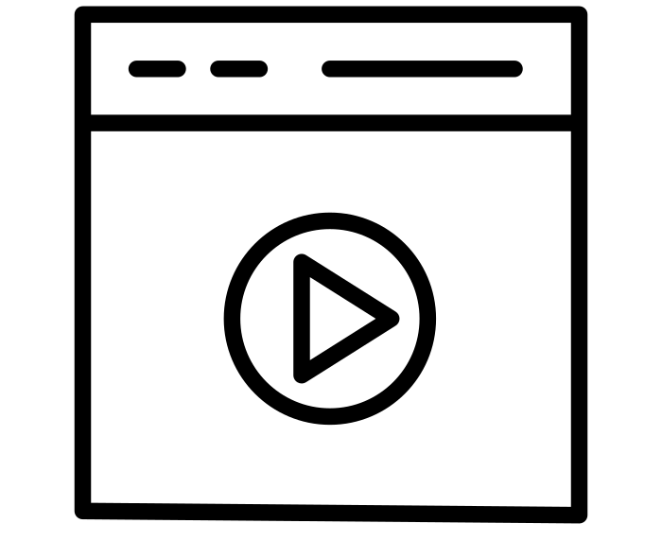
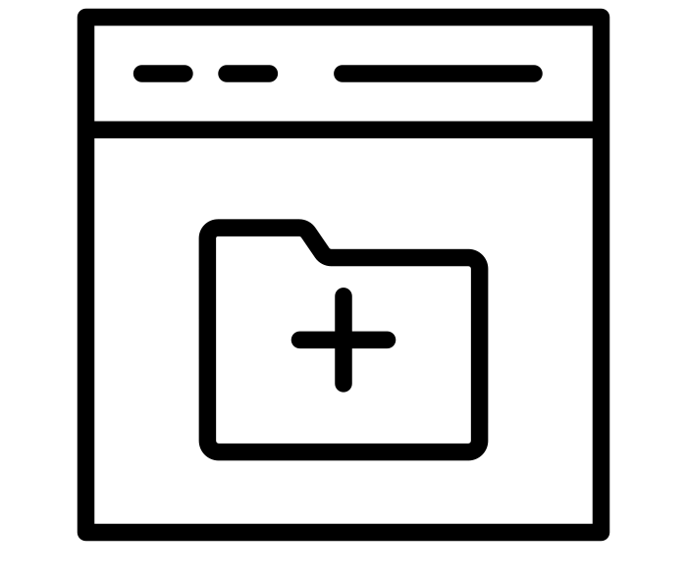
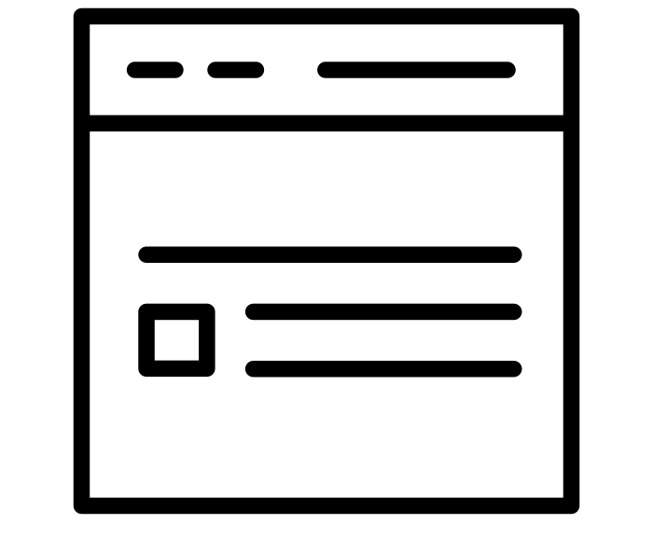
Cataloging Existing Support Resources
Knowledge Base
YouTube Channel
User Guides
Teaching Resources Website
Notes:
Bethany

Slide 13
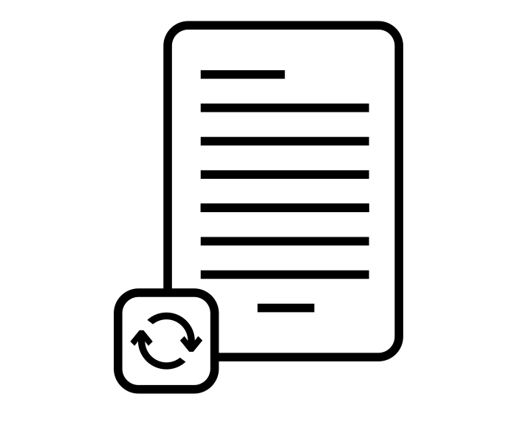
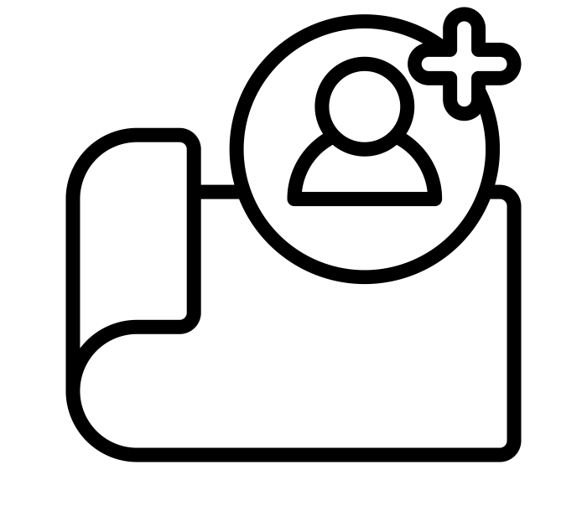
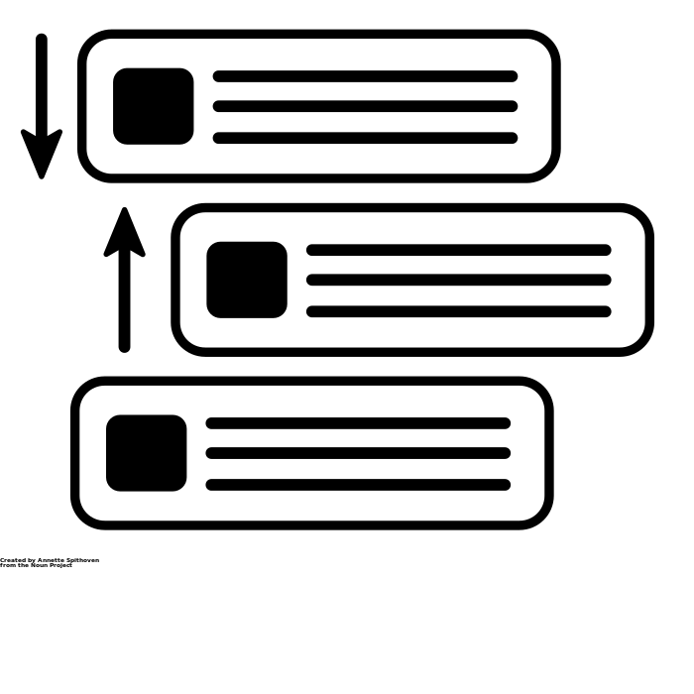
Cataloging Existing Support Resources
What needs to be changed?
Priority
Who will be updating?
Size of Job
Revision Needed?
Notes:
Bethany
https://docs.google.com/spreadsheets/d/10qTrn8qNvT5pSTXhjyaUKX1A6_2p4K0Rov-43tOkpD4/edit#gid=568077711

Slide 14
October Decision - Delays MAY Happen
As of today, we’re expecting 4.0 code to release on-schedule (Dec. 13) and agreed to begin providing information about the upgrade starting in the November 2021 newsletter. However, if code release is delayed until January AND if that delay includes key upgrade components (eg. those that would be difficult to integrate, test and deploy within a shortened time frame), then the team is prepared to delay the release past March. If so, a message within a future newsletter (most likely Dec or Jan) will explain the delay in an effort to be as transparent as possible.
Notes:
Jeff

Slide 15
What are our deal breakers
in moving to Moodle 4 in 2022?
Notes:
Jeff
Plug-ins and other items out of our control, can we get support resources and training up to date in time (need Preview Server)
Considered changes coming in our Moodle 4.0 - what has to be fully supported (quiz / question bank), what could be have light support, what could be delayed (Accessibility Toolkit)
We were already working with the 4.0 dev releases. How late could the final code release be and we still make launch targets?
What are our critical third party plugins for content creation vs. those needed for course delivery?

Slide 16
January 2021 - Decisions
March Moodle 4.0 Academic Server Launch
Moodle 4.0 Preview Server Launch February 1
Moodle 4.0 Academic Server Launch May 1
Moodle 4.0 Projects & Outreach Servers Upgrade
August 8th
Lack of time to prepare
Panopto integration
Third Party Plugins
March 15th date go/no go date based on plugin availability
Window of time between semesters
Notes:
Jeff
NO to a July 2022 upgrade to Moodle based on our research/conversations w/ faculty
(fall classes begin August 22)

Slide 17
Updated Timeline
Stock, Development & Test Servers
Latest Moodle Update is posted. A new stock, dev and test server are created.
Academic 22-23 Server Goes Live
The Academic Server goes live for requests for Fall 2022
February 2022
August 2022
Early 2022
May 2022
Preview Server
Preview server is created, at first for training and support team to provide feedback, but will eventually be released to NC State
Project & Outreach Servers Upgraded
The Project and Outreach servers are upgraded in place
Notes:
Jeff

Slide 18
Communication Strategy
Moodle 4 Coming next year
First official announcement of our upgrade plans.
DELTA Connections & Email
A Look Behind the Scenes of Academic Technologies
Moodle 4.0 Upgrade Info
Moodle 4 Preview Now Available
November & December 2021
March 2022
August 2021
January 2022
DELTA Connections Newsletter
Moodle will be upgraded to version 4.0 for Summer I 2022
Exciting Changes Coming to Moodle this Summer
Building a Path to Moodle 4 Article series
Series of five articles to build anticipation for Moodle 4.
Notes:
Bethany

Slide 19
Communication Strategy
College Dissemination
Sent emails to college and program representatives about update.
Provost Newsletter
Summer Workshops
Moodle 4 Playlist on YouTube
May 2022
August 2022
April 2022
June 2022
WolfWare Announcement
Announcement posted on our internal portal that Fall 2022 courses can be requested
Office of Information Technology News
Moodle Upgrade News for Students
Notes:
Bethany

Slide 20
What do we need ready for the May vs August date?
Notes:
Bethany May is when faculty would see full version and August is when Students will see the full version
Still supporting 3.9 for summer courses

Slide 21
May
August
Course / Content creation plugins
NC State Theme
Basic support resources
Support staff familiarity
User and enrollment management integrations
Course delivery plugins
Updated icons
Standard support resources
Support staff comfortable
Course outcome (grade, completion) integrations
Notes:
Bethany
Course creation plugins - Panopto, Poodll, H5P,
Course delivery plugins - Respondus LDB, quickmail, Top Hat

Slide 22
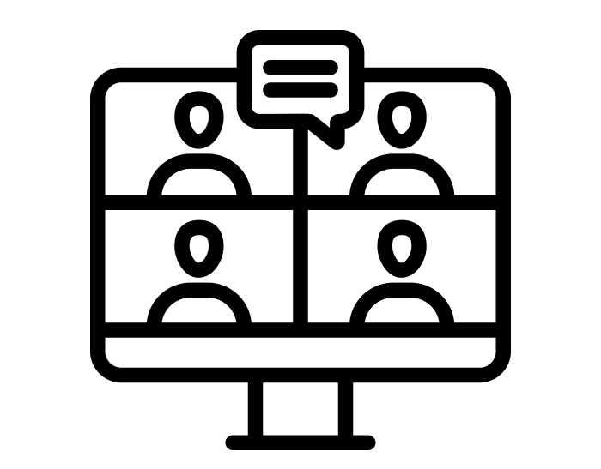
Preview Server
Allowed early adopters to have access
Used to give feedback to developers
Crucial for internal support resource creation
Utilized for workshops

Slide 23
Training Plan
Custom Workshops!
Train-the-Trainer on Moodle 4
Navigating Moodle 4
Moving to Moodle 4
Offered 10 times with 105 participants
Offered 5 times with 44 participants
Duration: 30 minutes
Audience: Power users
Quick overview of what the changes are from Moodle 3.9 & 4.0
Duration: 2 hours+
Audience: General audience of instructor
In-depth overview of Moodle 4 changes. Offers recommendations on how to adapt courses to the new look and feel of Moodle 4. Also include an Open lab time afterwards.
Offered Twice
Duration: 1 hour
Audience: Instructional Technologists and Designers on campus that are supporting faculty and instructors.
Covered the key differences between Moodle 3.9 & 4.0 and shared training resources.
Notes:
Bethany
Navigation & Basic Features of Moodle 4 https://docs.google.com/document/d/1XCHRdI4JR4N9MPeJCtyCrhaw8LX2J2AdTrb5RtcXkI4/edit?usp=sharing
Reorganizing Content https://docs.google.com/presentation/d/12iLB_GU9VJq_1S4JRsoVIgIole-wF45isYobTlPFnJs/edit?usp=sharing
Feedback from Evaluations:
The class was well-organized with a presenter and a facilitator for chat questions, which were quickly addressed. It was a well-done online workshop that helped demystify some aspects of Moodle 4.
Great, short overview of the changes that are happening with Moodle 4. It's exactly what I needed.
It was very helpful to get an overview highlighting frequently used tools and their new location. I also appreciated the opportunity to apply what was being discussed and being able to get answers to my questions in real time.
This was very beneficial in learning the new layout and navigation tools for Moodle 4.0. It allowed us an opportunity to explore and try different settings in real-time with someone there to answer questions, assist us navigate, and confirm we were clear on how 4.0 operates.

Slide 24
Resource Updates
Knowledge Base
YouTube Channel
User Guides
Teaching Resources Website
Overview KB
Waiting until Moodle 3.9 in no longer supported for live classes/ Project/ Outreach
Used Trello board to prioritize videos
Had Moodle 3.9 & 4.0 videos side by side
Had two versions of user guides available, 3.9 & 4.0
Updates as needed
Notes:
Bethany
Spreadsheet https://docs.google.com/spreadsheets/d/10qTrn8qNvT5pSTXhjyaUKX1A6_2p4K0Rov-43tOkpD4/edit#gid=568077711

Slide 25
Moodle Co-Working Day
Notes:
Bethany
https://docs.google.com/document/d/1PWOq9xmC_RPyfTQMebxSYJ8K1mBaDsF0IDFtRH4Nq_E/edit

Slide 26
Notes:
Bethany

Slide 27
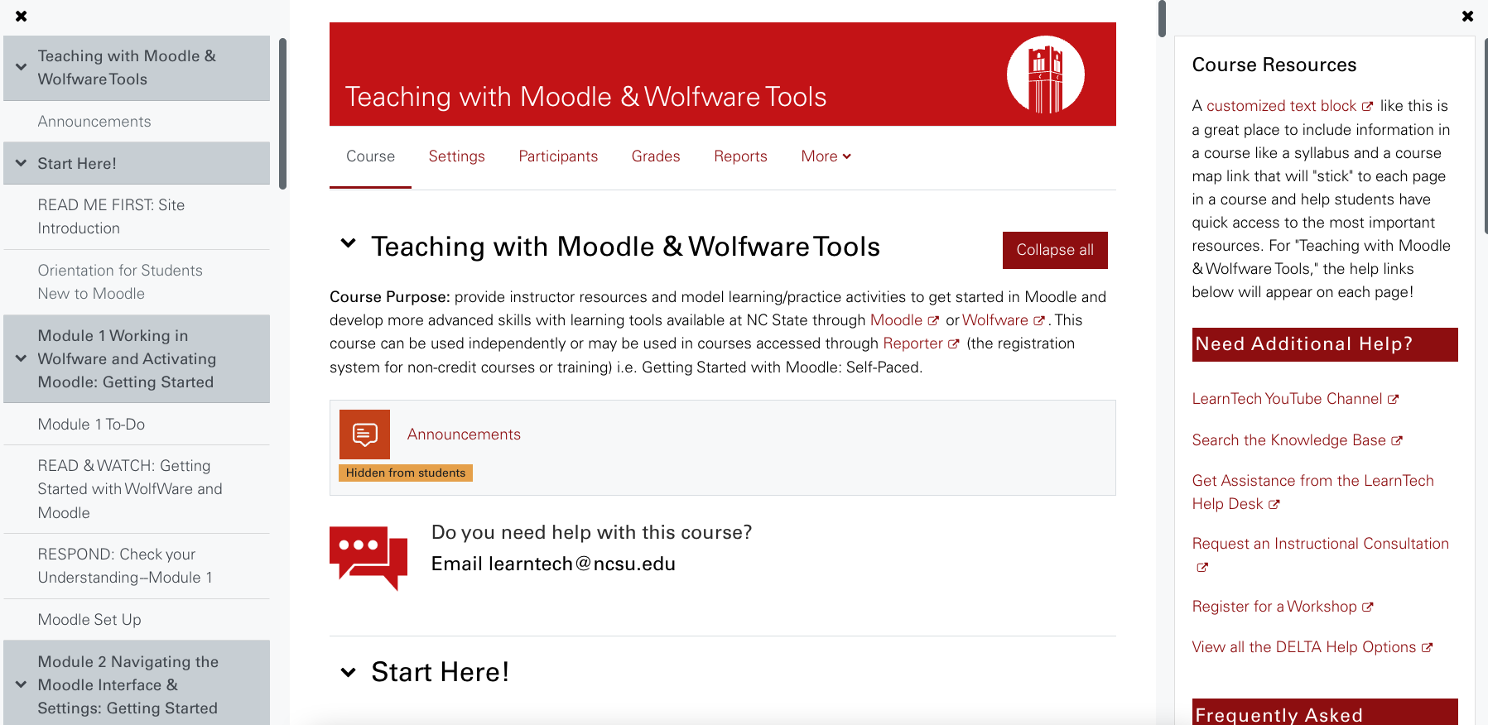
Notes:
Bethany
Teaching with Moodle Course - used in Workshops & Self-paced course

Slide 28
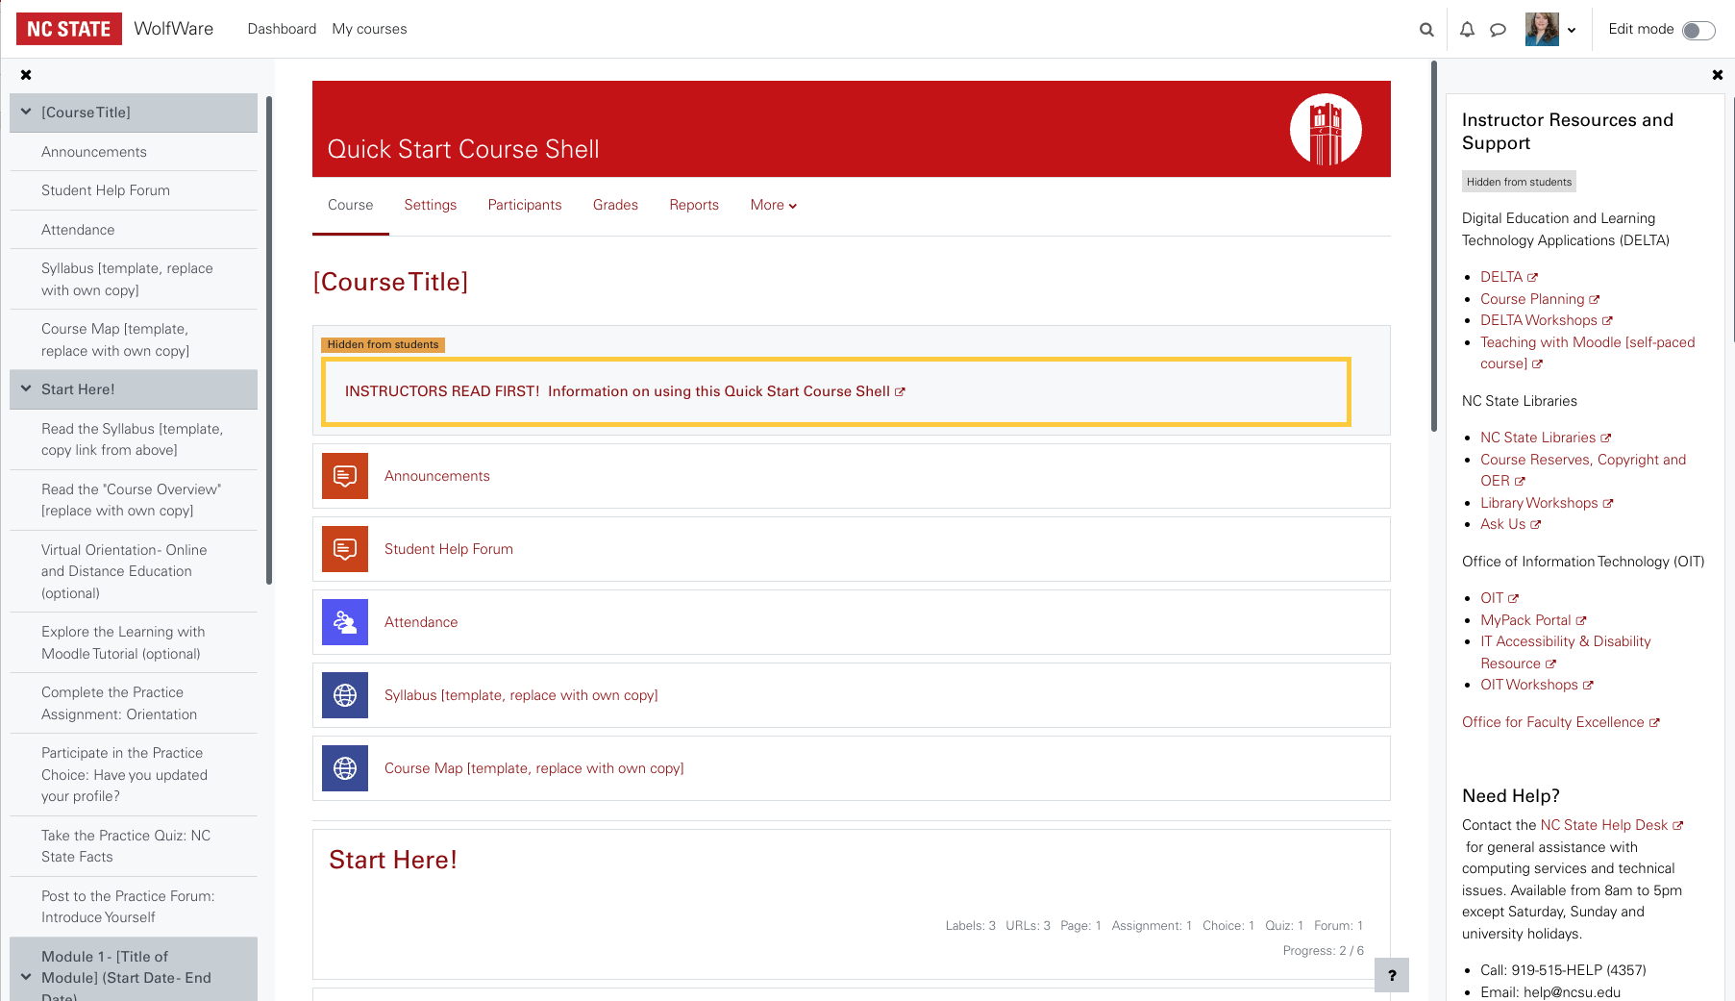
Notes:
Quick Start Course Shell Guide - https://docs.google.com/document/d/1gxwB_mw6a2BFoyfpwftl3NQU5keN7d4G5pNg-hVn3kU/edit?usp=sharing

Slide 30
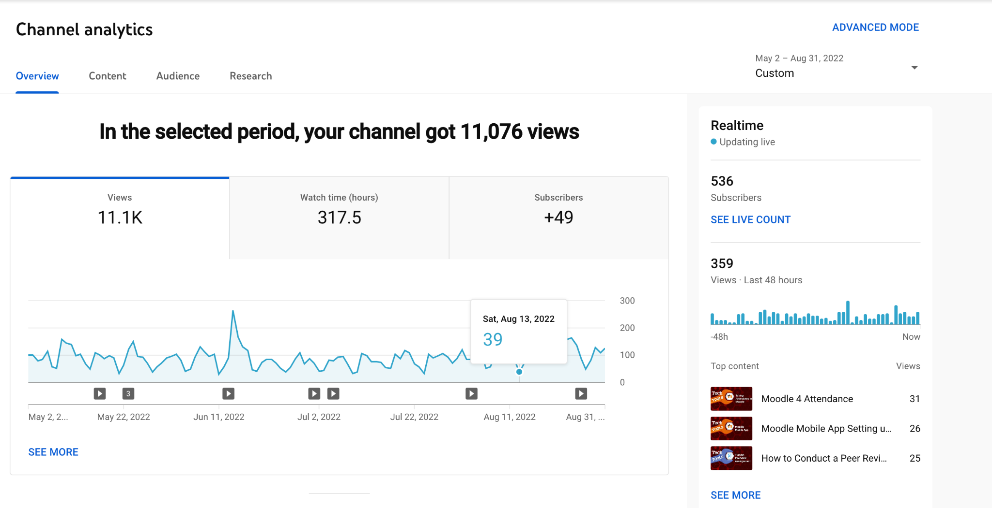

Slide 31
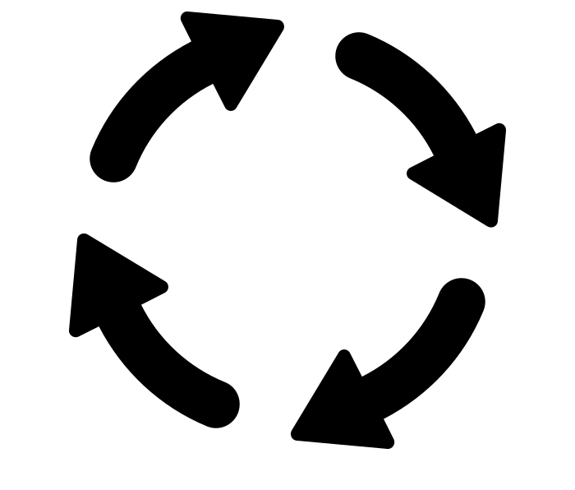
Feedback Cycle
Notes:
Bethany
Creating these courses helped us troubleshoot issues and add to the dev list. It also informed us what to create a User Tour about.

Slide 32
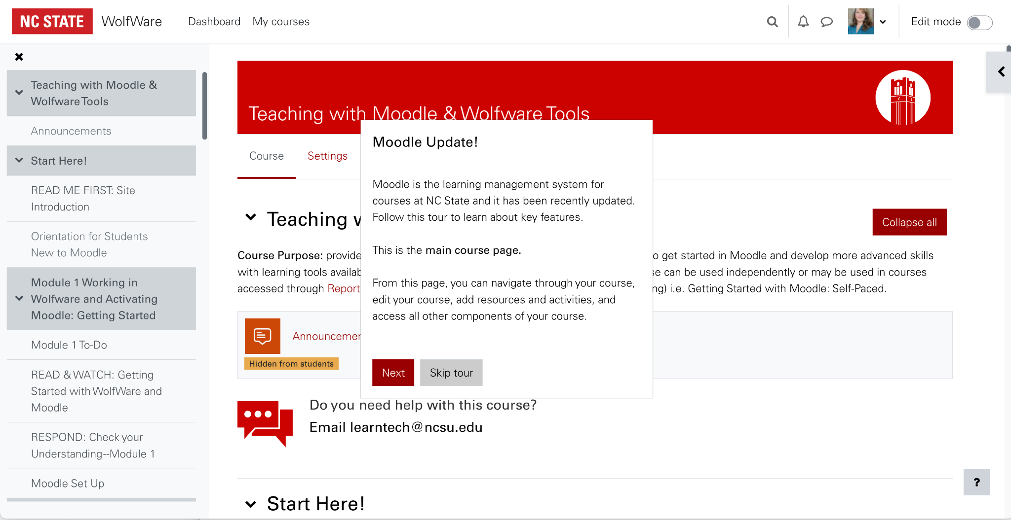

Slide 33
Were we successful?
Notes:
Marty

Slide 34
What would we have done differently?
Notes:
Marty

Slide 35
Questions?

Slide 36
Presenters
Bethany Smith
bethany_smith@ncsu.edu
Jeff Webster
jeff_webster@ncsu.edu
Martin Dulberg
martin_dulberg@ncsu.edu

Slide 37
Creative Commons images from Noun Project
Server by Juan Pablo Bravo
search web page by SBTS
Video Browser by SBTS
Add Archive by SBTS
content browser by SBTS
Email by Creative Stall
newsletter by CAMB
Revision by Aysegul Donmez
priorities by Eko Purnomo
paper edit by Assia Benkerroum
prioritization by Annette Spithoven
Assign Task by Pedro
creation by Nithinan Tatah
feedback by Amethyst Studio
early adopters by Dominik Mann
online workshop by Andi
cycle by Alice Design

