Slide 1
BIG SCALE,
TINY BUDGET
the road to 1,000,000 students

Slide 2
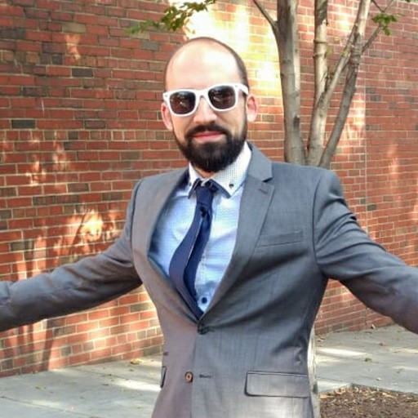
WHO AM I?
John Azinheira
(former)
Director of Technology
at
Saylor Academy
hello@johnazinheira.com

Slide 3
AND
SAYLOR ACADEMY?
A nonprofit working to offer free and open online courses to all who want to learn.
Open enrollment | Anyone can enroll, at anytime
Perpetual courses | No semesters or terms
 | No individual teachers putting up courses
Self-paced | Students can take as little or as long as they need to complete a course
Credit options | Number of courses have credit recommendation option
Global audience | Initial focus on US, then on students around the world
Sole-trustee non-profit | Translation: tiny budget!
Bottom line: Unique use case and workload!

Slide 4
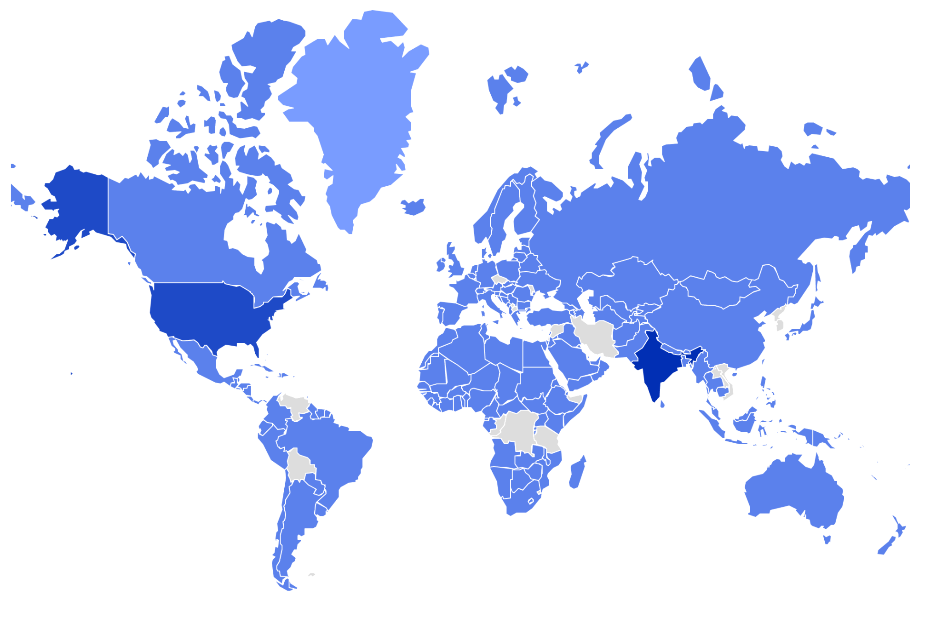

Slide 5
THE CATCH
Multiple instances, courses removed at end of semester, or accounts cleaned up?

Slide 6
1 371 000
Students in a single instance…

Slide 7
1 371 000
Students in a single instance…
…over the last 10 years.

Slide 8
173 892
Enrollments in ESL001

Slide 9
SOME MORE NUMBERS
15 000 - 20 000
104
100 - 400
sessions per day
course completions per day
concurrent users

Slide 10
SOME MORE NUMBERS
15 000 - 20 000
104
100 - 400
sessions per day
course completions per day
concurrent users
Large student count, large number of course enrollments, moderate traffic load.

Slide 11
THE
INFRASTRUCTURE
Moodle Web Tier
Discourse
GlusterFS
RDS

Slide 12
THE FIRST PROBLEM
PROBLEM
Had to schedule long down times (2 hours)
Upgrade process could take a long time
Led to longer time between updating
Between testing and upgrading, plugin inconsistencies could develop
“This plugin requires Moodle version X”

Slide 13
THE FIRST PROBLEM
PROBLEM
SOLUTION
Had to schedule long down times (2 hours)
Upgrade process could take a long time
Led to longer time between updating
Between testing and upgrading, plugin inconsistencies could develop
“This plugin requires Moodle version X”
Implemented a semi-automated build and deploy system using Jenkins!
Plugins and major versions/branches saved in version controlled code.
Prod database copied, latest (minor) version of Moodle and plugins pulled, and tested.
If successful, the build artifact was added to version control and later deployed.

Slide 14
THE RECOMMENDATIONS
USE A CI/CD SYSTEM
01

Slide 15
THE
INFRASTRUCTURE
Moodle Web Tier
Discourse
Jenkins
GlusterFS
RDS

Slide 16
WHY IS LOGGING IN SO SLOW?
PROBLEM
General slowness on occasion
Especially during session creation - it would take a long time to log in

Slide 17
WHY IS LOGGING IN SO SLOW?
PROBLEM
SOLUTION
General slowness on occasion
Especially during session creation - it would take a long time to log in
Session handling was being handled by default drivers.
DB and file session drivers are slow!
Switched to the Memcached driver
Later, used Redis - separate clusters for session and app caching

Slide 18
THE RECOMMENDATIONS
USE A CI/CD SYSTEM
USE CACHING
01
02

Slide 19
THE
INFRASTRUCTURE
Moodle Admin Tier
Discourse
Redis Session Cache
Jenkins
Redis App Cache
GlusterFS
RDS

Slide 20
ANOTHER DAY, ANOTHER PERFORMANCE DEGRADATION
PROBLEM
Reports of slowdowns
Noticed CPU spiking on multiple machines and being taken off the load balancer
Regular intervals
Reengagement plugin was taking so long to complete, the next scheduled task was starting over and interfering.

Slide 21
What is the Reengagement plugin?
Initial foray into student interventions
Allows you to remind students to complete activities via email
Used to give students more information after failing an exam, encouragement, and next steps

Slide 22
ANOTHER DAY, ANOTHER PERFORMANCE DEGRADATION
PROBLEM
SOLUTION
Reports of slowdowns
Noticed CPU spiking on multiple machines and being taken off the load balancer
Regular intervals
Reengagement plugin was taking so long to complete, the next scheduled task was starting over and interfering.
Triage: increased the time interval between scheduled tasks
Later removed the plugin entirely

Slide 23
THE RECOMMENDATIONS
USE A CI/CD SYSTEM
USE CACHING
01
02
CHECK YOUR PLUGINS
03

Slide 24
AND
NOT JUST PLUGINS
You should check your own code and Moodle features used.
Partner found that requesting all their users from the ProgramPartner API via email using ‘%’ would take a loooong time (> 5 minutes)
The function core_user_get_users was returning and iterating through all users for a permissions check
Rewrote the function to first get the cohorts they had permissions for, search through users in those cohorts, and then do a permissions check

Slide 25
BUT WHAT ABOUT
STUDENT INTERVENTIONS?
n8n
Free, open and self-hostable fair-code licensed workflow automation tool.
Consolidates student interventions/messaging in a single place
Allows for greater control:
Customized/personalized messages
More advanced logic
Pull in information from other systems
Reduces load on the learning environment

Slide 26
THE RECOMMENDATIONS
USE A CI/CD SYSTEM
USE CACHING
01
02
CHECK YOUR PLUGINS
PULL OUT WHAT YOU CAN
03
04

Slide 27
AND
NOT JUST FUNCTIONS
Think about putting large resources on a CDN.
Shared network drives are generally slow
Files uploaded into course are put into the shared moodledata folder
Performance cost serving these files - use systems designed to serve them
Example:
Migrating course videos from YouTube, put them into S3 bucket behind Cloudfront
Tip: Moodle Mobile won’t cache links to YouTube videos for offline use, but will cache links to mp4 files

Slide 28
AND
INFRASTRUCTURE
TOO
Recently with more traffic and background processes, slowdowns occurred with certain scheduled tasks as well.
Pulled out the Moodle cron from the front-end web tier servers and enabled on a new “admin” tier.

Slide 29
THE
INFRASTRUCTURE
Cloudfront
Moodle Web Tier
Moodle Admin Tier
Discourse
Redis Session Cache
Jenkins
Redis App Cache
GlusterFS
RDS
n8n

Slide 30
THE RECOMMENDATIONS
USE A CI/CD SYSTEM
USE CACHING
01
02
CHECK YOUR PLUGINS
PULL OUT WHAT YOU CAN
03
04
USE AND CONTRIBUTE TO OPEN SOURCE!
05

Slide 31
QUESTIONS?
John Azinheira
hello@johnazinheira.com

