Slide 2
Hi, I’m Edu!
UX/UI Designer in Mobile solutions team
1.5 years with Moodle Team
Moodle User for half of my life

Slide 3
App UX Process:
The Path from 3.9 to 4.0
Presented by Eduardo Manzanillo,
Mobile Solutions UX/UI Designer
Notes:
And today, I'm going to explain how we used the UX Design process to get from 3.9 to 4.0.

Slide 4
What is User Experience (UX)?
Notes:
But, first:
What is UX or User Experience ?

Slide 5
How people interact with a product.
Notes:
When we say “user experience” we’re referring to how people INTERACT with a product.
And when people use a product, they usually evaluate their experiences according to the following criteria:

Slide 6
User evaluation criteria:
Value
Does this product give me value?
Notes:
If the product provides value, is useful or responds to their needs

Slide 7
User evaluation criteria:
Value
Does this product give me value?
Usability
Is it easy to use?
Notes:
… If the product is easy to use or makes it easy for them to complete their task

Slide 8
User evaluation criteria:
Value
Does this product give me value?
Usability
Is it easy to use?
Function
Does this product work?
Notes:
… If the product works properly

Slide 9
User evaluation criteria:
Value
Does this product give me value?
Usability
Is it easy to use?
Function
Does this product work?
General impression
Is it pleasant to use?
Notes:
… And if the product is attractive and pleasant to use

Slide 10
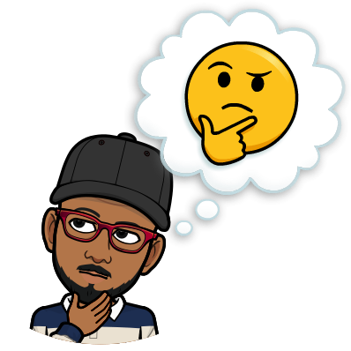
What is User Experience Design?
Notes:
So, What is User Experience Design?

Slide 11
UX design is not the same as UI design!
Notes:
First of all,
UX DESIGN is not the same as UI DESIGN!

Slide 12
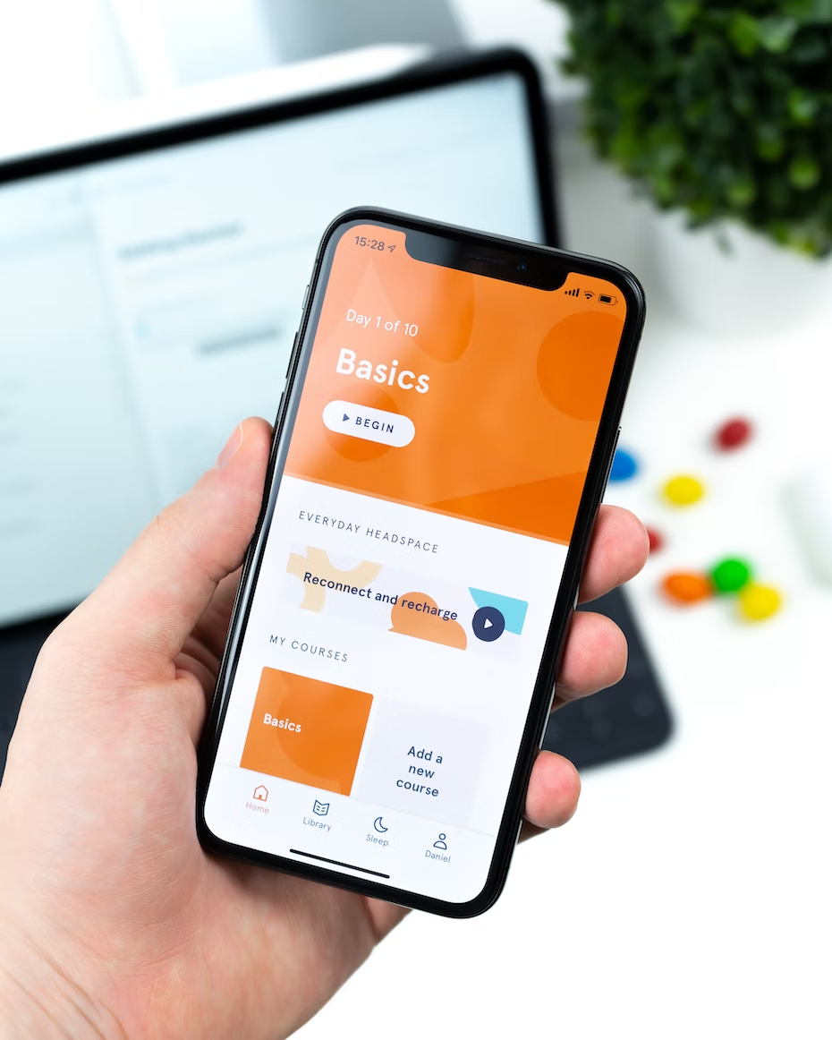
Notes:
User eXperience design is often mistakenly referred to as User interface design.

Slide 13
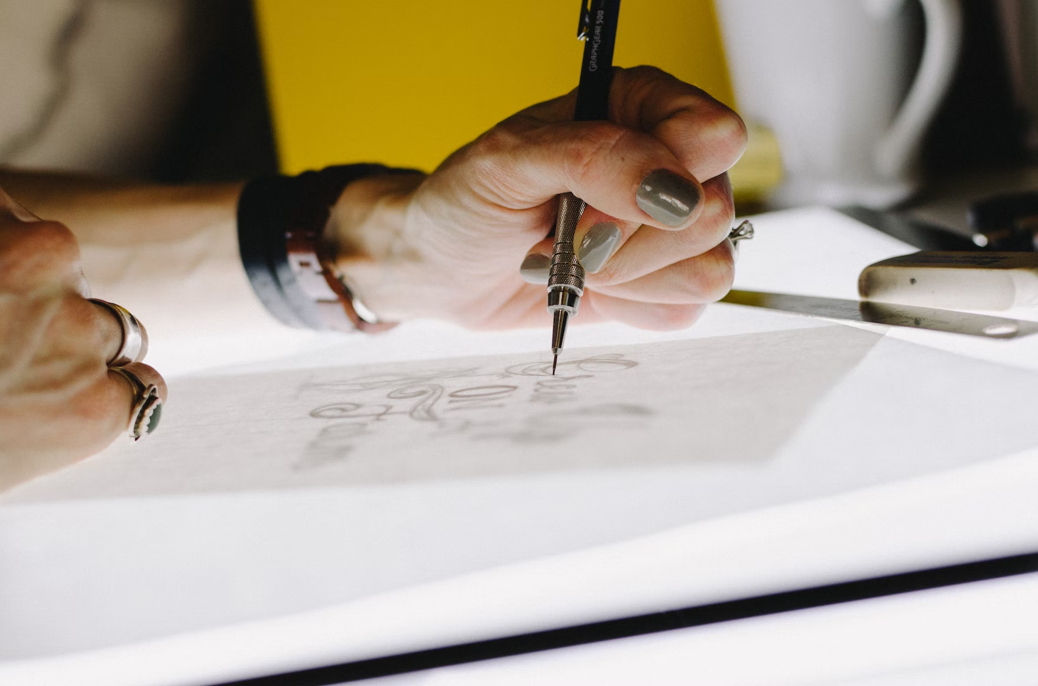
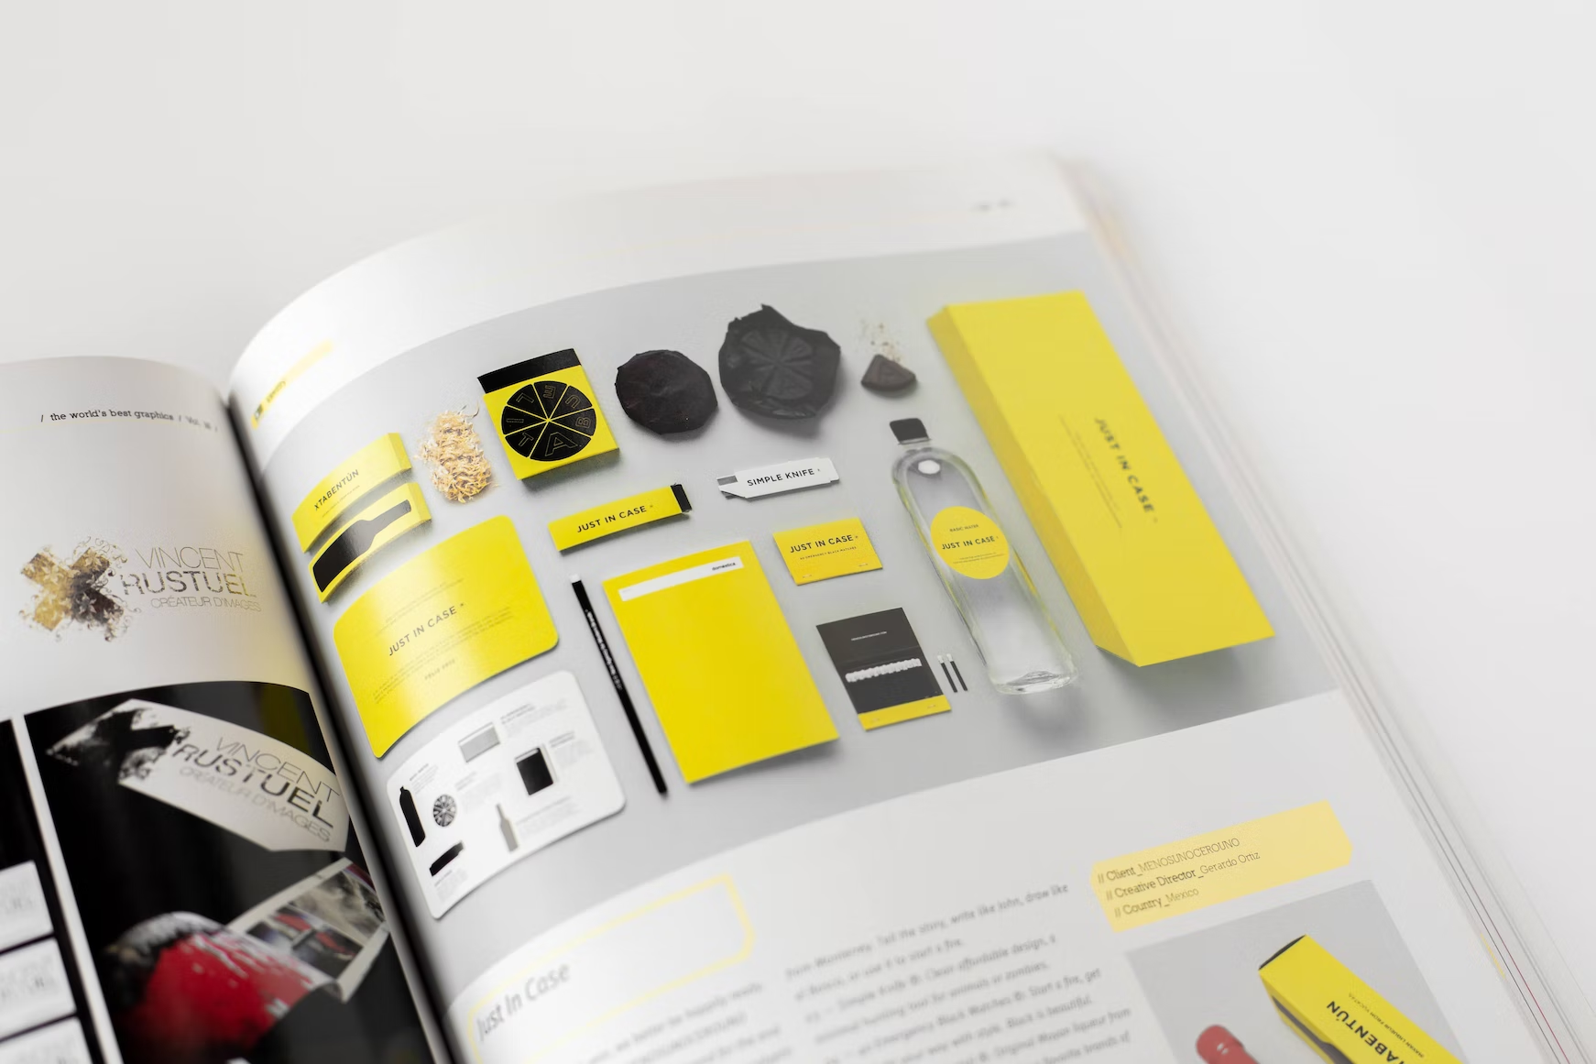
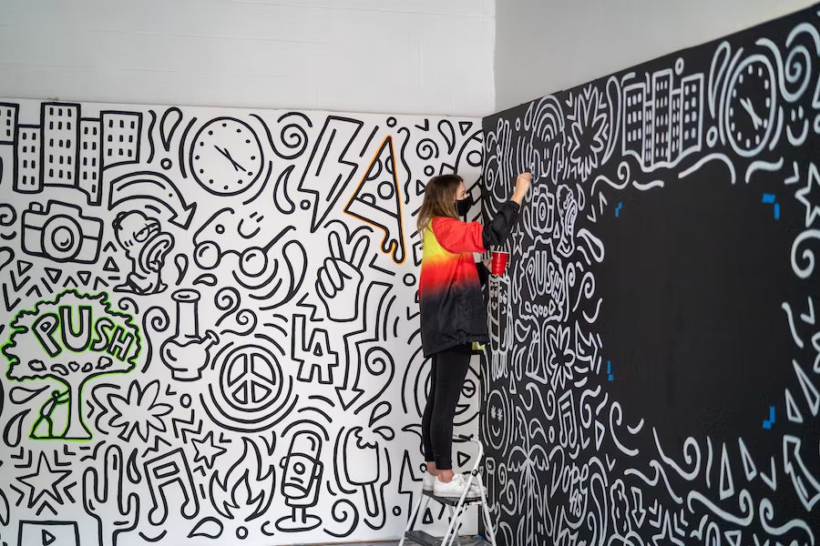
Notes:
That’s because many people associate the word “design” with visuals.

Slide 14
Notes:
As you can see in the image, UX encompasses many different aspects of product design,
And User Interface it’s just the surface layer of a product.

Slide 15
Useful
What is User Experience Design?
Usable
Desirable
Valuable
Findable
Accessible
According to Peter Morville, UX design is the process of creating products that are:
Credible
🔗 Peter Morville UX Honeycomb
Notes:
Peter Morville, In his “UX Honeycomb” Theory, states that
UX design is the process of creating products that are:

Slide 16
Useful
What is User Experience Design?
Usable
Desirable
Valuable
Findable
Accessible
According to Peter Morville, UX design is the process of creating products that are:
Credible
🔗 Peter Morville UX Honeycomb
Notes:
[Usable:] simple and easy to use.

Slide 17
Useful
What is User Experience Design?
Usable
Desirable
Valuable
Findable
Accessible
According to Peter Morville, UX design is the process of creating products that are:
Credible
🔗 Peter Morville UX Honeycomb
Notes:
[Useful:] that fill a need

Slide 18
Useful
What is User Experience Design?
Usable
Desirable
Valuable
Findable
Accessible
According to Peter Morville, UX design is the process of creating products that are:
Credible
🔗 Peter Morville UX Honeycomb
Notes:
[Desirable:] that are attractive and evoke positive emotions.

Slide 19
Useful
What is User Experience Design?
Usable
Desirable
Valuable
Findable
Accessible
According to Peter Morville, UX design is the process of creating products that are:
Credible
🔗 Peter Morville UX Honeycomb
Notes:
[Findable:] that are easy to navigate with locatable content.

Slide 20
Useful
What is User Experience Design?
Usable
Desirable
Valuable
Findable
Accessible
According to Peter Morville, UX design is the process of creating products that are:
Credible
🔗 Peter Morville UX Honeycomb
Notes:
[Accessible:] accessible to everyone, including those with disabilities.

Slide 21
Useful
What is User Experience Design?
Usable
Desirable
Valuable
Findable
Accessible
According to Peter Morville, UX design is the process of creating products that are:
Credible
🔗 Peter Morville UX Honeycomb
Notes:
[Credible:] Secure and trustworthy

Slide 22
Useful
What is User Experience Design?
Usable
Desirable
Valuable
Findable
Accessible
According to Peter Morville, UX design is the process of creating products that are:
Credible
🔗 Peter Morville UX Honeycomb
Notes:
[Valuable:] and that deliver value to the company that helps them to reach their objective.
However, UX Design is more than just create products;
is also about improving, fixing, iterate and learn, and is about Solving Problems.

Slide 23
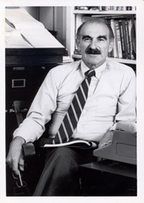
“People don't want to buy a quarter-inch drill. They want a quarter-inch hole!”
Theodore Levitt
Economist and professor
Notes:
Theodore Levitt put it, "People don't want to buy a quarter-inch drill. They want a quarter-inch hole!"
With this, Levitt argued that people don't buy products, they buy solutions.

Slide 24
“Good Design is about process, not Product”
Jared Sinclair
App designer and programmer
Notes:
But, UX Design is not a magic formula
“Good Design is about process”
And to reach that, UX Designers typically follow a user-centered design process,
ALSO known as Design Thinking Process

Slide 25
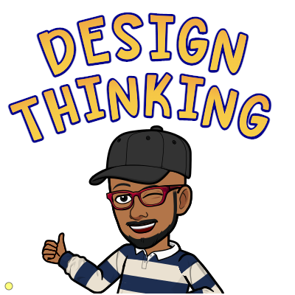
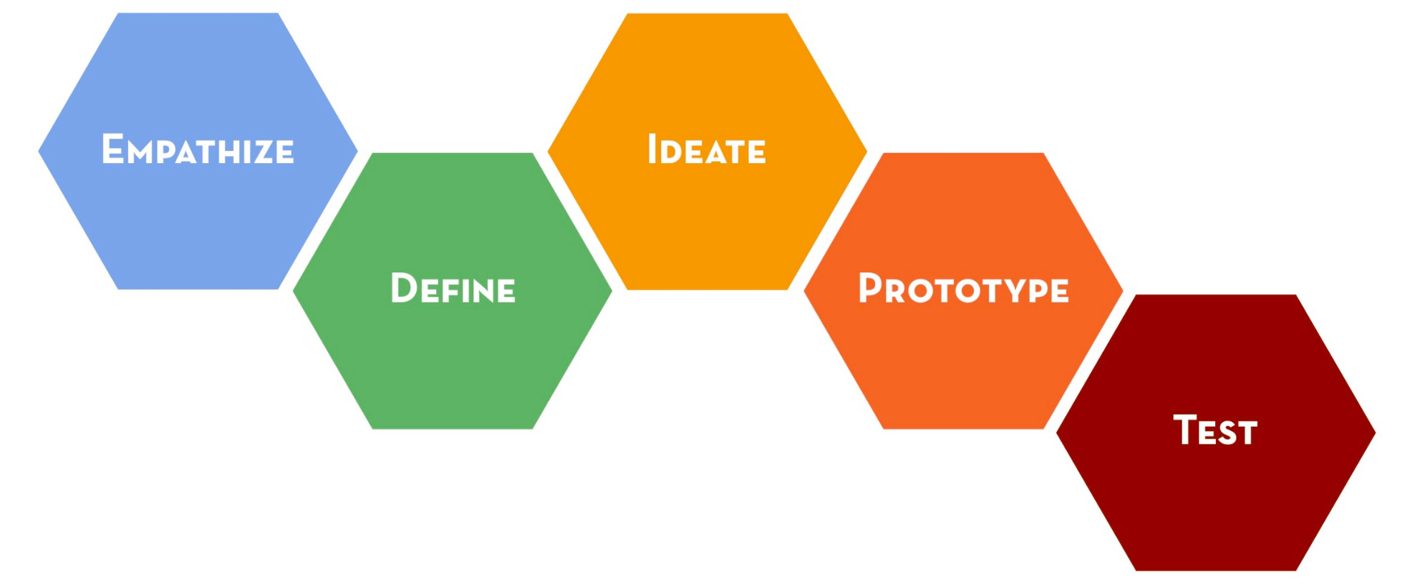
🧡️
Empathize
🫱🏼‍🫲🏾
Work together
✅
Fail effectively
Notes:
The Design thinking or Human Centered Design Process is a method that encourages people to identify and solve problems by doing 3 ESSENTIAL, tasks:
Empathize
Work Together, and
Fail Effectively.

Slide 26
🧡️
Empathize
🫱🏼‍🫲🏾
Work together
✅
Fail effectively
Notes:
And within this 3 tasks fall the 5 phases or steps: empathize, define, ideate, prototype, and test.

Slide 27
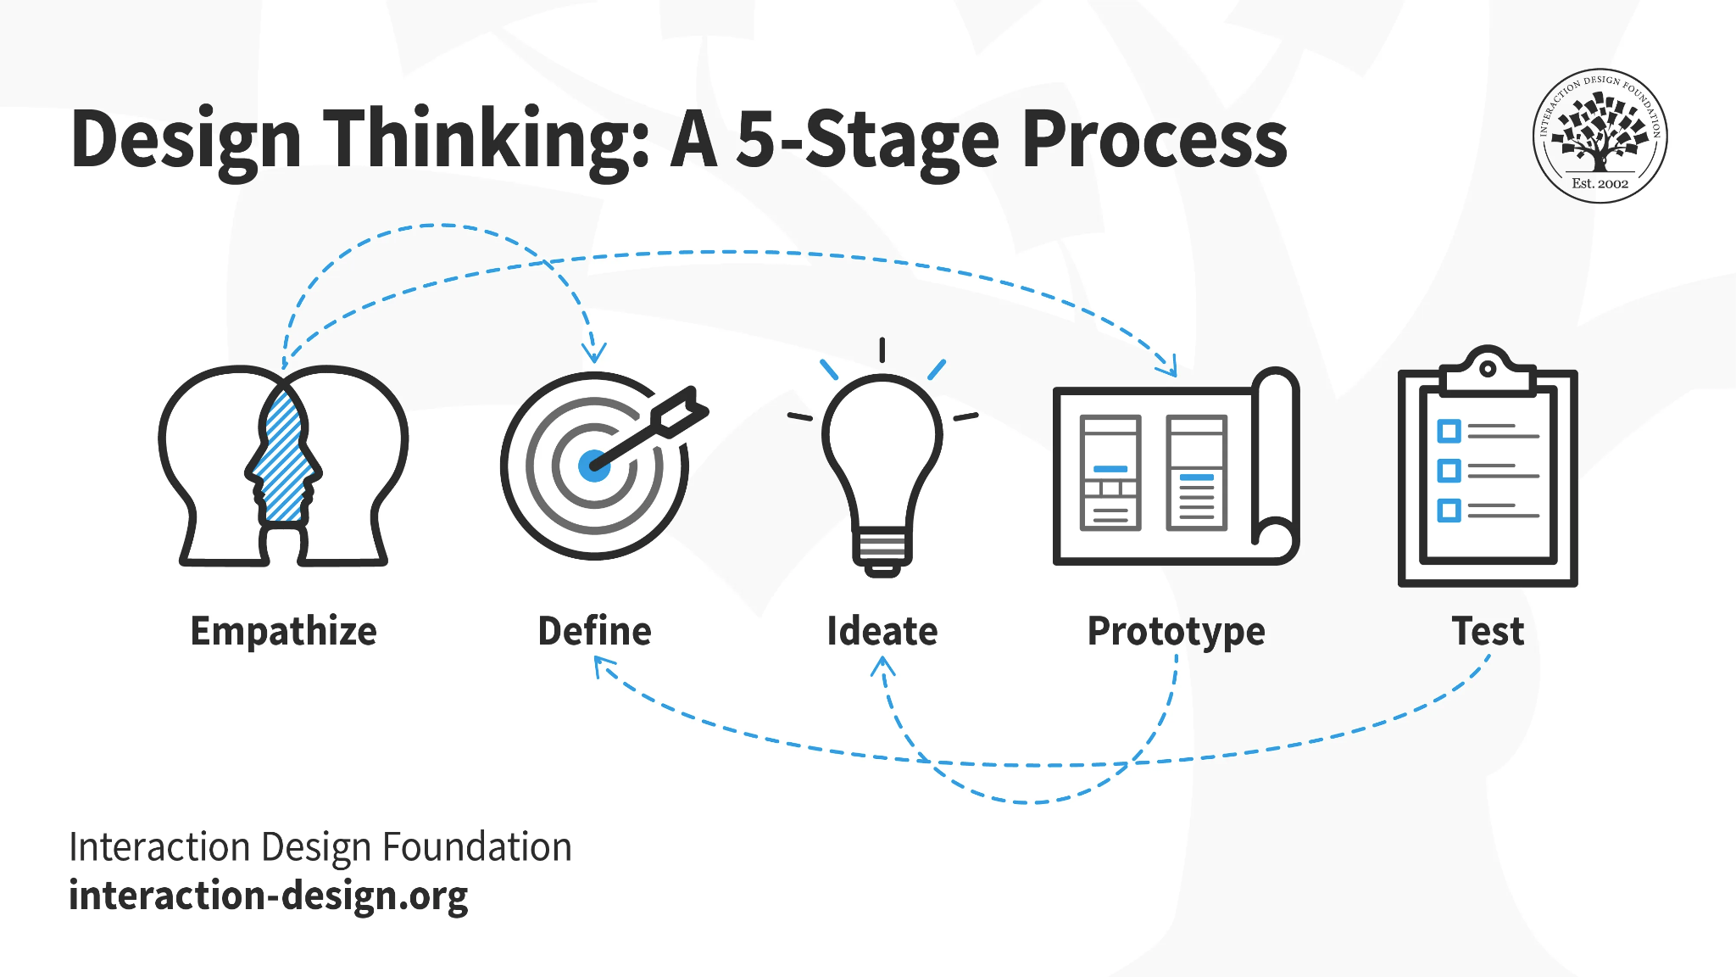
Notes:
BUT Design thinking is an iterative and non-linear process, stages are not always sequential,

Slide 28
Notes:
And so far, many companies have adopted and adapted this methodology, have proposed and put into practice different approaches OF THE PROCESS.
Said that, let’s jump to the heart of the matter:

Slide 29
How we have used Insights and the Design thinking processes to improve the user experience of the App.
Notes:
How we have used Insights and the Design thinking process to improve the user experience of the App

Slide 30
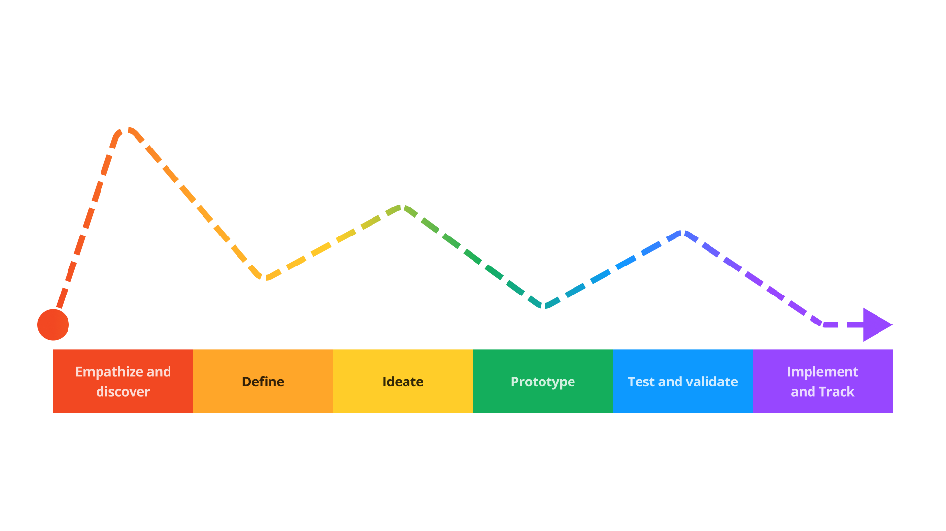
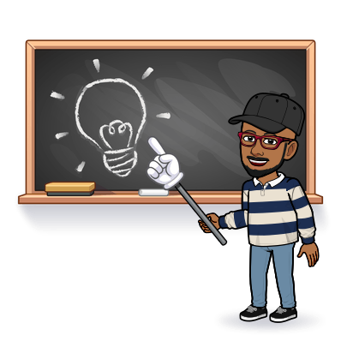
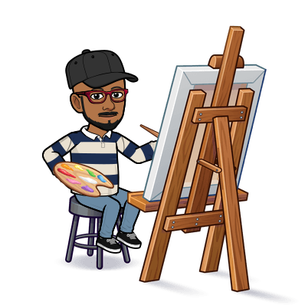
Moodle app design thinking approach
Notes:
this is a visual representation of what our approach to the process looked like, or at least how it felt like.
In general, it is a process that consists of collecting AND generating information, and then reducing possibilities and prioritizing
But let's go step by step

Slide 31
“Get insights to Better define the Problem ”
Conduct research in order to empathize and know about our users and about the company and its objectives
Notes:
THE EMPATHIZE AND DISCOVER phase consists of researching and gathering all the necessary information and asking the whys,
… in order to understand the business goals and be able to empathize with the user and understand their needs.

Slide 32
Discovery and Empathize Phase
What we did?:
Learned about the product
Knew the current status
Met the People
Empathized with users
Notes:
In this first phase, I focused on gather as much info as possible:
Learned about the product, how it works and its history
LEARNED ABOUT The current status of the product and the company, current projects, long term and short term objectives, necessities, and more
Met the people involved, the team and stakeholders, their roles, their work and their point of views
But mainly, I LEARNED ABOUT our users and empathized with them:

Slide 33
Key learnings:
The experience is more Students centered
Most of them are young people
Notes:
Here some key learnings I got:
Moodle app experience is more Students centered
And the majority of our users are young people, mostly high school and university students.

Slide 34
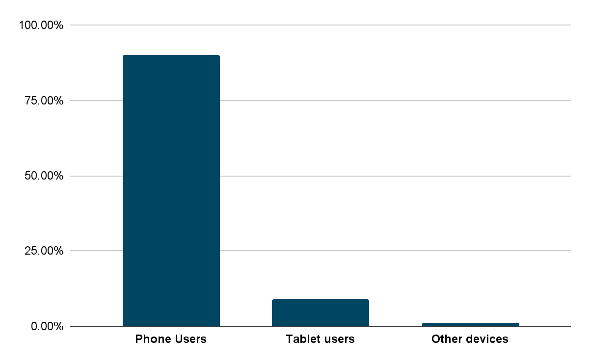
Key learnings:
The experience is more Students centered
Most of them are young people
90% are phone users
Notes:
90% are phone users, while only 9% use tablets and the rest 1% use other devices.

Slide 35
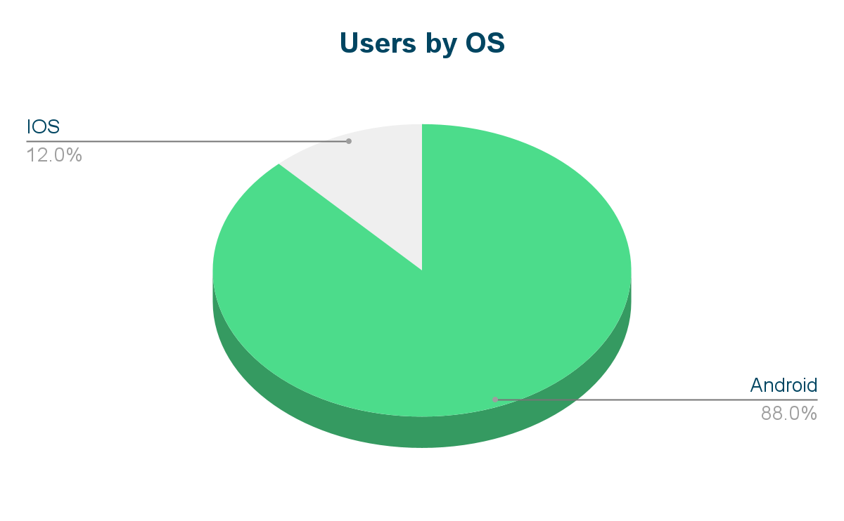
Key learnings:
The experience is more Students centered
Most of them are you people
90% are phone users
More android users
Notes:
Also, 88% of our user use Android devices and only the 12% of them use Apple

Slide 36
Research 5 Pillars:
🥊
Benchmark analysis
Watch competitors and market trends to be up-to-date
🗣
Feedback & Reviews
Listen to our users needs and complaints
💻
LMS 4.0 Redesign
Adapt Web UI and UX enhancements
♿️
Accessibility
Identify and fixing accessibility issues
⏳
The current Experience
Take into account the experience of our current users
Notes:
On the other hand, there were also 5 tasks or requirements we had to take into account.
Analyse direct and indirect competitors and other trending products to identify patterns.
Check comments, Feedback and reviews from Play Store, App store, Support, Moodle Partners, community forums & tracker to extract insights
Adapt and translate UX and UI improvements from LMS 4.0 to ensure consistency
Improve the app accessibility and fix current issues.
Take into account the current users experience

Slide 37
“Have a clear view of the problem, the goal and the users ”:
Combine all the research and observe where your users’ problems exist.
Notes:
The DEFINITION phase consists of combining all the research and learnings from the previous phase and looking at where the user problems exist.

Slide 38
Analyzing the data collected
What we did?:
Analyzed learnings
Understood the user
Defined the Process
Prioritized the main projects
Notes:
We Analyzed and synthesized the learnings from previous phase
Gathered insights and feedbacks to understand the users needs
Defined process, steps, methods and ways to work
And Defined the main fields and projects to work on
IN THIS PHASE, we used some mapping AND BRAINSTORMING methods such as:

Slide 39
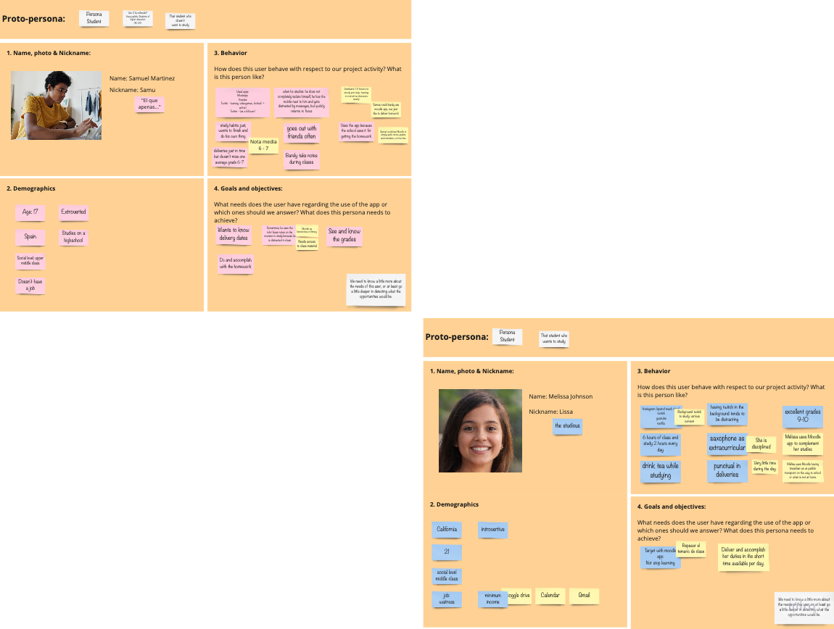
UX Mapping Methods:
Lean User Persona
Notes:
User personas to understand the user

Slide 40
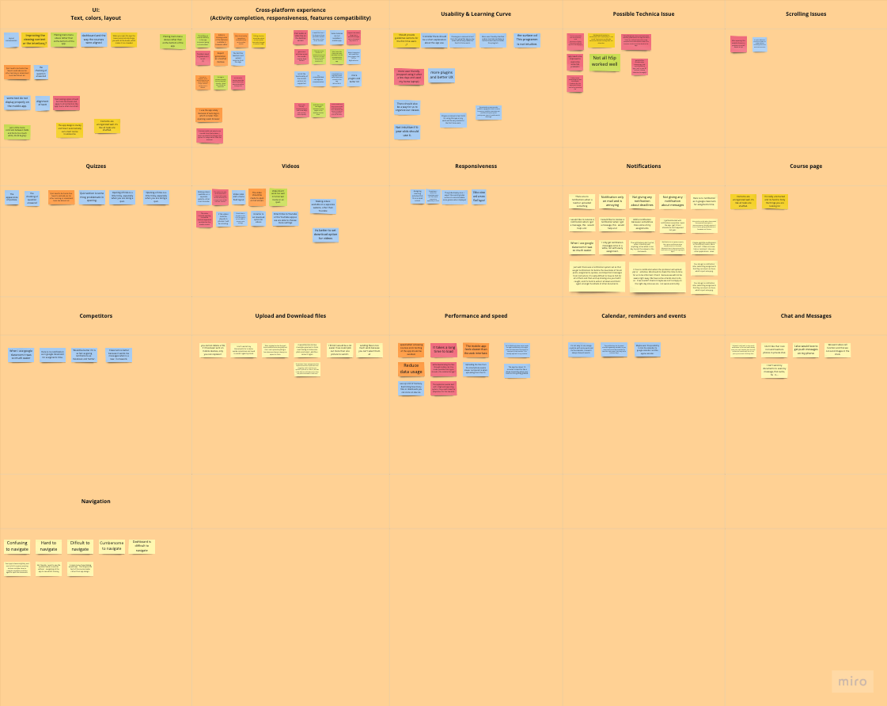
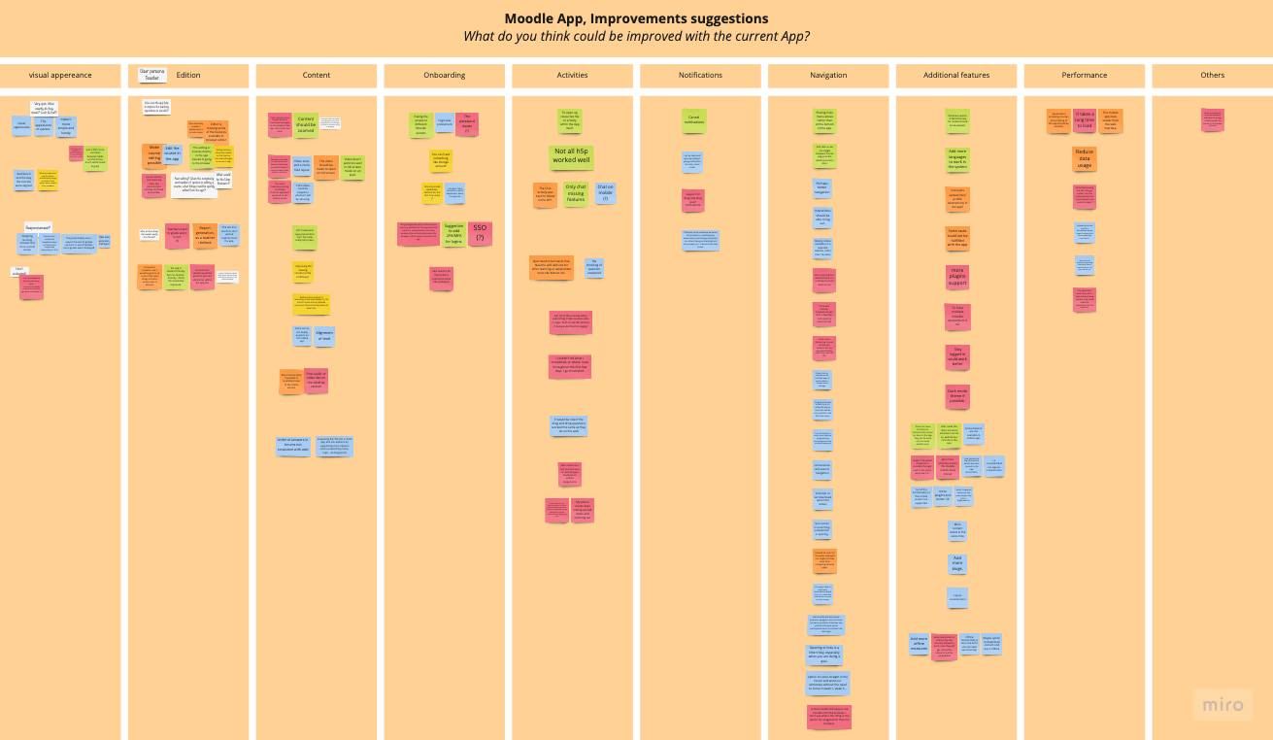
UX Mapping Methods:
Lean User Persona
Affinity maps
Notes:
Affinity maps to compile, group and categorize the different insights.

Slide 41
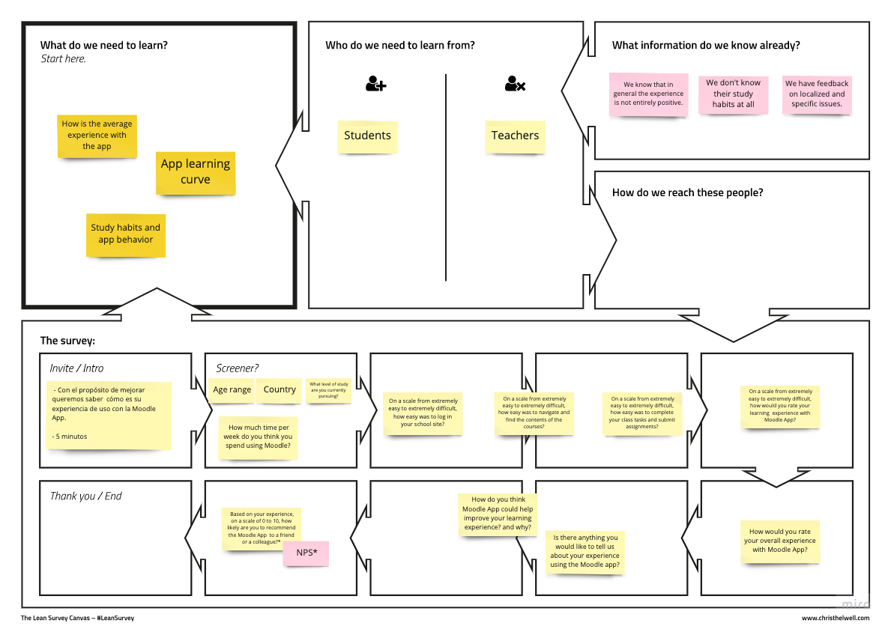
UX Mapping Methods:
Lean User Persona
Affinity maps
Lean survey canvas
etc…
Notes:
Lean survey canvas to plan surveys and obtain missing information
Among other methods

Slide 42
4 main areas of improvement:
Navigation
Main navigation menu
Main course navigation
Navigation between activities
Gestures and common navigation Patterns
Reminder of recent activity in the course
User Interface
New design
Consistency with LMS
New activity Icons set
Improve Accessibility
Improve content visualization
Performance
Accelerate performance and speed up
Reduce the number of web service requests
Reduce the storage of unneeded residual files
Show connection status feedback
Notifications
Improve notifications experience
Notify New course content
New devices (connection or just login)
Latest course activity
Other additional local notifications
Notes:
This helped us to identify the 4 main projects or major areas to work on:
Rethink and improve the navigation of the app.
Redesign and adapt the user interface.
Improve the app performance
And improve the notification experience

Slide 43
“Find solutions to the problems with the insights”
Brainstorm and purpose a range of creative ideas that address the unmet user needs identified in the define phase.
Notes:
It's time to get creative!
In the Ideate phase you start thinking and proposing creative ideas and possible solutions based on the needs defined in the previous phase.

Slide 44
Draft and exploration
What we did?:
Explored Design patterns
App flows and architecture analysis
First UI proofs and drafts
Notes:
In this phase we did a lot of exploration and drafts
We reviewed and analysed the app, the flows, the screen, the architecture, etc
And we started to purpose and asses ideas for the new UI.

Slide 45
“Build and test ideas. Make mistakes quickly to succeed faster”
Build real, tactile representations for a subset of the ideas.
Notes:
With the ideas and objectives clear, we jumped to prototype phase.

Slide 46
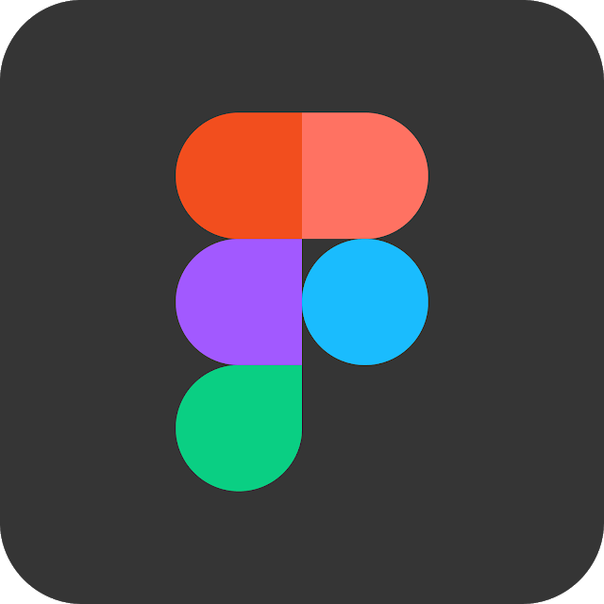
First prototypes
What we did?:
Screens drafts and proofs
UI kit and team library
4.0 interactive prototype
Notes:
The time has finally come to get down to work with Figma, or what is considered to be the real design part.

Slide 47
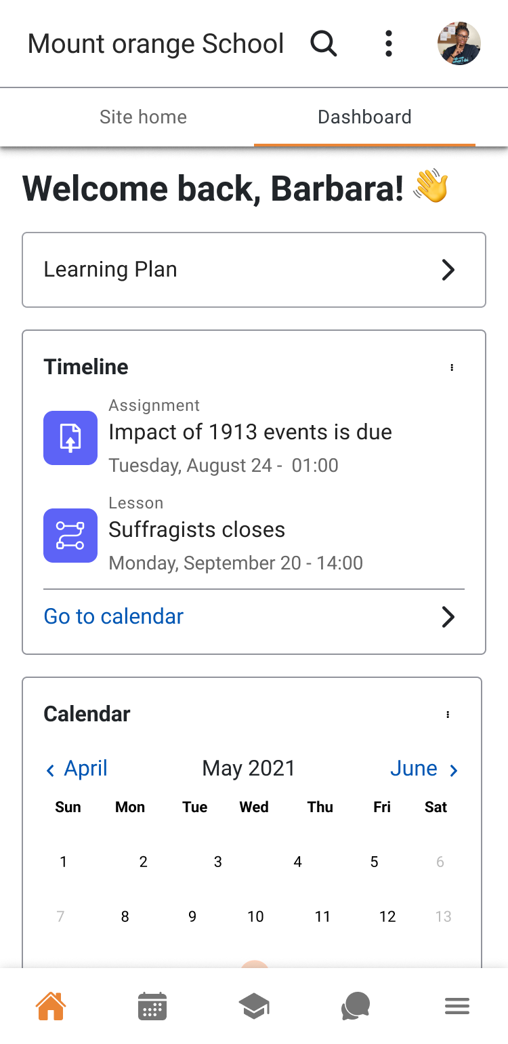
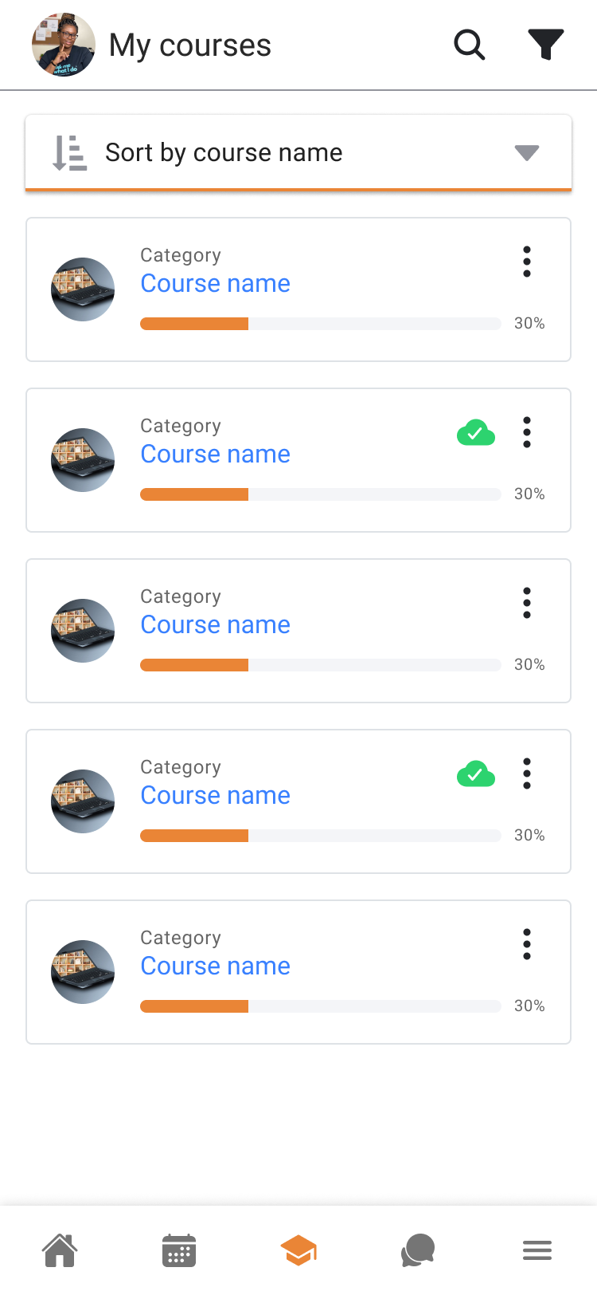
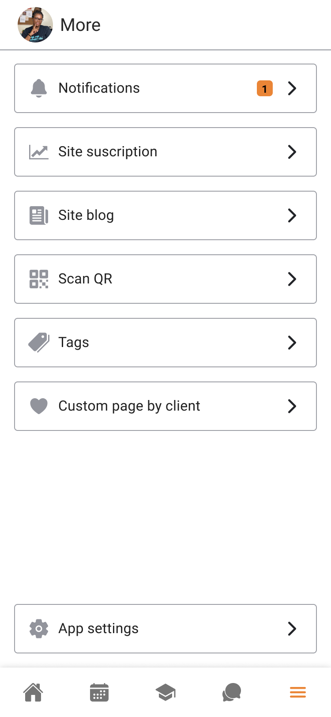
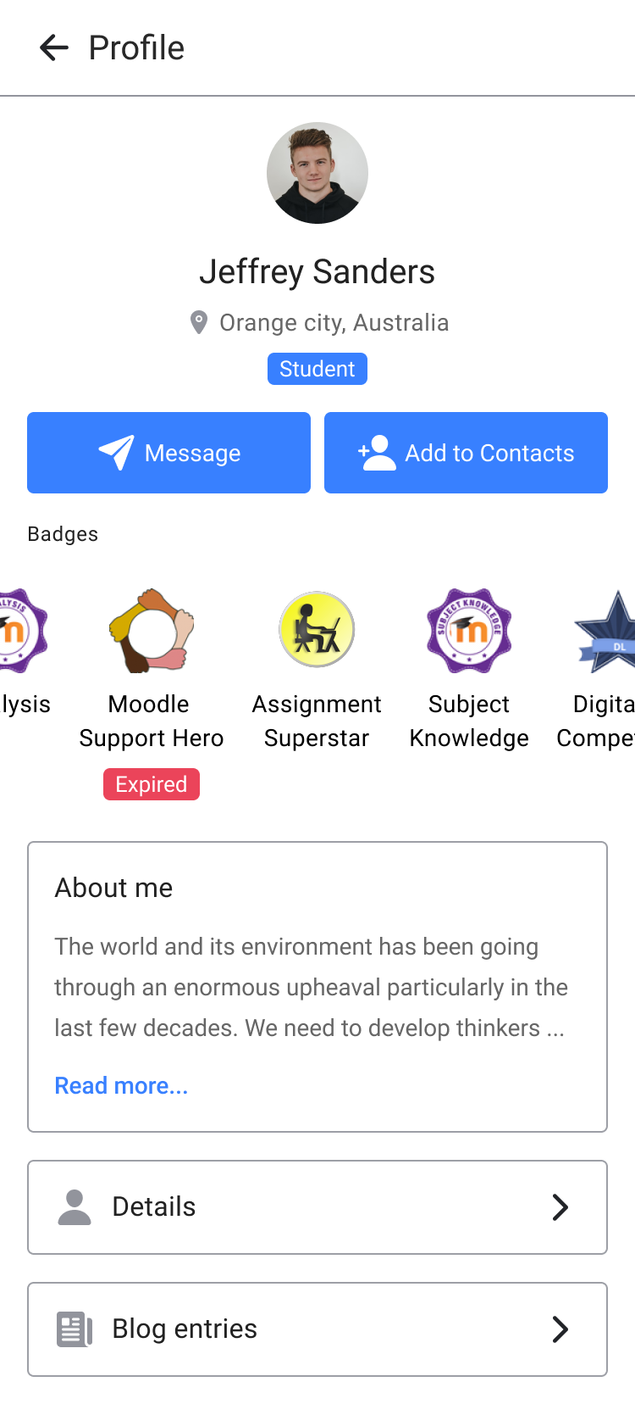
Notes:
We worked on the first proofs and proposals

Slide 48
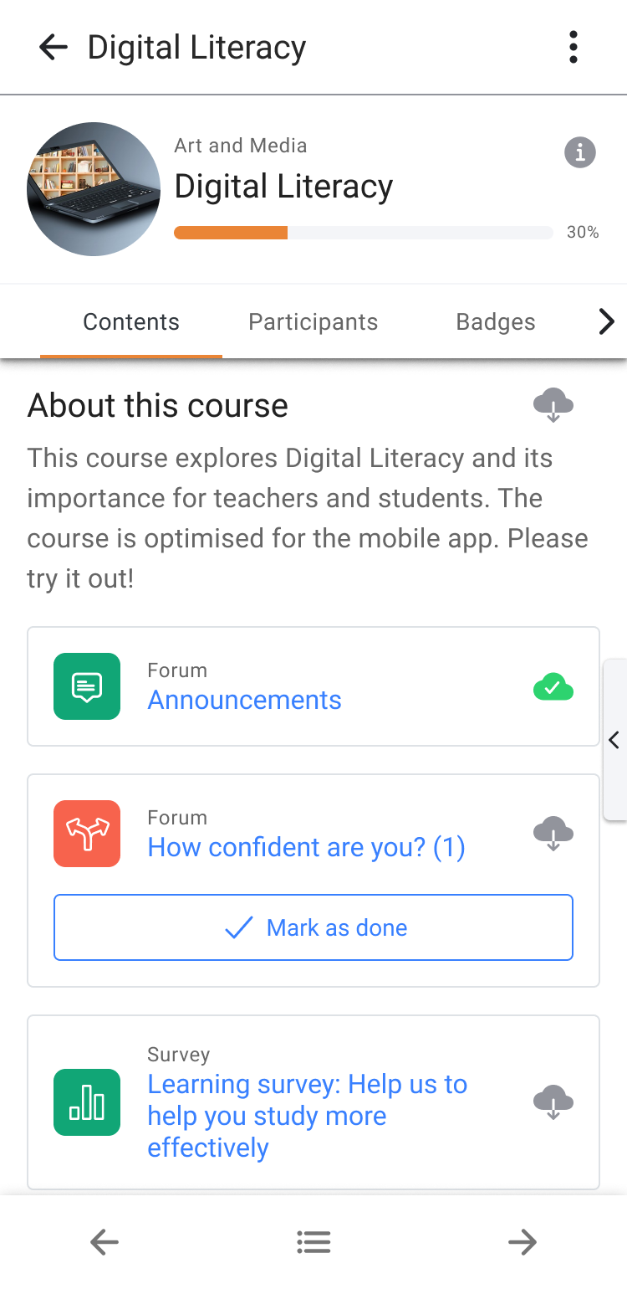
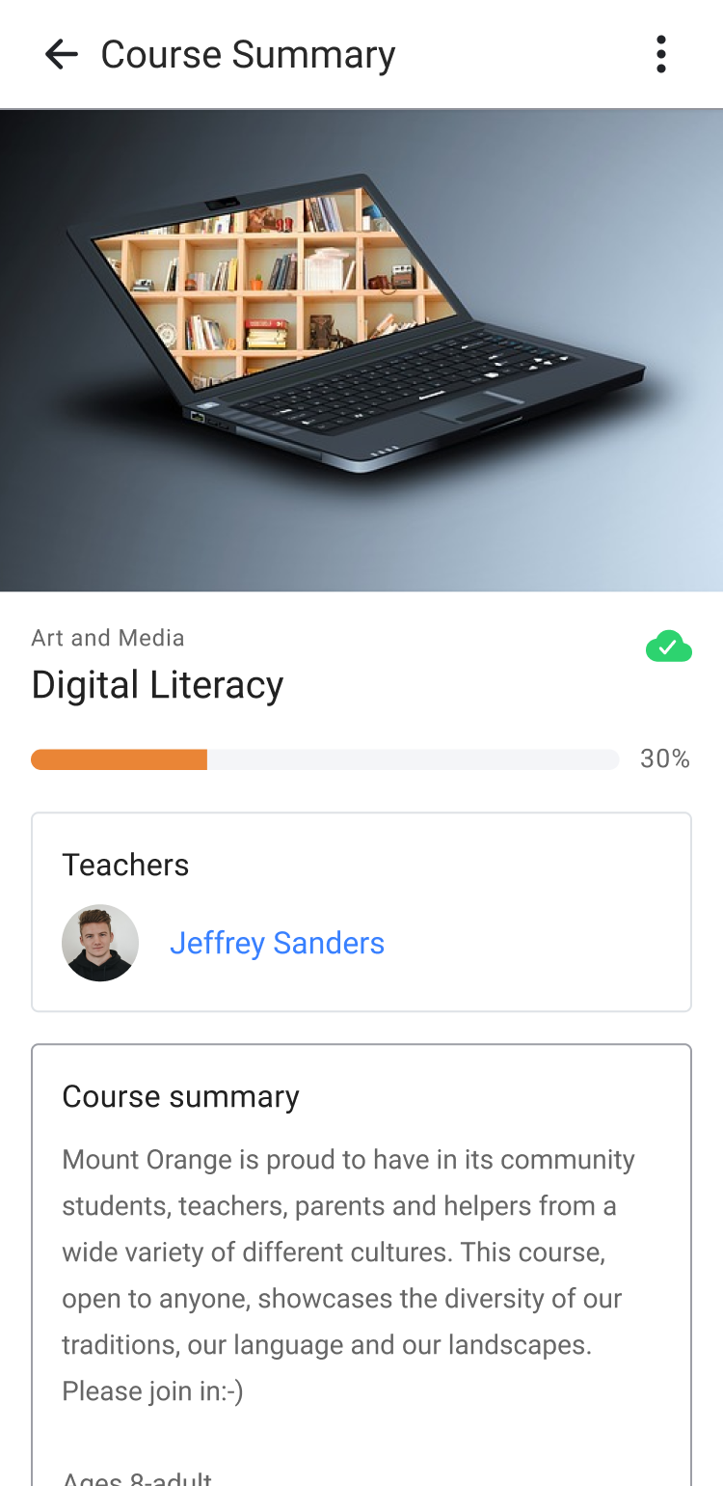
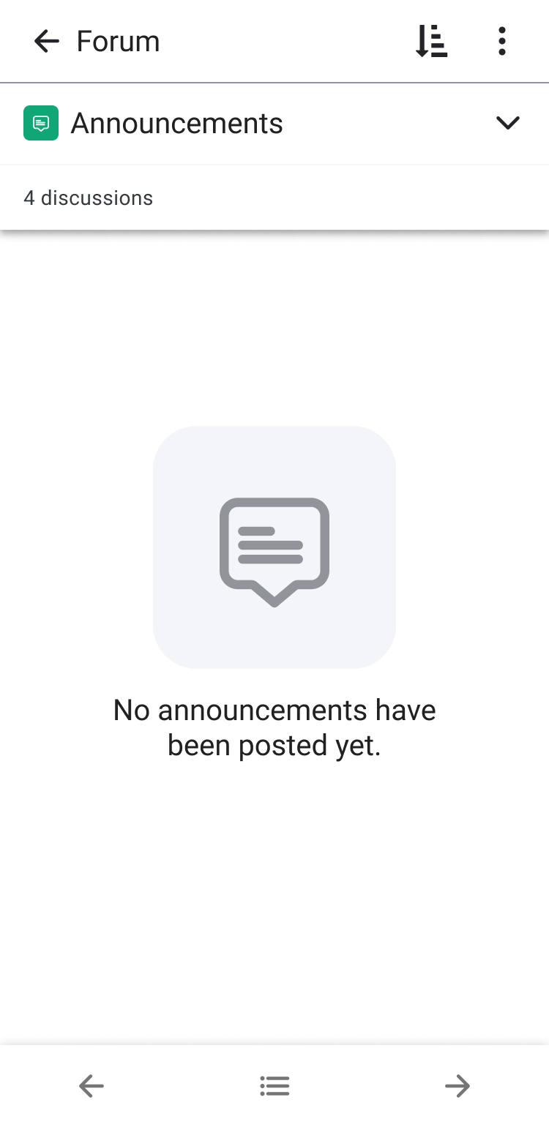
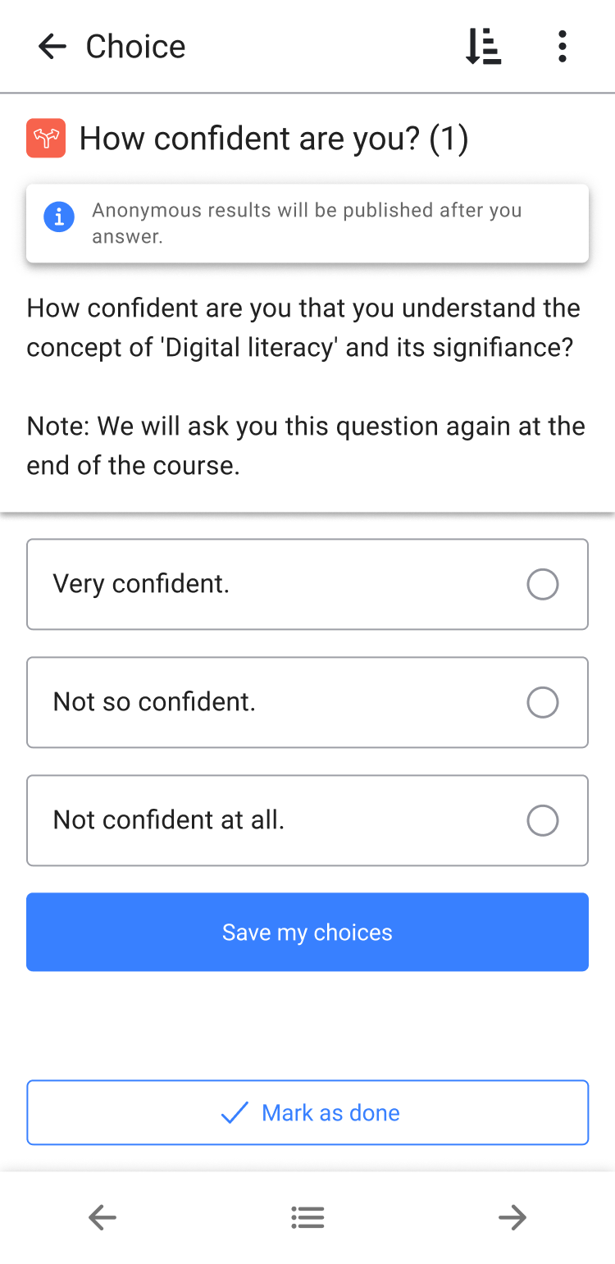
Notes:
We discussed and agreed the proposals within the team

Slide 49
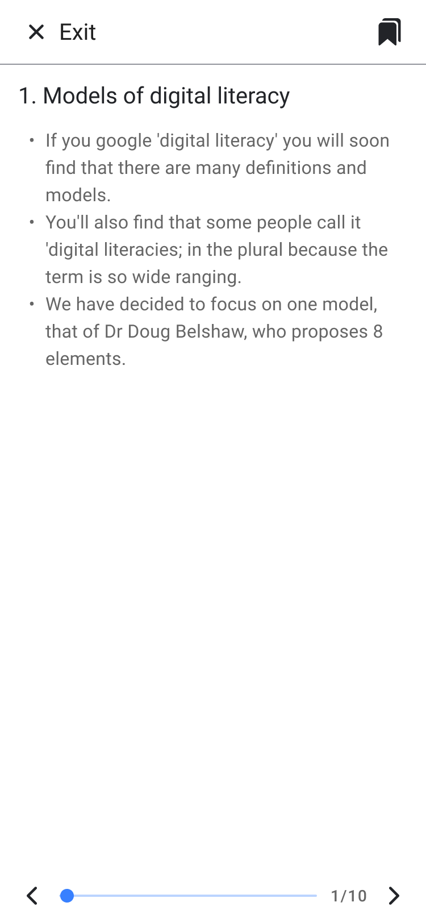
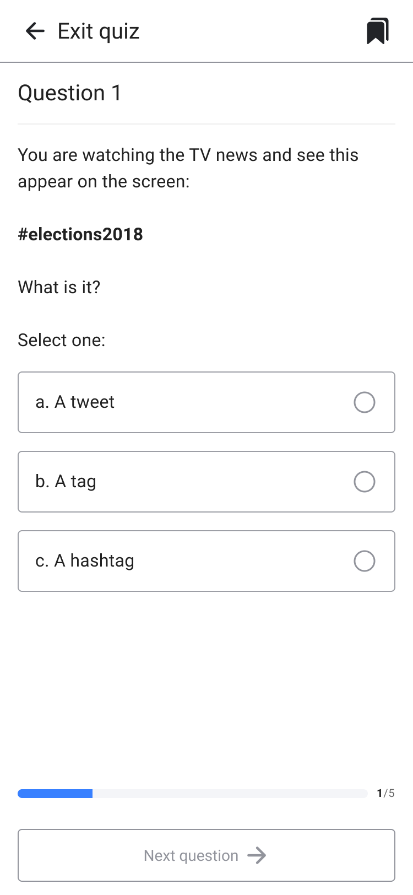
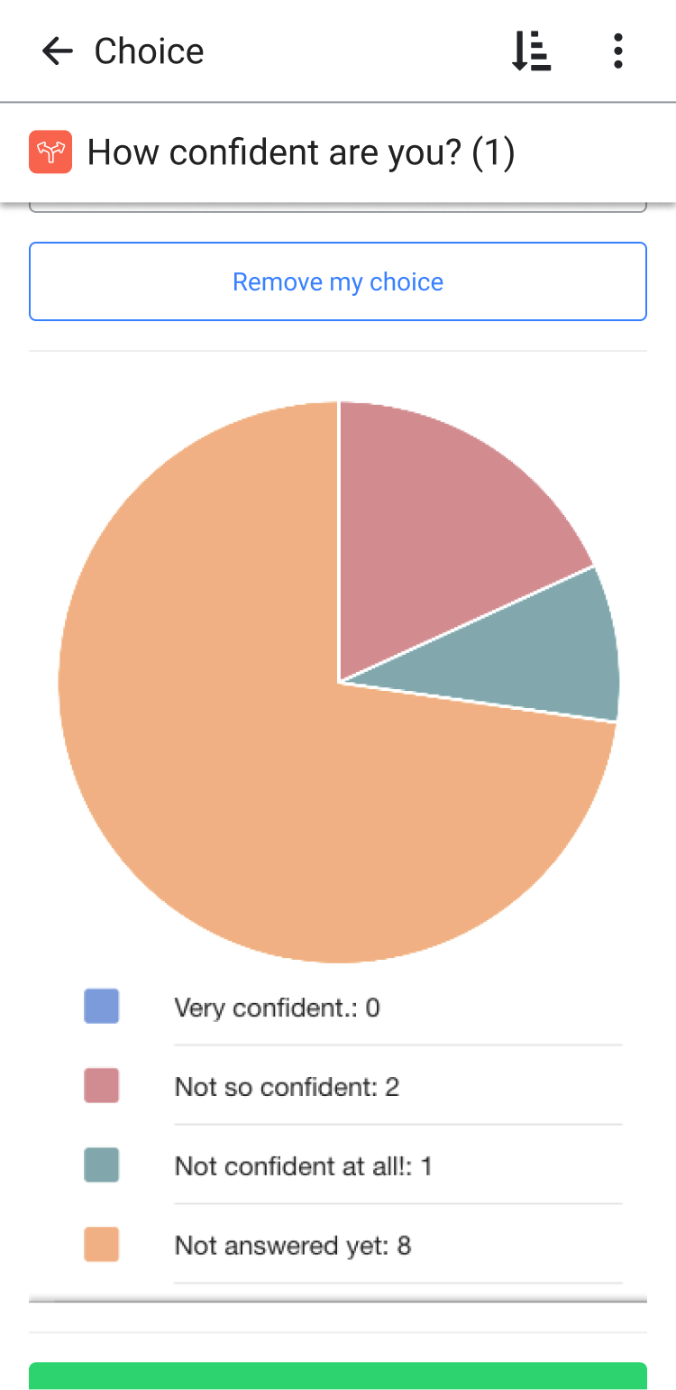
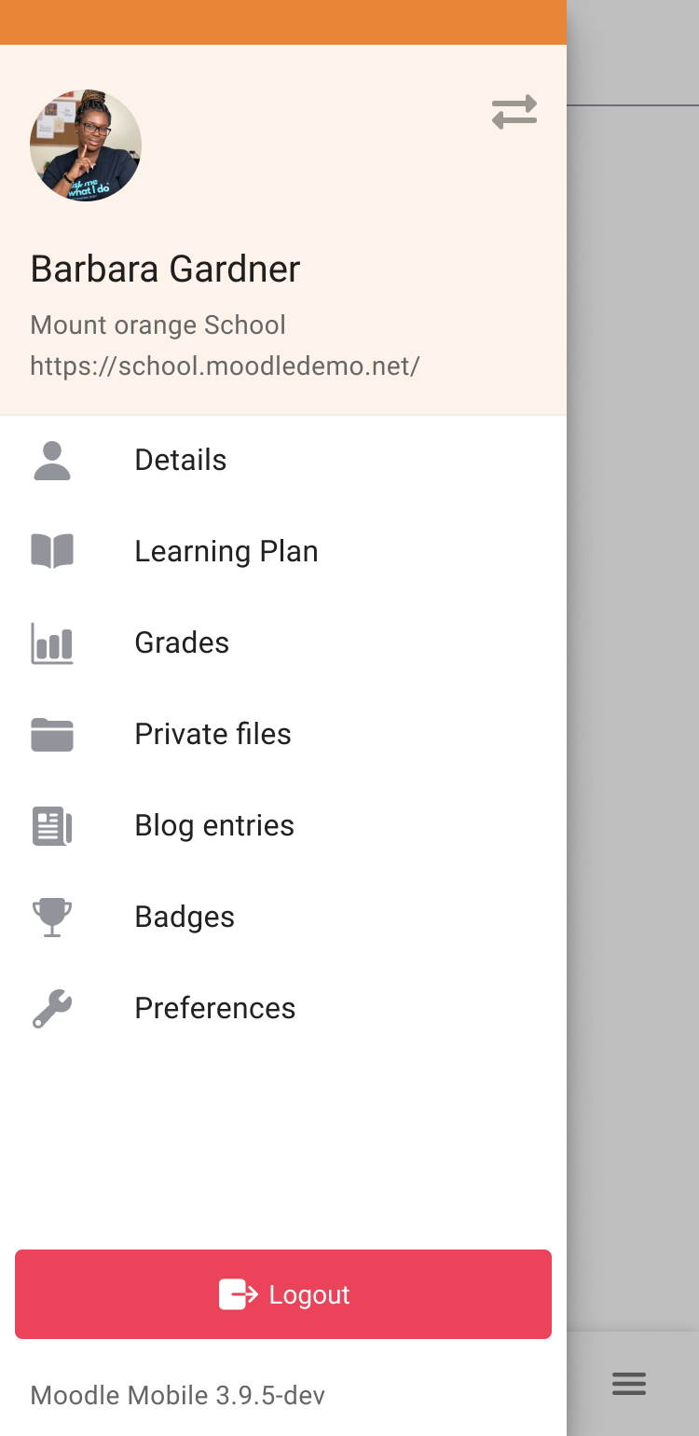
Notes:
And I drawn several screens and possible solutions

Slide 50
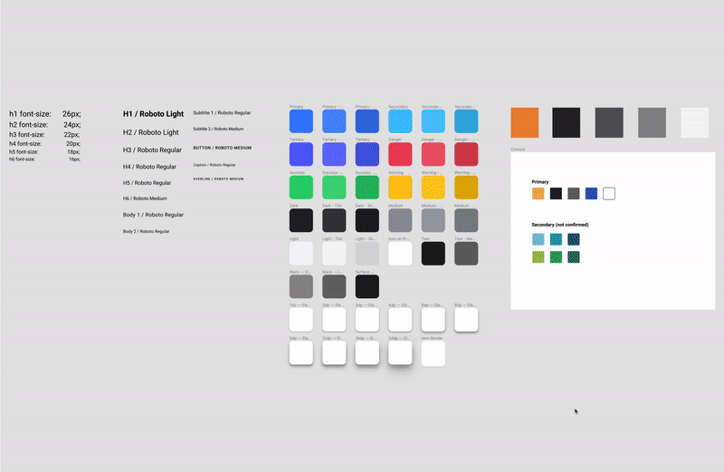
Notes:
At the same time, we were working on the first component libraries, a base on which we could continue to work.

Slide 51
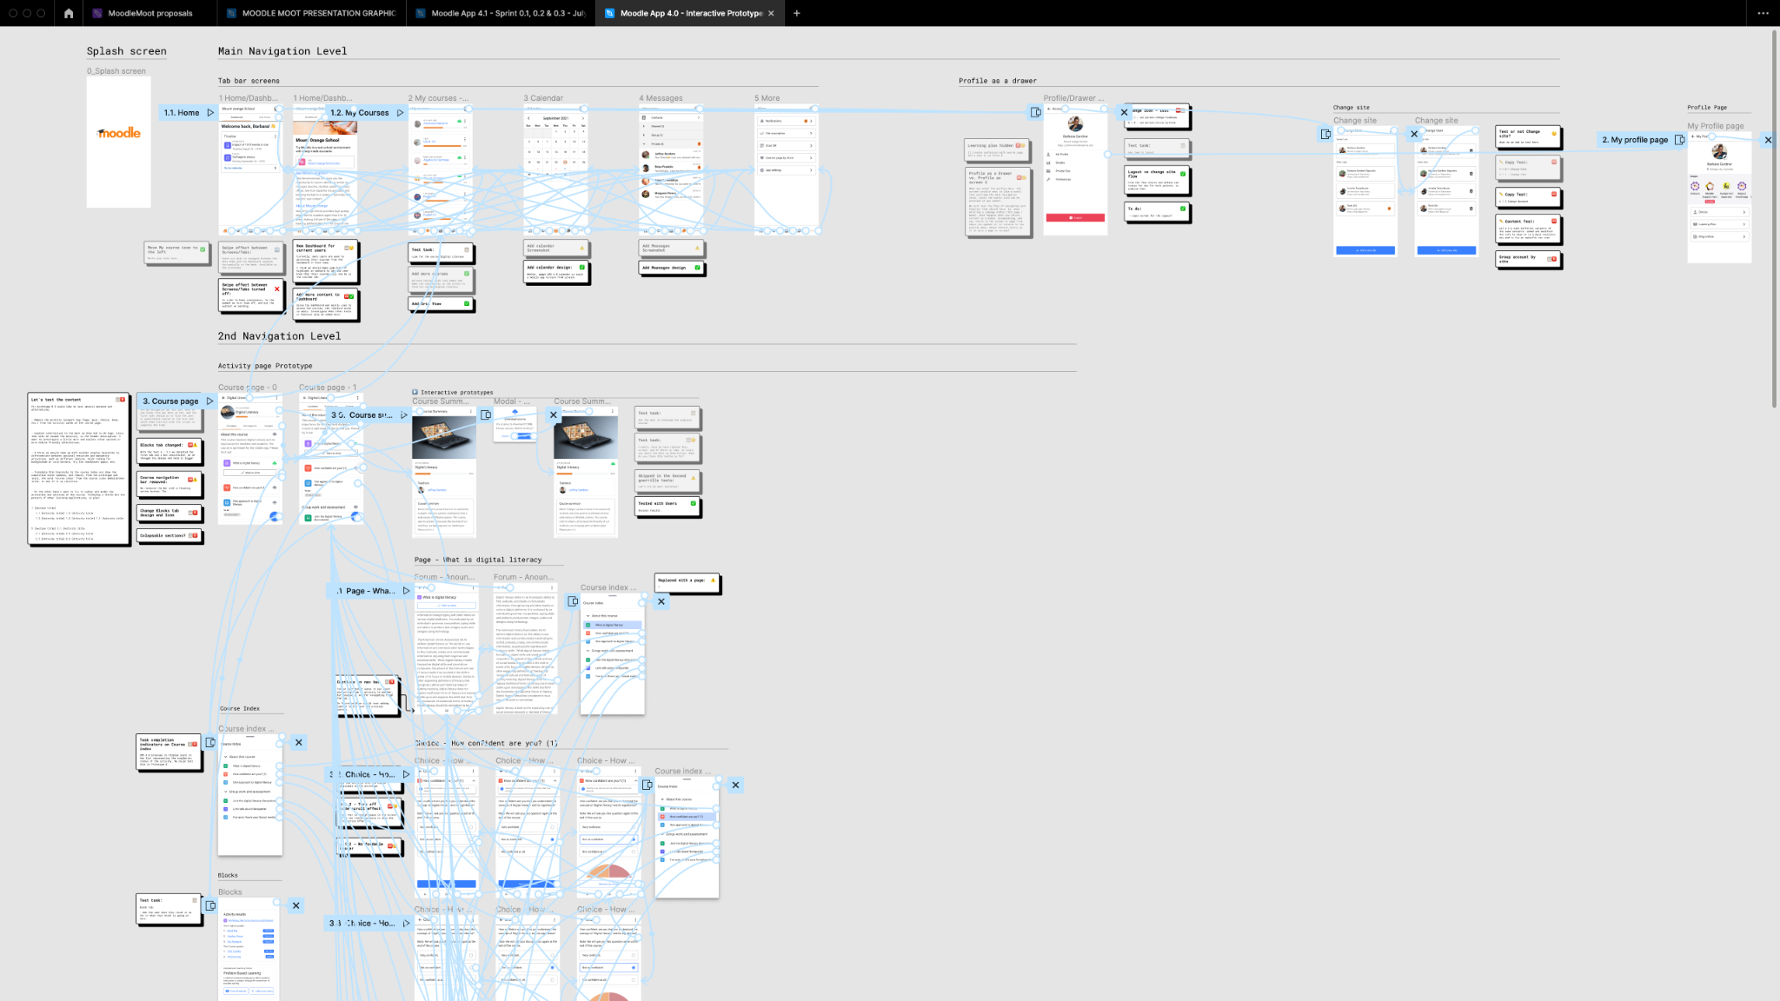
Notes:
And then, we built some interactive prototypes

Slide 52
“Evaluate if the solutions respond to the problem”
Return to our users for feedback.
Notes:
As the name says, at this stage it is time to test and validate, with the prototype and the selected solutions.
It is time to return to the users for feedback.

Slide 53
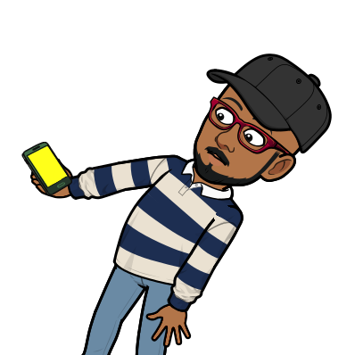
Testing to validate
What we did?:
Run quick guerrilla tests to validate usability, Patterns, Visual design, learnability…
Notes:
The objective was “Evaluate if the solutions respond to the problem”
In this point, our goal was to run tests with real users, but due to the difficulty on sourcing them, we tried other approach:
Run quick guerrilla tests to validate things like usability, Design Patterns, Visual design, learnability, etc.

Slide 54
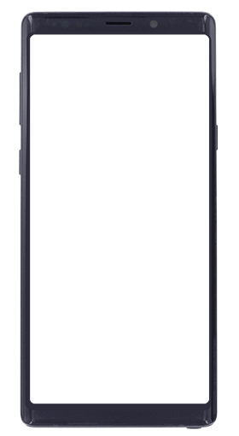
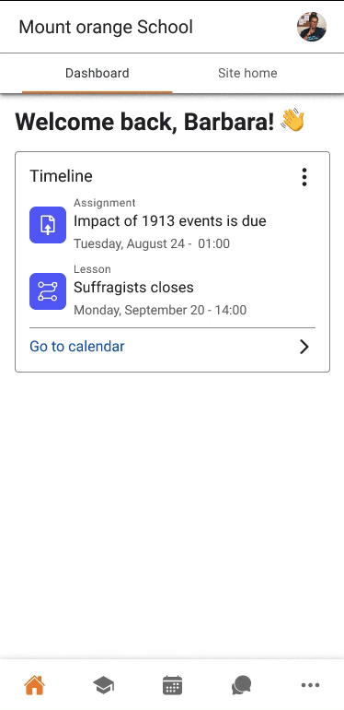
Why Guerrilla tests?
We made use of common design patterns
Goal: to validate the UI and design changes
Focus: validate usability and patterns
So we could test and validate with random people
Notes:
And Why Guerrilla testings?
First of all, during the design process we made use of Design patterns.
Our main interest with this first prototype was to validate the UI and design changes, as that was one of the main areas we were working on.
So we designed and prepared a user research strategy focused more on validating topics such as design patterns, usability, accessibility, information flows and architecture, and also listening to more impartial and less biased impressions and opinions.
This allowed us to test with people around us

Slide 55
To do:
Once validated, ensure that the solution is materialized and touches the lives of our end users, track and measure the success.
Notes:
Although the design thinking process is usually cyclical, it is also an iterative process, so it is important to take into account the phase of implementing and tracking, to check if the solution works and collect learnings.

Slide 56
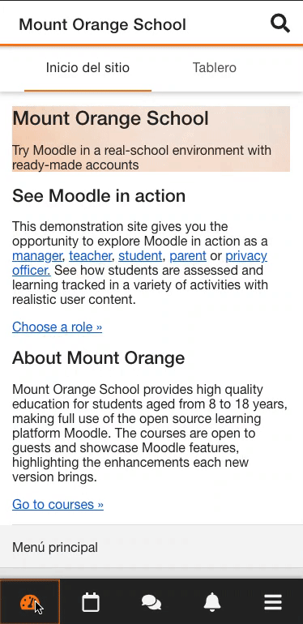
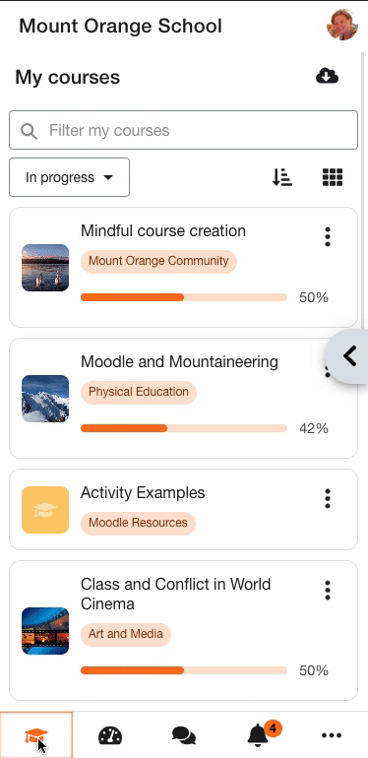
Before
After
Minimalist UI
Navigation improvements
User account menu
Notes:
Some of the most noticeable changes implemented include
A more Minimalist UI
Navigation improvements
The User account menu

Slide 57
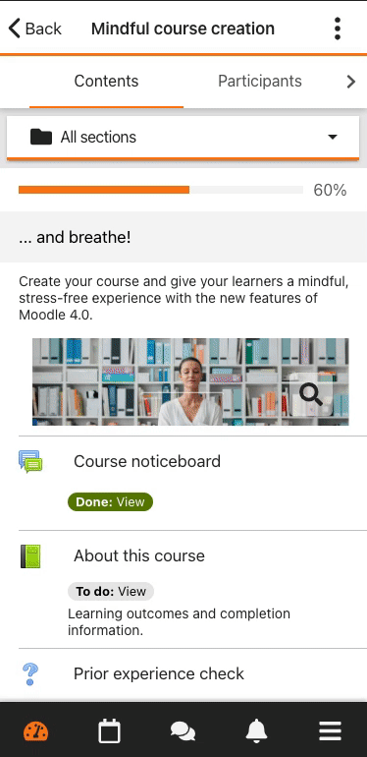
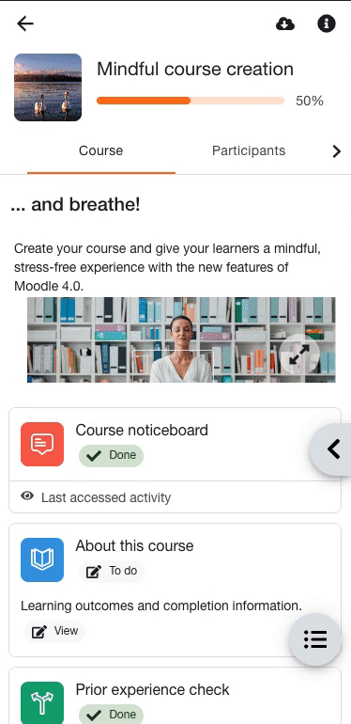
Before
After
Minimalist UI
Navigation improvements
User account menu
Course index
Navigation between sections
Notes:
The new Course index
improvement in the Navigation between sections

Slide 58
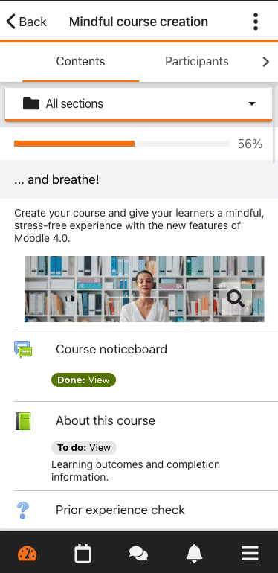
Before
After
Minimalist UI
Navigation improvements
User account menu
Course index
Navigation between sections
Blocks
Notes:
And the new blocks drawer

Slide 59
Doing and Learning!
What are we doing?:
We continue to work on providing the best possible experience
Notes:
We continue monitoring the ratings and comments from the app stores.
We are keeping an eye on the different discussions in the community forum.
We continue taking into account feedback and messages from our partners and users to Support.
We are still working on the improvement of the 4 big areas
We continue working on small improvements or easy wins.
But..

Slide 60
We want you to help us!
How?:
Pay attention
Providing useful information and cool insights
Helping us to source real App users for testing
Helping us to run tests
Notes:
Listen to your users and Pay attention to their needs and problems, the use cases, scenarios, context, ask them why
Provide useful information and cool insights, data, KPIs, results, Any useful and actionable information
Helping us to source real App users for testing

Slide 61
Please, contact us
Where?
✉️ eduardom@moodle.com
Moodle UX Community forum

Slide 62
Edu Manzanillo
eduardom@moodle.com
P: +34 672 04 87 42
W: edumanzanillo.com

